Slide 1

EmployeeVaccinationDetails (EVD) Health
TheBegginers
Koushik
Adarsh
Aalok
Bhaskar
Devbrath

Slide 2
Problem Statement
An organization should be able to monitor the vaccination related details of their employees. A smart surveillance system is required. Currently Its been difficult for the organization to confront employees to work from office due to Covid situation.

Slide 3
Our Solution
User can :
Register via phone and email
Login via their username and password
Update the vaccination details
Check vaccination details of team members

Slide 4
Technical Document
Technical document attached

Slide 5
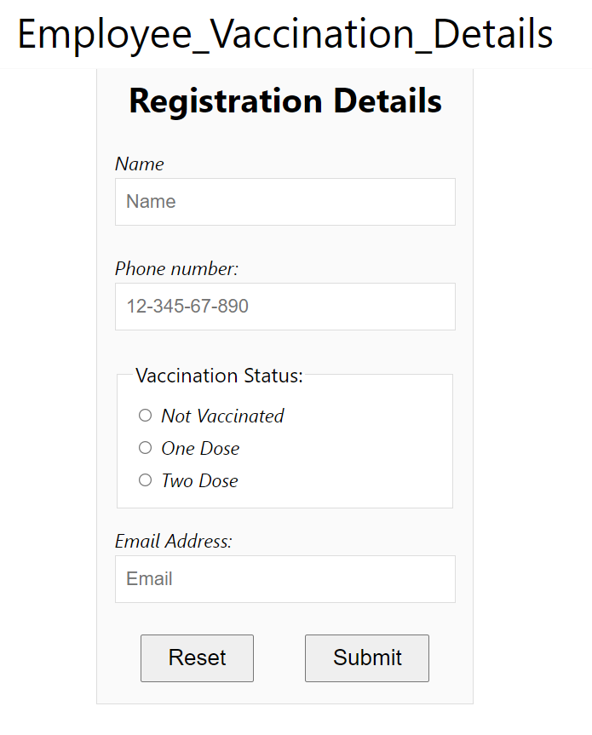
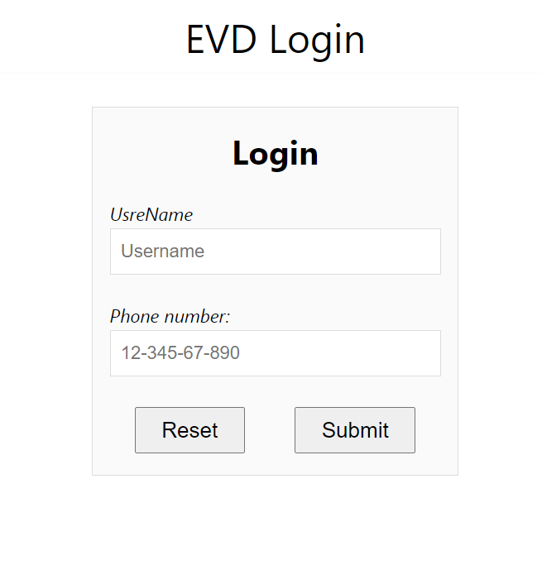
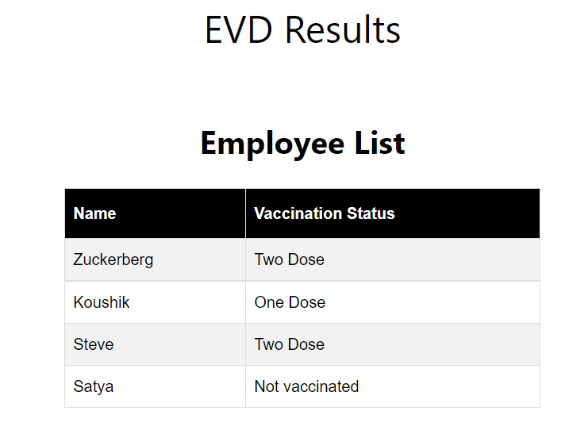
Templates Created

Slide 6
Impact
Monitoring of employee vaccination
Employees can update their vaccination status
Hierarchical access of information

Slide 7
Technology Stack
Language : Java
Framework : Spring Boot
Front-End : HTML5, CSS3, JavaScript
Database : MySQL and CSV

Slide 8
Future Prospects
Add details for different vaccines
New disease categories can be added
Certificate upload can be implemented

Slide 9
Innovation
Concept of knowing whether you will be safe when you are back to office with your colleague through this application.
Clearing the fear out of employees to come back to office.

Slide 10
Feasibility
Requires only phone number and email
Easy to use web interface
No app download required
Optimized for web and Mobile

