Slide 1

RAILWAY ACCIDENT PREVENTION SYSTEM
Under the guidance of
Associate Professor
R. NATARAJA
Submitted by :
AJAY KUMARD.R(1MV15EC005)
G. AKASH(1MV15EC036)
KOUSHIK .G(1MV15EC053)

Slide 2
OBJECTIVE :
Aim of this project is to control the unmanned rail gate automatically using embedded platform. Present project is designed to avoid such accidents if implemented in spirit.
To detect the derailments of the track and to inform the nearby stations quickly to take the appropriate measures. The location of the crack detected by the device will be shared immediately.
Using the same principle as that for gate control, we have developed a concept of automatic track switching. Considering a situation wherein an express train and a local train are traveling in opposite directions on the same track.

Slide 3
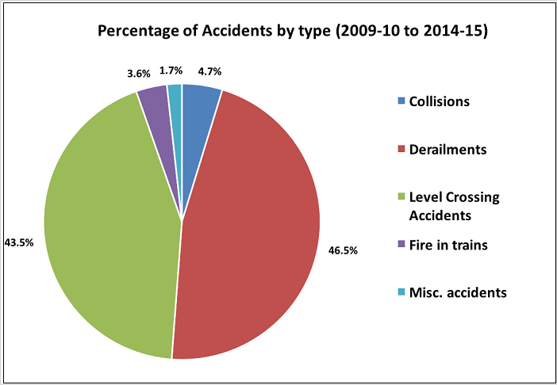
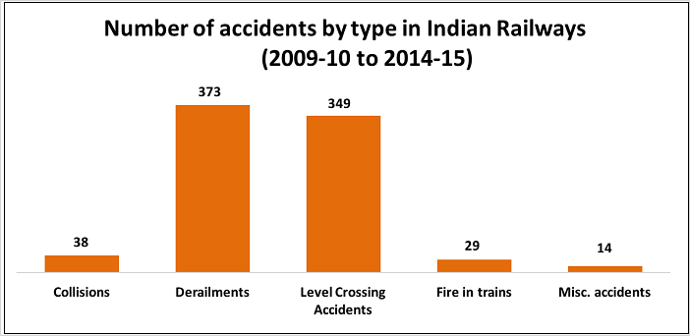
PROBLEM STATEMENT :
At present ,railway accident prevention technologies are limited which leads to three things:
Low efficiency.
Measurement error.
Manual inspection.

Slide 4
Problem facing:
In the 6-year period between 2009-10 and 2014-15, there were a total of 803 accidents in Indian Railways killing 620 people and injuring 1855 people. 47% of these accidents were due to derailment of trains.
By far, the highest number of accidents are because of derailments & accidents at level crossings. Nine (9) out of Ten (10) railway accidents during 2009-10 and 2014-15 have been due to derailments and accidents at level crossings. The other type of accidents includes collisions, etc. But their number is relatively much lower.
Though the number of accidents in 2009-10 was more than the number of accidents in 2010-11, 235 were killed in 2010-11 compared to only 67 in 2009-10. The accidents in 2010-11 were more fatal compared to the other years. The number of those killed has been on the decline since 2010-11 only to increase in 2014-15.

Slide 5
LITERATURE SURVEY :
PAPER 1:
Development of a Smart Railway System for Bangladesh.
The system features active train detection using global navigation satellite system (GNSS) coordinates and obstacle detection at level crossings using long range infrared; automatic signalling and gate control at level crossings using light emitting diodes (LEDs) and servo motors; automatic and manual communication between trains and level crossings using global system for mobile communicate on (GSM) technology and lastly development of a web-based central control system to monitor locations and activities of trains using navigation technology and to communicate with the entire railway community as well as the country’s emergency services. Our design includes the integration and interaction of three separate sub-systems: central control system, level crossing system and train system.

Slide 6
PAPER 2:
Evaluation of Communication Channel for Train Safety Monitoring System
Safety monitoring system usually consists of safety monitoring service module and sensor module. Safety monitoring service module analyses the key parameters which sensor module collects and make a decision on the safety status of moving a train. Sensor module acquires key parameter values such as the temperature of wheel and bearing or the vibration acceleration of wheel axles. Those values are directly related to the safety of the railway vehicles by using a physical sensor.

Slide 7
PAPER 3:
Unmanned Level Crossing Controller and Rail Track Broken Detection System Using IR Sensors and Internet of Things Technology
This paper proposes an unmanned gate crossing and faulty rail track detection. Unmanned level crossing is a IR sensors base system and crack detection is an dynamic approach which combines the use of GPS (global positioning system) tracking system and GSM (global system for mobile communication) modem to send geographical coordinate of location. Unmanned gate crossing controller system prevents accident which are caused due to railway track crossing and railway crack detection system prevents train derailment by detecting crack in railway track using internet of things technology.

Slide 8
PAPER 4:
Automatic Rail Fault Track Detection for Indian Railways
The use of accelerometer device on the track might facilitate to seek out if there's any abnormal bending is caused once a train passes over through the track. Also ultrasonic sensors are used along with this module, which are placed on both sides of the tracks. If any changes in the width or length of the tracks ,these sensors detects it and alert the operator.
When a higher degree deviation from the conventional value occurs the alerting system within the station master’s space might get activated and corrective measures can be taken in a timely manner. The power requirement for the proposed system is very less and it can be even powered with the assistance of solar cells or by the employment of piezoelectric energy generation methodology.

Slide 9
PAPER 5:

Slide 10
methodology:
This project has 3 objectives to establish :
1.Automatic Railway gate control unit.
2.Track monitoring system.
3.Unmanned crack detecting robot(or derailment detection).

Slide 11
IMPLEMENTATION PROCEDURE FOR RAILWAY GATE CONTROL UNIT
ULTRASONIC SENSOR 1
ULTRASONIC SENSOR 1
TRAIN TRAFFIC INDICATOR
ULTRASONIC SENSOR 2
ARDUINO -UNO
ULTRASONIC SENSOR 3
GATE1
SERVO MOTOR 1
POWER SUPPLY
SERVO MOTOR 2
GATE 2
BUZZER

Slide 12
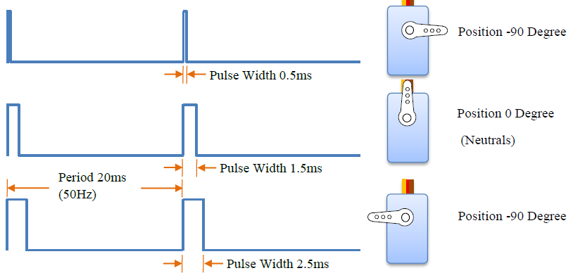
This project uses microcontroller like Arduino for programming and operation.
This project utilizes two powerful ultrasonic transmitters and two receivers.
Sensor activation time is calculated.
The servo motor are used for the purpose of gate control.
Output indicated by buzzer and leds.

Slide 13
LIGHT
INDICATOR
PIR SENSOR 1
ARDUINO-UNO
PIR SENSOR 2
POWER SUPPLY

Slide 14
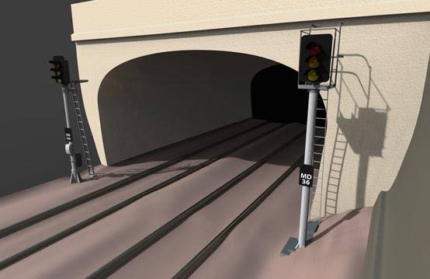
IMPLEMENTATION PROCEDURE FOR RAILWAY TRACK MONITORING UNIT
Multiple sensors unit for monitoring at certain places.
Halt indicating system
Automatic lighting system

Slide 15
IMPLEMENTATION PROCEDURE FOR CRACK DETECTION( DERAILMENTS) ON RAILWAY TRACK
ULTRASONIC SENSOR 1
ARDUINO- MEGA
ULTRASONIC SENSOR 3
ACCELEROMETER
ULTRASONIC SENSOR 2
BUZZER
POWER SUPPLY
MOBILE
DC MOTOR
DRIVER
GSM+GPS

Slide 16
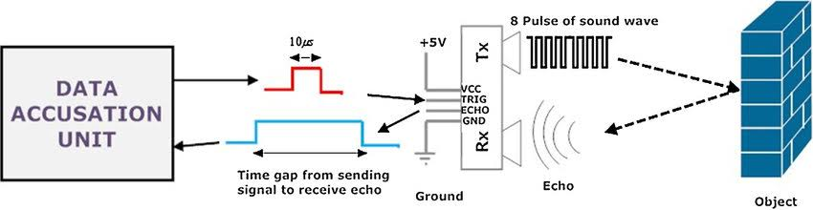
Crack Detection Unit:

Slide 17
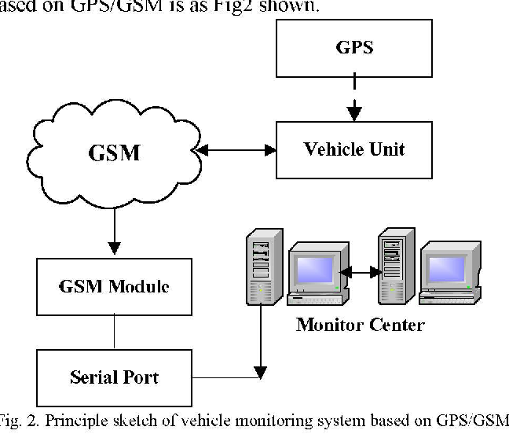
Communication Unit:

Slide 18
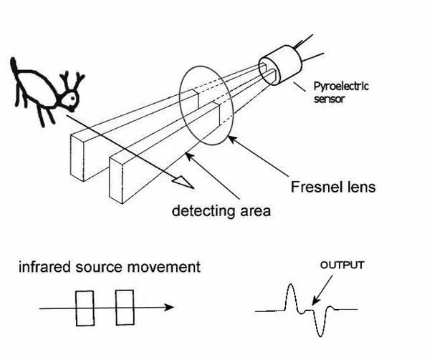
Obstacle Detection Unit:

Slide 19
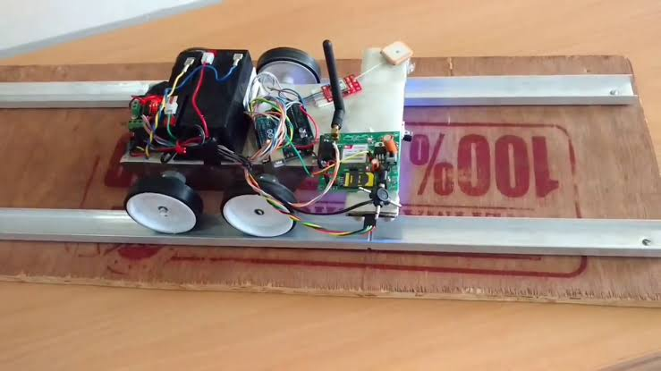
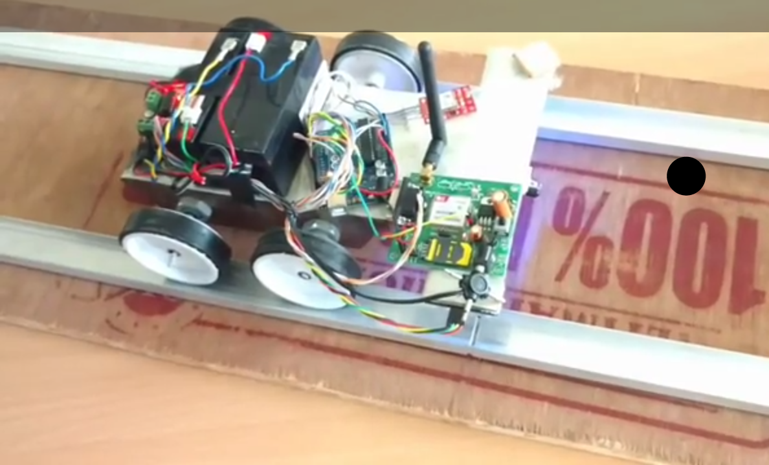
Expected Model :
Unmanned crack detecting robot(or derailment detection)

Slide 20
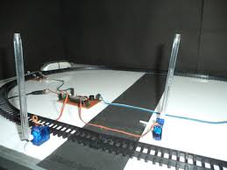
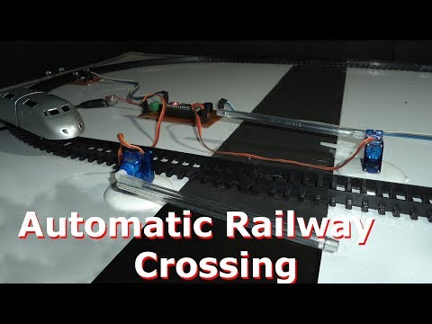
Automatic Railway gate control unit.

Slide 21
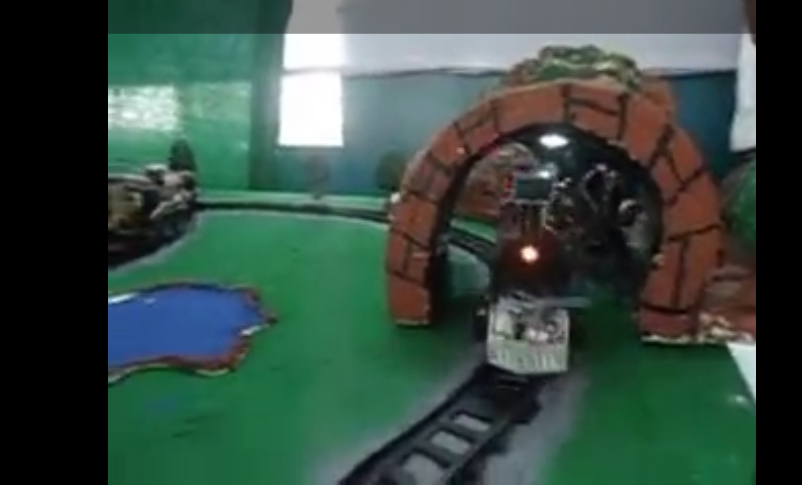
Track monitoring system

Slide 22
Hardware and Software requirements:
Railway gate control unit :
Arduino uno, ultrasonic sensor(two), servo motor, buzzer, led ’s, battery.
Railway track monitoring unit:
Arduino uno ,ultrasonic sensor,leds,
Crack detection unit:
Arduino (microcontroller), ultrasonic sensors, GPS and GSM module with SIM card, PIR sensor, Drivers ,DC motors, robot to fit all this components.
Software : Arduino IDE

