Slide 1

FACE DETECTION
Real-Time Face Detection using Webcam Feed
G.V.S.KOUSHIK

Slide 2

INTRODUCTION
The primary objective of this project was to create a system capable of detecting faces in real-time using a webcam feed.
The application of this technology spans a wide range of industries, from security systems to personalized user experiences.
The system I’ve developed uses a webcam to accurately identify and count faces, making it versatile tool with potential applications in security systems, user interfaces and more.

Slide 3
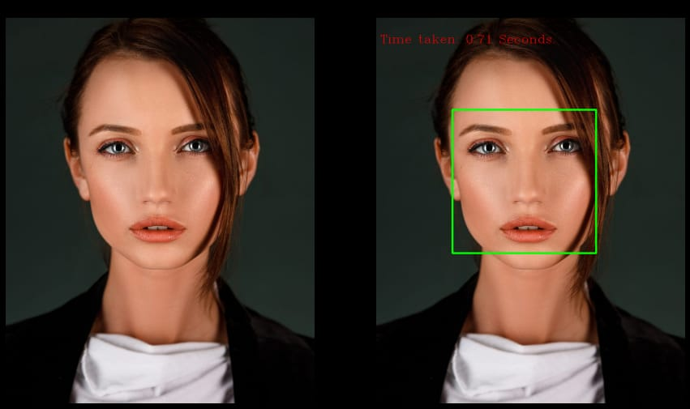
Key Features
Real-time face detection using a webcam feed.
Accurate identification of faces within the video feed

Slide 4
Conclusion
This project can be valuable asset in various industries where face detection plays a vital role.
This technology holds significant potential in various industries.

