Slide 1
ANALYSIS yolov2

Slide 2
Optimization techniques.
Exponentially Weighted Moving Average.
𝑣_{𝑡}=𝛽𝑣_{𝑡−1}+(1−𝛽)𝜃_{𝑡}.
Where 𝑣_{𝑡}= average at time stamp “t”. 𝑣_{𝑡−1 is previous average.}
𝛽 is hyper parameter, responsible for smoothness of the curve.
0<𝛽<1.
𝜃_{𝑡} is new data point.

Slide 3
𝑣_{0​}=0
𝑣₁​=𝛽𝑣 ₀​+(1−𝛽)𝜃_{1​}
𝑣₂=𝛽𝑣₁+(1−𝛽)𝜃₂
𝑣₃​=𝛽𝑣₂​+(1−𝛽)𝜃_{3​}
𝑣_{t​}=(1 − 𝛽)(𝑣_{t}​ + 𝛽¹ 𝑣_{t−1}​ + 𝛽²𝑣_{t−2}​ +…+ 𝛽^{t}𝑣_{0​}).
Here we can see that 𝛽 power increases for older data points thus, they are given less weightage.
Now, if we give 𝛽=0.9 is considered for better results. As curve will be smooth.

Slide 4
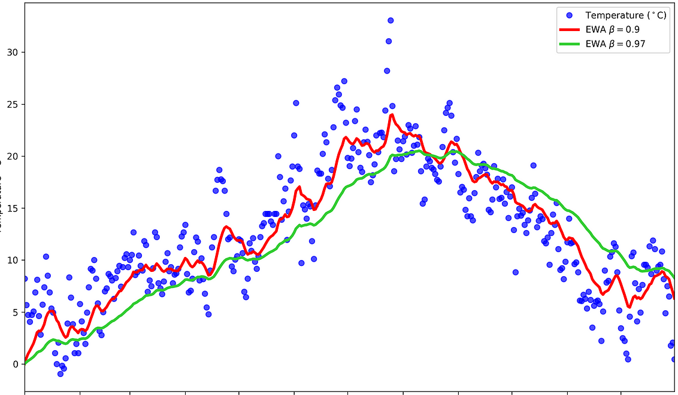

Slide 5
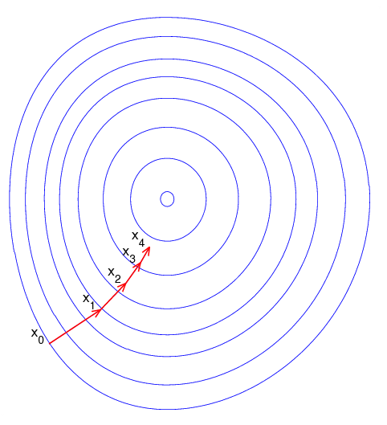
Introduction to Gradient Descent
Gradient descent is an optimization algorithm that’s used when training a machine learning model.
It’s based on a convex function and tweaks its parameters iteratively to minimize a given function to its local minimum.
A gradient simply measures the change in all weights with regard to the change in error.

Slide 6

You can also think of a gradient as the slope of a function. The higher the gradient, the steeper the slope and the faster a model can learn.
But if the slope is zero, the model stops learning. In mathematical terms, a gradient is a partial derivative with respect to its inputs.
Algorithm:
Initialize Weights: Start with an initial guess for the weights 𝑊.
Compute Gradient: Calculate the gradient of the function 𝐽(𝑊) with respect to the weights 𝑊

Slide 7

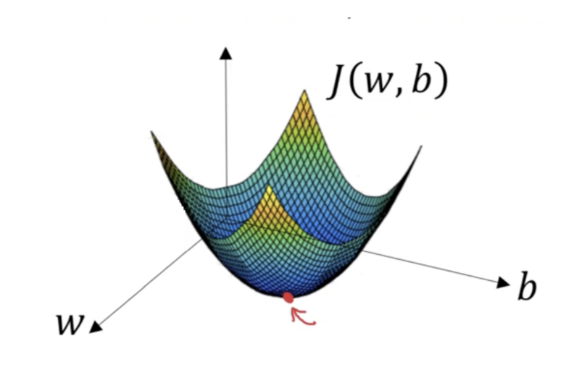
Update Weights: Adjust the weights in the opposite direction of the gradient to minimize 𝐽(𝑊):
where 𝛼 is
the learning rate, a small positive scalar.
Repeat: Iterate steps 2 and 3 until
convergence criteria are met.

Slide 8
Types of Gradient Descent
There are three popular types of gradient descent that mainly differ in the amount of data they use.
Batch Gradient Descent
Stochastic Gradient Descent
Mini-Batch Gradient Descent

Slide 9

Batch Gradient Descent
Calculates the error for each example within the training dataset, but only after all training examples have been evaluated does the model get updated.
This whole process is like a cycle and it’s called a training epoch.
batch gradient descent are computational efficient.
Sometimes result in a state of convergence that isn’t the best the model can achieve.
It also requires the entire training dataset to be in memory and available to the algorithm.

Slide 10

Stochastic Gradient Descent
SGD does this for each training example within the dataset, updates the parameters for each training example one by one.
This can make SGD faster than batch gradient descent.
Frequent updates allow us to have a pretty detailed rate of improvement.
Due to frequent updates are more computationally expensive than the batch gradient descent approach.
The frequency of those updates can result in noisy gradients, which may cause the error rate to jump around instead of slowly decreasing.

Slide 11

Mini-Batch Gradient Descent
Combination of the concepts of SGD and batch gradient descent.
It splits the training dataset into small batches and performs an update for each of those batches.
This creates a balance between the robustness of stochastic gradient descent and the efficiency of batch gradient descent.
Common mini-batch sizes range between 50 and 256.

Slide 12
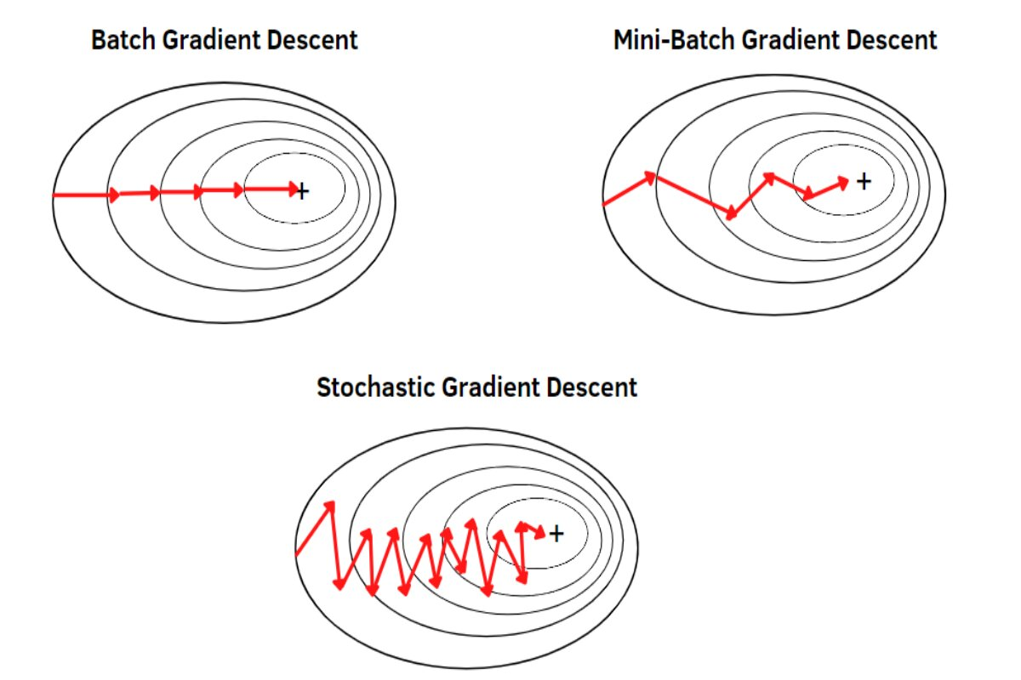

Slide 13
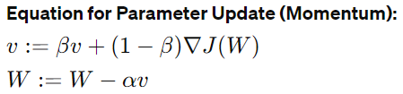
Momentum Optimizer
Momentum optimization is an extension of gradient descent that helps accelerate convergence and navigate through saddle points more effectively by adding momentum to the parameter updates.
v is the momentum term.
𝛽 is the momentum coefficient.
∇J(W) is the gradient of the loss function with respect to the parameters 𝑊.
α is the learning rate.

Slide 14
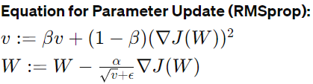
RMSprop Optimizer
RMSprop (Root Mean Square Propagation) is an adaptive learning rate optimization algorithm that adjusts the learning rates for each parameter based on the magnitudes of recent gradients.
v is the moving average of squared gradients.
𝛽 is the decay rate for the moving average.
∇J(W) is the gradient of the loss function with respect to the parameters 𝑊.
α is the learning rate.
ϵ is a small constant to prevent division by zero. 10^{-8 .}

Slide 15


ADAM optimizer
Adaptive Moment Estimation is an optimization algorithm commonly used for training deep learning models.
It combines the advantages of two other popular optimization algorithms, namely, RMSprop and Momentum.
ADAM is computationally efficient and requires minimal memory.
It automatically adapts the learning rate for each parameter, reducing the need for manual tuning.
Compute gradients: 𝑔=∇𝐽(𝑊).

Slide 16
Object Detection Using YOLO v2 Deep Learning:
Deep learning is a powerful machine learning technique that you can use to train robust object detectors.
Several techniques for object detection exist, including Faster R-CNN and you only look once (YOLO) v2.

Slide 17
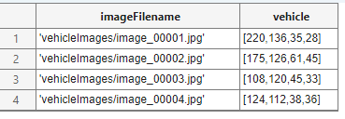
Load Data set :
In this we uses a small vehicle dataset that contains 295 images. Folder size 3.49MB.
Each image contains one or two labeled instances of a vehicle.
The vehicle data is stored in a two-column table, where the first column contains the image file paths and the second column contains the vehicle bounding boxes.

Slide 18

Organizing Data :
Split the dataset into training, validation, and test sets. Select 60% of the data for training, 10% for validation, and the rest for testing the trained detector.
Use imageDatastore and boxLabelDatastore to create datastores for loading the image and label data during training and evaluation.
Namely imdsTrain and bldsTrain for Training similarly we can do for validation and testing
Combine image and box label datastores.

Slide 19
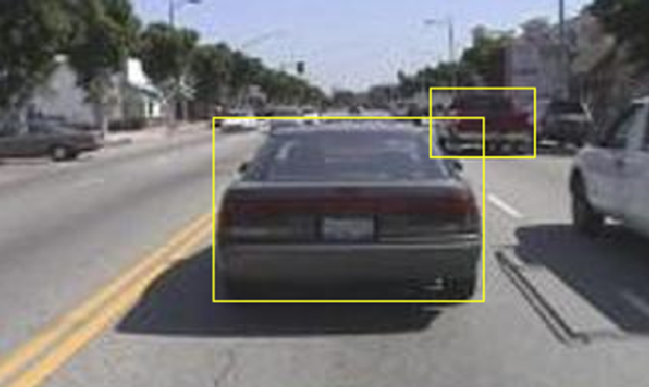
Displaying one of the training images with box labels

Slide 20
Create a YOLO v2 Object Detection Network
A YOLO v2 object detection network is composed of two subnetworks.
A feature extraction network followed by a detection network.
In this we are using ResNet-50(Pretrained CNN) for feature extraction.
The detection sub-network is a small CNN compared to the feature extraction network and is composed of a few convolutional layers and layers specific for YOLO v2.
Using the yolov2Layers (CV tool box) function to create a YOLO v2 object detection network automatically given a pretrained ResNet-50 feature extraction network. yolov2Layers requires you to specify several inputs that parameterize a YOLO v2 network

Slide 21
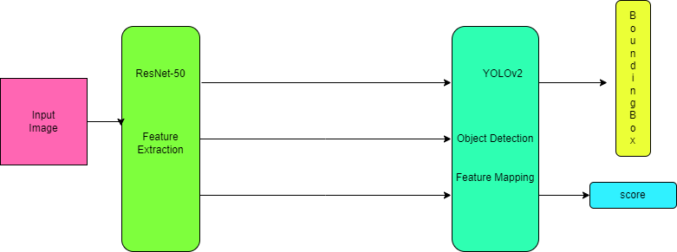
Network Model

Slide 22
Resnet-50
ResNet-50 consists of multiple layers organized in a deep convolutional neural network architecture.
Input Layer:
This is the first layer of the network, which receives the input image data. In ResNet-50, the input size is typically 224x224 pixels with three color channels (RGB).
Convolutional Layers:
ResNet-50 contains several convolutional layers, which perform feature extraction by applying convolutional filters to the input image. These layers are responsible for detecting edges, textures, and other low-level features.

Slide 23
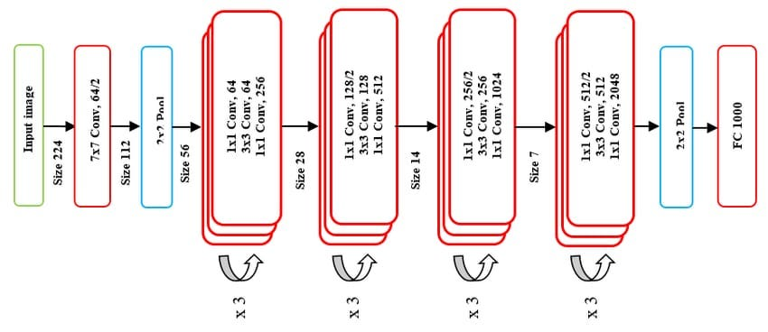
Pooling Layers: ResNet-50 includes pooling layers, typically max pooling, which downsample the feature maps to reduce spatial dimensions while preserving important features.
Fully Connected Layers: At the end of the network, ResNet-50 typically includes one or more fully connected layers followed by a softmax activation function. These layers perform classification by mapping the extracted features to the output classes.

Slide 24
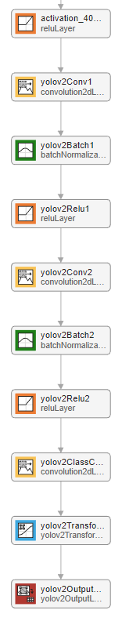
Now we select "activation_40_relu”, 141th Layer as the feature extraction layer. Specifically, we'll replace the layers after "activation_40_relu" with the detection subnetwork.
Creating YOLO V2 sub-Network this only of 9 layers consisting Convolution2DLayer, BatchNormalizationLayer, ReLULayer, YOLv2TransformLayer and YOLOv2OutputLayer.
Making overall Network of 150 Layers.

Slide 25
We need to preprocess the training and validation data before training.
Preprocessing includes image resizing to input layer size of network.
Training the Network
Now, we need to train the network. Here, we are keeping training options as.
1)We will change solver keeping other parameters constant.
1.1)
Solver = SGDM
MiniBatchSize = 16
InitialLearnRate = 1e-3
MaxEpochs = 20
Validation frequency = 50 iteration.

Slide 26
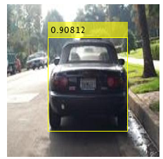
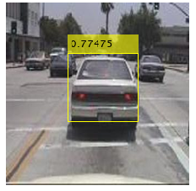
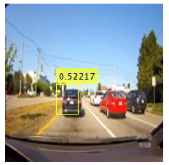
Testing
Training Time elapse = 22min 30 sec
FinalvalidationRSME = 0.7517
FinaltrainingRSME = 0.4282

Slide 27
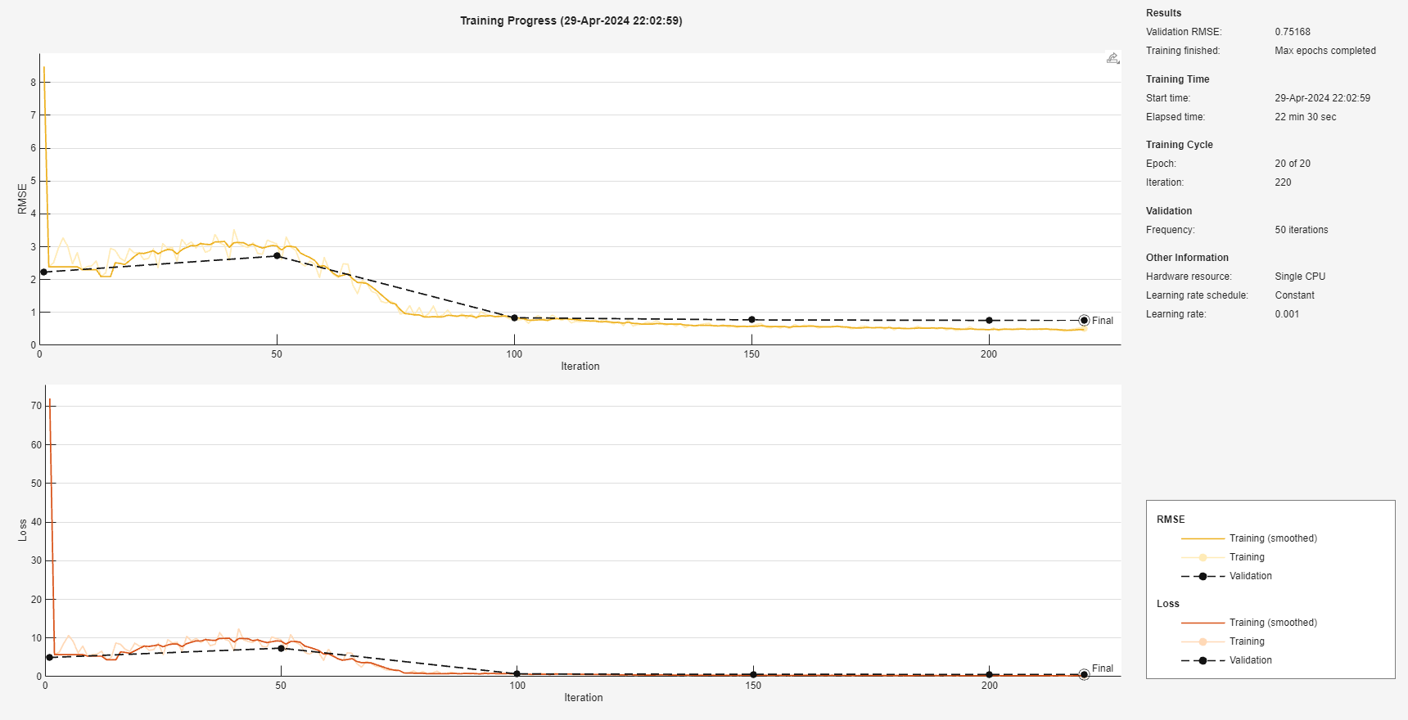

Slide 28
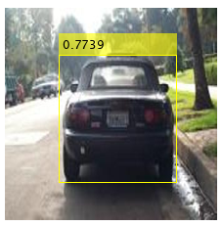
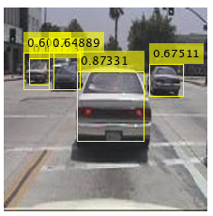
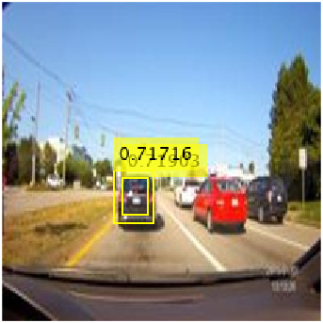
1.2)
Solver = rmsprop
MiniBatchSize = 16
InitialLearnRate = 1e-3
MaxEpochs = 20
Validation frequency = 50 iteration
Training Time elapse = 22min 58 sec
FinalvalidationRSME = 0.7272
FinaltrainingRSME = 0.3016

Slide 29
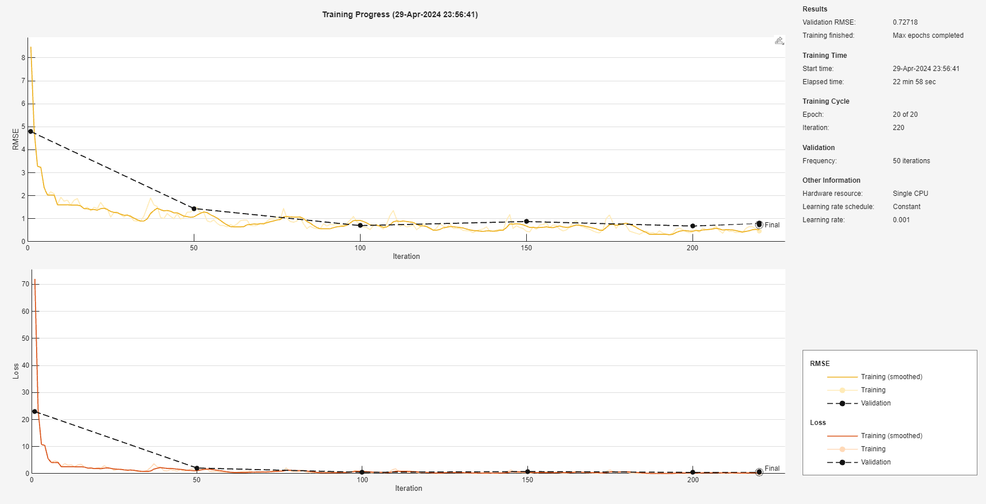

Slide 30
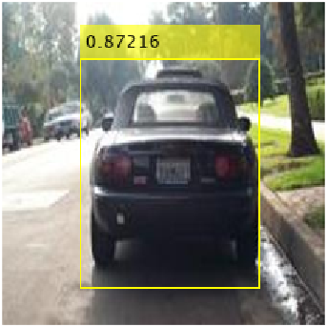
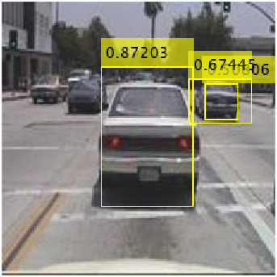
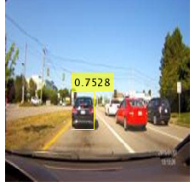
1.3)
Solver = ADAM
MiniBatchSize = 16
InitialLearnRate = 1e-3
MaxEpochs = 20
Validation frequency = 50 iteration.
Training Time elapse = 22min 42 sec
FinalvalidationRSME = 0.6596
FinaltrainingRSME = 0.2516

Slide 31
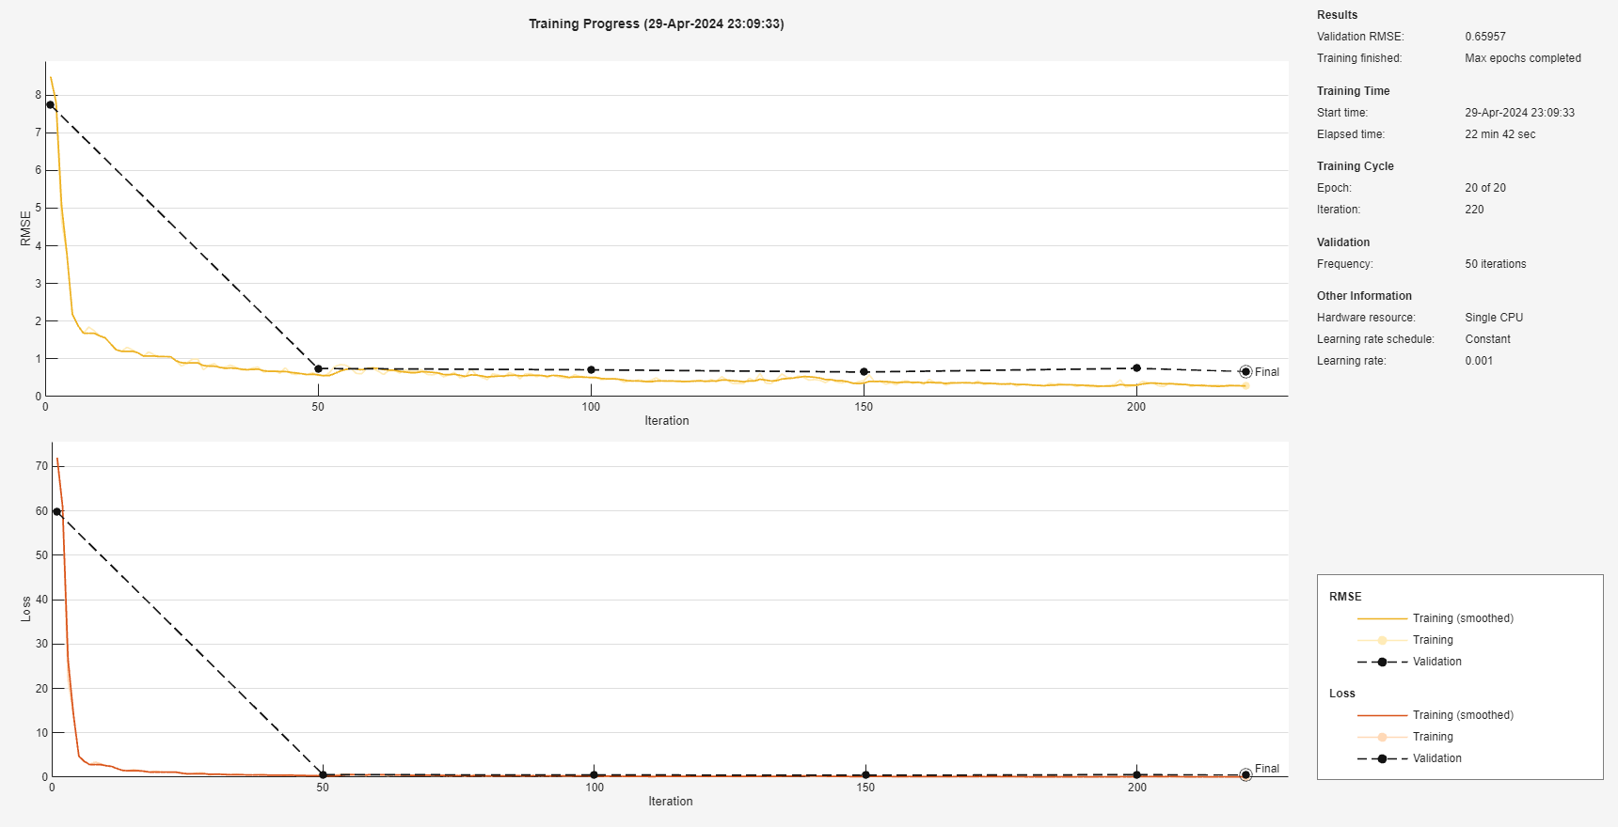

Slide 32
Analysis

Slide 33
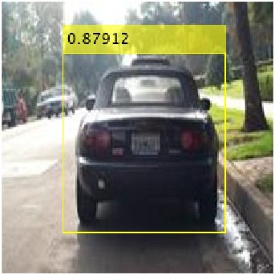
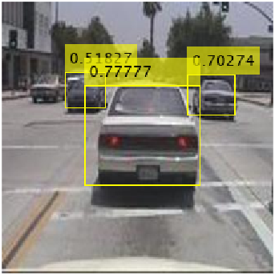
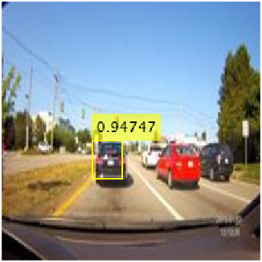
2)Now we will change mini-batch size.
2.1)
Solver = ADAM
MiniBatchSize = 10
InitialLearnRate = 1e-3
MaxEpochs = 20
Validation frequency = 50 iteration.
Training Time elapse = 23min 42 sec
FinalvalidationRSME = 0.68167
FinaltrainingRSME = 0.2413

Slide 34
