Slide 1

SREENIDHI INSTITUTE OF SCIENCE AND TECHNOLOGY (AN AUTONOMOUS INSTITUTION Approved by UGC) Yamnampet, Ghatkesar, R.R. District -501 301 DEPARTMENT OF COMPUTER SCIENCE & ENGINEERING
Seminar
CRIME PREDICTION USING MACHINE LEARNING
By:
KASHETTY KOUSHIK(16311A0525)
YADAPALLI GOPI (16311A0554)
BACHU SAI HARSHANK(16311A0560)
Internal guide Project Co-ordinator Head of Department
V.Satheesh Kumar Mrs.P.Vasavi Dr.Aruna Varanasi
Assistant Professor Assistant Professor Professor & HOD
Department of CSE Department of CSE Department of CSE

Slide 2
Contents:
Abstract
Introduction
Architecture
Existing system
Proposed system
Software and hardware requirements
Dataset used
Process of execution
Output Screens
conclusion

Slide 3
Abstract
Crime analysis and prevention is a systematic approach for identifying and analyzing patterns and trends in crime.
Our system can predict regions which have high probability for crime occurrence. Using the concept of machine learning we can extract previously unknown, useful information from an unstructured data.
The task is to predict which category of crime is most likely to occur given a time and place using different algorithms..

Slide 4
Introduction
In this research, we use python as a open source software for the project.
To conduct A comparative study between the violent crime patterns from the communities
We will implement the Linear regression, Multiple Linear Regression , Decision Tree Regression
And Random Forest Regression algorithms to solve the problem

Slide 5
Existing system:
S.NO | PAPER NAME | ALGORITHMS USED | ACCURACY
01 | PREDICTION OF CRIME USING K-MEANS | KNN,SVM | 79.6%
02 | PREDICTION OF CRIME USING DEEP LEARNING | DEEP LEARNING TECHNIQUE | 83.2%
03 | A SURVEY PAPER ON CRIME PREDICTION TECHNIQUE USING DATA MIONING | BAYESIAN NETWORK, ARTIFICIAL NEURAL NETWORK, FUZZY TIME SERIES | 90.9%

Slide 6
PROPOSED SYSTEM:
The existing system maintains accuracy is less.
So, we are using alogrithms with maintain more accuracy compare with this.
Before apply alogrithms to the dataset we must clean the data
It predicts where the crime happens and at which place crime happens before crime happened.

Slide 7
Dataset
Preprocessing
Model Building
Training
Testing
predict

Slide 8
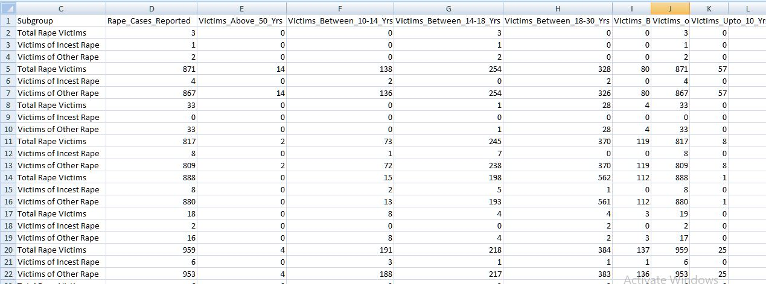
Data set is in the form of CSV file

Slide 9
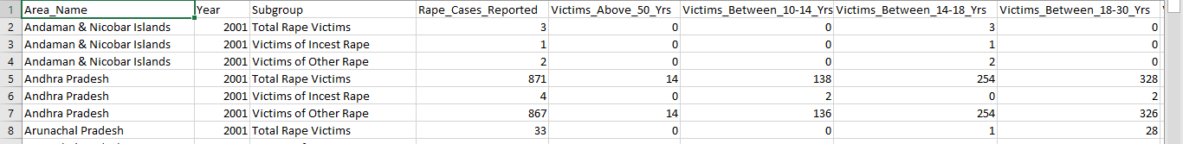
Process of execution
Initially the data was randomly distributed .
We modified the data according to the sorted order of the years. Here is a snapshot of the sorted dataset.

Slide 10
Later we segregated the input and output attributes and has split the data into training and test sets.
The next step is preprocessing of the data.
Later we applied the mentioned algorithms and found the accuracy with each of the algorithms.

Slide 11
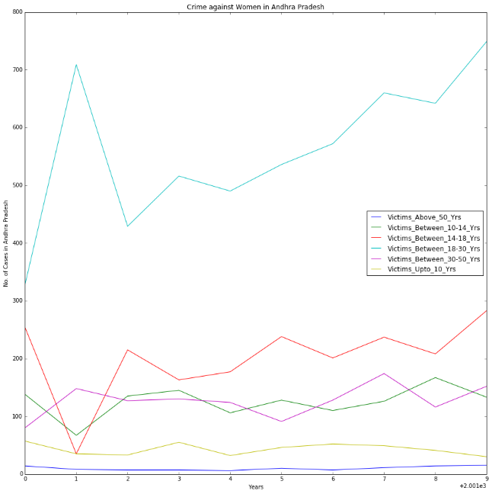
URFACE

Slide 12
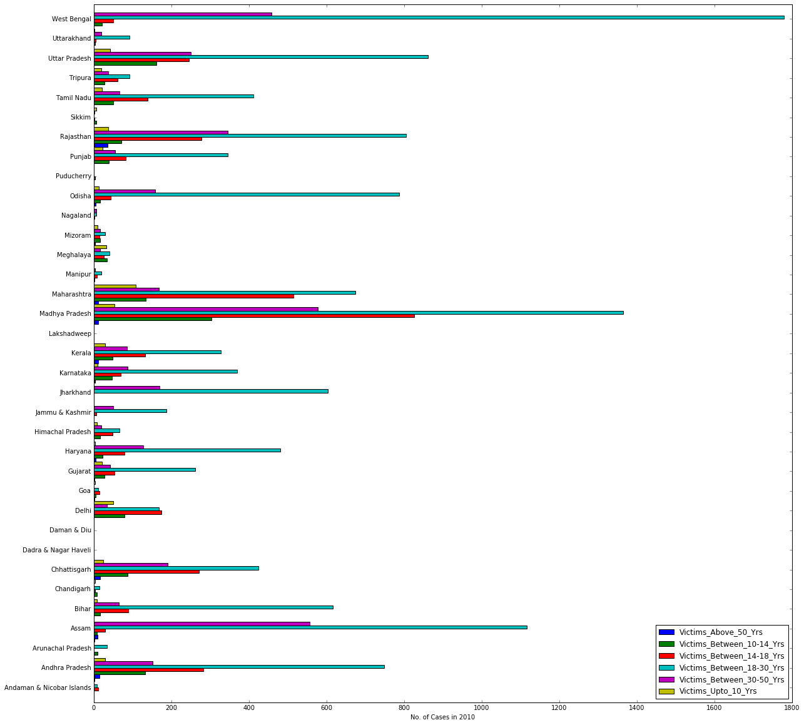

Slide 13
FUTURE ENHANCEMENT
For this research, only crime data has been used, but as many researched have showed that a particular area’s socio-economic standard is also a key indicator of possible criminal activity.
This machine learning agent could incorporate those data and might perform better. This model can be also used for other geographic locations.
This would also help to analyze crimes occurring in different locations and build a better understanding of different crimes and its relation with particular demography.

Slide 14
Continued:
there are many advanced machine learning approaches that can be explored.
Deep Learning & Neural Networks can provide a more balanced understanding of criminal activities.

Slide 15
Conclusion
We have performed all the algorithms mentioned above .
Among them we have found that decision tree and random forest algorithms are giving more accurate results.

Slide 16
References
https://www.kaggle.com/uciml/pima-indians-crime-database
https://www.coursera.org/learn/machine-learning
https://onlinecourses.nptel.ac.in/noc19_cs35/unit?unit=51&lesson=55
https://www.geeksforgeeks.org/understanding-multiple-regression

Slide 17
THANK YOU

