Slide 1

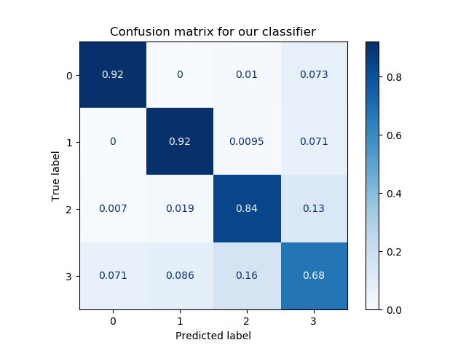
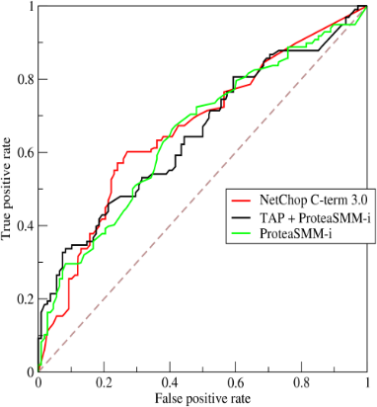





Architecture for a Simple Web App
( REST API Call )
Upload Data
Select Model
Set Hyper Parameters
browse
Random Forest
browse
PREPROCESSING
( PRE-TRAINED MODEL )
AUTHENTICATION
Download Report
( API Response )
DASHBOARD
BACKEND
CMD

