Slide 1
Salary Prediction EDA
DSDJ Team

Slide 2
Data Exploration Overview
Several plots were made to explore the relationships between various features
This will guide our approach to modeling the data, especially categorical features
The data covers over one million records (with few duplicates)
Generally appears to be uniformly distributed among many features

Slide 3
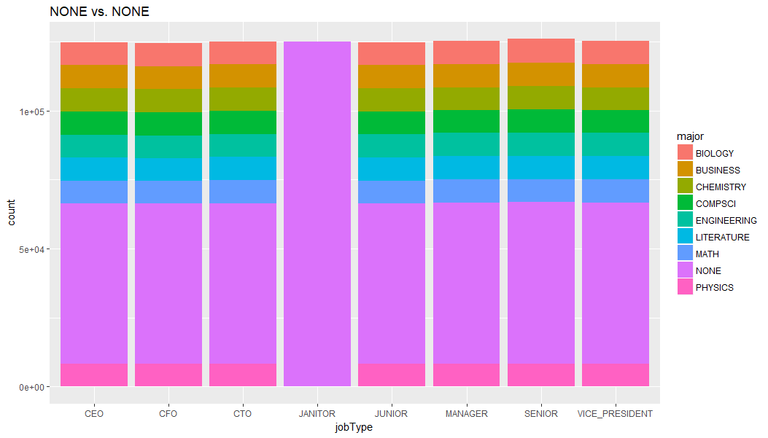
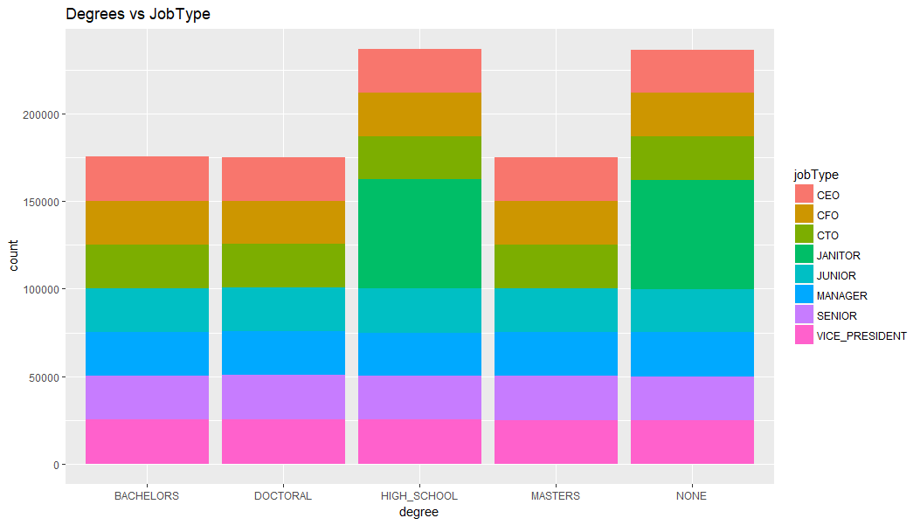
Left plot
All Janitors had “none” major
The rest have equal percentage of everting
None Major -> Janitor but the opposite is not necessarily true
Right plot
All jobs have similar distribution across majors, except Janitors

Slide 4
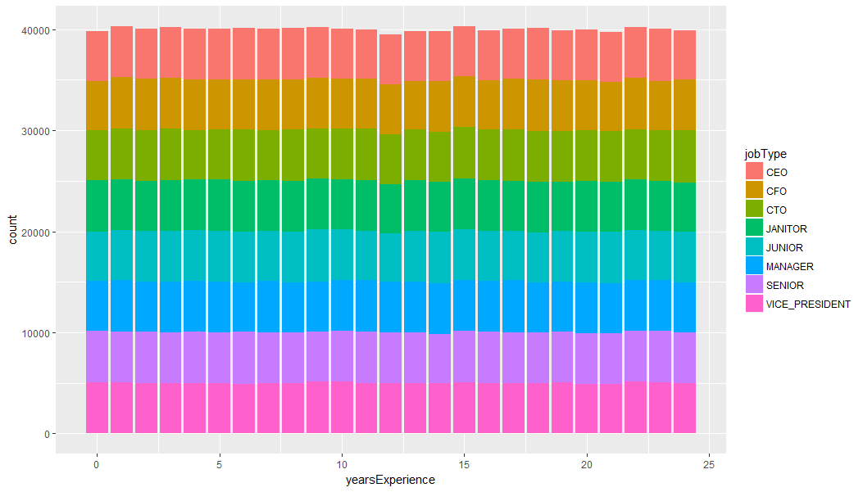
All JobTypes have the same experience distribution

Slide 5
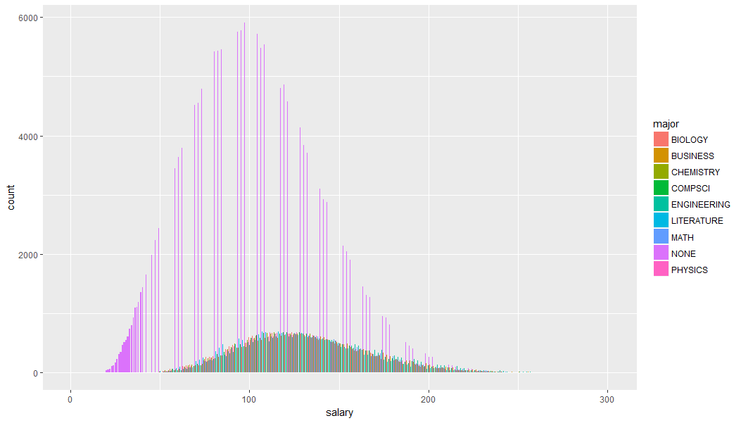
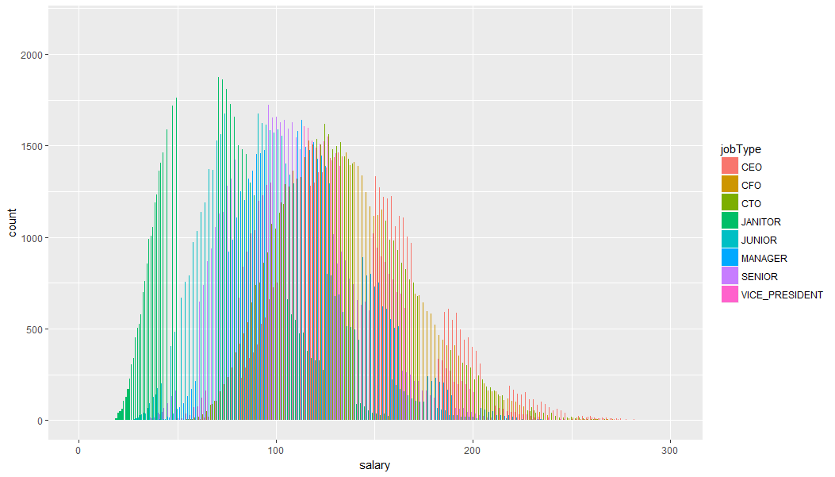
Left plot
Salary distribution for different majors
All seem to have gaussian distribution, NONE has more value (it cover two classes: pre-college and unlisted majors
Right plot
Salary distribution for different job types
Birds-eye view. We can see the all of the types have a distribution around a center

Slide 6
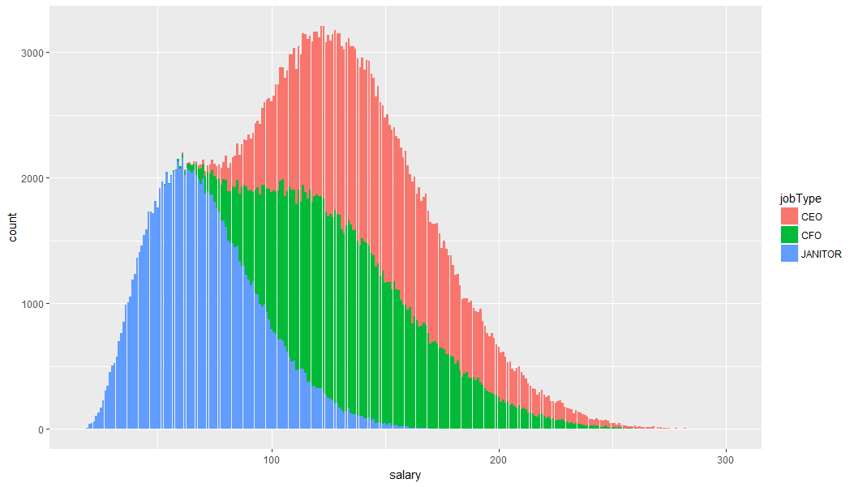
Similar plot to the one on the right of the previous slide. This time for 3 jobType values. Notice the overlap

Slide 7
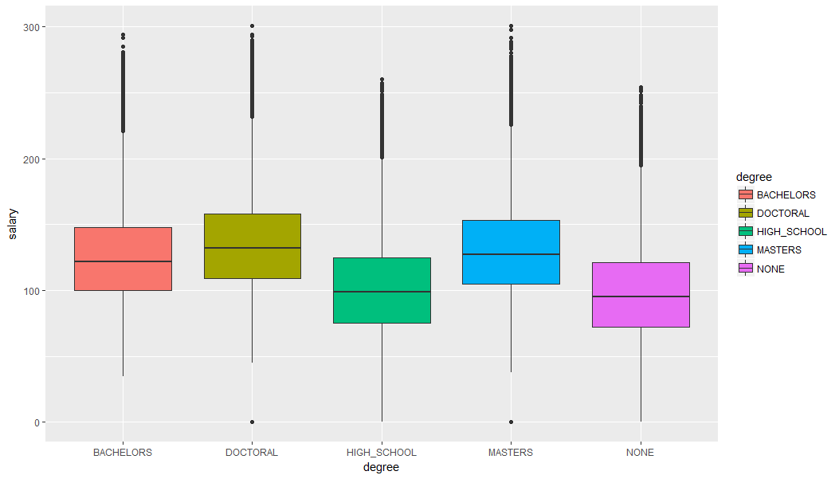
Clear difference is observed in the salary of different degree holders. Though the groups certainly overlap!
The box-plot shows a large number of outliers. A common there in all the box-plots we will show

Slide 8
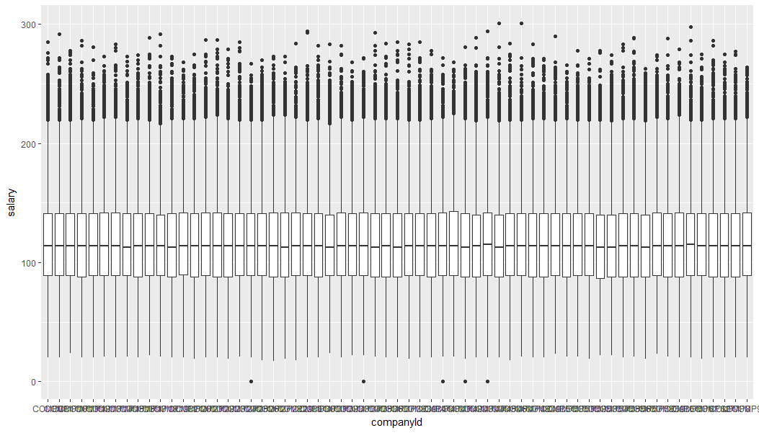
This box-plot shows all the companies with postings. Though cluttered a bit, it clearly shows that the salaries are distributed almost uniformly among the companies -> we will consider this data categorical without order

Slide 9
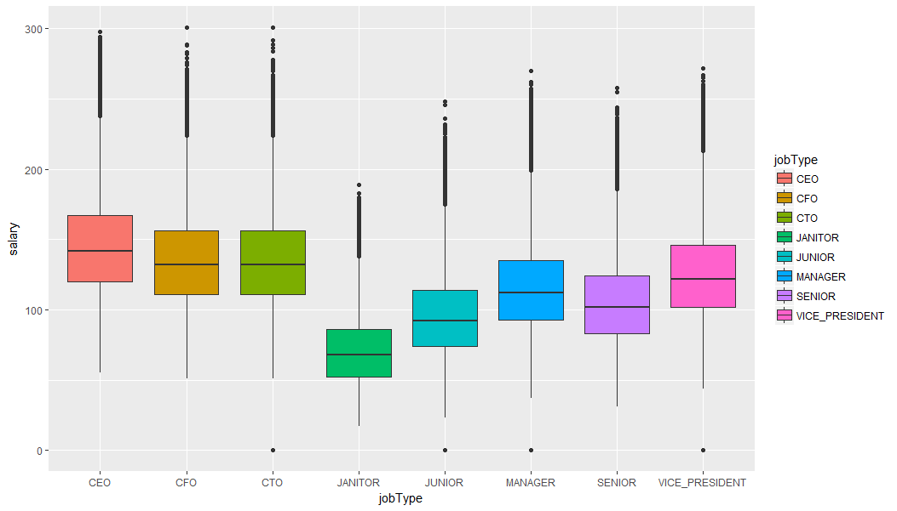
We see clear order for the salaries of different job types. We can either assign order to all eight or group few types together. Both were explored during the feature engineering phase

Slide 10
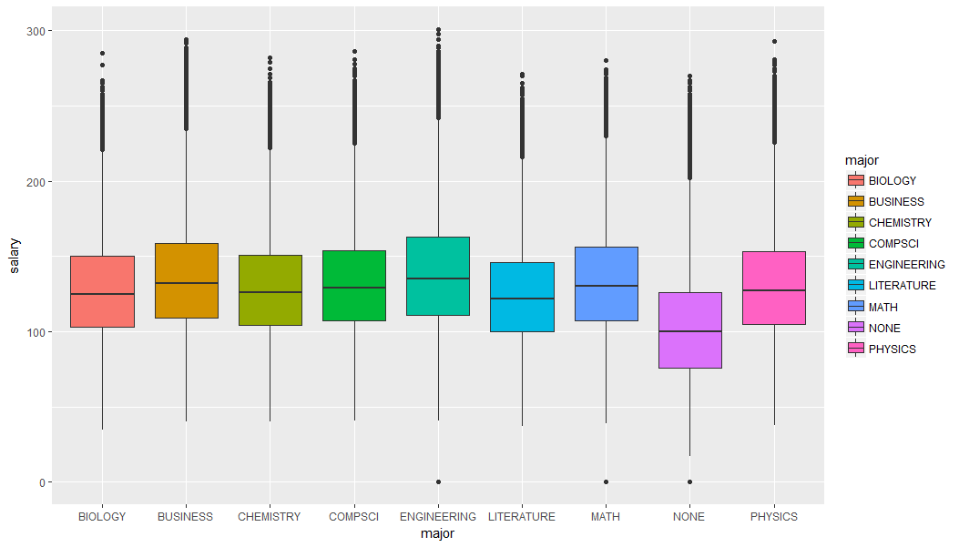
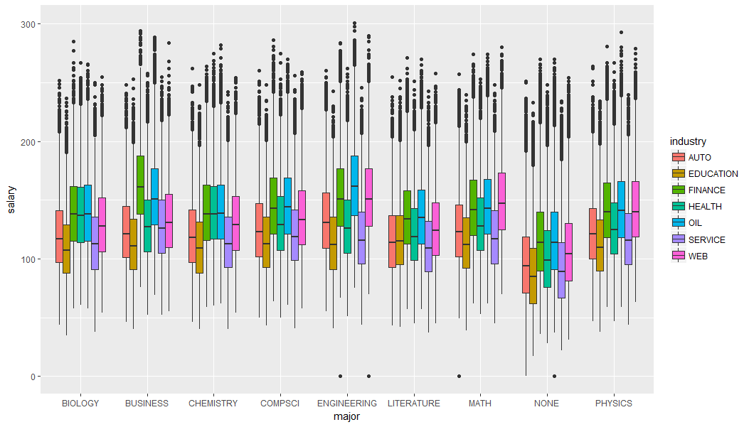
Left plot
Break down of the salary based on major
Right plot
Same plot, but with each major analyzed in terms of jobType openings

Slide 11
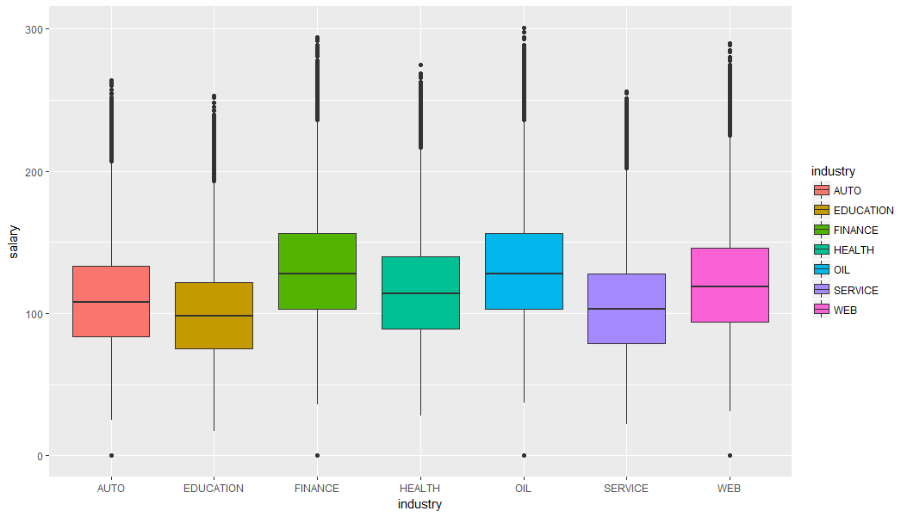
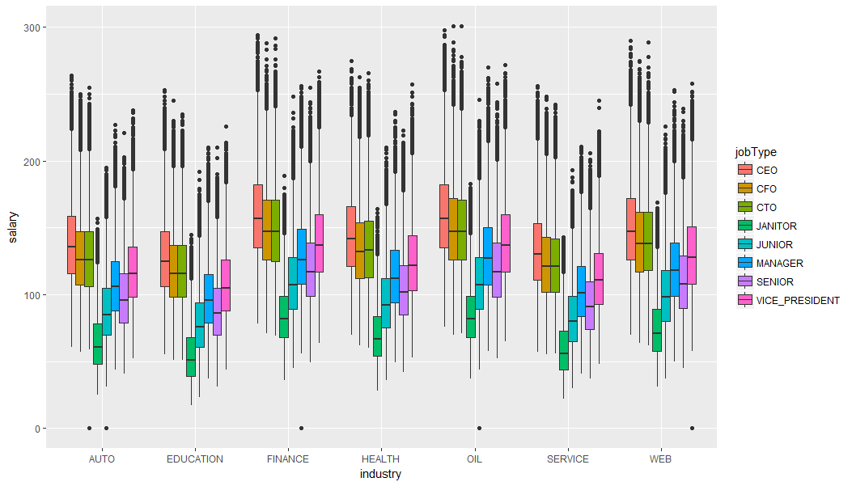
Left plot
The salary order among different industries
Right plot
Similar to left plot, only each industry is divided into jobTypes. Notice that the CEO in education makes, on average, less money than several executives in the financial industry

