Slide 1

Northeastern University
INFO 6150 Final Project
Team 21 - Team Members:
Asfan Sajid - NUID - 001546755
Gowtham Raghuraman - NUID - 001529954
Koushik Kumar Karre – NUID - 001568820

Slide 2
Northeastern University
Objective
University Offers online Cross training platform to learn and excel in skills that is outside your course curriculum.
This course is being offered hybrid due to Covid 19 restrictions and few classes are offered in-person too.
The Admin would add new courses based on the demand from the university students and can do CRUD operations on the courses being offered.
Students can login and enroll to courses that they would like to learn and drop them anytime as they wish.

Slide 3




Northeastern University
Login API
Email API
Features Implemented
React Video Player
File Upload
This Photo by Unknown Author is licensed under CC BY-NC-ND
This Photo by Unknown Author is licensed under CC BY-NC
This Photo by Unknown Author is licensed under CC BY-NC

Slide 4
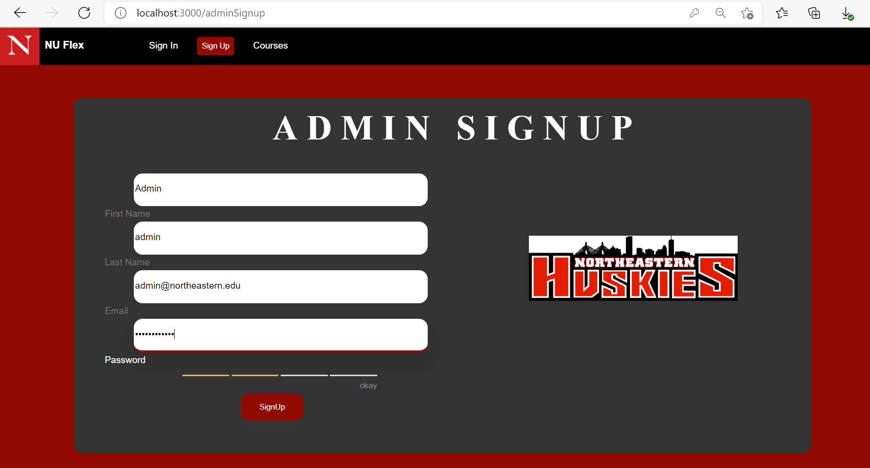
Northeastern University
Step 1:
Create Admin

Slide 5
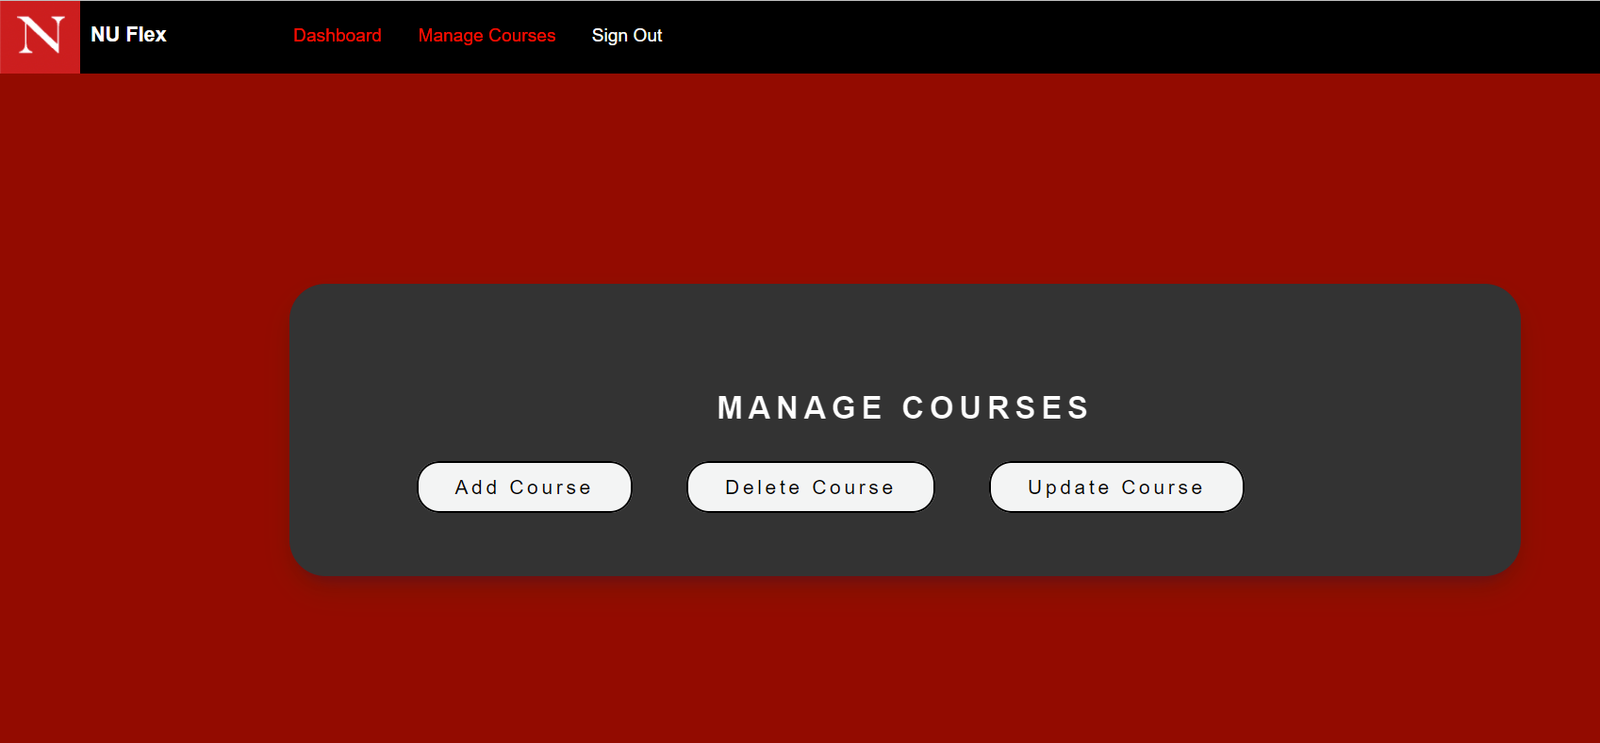
Northeastern University
Step 2:
Admin
CRUD Operations

Slide 6
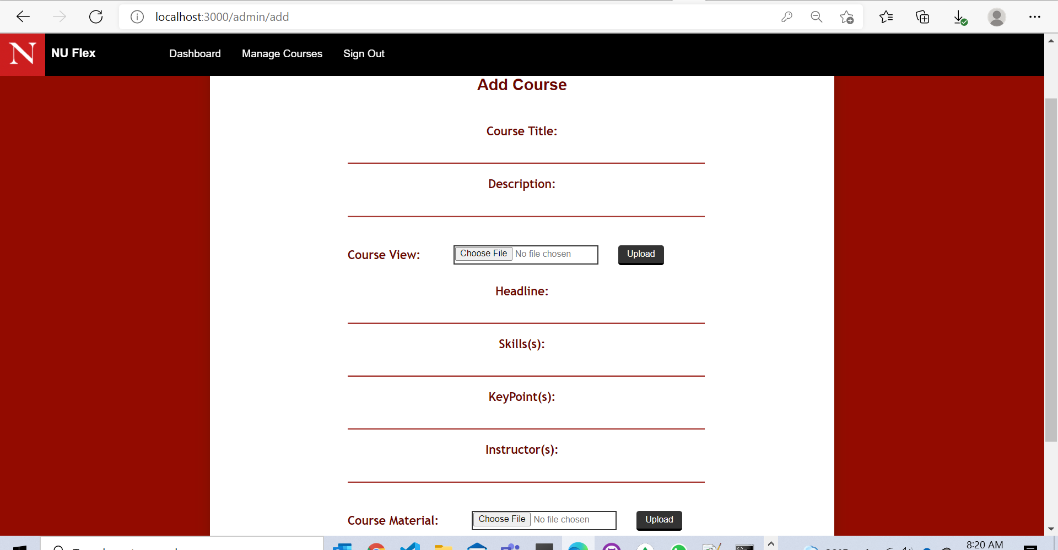
Northeastern University
Step 3:
Add New Course

Slide 7
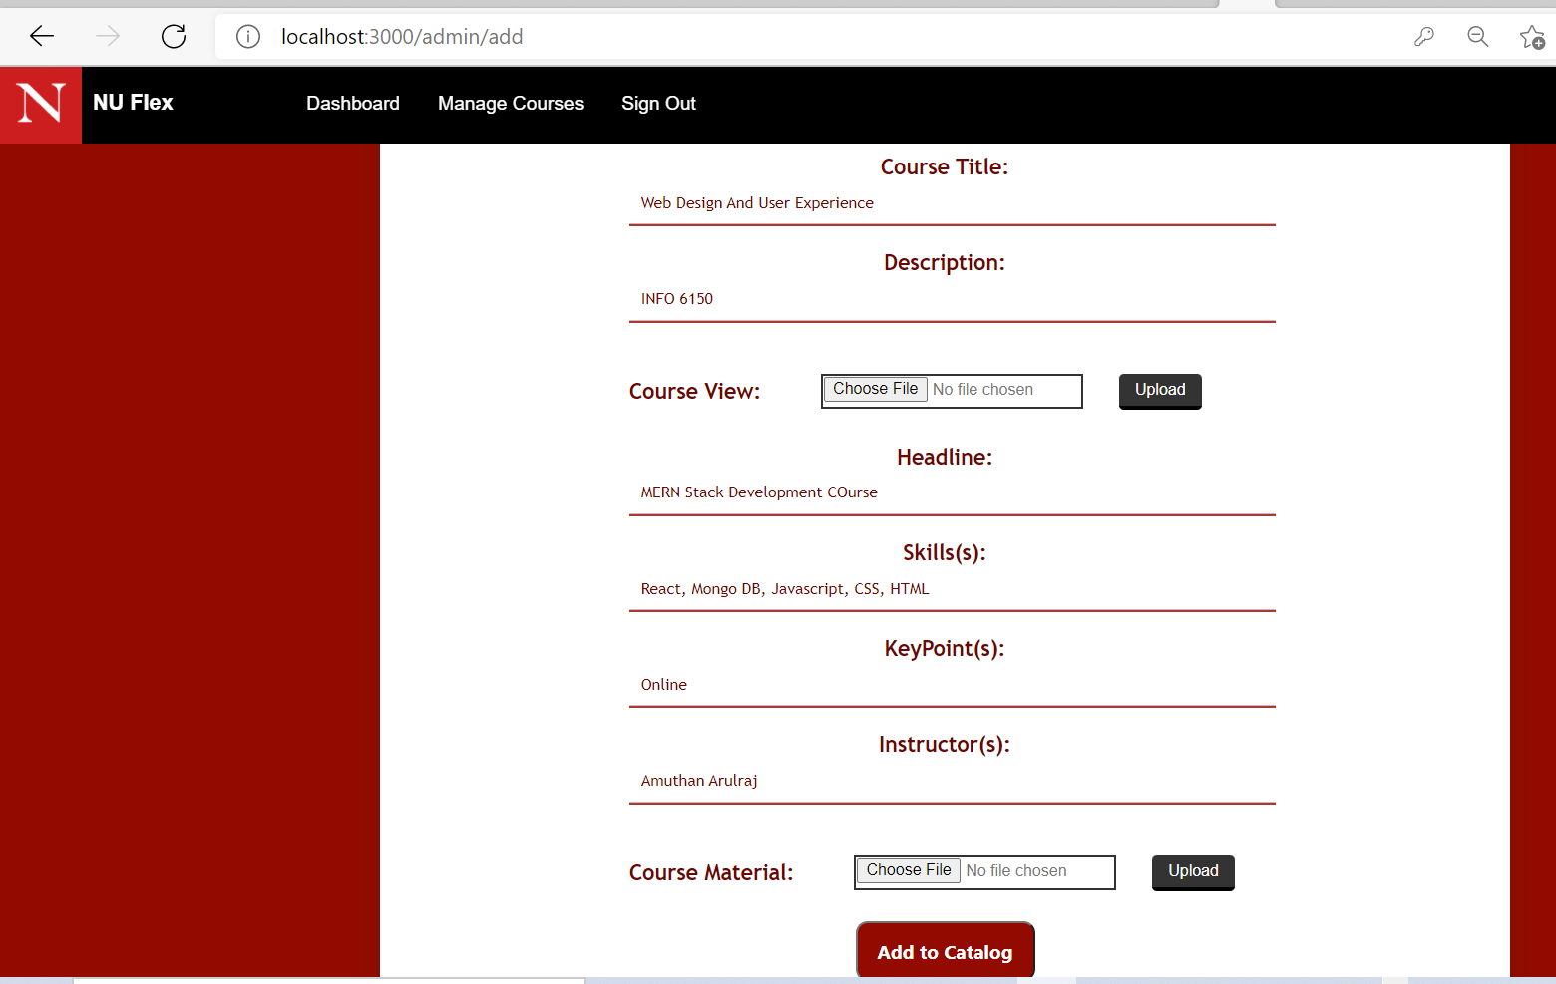
Northeastern University
Step 4:
Add New Course

Slide 8
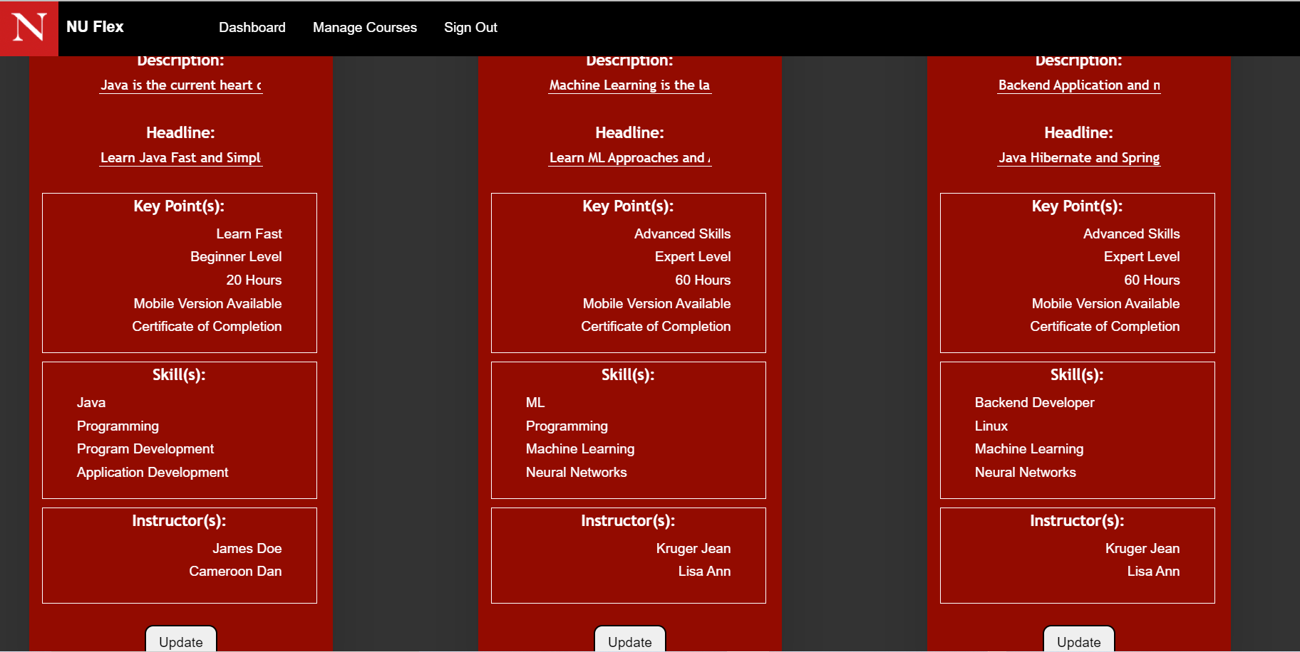
Northeastern University
Step 5:
Update
Courses

Slide 9
Northeastern University
Step 6:
Update
Courses or Delete Course

Slide 10
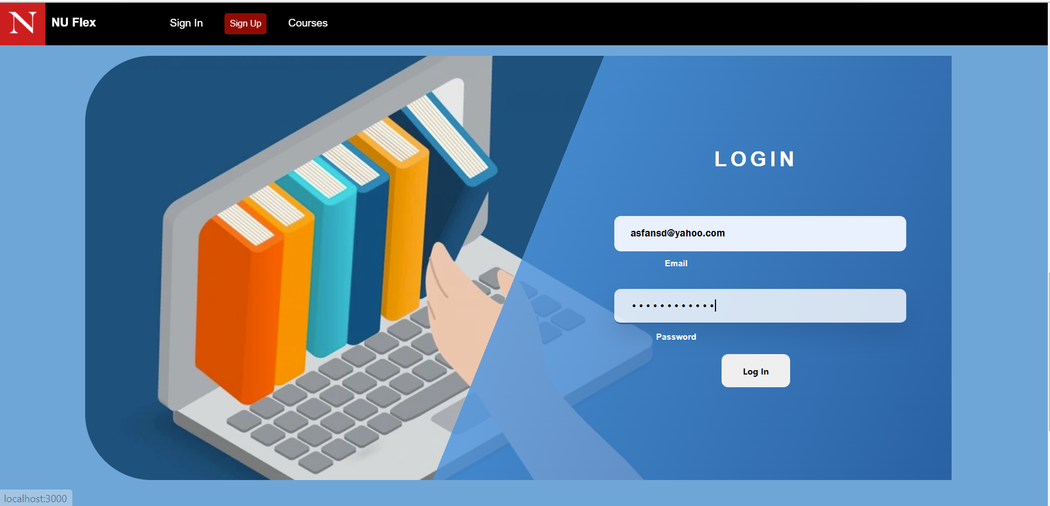
Northeastern University
Step 7:
User Login
Page

Slide 11
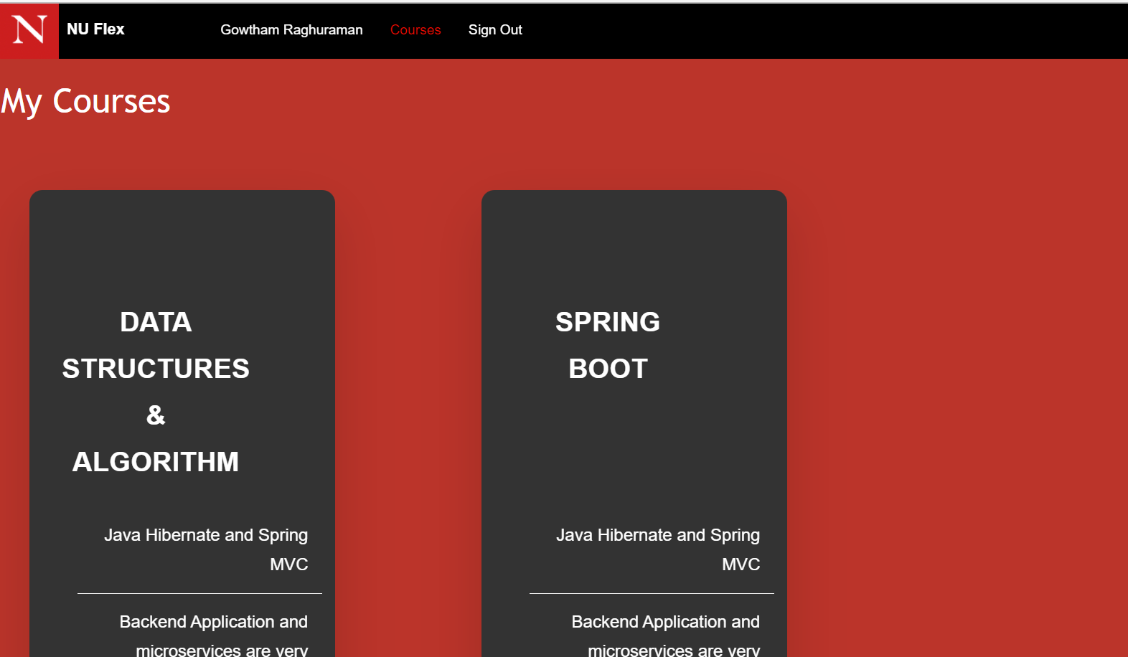
Northeastern University
Step 8:
User Registered Course

Slide 12
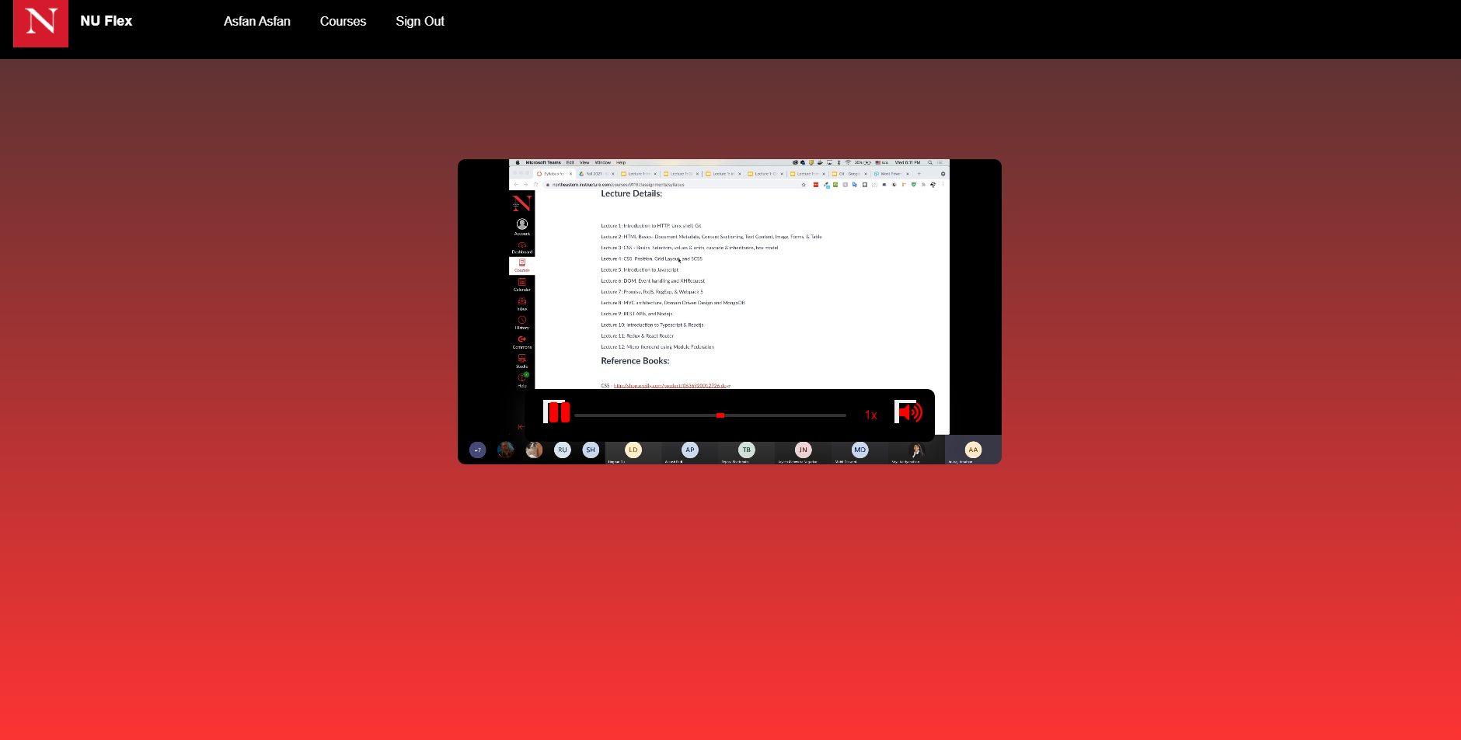
Northeastern University
Step 9:
Course: Study Now

Slide 13
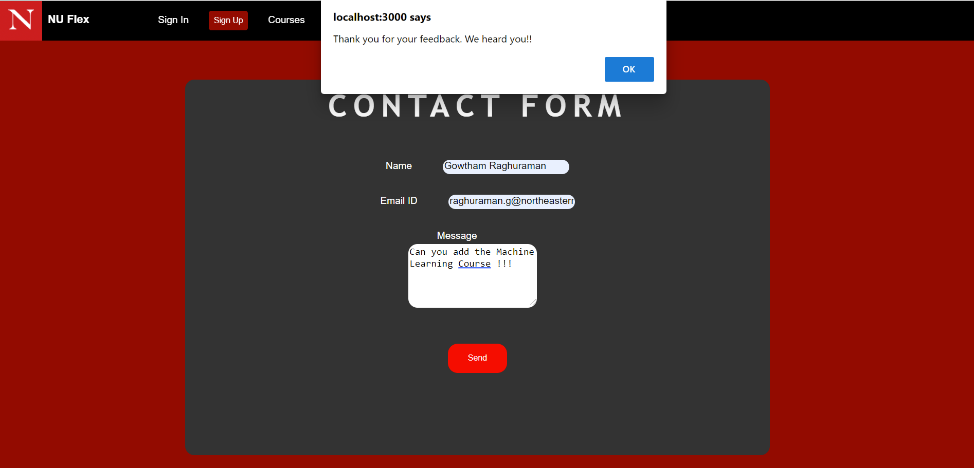
Northeastern University
Step 10:
Feedback Page

Slide 14
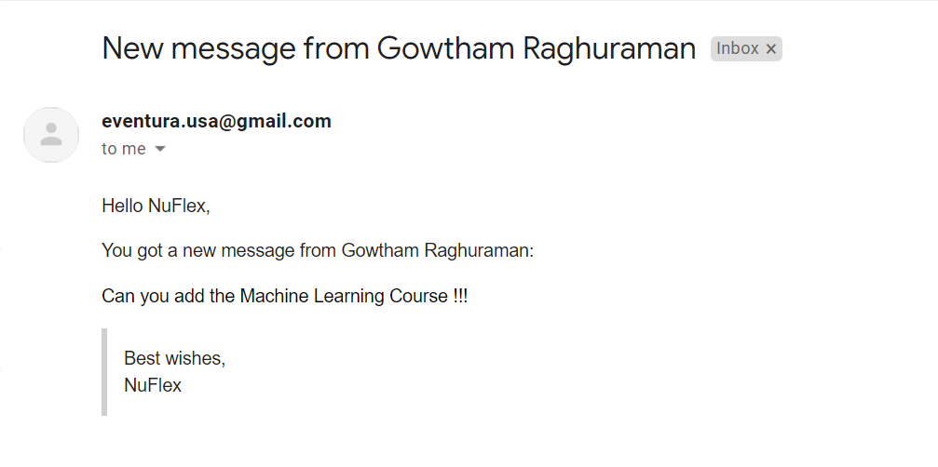
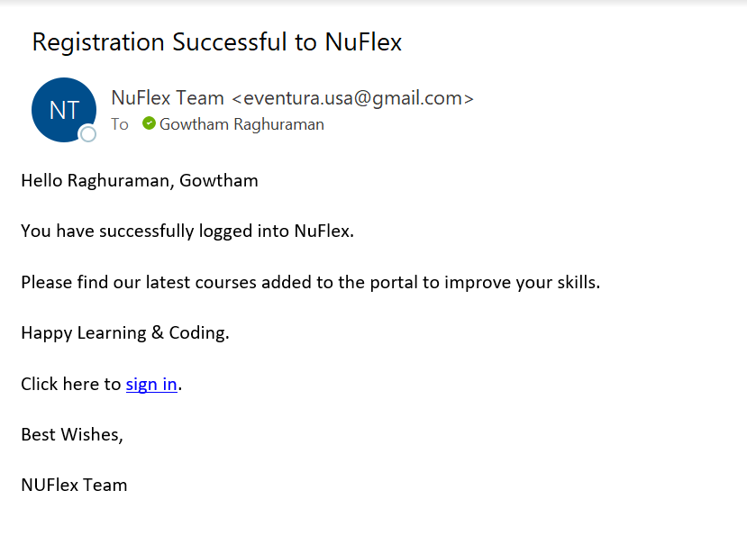
Northeastern University
Email Notifications

Slide 15
Northeastern University
Contributions
Name
Asfan Sajid | Node, Express, Auth API, Mongo DB, Carousel Theme, Controllers
Gowtham Raghuraman | React Hooks, Email API, React Video player, File Upload
Koushik Kumar Karre | Mongo DB Atlas, React Routers ,Theme SCSS, React Hooks
As a team we had equally contributed in creating Pages, Working on React components & Hooks, implementing JWT and applying SCSS styles to it.

Slide 16
Northeastern University
References
https://reactjs.org/docs/react-dom.html
https://reactjs.org/docs/hooks-intro.html
https://developer.mozilla.org/en-US/docs/Web/CSS
http://expressjs.com/en/guide/routing.html
https://reactjs.org/docs/react-component.html

Slide 17
Northeastern University
Thank you

