Slide 1
Multi-omics dissection of therapeutic resistance mechanisms in KRAS-mutant cancers to identify rational combination strategies
Koushik Muthuselvam, Sarvesh Sunil Kurup
College of Science, Northeastern University
BINF6420: Omics in Bioinformatics
Prof. Max Wolf
December 1, 2025
Notes:
Good [morning/afternoon]. I’m Sarvesh , and we're presenting work on **Multi-Omics Dissection of Therapeutic Resistance Mechanisms in KRAS-Mutant Cancers**. This research explores why patients rapidly develop resistance to KRAS therapies and how multi-layered omics can identify rational combination strategies to prevent it.

Slide 2

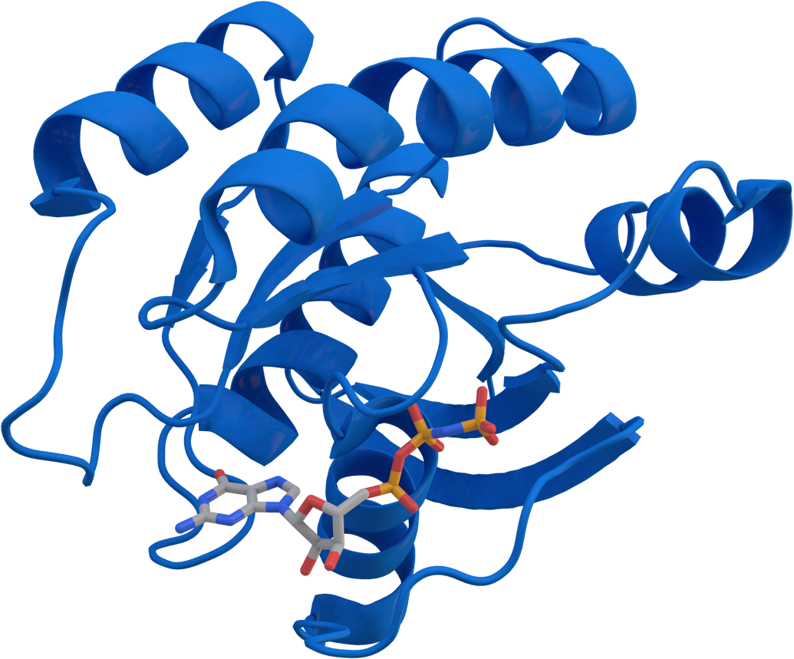
KRAS
WHY IT MATTERS?
KRAS as a Molecular Switch
KRAS encodes a membrane-bound GTPase a molecular switch controlling cell growth and survival signaling
Scale & Clinical Burden
KRAS mutations occur in ~23% of all human cancers—175,000 new cases/year in the US alone
The Paradox: Breakthrough + Failure
Non-G12C mutations (G12D, G12V, G13D) have NO direct inhibitors; these patients are untreated
Oncogenic mutations lock KRAS in its ‘on’ state, driving proliferation
Highest prevalence: pancreatic (92%), colorectal (49%), lung (35%)”
KRAS was considered ‘undruggable’ for 40 years until G12C inhibitors (sotorasib, adagrasib) were approved in 2021-2022”
Yet patients only benefit for 3-6 months before resistance emerges
Notes:
Let me set the stage with why KRAS is so important. KRAS is mutated in approximately **23% of all cancers**that's roughly **175,000 new cases every year in the United States alone**.
> The mutations we care about most are concentrated in three cancer types: **92% of pancreatic cancers**, **49% of colorectal cancers**, and **35% of lung cancers**. These are some of the most deadly cancer types we have.
>
> Now, what does KRAS actually do? It's a membrane-bound protein that acts like a molecular switch normally it alternates between an inactive GDP state and an active GTP state. But when KRAS is mutated, this switch gets *stuck in the on position*, causing constant signaling through the MAPK and PI3K/AKT pathways. That constitutive activation drives uncontrolled cell proliferation.
> For decades, KRAS was considered "undruggable we couldn't target it directly. But that changed in 2021-2022 when sotorasib and adagrasib KRAS G12C inhibitors were approved by the FDA. This was a huge breakthrough.
> But here's the problem: while these drugs work initially, patients develop resistance incredibly quickly. We're talking median progression-free survival of **6 months for lung cancer and only 3 months for colorectal cancer**. And worse 85% of KRAS-mutant patients *don't even have G12C mutations*. They have G12D, G12V, or G13D mutations for which no direct inhibitors exist. These patients have essentially no good options.

Slide 3
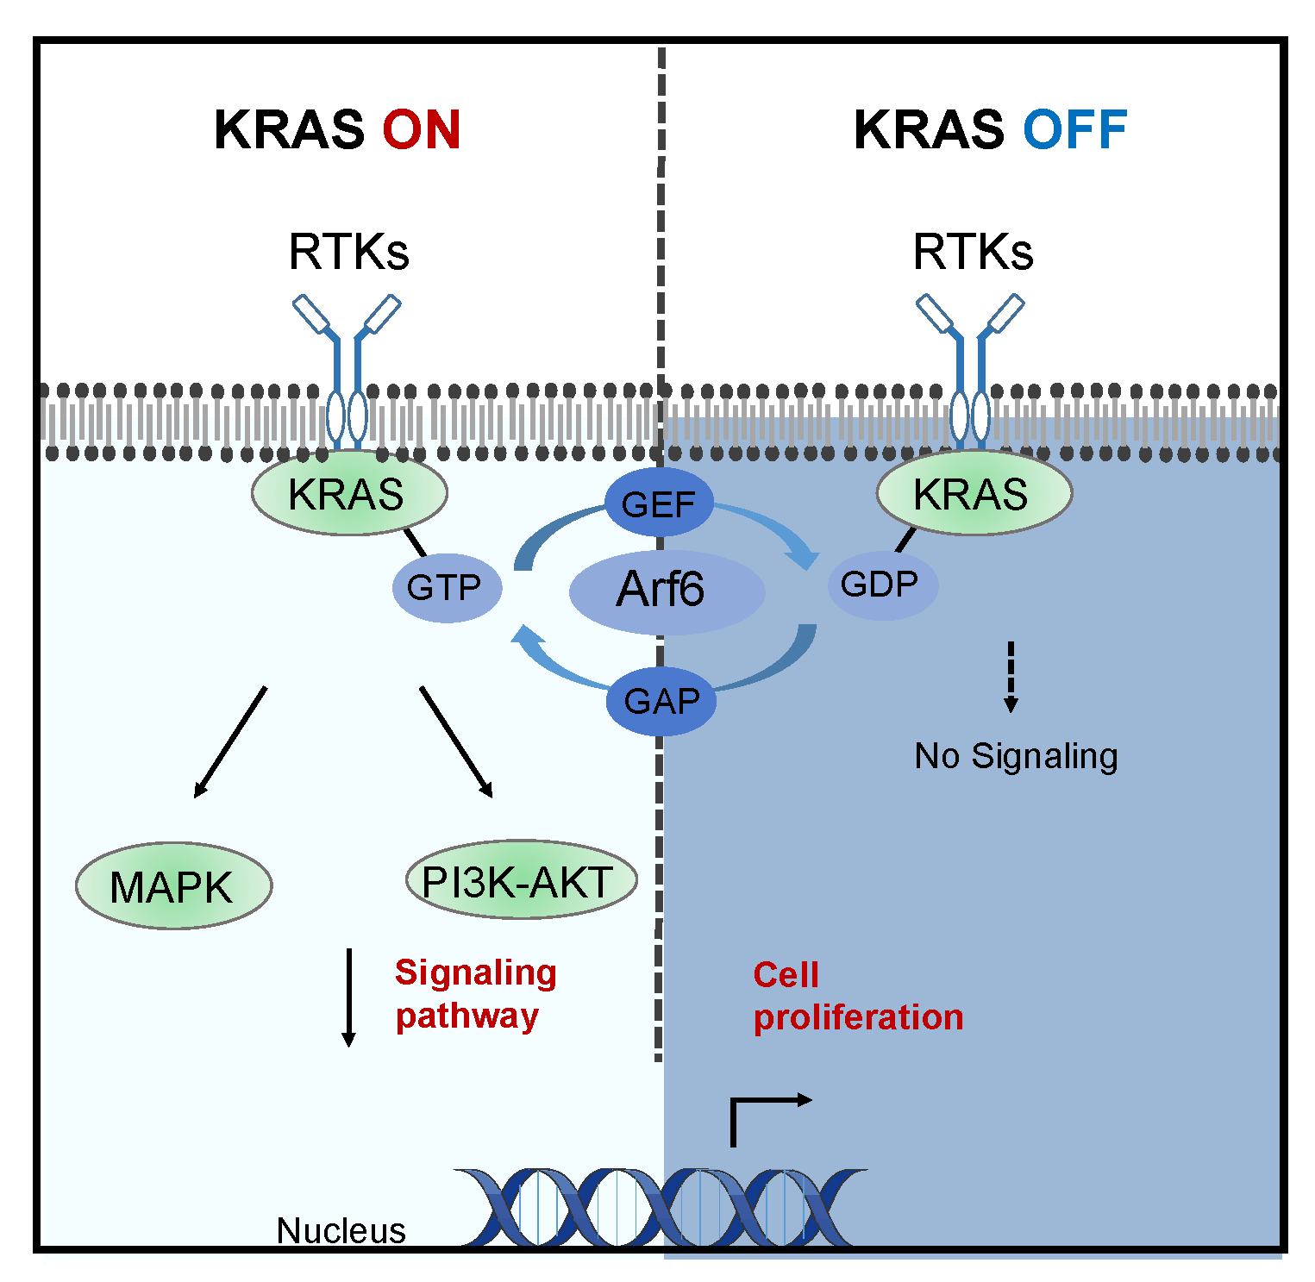
Resistance mechanisms
EGFR-mediated MAPK reactivation
  Alternative RTKs bypass KRAS inhibition; reactivate MAPK/ERK signaling within weeks
PI3K/AKT hyperactivation
  Independent survival pathway; enables proliferation despite KRAS blockade
Lipid remodeling & epigenetic plasticity
  Membrane lipid changes enable KRAS relocalization; chromatin accessibility changes stabilize resistance WITHOUT genetic mutations
Notes:
"So what happens when tumors become resistant?
First, EGFR-mediated MAPK reactivation. When you block KRAS, cells find alternative routes—receptor tyrosine kinases like EGFR and MET bypass KRAS entirely and reactivate the same downstream signaling within weeks.
Second, PI3K/AKT hyperactivation. This independent survival pathway enables proliferation even when KRAS is blocked. Different mutations show different dependencies here—G12D tends toward stronger PI3K activation.
Third—and this is what makes our proposal unique—lipid remodeling and epigenetic plasticity. KRAS must anchor to the membrane to signal. Cells can remodel their lipid composition to maintain this localization. Meanwhile, chromatin accessibility changes can stabilize resistance states without any new genetic mutations. This explains how resistance emerges so rapidly.
The diagram illustrates this: even when KRAS is 'OFF,' alternative pathways can still drive proliferation."

Slide 4
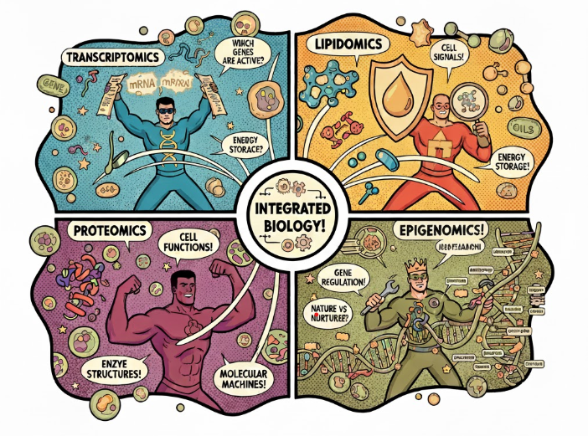
The Multiomics Approach
Transcriptomics → Compensatory pathways
Phosphoproteomics → Kinase network rewiring
Lipidomics → KRAS membrane localization
Epigenomics → Chromatin remodeling
Notes:
We integrated **four omics layers** to address all resistance mechanisms:
>
> - **Transcriptomics**: Identifies compensatory genes and pathways
> - **Phosphoproteomics**: Maps kinase network rewiring (happens within hours”faster than transcriptomics)
> - **Lipidomics**: Measures plasma membrane lipid remodeling sustaining KRAS signaling
> - **Epigenomics**: Reveals chromatin accessibility and histone modifications stabilizing resistance
>
> Each layer captures resistance mechanisms invisible to the others. Integration reveals rational combination therapy targets and predictive biomarkers.

Slide 5
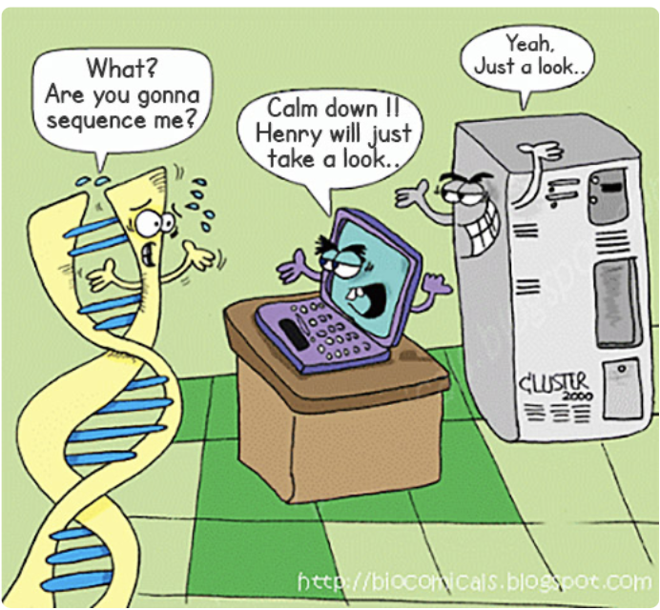
Transcriptomics Design
Bulk RNA-seq: 4 KRAS mutants × 3 cancer types
  Compare WT controls vs. G12C, G12D, G12V, G13D across PDAC, CRC, NSCLC
30-40M reads/sample; DESeq2 + GSEA pathway analysis
  n=3 replicates; NovaSeq 6000 platform; identify enriched pathways
Expected: ~ upregulated resistance genes
  RTK bypass targets (EGFR, MET, HER2/3), PI3K/AKT components, metabolic adaptation genes
Notes:
"For transcriptomics, we're using isogenic cell lines—same genetic background, different KRAS mutations. We compare wild-type controls against G12C, G12D, G12V, and G13D across three cancer types: pancreatic, colorectal, and lung.
Standard RNA-seq with 30-40 million reads per sample, three biological replicates, analyzed with DESeq2 for differential expression and GSEA for pathway enrichment.
Based on literature, we expect upregulation of RTK bypass genes like EGFR and MET, PI3K/AKT pathway components, and metabolic adaptation genes. These become our combination therapy targets."

Slide 6
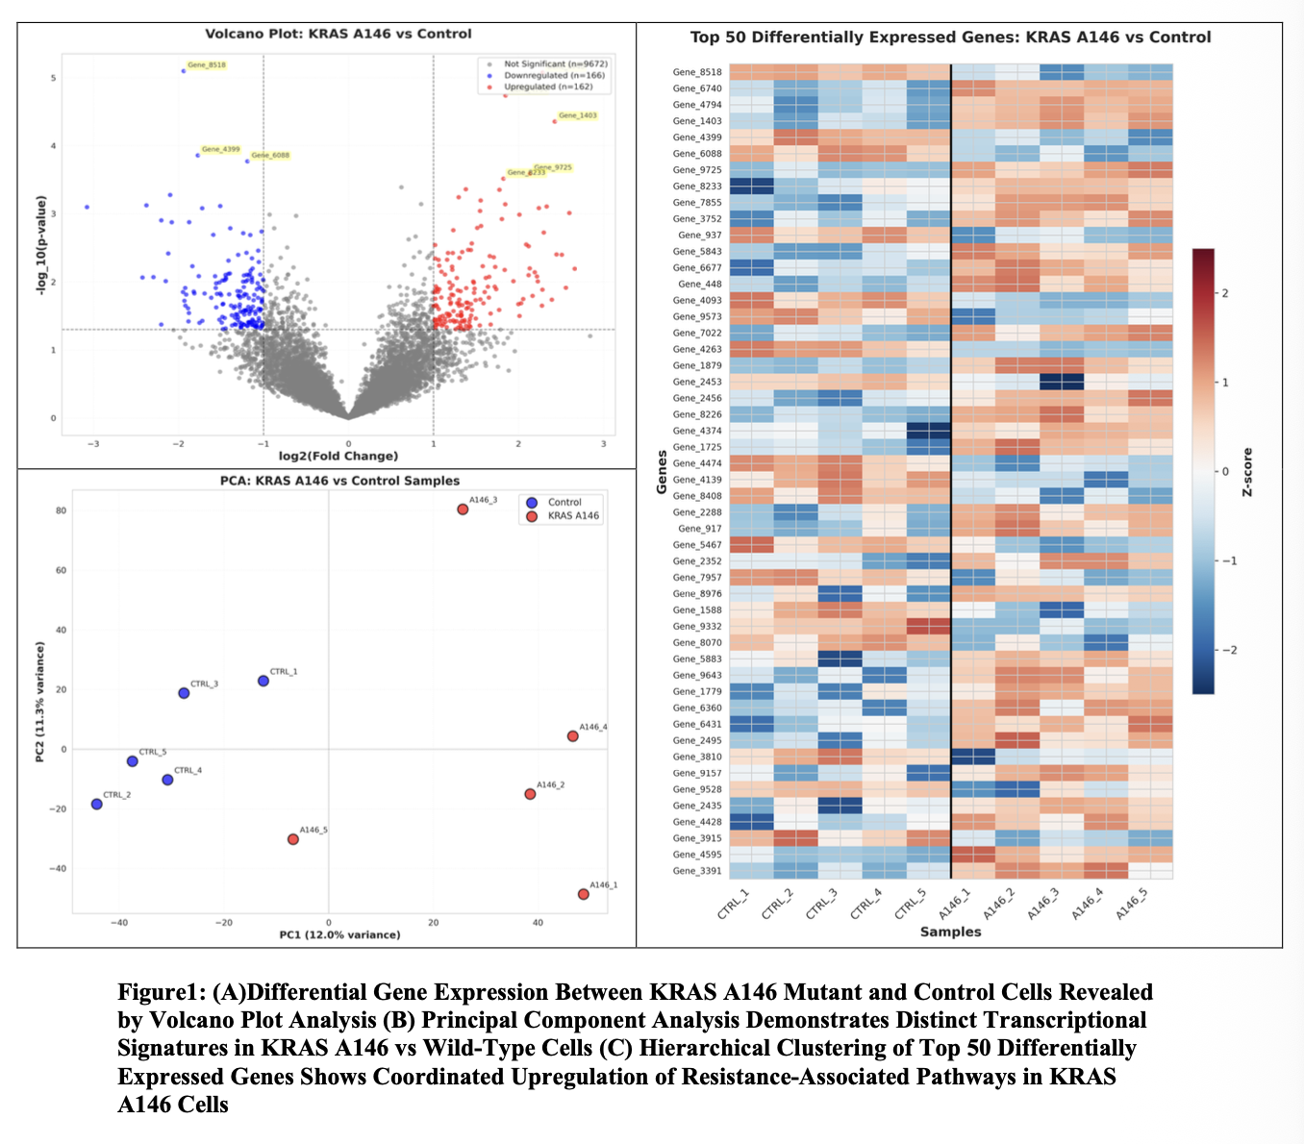
Simulated Transcriptomics Results
328 altered genes: 162 up, 166 down
  KRAS A146 mutant vs. control; includes predicted RTK bypass candidates
PCA separation: PC1 12% variance—robust signatures
  Clear clustering confirms KRAS drives distinct transcriptional program independent of tissue type
Stable program: Top 50 genes coordinated across replicates
  Consistent upregulation pattern validates repeatable resistance mechanism
Notes:
"Here's our proof-of-concept using simulated data calibrated against published KRAS studies.
The volcano plot shows differential expression between KRAS A146 mutant and control cells. We identified 328 significantly altered genes—162 upregulated in red, 166 downregulated in blue. The vertical lines mark our two-fold change cutoff; the horizontal line marks statistical significance. While these carry placeholder gene names, the effect sizes and distribution match what published studies report for KRAS comparisons.
In real experimental data, we'd expect genes in this upper-right quadrant—strong upregulation, high significance—to include RTK bypass candidates like EGFR and MET, PI3K/AKT components like PIK3CA and AKT1, and metabolic genes supporting altered energy demands.
The PCA plot confirms robust separation between conditions. Controls cluster on the left in blue; KRAS mutants cluster on the right in red. PC1 explains 12% of variance—realistic for a single genetic perturbation in a complex system. This separation confirms KRAS mutation drives a distinct transcriptional program independent of technical variation.
The heatmap shows the top 50 differentially expressed genes. Notice the coordinated pattern—genes flip from blue to red across the control-mutant boundary. This consistency across all five replicates indicates a stable transcriptional program, not random noise.
When we apply this pipeline to real experimental data, we'll perform GSEA to formally test pathway enrichment. Based on literature from Huang et al. and Liu et al., we anticipate enrichment in KRAS signaling, MAPK cascade, PI3K/AKT pathway, and metabolic reprogramming signatures.
The key point: this validated pipeline will identify specific combination therapy targets when applied to our isogenic cell line experiments—addressing the therapeutic gap for all KRAS-mutant patients, not just the 15% with G12C mutations."

Slide 7
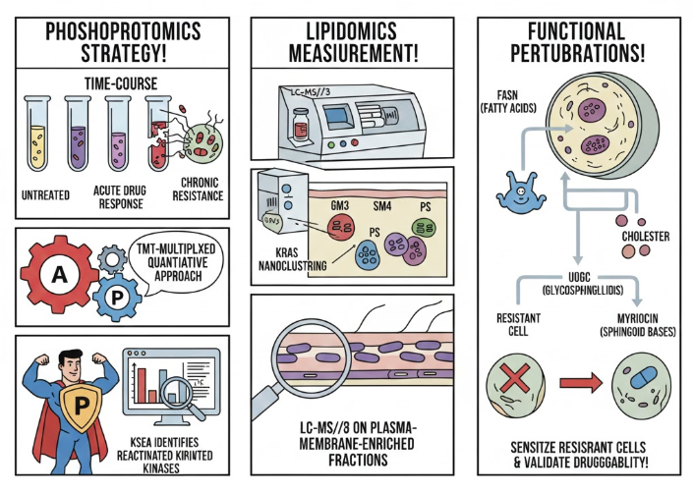
Phosphoproteomics & Lipidomics
PHOSPHOPROTEOMICS
STRATEGY
LIPIDOMICS
MEASUREMENT
FUNCTIONAL
PERTURBATIONS
Phosphoproteomics: TMT kinase network; identify reactivated ERK1/2, PI3K/AKT
  Time-course experiments; KSEA identifies activated kinases; occur within hours (faster than transcriptomics)
Lipidomics: LC-MS/MS; measure GM3, SM4 glycosphingolipids
  Plasma membrane-enriched fractions; characterize lipids maintaining KRAS nanoclustering
Perturbations: Test FASN, UGCG inhibitors to sensitize resistance
  Functional validation of lipid synthesis as druggable target
KSEA IDENTIFIES ACTIVATED KINASES
SENSITIZE RESISTANCE AND VALIDATE DRUGGABILITY
Notes:
Now let's move to two complementary layers : **phosphoproteomics and lipidomics**.
Phosphoproteomics captures how cancer cells rapidly rewire their signaling networks when exposed to therapy—detecting kinase activity shifts like ERK or PI3K/AKT reactivation within hours, which transcriptomics alone misses. We use TMT-based proteomics and KSEA to map these changes across time points in both naive and resistant cells.
Complementing this, lipidomics examines how cells remodel the plasma membrane—enriching specific glycosphingolipids to maintain KRAS anchoring and signaling. By targeting enzymes like UGCG or FASN, we disrupt these lipid adaptations, unlocking a mutation-independent vulnerability relevant for the majority of KRAS-mutant cancers who lack direct inhibitors

Slide 8
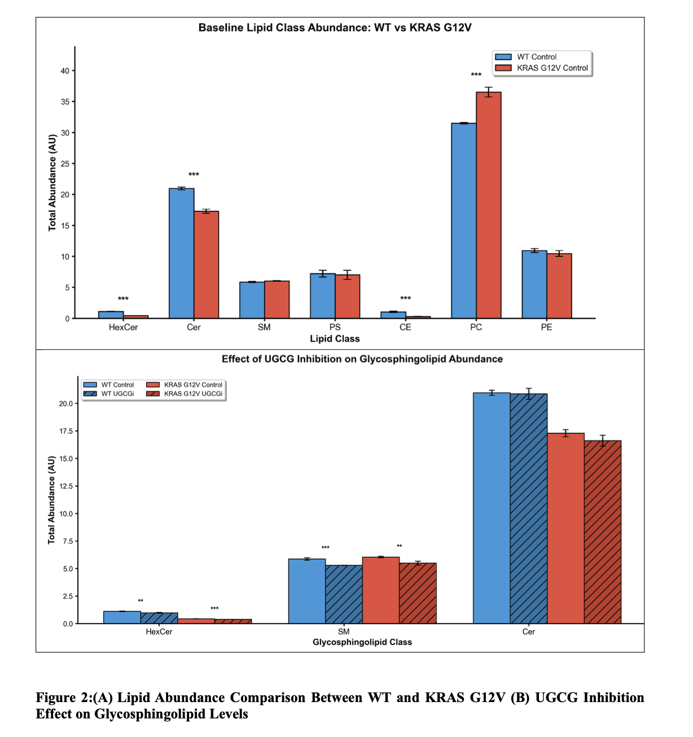
Lipid Remodeling Creates Vulnerability
KRAS G12V: 17% PC increase; 56% hexosylceramide decrease
  Indicates rapid flux through glycosphingolipid biosynthesis pathway
Rapid flux through glycosphingolipid pathway
  Ceramides converted to GM3 & SM4 (membrane-anchoring lipids) rather than stored as hexosylceramides
UGCG inhibition exploitable in non-G12C patients
  Blocks glycosphingolipid synthesis; mutation-agnostic strategy for 85% of KRAS patients
Notes:
KRAS G12V mutant cells show **lipid remodeling creating a therapeutic vulnerability
The Data**:
> - **Ceramides 17%** (36.7 vs 31.4 AU in WT)
> - **Hexosylceramides“ 56%** (0.4 vs 0.9 AU)
>
**What This Means**: Ceramides are building blocks for glycosphingolipids (GM3, SM4)â€”the lipids anchoring KRAS to the membrane. The pattern shows *rapid flux through the glycosphingolipid synthesis pathway*. Cells are specifically enriching the membrane lipids required for KRAS localization
**The Druggable Target**: UGCG inhibition blocks hexosylceramide synthesis, creating a metabolic bottleneck that disrupts KRAS membrane localization.
>
> **Clinical Significance**: UGCG inhibition works on **all KRAS-mutant cells** (G12C, G12D, G12V, G13D)â€”offering a mutation-agnostic strategy for the **85% of non-G12C patients**.
>
> **Rational Combination**: KRAS inhibitor + glycosphingolipid synthesis inhibitor = targeting both the protein AND its membrane anchor.

Slide 9
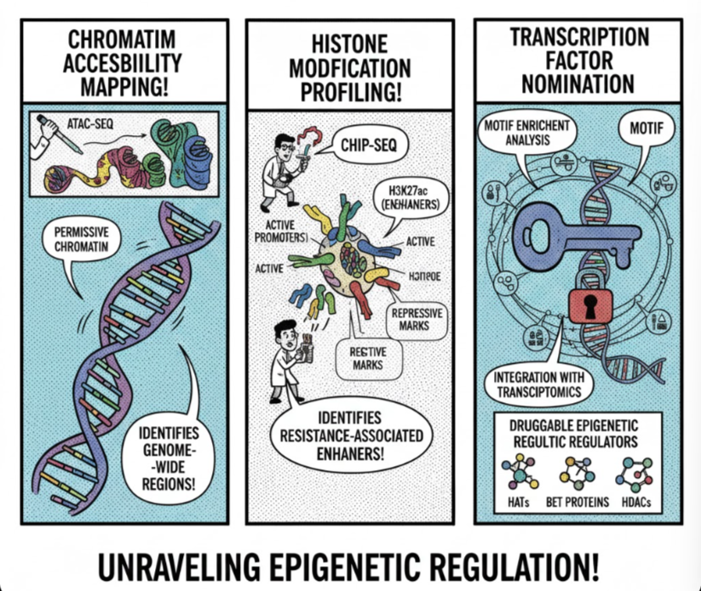
Epigenomics—Chromatin Plasticity
CHROMATIN
ACCESIBILITY
MAPPING
HISTONE
MODIFICATION
PROFILING
TRANSCRIPTION
FACTOR
NOMINATION
ATAC-seq + ChIP-seq: map chromatin accessibility & H3K27ac
  Identify regions gaining accessibility during resistance; profile active enhancers/promoters
Identify resistance-associated enhancers & transcription factors
  Motif enrichment nominates TFs driving resistance; overlay with transcriptomics to link chromatin to function
Nominate HATs, BET protein inhibitors for combinations
  Epigenetic regulators enable rapid adaptation without mutations; targeting them reverses resistance
DRUGGABLE EPIGENETIC
REGULATORS
Notes:
The final layer is epigenomics—revealing how cells develop resistance without any genetic mutations through chromatin remodeling. Using ATAC-seq, we map accessible chromatin regions that open during resistance evolution, identifying resistance-associated enhancers. ChIP-seq profiles active histone marks like H3K27ac at these enhancers and promoters. By integrating this with our transcriptomics data, we mechanistically link chromatin accessibility to resistance gene expression. Motif enrichment then nominates specific transcription factors—HIF-1α, MYC, NF-κB, STAT3—driving these programs. The therapeutic implication: targeting chromatin remodelers with HAT or BET protein inhibitors disrupts the epigenetic machinery stabilizing resistance. This enables another rational combination—KRAS inhibitor plus epigenetic drug—hitting both the immediate signaling and the transcriptional program maintaining resistance

Slide 10
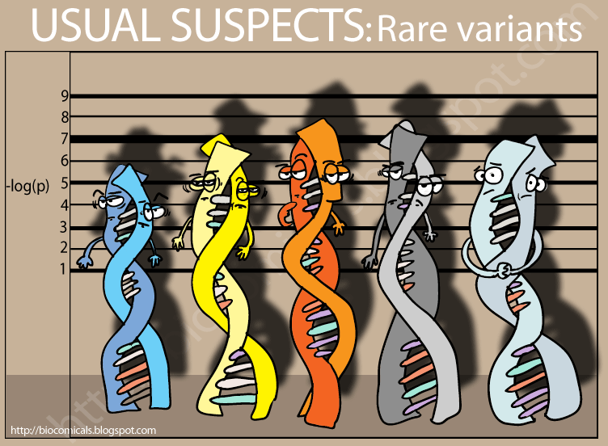
Expected Outcomes
Biomarker panels for early resistance detection
  Multi-omics signatures enable personalized intervention timing before clinical progression
Combination strategies targeting 4 resistance layers
  Rational multi-node targeting: KRAS inhibitors + MEK + PI3K/AKT + lipid inhibitors + epigenetic drugs
Therapeutic options for 85% non-G12C patients
  Mutation-specific vulnerabilities create actionable targets independent of direct KRAS inhibition
Notes:
This integrated approach delivers three critical outcomes: First, biomarker panels combining all four omics layers predict resistance before clinical progression, enabling early intervention. Second, rational four-layer combination strategies—KRAS/MEK inhibitors block the direct target, PI3K/AKT inhibitors block bypass signaling, glycosphingolipid synthesis inhibitors disrupt the membrane environment, and epigenetic drugs disable the transcriptional resistance program—each mechanistically justified by our data. Third, therapeutic options for the 85% of non-G12C patients through mutation-specific vulnerabilities: G12V’s lipid dependency, G12D’s PI3K/AKT reliance, and G13D’s epigenetic plasticity enable allele-selective strategies rather than one-size-fits-all approaches

Slide 11
TIMELINE, BUDGET & RESEARCH STRATEGY
Timeline & Budget
Duration: 24-30 months in 5 overlapping phases
Total cost: $145K–$210K (sequencing, MS, lipidomics, computation, cell culture)
Open access: GEO, PRIDE, MetaboLights
Challenges & Mitigation
Challenge 1: Resistance model authenticity → Multiple independent clones + patient-derived xenograft validation
Challenge 2: Data integration complexity → Established workflows (DESeq2, MaxQuant, MACS2) + network-based integration
Challenge 3: Multi-layer reproducibility → n≥3 biological replicates + orthogonal validation methods
Notes:
This is a 24-30 month project with overlapping phases: Months 1-8 establish cell lines and perform RNA-seq, followed by phosphoproteomics (7-16), lipidomics (10-18), epigenomics (12-22), and final integration and validation (18-30). The budget is $145,000-210,000, covering sequencing ($45-69K), mass spectrometry ($40-50K), lipidomics ($26-37K), computational infrastructure ($10-15K), and reagents ($25-35K)
Every major research project faces real challenges, and we’ve tackled them systematically to ensure credible results. To model authentic resistance, we use multiple independent clones and validate findings in patient-derived xenografts to ensure relevance beyond the lab. For complex data integration across transcriptomics, phosphoproteomics, lipidomics, and epigenomics, we apply gold-standard tools and network frameworks, confirming links at every step. Lipidomics relies on rigorous membrane fraction purity checks with multiple markers and cross-validation. To capture the full dynamics of resistance, we employ time-course experiments, sampling early through late adaptations. Reproducibility is built in with n≥3 biological replicates, batch correction, and orthogonal validation by independent assays. By testing KRAS mutations across three cancer types, we address context dependence, while our strategies for combination therapy and stepwise validation with clinical collaborators ensure results will translate to patient care, not just cell lines.

Slide 12



Thank You

Slide 13
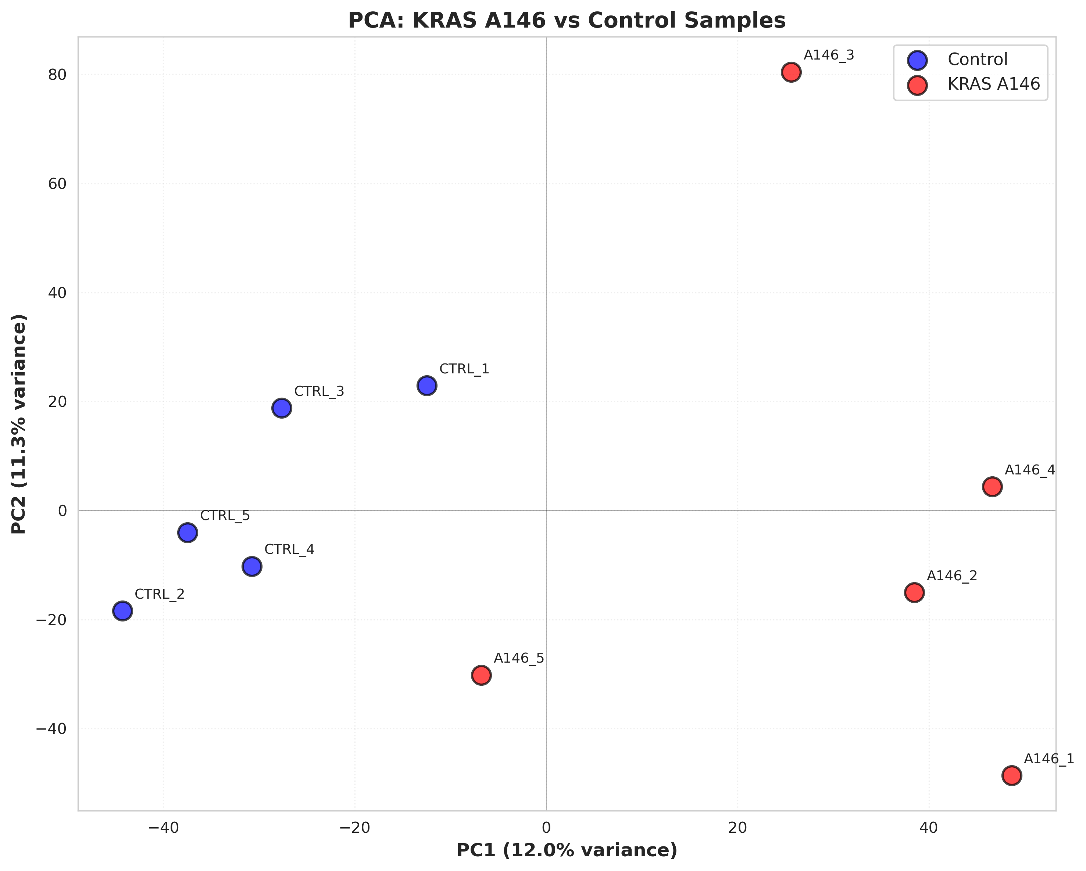

Slide 14
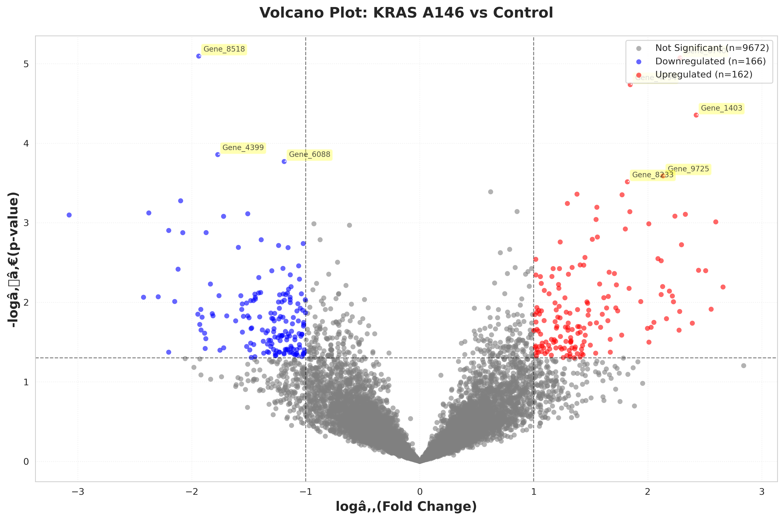

Slide 15
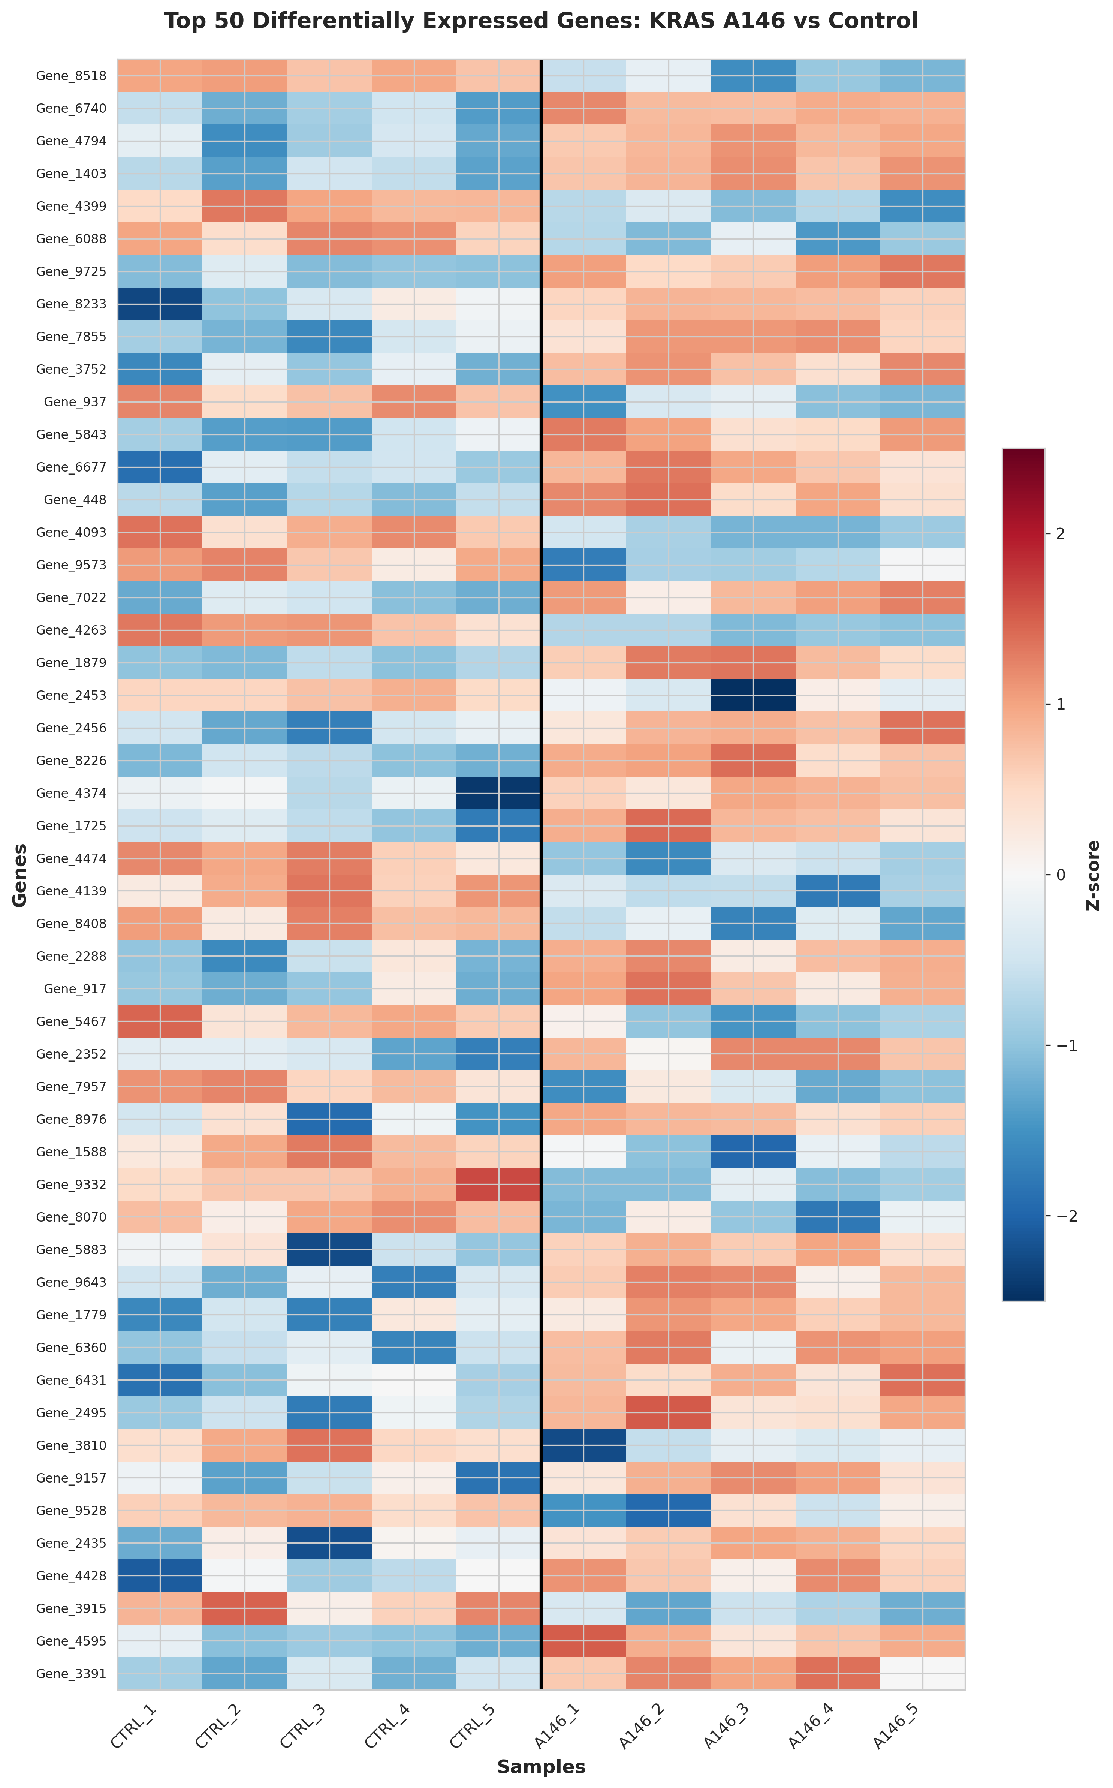

Slide 16
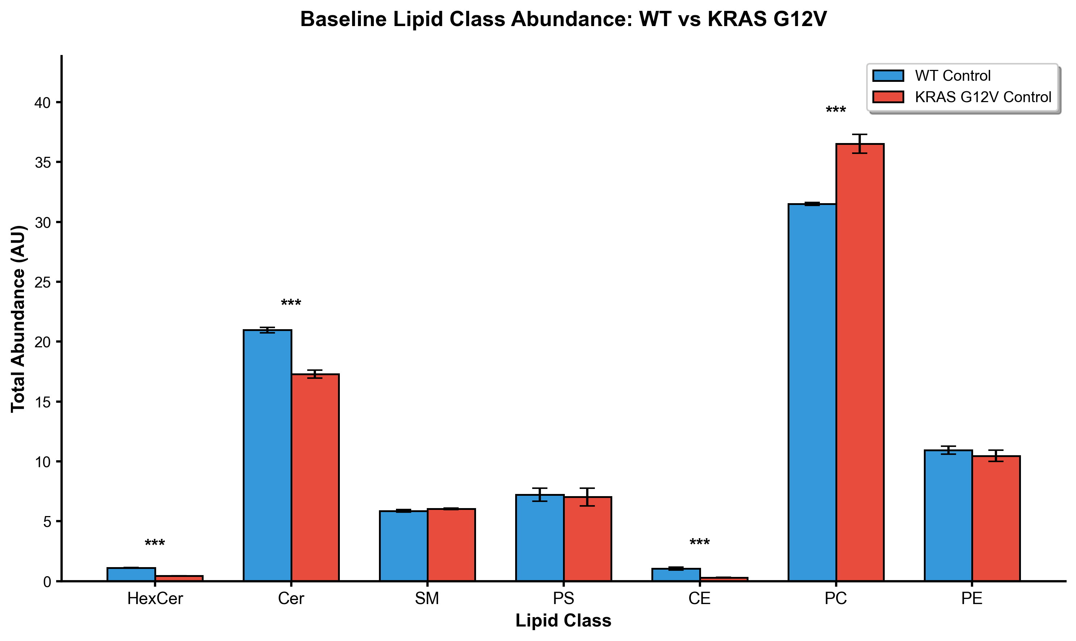

Slide 17
