Slide 1

DDCA SEM PROJECT
DESIGN AND SIMULATION OF
DIGITAL ACCESS CARD
VERIFICATION SYSTEM
TEAM
Koushik Reddy
2620030503
Pranil
2620030513
P. Naga Sai Ajay
2620030516
Y. Devi Harshini
2620030512
Guided by: Mr. Karteek

Slide 2
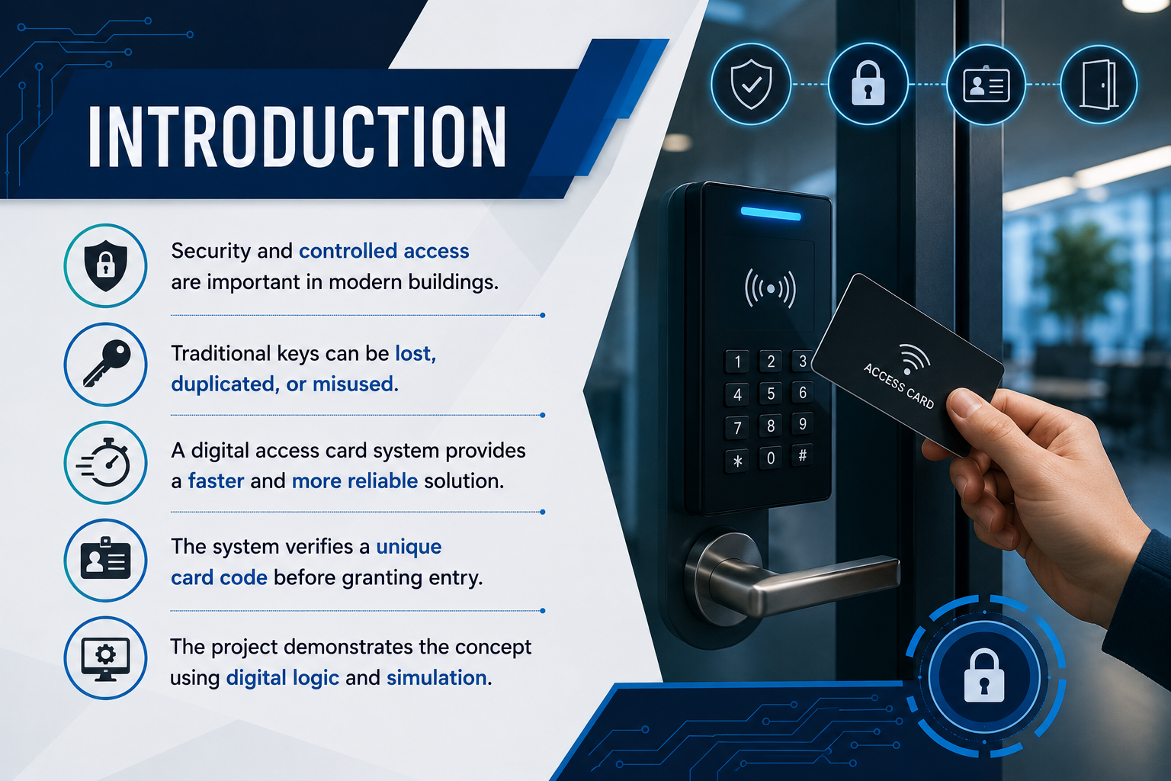

Slide 3
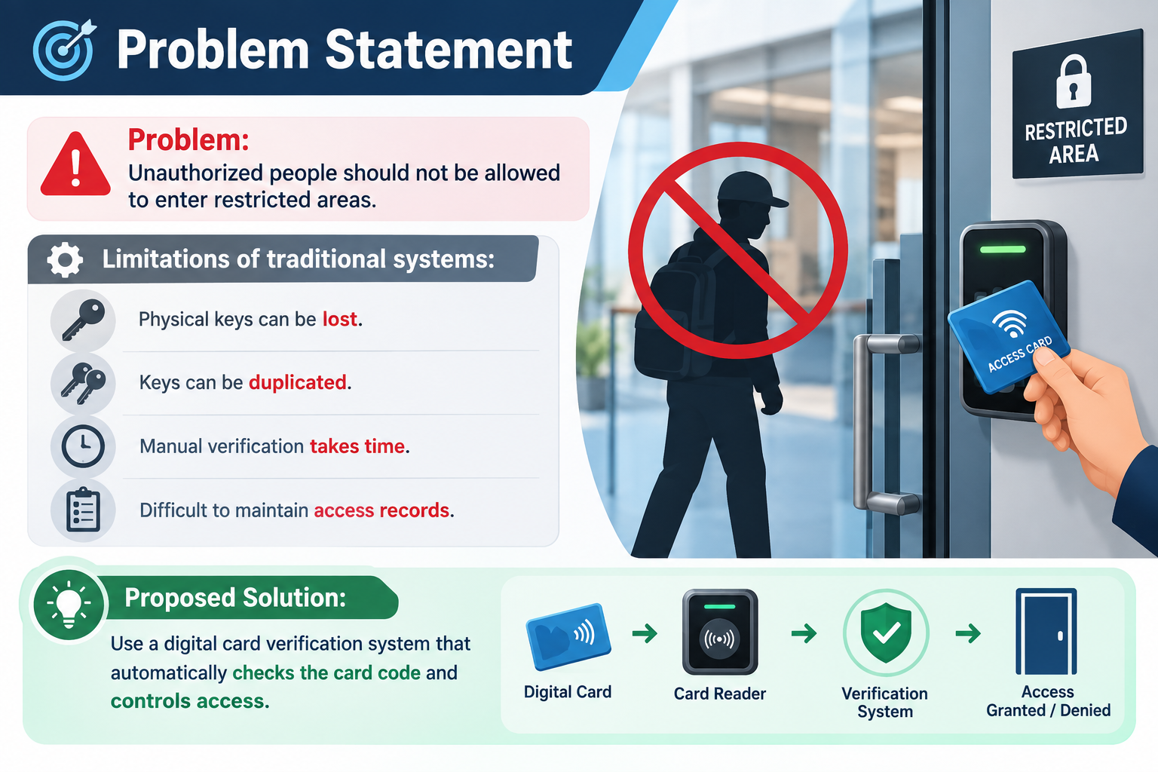

Slide 4
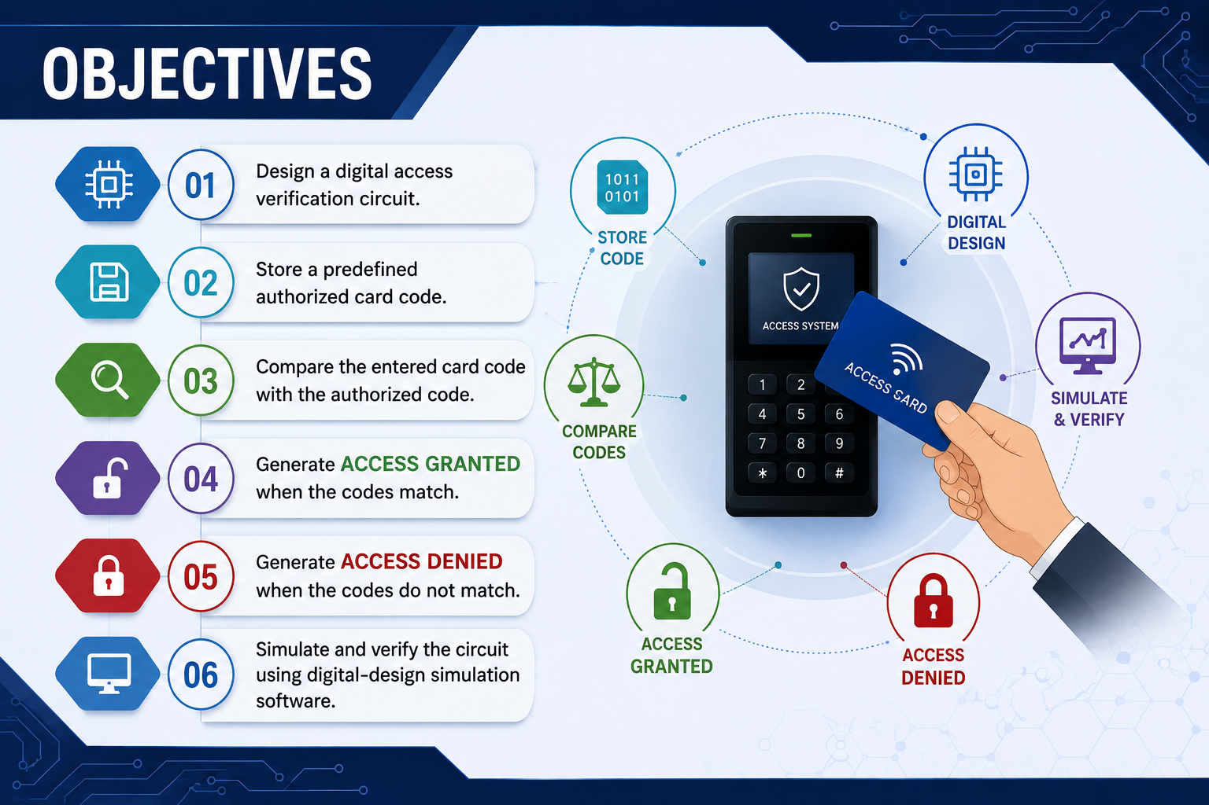

Slide 5
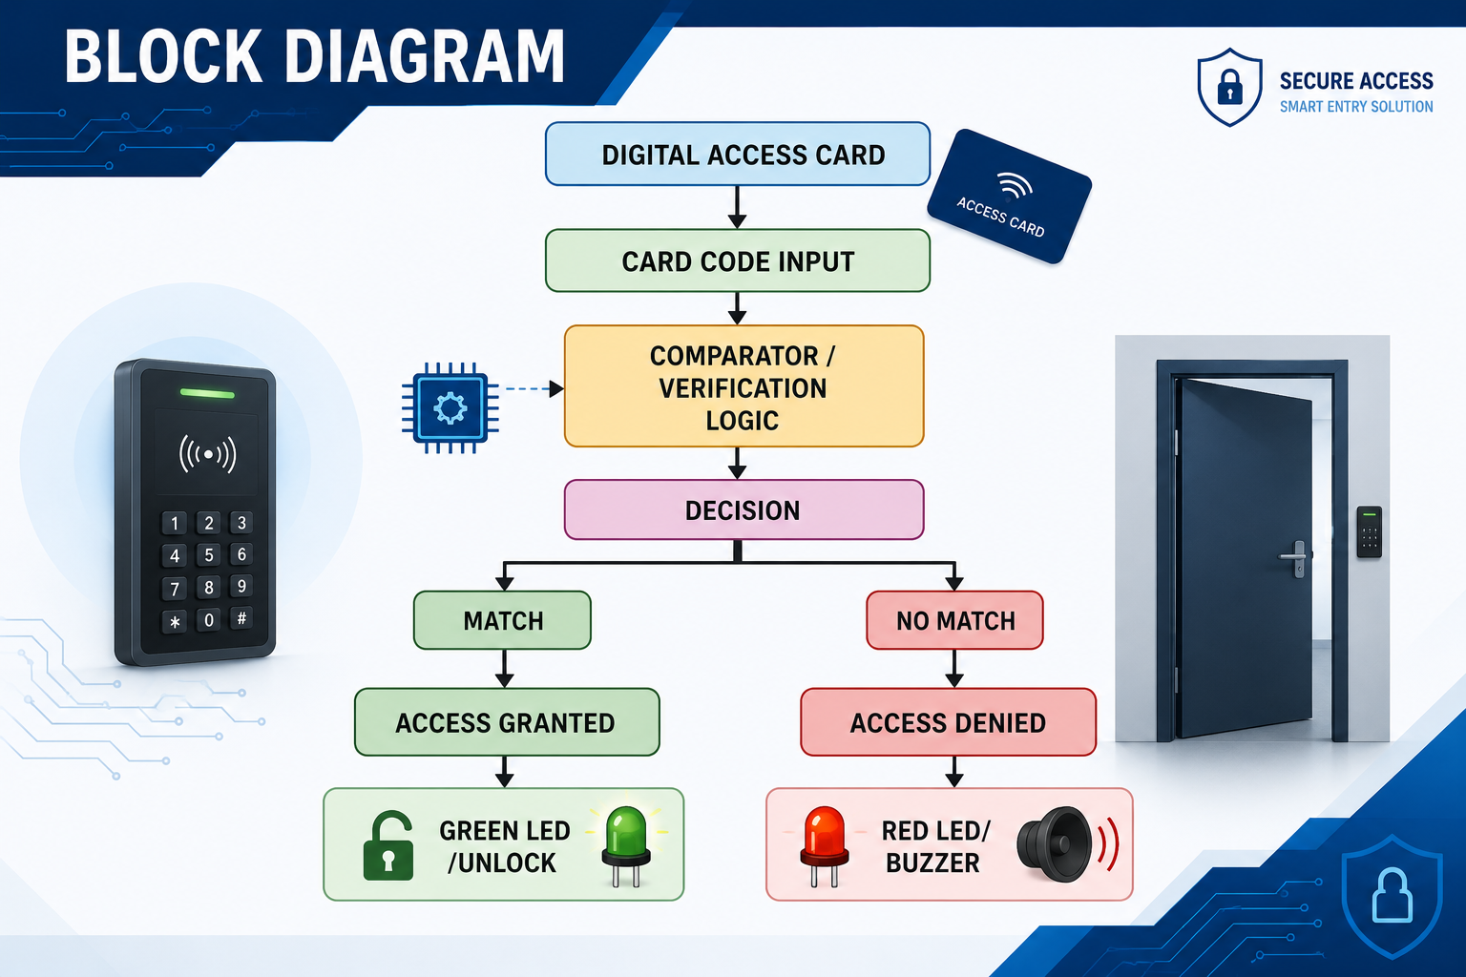

Slide 6
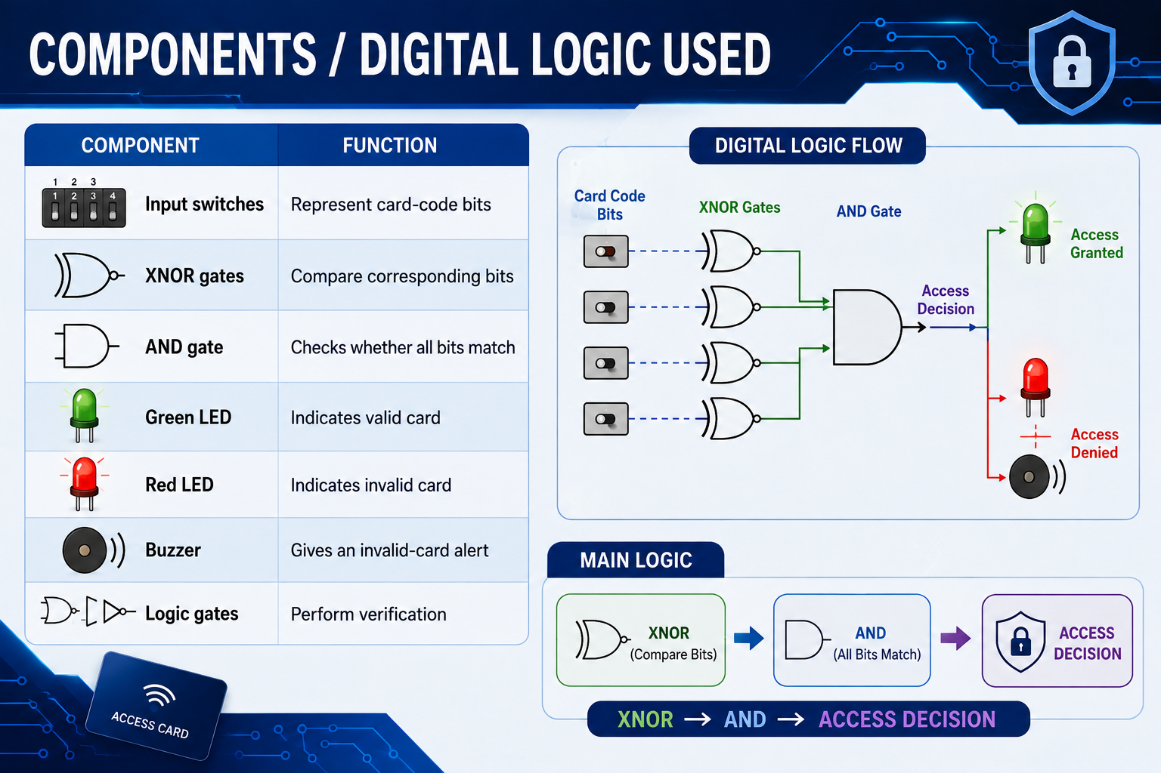
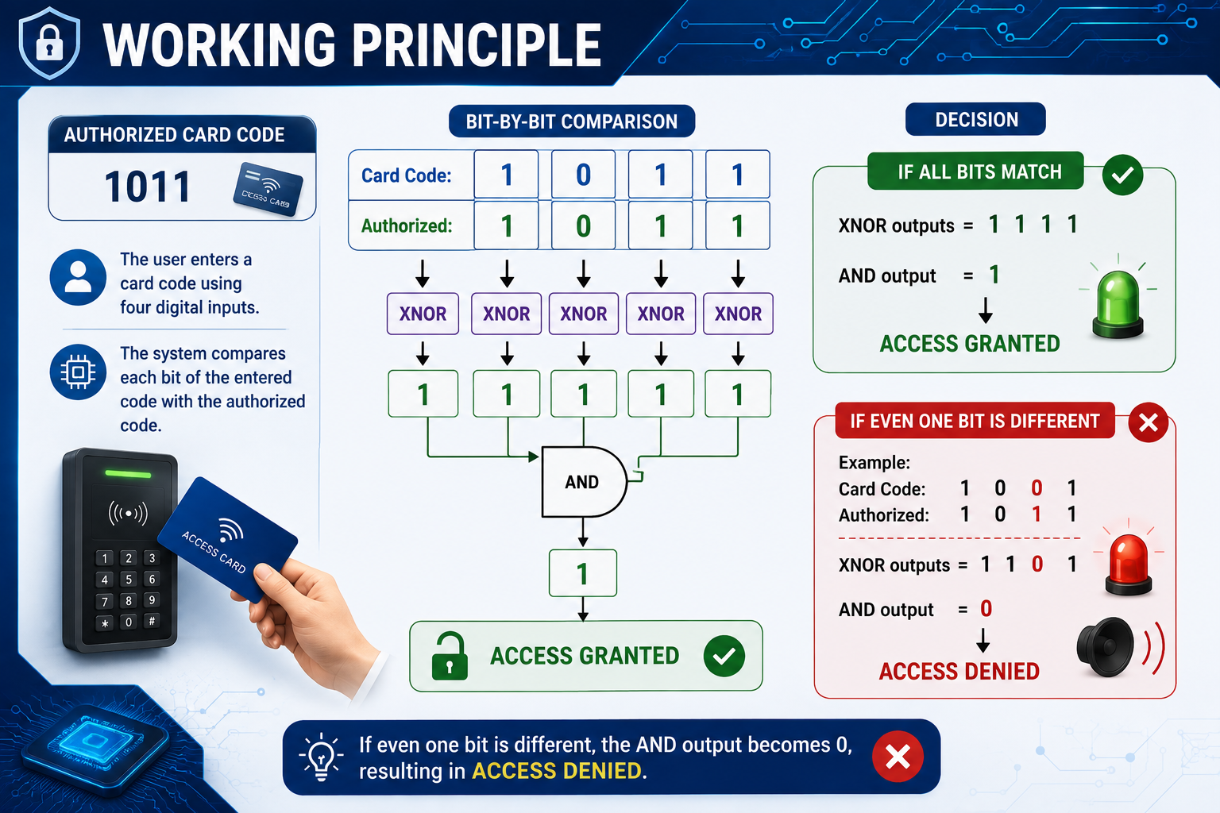

Slide 8
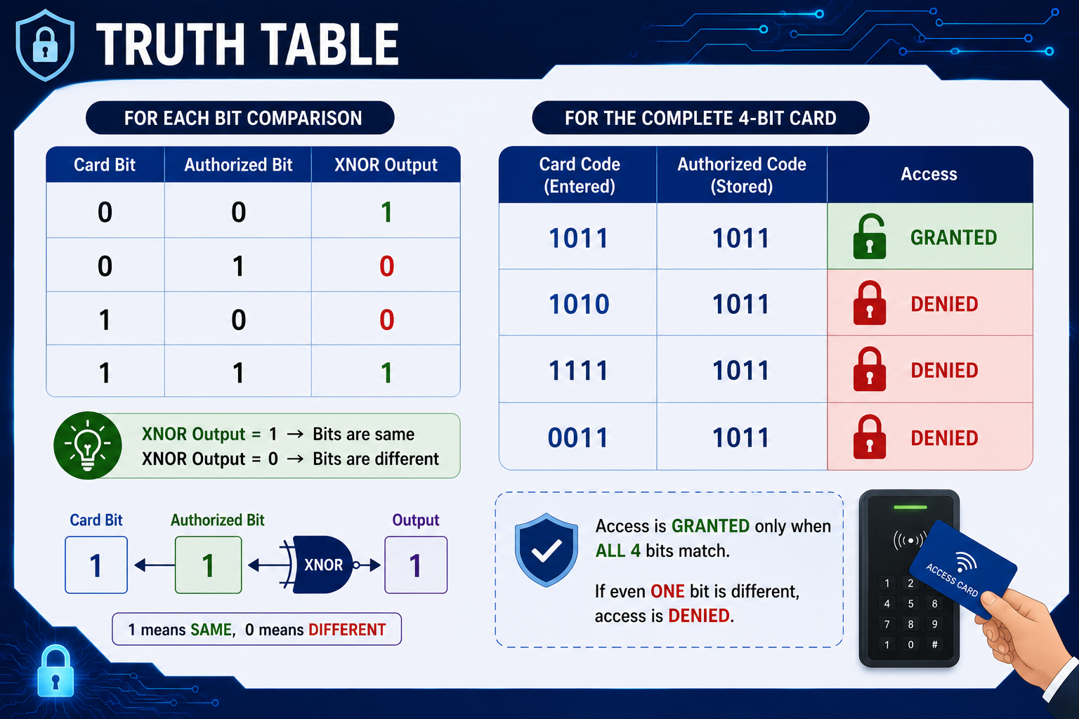

Slide 9
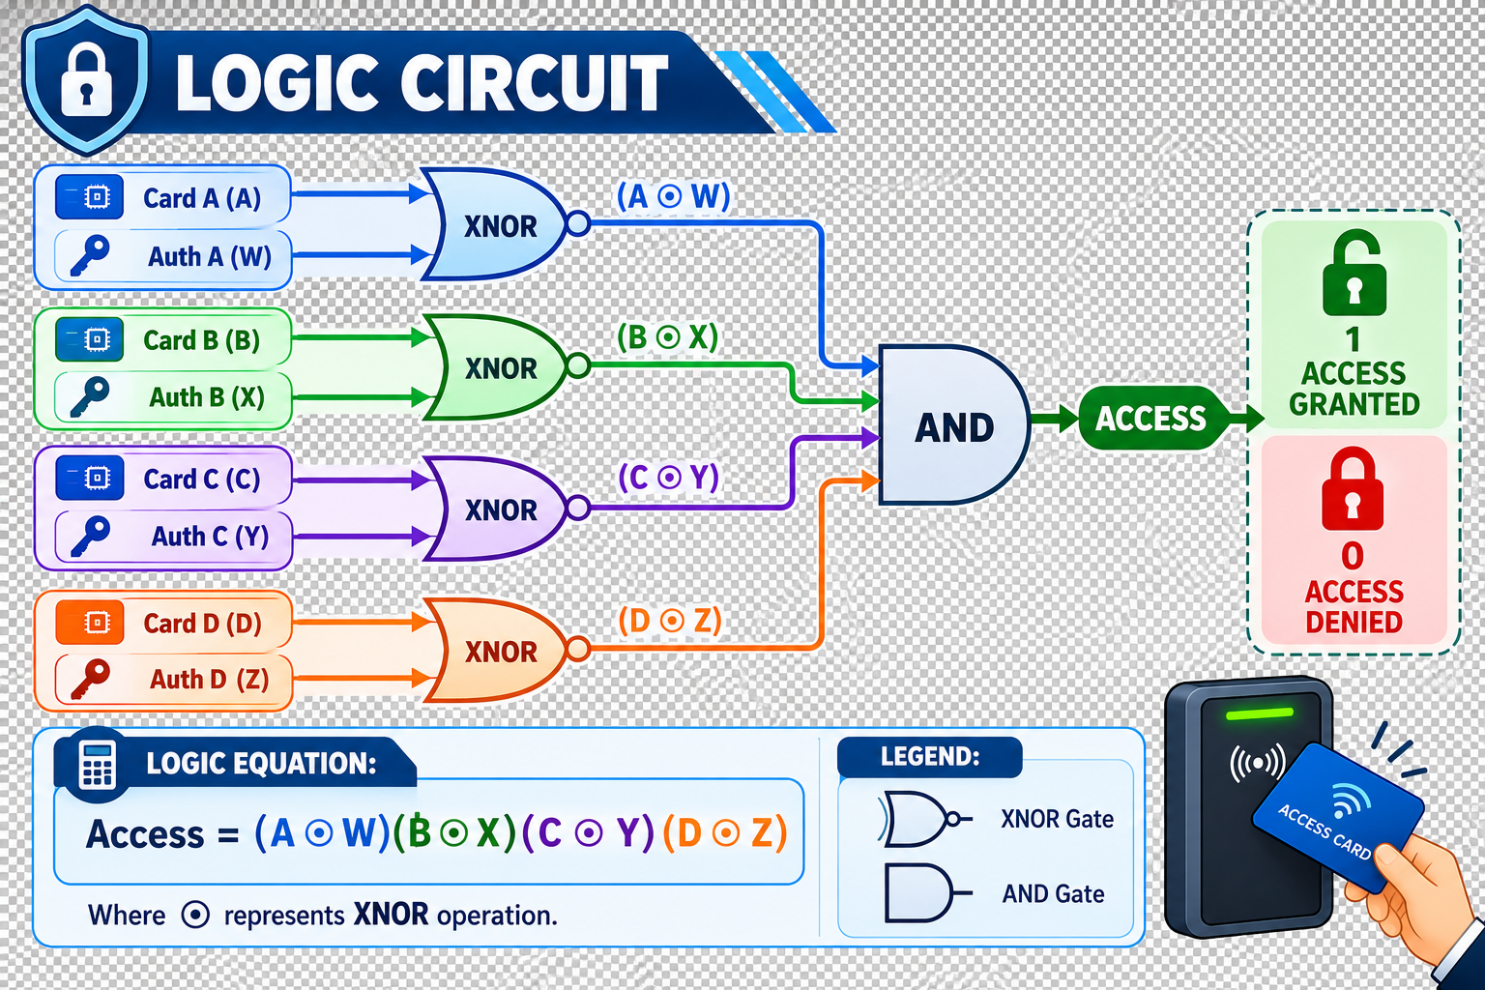

Slide 10
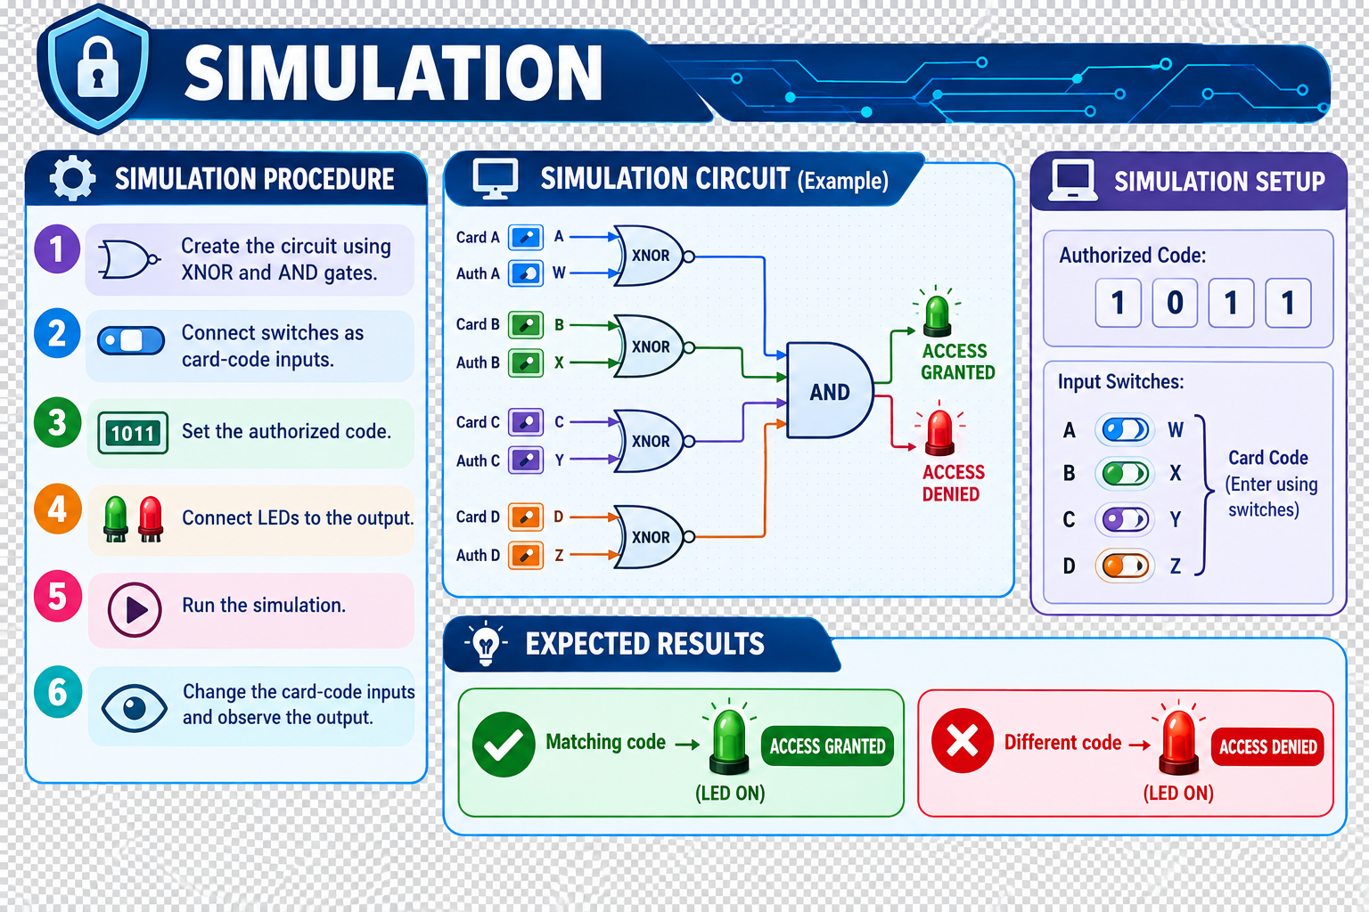

Slide 11


