Slide 1
CAPSTONE PROJECT • CSE445 • January–May 2026
TheAgriDoctor
An AI-Powered Crop Disease Diagnosis, Advisory and
Farm-Management Platform for Indian Smallholder Farmers
Submitted by: Ajay Reddy • Team Member 2 • Team Member 3
Mentor: (Name of Faculty Mentor) — School of Computer Science & Engineering
Lovely Professional University, Phagwara, Punjab
April 2026

Slide 2
Outline
What we will cover in the next ~25 minutes
• Why we built TheAgriDoctor — the problem & motivation
• Where existing tools fall short
• Scope, objectives and project plan
• Software requirements (functional + non-functional)
• System architecture and use-case overview
• Data-flow diagrams (Levels 0 → 3)
• Database design (ER diagram & schema)
• Process flowcharts (Diagnose, Advisor, Auth)
• Implementation highlights & tech stack
• Testing approach and current status
• Live demo • Q & A
TheAgriDoctor • Capstone Project (CSE445)
2 / 35

Slide 3
01
Problem & Motivation
TheAgriDoctor • Capstone Project (CSE445)
3 / 35

Slide 4
Background
The smallholder farmer’s reality in 2026
• ≈45 % of India’s workforce still lives off agriculture
• 20–35 % of every harvest is lost to pests & disease — most of it preventable
• One extension officer per 1,000+ farmers → answers arrive too late
• Smartphones are everywhere; structured agronomic help is not
• Free LLM tiers + Supabase + Vercel finally make a free unified product feasible
TheAgriDoctor • Capstone Project (CSE445)
4 / 35

Slide 5
Problem Statement
• Today: agri-shop, KVK SMS, WhatsApp groups, 4–5 single-purpose apps
• Each silo answers part of the question; none remember the farm
• English-first UIs lock out the majority language base
• Generic advice ignores soil, water, season, growth stage
• We need: one screen — image-in, structured answer-out — in the farmer’s language
TheAgriDoctor • Capstone Project (CSE445)
5 / 35

Slide 6
Existing Systems — What’s missing
System | Strength | Limitation
Plantix | Fast image diagnosis | Closed model, English-heavy, ad-driven
Kisan Suvidha | Govt-backed, weather + price | No image diagnosis, static advice
AgroStar / DeHaat | Marketplace + advice | Commerce-driven, brand bias
IBM Watson Decision | Sensor analytics | Enterprise pricing
mKisan SMS | SMS reach | One-way, generic, no history
WhatsApp groups | Peer wisdom | Unverifiable, no archive
TheAgriDoctor • Capstone Project (CSE445)
6 / 35

Slide 7
02
Scope & Objectives
TheAgriDoctor • Capstone Project (CSE445)
7 / 35

Slide 8
Scope of the Study
In-Scope
Out-of-Scope
• Mobile-first PWA (any modern browser)
• Auth, profile, multi-farm + crop cycles
• Vision diagnosis (1–5 images) → structured JSON
• Streaming AI advisor with voice input
• Weather, soil, UV, NDVI per farm polygon
• Diagnosis history, geo-clustered heatmap
• Mandi prices, community Q&A, alerts
• Native Android / iOS apps (PWA covers it)
• E-commerce / payment integration
• Offline / on-device inference
• Government scheme application workflows
• Drone or IoT sensor ingestion (future)
TheAgriDoctor • Capstone Project (CSE445)
8 / 35

Slide 9
Objectives of the Study
• Build a free, multilingual, mobile-first farmer cockpit
• Diagnose crop disease from a phone photo with structured remedies
• Ground every advisor reply in the farmer’s actual farms & last diagnosis
• Make external AI failures invisible to the user via provider fallback
• Surface weather + NDVI + market + community in a single dashboard
• Stay deployable on free / near-zero tiers up to ~10⁴ users
TheAgriDoctor • Capstone Project (CSE445)
9 / 35

Slide 10
Project Plan — 5-month sprint timeline
Phase | Window | Deliverable
1. Requirement & setup | Wk 1–2 | SRS, repo bootstrap, Supabase v1
2. Auth & profile | Wk 3 | Signup / login, RLS, middleware
3. Diagnose | Wk 4–6 | Vision pipeline, history, heatmap
4. Advisor chat | Wk 7–8 | Streaming SSE, dynamic prompt, voice
5. Farms & crops | Wk 9–10 | Polygon map, cycles, auto tasks
6. Weather & market | Wk 11–12 | Agro API, mandi prices
7. Community & alerts | Wk 13–14 | Posts, replies, AI replies, prefs
8. Test & harden | Wk 15–16 | Unit/integration, RLS audit, load
9. Docs & demo | Wk 17–20 | Report, deck, demo video, deploy
TheAgriDoctor • Capstone Project (CSE445)
10 / 35

Slide 11
03
Requirements
TheAgriDoctor • Capstone Project (CSE445)
11 / 35

Slide 12
Functional Requirements (highlights)
20 FRs in total — full list in Chapter 5 of the report
• FR-1 / FR-2 — Sign up + auto-create profile via DB trigger
• FR-3 / FR-4 / FR-5 — Manage farms, crop cycles & auto-generated tasks
• FR-6 / FR-7 — Multi-image diagnosis with 3-tier vision fallback
• FR-8 / FR-9 — History list and geo-clustered heatmap
• FR-10 / FR-11 — SSE-streamed advisor grounded in user context
• FR-12 / FR-18 — Voice input + multilingual replies
• FR-13 / FR-14 — Weather, soil, UV, NDVI + mandi prices
• FR-15 / FR-16 / FR-17 — Community board, alert prefs, notifications
TheAgriDoctor • Capstone Project (CSE445)
12 / 35

Slide 13
Non-Functional Requirements
ID | Category | Target
NFR-1 | Performance | P95 API < 1.5 s (excl. LLM); LLM TTFT < 3 s
NFR-3 | Availability | Auto-fallback keeps advisor usable on provider outage
NFR-4 | Security | JWT cookie, RLS-ready, no secrets in client bundle
NFR-5 | Privacy | Per-user folder enforced by storage policy
NFR-6 | Usability | Lighthouse mobile score ≥ 90
NFR-8 | Localisation | Replies in user’s preferred Indian language
NFR-9 | Maintainability | TS strict, ESLint, modular lib/* services
TheAgriDoctor • Capstone Project (CSE445)
13 / 35

Slide 14
04
System Design
TheAgriDoctor • Capstone Project (CSE445)
14 / 35

Slide 15
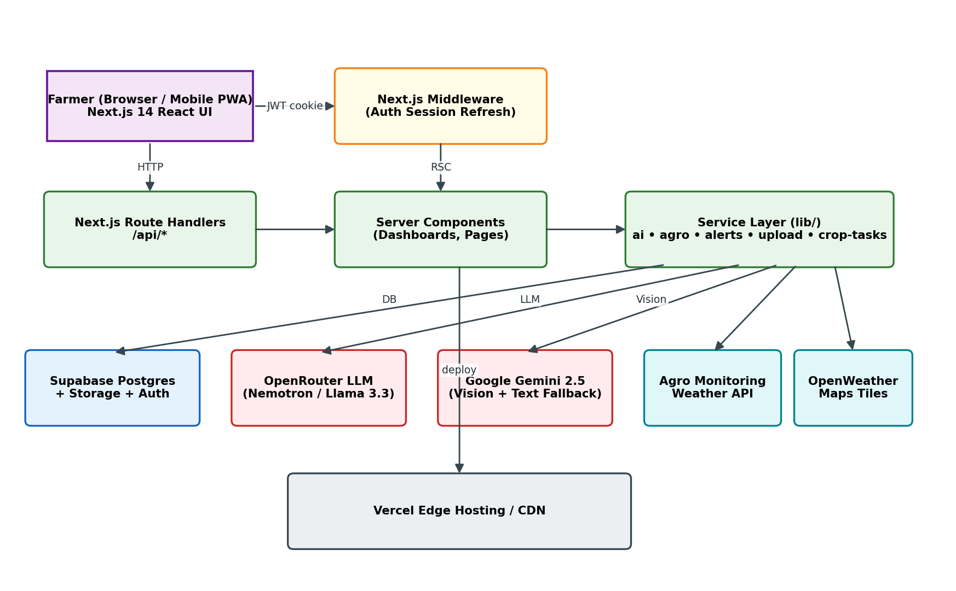
High-Level Architecture
Figure 6.1 — Three-tier architecture with multi-provider AI fallback
TheAgriDoctor • Capstone Project (CSE445)
15 / 35

Slide 16
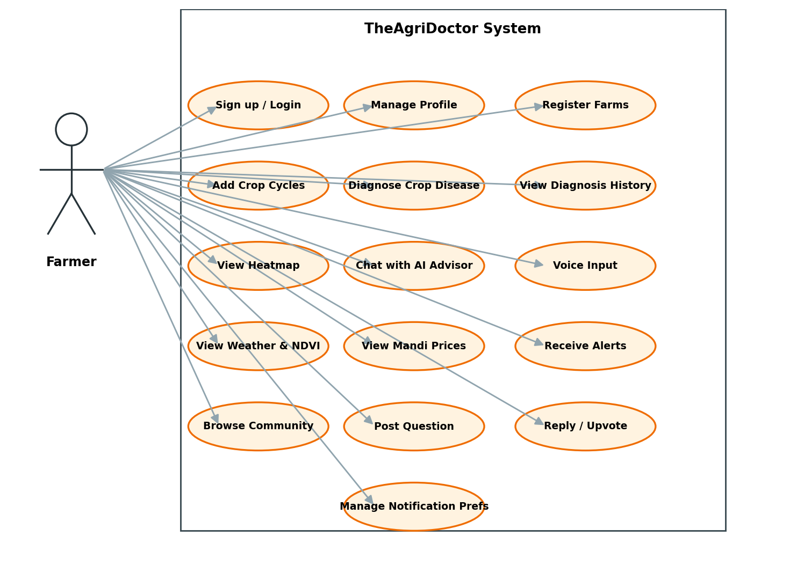
Use-Case Overview
Figure 6.2 — Farmer interactions across 16 use cases
TheAgriDoctor • Capstone Project (CSE445)
16 / 35

Slide 17
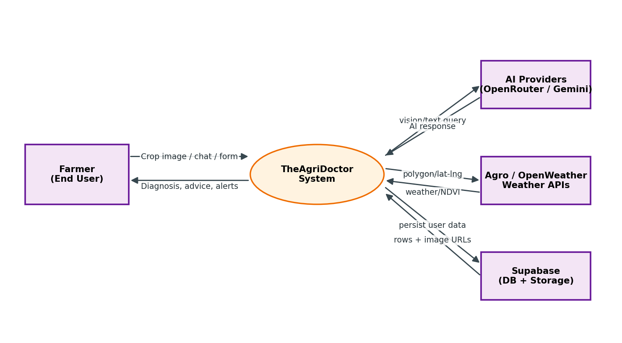
DFD Level 0 — Context
Figure 6.3 — TheAgriDoctor and the four external actors it talks to
TheAgriDoctor • Capstone Project (CSE445)
17 / 35

Slide 18
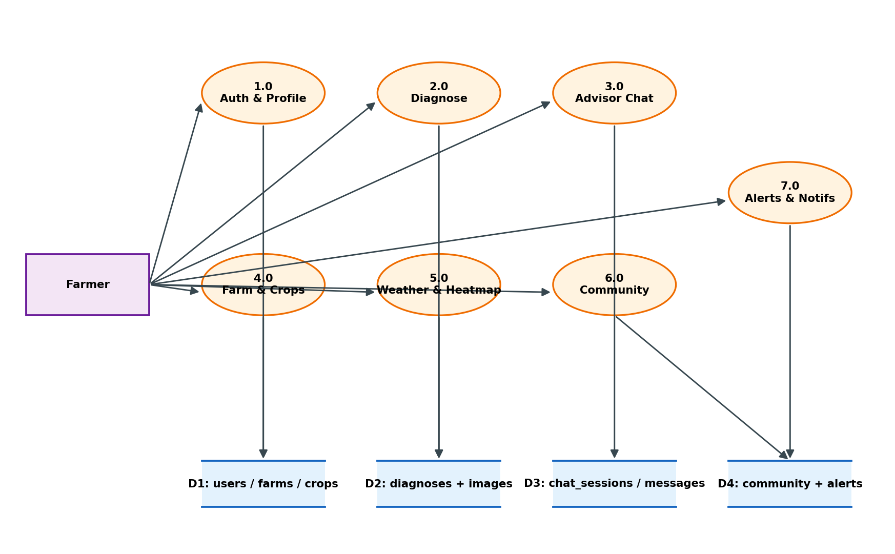
DFD Level 1 — Major Subsystems
Figure 6.4 — Seven subsystems and four data stores
TheAgriDoctor • Capstone Project (CSE445)
18 / 35

Slide 19
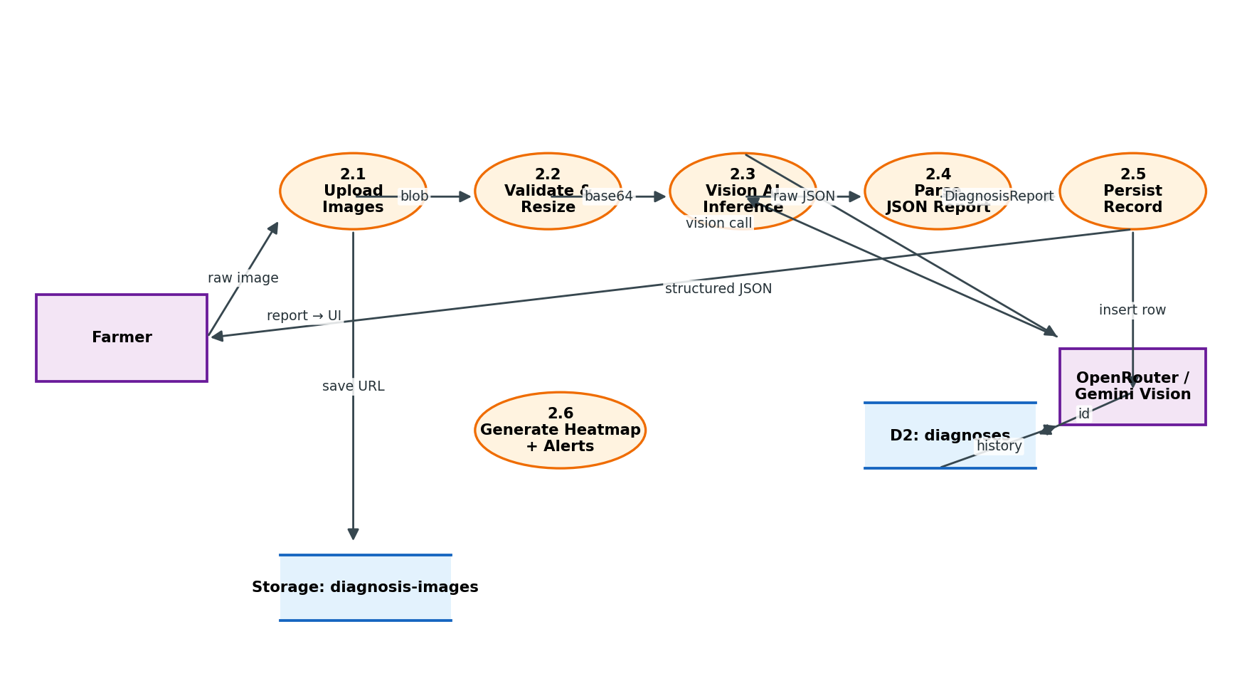
DFD Level 2 — Diagnose Module
Figure 6.5 — Image upload → vision AI → JSON report → persist
TheAgriDoctor • Capstone Project (CSE445)
19 / 35

Slide 20
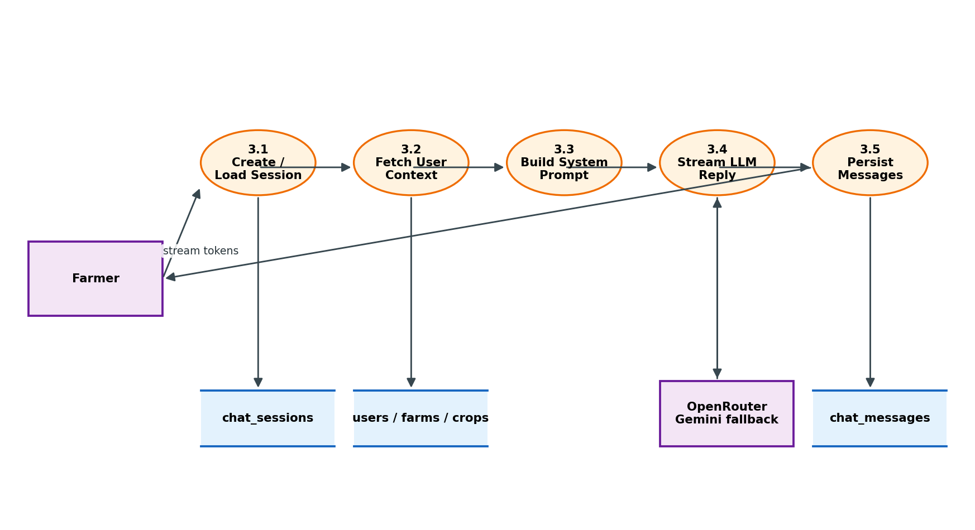
DFD Level 2 — Advisor Chat
Figure 6.6 — Context-grounded streaming chat
TheAgriDoctor • Capstone Project (CSE445)
20 / 35

Slide 21
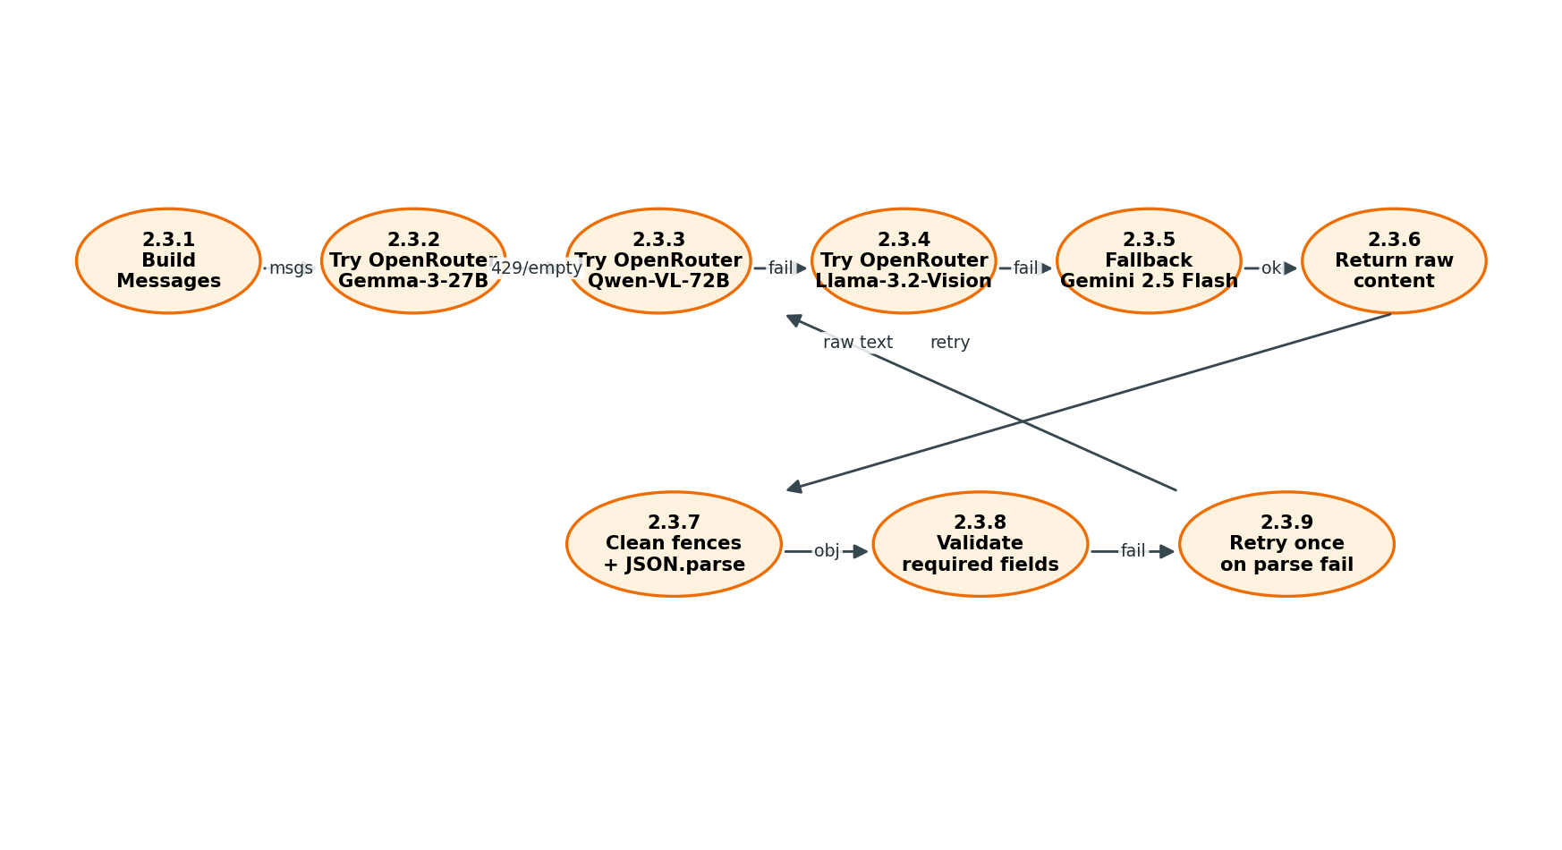
DFD Level 3 — Vision Inference Pipeline
Figure 6.7 — Three OpenRouter models then Gemini fallback, with retry on parse failure
TheAgriDoctor • Capstone Project (CSE445)
21 / 35

Slide 22
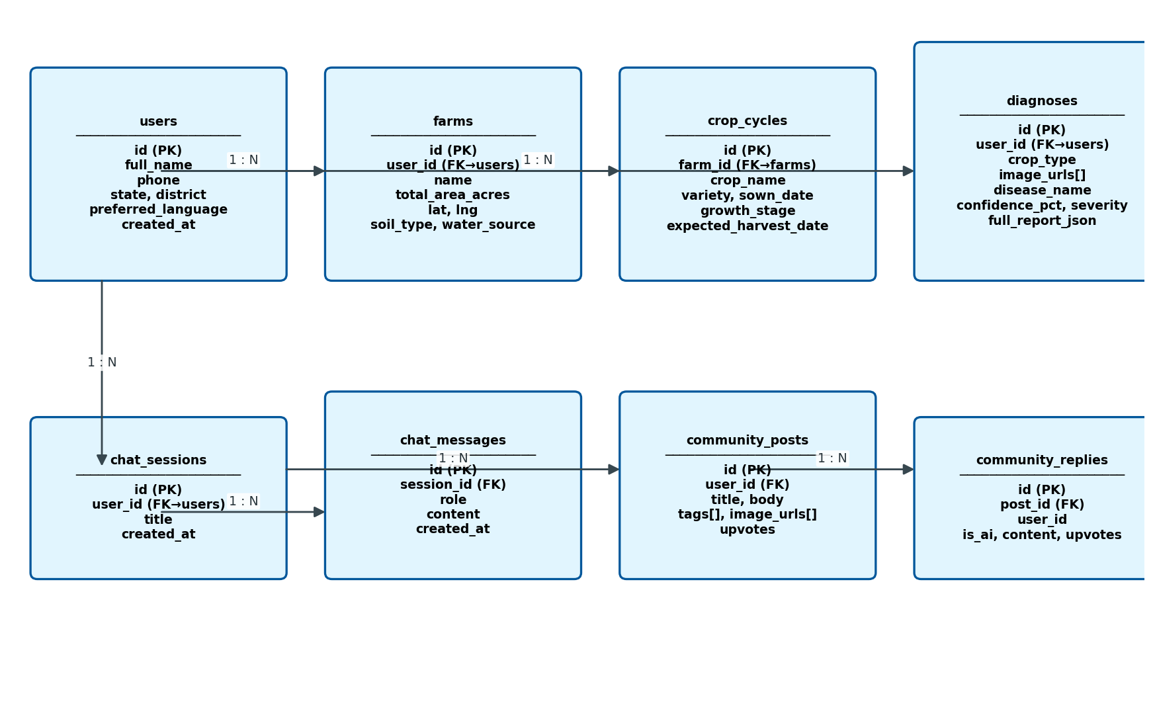
Database — ER Diagram
Figure 6.8 — Eight Postgres tables with RLS-ready policies
TheAgriDoctor • Capstone Project (CSE445)
22 / 35

Slide 23
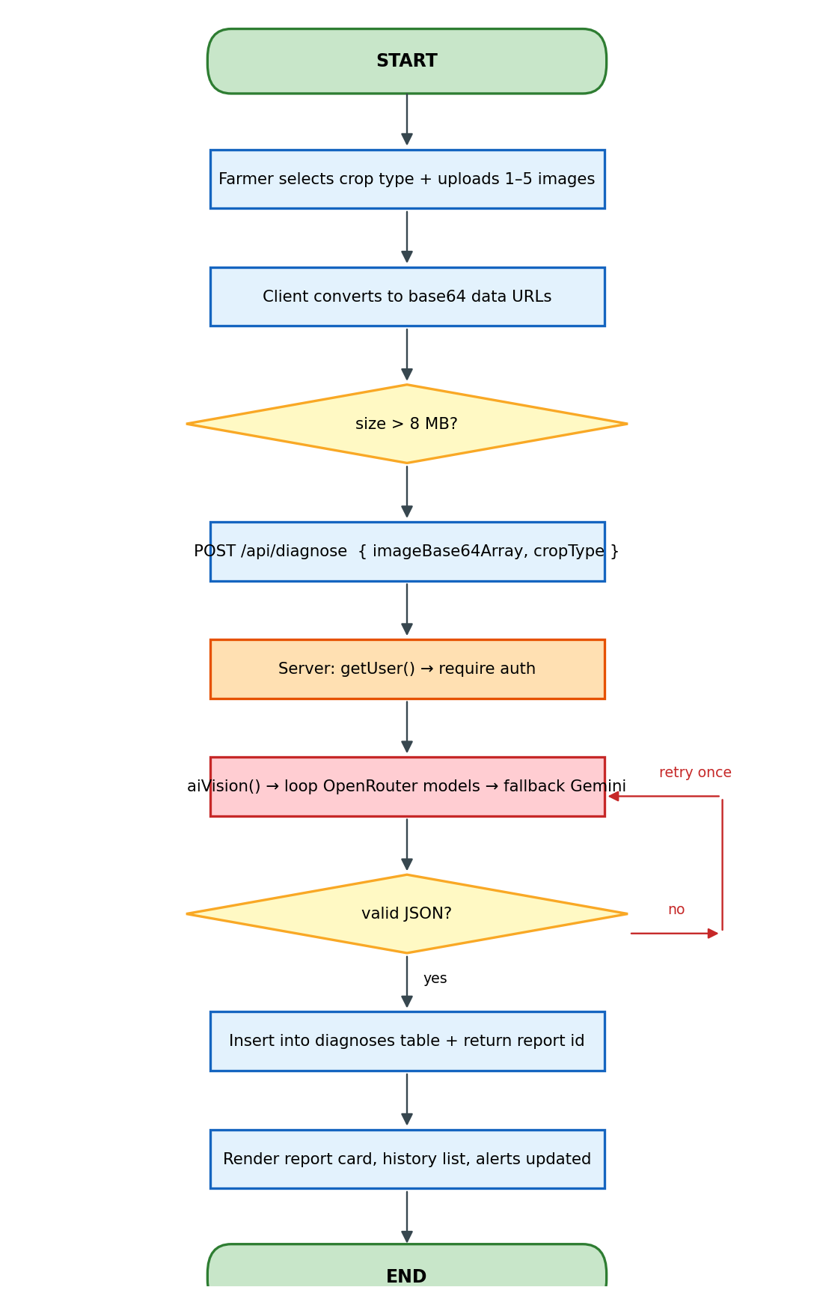
Flowchart — Disease Diagnosis
Figure 6.9 — End-to-end flow with one-shot retry on invalid JSON
TheAgriDoctor • Capstone Project (CSE445)
23 / 35

Slide 24
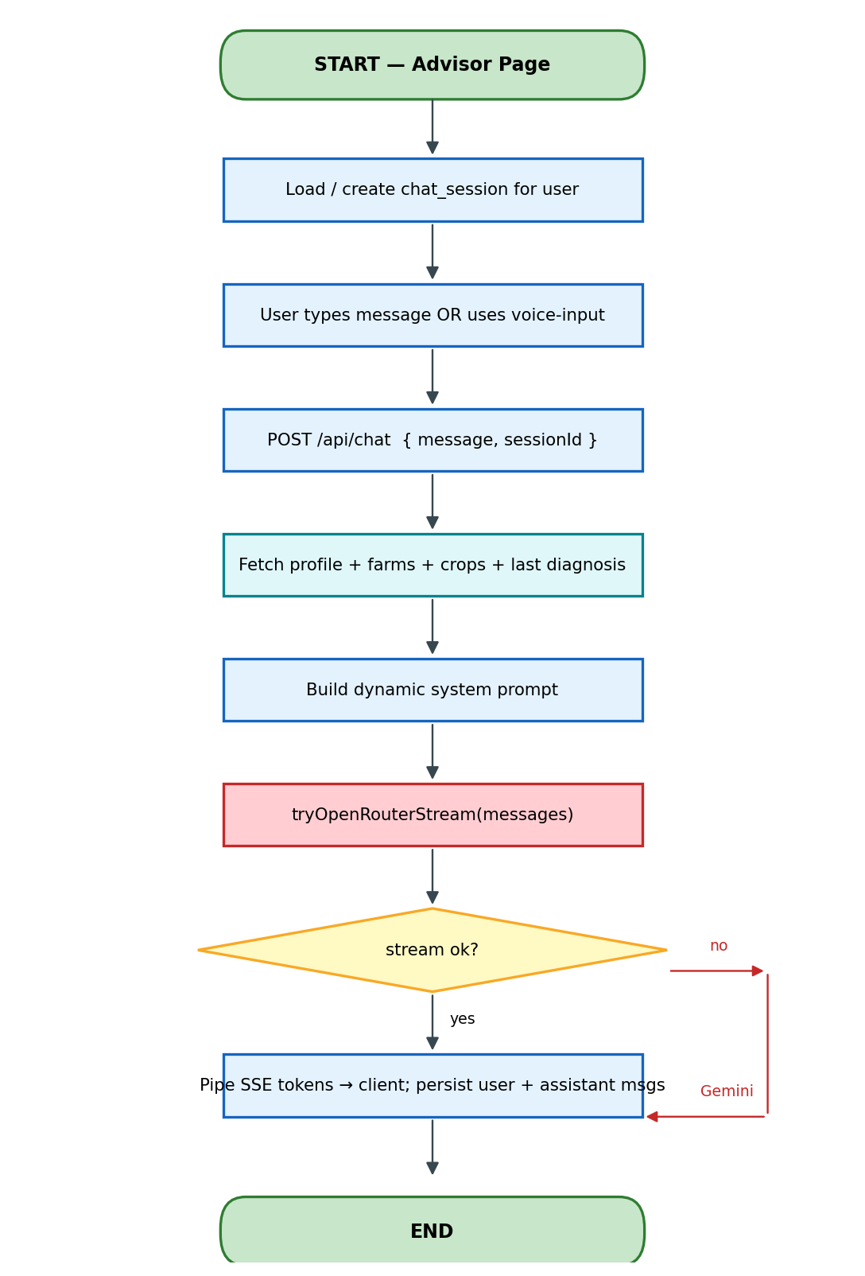
Flowchart — AI Advisor Chat
Figure 6.10 — Streaming OpenRouter → Gemini fallback
TheAgriDoctor • Capstone Project (CSE445)
24 / 35

Slide 25
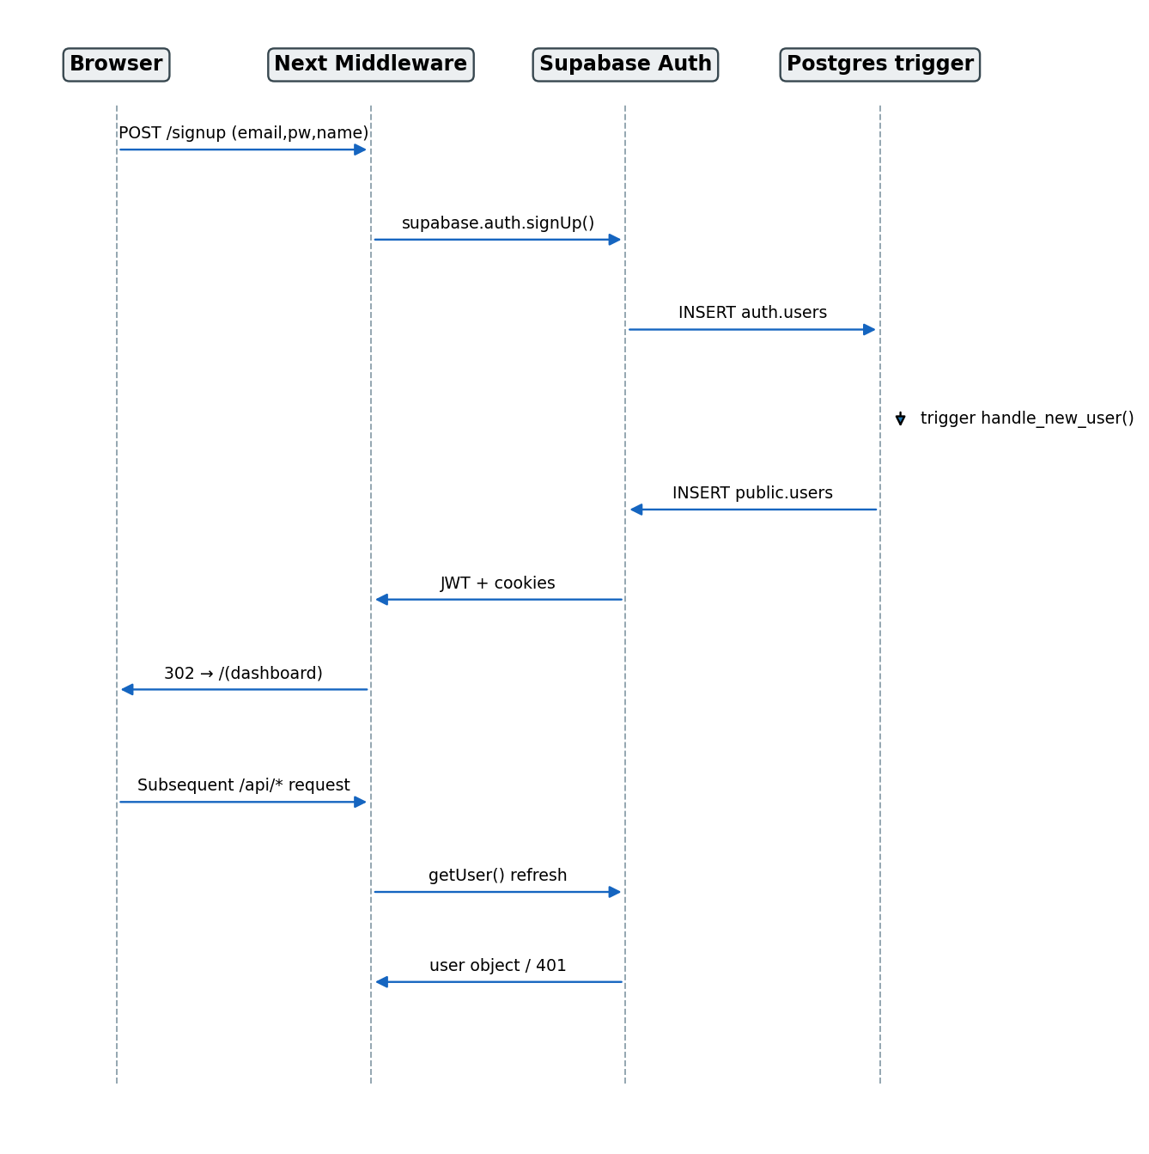
Sequence — Authentication & Profile
Figure 6.11 — Trigger-driven public.users provisioning
TheAgriDoctor • Capstone Project (CSE445)
25 / 35

Slide 26
05
Implementation
TheAgriDoctor • Capstone Project (CSE445)
26 / 35

Slide 27
Tech Stack
Frontend & Edge
Backend, Data & AI
• Next.js 14 (App Router) on Vercel
• React 18 + Server Components
• Tailwind CSS + shadcn/ui
• Zustand + TanStack Query
• Leaflet + react-leaflet-cluster
• react-markdown + remark-gfm
• TypeScript 5 (strict) + ESLint
• Next.js Route Handlers (Node 20)
• Supabase Postgres 15 + Storage + Auth
• @supabase/ssr (JWT cookie middleware)
• OpenRouter — Nemotron, Llama 3.3, Gemma-3, Qwen-VL, Llama-Vision
• Google Gemini 2.5 Flash (text + vision fallback)
• OpenWeather Agro-Monitoring (weather, soil, NDVI)
• OpenWeatherMap tiles for radar overlays
TheAgriDoctor • Capstone Project (CSE445)
27 / 35

Slide 28
Low-Level Design Highlights
• src/lib/ai.ts → orchestrates 3 vision models then Gemini, with retry
• src/app/api/chat/route.ts → SSE-stream from OpenRouter, falls back to Gemini
• src/lib/auth.ts → getUser() helper used by every Route Handler
• src/lib/upload.ts → client-side image compression before Supabase Storage
• src/lib/crop-tasks.ts → stage-wise auto-task generator
• DB trigger on_auth_user_created → auto-creates public.users from auth.users
• src/components/diagnose/heatmap-map-inner.tsx → dynamic-imported to keep TTFB low
TheAgriDoctor • Capstone Project (CSE445)
28 / 35

Slide 29
06
Testing & Status
TheAgriDoctor • Capstone Project (CSE445)
29 / 35

Slide 30
Test Cases (selected)
TC-ID | FR | Scenario | Result
TC-D1 | FR-6 | Upload 1 valid tomato leaf | Pass
TC-D3 | FR-6 | Upload 6 images → 400 error | Pass
TC-D4 | FR-7 | OpenRouter 429 → Gemini fallback | Pass
TC-A1 | FR-10 | Send chat → SSE stream + persisted | Pass
TC-A2 | FR-11 | Reply references active rice crop | Pass
TC-A3 | FR-12 | Hindi voice input transcribed | Pass
TC-A4 | FR-18 | Switch to Telugu — replies in Telugu | Pass
TheAgriDoctor • Capstone Project (CSE445)
30 / 35

Slide 31
Current Status & What’s Next
Done
Open / Next
• All 9 modules functionally complete
• Supabase schema + community migration shipped
• OpenRouter + Gemini fallback verified
• Lighthouse mobile ≥ 90 on dashboard
• Capstone deck + demo video produced
• Move to paid OpenRouter for larger pilots
• Service-worker push notifications
• i18n on the UI (only assistant text is localised today)
• Offline-aware diagnosis queue
• External pilot in 3 districts (50 farmers)
TheAgriDoctor • Capstone Project (CSE445)
31 / 35

Slide 32
Lessons Learnt
• Free LLM tiers without provider fallback are a recipe for outages
• Grounding the prompt in real farm + crop data is the single biggest UX lift
• React Server Components dramatically cut client bundle size
• Supabase RLS is powerful but unforgiving — write policies before any insert
• Lazy-loading map libraries (dynamic ssr:false) keeps TTFB acceptable
• Two-week sprints with a written acceptance checklist kept us aligned
TheAgriDoctor • Capstone Project (CSE445)
32 / 35

Slide 33
Selected References
Full bibliography (25 items) is in Chapter 12 of the report
• Mohanty et al. (2016) — Deep Learning for Plant Disease Detection
• Ferentinos (2018) — Deep learning models for plant disease
• FAO (2021) — State of Food and Agriculture
• Kamilaris & Prenafeta-Boldú (2018) — Deep learning in agriculture: a survey
• Vercel — Next.js 14 App Router docs
• Supabase — Platform Documentation
• OpenRouter — API Reference
• Google DeepMind — Gemini 1.5 Technical Report
TheAgriDoctor • Capstone Project (CSE445)
33 / 35

Slide 34
07
Live Demo
TheAgriDoctor • Capstone Project (CSE445)
34 / 35

Slide 35
Thank You!
Questions, suggestions and ideas welcome.
TheAgriDoctor — helping farmers, one photo at a time.
TheAgriDoctor • Capstone Project (CSE445)
35 / 35

