Slide 1



LEAD SCORING CASE STUDY
Focused business approach using logistic regression technique

Slide 2



most likely to convert into paying customers.
To help X Education select most promising leads (Hot Leads), i.e. the leads that are
Higher Lead Conversion Rate
Focused Marketing
Selection of Hot Leads

Slide 3
METHODOLOGY
To build a Logistic Regression model that assigns lead scores to all leads such that the
customers with higher lead score have a higher conversion chance and vice versa.
Target Lead Conversion Rate ≈ 80%

Slide 4




Importing and Observing the past data provided by the Company
Univariate and Bivariate analysis
Reading and Understanding the Data
Exploratory Data Analysis
Data Preparation
Data Cleaning
Missing value imputation
Removing duplicate data
and other redundancies
Outlier treatment
Dropping unnecessary columns
Dummy variable creation
Feature standardization

Slide 5
Feature selection using RFE
Manual feature elimination based on p-values and VIFs
Building another model using PCA
Comparing the two models
Assigning Lead Scores
Model Building
Model Evaluation
Comparison with PCA
Evaluating model based on various evaluation metrics
Finding the optimal
probability threshold
Finalizing the first model
Using predicted probabilities to
calculate Lead Scores:
Lead Score = Probability * 100

Slide 6
DATA VISUALIZATION
To identify important features
To get insights

Slide 7
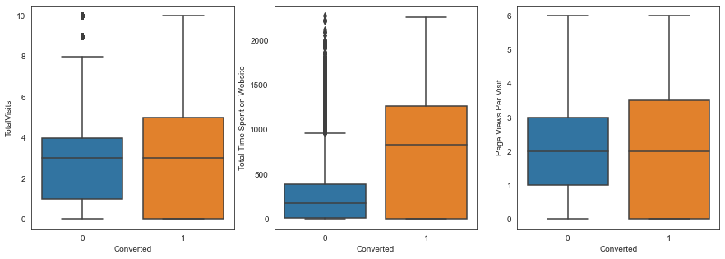
People spending more time on website are more likely to get converted.

Slide 8



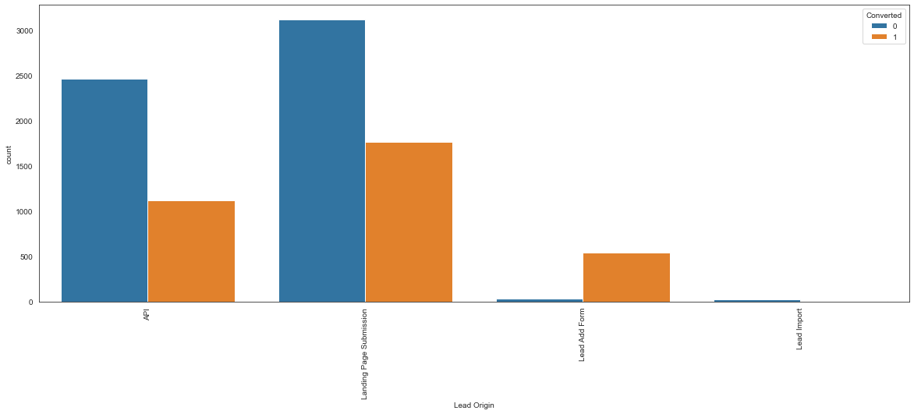
‘API’ and ‘Landing Page Submission’ generate the most leads but have less conversion rates, whereas ‘Lead Add Form’ generates less leads but conversion rate is great.
Try to increase conversion rate for ‘API’ and ‘Landing Page Submission’, and
increase leads generation using ‘Lead Add Form’.

Slide 9



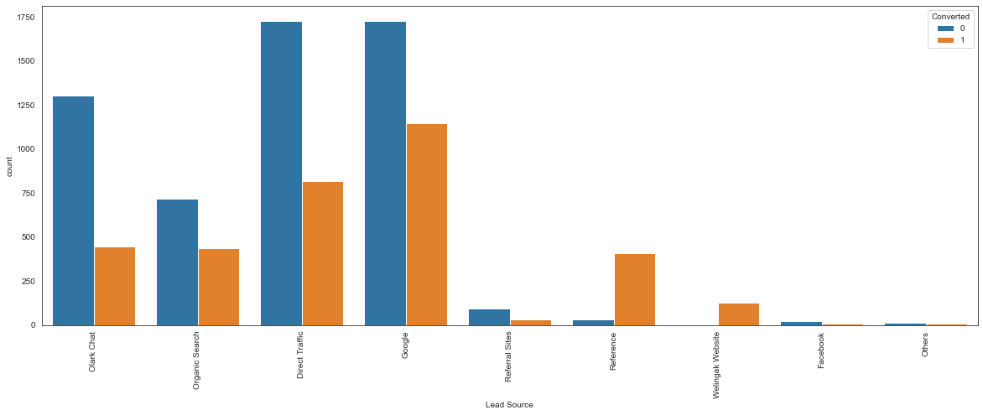
Very high conversion rates for lead sources ‘Reference’ and ‘Welingak
Website’.
Most leads are generated through ‘Direct Traffic’ and ‘Google’.

Slide 10
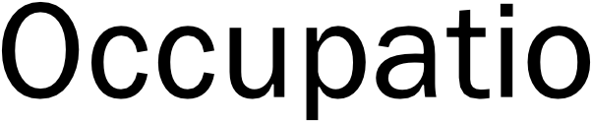



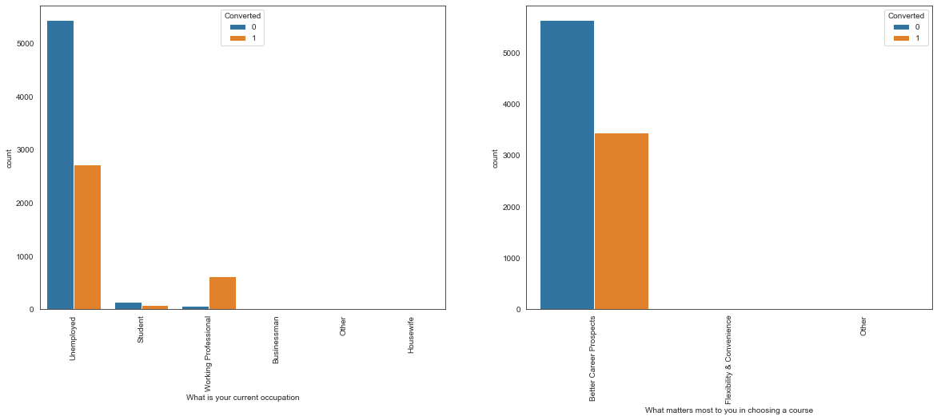
Working Professionals are most likely to get converted.

Slide 11


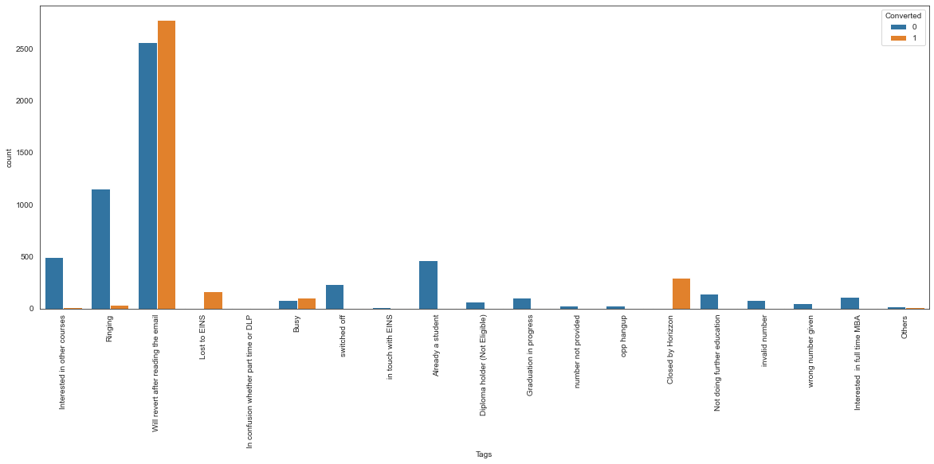
High conversion rates for tags ‘Will revert after reading the email’, ‘Closed by Horizon’, ‘Lost to EINS’, and ‘Busy’.

Slide 12


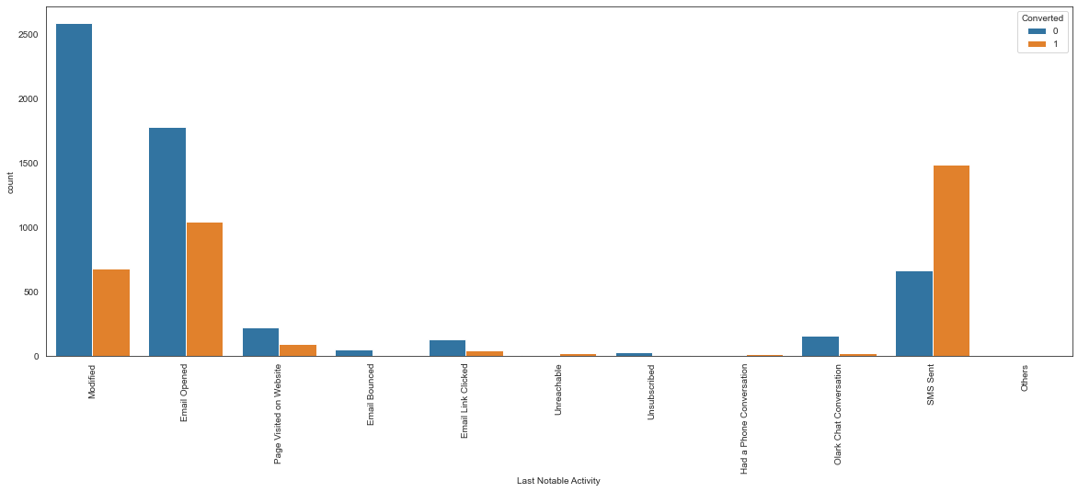
Highest conversion rate is for the last notable activity ‘SMS Sent’.

Slide 13
MODEL EVALUATION

Slide 14
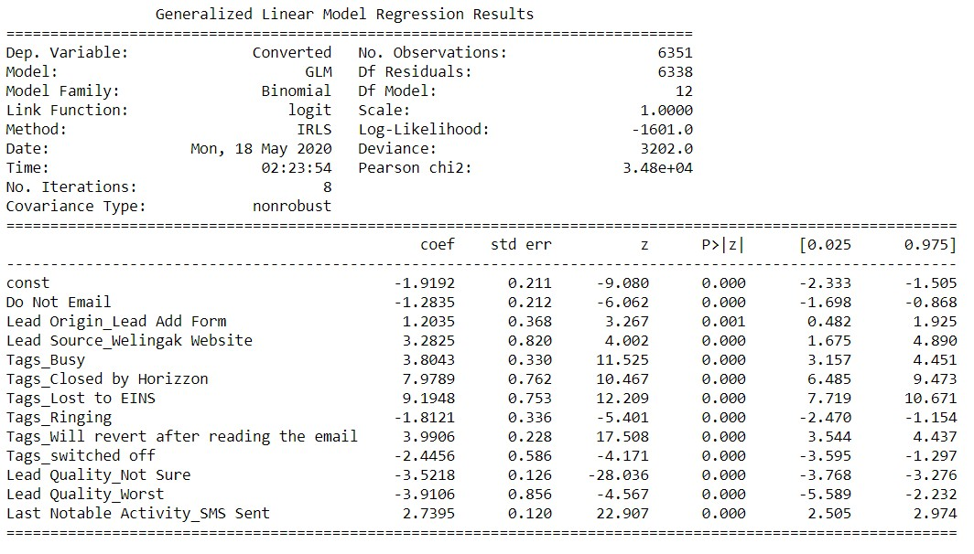




Final Model Summary: All p-values are zero

Slide 15


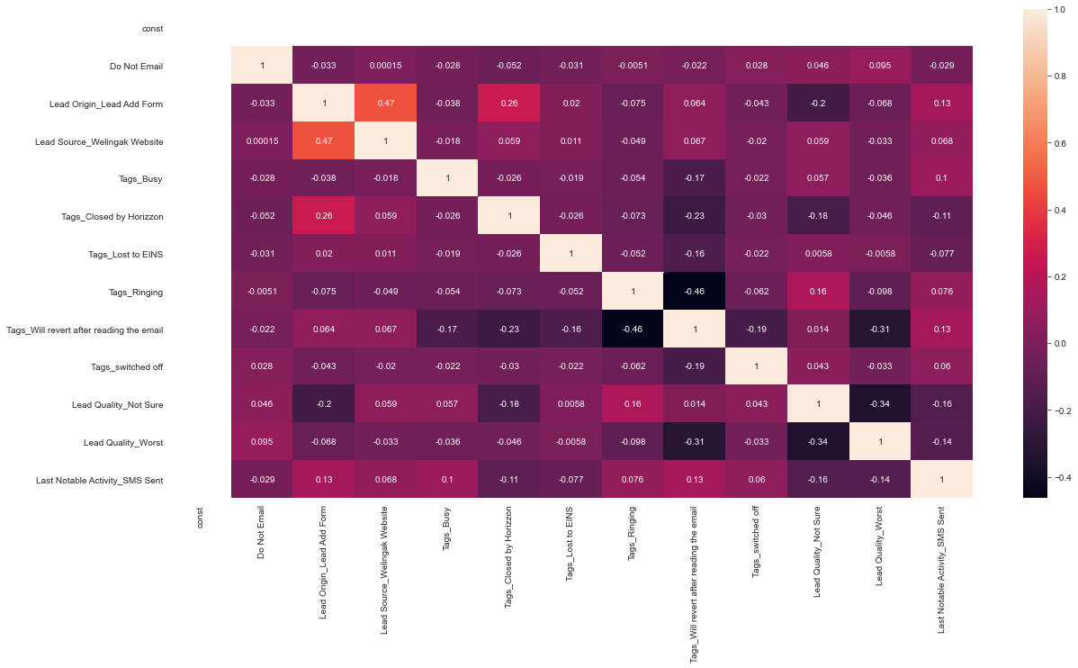
Correlations between features in the final model are negligible.

Slide 16


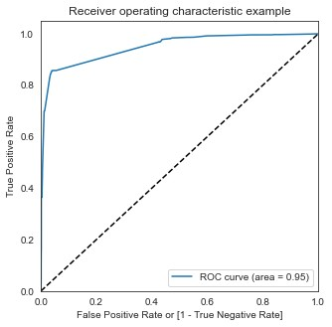
Area under curve = 0.95

Slide 17







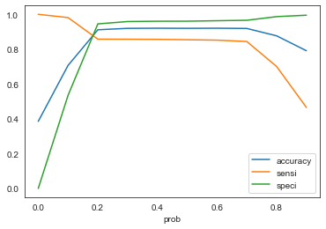
Graph showing changes in Sensitivity, Specificity and Accuracy with
changes in the probability threshold values
Optimal cutoff = 0.20

Slide 18

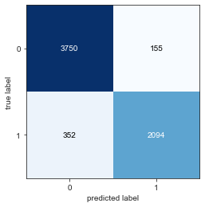

For train set
For test set

Slide 19


Data | Train set | Test set
Accuracy | 0.9111 | 0.9078
Sensitivity | 0.8573 | 0.8412
Specificity | 0.9449 | 0.9457
False Positive Rate | 0.0550 | 0.0542
Positive Predictive Value | 0.9070 | 0.8984
Negative Predictive Value | 0.9135 | 0.9126
AUC | 0.9488 | 0.9388

Slide 20
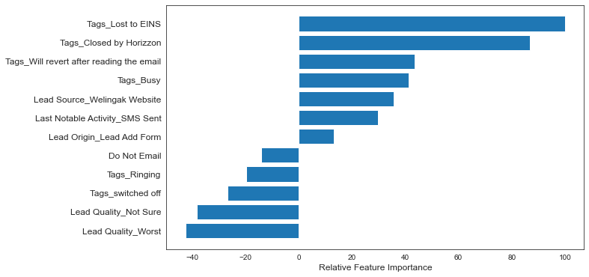

Slide 21
INFERENCES

Slide 22


Three variables which contribute most towards the probability of a lead conversion in decreasing order of impact are:
Tags_Lost to EINS
Tags_Closed by Horizzon
Tags_Will revert after reading the email
These are dummy features created from the categorical variable Tags.
All three contribute positively towards the probability of a lead conversion.
These results indicate that the company should focus more on the leads with these three tags.

Slide 23
Situation 1: Company has interns for 2 months. They wish to make lead conversion more aggressive. They want almost all of the potential leads to be converted and hence, want to make phone calls to as much of such people as possible.
Solution:
𝑺𝒆𝒏𝒔𝒊𝒕𝒊𝒗𝒊𝒕𝒚 = 𝑻𝒓𝒖𝒆 𝑷𝒐𝒔𝒊𝒕𝒊𝒗𝒆𝒔/ (𝑻𝒓𝒖𝒆 𝑷𝒐𝒔𝒊𝒕𝒊𝒗𝒆𝒔 + 𝑭𝒂𝒍𝒔𝒆 𝑵𝒆𝒈𝒂𝒕𝒊𝒗𝒆𝒔)
Sensitivity can be defined as the number of actual conversions predicted correctly out of total number of actual conversions. As we saw earlier, sensitivity decreases as the threshold increases.
High sensitivity implies that our model will correctly predict almost all leads who are likely to convert. At the same time, it may overestimate and misclassify some of the non-conversions as conversions.
As the company has extra man-power for two months and wants to make the lead conversion more aggressive, it is a good strategy to go for high sensitivity. To achieve high sensitivity, we need to choose a low threshold value.

Slide 24
Situation 2: At times, the company reaches its target for a quarter before the deadline. It wants the sales team to focus on some new work. So during this time, the company’s aim is to not make phone calls unless it’s extremely necessary.
Solution:
𝑺𝒑𝒆𝒄𝒊𝒇𝒊𝒄𝒊𝒕𝒚 = 𝑻𝒓𝒖𝒆 𝑵𝒆𝒈𝒂𝒕𝒊𝒗𝒆𝒔/ (𝑻𝒓𝒖𝒆 𝑵𝒆𝒈𝒂𝒕𝒊𝒗𝒆𝒔 + 𝑭𝒂𝒍𝒔𝒆 𝑷𝒐𝒔𝒊𝒕𝒊𝒗𝒆𝒔)
Specificity can be defined as the number of actual non-conversions predicted correctly out of total number of actual non-conversions. It increases as the threshold increases.
High specificity implies that our model will correctly predict almost all leads who are not likely to convert. At the same time, it may misclassify some of the conversions as non-conversions.
As the company has already reached its target for a quarter and doesn’t want to
make unnecessary phone calls, it is a good strategy to go for high specificity.
It will ensure that the phone calls are only made to customers who have a very high probability of conversion. To achieve high specificity, we need to choose a high threshold value.

Slide 25
By referring to the data visualizations, focus on
Increasing the conversion rates for the categories generating more leads and
Generating more leads for categories having high conversion rates.
Pay attention to the relative importance of the features in the model and their positive or negative impact on the probability of conversion.
Based on varying business needs, modify the probability threshold value for identifying potential leads.

Slide 26
THANK YOU

