Slide 1

DATA MINING PROJECT - ISM6136.004F23

Slide 2

TEAM- DATA HAWKS
1. Sai Shishir Ailneni – U38559388
2. Sai Koushik Thatipamula – U18895638
3. Deepshikha Sherpally - U57605062
4. Akshitha Katta – U38519838
5. Rohith Sahini - U18270323

Slide 3

AGENDA
INTRODUCTION
DATA EXPLORATION
BUSINESS CONTEXT
DATA CLEANING PROCESS
DATA PROCESSING
METRICS
RESULTS COMPARISION
CONCLUSION
REFERENCES

Slide 4

Diabetes
INTRODUCTION
Diabetes is a condition where the sugar levels in your blood become too high because your body can't make or use insulin properly. High sugar levels can cause damage to your body's nerves and blood vessels over time.
High blood sugar, known as hyperglycemia, happens a lot when diabetes isn't controlled. Over time, it can seriously harm many parts of the body, especially the nerves and blood vessels.
Signs of diabetes can be feeling really thirsty, needing to pee a lot, feeling very hungry, losing weight without trying, being tired, having blurry vision, having slow-healing cuts, and getting infections often.
To manage diabetes, it's important to eat healthy food, exercise regularly, check your blood sugar levels, take any medications given by your doctor, and sometimes use insulin. If diabetes isn't managed well, it can lead to problems like heart issues, strokes, kidney troubles, vision difficulties, nerve damage, and foot problems that might require amputation.

Slide 5
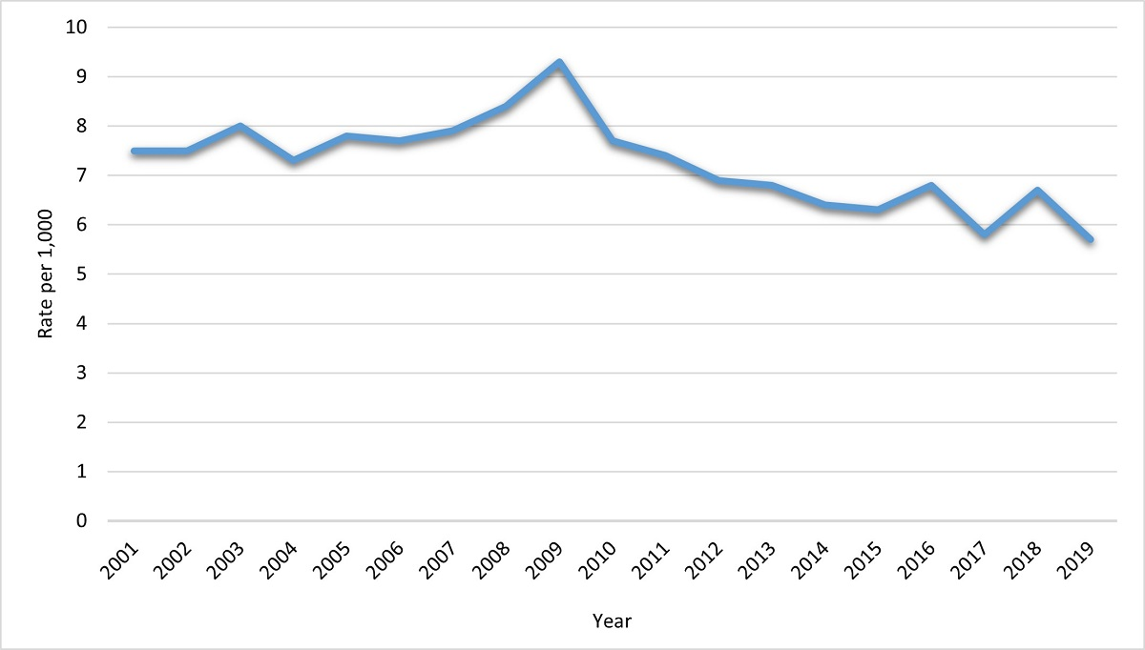
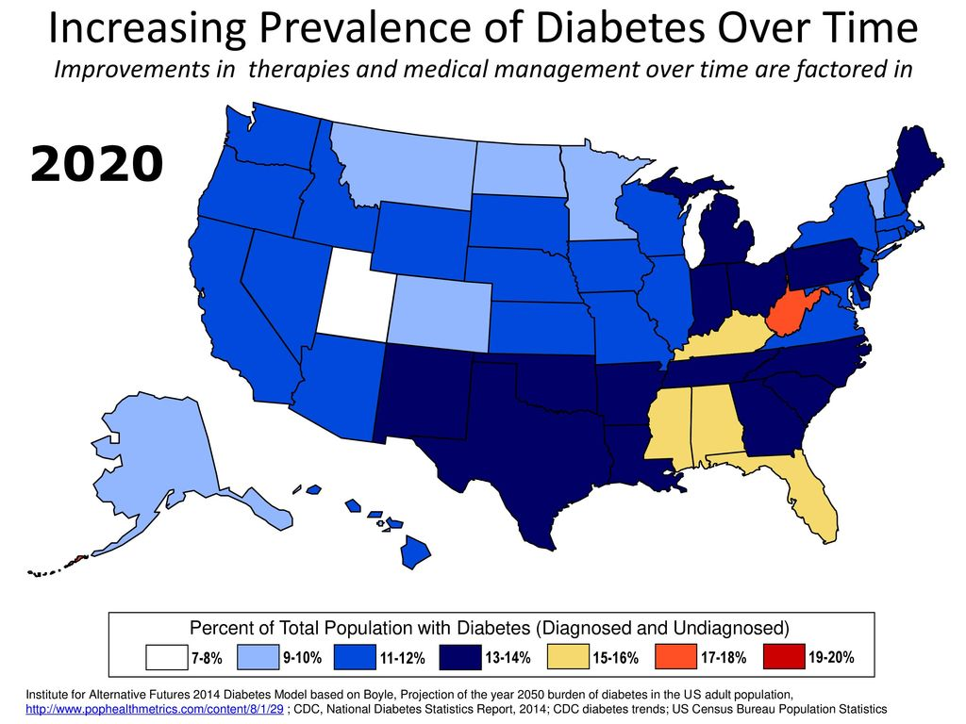
Trends in Incidence of Diagnosed Diabetes Among Adults Aged 18 Years or Older, United States, 2001–2019
Geographical distribution of diabetes cases in the USA

Slide 6
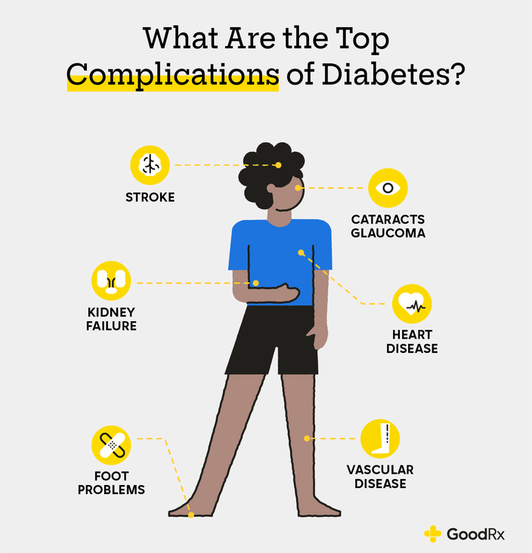
Long term effects
Diabetes can lead to severe problems that really affect overall health and increase the chance of premature death.
Complications include:
Heart disease
Kidney damage
Nerve problems
Vision loss

Slide 7
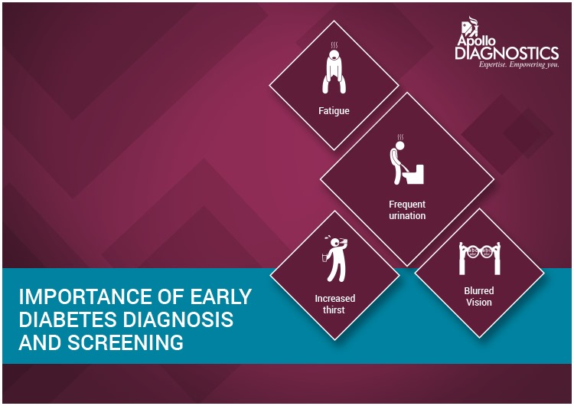
It's important to find diabetes early for better management. Not noticing symptoms, overlooking regular check-ups, or mistaking initial signs for minor problems are common reasons for missing its early detection.
Identifying diabetes early and taking preventive action is essential to avoid serious complications associated with the condition.
Early signs of diabetes involve tiredness, frequent urination, heightened thirst, and blurry vision.

Slide 8
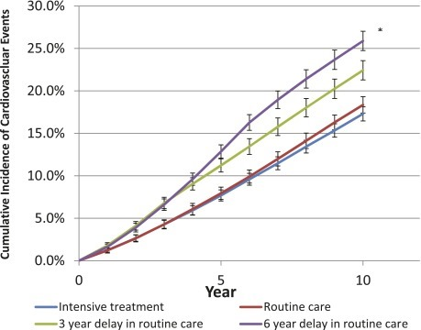
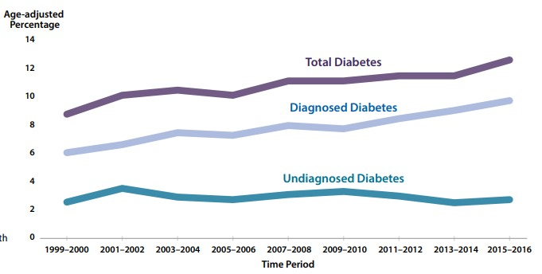
Credits- NCBI
Credits- US National Diabetes Report 2020
The picture shows that more patients getting intensive treatment had fewer heart issues compared to those getting regular care, especially after 10 years. Waiting for routine care made heart problems more likely, with longer waits leading to more issues. It suggests intense treatment might help avoid heart troubles, while waiting could make them more likely, but it doesn't prove for sure.
The graph depicts a rise in diabetes cases from 1999-2000 to 2015-2016, with diagnosed cases increasing slower than the total diabetic population, implying many remain undiagnosed. Stable undiagnosed cases signify ongoing unawareness, emphasizing the need for early detection, awareness, and preventive measures due to diabetes-related complications.

Slide 9

Data Exploration:
Over the span of ten years (1999-2008), data was collected from 130 United States hospitals and accumulated delivery networks regarding patients who are diagnosed with diabetes. The records included information about laboratory tests, medications given, and the duration of their hospital stays, which could last up to 14 days.
These data points include a patient's unique identifier, racial background, gender, and age, providing a comprehensive overview of the population under study. Additionally, it encompasses information regarding the nature of the patient's admission, the duration of their stay within the healthcare facility, as well as details concerning the specialized medical field associated with the admitting physician.
Furthermore, the dataset offers insights into the extent of medical assessments conducted during patient encounters, ranging from the number of laboratory tests performed to the specific outcomes of HbA1c tests. It also highlights the range of diagnoses made during these encounters, shedding light on the spectrum of health conditions that patients were being treated for during their hospital stays.
Source: Diabetes 130-US hospitals for years 1999-2008

Slide 10

- Despite considerable evidence supporting the benefits of various preventive and therapeutic interventions for diabetic patients, many individuals still do not receive needed care. One reason for this could be the inconsistent management of diabetes within hospital settings, leading to insufficient attention to glycemic control.
- This lack of proper diabetes care not only leads to increased management costs for hospitals, as patients end up being readmitted but also has a direct impact on the well-being of the patients.
- attempt to develop a predictive model examining how the measurement of HbA1c affects early readmission while controlling for covariates such as demographics, disease severity and type, and the type of admission.
Despite effective treatments, many diabetic patients do not receive needed care, partly due to inconsistent hospital management.
High cost of diabetes care is due to lack of proper care, which leads to readmission and affects patients' well-being.
Predictive model for HbA1c and early readmission in diabetic patients could improve care, reduce costs, and enhance well-being.

Slide 11

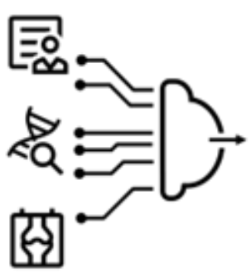

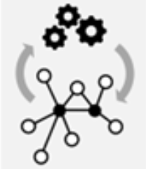



admission type
discharge disposition
Readmitted: “<30 ”
admission source
time in hospital
max glu serum
Readmitted:”No”
A1Cresult
PRE-PROCESSING
MODEL FITTING
TARGET
DATA CLEANING PROCESS

Slide 12

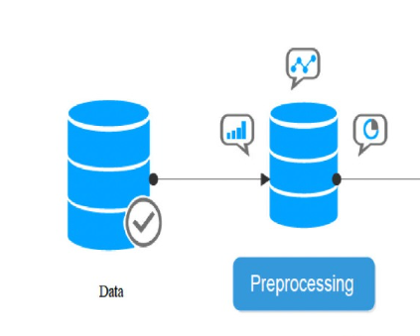
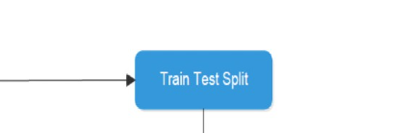
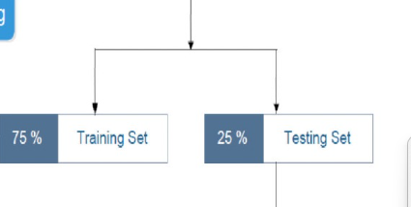
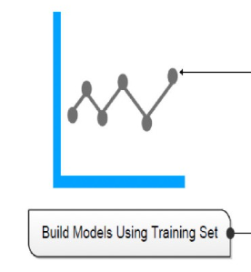
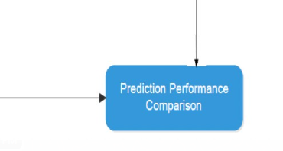


DATA PROCESSING

Slide 13

METRICS:
False Positives (FP):Definition: Patients predicted to be at risk of early readmission ("<30 days"), but they were not readmitted within 30 days.
Significance: False positives represent cases where the model incorrectly identifies patients as at risk of early readmission when, in reality, they do not experience early readmission. This can lead to unnecessary interventions or resources allocated to these patients.
False Negatives (FN):Definition: Patients who are not predicted to be at risk of early readmission ("<30 days"), but they are actually readmitted within 30 days.
Significance: False negatives represent cases where the model fails to identify patients who are at risk of early readmission. Missing these cases can have clinical implications, as these patients may benefit from closer monitoring or intervention to prevent early readmission.
The trade-off between FP and FN is a critical aspect of model evaluation in healthcare scenarios. In this specific problem, minimizing FNs (patients who are truly at risk but not identified) might be more crucial because failing to detect early readmission can have adverse consequences for patient care.
Therefore, the model's performance should be evaluated based on its ability to minimize FN cases and increase recall.

Slide 14

RESULTS COMPARISION:
Alloghani M, Et al:
 | AUC | RECALL
SVM | 0.547 | 0.475
RANDOM FOREST | 0.602 | 0.529
Data Hawks Results:
 | AUC | RECALL
SVM | 0.615 | 0.545
RANDOM FOREST | 0.61 | 0.5933
XG BOOST | 0.611 | 0.597
DECISION TREE | 0.531 | 0.532

Slide 15

CONCLUSION
While AUC provides an overview of the models' ability to separate classes, the focus on recall is crucial in this scenario. The problem statement highlights the importance of minimizing False Negatives (missing at-risk patients) as a primary concern.
Therefore, the models should prioritize recall over precision.Random Forest, XGBoost, and SVM exhibit similar AUC scores, but Random Forest and XGBoost outperform SVM and the Decision Tree in recall. This suggests that Random Forest and XGBoost are better at identifying patients at risk of early readmission.
The performance of the Decision Tree is notably lower, with both lower AUC and recall scores. This may indicate that the Decision Tree struggles to capture the complexities of the dataset and requires further refinement.

Slide 16

REFERENCES:
https://archive.ics.uci.edu/dataset/296/diabetes+130-us+hospitals+for+years+1999-2008
Alloghani M, Aljaaf A, Hussain A, Baker T, Mustafina J, Al-Jumeily D, Khalaf M. Implementation of machine learning algorithms to create diabetic patient re-admission profiles.
https://www.cdc.gov/diabetes/data/statistics-report/diagnosed-undiagnosed-diabetes.html
https://www.uni-mannheim.de/dws/news/new-project-on-early-stage-diabetes-detection/
https://www.cdc.gov/diabetes/library/reports/reportcard/national-state-diabetes-trends.html
https://www.goodrx.com/conditions/diabetes/diabetes-complications

Slide 17
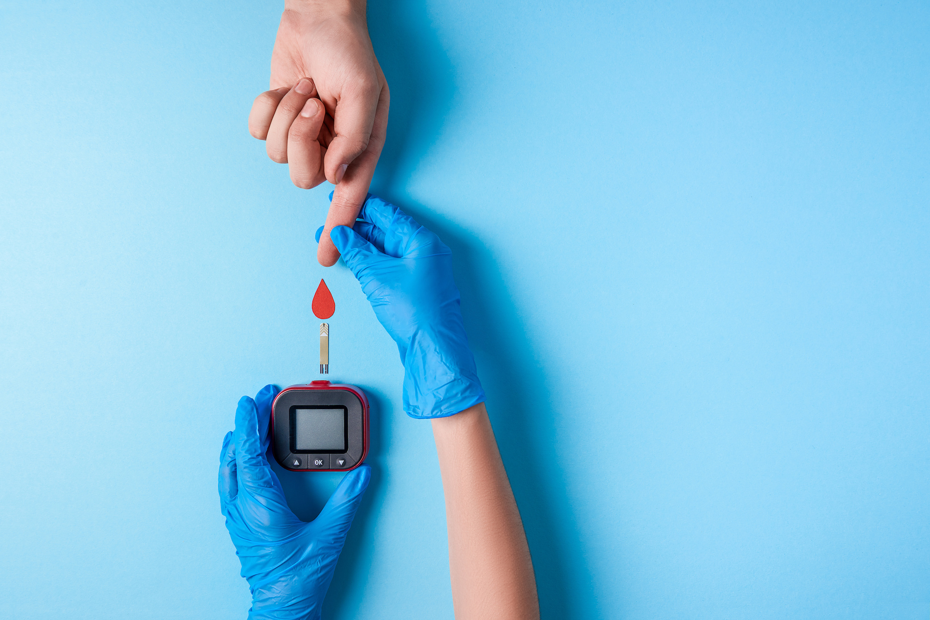
THANK YOU

