Slide 1
Create sentiment analysis model
Shri Shankaracharya Institute of Professional Management & Technology, Raipur
Mini Project Report on
CSE 5th Semester
Department of Computer Science and Engineering,
Session July – Dec 2021
Presentation Date:
Project Group Members:
Krishna Kant Kurre, 303302219056 Koushubh Yadav, 303302219055
Project Guide
Prof. DEEPAK RAO KHADATKAR
(Department of Computer Science & Engineering)

Slide 2
Introduction About Project
Processing text in such a way to extract useful information from it known as text processing. It is the textual data analysis using different tools and techniques. In order to pass the text to a machine learning model, we need to process it to find out certain important information and the numerical features about the text.
Sentiment analysis is useful for quickly gaining insights using large volumes of text data.
In today’s environment where we’re having data overload, companies have mountains of customer feedback collected and it’s impossible for humans, to analyze it manually without any sort of error.
If we take a customer feedback as example, sentiment analysis measures the attitude of the customer towards the aspects of a service or product which they describe in text.
This involves taking a piece of text, whether it’s a sentence or a comment and returning a “score” that measures how positive or negative the text is.
Another application of sentiment analysis is for social media posts to avoid trolling.

Slide 3
Project Requirements
Google Colab - a free Jupyter notebook environment that runs entirely in the cloud. It does not require a setup and the notebooks can be simultaneously edited by team members, just like documents in Google Docs.
TextBlob (Library) - TextBlob is a Python library for processing textual data. It provides a simple API for tasks such as noun phrase extraction, sentiment analysis, classification, translation, and more.

Slide 4
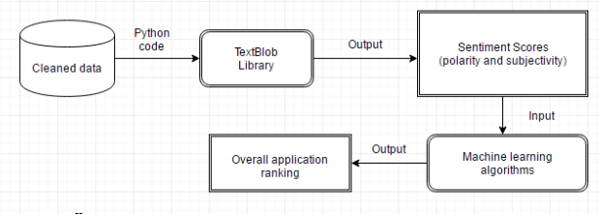
Work Flow Diagram
Textblob is built on top of NLTK and Pattern also it is very easy to use and can process the text in a few lines of code. Textblob can help you start with the NLP (Natural Language Processing) tasks.
A standard analyzer defines up to three basic polar emotions (positive, negative, neutral)
TextBlob’s output for a polarity task is a float within the range [-1.0, 1.0] where -1.0 is a negative polarity and 1.0 is positive. This score can also be equal to 0, which stands for a neutral evaluation of a statement as it doesn’t contain any words from the training set.

Slide 5
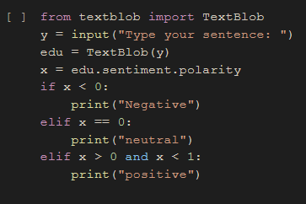
Snapshot of your Project

Slide 6



Expected Outcomes/Result
The project displays 3 outcomes -
Neutral
Positive
Negative
Video Demonstration -

Slide 7
References
Web Resources -
http://www.stackoverflow.com
https://textblob.readthedocs.io/en/dev/
https://pypi.org/project/textblob/0.9.0/

