Slide 1

Modern AI: From Foundations to Production
A structured journey through the AI stack — from core concepts like Machine Learning and Deep Learning, through Large Language Models and Generative AI, to building and deploying real-world intelligent systems.
AI FUNDAMENTALS
ML · DL · GENAI

Slide 2
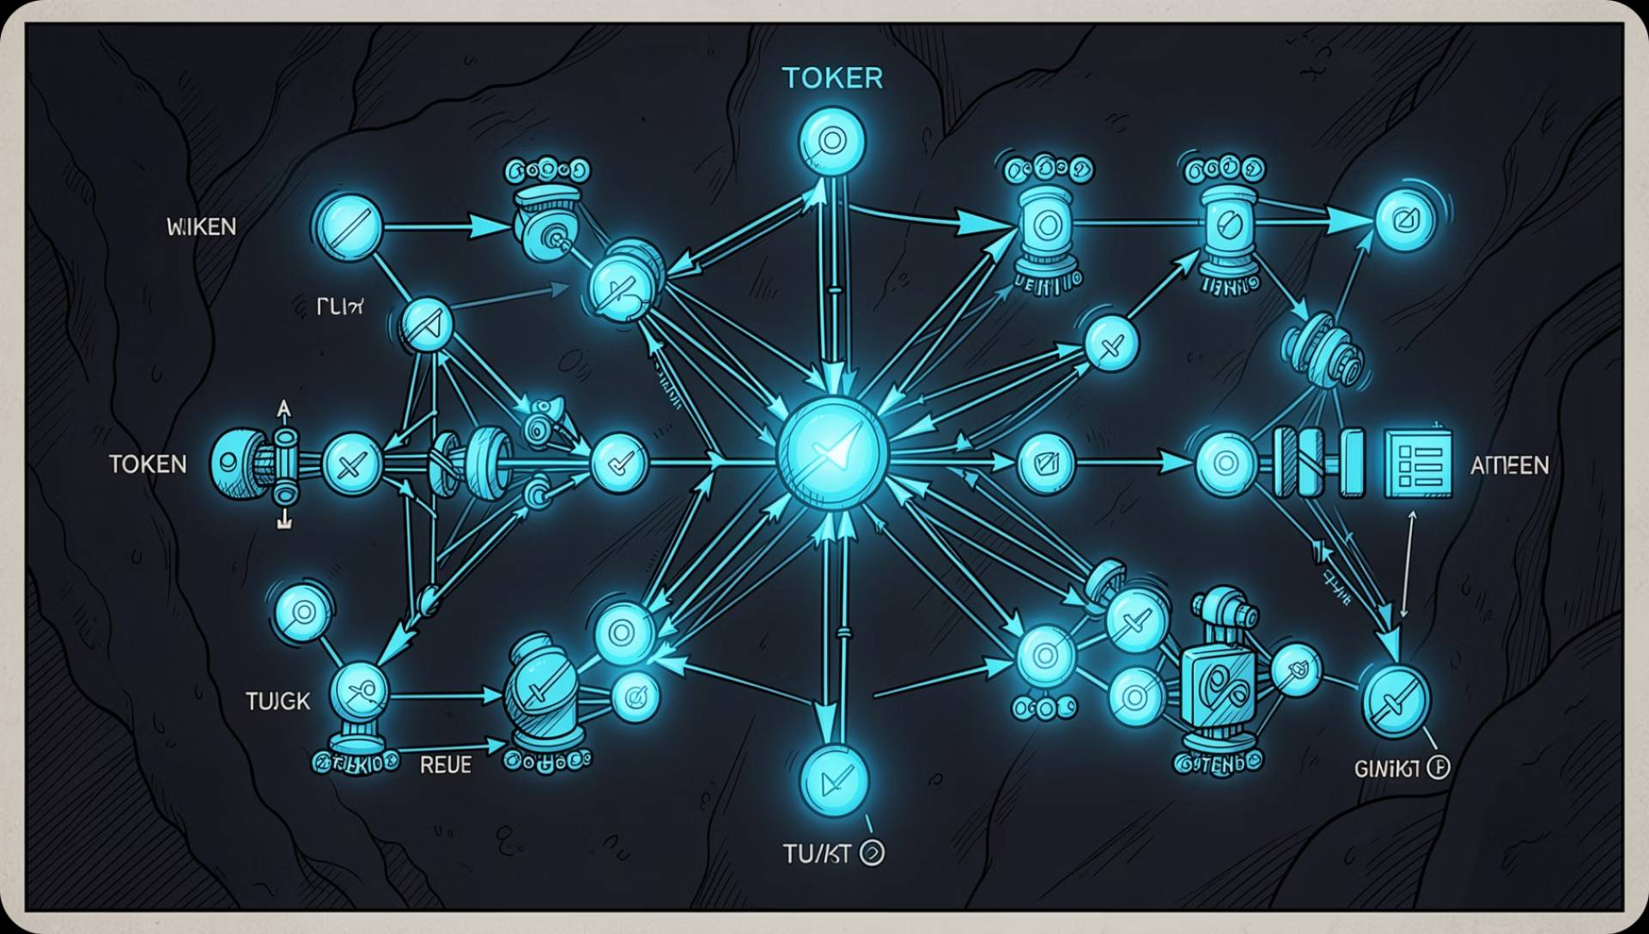
Large Language Models
What is an LLM?
LLMs are neural networks trained on vast text corpora to understand, generate, and reason over language.
Transformer Architecture
Tokens & Tokenization
Context Window
Attention Mechanism
Text is split into subword units before model processing.
Defines how much text the model can attend to at once.
Weighs token relevance dynamically across the sequence.
Self-attention enables parallel processing of entire sequences.

Slide 3


Generative AI & Agentic AI
Generative AI
Creates new content — text, images, code — from learned patterns. Output-focused and reactive.
Agentic AI
Autonomous systems that plan, decide, and act across tools and environments to achieve goals.
AI Agents
Perceive, reason, and act with defined goals and memory.
Multi-Agent Systems
Agents collaborate, delegate, and negotiate to solve complex tasks.
AI Workflows
Orchestrated pipelines connecting agents, tools, and LLM calls.

Slide 4
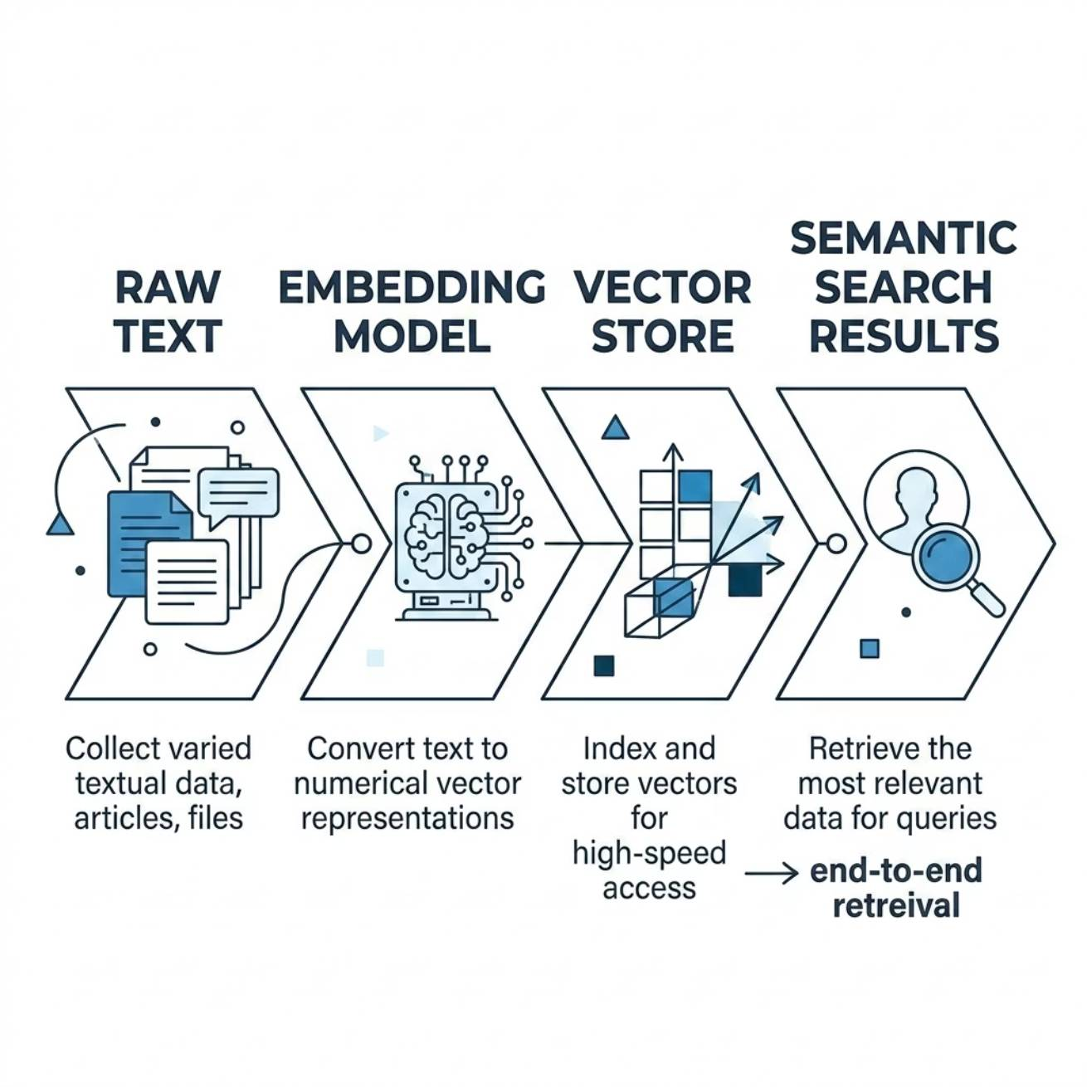

Embeddings & Vector Databases
From Text to Vectors
Embeddings map words, sentences, or documents into high-dimensional numeric space — capturing semantic meaning rather than exact text matches.
Semantic Similarity
Cosine Similarity
Similar meanings cluster close together in vector space.
Measures the angle between two vectors — the standard similarity metric.
Vector Search
Metadata Filtering
Approximate Nearest Neighbor (ANN) search enables fast, scalable retrieval.
Combine vector search with structured filters for precise results.

Slide 5

Retrieval-Augmented Generation (RAG)
RAG grounds LLM responses in verified, up-to-date external data — reducing hallucinations and enabling domain-specific intelligence.
Ingest
Store
Retrieve
Generate
This pipeline ensures every LLM response is anchored in retrieved, relevant context rather than relying solely on parametric memory.
Chunking Strategies
Real-World Use Cases
Fixed-size, semantic, or recursive chunking affects retrieval precision and context quality.
Enterprise knowledge bases, legal document Q&A, customer support bots, and research assistants.

Slide 6
Prompt Engineering
1
Zero-Shot Prompting
Task with no examples — relies purely on the model's pre-trained knowledge.
2
Few-Shot Prompting
Include 2–5 examples in the prompt to guide output format and reasoning.
3
Chain of Thought
Ask the model to "think step by step" — dramatically improves complex reasoning.
4
ReAct Prompting
Interleaves Reasoning and Action — the model decides when to call tools.
5
Persona & Structured
Assign a role and enforce output schemas (JSON, XML) for predictable results.
6
Guardrails
Protect against prompt injection, jailbreaking, and unintended behavior.

Slide 7
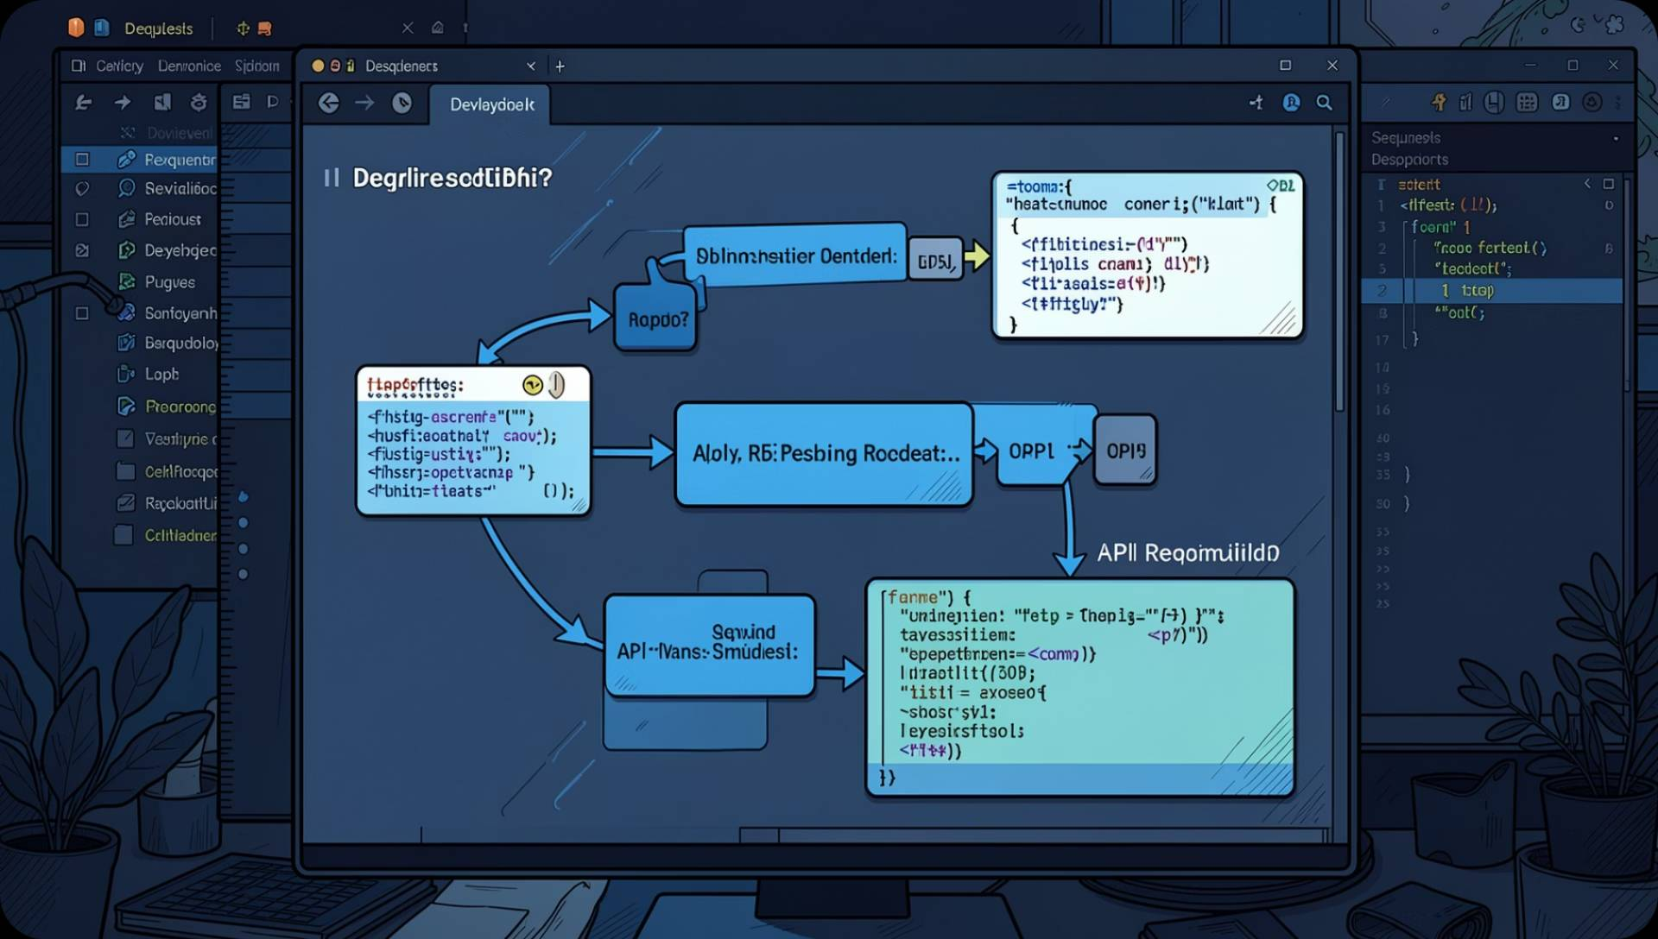
LLM APIs & Structured Outputs
API Lifecycle
Authenticate → Construct Request → Stream or Wait → Parse Response → Handle Errors.
Chat vs Completion
Chat models use role-based messages; completion models continue raw text.
System / User / Assistant
Three roles define conversation context, input, and model output.
JSON Mode
Enforces structured output — essential for reliable downstream parsing.
Streaming
Token-by-token delivery reduces latency and enables real-time UX.

Slide 8

AI Agents & Tool Calling
Observe Input
Reason & Plan
Reflect & Evaluate
Act (Call Tool)
The ReAct loop enables agents to dynamically decide when to think and when to act, creating flexible, goal-driven behavior.
Agent Architecture
ReAct Architecture
Planning: Break goals into sub-tasks
Memory: Short-term (context) + long-term (vector store)
Tool Calling: Invoke APIs, databases, or functions
Function Calling: Structured schema-based tool invocation
Combines Reasoning (chain-of-thought) with Action (tool execution) in a single loop — the dominant pattern for agentic systems.

Slide 9
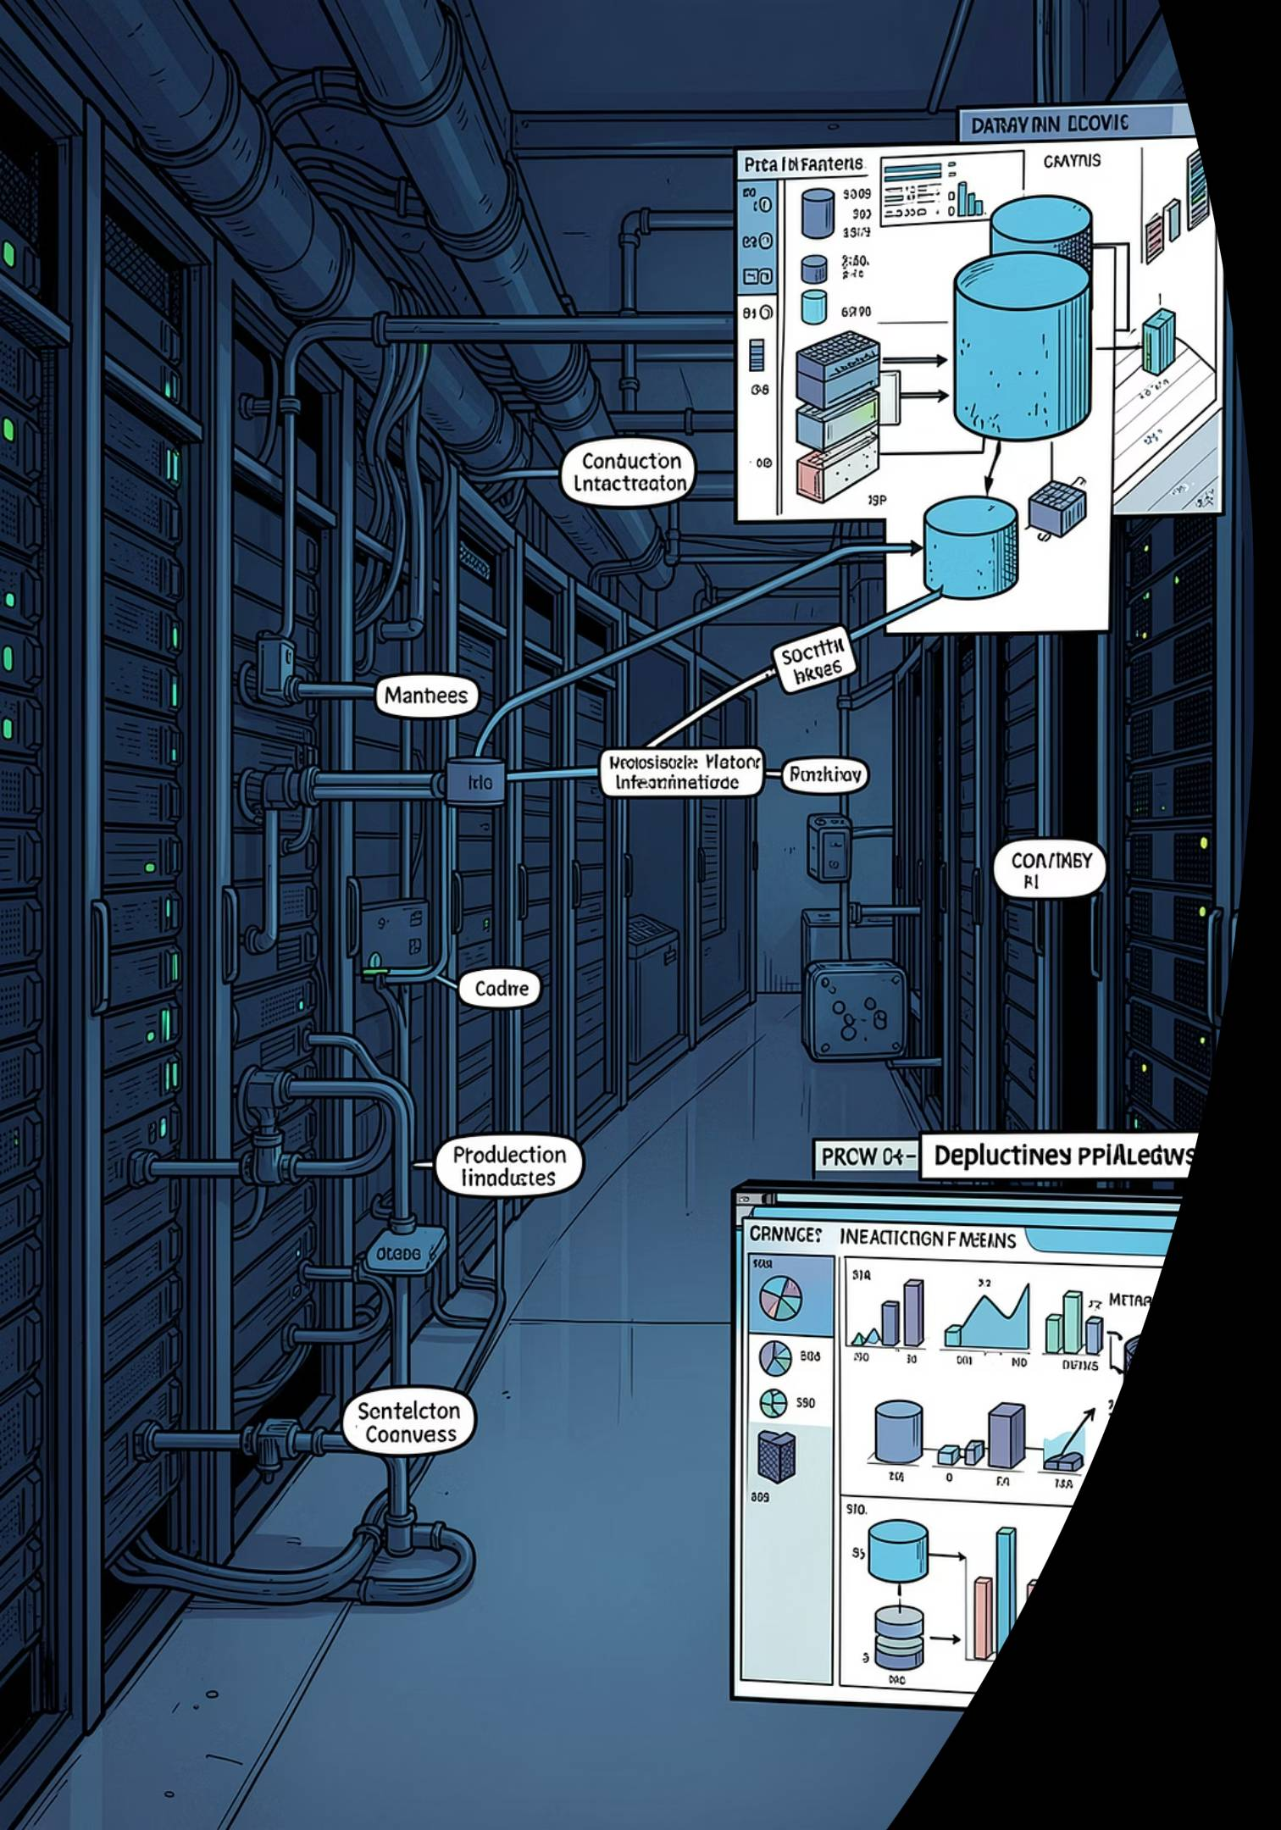
Production AI Engineering
FastAPI & Async
Build high-performance AI APIs with async Python for non-blocking LLM calls.
Logging & Observability
Trace LLM calls, token usage, latency, and errors with structured logging.
Docker & Redis
Containerize services for reproducibility; use Redis for caching and message queues.
AI Evaluation
Measure accuracy, relevance, latency, and cost — continuously in production.

Slide 10

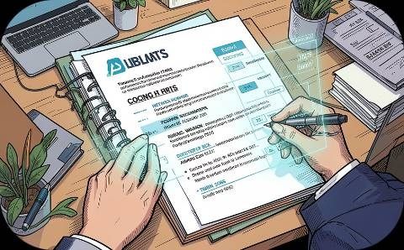



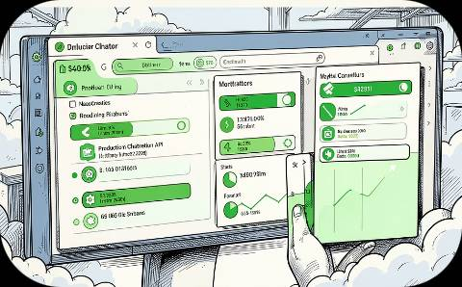
Hands-On Projects & Implementation
Apply every concept through six progressively complex, production-grade projects.
CLI AI Chatbot
Resume Reviewer
PDF Q&A Chatbot
Personal AI Assistant
Terminal-based chatbot using LLM APIs with conversation history.
AI-powered resume scorer with structured feedback and ranking.
RAG-based system that answers questions from uploaded PDFs.
Multi-tool agent managing tasks, reminders, and information retrieval.
Streaming AI API
Production Chatbot API
Real-time token streaming endpoint with FastAPI and async generators.
Full-stack, containerized chatbot API with logging, auth, and eval.

