Slide 1
Project Presentation of Full Stack Engineering Project (FSE)
on
Task Manager App
Team Details Koustav Manna(2210991807)
Kumar Kundan (2210991822)
Supervised By
Rahul Sir
Department of Computer Science and Engineering,
Chitkara University, Punjab

Slide 2
Introduction
A Task Manager application
A tool to help users organize, track, and complete tasks efficiently.
2. Enhances productivity, manages workload, and improves time management.

Slide 3


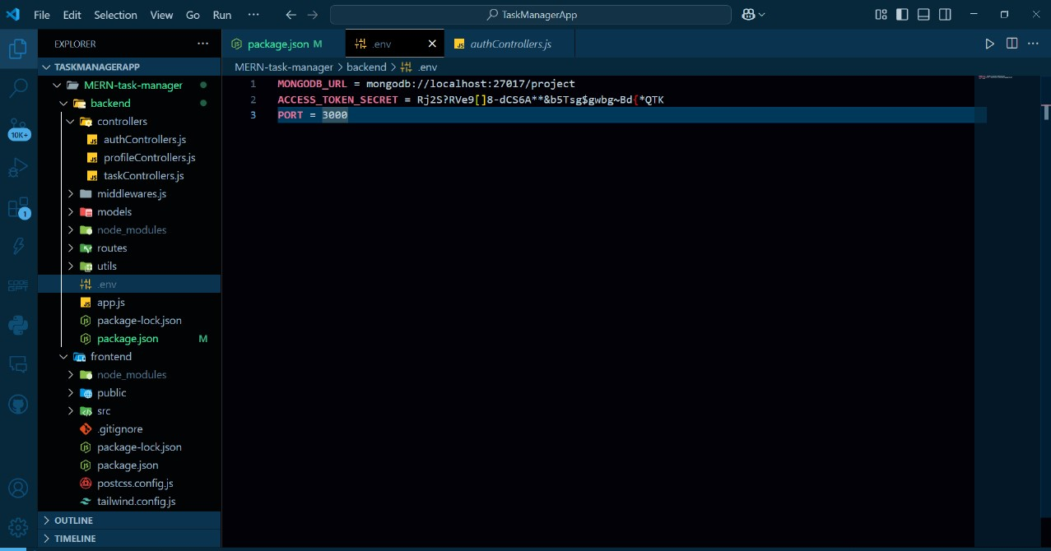
Primitive Idea for the Backend
Users can create, update, delete, and categorize tasks.
Backend Technologies:
Node.js (JavaScript)
4. Database: MongoDB
5. RESTful API for seamless communication.

Slide 4
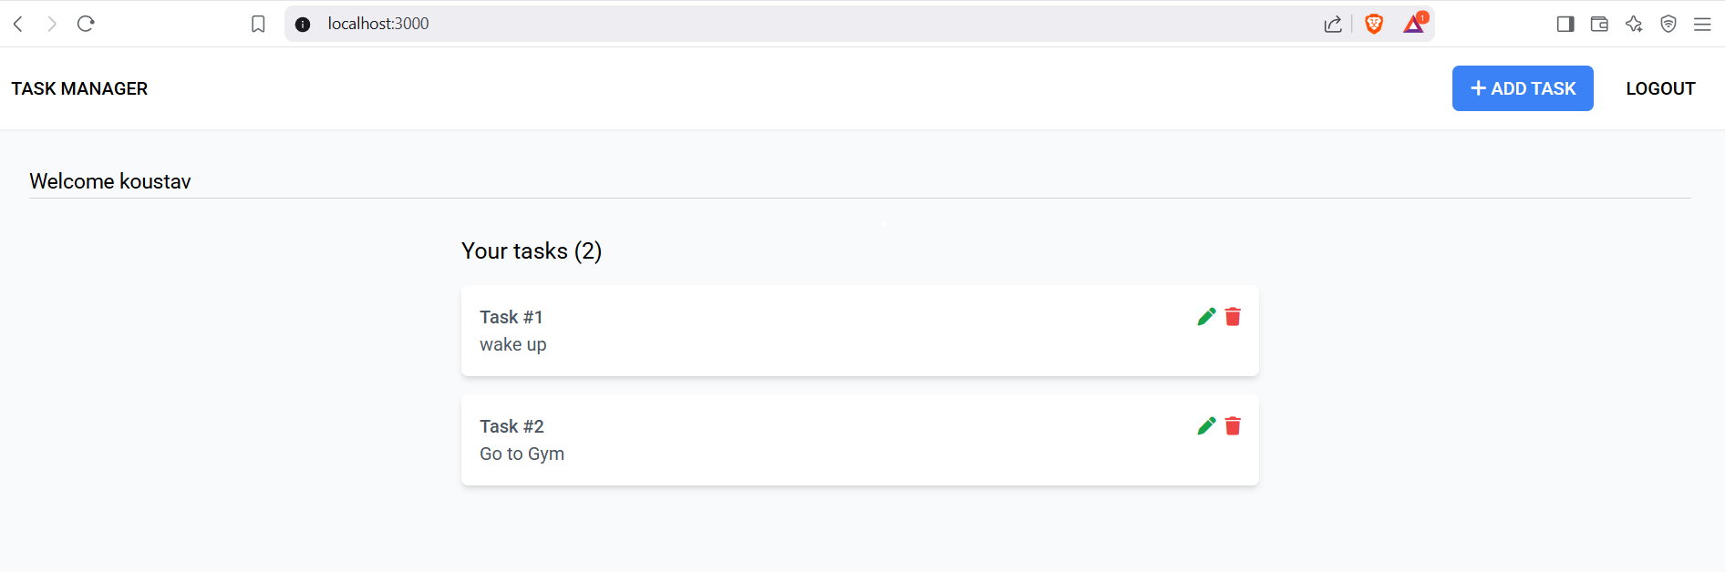
Key Features & Functionalities
Task Creation & Management: Add, edit, delete, prioritize tasks.
Categorization & Tags: Group tasks with labels.
3. Collaboration & Sharing: Assign tasks to team members.
4. Progress Tracking: Monitor productivity trends.

Slide 5
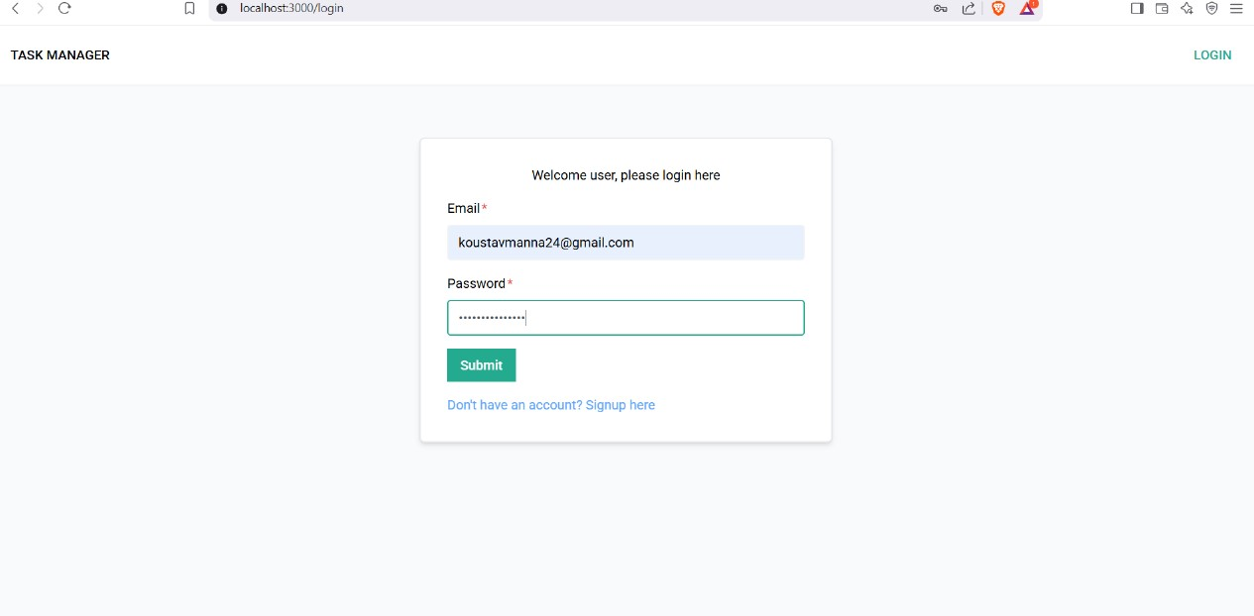
Technical Architectural Framework
Frontend: React.js
- Backend: Node.js with Express
- Database: MongoDB
- Authentication: JWT / OAuth

Slide 6
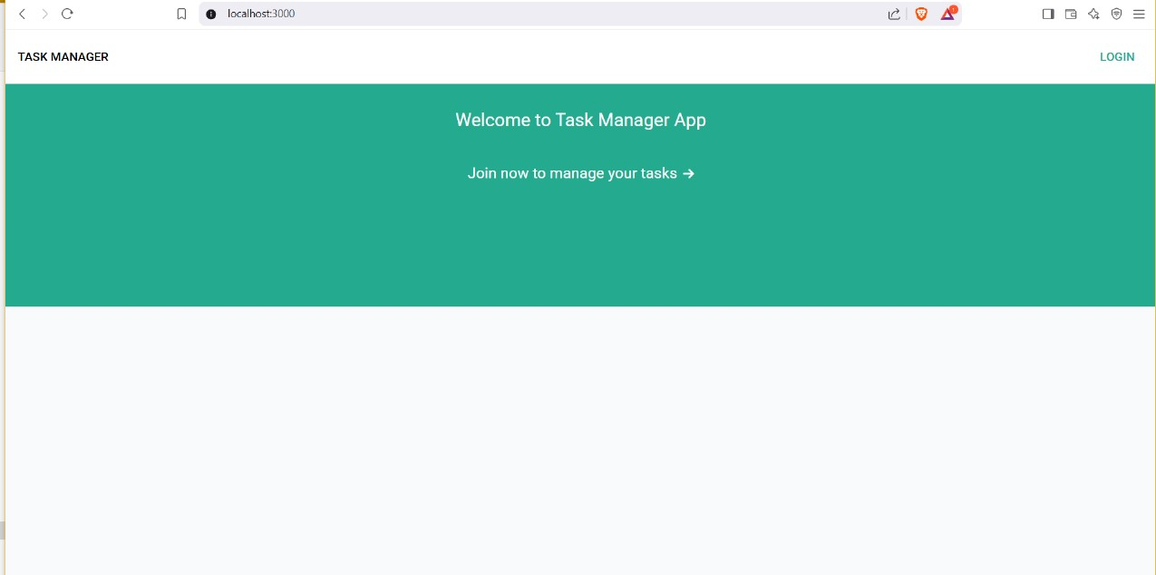
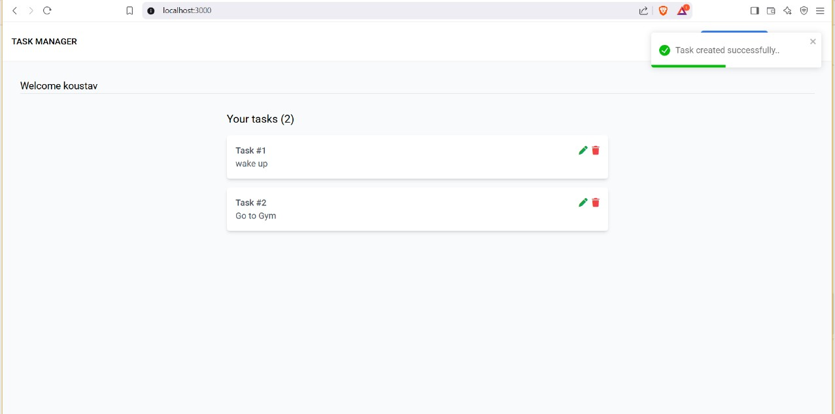
User Interface & Accessibility
Intuitive dashboard with simple navigation.
2. Mobile & Web Compatibility.
3. Accessibility Features: Task commands, screen reader support.

Slide 7
Thank You

