Slide 1


Enhancing Data-Driven Decisions: MySQL Analysis for Atliq Hardwares Consumer Goods
Koustuba.R

Slide 2
Company: Atliq Hardwares
OVERVIEW
Objective – Expand Data Analytics team
Issue: Insufficient decision-making insights
Target Position: Junior Data Analysts
Skills Needed:
*Technical skills (SQL)
Soft skills

Slide 3
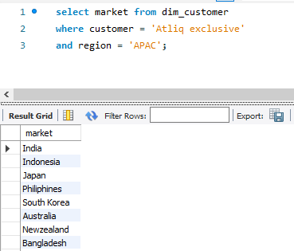
AD-HOC REQUEST 1
Provide the list of markets in which customer "Atliq Exclusive" operates its business in the APAC region.

Slide 4
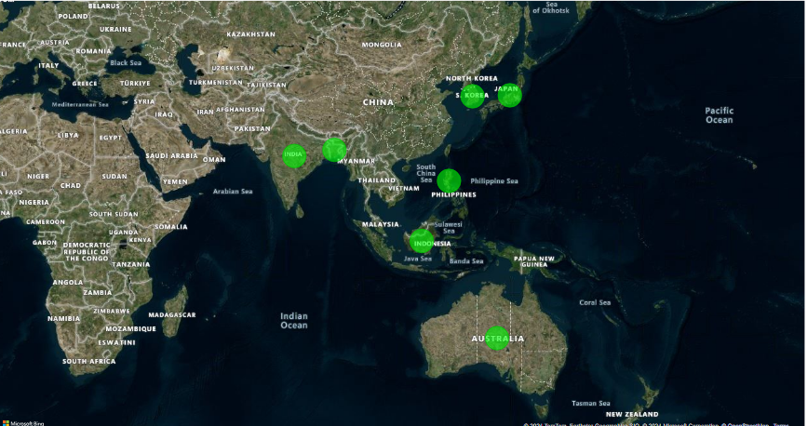

Slide 5
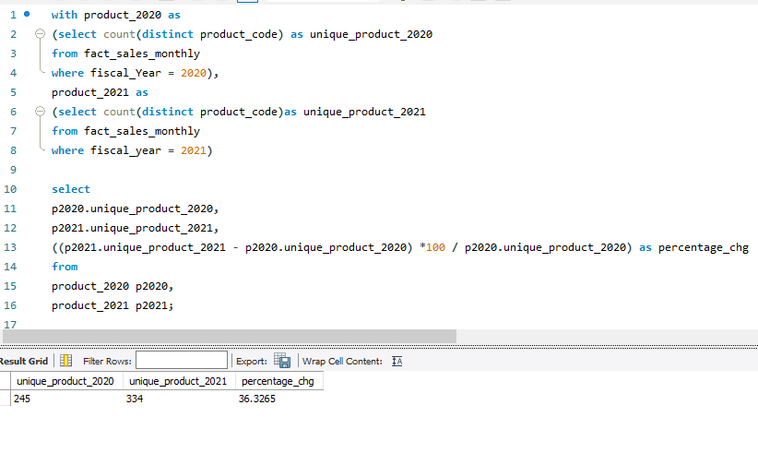
AD-HOC REQUEST 2
What is the percentage of unique product increase in 2021 vs. 2020? The final output contains these fields, unique_products_2020 unique_products_2021 percentage_chg

Slide 6
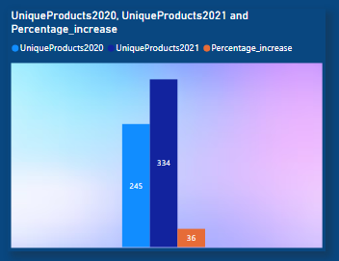
Insights
There was a significant 36.33% increase in the number of unique product from 2020 to 2021.
This growth could indicate successful product expansion or diversification strategies
36.33%

Slide 7
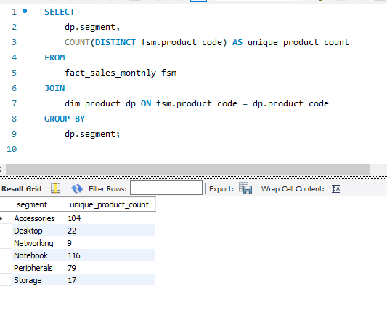
AD-HOC REQUEST 3
Provide a report with all the unique product counts for each segment and sort them in descending order of product counts. The final output contains 2 fields,
segment product_count

Slide 8
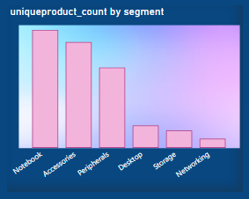
Insights The Notebook and Accessories have the highest number of unique products indicating a focus on these product lines. Networking and Storage have the fewest products , which could be areas for potential growth or focus

Slide 9
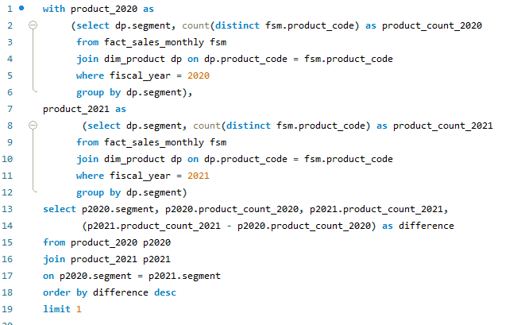

AD-HOC REQUEST 4
Which segment had the most increase in unique products in 2021 vs 2020? The final output contains these fields,
segment product_count_2020 product_count_2021 difference

Slide 10

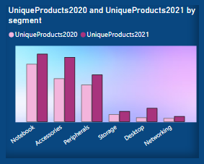
Insights
The Accessories segment saw the largest increase in unique products with a difference of 34 products .
This suggests a strong focus on expanding the Accessories product line in 2021
34

Slide 11
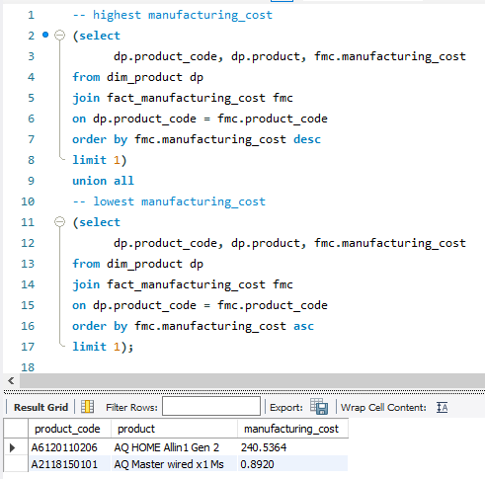
Ad-hoc Request 5
Get the products that have the highest and lowest manufacturing costs. The final output should contain these fields,
product_code product manufacturing_cost

Slide 12
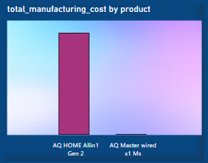
Insights
The product with the highest manufacturing cost is AQ HOME Allin1 Gen 2, suggesting a potentially premium product.
The lowest cost product is AQ Master wired x1 Ms, which might be a budget or high-volume product.

Slide 13
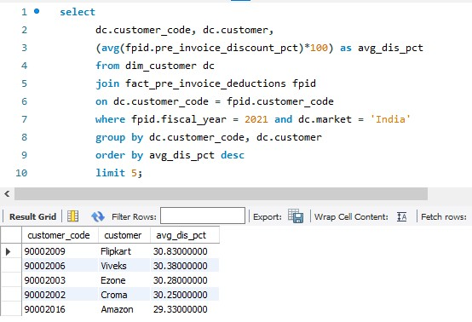
Ad-hoc Request 6
Generate a report which contains the top 5 customers who received an average high pre_invoice_discount_pct for the fiscal year 2021 and in the Indian market. The final output contains these fields, customer_code
customer average_discount_percentage

Slide 14
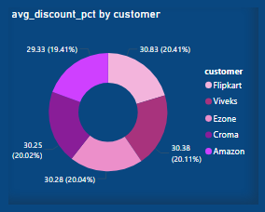
Insights
Flipkart receives the highest average pre-invoice discount at 30.83%,
indicating its significant sales volume and strategic partnership with the
company. Consistent high discounts among top retailers
like Viveks, Ezone, and Croma suggest a policy of incentivizing key partners
to boost sales and market presence. The strategic use of discounts,
while beneficial for increasing sales, needs to be balanced
with maintaining profit margins to ensure long-term financial health.

Slide 15
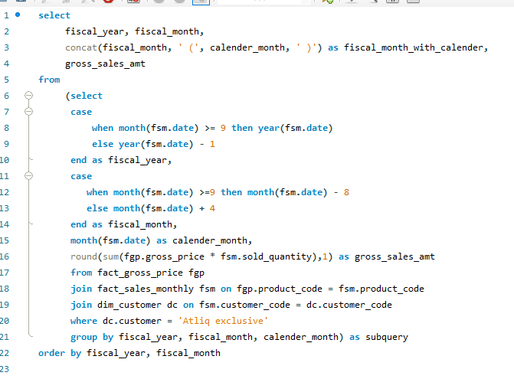
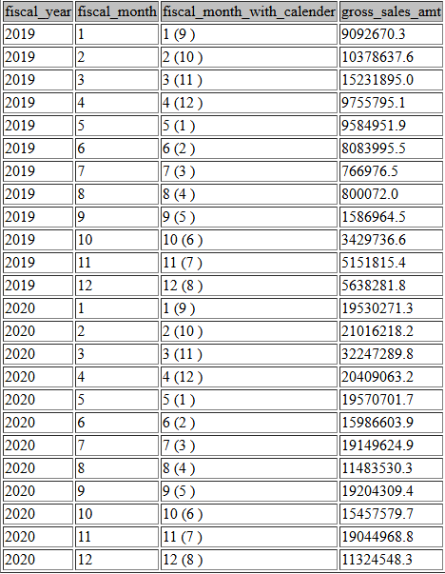
Ad-hoc Request 7
Get the complete report of the Gross sales amount for the customer “Atliq Exclusive” for each month. This analysis helps to get an idea of low and high-performing months and take strategic decisions. The final report contains these columns: Month
Year
Gross sales Amount

Slide 16
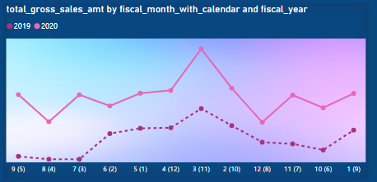
Insights
Gross sales showed a significant increase from 2019 to 2020,
with peak sales in the third month of the fiscal year 2020 at
approximately 32.25 million. The first fiscal quarter of 2020
saw a dramatic rise compared to the same period in 2019,
suggesting a successful sales strategy or market demand
during that time. However, sales fluctuated throughout the fiscal year,
indicating potential areas for improvement in maintaining consistent sales
performance.

Slide 17
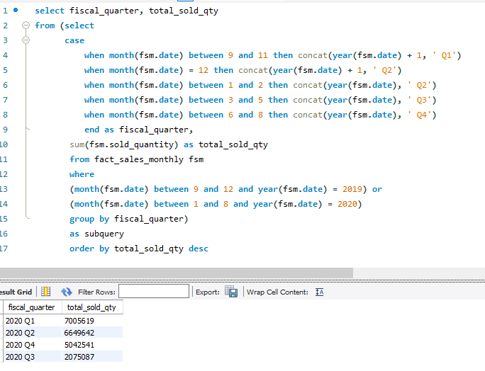
Ad-hoc Request 8
In which quarter of 2020, got the maximum total_sold_quantity? The final output contains these fields sorted by the total_sold_quantity,
Quarter
total_sold_quantity

Slide 18
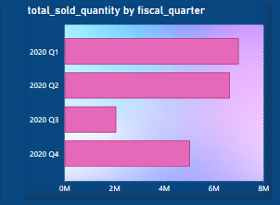
Insights
In 2020, the first quarter had the highest total sold quantity,
amounting to approximately 7 million units, indicating strong sales at the beginning of the year.
The second quarter followed with approximately 6.6 million units, showing a slight decrease but still maintaining robust sales figures.
The third quarter observed significantly lower sales,
with only about 2.1 million units, likely due to the COVID-19 outbreak
during that period, impacting market dynamics.

Slide 19
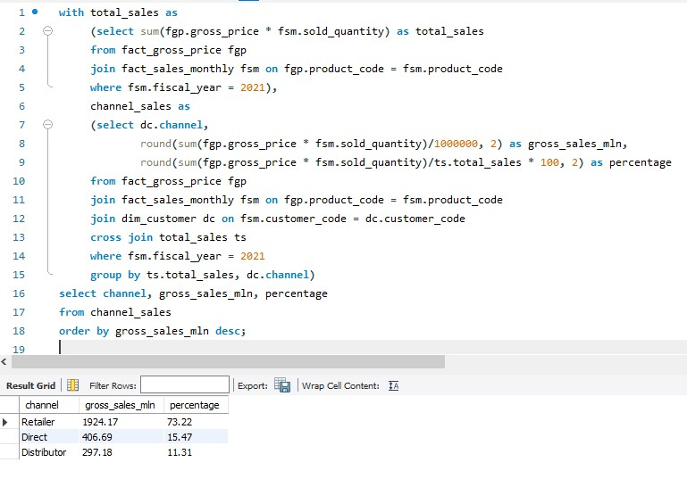
Ad-hoc Request 9
Which channel helped to bring more gross sales in the fiscal year 2021 and the percentage of contribution? The final output contains these fields,
channel
gross_sales_mln
percentage

Slide 20
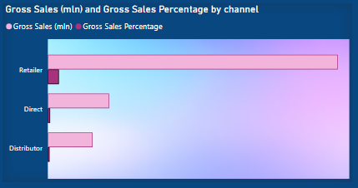
Insights
In the fiscal year 2021, the Retailer channel was the most
significant contributor to gross sales, generating approximately
1924.17 million and accounting for 73.22% of the total sales.
The Direct channel followed, contributing 406.69 million,
representing 15.47% of the overall sales.
The Distributor channel
had the lowest contribution, with 297.18 million in sales,
making up 11.31% of the total.
These insights suggest that Retailers played a crucial role in driving sales,
highlighting their importance in the sales strategy.

Slide 21
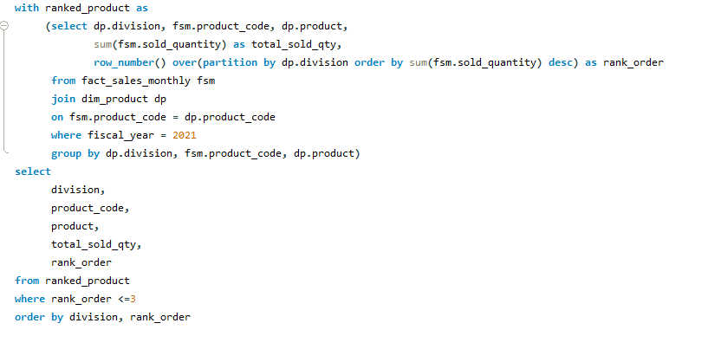
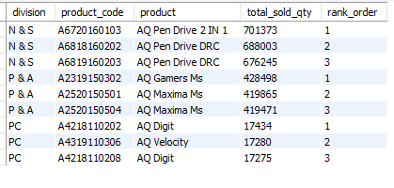
Ad-hoc Request 10
Get the Top 3 products in each division that have a high total_sold_quantity in the fiscal_year 2021? The final output contains these fields,
division
product_code
product
total_sold_quantity rank_order

Slide 22
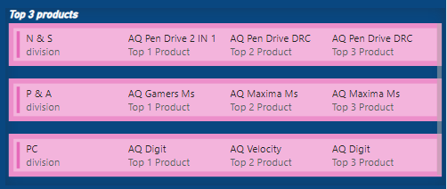
Insights
The analysis of top products by division reveals that the "N & S" division heavily relies on the AQ Pen Drive series, indicating strong
consumer preference for these products.
The "P & A" division shows
significant sales in gaming and peripheral accessories, with the
AQ Gamers Ms leading the segment.
The "PC" division's top products
have much lower sales volumes compared to the other divisions,
suggesting a potential area for growth or increased marketing focus.
This breakdown provides valuable insights for targeted marketing and
inventory management strategies within each division.

Slide 23
Thank you

