Slide 1
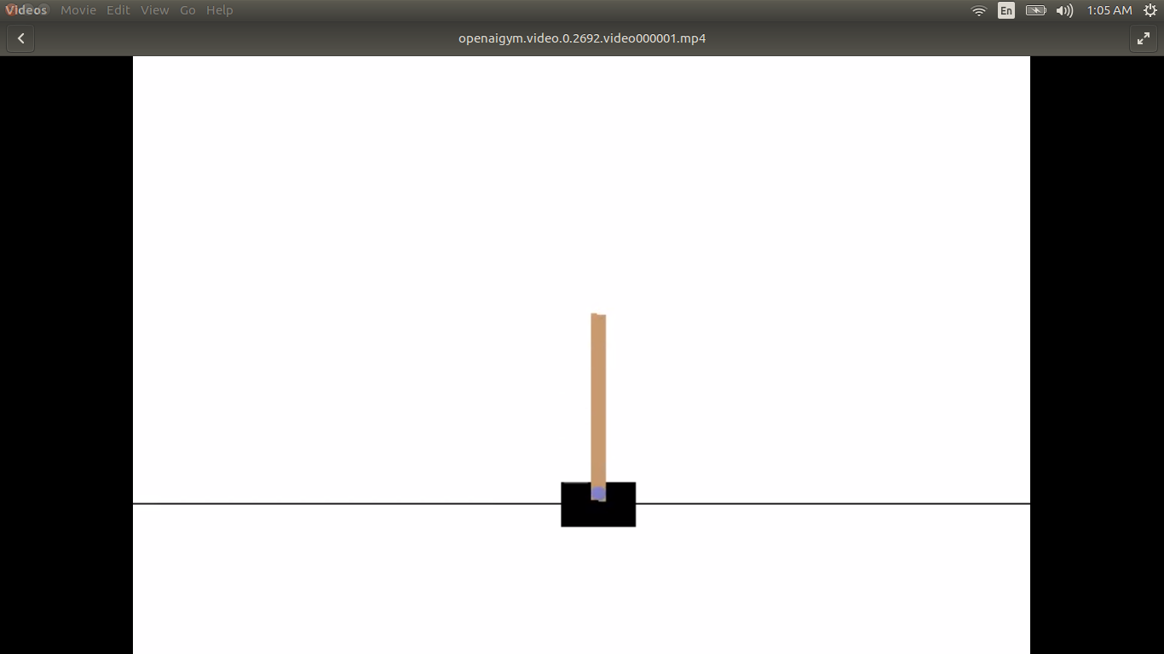
Inverted Pendulum Control using Neural Networks and Genetic Algorithm
By:
Koustubh Dwivedy
140010016

Slide 2
Problem Statement
Balance an inverted pendulum on a cart which moves left and right
Balance: Pendulum remains in the range ± 15° from vertical AND ± 2.1m from center
CONTROL VARIABLES:
  Force (Left or Right)
    F Є {0, 1}
OBSERVABLES:
  4 Variables
    {a, b, c, d} Є [{-4.8, -inf, -0.4188, -inf}, {4.8, +inf, 0.4188, +inf}]

Slide 3
Code Structure

Slide 4
Code Structure
Coded in python
Code can be found on https://github.com/koustubh-dwivedy/GA-for-CartPole-v0
Neural Net architecture: 1 input layer, 1 hidden layer, 1 output layer.
    Input layer: 4 nodes
    Hidden layer: 10 nodes
    Output layer: 1 node
GA parameters:
    Number of Generations: 400
    Mutation Probability: 0.2%
    Crossover Probability: 50%
    Selection done by choosing 500 individuals from the input individuals using 500 tournaments of 3 individuals.

Slide 5


Dependencies

Slide 6
Runtime
1 entire loop of code took ~4-6 hours of time
Desktop unavailable during this time because of periodic window interruptions by code
Kept for training during night
Wasn’t possible to study the affect of various parameters and schemes

Slide 7
Results

Slide 8
LIVE DEMO

Slide 9
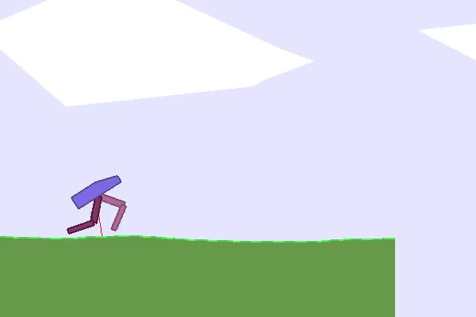
Future Work
Apply this to the problem of BipedalWalker-v2 problem in OpenAI
Perform a comparative study between Genetic Algorithm and PSO (PSO is known to be effective for training Neural Networks)
Eventually formalize this method and develop it into a proper framework for training general systems
*FUN FACT: This problem ran for 12 hours and was still in progress when it was interrupted (closed)

