Slide 1
Genetic Algorithm Based Approach for Mobile Robot Path Planning
ENPM 661: Planning for Autonomous Robots
Project 5
By: FNU Koustubh (UID:120273766)
Keyur Borad (UID: 120426094)
Aryan S Mishra (UID:120106521)

Slide 2
Topics Covered
Introduction
Description of the paper
Detailed Algorithm explanation
Simulation
Results
Problems Faced & Future Work
Conclusion

Slide 3
Introduction
We aim to implement genetic algorithm based path planner for a autonomous mobile robot. A genetic algorithm-based path planner leverages evolutionary principles to optimize routes, effectively adapting solutions over generations to find the most efficient path.
Can be applied as an additional layer to any probabilistic sampling based path planning method

Slide 4
Genetic Algorithm Based Approach for Autonomous Mobile Robot Path Planning
Chaymaa Lamini, Said Benhlima, Ali Elbekri, Genetic Algorithm Based Approach for Autonomous Mobile Robot Path Planning, Procedia Computer Science, Volume 127, 2018, Pages 180-189, ISSN 1877-0509,
https://doi.org/10.1016/j.procs.2018.01.113

Slide 5
Genetic Algorithm Based Approach for Autonomous Mobile Robot Path Planning
Aim: To Enhance the effectiveness of genetic algorithms (GA) in the path optimization problem
Description:
Introduces a new crossover operator designed to prevent premature convergence and produce feasible paths with superior fitness values compared to their parent solutions.
Proposes a new fitness function that incorporates considerations of distance, safety, and energy
Method:
Modifies GA's crossover operators to manage variable-length chromosomes and ensure feasible paths.
Introduces a detailed algorithm to boost genetic diversity without compromising path feasibility
Genetic Algorithm Based Approach for Mobile Robot Path Planning

Slide 6
Algorithm Explanation

Slide 7
Genetic Algorithm
Optimizes pathfinding via natural selection principles.
Chromosomes represent possible paths between start and end points.
Fitness function evaluates path length, safety, and efficiency.
Crossover and mutation generate diverse, feasible path solutions.
Algorithm iteratively refines paths for optimal navigation results.
Genetic Algorithm Based Approach for Mobile Robot Path Planning

Slide 8
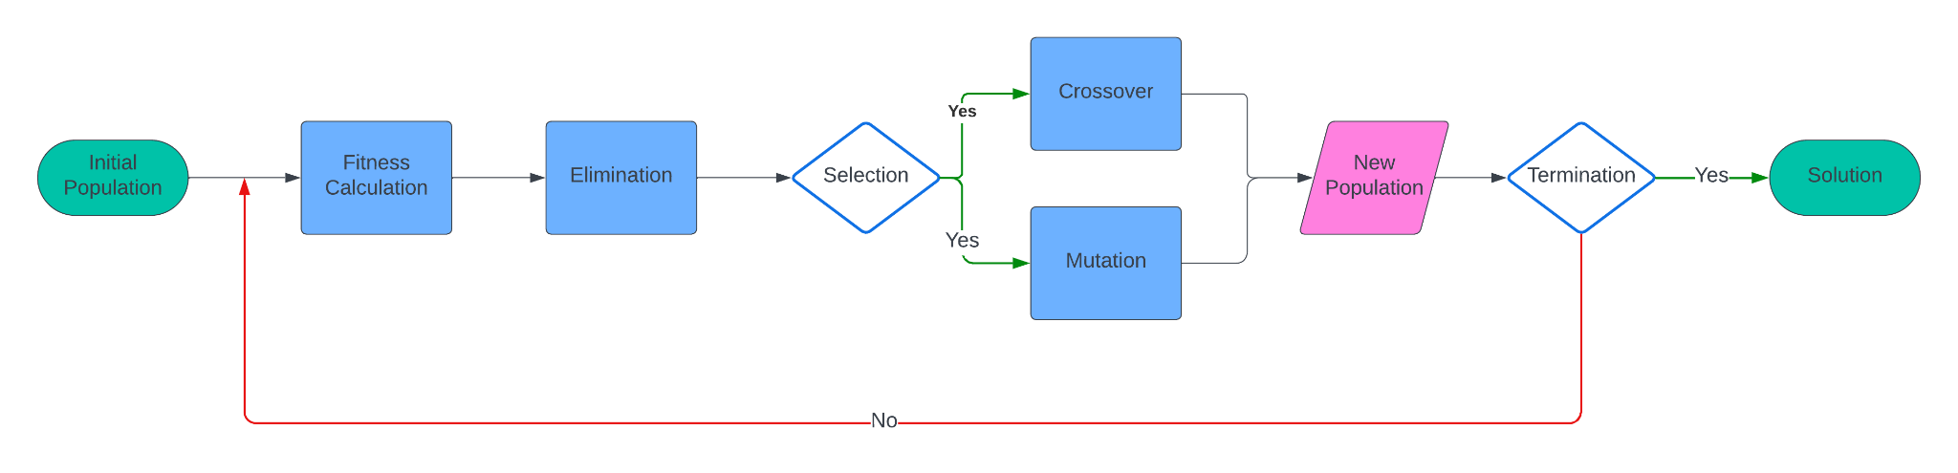
Genetic Algorithm
Genetic Algorithm Based Approach for Mobile Robot Path Planning

Slide 9
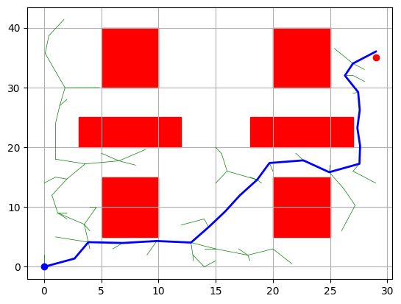
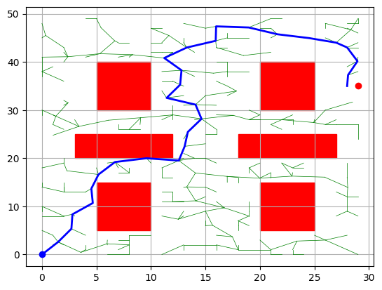
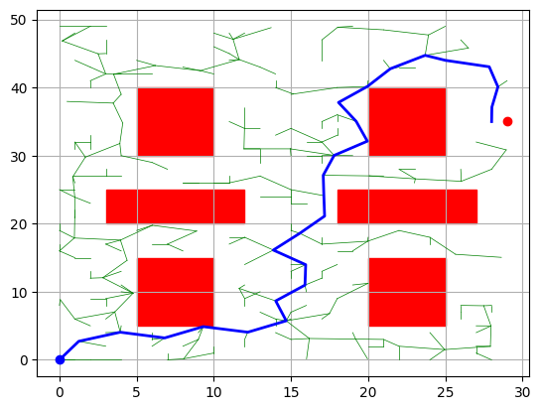
Genetic Algorithm
Initial Population Generation:
Input: Random Valid Paths generated via RRT Sampling Based Algorithm.
Genetic Algorithm Based Approach for Mobile Robot Path Planning

Slide 10
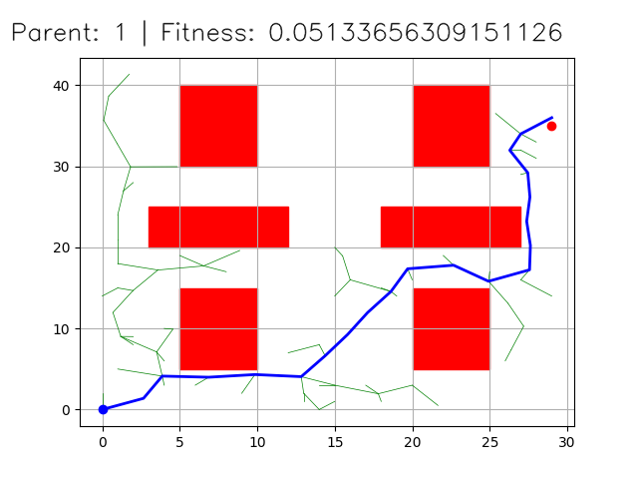
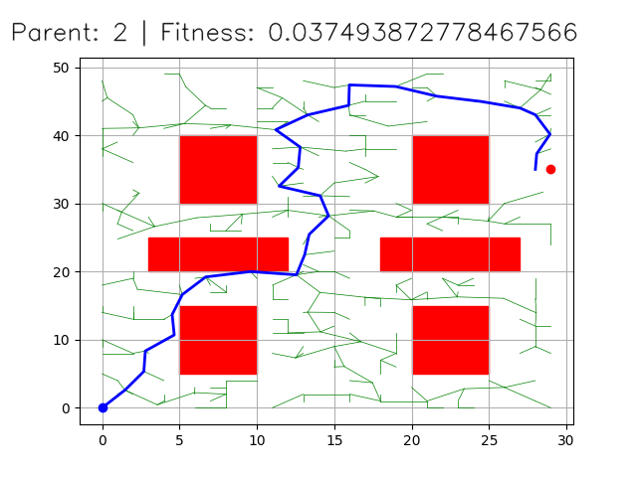
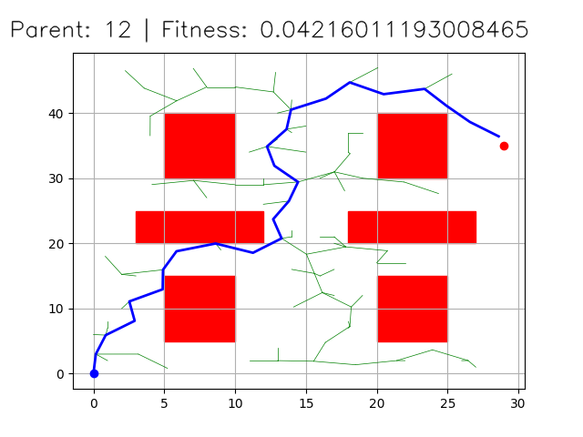
Genetic Algorithm
Fitness Calculation:
The fitness of each generated path based on total distance, energy consumption(turn sharpness) and safety margin from obstacles.
Genetic Algorithm Based Approach for Mobile Robot Path Planning

Slide 11
Genetic Algorithm
Selection and Crossover:
Crossover Paths for GA : Elitism, Tournament Selection, Roulette selection, Random Selection etc.
Used Elitism selection for faster convergence.
Genetic Algorithm Based Approach for Mobile Robot Path Planning

Slide 12
Genetic Algorithm Based Approach for Mobile Robot Path Planning

Slide 13
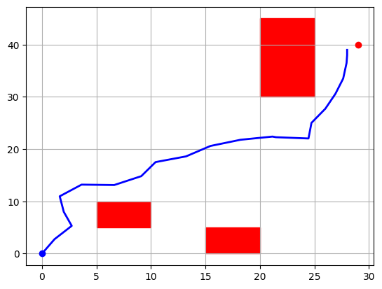
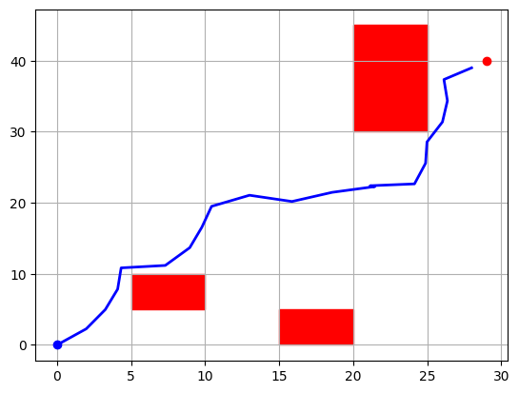
Parent 1 Parent 2

Slide 14
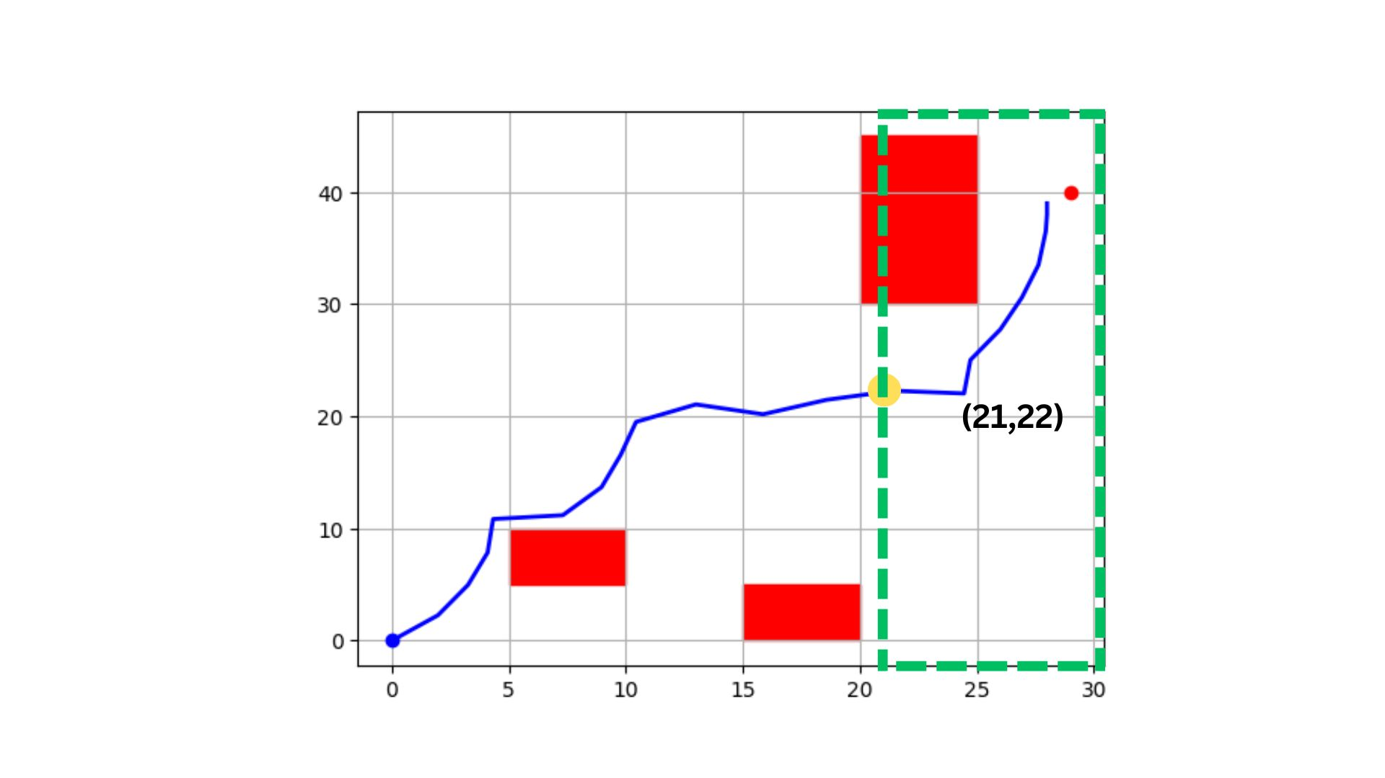
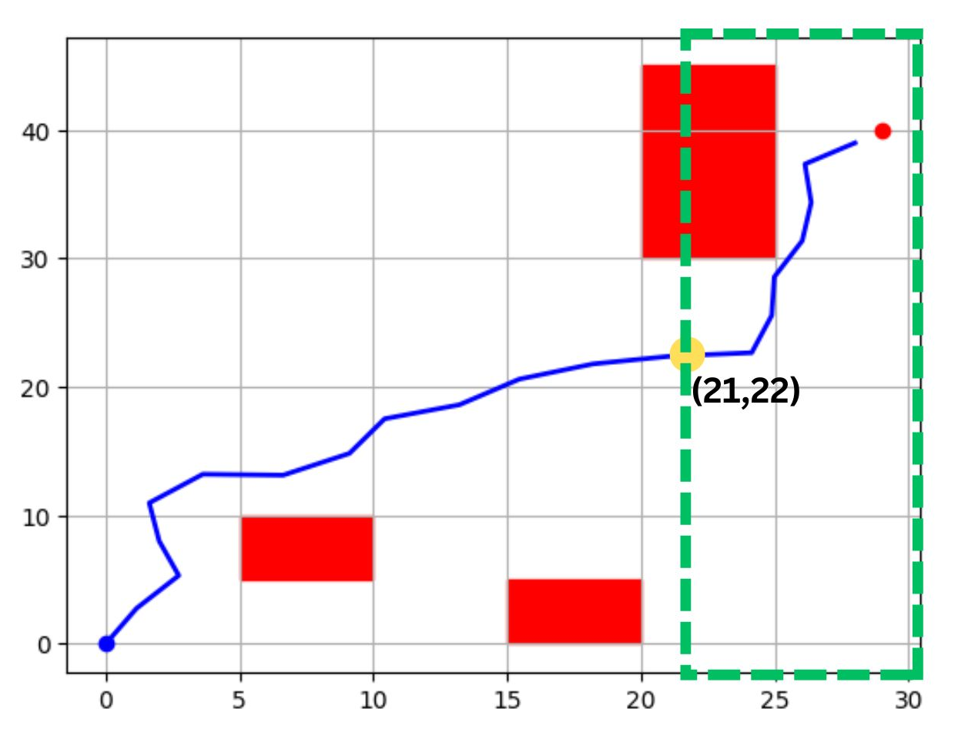
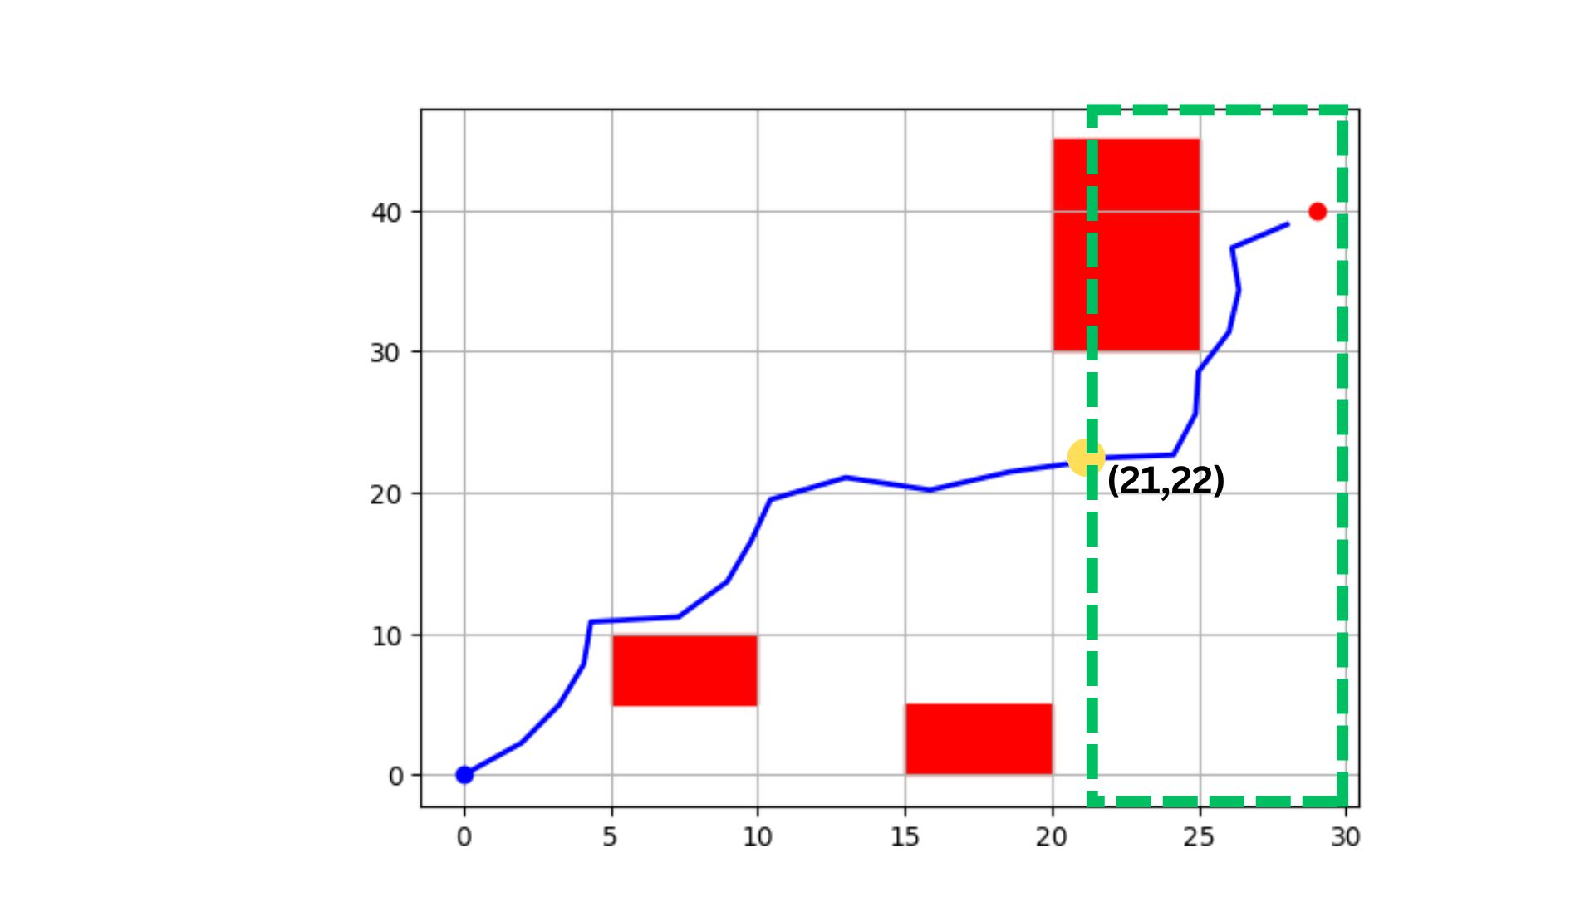
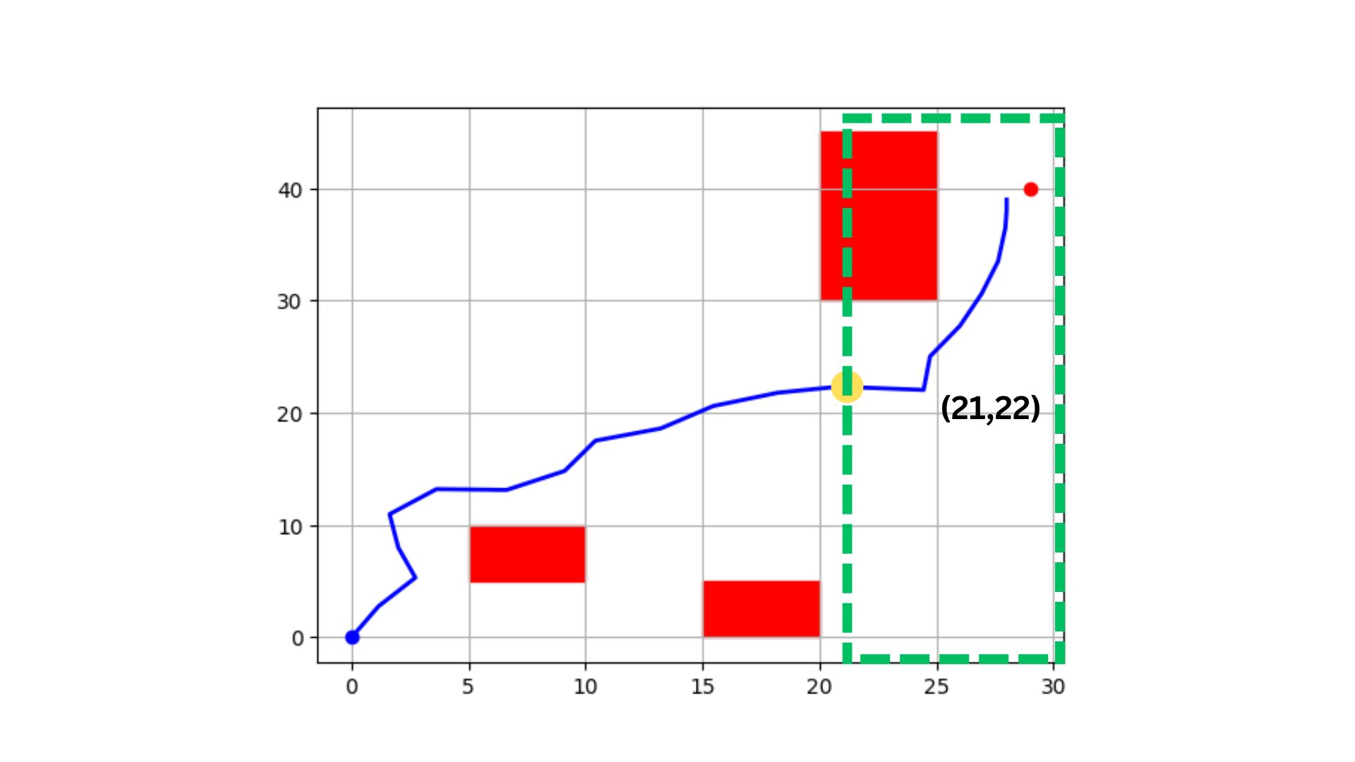
Parent 1 Parent 2
Offspring 1 Offspring 2

Slide 15
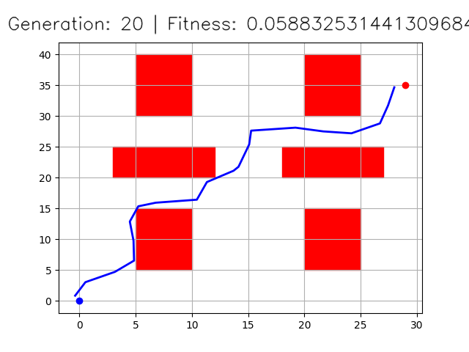
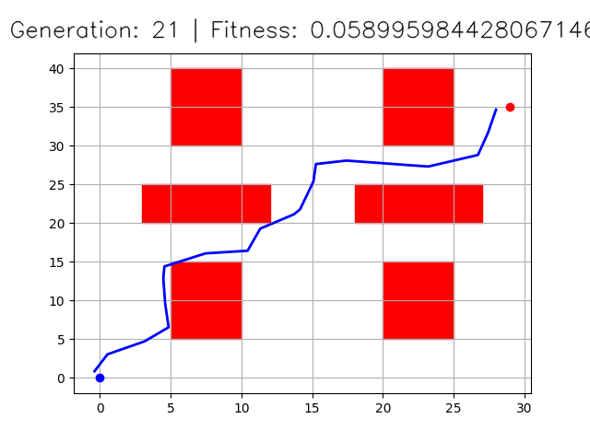
Genetic Algorithm
Mutation
Mutation operator is used to maintain diversity of the population.
Randomly selects a node from a path and moves that node in a random direction.
Genetic Algorithm Based Approach for Mobile Robot Path Planning

Slide 16
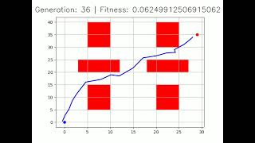
Results
Genetic Algorithm Based Approach for Mobile Robot Path Planning

Slide 17
Problems Faced and Future Work
Problems Faced
Fitness Calculation for Safety Second Level
Inadequacies in Mutation Function
Initial Population and Number of Generations
Future Works
Robust Fitness Function based on Terrain
Potent Mutation Function and different types for better generations
Initial Population calculated with simpler or faster path planning algorithm
Path Smoothing
Genetic Algorithm Based Approach for Mobile Robot Path Planning

Slide 18
Conclusion
Successfully Implemented Genetic Algorithm for an autonomous mobile robot path planning.
Genetic Algorithm Based Approach for Mobile Robot Path Planning

