Slide 1

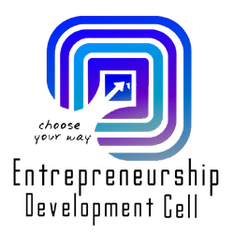



HASTKALA
TEAM ALCHEMIST
IDEA-BUILDUP
DOMAIN: Social Commerce powered by FinTech, AI & Web3
TEAM MEMBERS
INSTITUTE
Ayushman Swain (BackEnd)
Koustubha Pathy (CyberSecurity)
Dharitri Aich (Research and Data Collection)
Sibani Bisoyi ()
Asish Kumar Behera ()
NIST UNIVERSITY
SparkUp Summit 2026

Slide 2


PROBLEM STATEMENT
The Predatory Profit Leak (Exploitation)
The Problem: Fragmented supply chains allow middlemen to absorb 80–90% of the total product value.
The Brutal Reality: While a luxury store sells a hand-woven saree for ₹45,000, the artisan who spent 20 days making it receives only ₹1,800.
The Impact: Artisans are forced into daily-wage labour (construction/cleaning) to survive, killing the craft.
2. The Trust Deficit (The Clone Crisis)
The Problem: ₹32,000 Crore is lost annually to power-loom and machine-made "fakes" sold as authentic handloom.
The Brutal Reality: 78% of customers want to support "vocal for local" but end up buying factory-made clones because there is zero unhackable proof of origin.
The Impact: Machine-made speed is bankrupting the slow, authentic hand-made tradition.
IDEA-BUILDUP
3. The Identity Heist (IP Plagiarism)
The Problem: Global fast-fashion brands "screenshot" sacred tribal patterns at craft fairs and mass-produce them without credit.
The Brutal Reality: 78% of artisans have no legal documentation of their designs. They are powerless as their 500-year-old heritage is sold on Myntra for ₹299.
The Impact: The "Human behind the Art" is erased, and ancestral knowledge is stolen for corporate profit.
4. The Awareness Void (The Literacy Tax)
The Problem: Over ₹3,55,000 in Government benefits per artisan remains untouched due to digital illiteracy.
The Brutal Reality: Complex English/Hindi forms and "middleman-facilitators" act as a gatekeeper to survival capital.
The Impact: Thousands of crores in PM Vishwakarma and National Artisan Grants expire every year while artisans live in debt.
SparkUp Summit 2026
graphic designer
"We are witnessing the economic collapse of India’s second-largest employer—not due to a lack of skill, but a total lack of digital infrastructure."

Slide 3
SOLUTION
1. .
1. PriceMirror Engine | The Middleman Killer
Tech: Smart-Contract Payment Splitting.
Action: Automatically splits buyer payments at the source.
Result: Bypasses the 80-90% middleman margin, sending the artisan’s fair share instantly to their digital wallet.
2. TruthMark System | The Authenticity Shield
Tech: QR Code + IPFS Blockchain Storage.
Action: Every product receives a unique, non-copyable QR code.
Result: Scanning opens a "Digital Birth Certificate" featuring a creation video, the artisan’s face, and GPS-verified village coordinates to kill the counterfeit market.
3. SchemeGPT | The Capital Unlocker
Tech: Voice-First Multilingual LLM.
Action: A voice-activated AI that speaks local dialects to scan 100+ Govt. schemes (e.g., PM Vishwakarma).
Result: Auto-fills complex applications in <60 seconds, unlocking unclaimed capital for rural clusters.
4. CraftMark IP Shield | The Identity Guard
Tech: Perceptual Hashing (pHash) + AI Web Crawlers.
Action: Generates a unique digital fingerprint for every design.
Result: AI bots scan global platforms (Amazon/Myntra) 24/7 and auto-send legal IP Takedown Notices the moment a copy is detected.
IDEA-BUILDUP
SparkUp Summit 2026
graphic designer
"We are building the Decentralized Infrastructure to move India's 7 million artisans from 'Survival' to 'Sovereignty'."
Integrated Tech Stack: ONDC Protocol | IPFS & Pinata | MONGO DB | Python (pHash) | Multilingual Voice-LLM

Slide 4
MARKET ANALYSIS
Needs/Demands of the Market
Target Audience
Competitors
India’s 70 lakh artisans earn Rs. 180 on products worth Rs. 4,500. The market urgently needs:
Fair, transparent pricing for artisans.
Authentic product verification — Rs. 32,000 Cr lost to fakes yearly.
Design ownership protection from fast fashion theft.
Digital access for rural artisans with zero online presence.
Cultural preservation — India loses 3-5 craft forms every year.
Global market opportunity: $32 Billion in authentic handicrafts.
ARTISANS (Supply): * 70 lakh registered artisans across India.
Women doing 70% of craft labor.
Rural clusters with zero digital presence.
BUYERS (Demand):
Urban Indians aged 25-45 seeking authentic decor.
NRI and global diaspora.
Corporate gifting buyers.
INSTITUTIONS (B2B):
Fashion brands needing trend data.
NGOs, Govt bodies, Design colleges.
Existing platforms (Etsy, Amazon Karigar) fall short:
Charge 15-30% hidden fees vs our 3.5% flat fee.
Self-declared "handmade" — zero authenticity check.
No design protection for artisans.
English-only — excludes 80% of rural artisans.
Payments held 14-21 days vs our instant payout.
No competitor combines marketplace + IP protection + AI pricing + cultural preservation.
IDEA-BUILDUP
SparkUp Summit 2026

Slide 5
BUSINESS PLAN & REVENUE MODEL
Branding Strategies
Pricing Strategies
Scaling Plans
Every product shows artisan's face + village + 30-sec creation video — buyers buy a story, not a product.
TruthMark QR scan experience goes viral on social media — free organic marketing.
'Last Living Master' badge creates exclusivity around endangered crafts.
WhatsApp word-of-mouth — artisans bring other artisans.
Corporate CSR partnerships with Tata, Infosys build instant credibility.
Core: 3.5% flat fee per sale (vs 15-30% competitors).
Price Predict AI: Free / Rs.149 / Rs.499 per month.
CraftMark IP Shield: Free / Rs.99 / Rs.299 per month.
Hastkala Pro SaaS: Rs.199-499 per month.
B2B Trend Data: Rs.5-50L per year per brand.
CSR Sponsorships: Rs.10-50L per deal.
Year 1 Target: Rs.1.85 Cr | Year 3: Rs.21.2 Cr
Phase 1 (0-6 Months): Pilot in 5 GI-tagged clusters. Onboard 500 master artisans. Achieve 0% counterfeit rate.
Phase 2 (6-18 Months): Full ONDC integration. Expand to 50+ clusters across 15 states. Launch IP Shield and Price AI commercially.
Phase 3 (18+ Months): Global expansion. UNESCO archive partnership. Target 10 lakh artisans onboarded.
IDEA-BUILDUP
Associated Risks
Artisan onboarding in rural areas: Partner with existing SHGs, NGOs and govt craft bodies on the ground.
Blockchain complexity for rural users: WhatsApp-first interface — all tech is invisible to the artisan.
RBI/UIDAI compliance for biometrics: Razorpay + UPI as primary layer — biometrics as optional add-on.
Platform crawlers getting blocked: pHash database + user-reported theft as primary detection method.
SparkUp Summit 2026

Slide 6
FEASIBILITY, VIABILITY AND FUTURE IMPROVEMENTS
🛡️ Feasibility
1. Low-Data Stack: Uses Node.js and React Native; optimized as a PWA for 2G/3G rural connectivity.
2. Resilient Infrastructure: Secure media storage via IPFS and real-time artisan alerts through WhatsApp Cloud API.
3. Zero-Barrier UX: Removes literacy hurdles with Voice-First AI and QR-based navigation.
4. TruthMark Automation: Instant blockchain authentication in <60 seconds via tamper-proof QR stickers.
Initial Proof of Concept: Launch a pilot in 5 high-value GI-tagged clusters (like Pashmina and Kanjeevaram Silk) to onboard 500 master artisans and establish a 0% counterfeit rate within those zones.
ONDC Integration: Fully integrate the platform's Node.js backend with the Open Network for Digital Commerce (ONDC) protocol to significantly increase market reach and transaction volume.
End-to-End Logistics: Partner with third-party logistics (3PL) providers to create an automated shipping layer that tracks products directly from the artisan's village to the buyer.
B2B Data Intelligence: Monetize the platform by selling anonymized, aggregated market trend insights (such as demand for specific dyes or patterns) to major global fashion houses.
Looking to integrate a system that supports AI predicted discounts and customizations if the buyer is from same cultural background as the seller.
WhatsApp navigation and Voice-first AI integration.
IDEA-BUILDUP
📈 Viability
1. 750% Revenue Jump: Replaces 80% middleman cuts with a transparent 3–5% platform fee.
2. Verified Luxury Market: Converts crafts into authenticated assets, tapping into a $32B global opportunity.
3. Instant Capital Unlock: AI matches artisans to Govt. schemes, accessing ₹3.5L+ in unclaimed benefits.
4. Modular Scalability: One "Stack" adaptable across 2,000+ craft clusters with zero re-architecture.
SparkUp Summit 2026

Slide 7
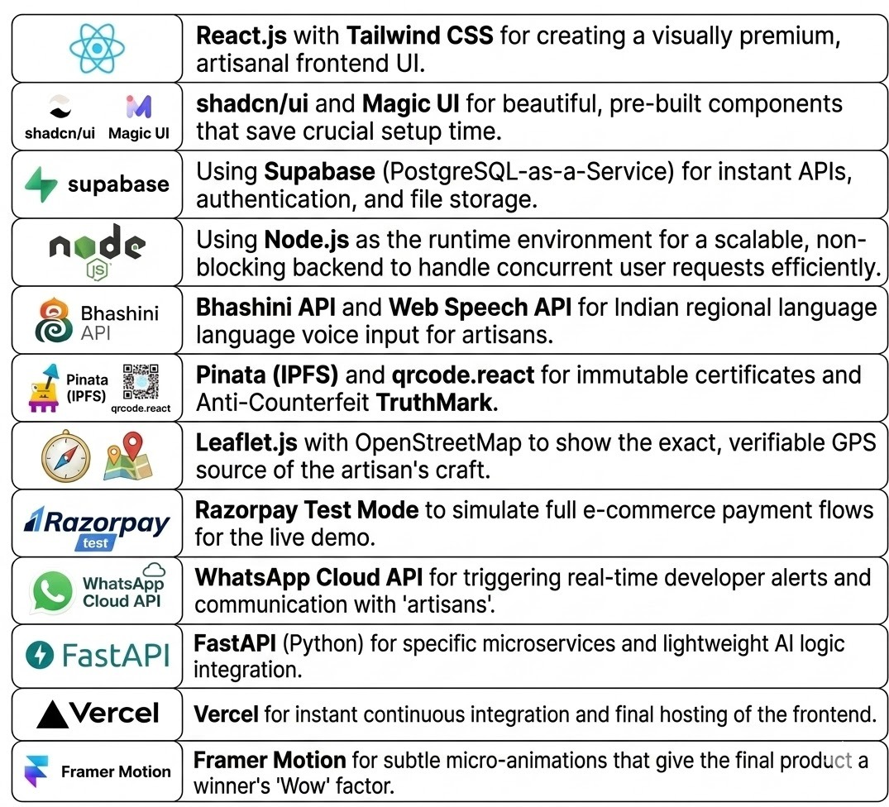
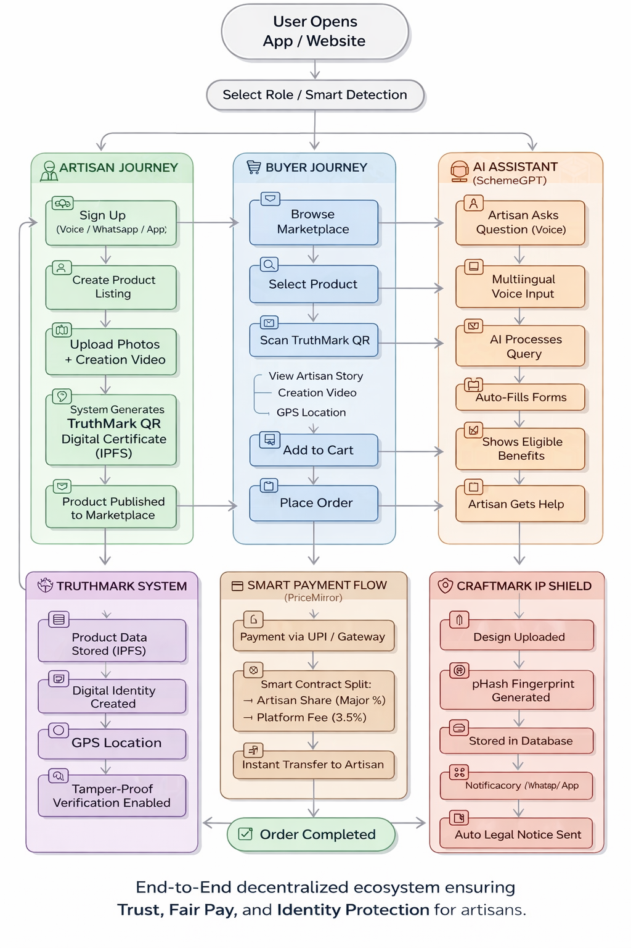
WORK FLOW
TECHSTACK USED
WORKFLOW
IDEA-BUILDUP
SparkUp Summit 2026

Slide 8
CONCLUSION
CONCLUSION
HASTKALA is a next-generation social commerce ecosystem that transforms India’s artisan economy from fragmented survival to scalable economic sovereignty. By integrating the PriceMirror smart payment engine, the platform eliminates exploitative middlemen and ensures instant, transparent income distribution directly to artisans. The TruthMark system establishes trust through tamper-proof digital identities, enabling buyers to verify authenticity via QR-based “Digital Birth Certificates”. Beyond commerce, HASTKALA empowers artisans through SchemeGPT, a multilingual voice-AI that removes literacy barriers and unlocks access to critical government benefits, while the CraftMark IP Shield safeguards cultural heritage by detecting and preventing global design theft in real time. Together, this AI + Blockchain powered infrastructure bridges the trust deficit, profit leakage, and awareness gap—building a transparent, inclusive, and globally scalable marketplace where artisans don’t just survive, but thrive.
IDEA-BUILDUP
SparkUp Summit 2026

Slide 9
IMPORTANT INSTRUCTIONS
*MAXIMUM SLIDES
ENSURE THE PRESENTATION DOES NOT EXCEED 10 SLIDES INCLUDING THE TITLE.
IDEA-BUILDUP
*TEMPLATE USAGE
FOLLOW ONLY THE PROVIDED TEMPLATE STRICTLY FOR MAKING THE PPT.
ONLY FONT SIZE AND LAYOUT MAY BE ADJUSTED AS NEEDED FOR READABILITY.
SparkUp Summit 2026

Slide 10
THANK YOU
IDEA-BUILDUP
TEAM ALCHEMIST
SparkUp Summit 2026

