Slide 1
Week 1 Session B
Thursday, Jan 15 2026

Slide 2
AI in Our Lives
Where do you see it?
What applications do you think use AI?
Create a Google doc and we will work on it together

Slide 3
What is Artificial Intelligence? (I)
What do people say?
BBC clip
Simplilearn
LearnFree
WhiteboardDoodles
From IBM
Now let’s judge them
When was the source published?
Who published them?
Are you seeing any contraindication? Who might be right?

Slide 4
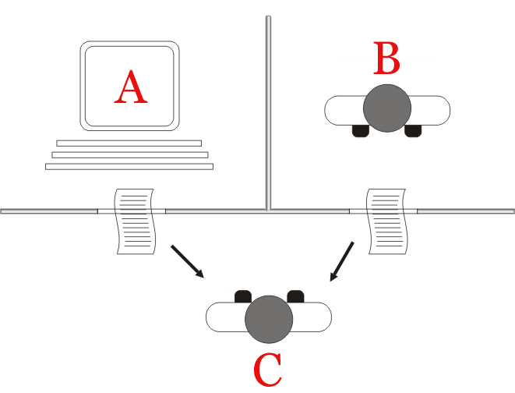
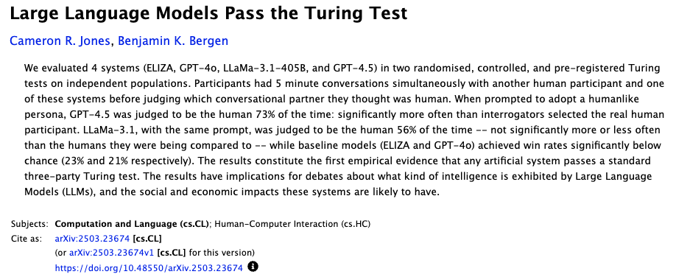
What is Artificial Intelligence? (II)
Turing Test “The Imitation Game” (1950)
Notes:
https://en.wikipedia.org/wiki/Turing_test#/media/File:Turing_test_diagram.png
https://arxiv.org/abs/2503.23674

Slide 5
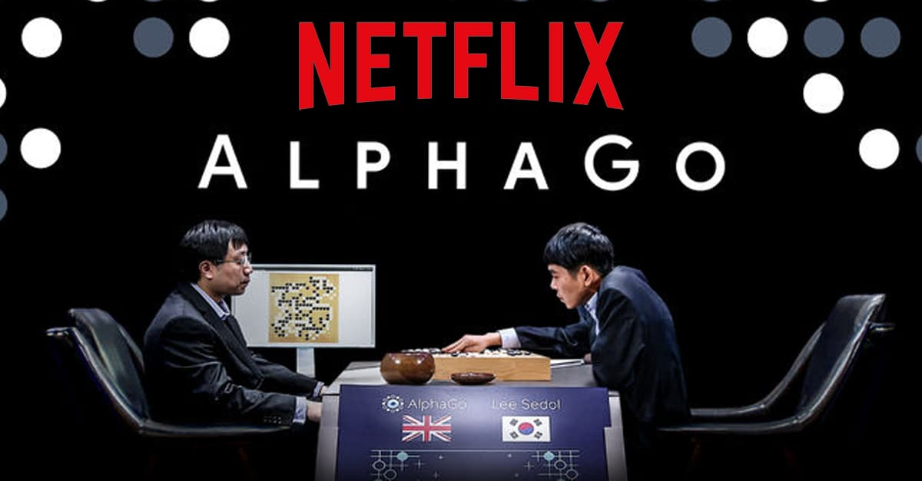
What is Artificial Intelligence? (III)
Applications:
Google AlphaGo vs Lee Sedol (2016): Go game
AlphaGo Movie 2017
Garry Kasparov vs IBM computer Deep Blue (1997): chess match

Slide 6
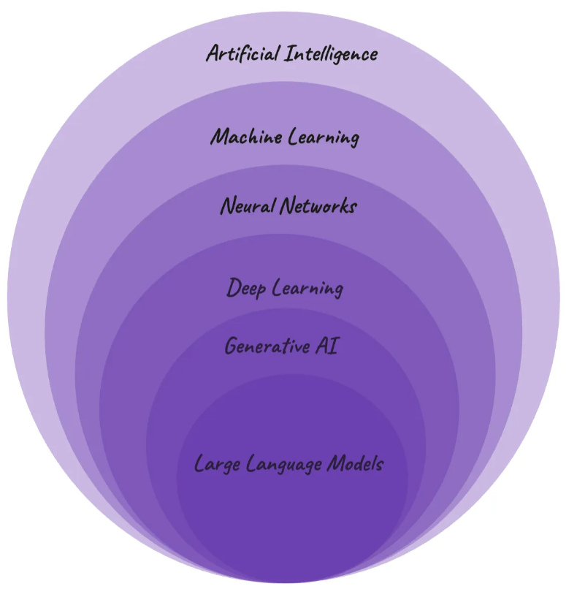
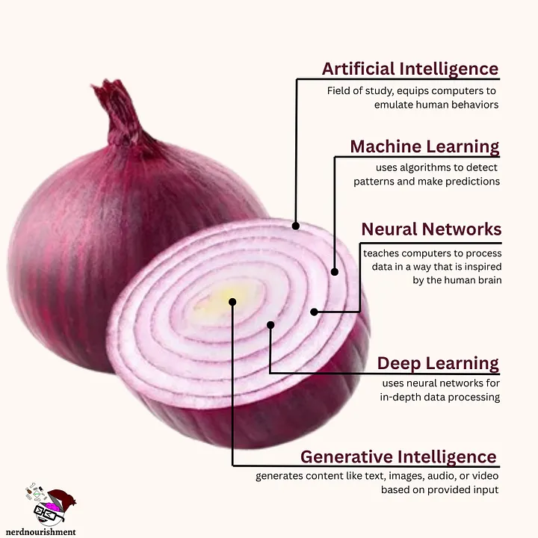
Look at the Onion (Hierarchy)
Notes:
Image on the left: Source: Chiara Caprasi, “Artificial Intelligence, Machine Learning, Deep Learning, GenAI and more ”, 2023, https://medium.com/womenintechnology/ai- c3412c5aa0ac.
Image on the right: https://medium.com/@nerdnourishment/ai-are-like-onions-7c664ee3d768
Neural networks simulate the human brain to help machines learn using interconnected artificial neurons, which can help predict patterns.
Deep learning uses multiple layers of artificial neurons that enable the machine to engage in sophisticated learning, such as that necessary for applications like self-driving vehicles, which must analyze factors like distance and depth for the machine to perform effectively.

Slide 7
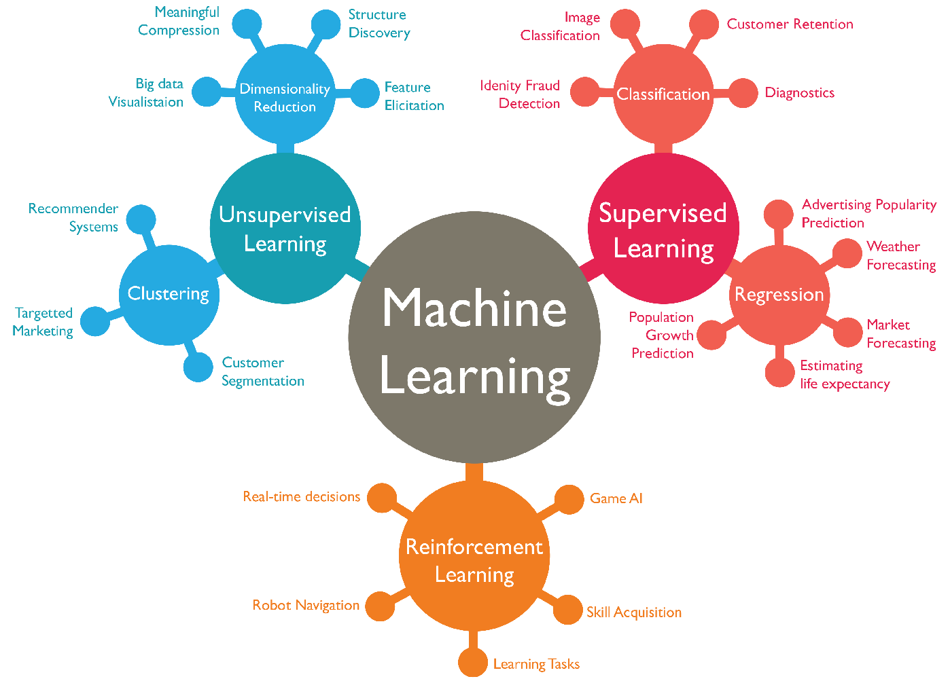
Machine Learning
Machine learning is a branch of AI.
Machine Learning refers to the methods and algorithms that enable AI systems to identify patterns, make decisions, and improve themselves through all sources of input data (Sun et al.).
Applications:
Siri, Alexa
Amazon’s recommendation system
Speech language recognition
Spotify’s daily mix
Notes:
https://medium.com/@1154_75881/what-is-machine-learning-fb3821129ff0

Slide 8
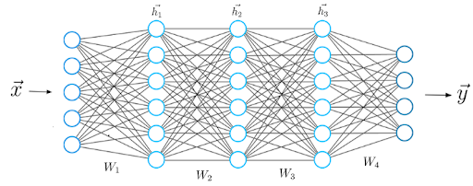
Neural Network
Neural network is a subset of machine learning.
Neural networks are inspired by the human brain, mimicking the way that biological neurons signal to one another (Caprasi).
They are algorithms modeled after the brain and designed to recognize patterns.
They work by taking an input and producing an output (prediction and decision).
Applications/Examples:
Doing laundry
Your friend’s handwriting
Machine being able to recognize cat/dog
Notes:
https://www.ibm.com/think/topics/neural-networks

Slide 9
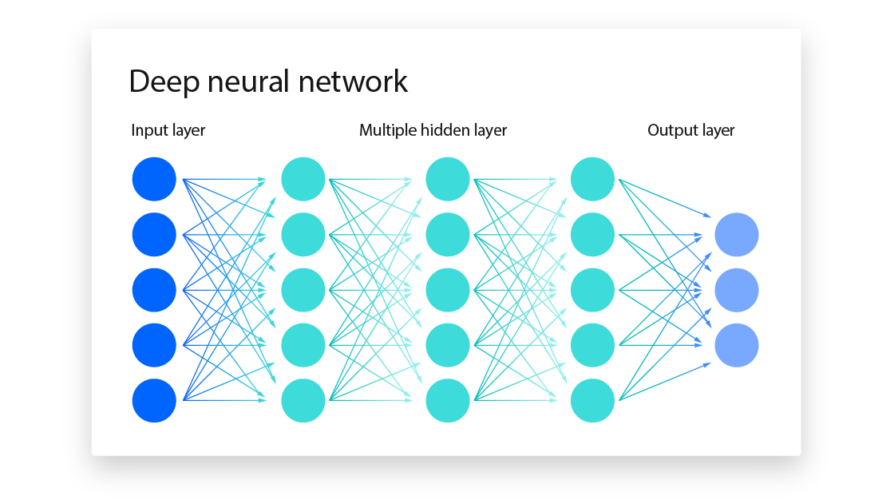
Deep Learning
Deep learning is a subset of machine learning driven by multilayered neural networks whose design is inspired by the structure of the human brain (IBM).
Able to process more complicated task through huge amounts of data.
Applications/Examples:
You being able to recognize your friend→ your phone has face recognition
Notes:
https://www.ibm.com/think/topics/deep-learning

Slide 10
AI vs Gen AI
AI is a discipline, it’s a field of study.
A common definition of AI is that it is a technology that enables machines to imitate various complex human skills (Sheikh et al.).
Generative AI is a type of artificial intelligence technology that applies computational techniques, such as machine learning and deep learning, to generate seemingly new content in the forms of text, images, audio, and video from training data (Yu and Guo; Feuerriegel et al.).
ChatGPT in 2022

Slide 11

Large Language Models (LLMs)
A LLM is a form of gen AI. LLM focuses on generating human-like text based on the patterns learned from vast amounts of textual data during training process (Caprasi).
Language Models:
Gemini, Claude, GPT4/5, Deepseek, Llama, Gork, Qwen, Mistral, BERT …
Who owns them?
Where are they based?
Notes:
https://www.shakudo.io/blog/top-9-large-language-models
Image from Ollama’s website: https://docs.ollama.com/

Slide 12
Heroes we don’t talk about
Ada Lovelace
Grace Hopper
Notes:
Ada Lovelace: https://youtu.be/J7ITqnEmf-g?si=GQMIhGDWnk3V_G8F
Grace Hopper: https://youtu.be/1LR6NPpFxw4?si=B_a9RhsHHSZOLyF9

Slide 13
AI in Our Lives (II)
Reflecting on what we have talked about today, would you like to make some improvements of your document?
Make updates in your Google doc

Slide 14
References
Caprasi, Chiara. “Artificial Intelligence, Machine Learning , Deep Learning & Generative AI and More.” Women in Technology, 24 July 2023, https://medium.com/womenintechnology/ai-c3412c5aa0ac.
Feuerriegel, Stefan, et al. “Generative AI.” Business & Information Systems Engineering, vol. 66, no. 1, Feb. 2024, pp. 111–26.
Sheikh, Haroon, et al. “Artificial Intelligence: Definition and Background.” Mission AI: The New System Technology, edited by Haroon
Sheikh et al., Springer International Publishing, 2023, pp. 15–41.
Sun, Kai, et al. “Artificial Intelligence and Machine Learning: Definition of Terms and Current Concepts in Critical Care Research.” Journal of Critical Care, vol. 82, Aug. 2024, p. 154792.
Yu, Hao, and Yunyun Guo. “Generative Artificial Intelligence Empowers Educational Reform: Current Status, Issues, and Prospects.” Frontiers in Education, vol. 8, June 2023.

