Slide 1
Week 2 Session A
Tuesday, Jan 20 2026

Slide 2
Overview
Review: AI, ML, (NN,) DL
Activity in Miro Board
Generative AI
Large Language Models
Famous LLMs
What is a model?
What is a language model?
What is a LLM?
Feeling how it works

Slide 3

Review: AI, ML, (NN,) DL
Invite you to the Miro Board
Once you all gained access, move items on the left to the right and reason your decisions

Slide 4
Review: AI, ML, (NN,) DL
Judge the following statements:
Machine learning is a subset of deep learning.
All machine learning is a form of artificial intelligence.
All artificial intelligence touch on deep learning.
Deep learning is a subset of machine learning.
All machine learning uses neural networks.

Slide 5
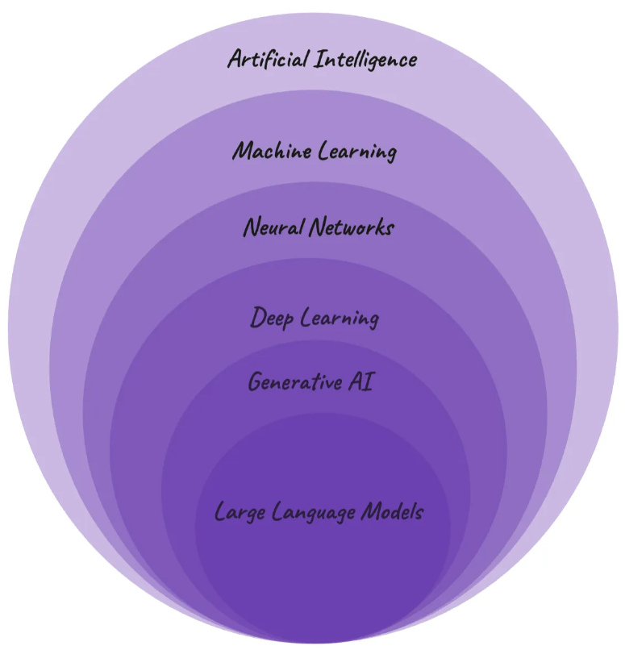
Generative AI
Where does the concept “generative AI” fit into our visual?
Generative AI are deep learning models that can generate high-quality text, images, and other content based on the data they were trained on.
It generates.
It’s creative in a probabilistic way.
It comes from deep learning.
Notes:
https://research.ibm.com/blog/what-is-generative-AI

Slide 6
Large Language Models
Where does the concept “Large Language Models” fit into our visual?
Judge the following statements:
Large Language Models are one specific type of Generative AI.
All LLMs are Generative AI, but not all Generative AI are LLMs.

Slide 7

Large Language Models
What are some of the popular LLMs?
Which companies own these models?
Where are they based?

Slide 8

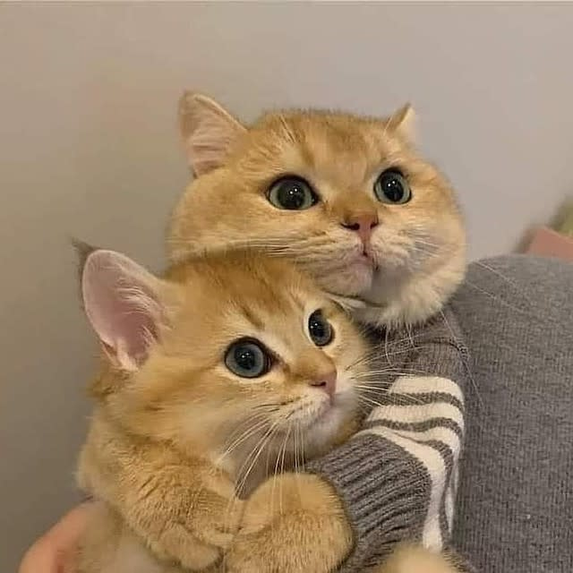


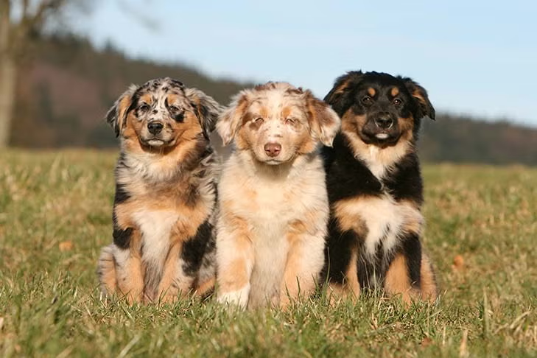
LLMs Basics I
What is a model? What is modeling?
Notes:
https://www.pawlicy.com/blog/cat-photos-for-monday/
https://www.akc.org/expert-advice/puppy-information/difference-between-show-dogs-and-pet-puppies/
What patterns helped you decide which is the dog? Pattern listing itself is modeling. A model is a learned pattern from examples.

Slide 9
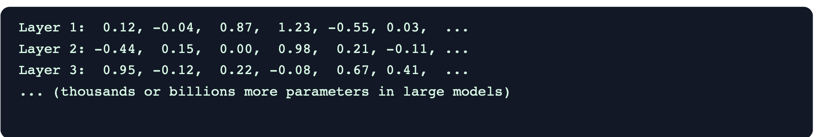
LLMs Basics I
What does a model look like?
Parameters
Architecture
Notes:
This image is generated by Copilot.
A computer model is essentially a big file full of numbers. These numbers are arranged in a very particular structure.
A model is basically a giant collection of learned patterns, saved as numbers.
Imagine the layer 1 as a spreadsheet. Each row and column contains numbers. Layer 1 (spreadsheet 1) passes information to Layer 2. A model is a stack of them.

Slide 10
LLMs Basics II
What is a language model?
Guess the next word:
This morning I spilled coffee on my…
It’s so cold outside, remember to wear your …
Titi is sick this week, so we are not meeting …
Teddy has a pet and it is a …
Rebecca comes from New York and people in Michigan always ask her why she decided to come …
Theo studies journalism and we assume he enjoys reading and …
Notes:
The answers can be diverse but at least it has to follow some sort of pattern/logic. A language model does one thing: it is trained on text to predict text.

Slide 11
LLMs Basics II
What does a language model look like?

Slide 12
LLMs Basics III
What is a large language model?
Large! (trained on massive dataset)
Language! (text! human language)
Model! (learned pattern → predict pattern)
It is essentially a collection of numbers/parameters in a specific way, and it is trained on huge amounts of text (books, articles, websites) using deep learning so it can generate fluent, human-like language.

Slide 13
LLMs Basics III
How large?
Old models:
124 million parameters (gpt2)
774 million parameters (gpt2-large)
Mid-size models: 7-70 billion (Llama 2)
Large LLMs: 70 billion - trillion (gpt 4o)

Slide 14
Week 2 Assignment
Explain LLMs in different ways: elevator talk, Instagram reels, YouTube shorts, “explain at family Thanksgiving party.”

