Slide 1
Week 2 Session B
Thursday, Jan 22 2026

Slide 2
Overview
Review: LLMs
How does a LLM work?
The two phases of a LLM
Pipelines of the two phases
Week 2 assignment: how to create a clip?
Platform
Script

Slide 3
Review: LLMs
L
L
M

Slide 4
How does an LLM work? I
The two phases of an LLM
Phase A: Training
Example: GPT3
How many days roughly did it take to train the model once? A. 3 days B. 34 days C. 134 days
How much did it cost to train the model each time?
A. $300k B. 2.8 million C. 4.6 million
Phase B: Inference
This happens everytime you use an application like ChatGPT, the model responds to you in real time.

Slide 5
How does an LLM work? I
Judge the following statements:
When I chat with a LLM like GPT4o, the LLM learns new facts from our conversations.
LLMs do not learn new facts while chatting with human, they use the patterns they learned during Phase A and make predictions.
LLMs remember what I typed, and will update the parameters in the model as our conversation continues.
LLMs only have limited short term memory, and this memory gets wiped when the chat resets.

Slide 6
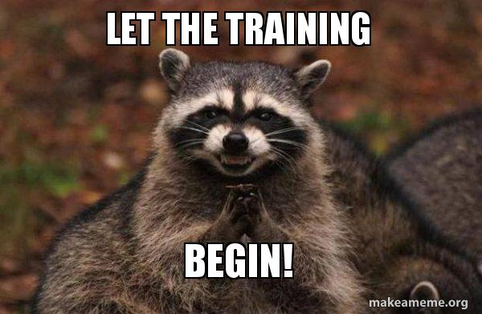
How does an LLM work? II
Pipeline that happens at Phase 1 Training
Input (all the text from the world)
Tokenization:
Token: A token is a small piece of text that the AI reads. It can be part of a word or a symbol. [From Teddy]
Neural network
Prediction (next token guess)
Compare guess to the real next token
Adjust parameters (learning!)
Repeat millions/billions of times

Slide 7
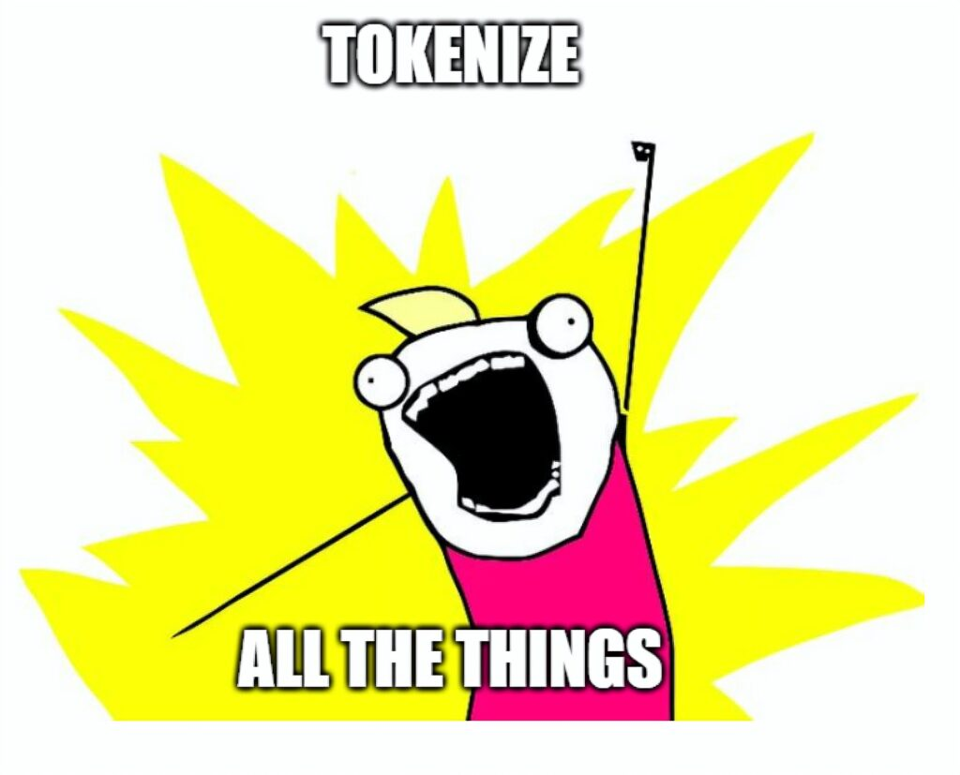
How does an LLM work? II
What is a token/tokenization?
https://platform.openai.com/tokenizer

Slide 8
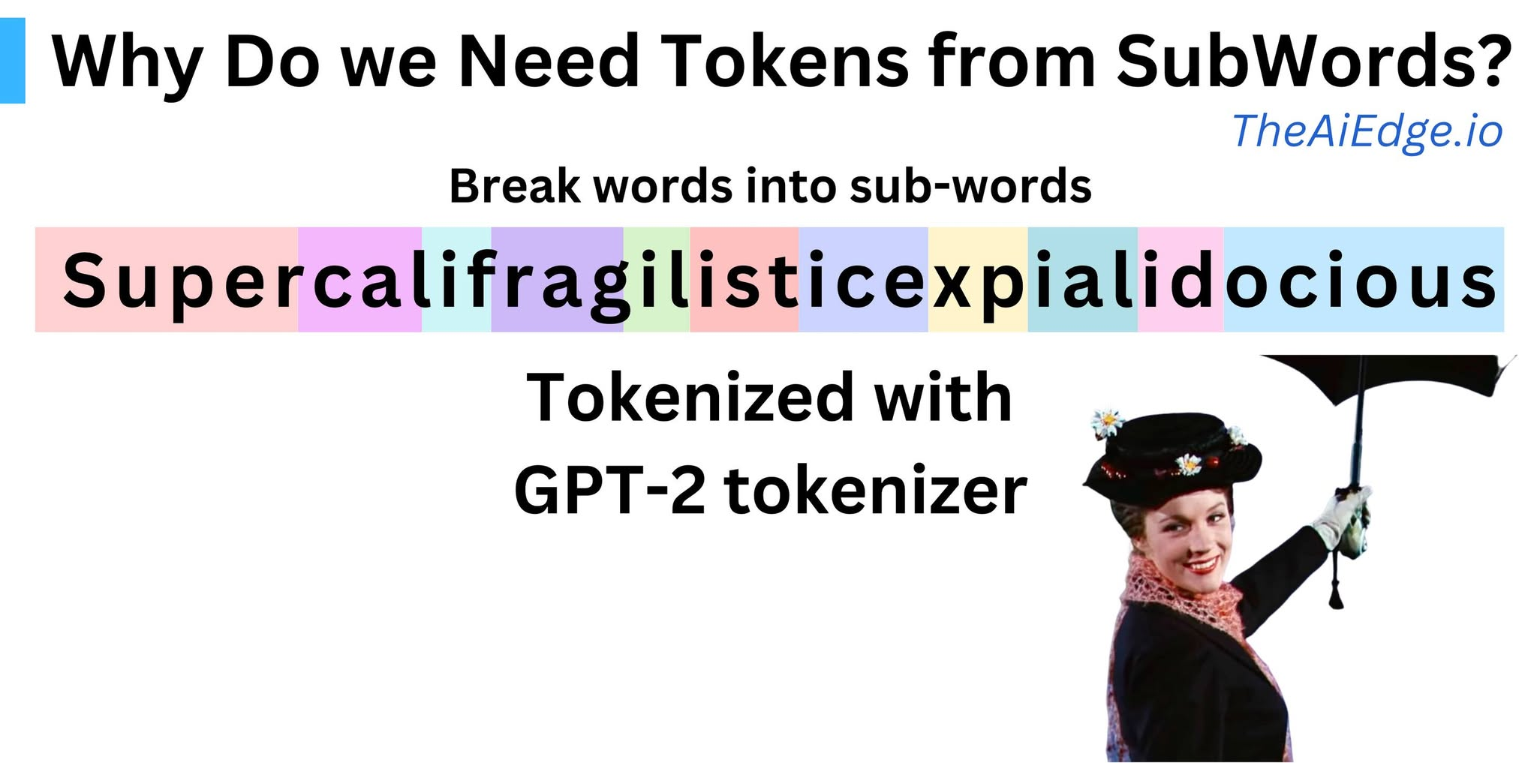
How does an LLM work? II

Slide 9
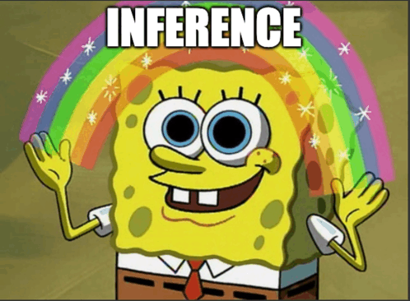
How does an LLM work? II
Pipeline that happens at Phase 2 Inference
Your input (prompt)
Tokenization
Neural network (with frozen parameters)
Prediction (guess next token)
Prediction (guess next token)
Prediction (guess next token)
…
Output an answer to user

Slide 10
How does an LLM work? III
Why are LLMs so powerful?
Example:
GPT2, training data:
https://huggingface.co/openai-community/gpt2
https://github.com/openai/gpt-2/blob/master/domains.txt

Slide 11
How does an LLM work? III
Why are LLMs also very limited?
Examples:
https://huggingface.co/openai-community/gpt2
See section “limitations and bias”

Slide 12
Before we move on
Some takeaways:
LLMs might sound intelligent because the pattern they learned are intelligent. They don’t understand. They predict based on patterns they learned.
LLMs follows your prompt/input!!!!!. You give a clear prompt, it gives better output.
LLMs themselves are not search engines, they generate (gen AI!). They don’t retrieve information.

Slide 13
Week 2 Assignment
Explain LLMs in different ways: elevator talk (to your future employers), Instagram reels/YouTube shorts (to your peer), “explain at family Thanksgiving party” (to your family members)
Pick a format (you just need to pick one)
Decide which aspect of LLMs do you want to focus on
Update your google doc with a complete written draft.
Submit a recording of your talk (video).

Slide 14
References
Li, Chuan. OpenAI's GPT-3 Language Model: A Technical Overview: https://lambda.ai/blog/demystifying-gpt-3

