Slide 1
Week 3 Session A
Tuesday, Jan 26 2026

Slide 2
Overview
Review: The two phases of a LLM & two pipelines of a LLM
Setting Up and Exploring Models Together:
“Where does AI actually run?”
The Physicality of AI Systems
Week 3 Assignment

Slide 3

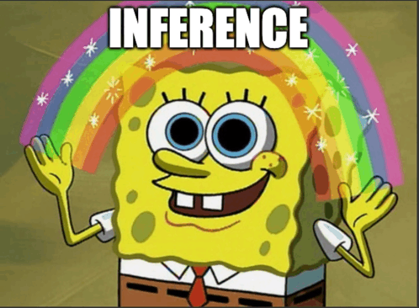
Review
LLMs have two phases:
Phase A
Phase B
Ture or False?
Tokenization happens at both phases!
Tokens and characters are pretty much the same thing.

Slide 4
Review
LLMs don’t retrieve information, they generate!
BUT gen AI tools are different! They can do both! RAG (Retrieval-Augmented Generation) helps optimize the output of LLMs.

Slide 5
“Where does AI actually run?”
Activity I:
Draw a visual representation of this statement “most people use AI through the cloud.”
Draw what you think happens when you ask a genAI tool (like ChatGPT, Copilot, etc.) a question.

Slide 6
What does the “Cloud” actually mean?
Activity II:
Search the word “Cloud” in your preferred browser. What are some key terms you are seeing?
Work with each other, and come up with a definition for cloud in the context of this class.

Slide 7

What does the “Cloud” actually mean?

Slide 8
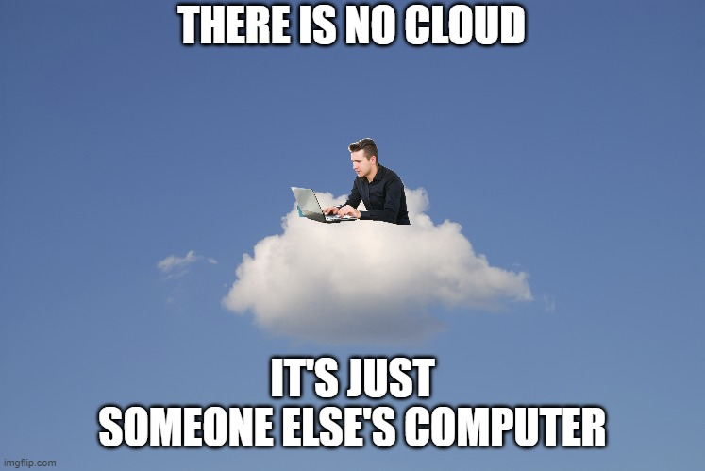
What does the “Cloud” actually mean?
From my point of view:
Cloud is someone else’s computer/server (server is a powerful computer), and I can have access to via internet.
There are multiple Cloud providers (Google, Microsoft, etc.).
Some terms: data center, server, cloud computing, etc.
Bottom line: GPT-5.2 doesn’t live in the air; it lives in a box (or racks of boxes) of GPUs somewhere in Iowa (maybe).

Slide 9
“Where does AI actually run?”
So what happens when I actually send a question to a genAI chatbot like ChatGPT?

Slide 10
Let’s Map Out the Ecosystem
Activity:
Build a physical map of the journey your prompt takes: from your laptop all the way to the machine that runs the model. Place these cards on the table in that order.

Slide 11
Let’s Map Out the Ecosystem
From my point of view:
AI does have carbon footprint.
People build it; people maintain it. It costs $, water, labor.
Nothing lives “in the cloud”. It lives in a building with machines.

Slide 12
Oh wait… what does MSU have?
ChatGPT runs far away in Des Moines Iowa. But MLStudio that we are going to use runs right here at MSU on ICER’s hardware.
MSU Campus HPC vs Commercial Cloud:
Shorter network path
Smaller and open models
Job scheduled for specific GPUs
Local policies for power and cooling

Slide 13
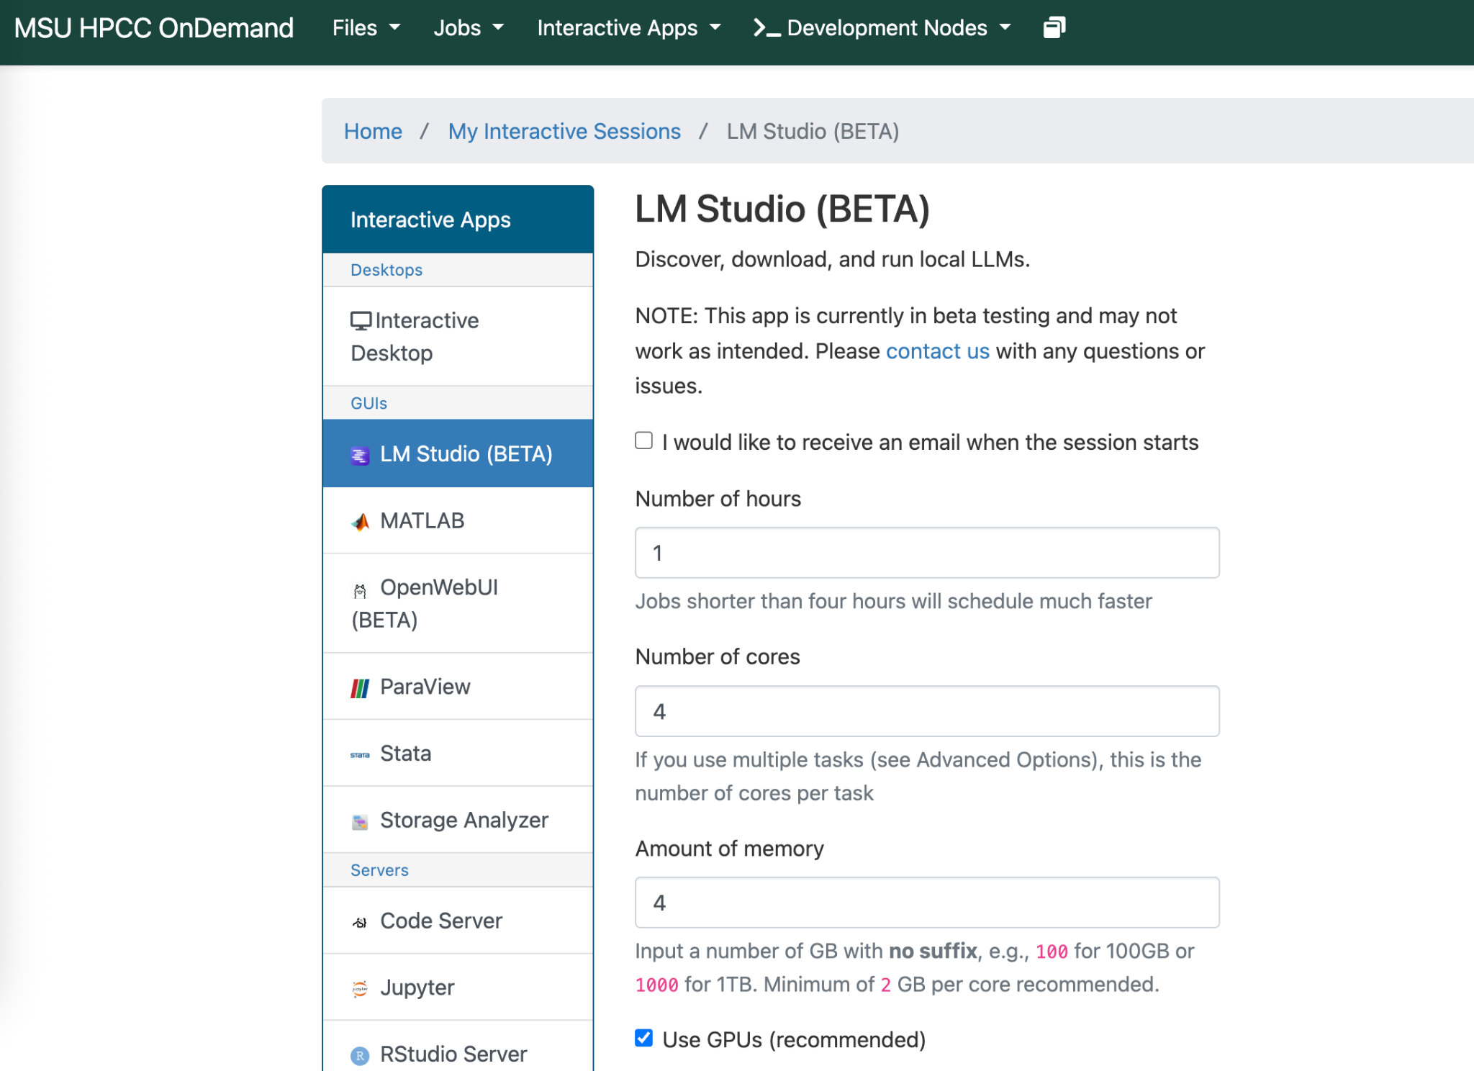
LMStudio!
ICER MLStudio on Campus HPCC

Slide 14
Week 3 Assignment
Select a language model on LMStudio, explain why you picked this one (short rationale + screenshot).

