Slide 1
Week 4 Session A
Tuesday, Feb 3 2026

Slide 2
Overview
Logistics:
Plans for Week 5 and Week 6
End of Year Celebration
Workshop:
Setting Up with HPCC
Registration for UURAF
Feedback on UURAF Abstract
Week 4 Assignment

Slide 3

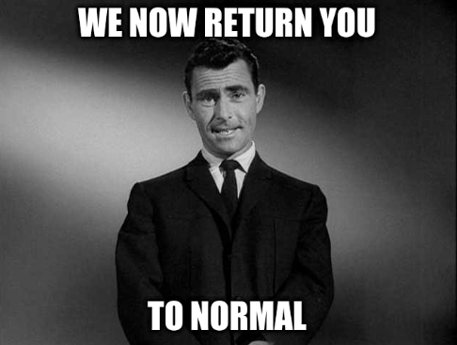
Week 5’s Plan
Tuesday, 2/10 Data Center Field Trip Day!
Location: west campus
4PM - 5PM, we need to arrive 10 minutes early
Thursday, 2/12 Back to Normal Class Day!
Location: DSL (in the library)
4:10PM - 5:20PM

Slide 4

Week 6’s Plan
Tuesday, 2/17 NO CLASS!
Please visit this event “AI and the Body in the Age of Noise” on 2/12,
7 - 8:30PM (Registration required)
Thursday, 2/19 Back to Normal Class Day!
Location: DSL (in the library)
4:10PM - 5:20PM

Slide 5

Digital Humanities End of Year Celebration
Week 14 Thursday, 4/23 End of Year Celebration!
Location: LEADR (Old Horticultural Building, Rm 112; 506 E. Circle Drive)
3PM - 5PM (Registration required)

Slide 6
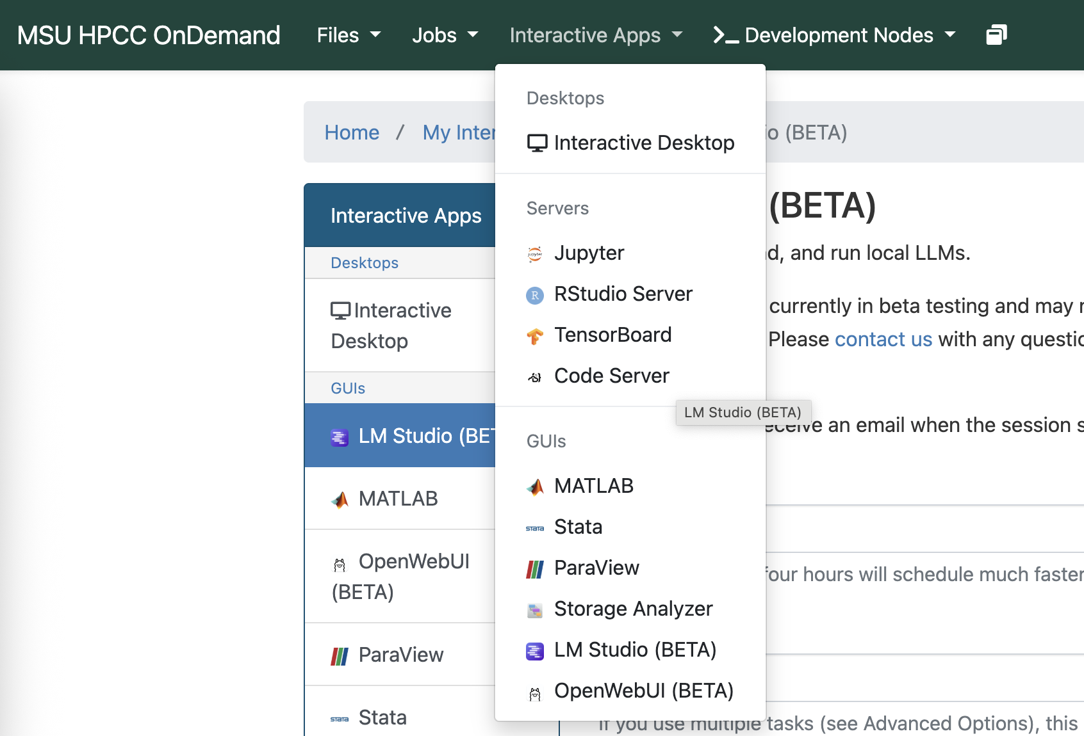
Workshop - Part I
Setting up with HPCC
Login here: ondemand.hpcc.msu.edu/pun/sys/dashboard
Select “Interactive Apps” tab, and click “LM Studio”

Slide 7
Workshop - Part I
Setting up with HPCC
3. Based on this documentation, set up your first LM Studio session:
https://docs.icer.msu.edu/OnDemand_LMStudio/
4. Read through the “Interim Guidance on Data Uses and Risks of Generative AI.”

Slide 8
Workshop - Part I
Setting up with HPCC (Terms explained)
Cores: how many workers you want to work on this task; loading files, running the server; if you need GPU, 2-4 is enough, if you don’t, you need 8-16
RAM (amount of memory): language models are huge blobs of numbers, RAM holds that blob in memory, so we can use it; generally we do 2GB per core.
*** If you see “not enough memory,” you need to increase RAM
GPU: imagine it being a super worker that is just really good at math with huge matrices. GPU makes it faster.
GPU types: V100 (older generation); V100s (slightly newer); A100 (faster)
Node type: different types of CPU architectures, if you use GPU, it doesn’t matter much.

Slide 9
Workshop - Part I
Play with the model
Once you get the LM Studio up and running, you can select between different models and test it with any questions.

Slide 10
Workshop - Part II
UURAF!
Rebecca and Theo: start the UURAF application (app.mystory.msu.edu), due 2/12.
(You do not need to have all materials finalized)
Select “digital humanities” if you can find the tag
Rebecca: invite Teddy to the project, add Titi as mentor; Theo: add Kristen as mentor
All: edit the abstract, make final adjustment, due 3/12.
All: continue to work on the project, until 4/17.
All: complete RCR training in the system, prior to 4/17.
Final presentation: April 17 at the Breslin Center and Online

Slide 11
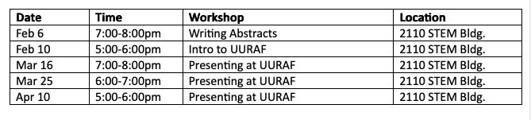
Workshop - Part II
UURAF!
Per their email: “As you submit a registration, you will automatically receive an email with more information.”
“Our office hosts workshops for undergraduate students to attend and I highly recommend stopping by some of the workshops we host if students have any questions or concerns about UURAF.”

Slide 12
Workshop - Part III
Feedback on UURAF’s abstract

Slide 13
Week 4 Assignment
Select a language model on LMStudio, explain why you picked this one (short rationale + screenshot).

