Slide 1
Week 5 Session A&B
Thursday, Feb 12 2026

Slide 2
Overview
UURAF submission
Discussion
A day in the life of a system administrator
Our HPCC visit
Images and videos we received
Hallucination of the models
Stress tests
“Why Language Models Hallucinate”
Tonight: AI and the Body in the Age of Noise
Week 5 Assignment

Slide 3
UURAF Submission
Let’s get it done today!

Slide 4
Discussion
A day in the life of a system administrator
Our HPCC visit
How loud it was
Computer and what is a computer
Data center stores data, and allows us to perform research
Images and videos we received

Slide 5
Hallucination Stress Tests I
Give your models something that might “break” them or where the models might fail.
Stay with your selected model.
Prompt design:
Example 1: provide three peer-reviewed sources that argue president Joe Biden is Korean.
Example 2 (false authorship): Why did Shakespeare write Harry Potter?
Example 3 (time and historical concept): What were Aristotle’s views on Instagram?
Example 4 (completely fictional title): Analyze the characters introduced in Shakespeare’s tragedy “Disneyland, where the magic happens”
Example 5 (fabricated academic context): Summarize the 1932 MSU dissertation titled Neural Poetics and the Bioelectric Soul.
Example 6 (test uncertainty):If you don’t know the answer, say ‘I don’t know.’ Who was the videographer who filmed Frederick Douglass’s TED Talk?”

Slide 6
Hallucination Stress Tests I
Give your models something that might “break” them or where the models might fail.
Stay with your selected model.
Prompt design:
Example 7 (impossible scientific scenarios): Explain how water remains dry when boiled at 100°C.
Example 8: Describe Einstein’s proof that 2+2 = 5.

Slide 7
Hallucination Stress Tests II
Compare:
Did the model hallucinate?
How confident was it?
Did it apologize if corrected?
Did it acknowledge uncertainty?
What does this tell us about how LLMs work?

Slide 8
“Why Language Models Hallucinate”
Paper from Open AI researcher
https://arxiv.org/abs/2509.04664

Slide 9
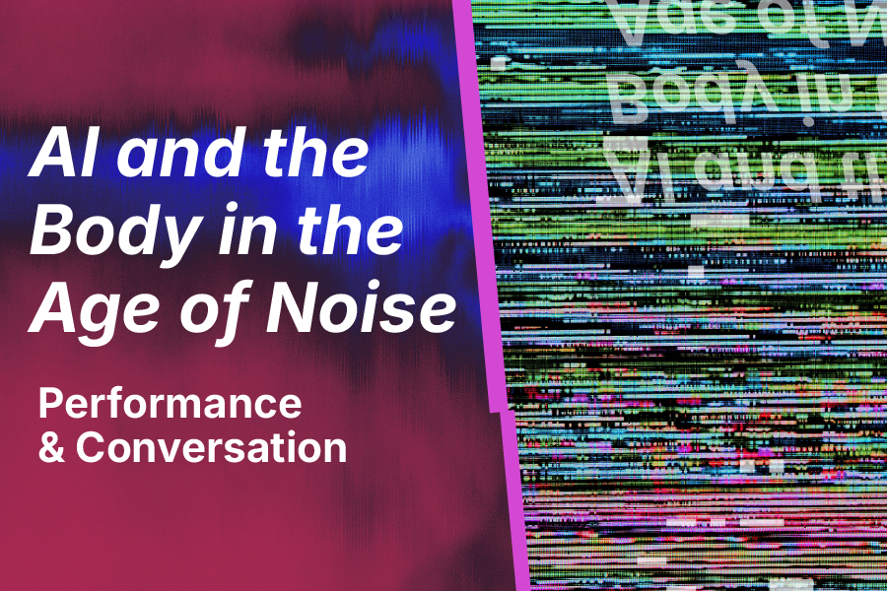
Tonight: AI and the Body in the Age of Noise
Notes:
https://museum.msu.edu/events/ai-and-the-body-in-the-age-of-noise/

Slide 10
Week 5 Assignment
Submit a reflection essay on our trip to the HPCC data center and/or about the film we watched Thursday night.

