Slide 1
Week a Session A
Tuesday, Feb 24 2026

Slide 2
Overview
Environmental Impact of AI: Energy
Data Centers:
Data centers in our lives
Data centers in Lansing and in Saline Township
Week 7/Spring Break Assignment
Notes:
ICER’s data center
Data centers
around the world
in the US
in Michigan
in Lansing (hopefully not)

Slide 3

Environmental Impact of AI
GHG Emissions:
Gases that trap heat in the atmosphere are called greenhouse gases. The main type of gas is carbon dioxide (CO₂). It enters the atmosphere through burning fossil fuels, solid waste, etc.
The greenhouse gas allow sunlight to enter the atmosphere but prevent heat from escaping, which leads to global warming.
Where does GHG come from?
Energy production (electricity), transportation, industry, etc.
Energy used by data centers:
EcoLogits and its calculator
Notes:
https://www.epa.gov/ghgemissions/overview-greenhouse-gases

Slide 4
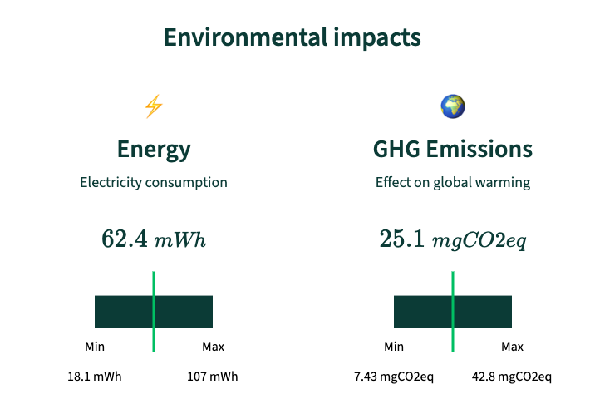
Environmental Impact of AI
Terms:
mWh: milliwatt-hour, = 0.001 watt-hour. A smartphone battery is about 10,000–15,000 mWh (10–15 Wh). 62.4 mWh is 0.6% of 1% of a phone battery.
mgCO₂eq: megagrams of carbon dioxide equivalent. A Google search: 0.2–1 g CO₂ (200–1000 mg).

Slide 5



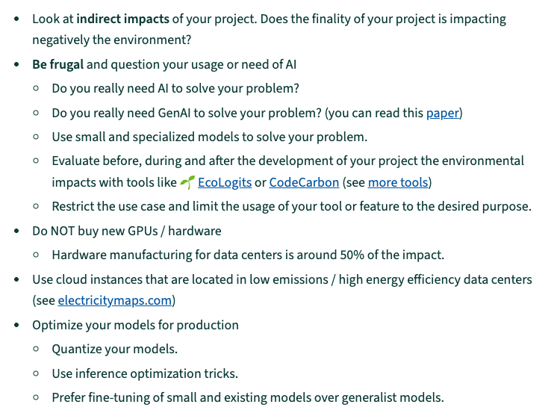
Environmental Impact of AI
What are the goals of this?
How to reduce AI environmental impact?
Notes:
https://huggingface.co/spaces/genai-impact/ecologits-calculator

Slide 6
Data Centers in Our Lives
Activity:
We are adding a table to our presentation poster and on our future website. Complete the table below based on information found on this website: data centers map
Regions | Numbers | Notes
Virginia | 570 in the whole state | 128 in just the one town Ashburn
Michigan | 70 | 7 in Lansing
New york | 137 | 56 just in NYC
California | 288 | 64 in Santa Clara

Slide 7
Local Data Centers
Class activity:
Lansing: proposed by Deep Green
Saline Township: proposed by Open AI
Take notes of your findings in this document
Societal response:
Economic Development Responsibility Alliance of Michigan (EDRA)
A documentary on Meta’s data center

Slide 8
Week 7/Spring Break Assignment
Data collection for our final project: Nexis Academic database

