Slide 1
Week 8 Session B
Thursday, March 12 2026

Slide 2
Overview
Data Collection: What a depressing week…
Week 8 Assignment

Slide 3

Data Collection - What happened?
Data:
I was told that we can no longer use Lexis Nexis’s data even we download their data and run all analysis locally (or on HPCC/ICER’s machine).
AI Tool use: Terms of Use for Electronic Journals and Other Electronic Resources
Lexis Nexis’ General Terms and Conditions:
1.2 You may not:
(h) use any of the Materials to train (or facilitate the training of) large language models, machine learning models, generative AI, or other similar technologies (“AI Technologies” or “AI Technology”). The uploading or submission of Materials into third party applications, software or websites that utilize AI Technologies is prohibited unless approved in writing by LN;

Slide 4

Data Collection - In an ideal world…
Result with 50 articles:
I ran it on HPCC using their Jupyter notebook, and we got some beautiful results…
Now if 50 articles work, let’s try it with 500 articles!

Slide 5
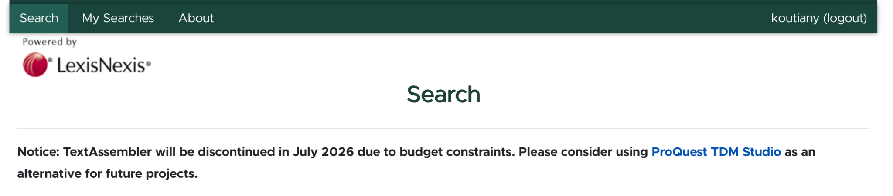
Data Collection - What happened?
Data:
Next steps:
Delete the files you downloaded within 90 days.
Find the next database that we are allowed to use.
What now?
We can try LexisNexis TDM (text and data mining)
This is what MSU offers: Text Assembler

Slide 6
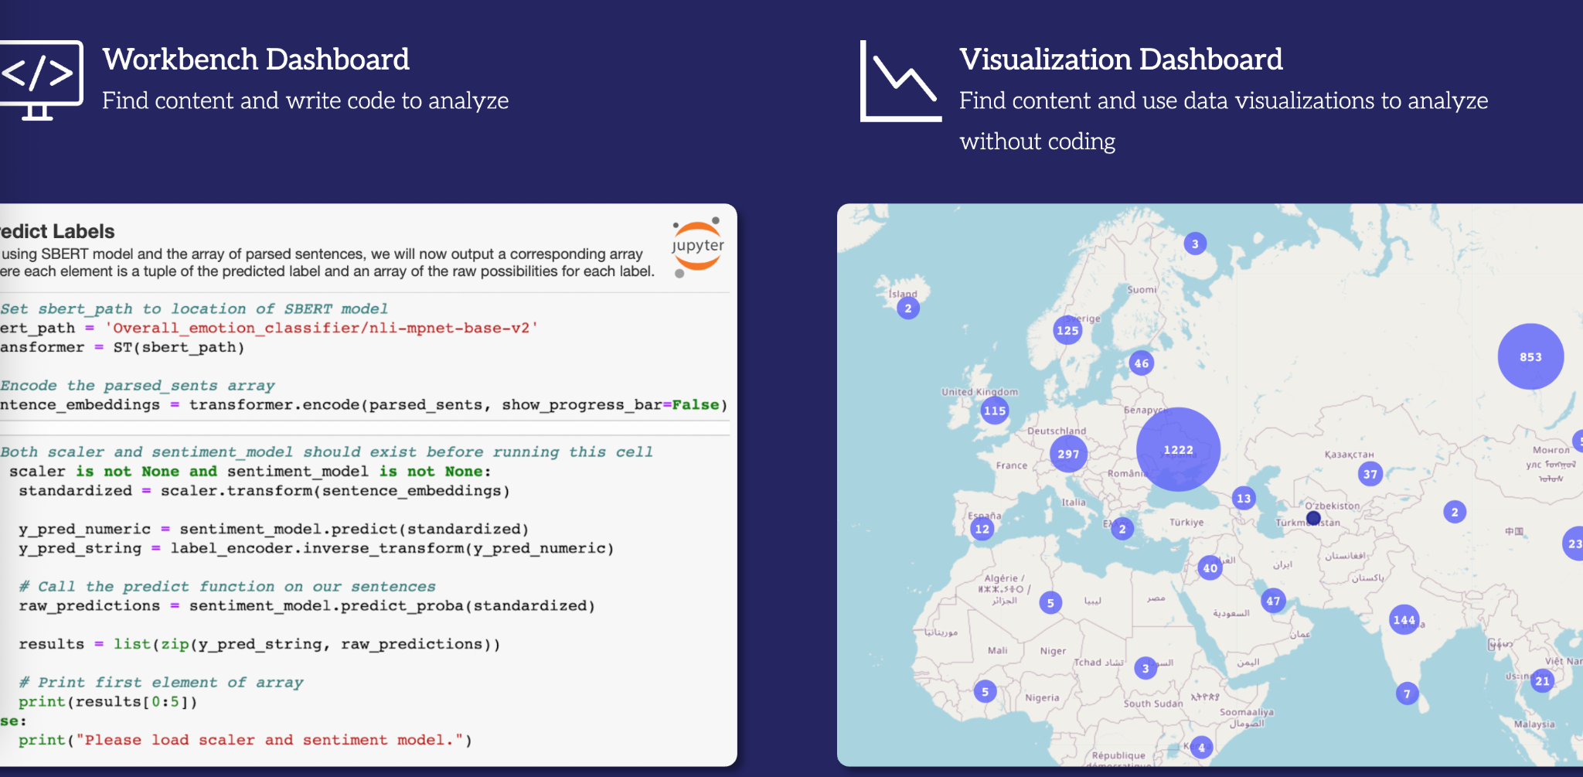
Data Collection - What’s next?
Data:
We are going to ProQuest TDM Studio: https://tdmstudio.proquest.com/home
Register an account using your MSU credentials
Navigating Proquest:
Search: ALL("data center") AND ALL (Michigan)

Slide 7
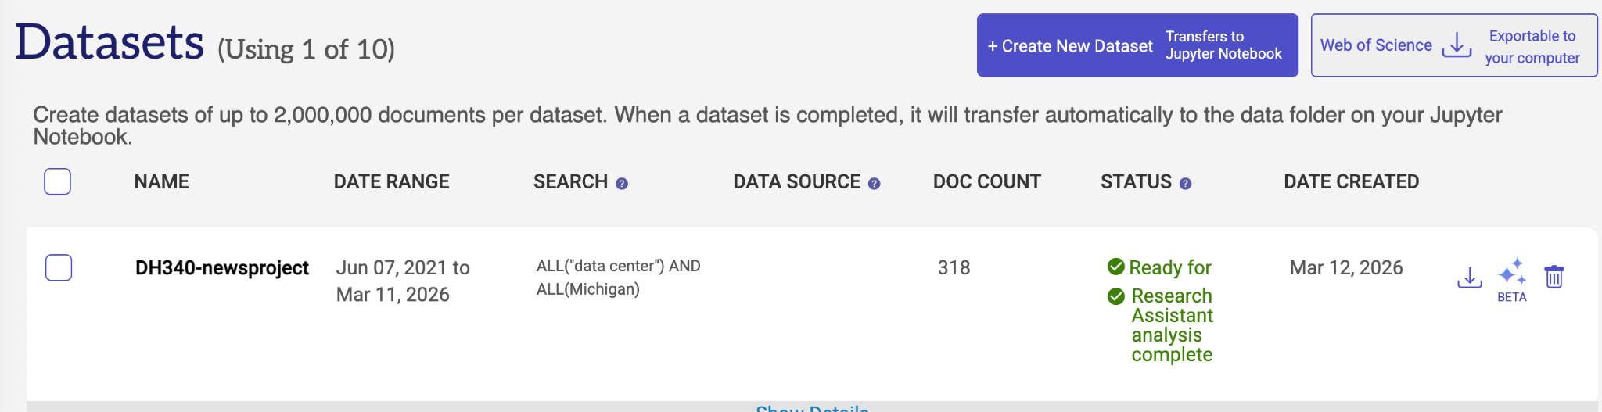
Data Collection - What’s next?
It’s all about ProQuest now:
Let’s start with Workbench:
Create a dataset, request it, and wait

Slide 8
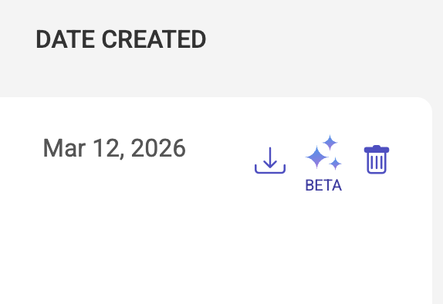
Data Collection - What’s next?
It’s all about ProQuest now:
After you received the dataset, we will test one of their tools (still in BETA version) to receive topics for each articles.

Slide 9
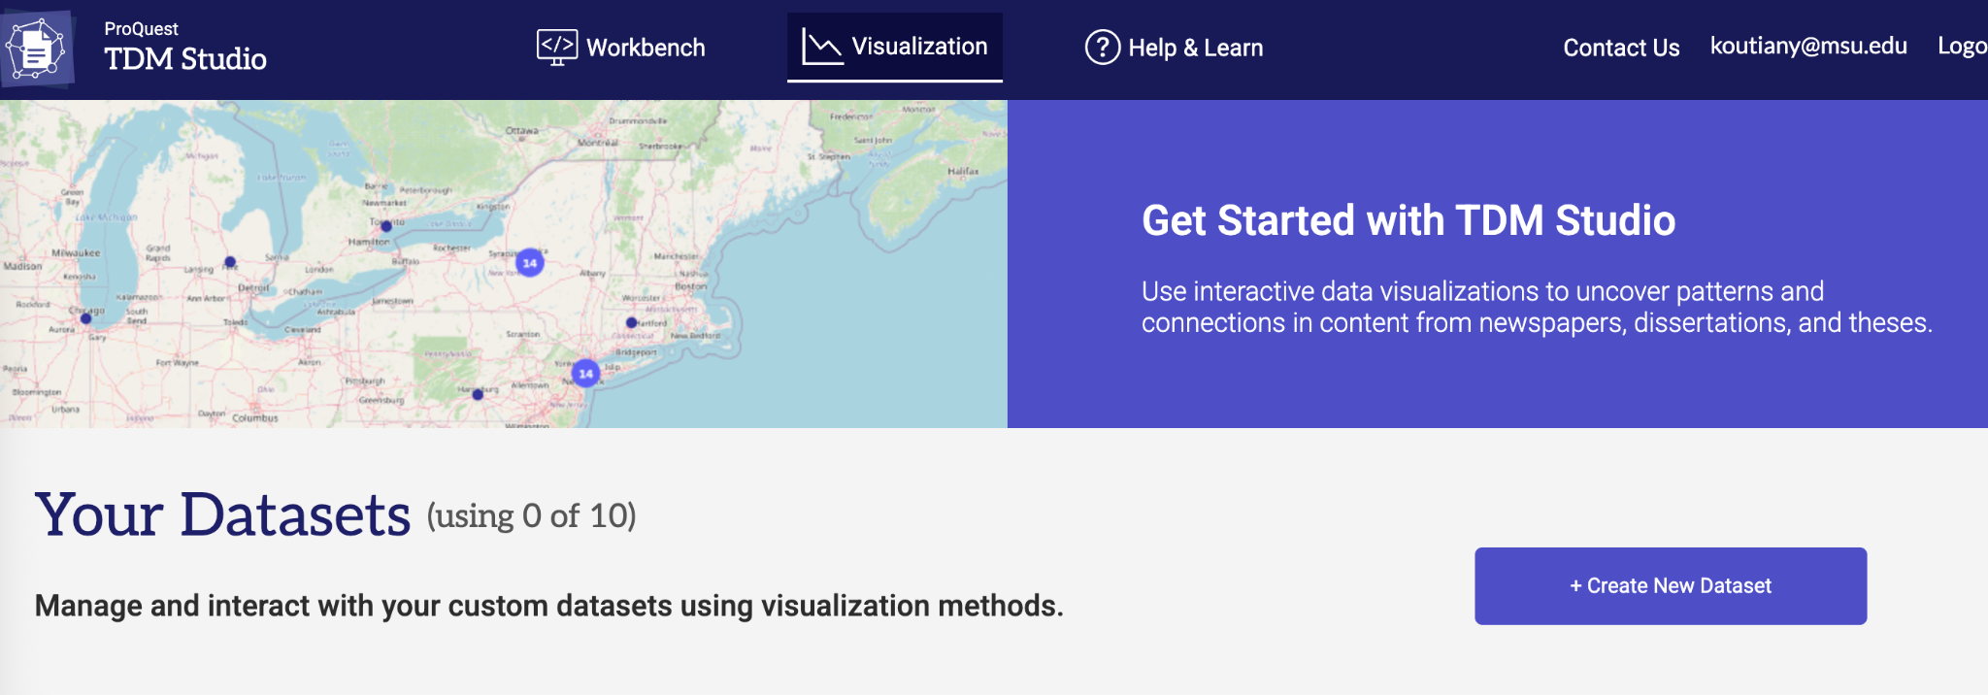
Data Collection - What’s next?
It’s all about ProQuest now:
Create the same database in their “Visualization” space

Slide 10
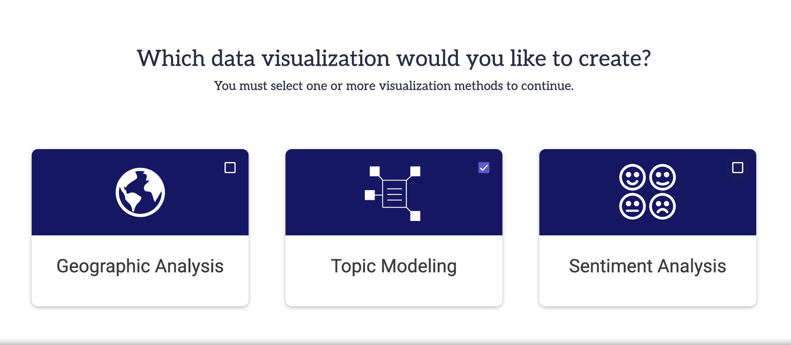
Data Collection - What’s next?
It’s all about ProQuest now:
Create the same database in their “Visualization” space, and test the topic modeling function.

Slide 11
Week 8 Assignment
Examine the results generated from ProQuest’s built in function of topic modeling.

