Slide 1
Week 9 Session A
Tuesday, March 17 2026

Slide 2
Overview
ProQuestTDM (text and data mining)

Slide 3
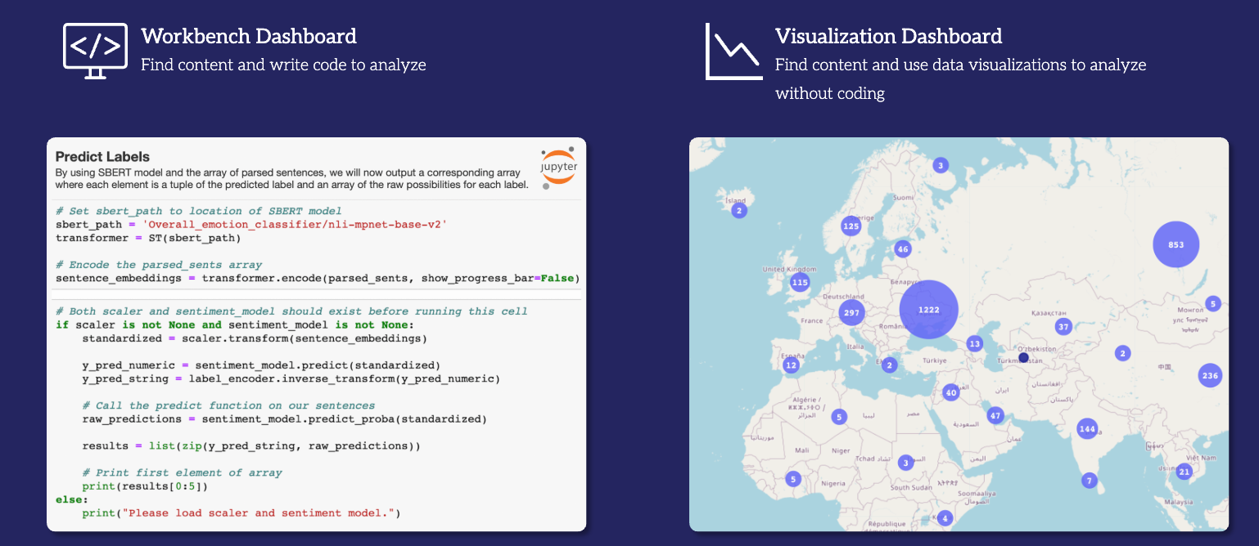
Text Analysis and ProQuestTDM
Dataset:
Search terms: “data center” AND Michigan
Timeframe: 1/1/2025 - 3/10/2026
Sources: US Newsstream Collections, newspapers
Results: 469 documents

Slide 4
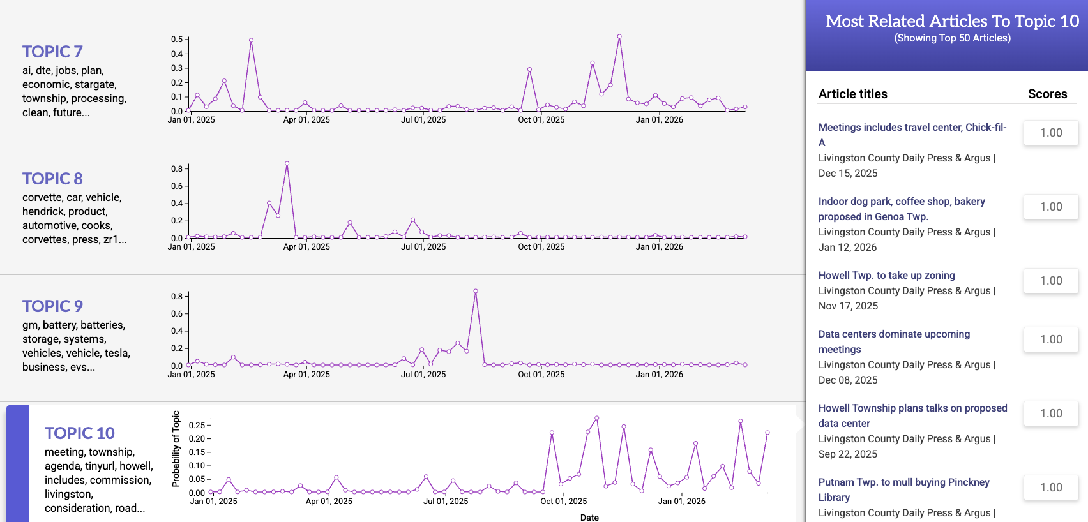
Text Analysis and ProQuestTDM
Visualization Dashboard on Topic Modeling
When you clicked Topic Modeling, what are your findings?
How many topics did you review?
What do you like about this dashboard?
What are some potential limitations?
Let’s compare our results!

Slide 5
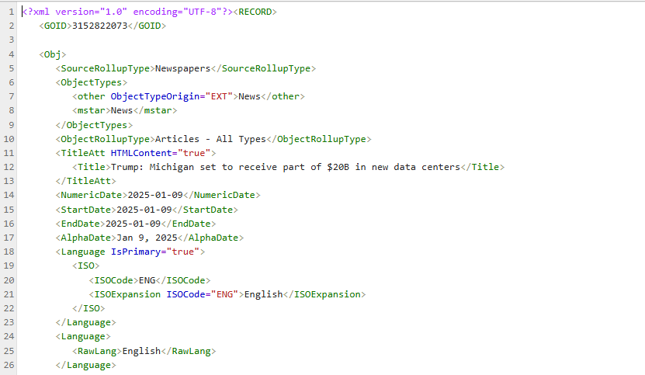
Text Analysis and ProQuestTDM
Workbench in ProQuestTDM: Hands-on coding!
Let’s run things in Jupyter Notebook and see the backend of this!
What does the data actually look like?
.xml files

Slide 6
Our results vs ProQuestTDM’s results
Are they the same?
If not, why?
LDA is a probabilistic model, so small differences between runs are normal, but when we fix the random seed and keep preprocessing constant, the results stabilize. ProQuest’s topics look consistent because they run the model once with fixed settings and reuse the results.

Slide 7
Week 9 Assignment
Examine the results generated from ProQuest’s built in function of topic modeling.

