Slide 1
HANDLING OUT OF ORDER
EVENTS IN
CORE

Slide 2
General Explanation of Core
CORE is a Complex Event Recognition (CER) engine built to detect patterns in high‑velocity data streams with low latency.
It evaluates complex event queries efficiently, including those involving time windows, filters and partition‑by correlations.
CORE is powered by CEQL, a practical query language supporting sequencing, disjunction, iteration, filtering, time windows, and partition‑by.

Slide 3
Event
A single event is one complete, atomic record that describes a specific real-world occurrence at a single point in time, containing all relevant attributes needed to process it independently.
Event
Event Type (CARRIER_NAME): Delta_Air_Lines_Inc
Event_Timestamp: 1735690200
Arrival_Timestamp: 1735697400
FL_NUM: 2080
ORIGIN: SFO
DEST: MSP
DEP_TIME: 05:59

Slide 4
Complex Event
A complex event is a higher-level event that is derived by correlating, aggregating, or analysing multiple single events over time to identify a meaningful operational pattern or condition.
Event 1
Event Type (CARRIER_NAME): Delta_Air_Lines_Inc
DEST: LAX
ARR_DELAY: 15 min
Event 2
Complex Event
Event Type (CARRIER_NAME): American_Airlines_Inc
CORE engine
DEST: LAX
ARR_DELAY: 10 min
“High arrival traffic at LAX airport”
Event 3
Event Type (CARRIER_NAME): United_Air_Lines_Inc
DEST: LAX
ARR_DELAY: 7 min

Slide 5
Complex Event Query Language (CEQL)
Syntactically, a CEQL query has this form:
SELECT < list-of-variables >
FROM < list-of-streams >
WHERE < CEL-formula >
[FILTER < list-of-filters>]
[PARTITION BY < list-of-attributes >]
WITHIN < time-value >
CONSUME BY NONE/ANY
[LIMIT < number >]
Example:
It detects sequences of four events — BTC, then BNB, then DOGE, then NEAR — that all come from the same Exchange and occur within 10 time units of each other.
SELECT * FROM S
WHERE (BTC as btc; BNB as bnb; DOGE as doge; NEAR as near)
PARTITION BY [Exchange]
WITHIN 10 [Event_Timestamp]
CONSUME BY ANY

Slide 6
Event Time vs. Arrival Time
Each event in the datasets is associated with two distinct timestamps.
Event Time represents when the event actually occurred in the real world.
Arrival Time represents when the event was arrived at the system.
The difference between these timestamps captures network delays and is called System Arrival Delay.
System Arrival Delay = Arrival Time − Event Time

Slide 7
Detection Delay
The detection delay represents the total end-to-end latency of an event, measuring the complete duration from its initial generation to the final reporting of the result.
Detection Delay = System Arrival Delay + Processing Delay
The System Arrival Delay accounts for external network latency
System Arrival Delay = Arrival Time − Event Time
The Processing Delay is the time the CORE system itself requires to execute processing logic, calculated from event arrival at CORE to result generation within CORE
Processing Delay = Output Result Time - Arrival Time

Slide 8
Quarantine Policies of CORE
Quarantine is a mechanism that temporarily holds incoming events and ensures that late-arriving events can still be correctly ordered within a specified time window.
CORE supports two policies:
Direct Policy
Fixed Time Policy
Notes:
να εξηγησουμε τι ειναι καραντινα

Slide 9
DIRECT policy
DIRECT - Defines no quarantine, events pass directly to the CORE engine
Input Stream
Event 1 Event Type (CARRIER_NAME): Delta_Air_Lines_Inc DEST: LAX ARR_DELAY: 15 min
Event 2 Event Type (CARRIER_NAME): American_Airlines_Inc DEST: LAX ARR_DELAY: 10 min
Event 3 Event Type (CARRIER_NAME): United_Air_Lines_Inc DEST: LAX ARR_DELAY: 7 min
CORE engine

Slide 10
Fixed Time Policy
Defines that each event must stay in quarantine a fixed amount of (wall-clock) time, waiting for late events to arrive, before it is sent to CORE
The event is added to a set sorted by event time at the correct position.
From the event with the smaller Event time in quarantine, that event is released together with all events in quarantine that their quarantine time has passed.
Any late events that arrive after this point with event time smaller than the last sent event are dropped.
Input Stream
Event 1 Event Type (CARRIER_NAME): Delta_Air_Lines_Inc Event_Timestamp: 1735690200 DEST: LAX
Event 2 Event Type (CARRIER_NAME): American_Airlines_Inc Event_Timestamp: 1735697400 DEST: LAX
ordered stream
Quarantine
CORE engine

Slide 11
New Fixed Time Policy
Defines that events are held in quarantine based on data timestamps, not real-world (wall-clock) time.
The policy tracks the arrival time of the latest received event to measure how far the data stream has progressed.
From the event with the smaller event time in quarantine, that event is released only when the time interval between the arrival time of the latest received event and the event’s arrival time exceeds the configured wait time.
Any late events that arrive after this point with event time smaller than the last sent event are dropped.
Input Stream
Event 1 Event Type (CARRIER_NAME): Delta_Air_Lines_Inc Event_Timestamp: 1735690200 Arrival_Timestamp: 1735690200
Event 2 Event Type (CARRIER_NAME): American_Airlines_Inc Event_Timestamp: 1735697400 Arrival_Timestamp: 1735697400
Quarantine
ordered stream
CORE engine

Slide 12
Example of new FIXED TIME POLICY
Input stream
Event | Event Time | Arrival Time
Event 1 | 17 | 17
Event 2 | 8 | 20
Event 3 | 30 | 30
Event 4 | 10 | 32
Quarantine time: 5 sec.
Arrival Time | Input Stream Description | Drop check | Quarantine before insertion | Expiry check | Quarantine after insertion | Last event sent to CORE
17 | Arrive Event 1 (ET:17) | Nothing sent yet | [ ] | — | [Event 1] | —
20 | Arrive Event 2 (ET:8) | Nothing sent yet | [Event 1] | 20-17=3<5, Hold Event 1 | [Event 2, Event 1] | —
30 | Arrive Event 3 (ET:30) | Nothing sent yet | [Event 2, Event 1] | 30-20=10>5, Release Event 2 | [Event 1, Event 3] | Event 2
 |  |  | [Event 1, Event 3] | 30-17=13>5, Release Event 1 | [Event 3] | Event 1
32 | Arrive Event 4 (ET:10) | ET₁=17 > ET₄=10 DROP | [Event 3] | — | [Event 3] | Event 1
 | End of stream |  | [Event 3] | Release Event 3 | [ ] | Event 3
Events sent from quarantine: [Event 2, Event 1, Event 3]
Dropped events: [Event 4]

Slide 13
Dynamic quarantine policies
We introduce new quarantine policies that improve CORE’s performance. They reduce drops and increase complex events found, while execution time remains the same as existed quarantine policies without adding extra overhead:
Dynamic Average Policy (AVG, Mean)
Dynamic p99-EMA Policy (p99-EMA)
Dynamic MAX-EMA Policy (MAX-EMA)
Dynamic MAX Policy (MAX)
Dynamic Jump-and-Decay Policy (Jump/Decay)
Dynamic Per-Event Policy (Per-Event)
All new quarantine policies have in common:
A quarantine buffer where events are held before being sent
A sliding window of 500 recent events (their System Arrival Delay) to adapt to network conditions.
Out-of-order events are dropped to maintain correct ordering.
The minimum quarantine time is a fixed, user-defined value.
The maximum quarantine time is 1M seconds.

Slide 14
1. Dynamic Average Policy (AVG, Mean)
The quarantine time is dynamically computed from the average latency (System Arrival Delay) of recent events.
Quarantine time is calculated as:
  Q_{t} = avg(L_{t}),
  where:
    L_{t} : list of latencies in the sliding window (500 recent events)

Slide 15
2. Dynamic p99-EMA Policy (p99-EMA)
The quarantine time is dynamically computed from the 99th percentile latency (System Arrival Delay) of recent events and smoothed with an EMA (α = 0.1).
Quarantine time is calculated as:
  Q_{t} = (1 - α) * Q_{t-1} + α * P₉₉ ,
  where:
  α : EMA smoothing factor (α = 0.1)
  P₉₉ : 99th percentile of latencies in the sliding window

Slide 16
3. Dynamic MAX-EMA Policy (MAX-EMA)
The quarantine time is dynamically computed from the maximum latency (System Arrival Delay) of recent events and smoothed using an EMA (α = 0.1).
Quarantine time is calculated as:
  Q_{t} = (1 - α) * Q_{t-1} + α * max(L_{t}),
  where:
  α: 0.1
  L_{t} : list of latencies in the sliding window (500 recent events)
  max(L_{t}) : maximum latency in the window

Slide 17
4. Dynamic MAX Policy (MAX)
The quarantine time is dynamically computed from the maximum latency (System Arrival Delay) of recent events.
Quarantine time is calculated as:
  Q_{t} = max(L_{t}),
  where:
  L_{t} : list of latencies in the sliding window (500 recent events)
  max(L_{t}) : maximum latency in the window

Slide 18
5. Dynamic Jump-and-Decay Policy (Jump/Decay)
The quarantine time is dynamically computed using the maximum latency (System Arrival Delay) in the recent window, with a jump on spikes and gradual decay for smaller latencies.
Quarantine time is calculated as:
  window_max = max(L_{t})
  if window_max > Q_{t-1}:
  Q_{t} = window_max
  else:
  Q_{t} = (1 - α) * Q_{t-1} + α * window_max
  where:
  L_{t} = list of latencies in the sliding window (500 recent events)
  α = 0.1

Slide 19
6. Dynamic Per-Event Policy (Per-Event)
Each event type has its own dynamic quarantine time, computed from recent latencies of that type.
Each event type has its own sliding window of 500 recent events to adapt to network conditions.
Quarantine time per event type is calculated using the Dynamic Jump-and-Decay Policy (Jump/Decay) formula:
  window_max = max(L_{t})
  if window_max > Q_{t-1}:
  Q_{t} = window_max
  else:
  Q_{t} = (1 - α) * Q_{t-1} + α * window_max
  where:
  L_{t} = list of latencies in the sliding window (500 recent events)
  α = 0.1

Slide 20
Datasets Overview
To evaluate and test the new quarantine policies we used three different datasets.
Each dataset contains event time and arrival time.
These datasets come from distinct sources with different
  Distributions
  Event frequencies
  Delays
Dataset | Number of events | Types of events | Disordered events (%) | Mean Disorder Delay
Fires Incidents | 563.683 | 4 | 12.84% | 3.95 min
Aviation | 1.005.411 | 14 | 23.13% | 42.39 min
Crypto | 1.756.833 | 8 | 41.08% | 39.16 min

Slide 21
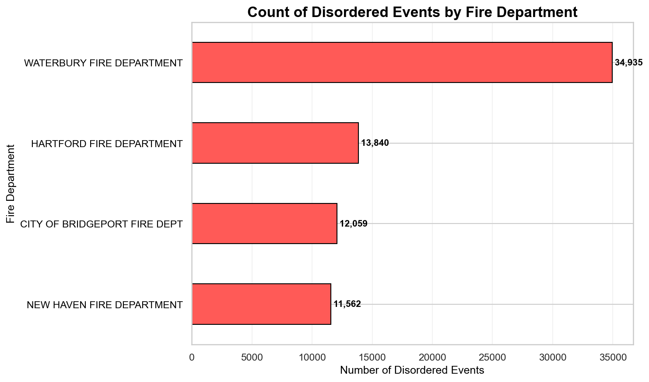
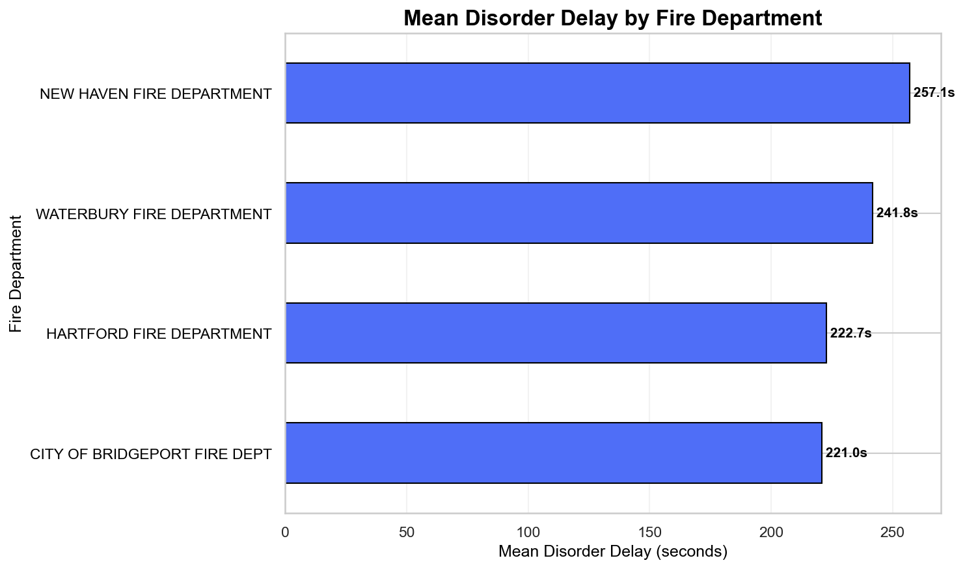
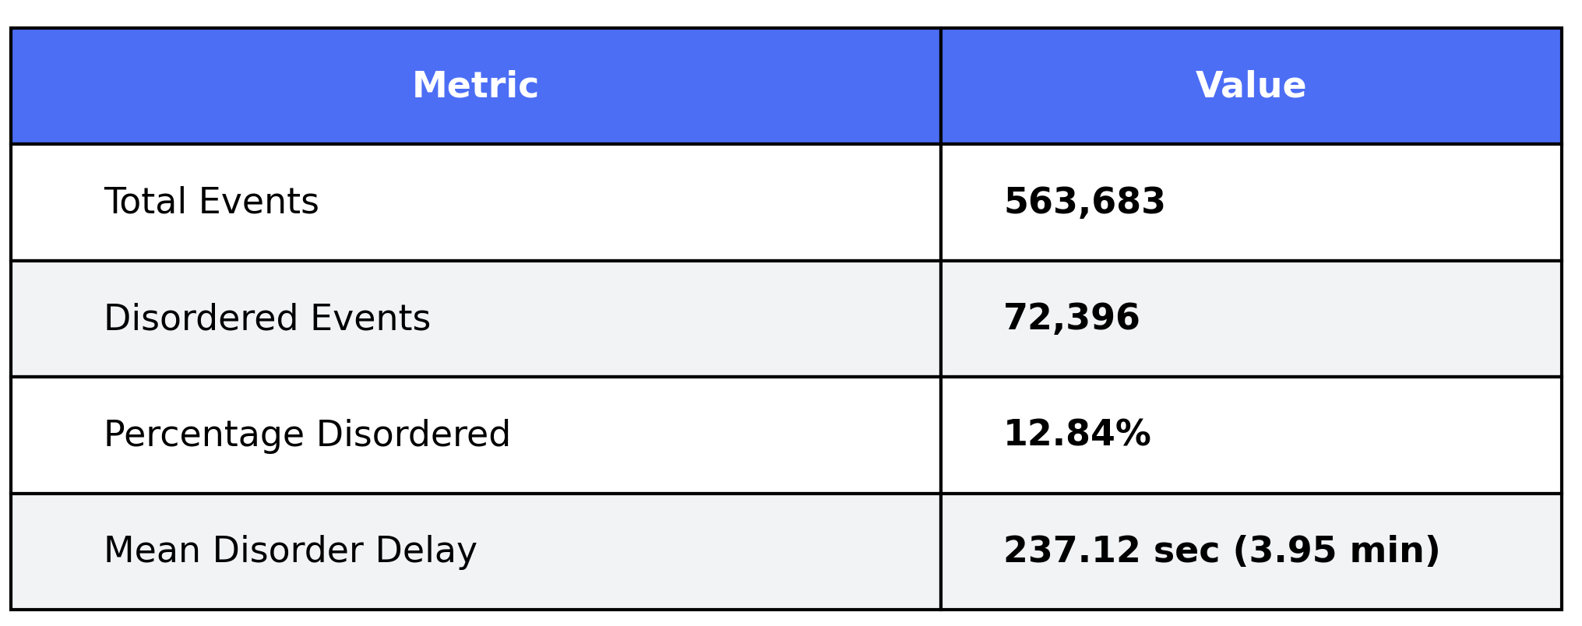
Fires dataset
The dataset contains information about fire department incidents.
Each row includes the:
  Fire_Department_Name, identifying which department reported the event,
  Event_Timestamp
  Arrival_Timestamp
  Additional columns provide context about the incident location, including Incident_Street_Address, Incident_City, and Incident_Zip_Code.
Types of events: 4 fire departments

Slide 22
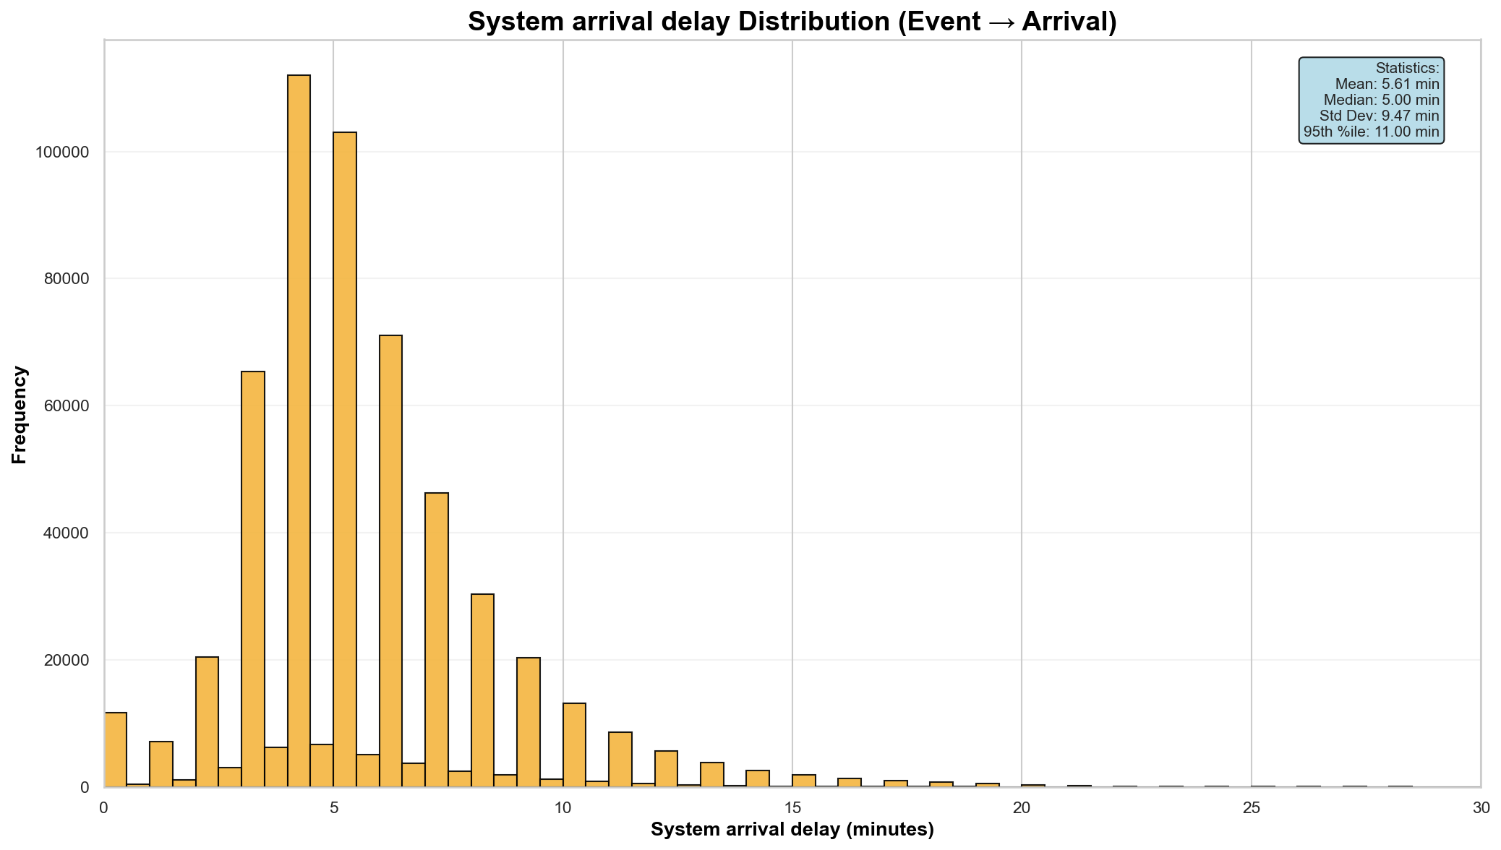
System arrival delay distribution - Fires
The chart shows the distribution of response times (latency) between event occurrence and system arrival.
Most events cluster between 4 and 7 minutes, indicating a typical and stable delay range for the majority of data.
Most responses clustered early with a long tail of slower ones.

Slide 23
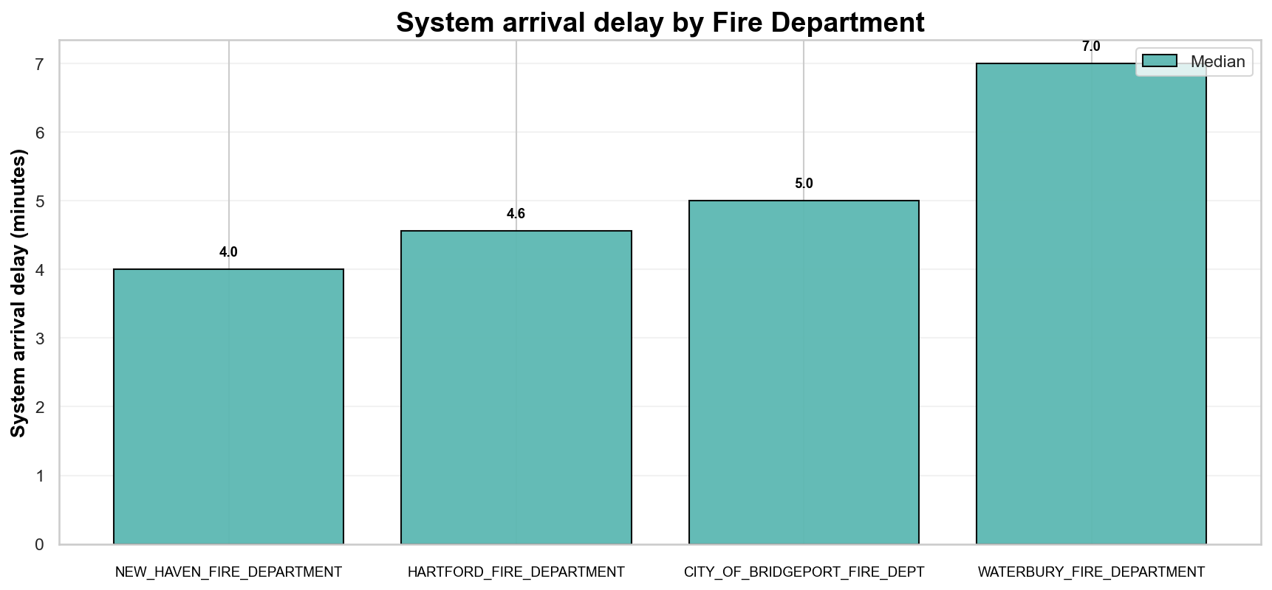
System arrival delay by event type - Fires
This chart compares the system arrival delay across different fire departments using the median.
Waterbury Fire Department exhibits a higher median system arrival delay, suggesting generally slower arrivals, whereas the others are more closely grouped.

Slide 24
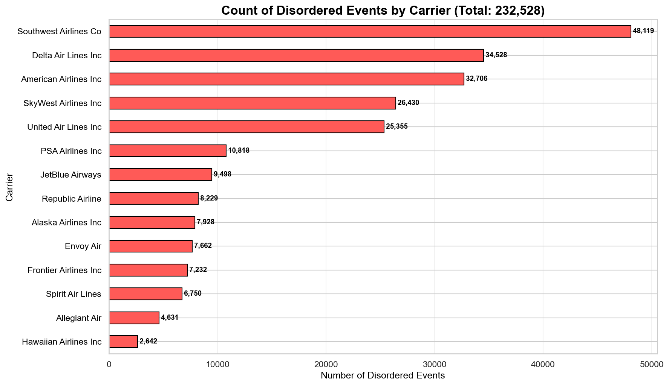
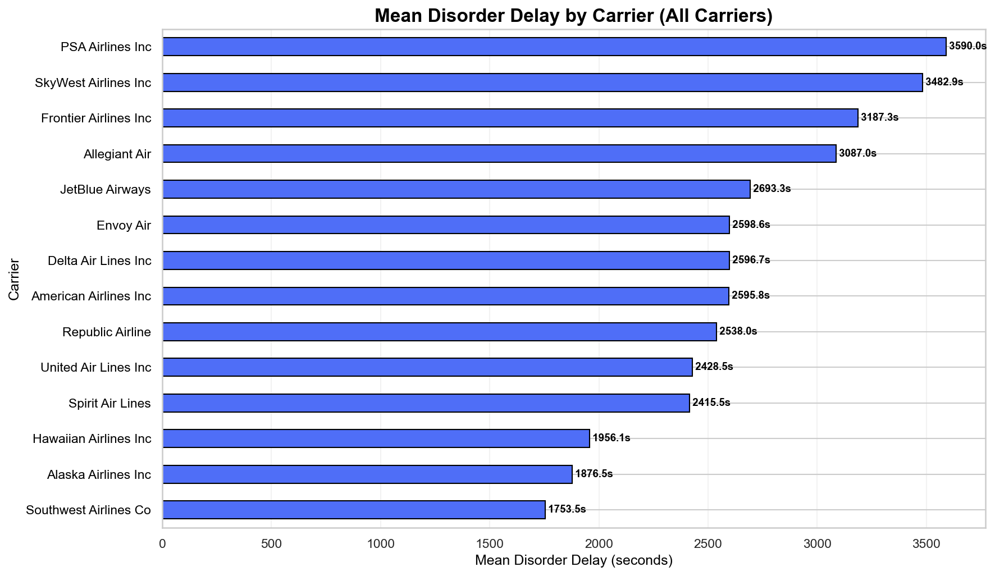
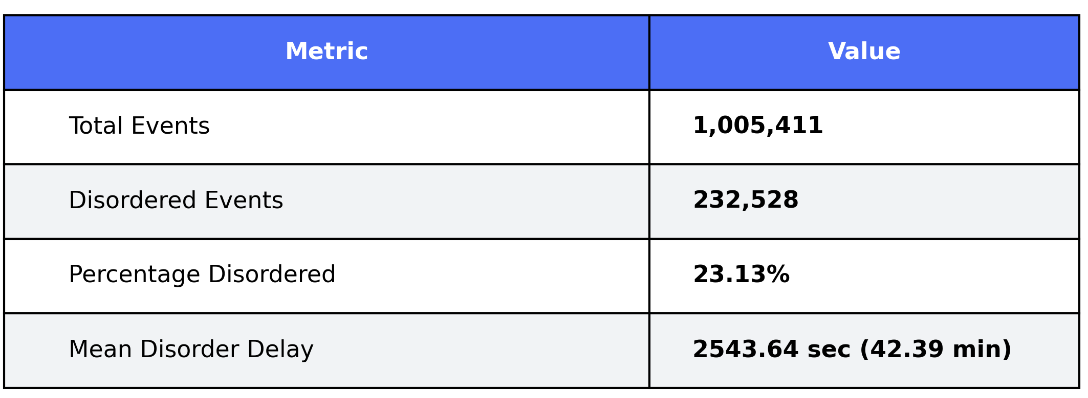
Aviation dataset
The dataset describes commercial flight operations.
Each row includes:
  CARRIER_NAME identifying the airline
  OP_CARRIER_FL_NUM representing the flight number.
  Event_Timestamp
  Arrival_Timestamp
  ORIGIN and DEST airport codes.
  Operational timing is detailed using scheduled and actual arrival times (CRS_ARR_TIME, ARR_TIME) and delay metrics (DEP_DELAY, ARR_DELAY), while CANCELLED indicates whether a flight was cancelled.
  Additional performance data includes planned and actual durations (CRS_ELAPSED_TIME, ACTUAL_ELAPSED_TIME, AIR_TIME) and the total flight DISTANCE.
Types of events: 14 airline carriers

Slide 25
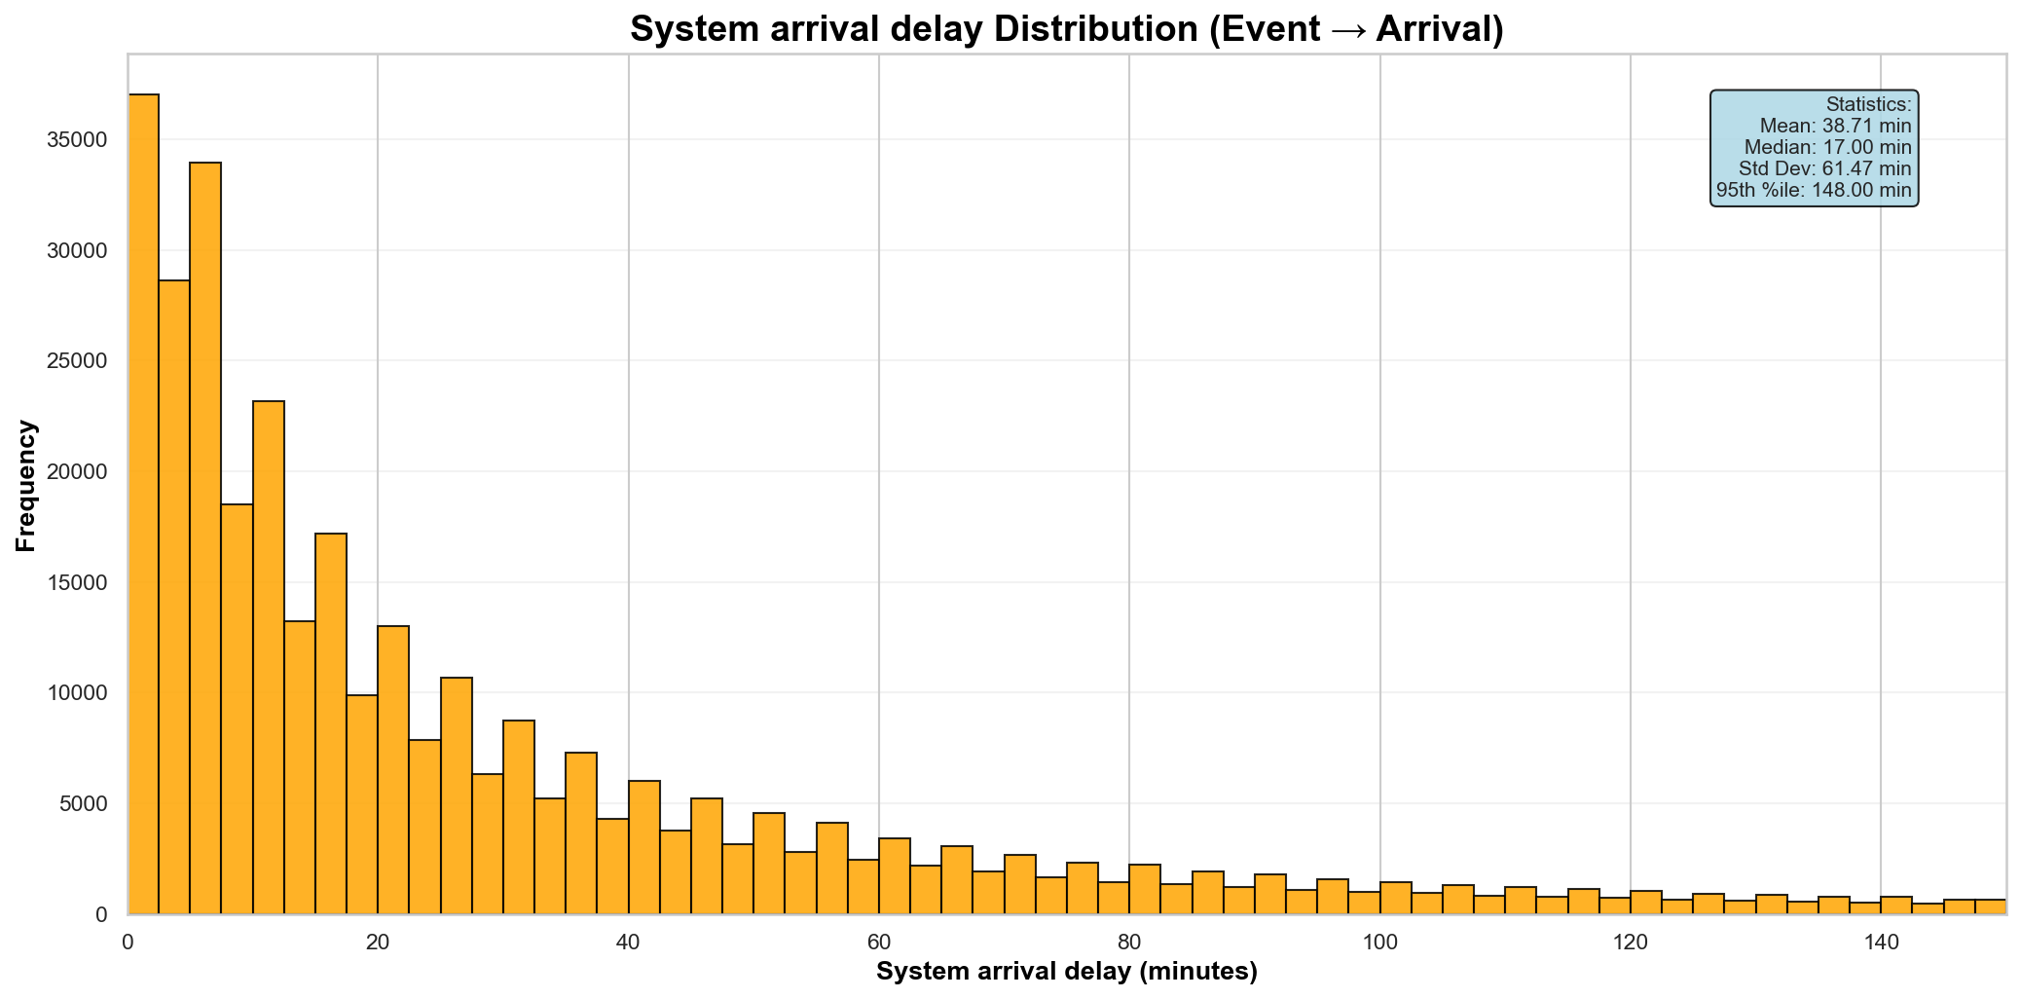
System arrival delay distribution - Aviation
The most system arrival delays concentrated under 30 minutes.
The mean (38.71 min) is much higher than the median (17.00 min), showing the impact of long delays.
95% of responses occur within 148 minutes, but the high standard deviation (61.47 min) indicates wide variability.

Slide 26
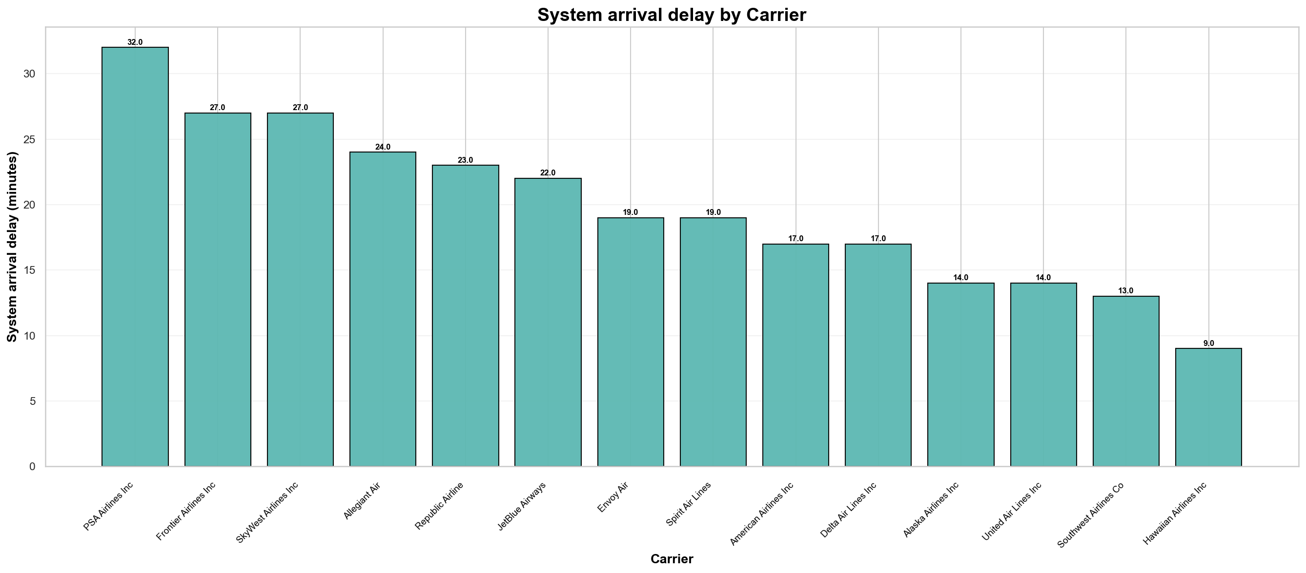
System arrival delay by event type - Aviation
The chart shows clear differences in median system arrival delay by carrier.
A few carriers have slightly faster median system arrival delay, while others are slower but still comparable.

Slide 27
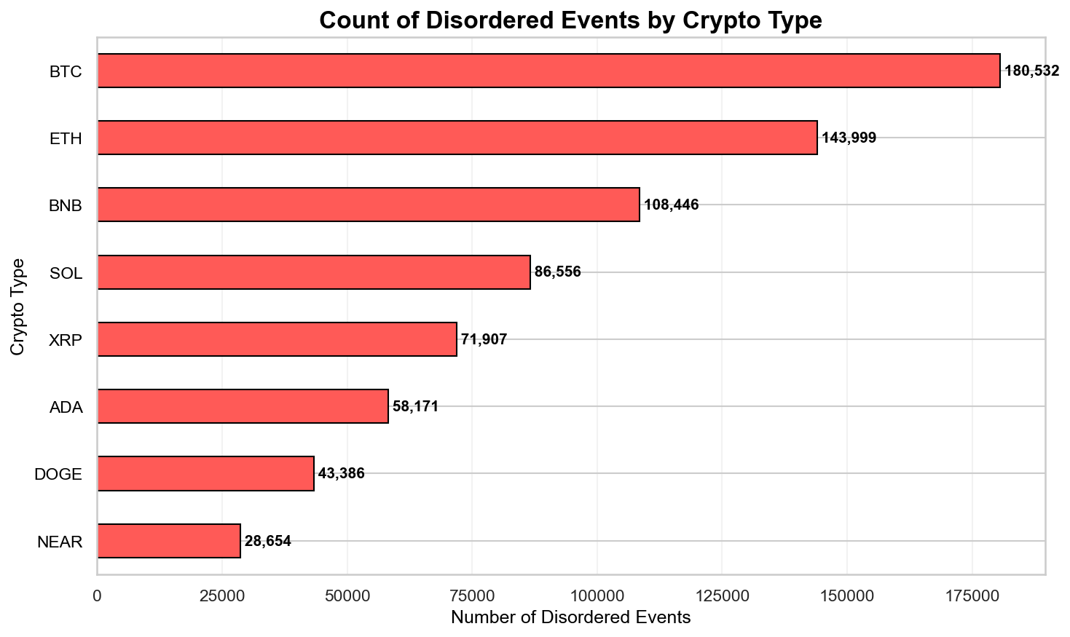
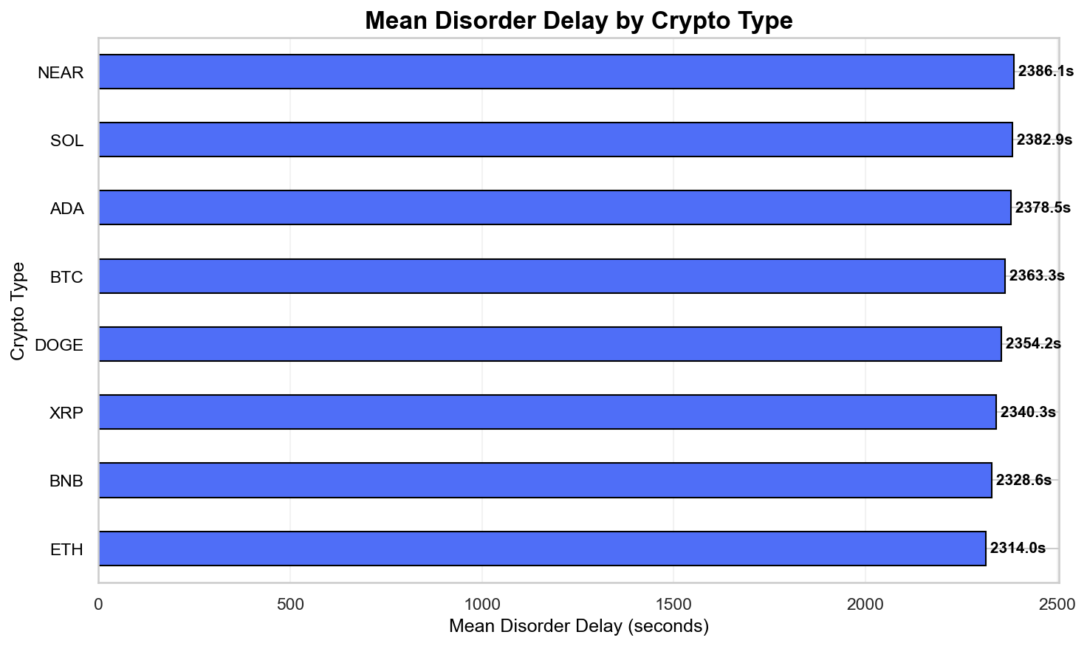
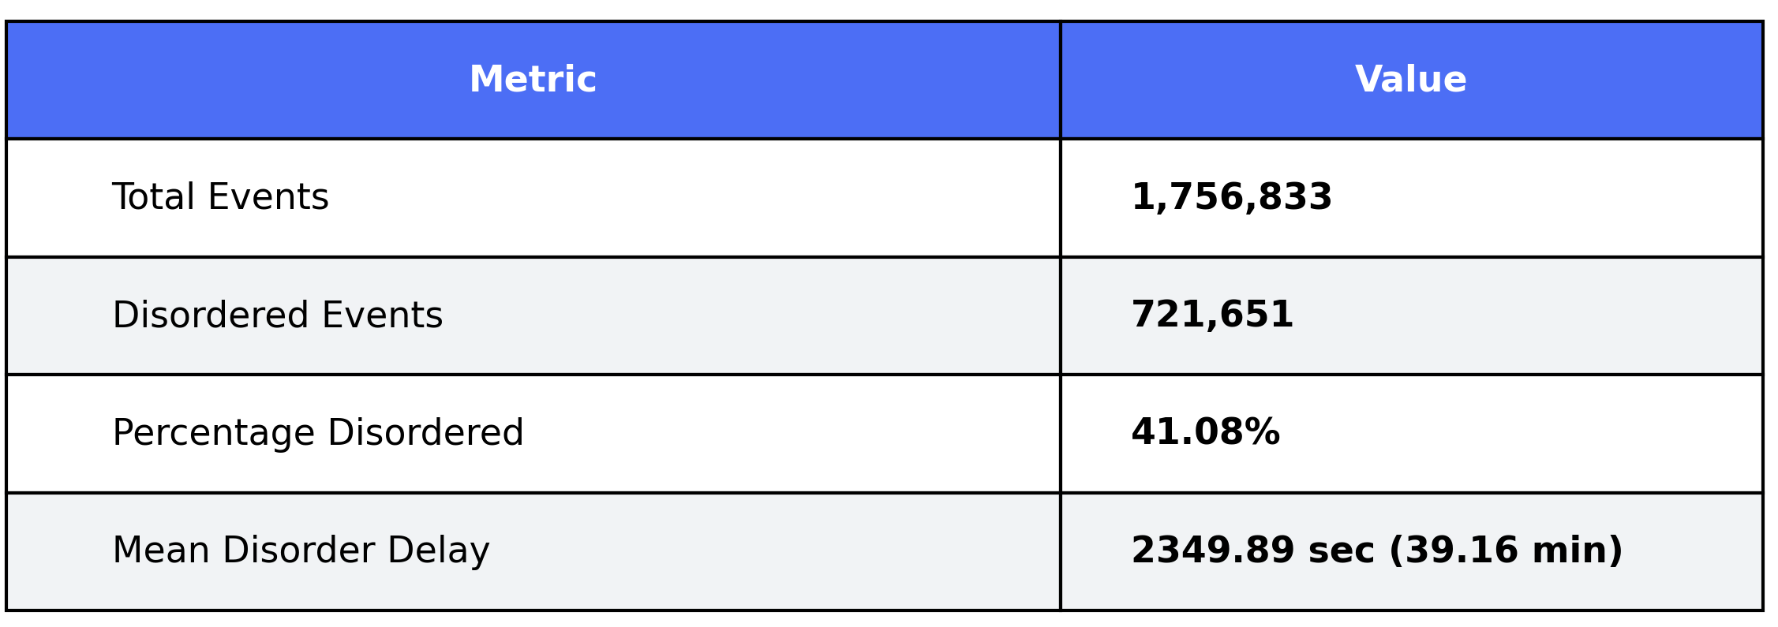
Crypto dataset
The dataset captures cryptocurrency transaction events.
Each row includes:
  Event_type
  Event_Timestamp
  Arrival_Timestamp
  Transaction characteristics are described by TxSize, TxFee, TxIn, and TxOut, representing size, fee, and input/output counts.
  Blockchain progress is reflected through ExitBlock, BlocksToConfirm, and SecSinceLB, indicating confirmation-related metrics.
  Additional timing and ordering information is provided by Offset and CountOnEntryTime,
  Exchange identifies the platform through which the transaction was observed.
Types of events: 8 crypto assets

Slide 28
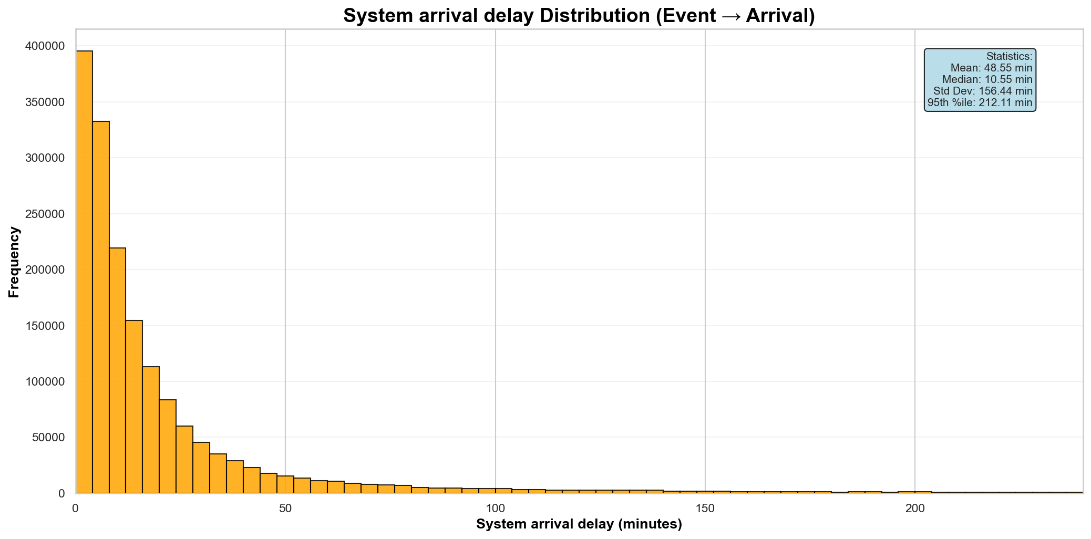
System arrival delay distribution - Crypto
The most system arrival delays happening quickly with a long tail of delays.
The mean (48.55 min) is much higher than the median (10.55 min), showing that long delays inflate the average.
A very high standard deviation (156.44 min) shows extreme variability and the presence of significant outliers.

Slide 29
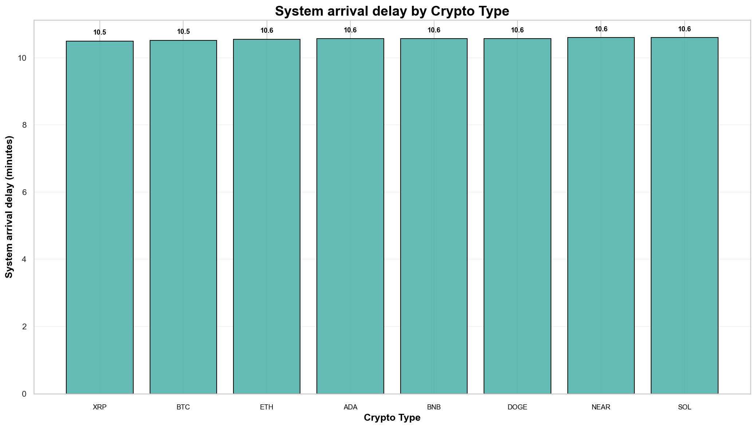
System arrival delay by event type - Crypto
The chart shows that median system arrival delays are very similar across all crypto types, with only minor differences between assets.

Slide 30
Experiments Overview
For each dataset, three experiments were conducted to evaluate query performance under increasing complexity. Each experiment used a different query pattern:
Experiment 1 – Simple Query
  - Retrieves events and their timestamps only
  - No partitions or filters applied
  - Serves as the baseline performance
Experiment 2 – Partitioned Query
  - Uses PARTITION BY to group events
  - Introduces moderate query complexity
  - Measures impact of partitioning on response time
Experiment 3 – Partitioned & Filtered Query
  - Combines PARTITION BY with filtering conditions
  - Represents the most complex query
  - Evaluates performance under realistic analytical workloads
This progression allows comparison of performance impact as query complexity increases.

Slide 31
Crypto dataset – Median Complexity
Query:
SELECT * FROM S
WHERE (BNB as bnb; DOGE as doge; NEAR as near)
PARTITION BY [Exchange]
WITHIN 10 [Event_Timestamp]
CONSUME BY ANY
Identify patterns for BNB, DOGE, and NEAR by grouping exchanges within a 10-unit window
Quarantine times to test (sec):
1, 2, 4, 8, 16, 32, 64, 128, 256, 512, 1.024, 2.048, 4.096, 8.192, 16.384

Slide 32
Comparison of New Dynamic Quarantine Policies
The following graphs compare the six new dynamic quarantine policies: AVG, p99-EMA, MAX-EMA, MAX, Jump-and-Decay, and Per-Event.
Each policy is evaluated across five metrics, in the following order:
  Drop rate
  Number of detected complex events
  Execution time
  Detection delay
  Comparison with ideal results

Slide 33
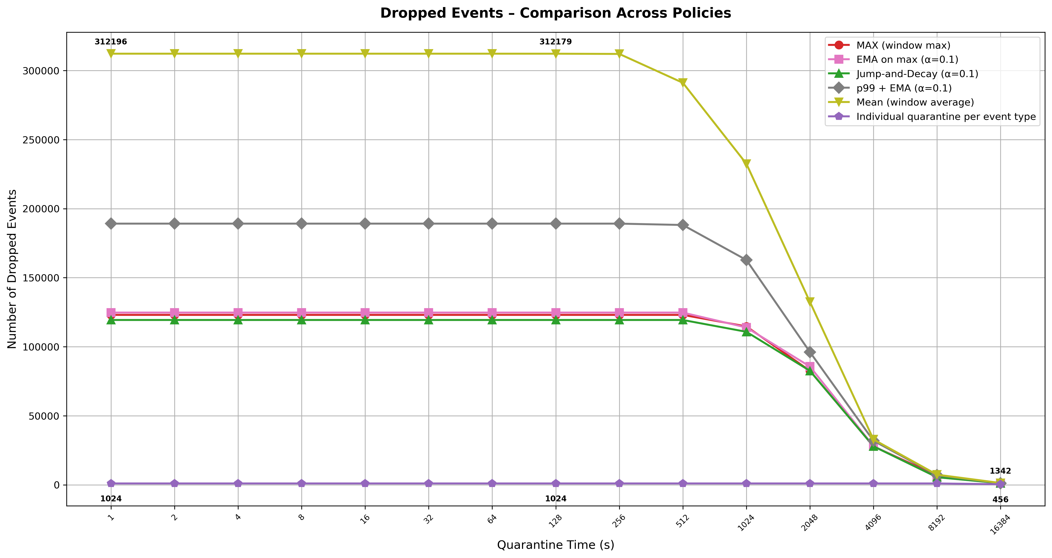
Dynamic Policies Comparison - Drops
This graph compares how different solutions handle dropped events as quarantine time increases.
The Per-Event policy consistently outperforms all others, maintaining a minimal drop count that starts at 1,024 events and reduces to the lowest value of 456.
All other policies show higher drop rates that remain relatively stable, only beginning to decrease significantly when quarantine times exceed 512 seconds

Slide 34
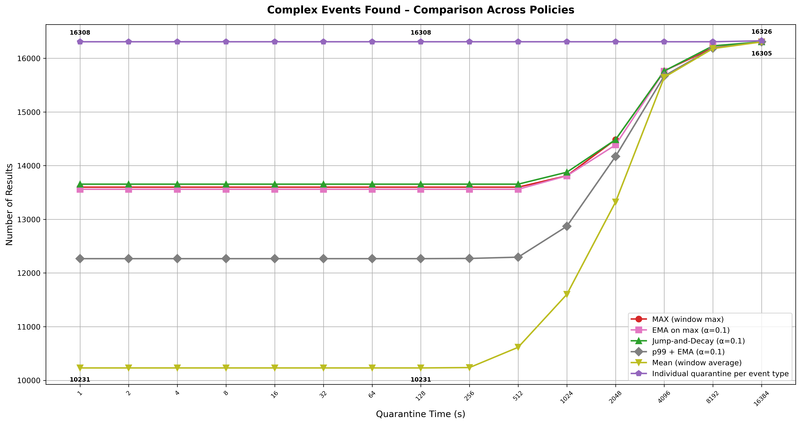
Dynamic Policies Comparison - Results
This graph compares how many complex events each solution detects as quarantine time increases.
Per-Event consistently finds the most events, starting at 16,308 and rising slightly to 16,326.
The other quarantines stay stable early on and begin to improve after 512 seconds but never surpass Per-Event.
The graph shows that Per-Event is the most effective across all solutions, while AVG benefits the most from longer quarantine.

Slide 35
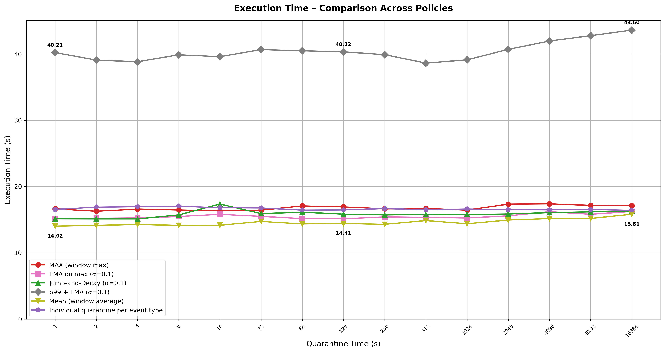
Dynamic Policies Comparison – Execution Time
This graph compares how execution time affects each quarantine policy.
The p99-EMA policy has the worst execution time, taking over 40 seconds to run because it must constantly recalculate percentiles.
Per-Event policy is highly optimized, running in just ~14 seconds.

Slide 36
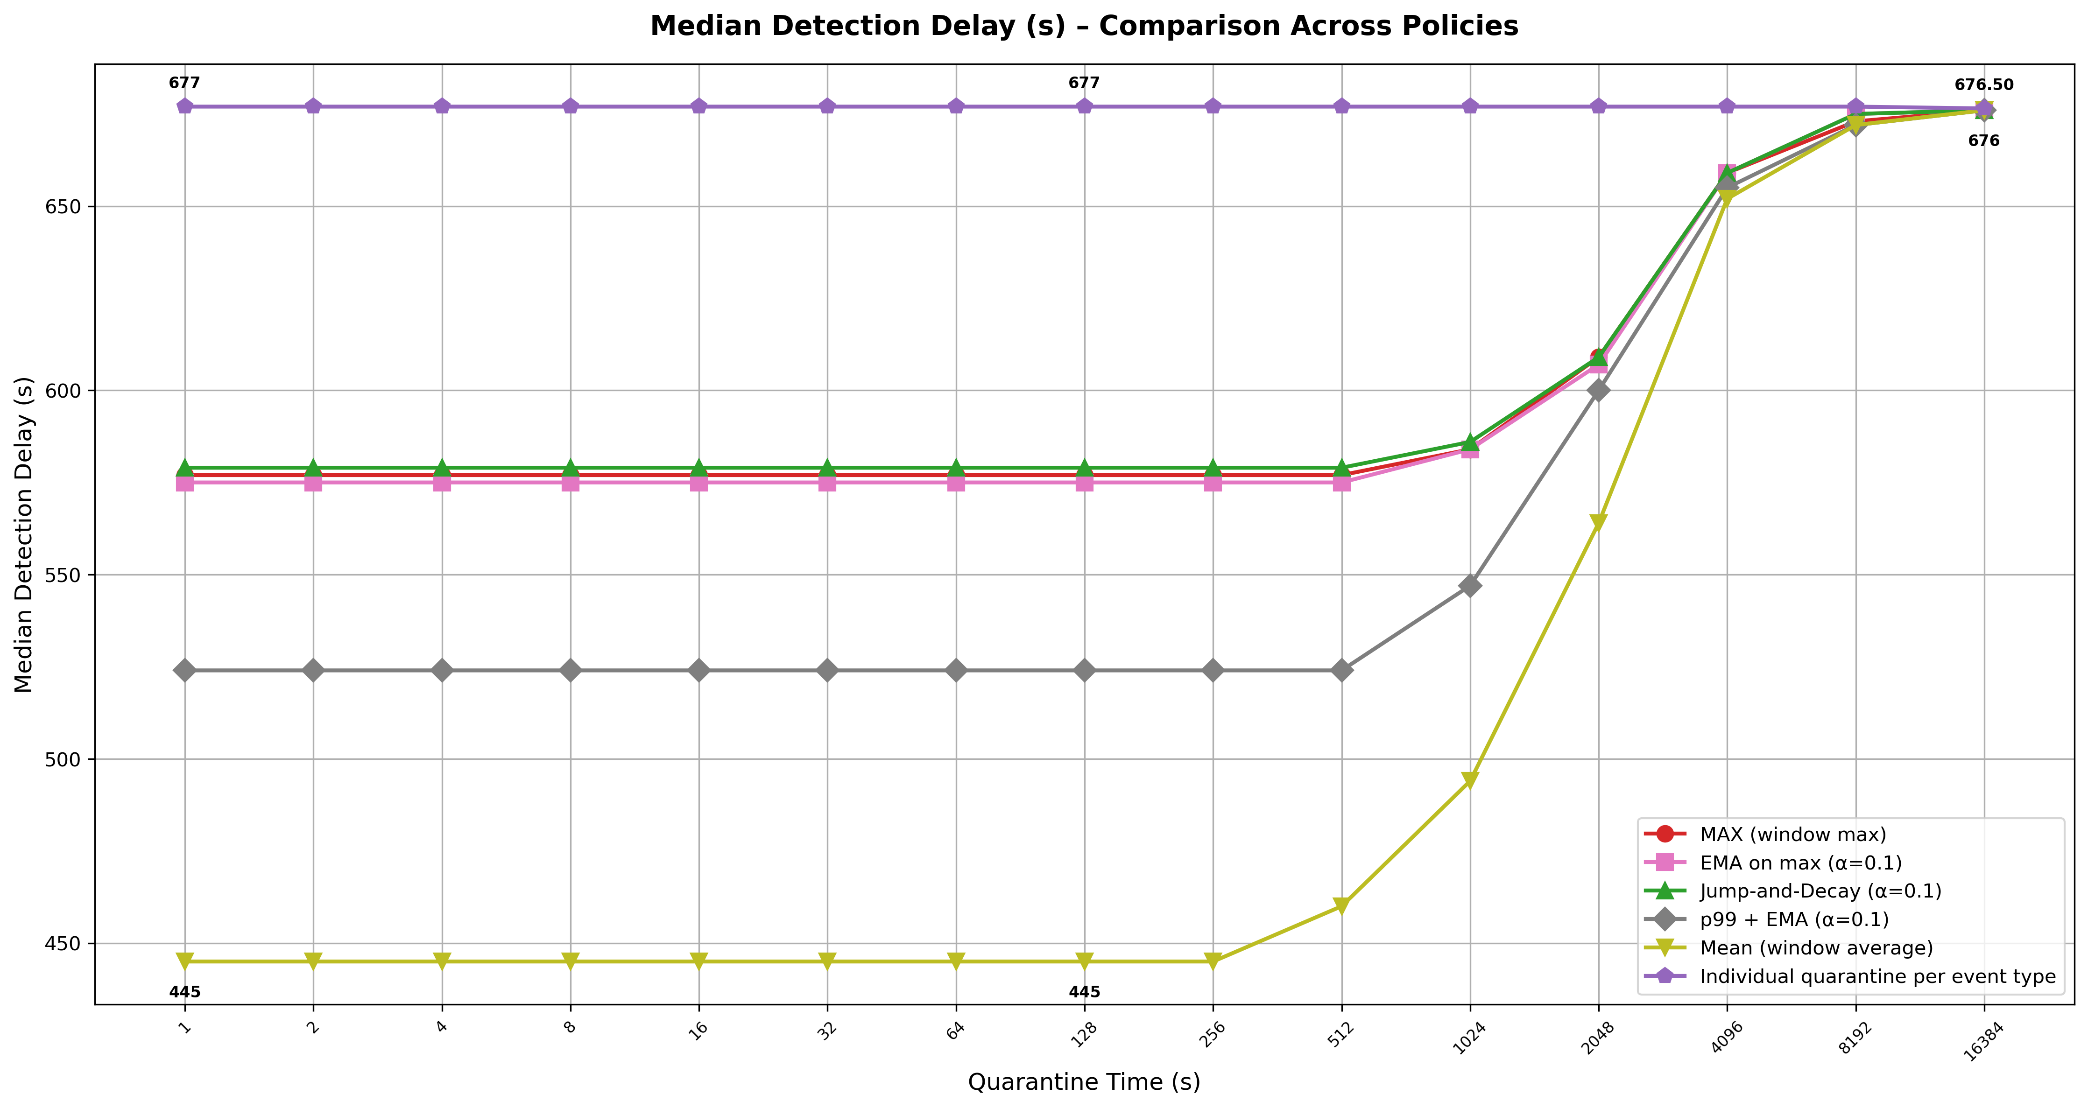
Dynamic Policies Comparison – Median Detection Delay
This chart compares how median detection delay changes with quarantine time across the different implementations.
Per-Event has the highest and most stable detection delay, slightly increasing at the longest quarantine time.
The other methods stay low for small quarantine times, but their delays also increase significantly after 1024 seconds.
The chart shows that while AVG is fastest at first, Per-Event and others become more consistent over time, with longer quarantine leading to higher detection delays but with more results and less drops.

Slide 37
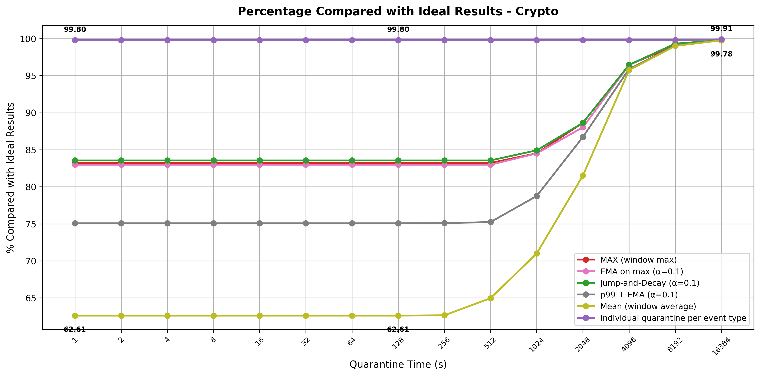
Dynamic Policies Comparison With Ideal Results
This chart compares how each quarantine policy approaches the ideal results if the steam was ordered with no late events as the quarantine time increases.
The Individual Per‑Event policy consistently stays near 100%, showing almost perfect accuracy across all time scales.
The other policies start lower and gradually improve, with some converging only at larger quarantine times.

Slide 38
Top Dynamic Policies vs. Baseline Policies
The remaining graphs compare the top three performing dynamic policies (MAX, Jump-and-Decay, Per-Event) against Direct and Fixed-Time quarantine policies .
The comparison follows the same evaluation order:
  Drop rate
  Number of detected complex events
  Execution time
  Detection delay
  Comparison with ideal results
  Quarantine Size in MB

Slide 39
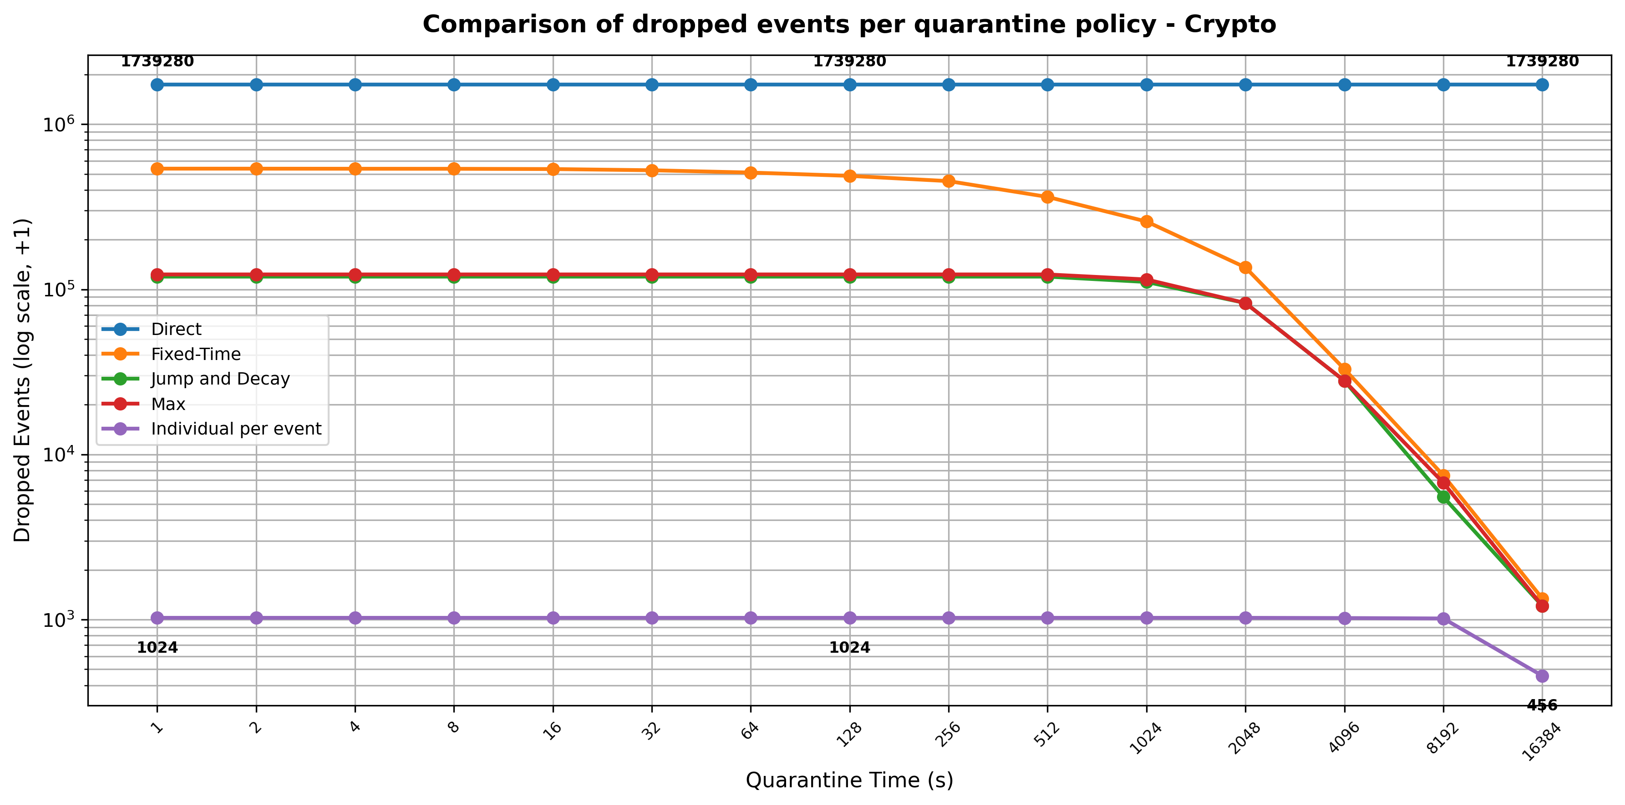
Comparison of Dropped Events by Quarantine Policy (Log Scale)
This chart shows how different policies perform in reducing dropped events in the crypto dataset as quarantine time increases.
Direct performs worst, consistently dropping over 1.7 million events.
Per-Event is the most efficient, starting at just 1025 dropped events and improving to 457 at the longest quarantine time.
Fixed-Time, Jump/Decay, and MAX all show steady improvement, starting higher and converging toward lower values as quarantine time grows.
Overall, the chart highlights that longer quarantine times help all methods reduce dropped events, but Per-Event stands out as the most effective throughout.

Slide 40
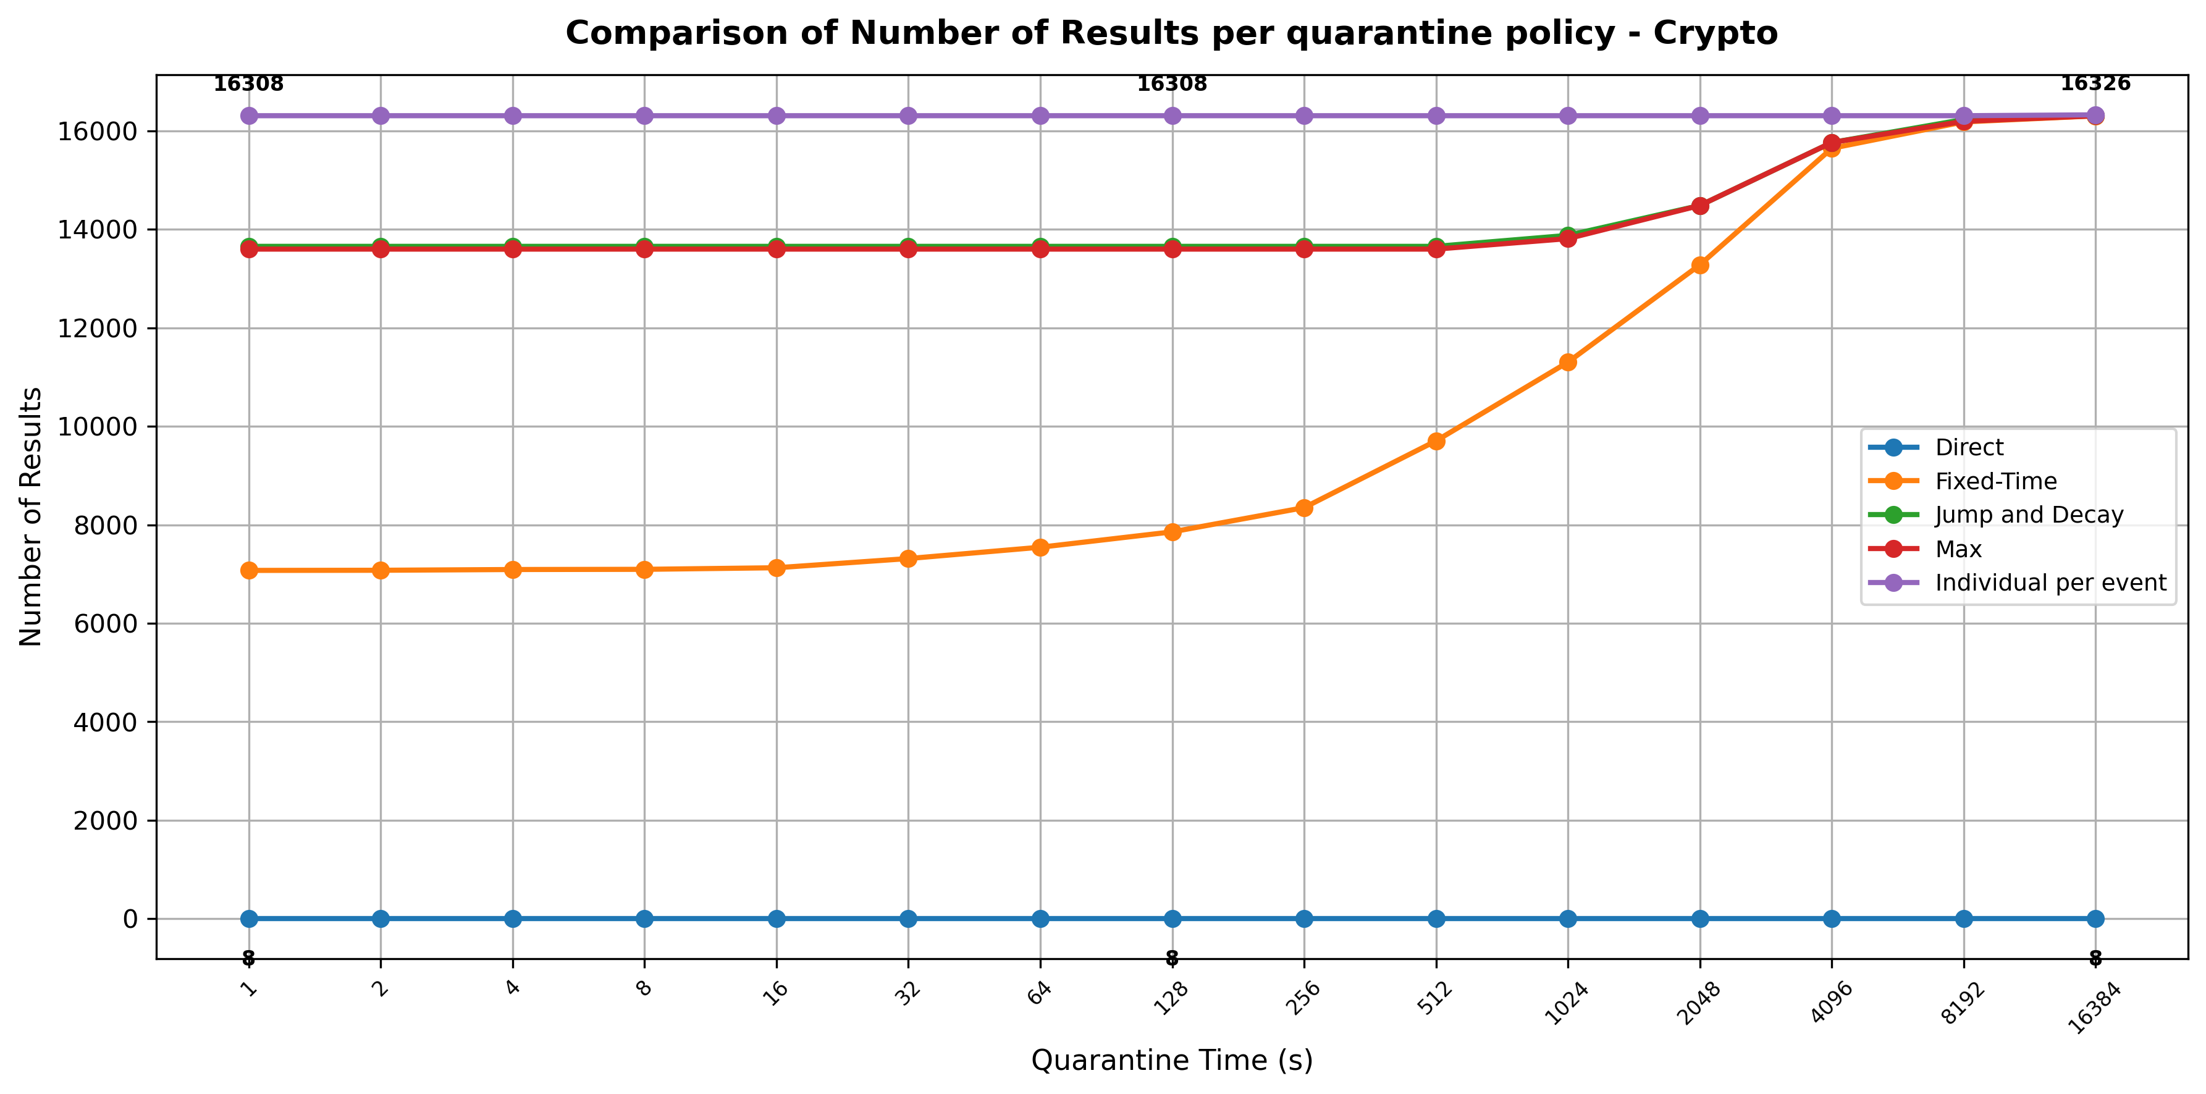
Comparison of the number of results by Quarantine Policy
This graph shows how different quarantine policies perform in terms of the number of results as quarantine time increases.
Direct stays at a low result count, showing no benefit from longer quarantine.
Fixed-Time starts around 7000 results and steadily improves.
Jump/Decay and MAX begin higher and gradually converge with Fixed-Time.
Per-Event consistently delivers the best performance, starting at 16,308 and slightly increasing to 16,326 at the longest quarantine time.
Overall, Per-Event is the most effective, while other policies benefit from longer quarantine but never surpass it.

Slide 41
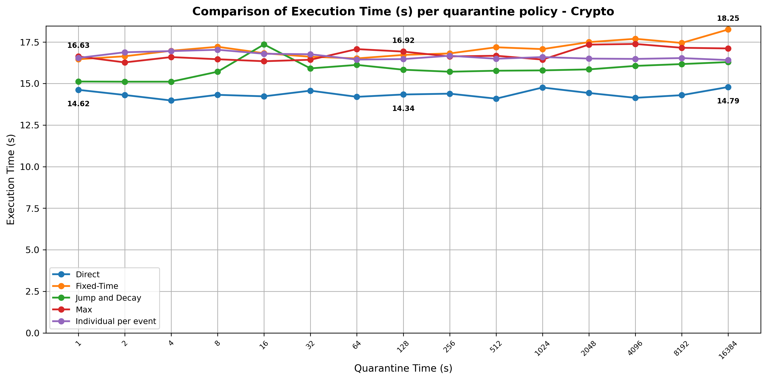
Comparison of Execution time by Quarantine Policy
This graph shows how different policies perform in terms of execution time as quarantine time increases.
All policies have nearly identical execution times, showing that the additional logic of the Per-Event policy has little impact on execution time.
Despite the similar runtime, Per-Event achieves significantly fewer dropped events making it the most efficient solution overall.

Slide 42
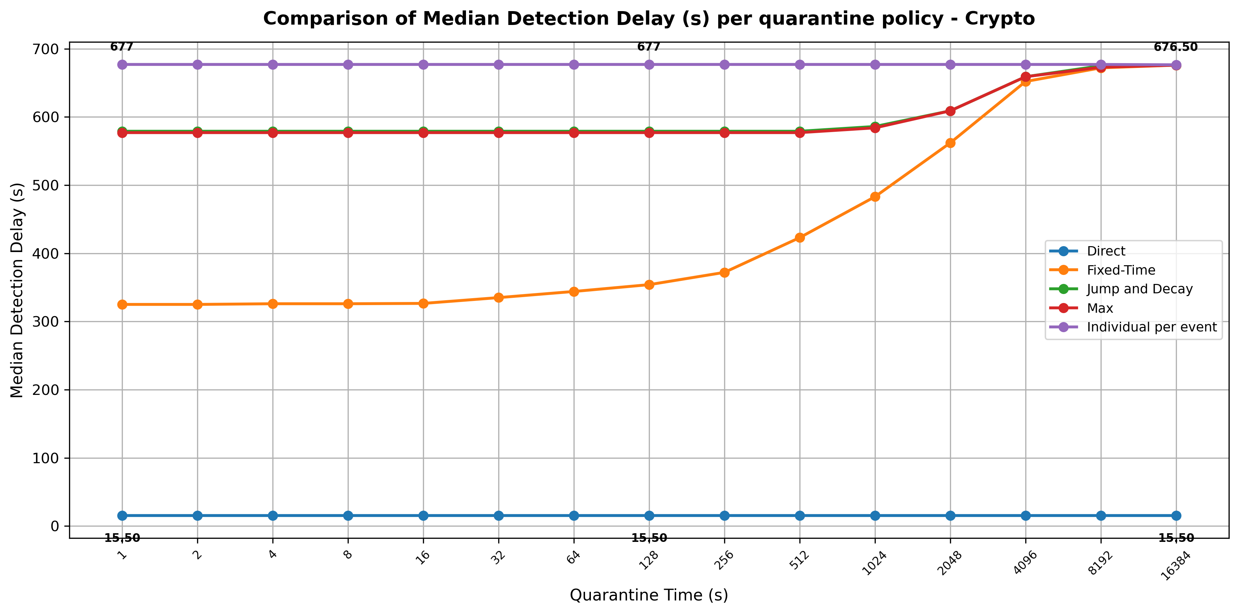
Comparison of Median Detection Delay by Quarantine Policy
This graph compares how detection delay evolves as quarantine time grows.
Direct has a very low median detection delay, because it releases events immediately, without using quarantine.
The Per‑Event policy maintains the highest and most stable delay.
The other policies start lower and only increase significantly when the quarantine window becomes very large.
The chart highlights a trade-off: Direct is fastest but yields fewer results, while Per-Event and other quarantines offer more results at the cost of longer delays.

Slide 43
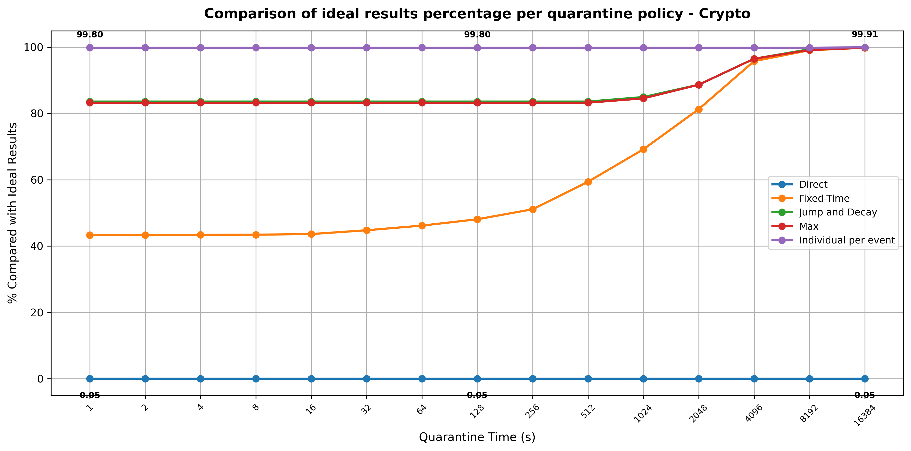
Comparison of Ideal Results Percentage per Quarantine Policy
This chart compares how each quarantine policy approaches the ideal results if the steam was ordered with no late events as the quarantine time increases.
Direct remains near 0% of ideal results, showing that without holding events in quarantine, it cannot approach the accuracy of the other policies.
The Per‑Event policy stays near perfect accuracy across all quarantine time.
The other policies begin at lower performance levels and only approach ideal results when the quarantine window becomes sufficiently large.

Slide 44
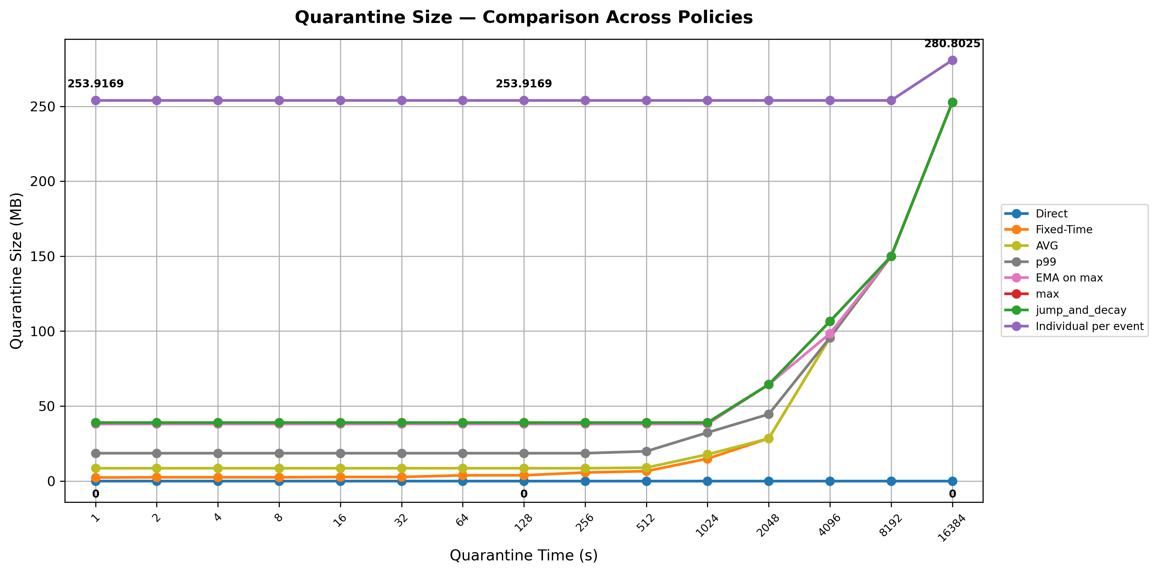
Comparison of Quarantine Size in MB across All Policies
This graph shows how quarantine memory usage changes with longer quarantine windows in MB.
Direct has no quarantine, so it always holds zero events regardless of the window size.
The Per‑Event policy consistently has stable quarantine size across all quarantine times, holding a consistently large buffer in MB.
The other policies gradually consume more memory, with some rising at high quarantine times.

Slide 45
Overall Conclusion
Across all datasets and all experiments, the results point to a clear and consistent conclusion:
Dynamic quarantine policies, especially the Per‑Event, offer the best balance between correctness, efficiency, and stability.
While simpler approaches like Direct and Fixed‑Time lose large amounts of data, the dynamic policies adapt naturally to the disorder characteristics of each dataset.
Per‑Event stands out as the most robust strategy. It minimizes dropped events, maintains maximum complex events even at very small quarantine windows and does not add any computational overhead.

Slide 46
Thank you for your attention!
Any questions?
We also learn something valuable:
“If you have time to complain, you have time to do something about it”

