Slide 1
第二讲 深度前馈神经网络
1

Slide 2
目录
感知机
前馈神经网络与反向传播算法
反向传播算法分析
过度拟合与正则化
深度神经网络的优化与扩展
2

Slide 3
感知机
前馈网络与递归网络结构及数学模型
How to mimic some intelligent behaviors?
Perceptron: Data Classification
An Intuitive Example
3

Slide 4
Neural Network Structures
A Neural Network＝Neurons＋Connection
Connection
Neuron
Neuron
神经网络分类:
前馈神经网络（Feed forward NNs）：没有后向反馈连接
递归神经网络（Recurrent NNs）：有后向反馈连接
4

Slide 5
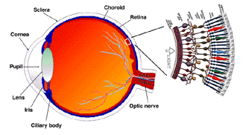
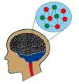
Neural Networks
Feed forward NNs (FNNs):
No feedback connection
Recurrent NNs (RNNs)：
have feedback connection
5

Slide 6
Neural Networks
Feed forward NNs
Recurrent NNs
6

Slide 7
Feed Forward NNs
7

Slide 8
Math Model of FNNs
8
Notes:
单个神经元的工作原理，生物神经元的功能，以及biologically-inspired computation

Slide 9
Math Model of FNNs
9
Notes:
通常采用3层NNS：输入层-隐层-输出层。非线性问题，隐层采用非线性函数

Slide 10
Math Model of FNNs
10
Notes:
感知机：单层NNS

Slide 11
Three Steps for Neural Network
Step 1: define a set of function
Step 2: goodness of function
Step 3: pick the best function
Neural
Network
Notes:
http://www.twword.com/wiki/%E8%85%A6%E6%88%B6%E7%A9%B4
http://ukenglish.pixnet.net/blog/post/105691160-%E3%80%90%E5%8F%B0%E5%8D%97%E5%B8%82%E5%AD%B8%E8%8B%B1%E8%AA%9E%EF%BC%8C%E5%84%AA%E9%85%B7%E8%8B%B1%E8%AA%9E%E6%96%87%E7%90%86%E5%85%AC%E5%91%8A%E3%80%91%E6%9C%AC%E4%B8%AD%E5%BF%83
http://onepiece1234567890.blogspot.tw/2013/12/blog-post_8.html

Slide 12
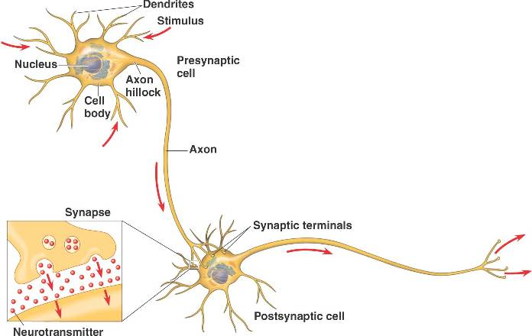
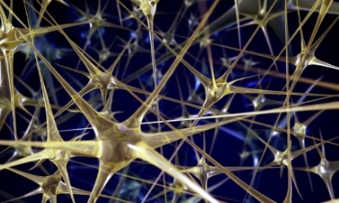
Neural Network
“Neuron”
Neural Network
Different connection leads to different network structures
Network parameter $θ$: all the weights and biases in the “neurons”
Notes:
瞬間潮了起來

Slide 13
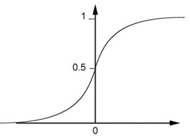
Fully Connect Feedforward Network
1
4
0.98
1
-2
1
-1
-2
0.12
-1
1
0
Sigmoid Function
Notes:
Ignore +

Slide 14
Fully Connect Feedforward Network
1
4
0.98
2
0.86
3
0.62
1
-2
-1
-1
1
0
-2
-1
-2
0.12
-2
0.11
-1
0.83
-1
1
-1
4
0
0
2

Slide 15
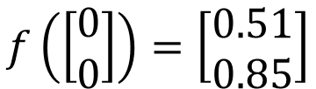
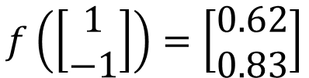
Fully Connect Feedforward Network
1
0.73
2
0.72
3
0.51
0
-2
-1
-1
1
0
-2
-1
0.5
-2
0.12
-1
0.85
0
1
-1
4
0
0
2
This is a function.
$$f\left(\left[\begin{matrix}1 \\ −1\end{matrix}\right]\right)=\left[\begin{matrix}0.62 \\ 0.83\end{matrix}\right]$$
$$f\left(\left[\begin{matrix}0 \\ 0\end{matrix}\right]\right)=\left[\begin{matrix}0.51 \\ 0.85\end{matrix}\right]$$
Input vector, output vector
Given network structure, define a function set
Notes:
For example, if we modify “1” to “2”, then we have another function

Slide 16
Fully Connect Feedforward Network
neuron
Input
Layer 1
Layer 2
Layer L
Output
……
y₁
……
y₂
……
……
……
……
……
……
y_{M}
Input Layer
Output Layer
Hidden Layers
Notes:
You can connect the neurons by other ways you like ☺
How many layer is deep?
CNN just another way to connect the neuros.
You can always connect the neurons in your own way.
“+” is ignored
Each dimension corresponds to a digit (10 dimension is needed)

Slide 17
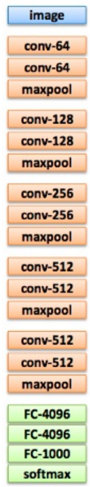
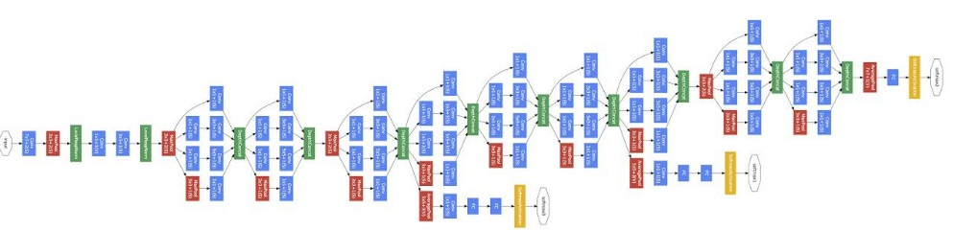
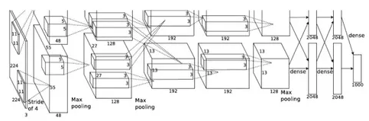
Deep = Many hidden layers
22 layers
http://cs231n.stanford.edu/slides/winter1516_lecture8.pdf
19 layers
8 layers
6.7%
7.3%
16.4%
AlexNet (2012)
VGG (2014)
GoogleNet (2014)

Slide 18
Deep = Many hidden layers
152 layers
Special
structure
Ref: https://www.youtube.com/watch?v=dxB6299gpvI
3.57%
7.3%
6.7%
16.4%
AlexNet (2012)
VGG
(2014)
GoogleNet
(2014)
Residual Net
(2015)
Notes:
169層

Slide 19
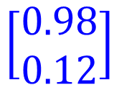


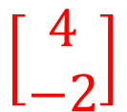

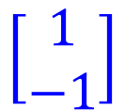

Matrix Operation
1
4
0.98
1
-2
1
-1
-2
0.12
-1
1
0
$$\left[\begin{matrix}1 & −2 \\ −1 & 1\end{matrix}\right]$$
$$\left[\begin{matrix}1 \\ −1\end{matrix}\right]$$
$$\left[\begin{matrix}1 \\ 0\end{matrix}\right]$$
$$=$$
$$\left[\begin{matrix}0.98 \\ 0.12\end{matrix}\right]$$
$$σ\left( \right)$$
$$+$$
$$\left[\begin{matrix}4 \\ −2\end{matrix}\right]$$
Notes:
Make sure you know how to do it
author: Adam Coates, Baidu, Inc.
Deep Learning (hopefully faster)
http://videolectures.net/deeplearning2015_coates_deep_learning/

Slide 20



Neural Network
……
y₁
W¹
W²
W^{L}
……
y₂
b¹
b²
b^{L}
……
……
……
……
……
x
a¹
a²
y
……
y_{M}
W¹
x
b¹
+
$$σ\left( \right)$$
a¹
b²
W²
+
$$σ\left( \right)$$
W^{L}
b^{L}
a^{L-1}
+
$$σ\left( \right)$$
Notes:
Draw it?

Slide 21


Neural Network
……
y₁
W¹
W²
W^{L}
……
y₂
b¹
b²
b^{L}
……
……
……
……
……
x
a¹
a²
y
……
y_{M}
y
x
Using parallel computing techniques to speed up matrix operation
$$=f\left( \right)$$
W^{L}
…
W²
W¹
x
b¹
b²
…
b^{L}
+
+
+
$$σ\left( \right)$$
$$=σ\left( \right)$$
$$σ\left( \right)$$
Notes:
Draw it?

Slide 22
Output Layer as Multi-Class Classifier
Feature extractor replacing feature engineering
……
y₁
……
y₂
Softmax
……
……
……
……
……
……
y_{M}
Input Layer
Output Layer
= Multi-class Classifier
Hidden Layers

Slide 23
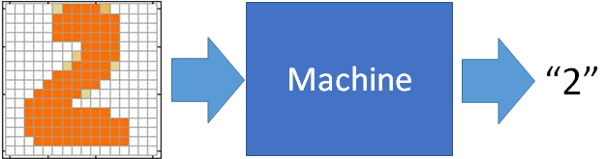
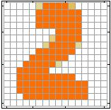
Example Application
Input
Output
y₁
is 1
0.1
y₂
is 2
0.7
The image is “2”
……
……
……
y₁₀
0.2
is 0
16 x 16 = 256
Ink → 1
No ink → 0
Each dimension represents the confidence of a digit.
Notes:
The same for even more complex tasks.

Slide 24
Example Application
Handwriting Digit Recognition
y₁
is 1
Machine
y₂
is 2
Neural
Network
“2”
……
……
……
y₁₀
is 0
What is needed is a function ……
Input:
256-dim vector
output:
10-dim vector
Notes:
The same approach for other cases

Slide 25
Example Application
Input
Layer 1
Layer 2
Layer L
Output
……
y₁
is 1
……
A function set containing the candidates for
Handwriting Digit Recognition
y₂
is 2
“2”
……
……
……
……
……
……
……
y₁₀
is 0
Input Layer
Output Layer
Hidden Layers
You need to decide the network structure to let a good function in your function set.
Notes:
CNN just another way to connect the neuros.
You can always connect the neurons in your own way.
“+” is ignored
Each dimension corresponds to a digit (10 dimension is needed)

Slide 26
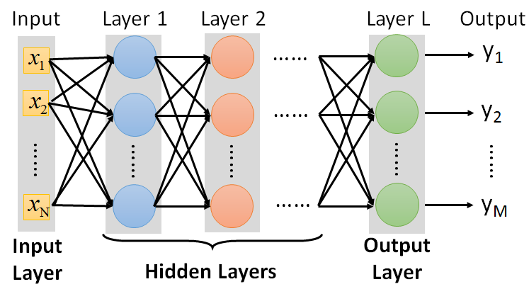
FAQ
Q: How many layers? How many neurons for each layer?
Q: Can the structure be automatically determined?
E.g. Evolutionary Artificial Neural Networks
Q: Can we design the network structure?
Trial and Error
+
Intuition
Convolutional Neural Network (CNN)

Slide 27
Three Steps for Deep Learning
Step 1: define a set of function
Step 2: goodness of function
Step 3: pick the best function
Neural
Network
Notes:
http://www.twword.com/wiki/%E8%85%A6%E6%88%B6%E7%A9%B4
http://ukenglish.pixnet.net/blog/post/105691160-%E3%80%90%E5%8F%B0%E5%8D%97%E5%B8%82%E5%AD%B8%E8%8B%B1%E8%AA%9E%EF%BC%8C%E5%84%AA%E9%85%B7%E8%8B%B1%E8%AA%9E%E6%96%87%E7%90%86%E5%85%AC%E5%91%8A%E3%80%91%E6%9C%AC%E4%B8%AD%E5%BF%83
http://onepiece1234567890.blogspot.tw/2013/12/blog-post_8.html

Slide 28




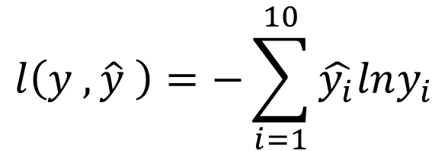


Loss for an Example
target
“1”
……
y₁
$${\hat{y}}_{1}$$
1
……
0
Given a set of parameters
y₂
$${\hat{y}}_{2}$$
Softmax
……
……
……
……
Cross
Entropy
……
……
……
y₁₀
0
$${\hat{y}}_{10}$$
$$y$$
$$\hat{y}$$
$$l\left(y ,\hat{y} \right)=−\sum_{i=1}^{10}{\hat{y_{i}}lny_{i}}$$
Notes:
https://www.youtube.com/watch?v=XWTfgehRxzU
You can never tind this in the textbook!
With softmax, the summation of all the ouputs would be one.
Can be considered as probability if you want ……

Slide 29





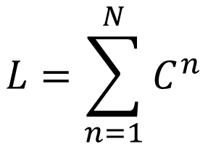
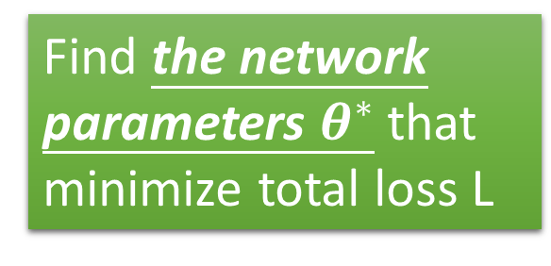







Total Loss
Total Loss:
$$L=\sum_{n=1}^{N}{l^{n}}$$
For all training data …
x¹
NN
y¹
$${\hat{y}}^{1}$$
$$l^{1}$$
NN
Find a function in function set that minimizes total loss L
x²
y²
$${\hat{y}}^{2}$$
$$l^{2}$$
x³
NN
y³
$${\hat{y}}^{3}$$
$$l^{3}$$
……
……
……
……
Find the network parameters $θ^{∗}$ that minimize total loss L
x^{N}
NN
y^{N}
$${\hat{y}}^{N}$$
$$l^{N}$$
Notes:
Randomly picked one
Two approaches update the parameters towards the same direction, but stochastic is faster!
Better!

Slide 30
Three Steps for Deep Learning
Step 1: define a set of function
Step 2: goodness of function
Step 3: pick the best function
Neural
Network
Notes:
http://www.twword.com/wiki/%E8%85%A6%E6%88%B6%E7%A9%B4
http://ukenglish.pixnet.net/blog/post/105691160-%E3%80%90%E5%8F%B0%E5%8D%97%E5%B8%82%E5%AD%B8%E8%8B%B1%E8%AA%9E%EF%BC%8C%E5%84%AA%E9%85%B7%E8%8B%B1%E8%AA%9E%E6%96%87%E7%90%86%E5%85%AC%E5%91%8A%E3%80%91%E6%9C%AC%E4%B8%AD%E5%BF%83
http://onepiece1234567890.blogspot.tw/2013/12/blog-post_8.html

Slide 31
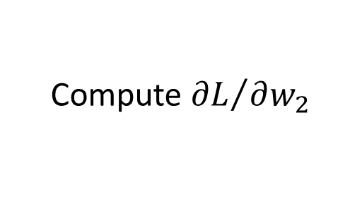
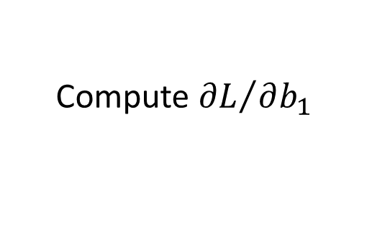
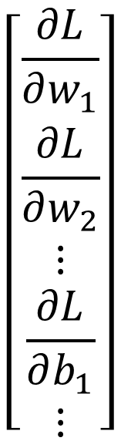
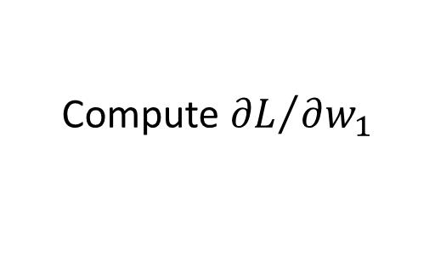





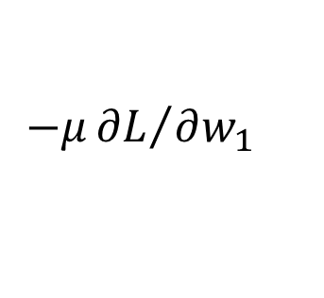
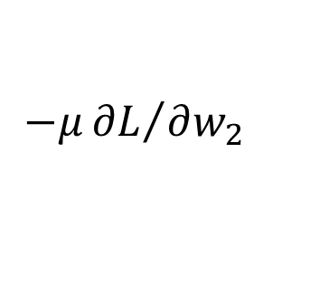
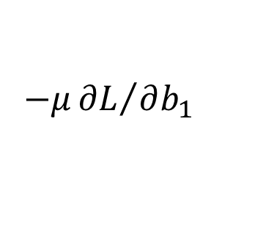
Gradient Descent
$$θ$$
Compute ${∂L}/{∂w_{1}}$
$$\left[\begin{aligned}\frac{∂L}{∂w_{1}} \\ \frac{∂L}{∂w_{2}} \\ ⋮ \\ \frac{∂L}{∂b_{1}} \\ ⋮\end{aligned}\right]$$
$$w_{1}$$
0.2
0.15
$$−μ{∂L}/{∂w_{1}}$$
Compute ${∂L}/{∂w_{2}}$
$$w_{2}$$
-0.1
0.05
$$∇L=$$
$$−μ{∂L}/{∂w_{2}}$$
……
Compute ${∂L}/{∂b_{1}}$
$$b_{1}$$
0.3
0.2
$$−μ{∂L}/{∂b_{1}}$$
……
gradient

Slide 32
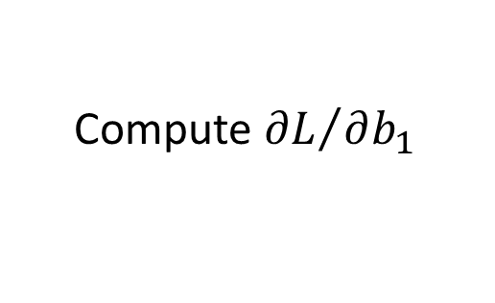
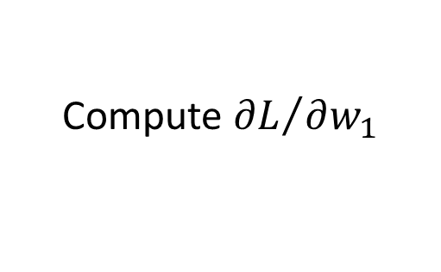
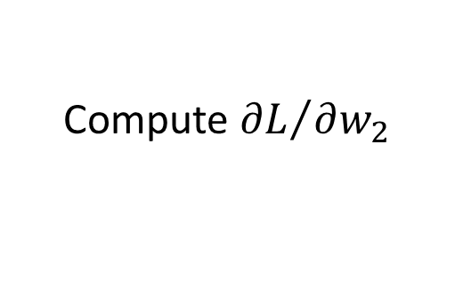
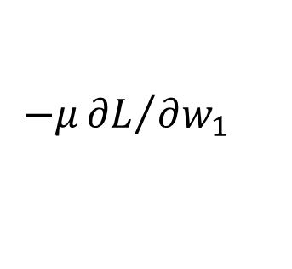
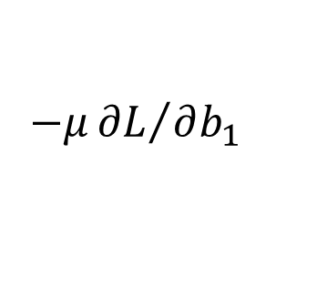
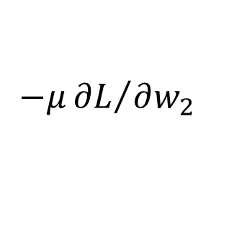
Gradient Descent
$$θ$$
Compute ${∂L}/{∂w_{1}}$
Compute ${∂L}/{∂w_{1}}$
$$w_{1}$$
0.2
0.15
0.09
$$−μ{∂L}/{∂w_{1}}$$
$$−μ{∂L}/{∂w_{1}}$$
……
Compute ${∂L}/{∂w_{2}}$
Compute ${∂L}/{∂w_{2}}$
$$w_{2}$$
-0.1
0.05
0.15
$$−μ{∂L}/{∂w_{2}}$$
$$−μ{∂L}/{∂w_{2}}$$
……
……
Compute ${∂L}/{∂b_{1}}$
Compute ${∂L}/{∂b_{1}}$
$$b_{1}$$
0.3
0.2
0.10
$$−μ{∂L}/{∂b_{1}}$$
$$−μ{∂L}/{∂b_{1}}$$
……
……

Slide 33
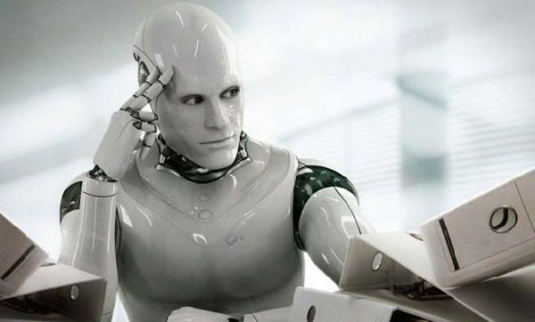
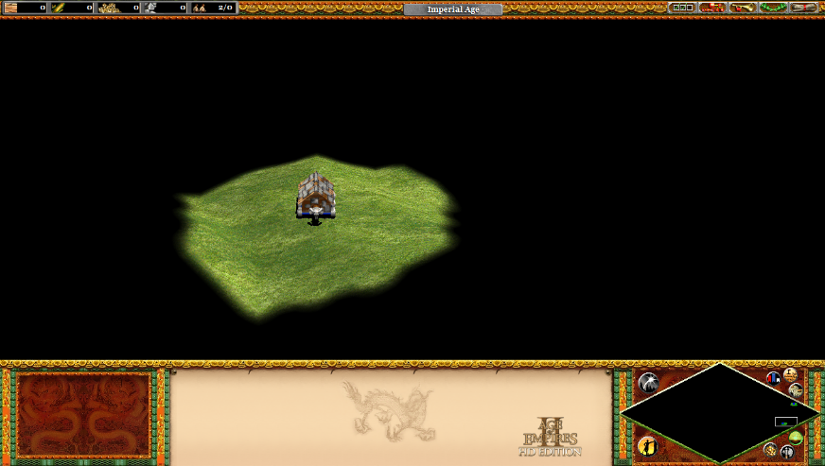
Gradient Descent
This is the “learning” of machines in deep learning ……
Even alpha go using this approach.
People image ……
Actually …..
I hope you are not too disappointed :p
Notes:
Congugate gradient

Slide 34






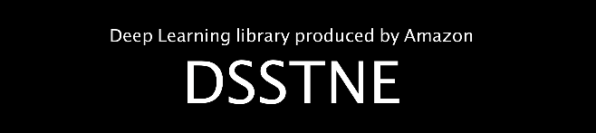

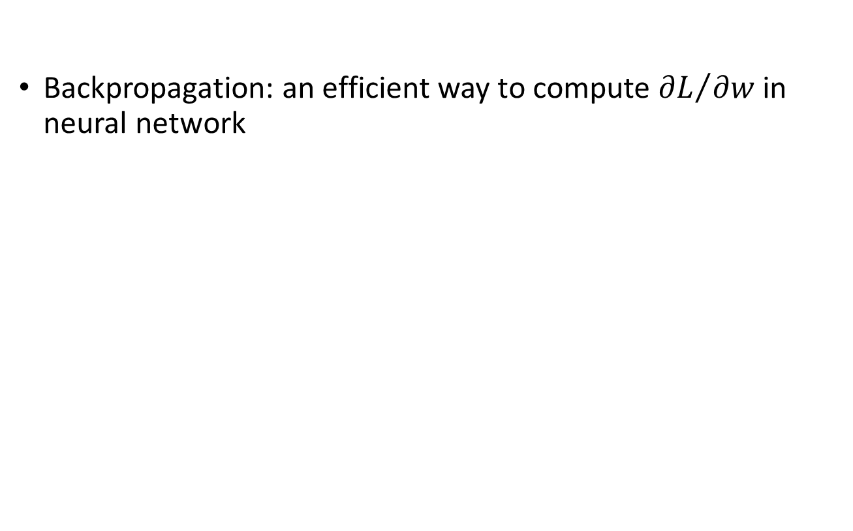
Backpropagation
Backpropagation: an efficient way to compute ${∂L}/{∂w}$ in neural network
Notes:
amazon-dsstne

Slide 35
Three Steps for Deep Learning
Step 1: define a set of function
Step 2: goodness of function
Step 3: pick the best function
Neural
Network
Notes:
http://www.twword.com/wiki/%E8%85%A6%E6%88%B6%E7%A9%B4
http://ukenglish.pixnet.net/blog/post/105691160-%E3%80%90%E5%8F%B0%E5%8D%97%E5%B8%82%E5%AD%B8%E8%8B%B1%E8%AA%9E%EF%BC%8C%E5%84%AA%E9%85%B7%E8%8B%B1%E8%AA%9E%E6%96%87%E7%90%86%E5%85%AC%E5%91%8A%E3%80%91%E6%9C%AC%E4%B8%AD%E5%BF%83
http://onepiece1234567890.blogspot.tw/2013/12/blog-post_8.html

Slide 36
感知机
1.感知机的网络结构
2.例子
3.感知机的训练规则
4.感知机的局限

Slide 37
Single Layer FNNs
How to mimic intelligent behaviors?
37

Slide 38
Perceptron
Data Classification
Data
classification
Data Set
perceptron
38

Slide 39
An Intuitive Example
39

Slide 40
Apple/Banana Classifier
40

Slide 41
Apple/Banana Classifier
特征描述（Measurement Vector）
NN结构设计
NN学习，以具备分类能力
NN性能分析
41

Slide 42
Prototype Vectors
Banana
Apple
Measurement
Vector
Perceptron
perceptron
Shape: {1 : round ; -1 : eliptical}
Texture: {1 : smooth ; -1 : rough}
Weight: {1 : > 1 lb. ; -1 : < 1 lb.}
1
－1
42

Slide 43
Apple/Banana Classifier
特征描述（Measurement Vector）
NN结构设计
NN学习，以具备分类能力
NN性能分析
选择网络结构：多少神经元？多少层网络？
43

Slide 44
Perceptron Design
Banana
Apple
Perceptron
perceptron
1
－1
44
Notes:
1个神经元，具有区分2类的能力

Slide 45
Perceptron Design
Banana
Apple
shape
texture
Perceptron
perceptron
weight
1
－1
45

Slide 46
Perceptron Design
46

Slide 47
Perceptron Design
Decision plan
total 89 pages
47
Notes:
决策面：位于2类中间的平面

Slide 48
Decision Plan
Banana
Apple
48

Slide 49
Perceptron Design
49

Slide 50
Check
Banana
Banana
50

Slide 51
Check
Apple
apple
51

Slide 52
Check
shape
“Rough” Banana:
texture
Banana
weight
Banana
52

Slide 53
Banana:
Apple:
“Rough” Banana:
total 89 pages
53

Slide 54
Perceptron
How to adjust W by learning?
54

Slide 55
Perceptron Learning
Perceptron – Part Two
55

Slide 56
Perceptron
Math Model
56
Notes:
人工神经网络如何学习？如何存储知识？

Slide 57
Learning Rules
target
input
• Supervised Learning
- Network is provided with a set of examples
of proper network behavior (inputs/targets)
57
Notes:
老师知道网络的目标输出,通过网络的实际输出与目标输出之间的误差,调整网络的权重.表示成为{样本输入,目标输出}。通过教师的指导，调节网络连接权重，使网络逐步迭代接近目标输出。从网络的性能看，训练过程中每次获得的误差可以看作是性能误差曲面上的一个点。训练网络提高性能的过程就是根据教师的指导，使误差点在误差曲面上移动，以逐渐接近局部或全局最小点，教师知道这种下降的梯度，可以实现最速下降梯度。这样，只要给定最小代价函数，足够的（输入，输出）样本，以及足够的训练时间，一个有监督学习系统总是能训练成为一个具备分类或聚类能力的系统。
57

Slide 58
Learning Rules
target
input
Learning aim: adjusting connection weights
Perceptron
58
Notes:
58
学习目标：使网络的输出接近目标输出。若网络的每次输出等于目标输出，则学习结束。

Slide 59
Decision Plan
为了获得决策面，令净输入为0：
决策面的法向量即W
total 89 pages
59
59

Slide 60
Learning Rules
target
input
Adjusting weights W
60

Slide 61
Learning Rules
target
input
Question : How to adjust W?
61

Slide 62
Learning Rules
62

Slide 63
Learning Rule
q2
q1
Classification:
2 classes
q3
63

Slide 64
Learning Rule
q2
q1
p1
w1
a
w2
p2
q3
64
64

Slide 65
Learning Rule
W
65
Notes:
65
决策面：平面上是净输入为0的一条线，关键要素：其法向量

Slide 66
Starting Point
Random initial weight:
66

Slide 67
Starting Point
Random initial weight:
Present q₁ to the network:
Incorrect Classification！
67
Notes:
67
需要旋转决策线（法线），使净输入为正，最后网络输出为+1

Slide 68
Adjusting W
68

Slide 69
First Iteration
Learning Rule:
69

Slide 70
First iteration
Learning Rule:
70

Slide 71
First Iteration
Learning Rule:
71

Slide 72
Checking
Incorrect Classification！
72

Slide 73
Second Iteration
Learning Rule:
73

Slide 74
Second Iteration
Learning Rule:
74

Slide 75
Second Iteration
Learning Rule:
75

Slide 76
Checking
Incorrect Classification！
76

Slide 77
Third Iteration
Learning Rule:
77

Slide 78
Third Iteration
Learning Rule:
78

Slide 79
Algorithm Converged
Patterns are now correctly classified.
Learning Rule:
79

Slide 80
Unified Learning Rule
Learning Rule:
80

Slide 81
Unified Learning Rule
Learning Rule:
81

Slide 82
Unified Learning Rule
Learning Rule:
82

Slide 83
Unified Learning Rule
Since, a bias is a weight with an input of 1.
Learning Rule:
83
Notes:
83
显然，学习算法与维数无关。因此，可以推广到高维空间。

Slide 84
Perceptron
84

Slide 85
Multiple-Neuron Perceptrons
Learning Algorithm
85
Notes:
一般准则：若分类数为M，则需要神经元的数目S是其2的对数

Slide 86
Multiple-Neuron Perceptrons
Step 1: Design the perceptron structure.
Step 2: Training the network by learning algorithm.
Learning Algorithm
total 89 pages
86

Slide 87
Apple/Banana Example
Training Set
87

Slide 88
Apple/Banana Example
Initial Weights:
First Iteration:
e
=
t
–
a
=
1
–
0
=
1
1
88

Slide 89
Second Iteration
89
Notes:
89
反复迭代训练，直到权值不再变化为止。

Slide 90
Check
90

Slide 91
Perceptron Ability
The perceptron rule will always converge to weights which accomplish the desired classification, assuming that such weights exist.
91
Notes:
91
若给定数据存在决策面，则该学习算法一定收敛。

Slide 92
Perceptron limitation
Linear Decision Boundary：
Linearly Inseparable Problems：
92
Notes:
92
由于实际应用中大多无法确定是否存在线性可分决策面，故，感知机很难进行实际应用。也因此，影响神经网络的发展。直到80年代，由于感知机的局限性得到解决，神经网络得以重新发展，90年代达到高潮期。目前，神经网络的应用已深入到各行各业。
此外，感知机对噪声敏感，因为其训练模式常接近网络的 判定边界。

Slide 93
Exercise 1
设有4类，其输入向量分别如下所示：
C1:
C2:
C3:
C4:
试设计一种感知机网络，进行分类。
93
Notes:
93
4个类，线性可分。需要几个神经元？2个

Slide 94
Solution to exercise 1
C1:
C3
C1
C2:
C4
C2
C3:
C4:
由于，2^{S}个线性可分类别可以用具有S个神经元的感知机进行分类，
因此，此类问题至少需要具有2个神经元的感知机。
94

Slide 95
Solution to exercise 1
定义4个类别的目标输出：
C3
C1
C1:
C2
C2:
C4
C3:
2个神经元的感知机可以生成两条决策线
C4:
95

Slide 96
Solution to exercise 1
可以设定2个权值向量为：
C3
C1
权值向量的矩阵表示形式：
C2
C4
96
Notes:
96
注意：权值向量的长度无关紧要，重要的是其方向，且与决策面垂直。

Slide 97
Solution to exercise 1
可以设定2个权值向量为：
C3
C1
计算偏移量，令：
C4
C2
97
Notes:
97
注意：权值向量的长度无关紧要，重要的是其方向，且与决策线垂直。

Slide 98
Exercise 2
请利用感知机学习规则训练一个感知机网络，求解上述分类问题。
98
Notes:
98
8个类，需要4个神经元

Slide 99
Solution to exercise 2
利用上述设定的目标向量以及输入向量，构成的训练集为：
99

Slide 100
Solution to exercise 2
设初始权值和偏移向量为：
100

Slide 101
Solution to exercise 2
The 1st Iteration ：
101
101

Slide 102
Solution to exercise 2
The 2nd Iteration ：
102

Slide 103
Solution to exercise 2
The 3rd Iteration ：
103

Slide 104
Solution to exercise 2
继续迭代，直至第8次：
104

Slide 105
Solution to exercise 2
The 9th Iteration ：
105

Slide 106
Solution to exercise 2
至此，算法收敛。最终决策线如图所示：
C3
C1
C4
C2
106

