Slide 1
Feedback Control for Rotational Movements in Feature Space
Mazen Al Borno Eugene Fiume Aaron Hertzmann Martin de Lasa
Peter Kovács
Ján Vodila

Slide 2
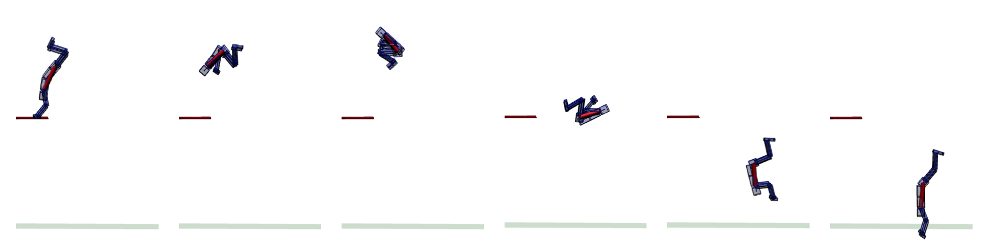
Feedback Control for Rotational Movements in Feature Space
Main problem:
global orientation
angular momentum
inertia
run computation at interactive rates
do not rely on any input motion
or offline optimization
time-invariant
generality
Peter Kovács
Ján Vodila

Slide 3
Feedback Control for Rotational Movements in Feature Space
q - generalized joint positions (vector)
q_{i} - controlled variable
q_{i} ≠ q_{i}(t)
q_{i} = h_{i}(θ)
θ - phase variable
- strictly monotonic with respect to time
- time-invariant controller
Peter Kovács
Ján Vodila

Slide 4
Feedback Control for Rotational Movements in Feature Space
q - generalized joint positions (vector)
q_{i} - controlled variable
q_{i} ≠ q_{i}(t)
q_{i} = h_{i}(θ)
θ - phase variable
- strictly monotonic with respect to time
- time-invariant controller
Feature space :
i.e. Center-of-Mass (COM), angular momentum, end-effector
output of a map of the character’s state: y = f(q,q') q' – velocity
feature-based control
Peter Kovács
Ján Vodila

Slide 5
Feedback Control for Rotational Movements in Feature Space
q - generalized joint positions (vector)
q_{i} - controlled variable
q_{i} ≠ q_{i}(t)
q_{i} = h_{i}(θ)
θ - phase variable
- strictly monotonic with respect to time
- time-invariant controller
Feature space :
i.e. Center-of-Mass (COM), angular momentum, end-effector
output of a map of the character’s state: y = f(q,q') q' – velocity
feature-based control
Let's take it all together :
y_{i} = h_{i}(θ,q,q') y_{i} - desired feature
Note: - In rotational movements θ is an angle in the plane perpendicular to the axis of rotation of the revolution.
- θ increases as the revolution progresses
Peter Kovács
Ján Vodila

Slide 6
Feedback Control for Rotational Movements in Feature Space
Benefits of phase variable (parametrizing controllers) :
make the controllers more general
    i.e. in a flip, the character roughly completes a full revolution, no matter how far, high or fast the character jumps
make the controllers more robust because of feedback
    i.e. character performing a cartwheel (no disturbances vs. strong wind forces)
Peter Kovács
Ján Vodila

Slide 7
Feedback Control for Rotational Movements in Feature Space
Rotational movements of characters (controllers) :
Cartwheel
Flips
Diving
Backhandspring
Pirouette
Front Aerial
...
Peter Kovács
Ján Vodila

Slide 8
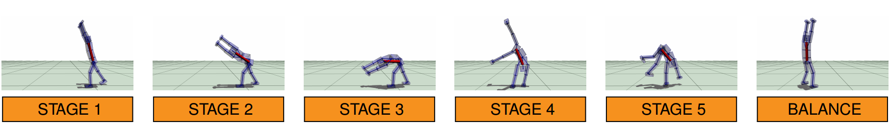
Feedback Control for Rotational Movements in Feature Space
Rotational movements of characters (controllers) :
Cartwheel
Stage i is triggered when: θ ∈ (l_{i},u_{i})
Stage 1: y_{COM} = c + ηd + [0,l,0]^{T}
          the character tilts towards its left/right side
          d – direction of characters move
          c – position of the COM
          η and l – scalars: η > 0 and l < 0 (y axis to the ground)
          active until both hands touch the ground
Peter Kovács
Ján Vodila

Slide 9
Feedback Control for Rotational Movements in Feature Space
Rotational movements of characters (controllers) :
Cartwheel
Stage 2
          move left character's hand
          left hand:
Θ_{i} - the value of θ when the character should begin to lower its hand
Θ_{f} - is the value of θ when the hand should be on the ground
Stage 3
          place the right hand
          right hand:
s – desired distance between the hands when in contact
Peter Kovács
Ján Vodila

Slide 10
Feedback Control for Rotational Movements in Feature Space
Rotational movements of characters (controllers) :
Cartwheel
Stage 4
          hands are deactivated – foots are activated
          left foot:
          analogous feedback law applies for right foot
                orientation of the lumbar joint is a good choice for Φ
Φ - is an estimate of the character’s global orientation
R_{Φ} - rotation matrix associated with Φ
p^{lo f f} - fixed horizontal offset term for the left foot
Stage 5
          oposite to stage 2 and stage 1 – straighten character
          movement ends with a balance controller
Peter Kovács
Ján Vodila

Slide 11
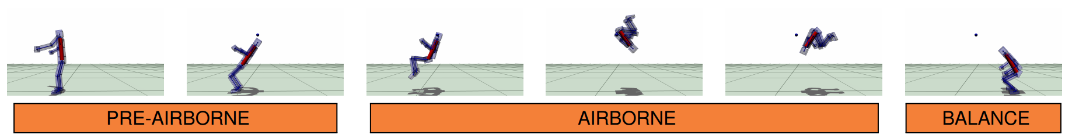
Feedback Control for Rotational Movements in Feature Space
Rotational movements of characters (controllers) :
Flips
two main stages: pre-airborne & airborne
pre-airbone stage:
place the character in a crouch position that is slowly tilting on its back
generate the necessary angular momentum for the character to flip
avoid insufficient or excessive angular momentum
Peter Kovács
Ján Vodila

Slide 12
Feedback Control for Rotational Movements in Feature Space
Rotational movements of characters (controllers) :
Flips
two main stages: pre-airborne & airborne
pre-airbone stage:
place the character in a crouch position that is slowly tilting on its back
generate the necessary angular momentum for the character to flip
avoid insufficient or excessive angular momentum
estimate the duration of the airborne stage of the flip:
ε - estimated velocity of the COM
g - gravitational constant
Peter Kovács
Ján Vodila

Slide 13
Feedback Control for Rotational Movements in Feature Space
Rotational movements of characters (controllers) :
Flips
two main stages: pre-airborne & airborne
airbone stage:
land with a desired orientation (θ_{land}) and inertia (I_{land})
current angular velocity:
desired angular velocity at landing:
character is rotating too slowly – decrease the character’s inertia to increase the angular velocity
character is rotating too quickly – increase the character’s inertia to decrease the angular velocity
M - angular momentum
I - Inertia
Peter Kovács
Ján Vodila

Slide 14
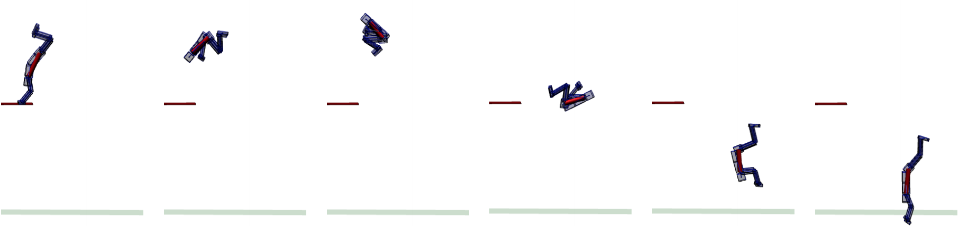
Feedback Control for Rotational Movements in Feature Space
Rotational movements of characters (controllers) :
Diving
The goal is to have the character enter the water with a straight posture and with its arms raised upwards
for generality – input can contain desired number of complete revolutions
before entry
almost identical to flip controller
identical airborne controller can generate forward, backward, straight and armstand dives
Θ_{land} , I_{land} - different because of the different desired landing positions
take into account the number of complete revolutions when calculating the desired average angular velocity
shoulders are now included in computation because of arms raising
Peter Kovács
Ján Vodila

Slide 15
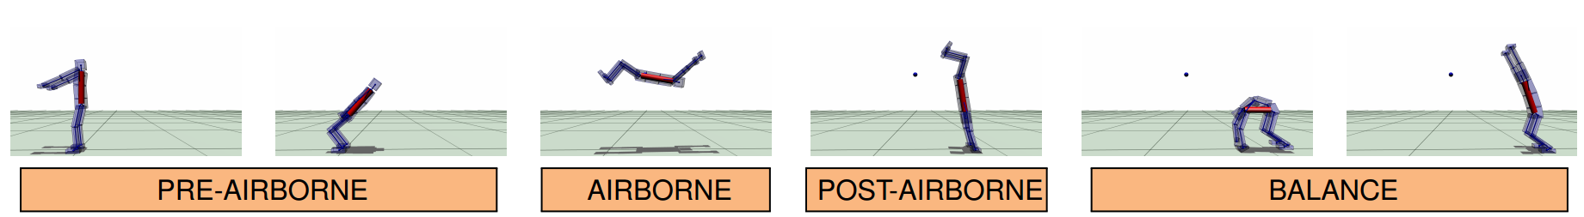
Feedback Control for Rotational Movements in Feature Space
Rotational movements of characters (controllers) :
Backhandspring
pre-airborne stages is different to backflip controllers only in the values of θ_{land} and I_{d}
not significant change of the inertia in the airborne stage
rest pose of the shoulders vary when the character is airborne
      the character raises its arms as a function of θ in order to land on its hands
      the character enters a post-airborne stage when its hands are close enough to the ground
Peter Kovács
Ján Vodila

Slide 16
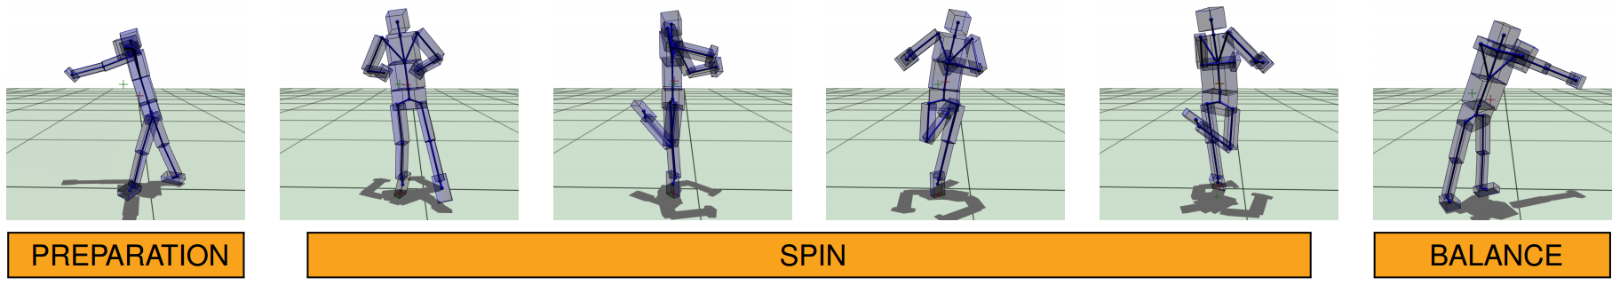
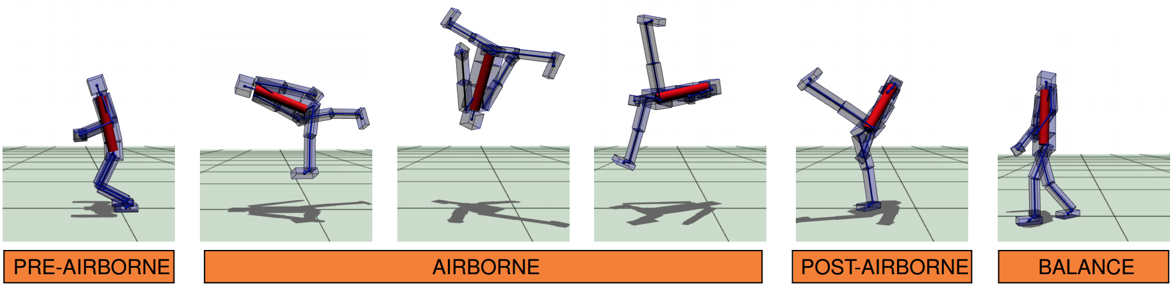
Feedback Control for Rotational Movements in Feature Space
Rotational movements of characters (controllers) :
Pirouette
Front Aerial
Peter Kovács
Ján Vodila

Slide 17
Feedback Control for Rotational Movements in Feature Space
RESAULTS
feature-based control algorithms for a wide variety of rotational movements
(aerials, cartwheels, dives, and flips), that do not require any input motion or offline optimization
most of these movements have not previously been generated by physics-based methods without prior data
controllers are general and robust
results lack some aspects of natural human motion
most of the rotations are planar, but phase parametrization can be extended to three-dimensional rotations
it is not able to synthesize some movements that are at the periphery of performance, such as certain ballet moves that require an enormous amount of precision
Peter Kovács
Ján Vodila

Slide 18
Thank you for your attention
Peter Kovács
Ján Vodila

