Slide 1

Continuous Collision Detection: Progress and Challenges
Gino van den Bergen
dtecta
gino@dtecta.com

Slide 2
Overview
Explain the concept of Continuous 4D Collision Detection.
Briefly discuss the GJK algorithm.
Present the GJK Ray Cast algorithm.
Discuss how to go about rotations.

Slide 3
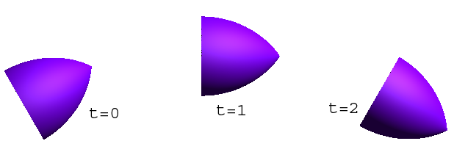
4D Collision Detection (1/2)
Object placements are computed for discrete moments in time.
Object trajectories are assumed to be continuous.

Slide 4
4D Collision Detection (2/2)
Perform collision detection in continuous 4D space-time:
  Construct a plausible trajectory for each moving object.
  Check for collisions along these trajectories.

Slide 5

Plausible Trajectory? (1/2)
Limited to trajectories with piecewise constant derivatives.
Thus, linear and angular velocities are assumed to be fixed between samples.

Slide 6
Plausible Trajectory? (2/2)
Lots of constant-velocity trajectories result in the same displacement.
Obtain a unique trajectory by:
  Fixing translation and rotation to the same axis (screw motion).
  Fixing the rotation axis to a given point in the object’s local frame.

Slide 7
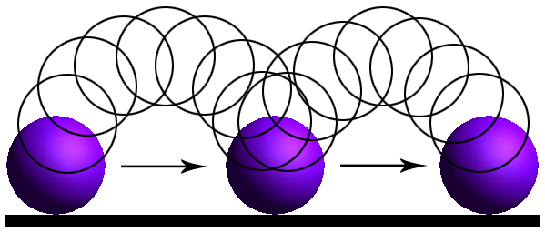
Screw Motions
Redon uses piecewise screw motions for 4D collision detection.
Screw motions often appear unnatural, for example, a rolling ball:

Slide 8
Rotate about Center of Mass
Corresponds more closely to Newtonian mechanics.
Unconstrained rigid body motion:
  Translations of center of mass.
  Rotations leave center of mass fixed.
Decoupling of translations and rotations adds DOFs and constraints.

Slide 9
Only Translations (for now)
Only translations are interpolated.
Rotations are instantaneous.
The center of mass still follows a continuous piecewise linear path.
Points off the rotation axis may suffer from tunneling, but we’ll fix that later.

Slide 10

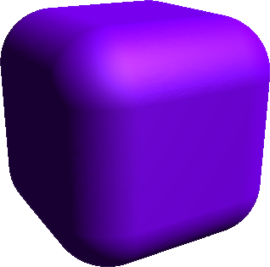
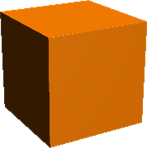



Configuration Space (1/2)
The configuration space obstacle of objects A and B is the set of all vectors from a point of B to a point of A.

Slide 11

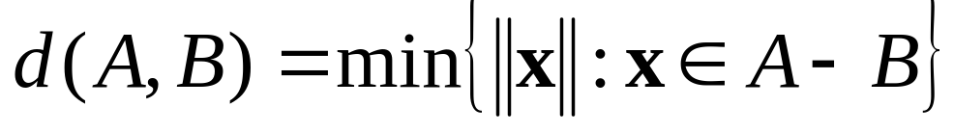
Configuration Space (2/2)
A and B intersect: zero vector is contained in A – B.
Distance between A and B: length of shortest vector in A – B.

Slide 12
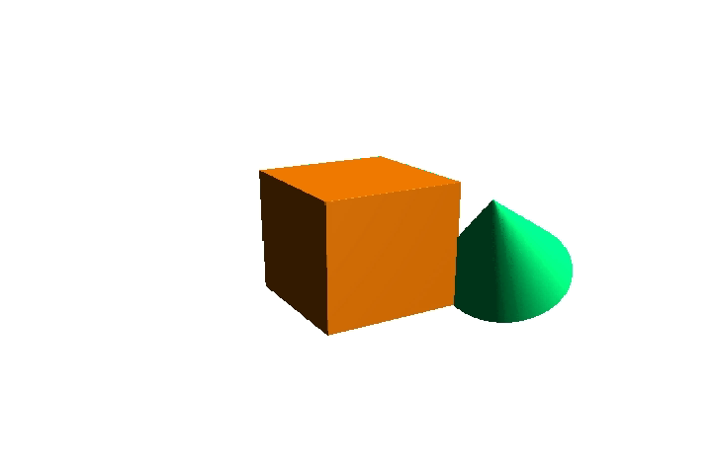
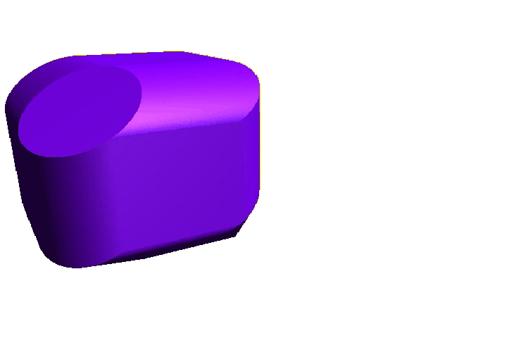
Translation
Translation of A and/or B results in a translation of A – B.

Slide 13
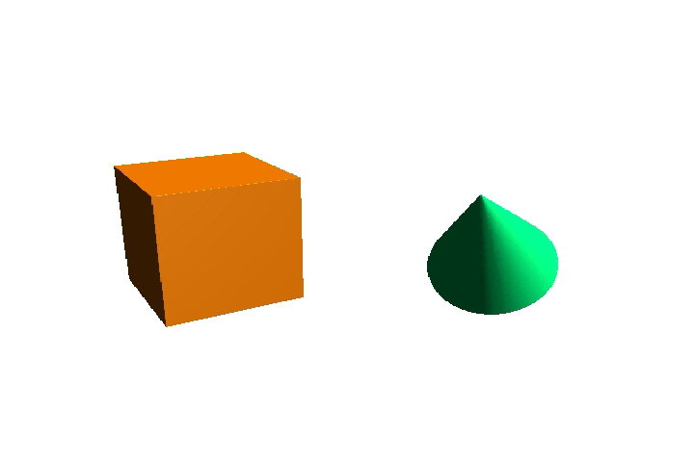
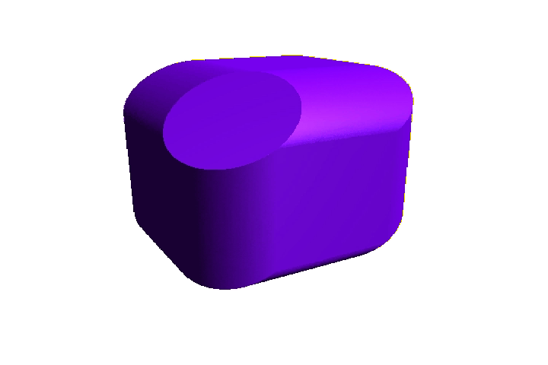
Rotation
Rotation of A and/or B changes the shape of A – B.

Slide 14
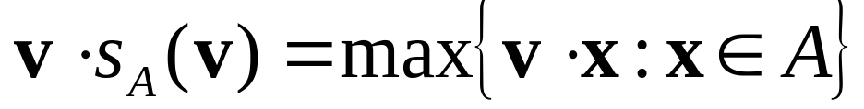
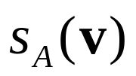




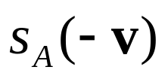
Support Mappings
A support mapping s_{A} of an object A maps vectors to points of A, such that
Any point on this face may be returned as support point

Slide 15
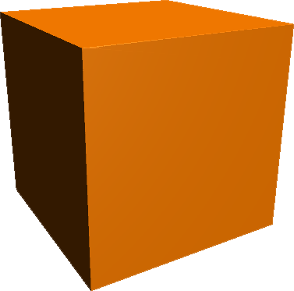
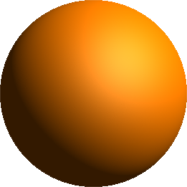
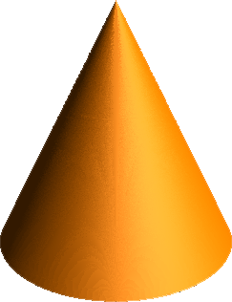
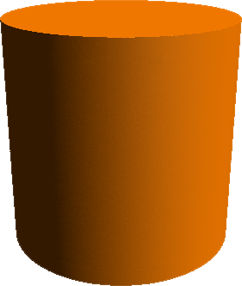
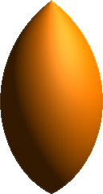
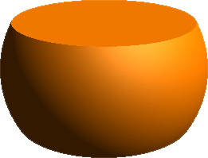
Primitives

Slide 16


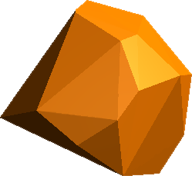
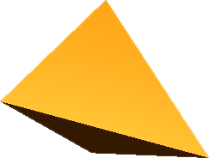
More Primitives

Slide 17
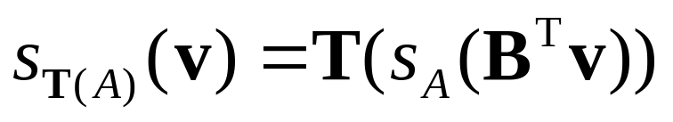
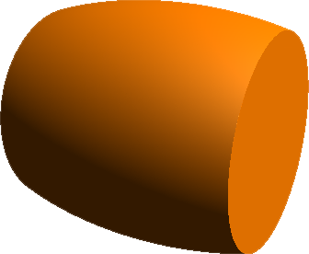
Affine Transformation
Primitives can be translated, rotated, and scaled. For T(x) = Bx + c, we have

Slide 18
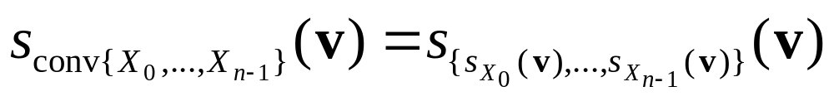
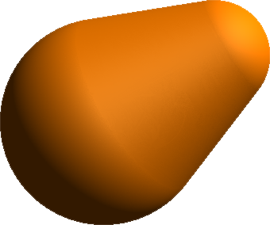
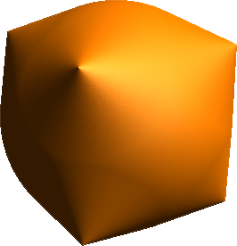
Convex Hull
Convex hulls of arbitrary convex shapes are readily available.

Slide 19
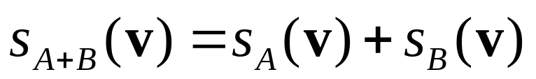
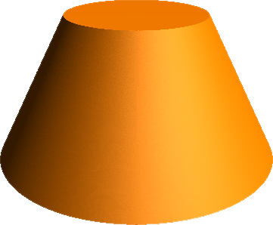


Minkowski Sum
Objects can be fattened by Minkowksi addition.

Slide 20
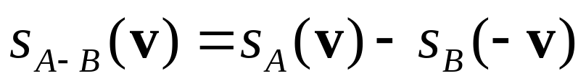
GJK Algorithm
An iterative method for computing the point closest to the origin of a convex object.
Uses a support mapping as the object’s geometric representation.
Support mapping for A – B is

Slide 21
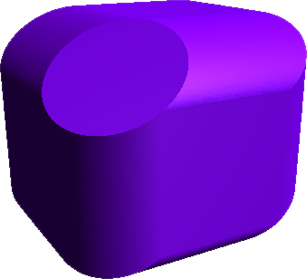
Basic Steps (1/6)
Suppose we have a simplex inside the object...

Slide 22

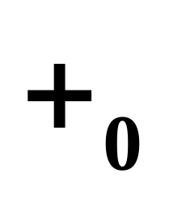
Basic Steps (2/6)
…and the point v of the simplex closest to the origin.

Slide 23


Basic Steps (3/6)
Compute support point w for the vector -v.

Slide 24
Basic Steps (4/6)
Add support point w to the current simplex.

Slide 25
Basic Steps (5/6)
Compute the closest point of the simplex.

Slide 26
Basic Steps (6/6)
Discard all vertices that do not contribute to v.

Slide 27

Shape Casting
For objects A and B being translated over respectively vectors s and t, find the first time of contact.
Boils down to a ray cast from the origin along the vector r = t – s onto A – B.

Slide 28
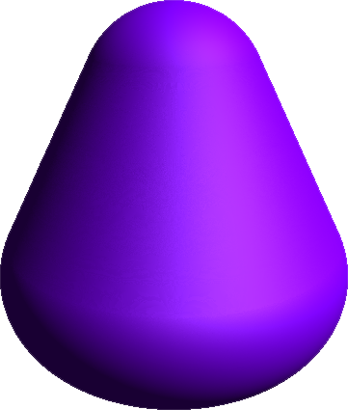
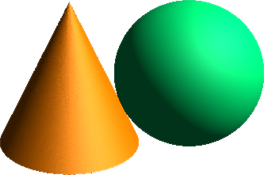
Normals
A normal at the hit point of the ray is normal to the contact plane.

Slide 29
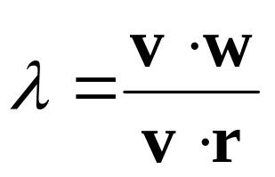


Ray Clipping (1/2)

Slide 30
Ray Clipping (2/2)
For , we know that
If v·r > 0 then λ is a lower bound for the hit spot, and if also v·w > 0, the ray is clipped.
If v·r < 0 then λ is an upper bound, and if also v·w > 0, then the ray misses.
If v·r = 0 and v·w > 0, the ray misses as well.

Slide 31
GJK Ray Cast (1/2)
Do a standard GJK iteration, and use the support planes as clipping planes.
Each time the ray is clipped, the origin “is shifted to” λr.
…and the current simplex is set to the last-found support point.
The vector -v that corresponds to the latest clipping plane is the normal at the hit point.

Slide 32

GJK Ray Cast (2/2)
The origin advances to the new lower bound.
The vector -v is the latest normal.

Slide 33
Termination (1/2)
The origin advances only if v·w > 0, which must happen within a finite number of iterations if the origin is not contained in the query object.
Terminate as soon as the origin is close enough to the query object, or we found evidence that the ray misses.

Slide 34
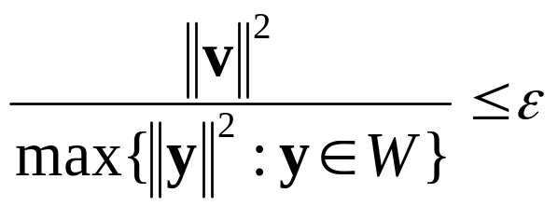
Termination (2/2)
As termination condition we use
where v is the current closest point, W is the set of vertices of the current simplex, and ε is the error tolerance.

Slide 35
Accuracy vs. Performance
Accuracy can be traded for performance by tweaking the error tolerance ε.
A greater tolerance results in fewer iterations but less accurate hit points and normals.

Slide 36
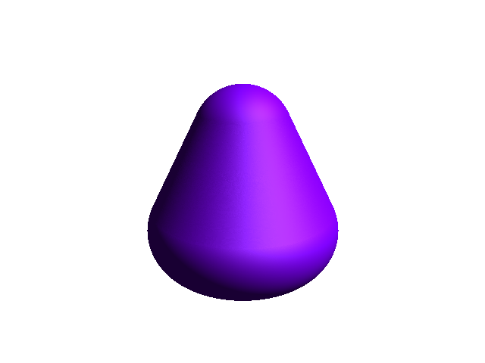
Accuracy vs. Performance
ε = 10⁻⁷, avg. time: 3.65 μs @ 2.6 GHz

Slide 37

Accuracy vs. Performance
ε = 10⁻⁶, avg. time: 2.80 μs @ 2.6 GHz

Slide 38
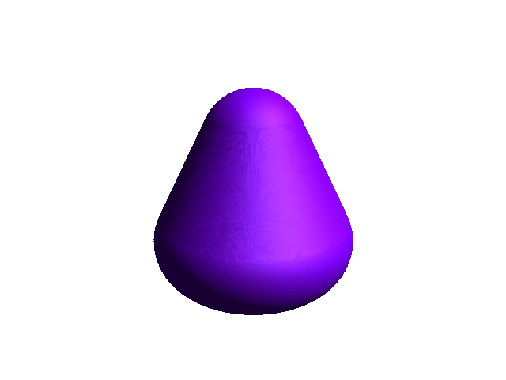
Accuracy vs. Performance
ε = 10⁻⁵, avg. time: 2.03 μs @ 2.6 GHz

Slide 39

Accuracy vs. Performance
ε = 10⁻⁴, avg. time: 1.43 μs @ 2.6 GHz

Slide 40

Accuracy vs. Performance
ε = 10⁻³, avg. time: 1.02 μs @ 2.6 GHz

Slide 41
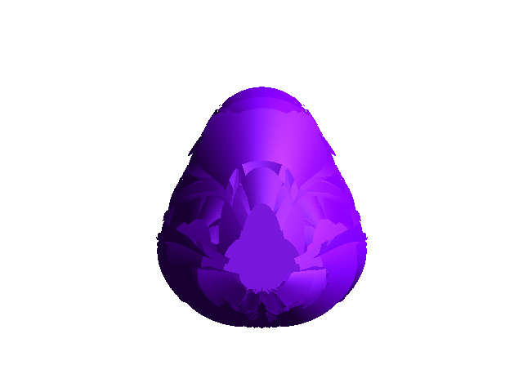
Accuracy vs. Performance
ε = 10⁻², avg. time: 0.77 μs @ 2.6 GHz

Slide 42
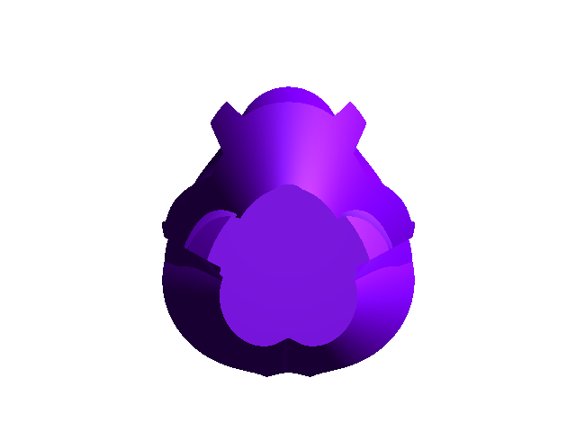
Accuracy vs. Performance
ε = 10⁻¹, avg. time: 0.62 μs @ 2.6 GHz

Slide 43
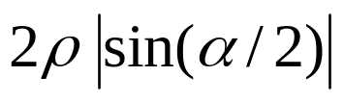
Rotations (1/2)
All trajectories of points on a rotating object are contained by a disk of radius
where ρ is the max. distance
from the axis to a point of the
object, and α the rotation angle
clamped between –π and π.

Slide 44
Rotations (2/2)
Add the disk to the rotating object by Minkowski addition to obtain a conservative bound.
If necessary, reduce the bound by bisection of the time interval. Shorter intervals result in smaller angles, and thus tighter bounds.

Slide 45
GJK Ray Cast Revisited
Add trajectory-bounding disks to the cast objects.
Each time the ray is clipped, reduce the radii of the disks.
Q: Is it possible to find exact collision times for rotating objects without bisection? A: Not likely.

Slide 46
Open Issues
How should bisection be incorporated into the GJK Ray Cast routine?
First guess: Bisect until the origin is able to advance.
How do we compute the extreme radius of a rotating convex object, using only a support mapping?
Difficult due to multiple local maxima.

Slide 47
Conclusion
Exact 4D collision detection of convex objects under translation is doable in real time.
Next big step: Exact 4D collision detection of convex objects under general rigid motion.

Slide 48
References
Gino van den Bergen. Collision Detection in Interactive 3D Environments. Morgan Kaufmann Publishers, 2004.
F.C. Park and B. Ravani. Smooth Invariant Interpolation of Rotations. ACM Transactions on Graphics, 16(3):277-295, 1997.
Stephane Redon. Continuous Collision Detection for Rigid and Articulated Bodies.
ACM SIGGRAPH Course Notes, 2004.

Slide 49
Thank You!
For papers and other information, please visit:
http://www.dtecta.com

