Slide 1

Apache CouchDB 3.5.2
NoSQL databases · Big Data Management and Processing · 2026
Replication conflicts, partitioned queries and document-level atomicity, demonstrated on a shop-order database
Daniel Kovacs
Csaba Pipa
MSc Computer Science
Notes:
Both of us. One sentence each to introduce ourselves, then Daniel opens Part 1.
---
Csaba: "Hi everyone, I’m Csaba. My colleague and I are MSc CS students at Eszterhazy Karoly University, and we're glad to be walking you through our analysis of Apache CouchDB today. "
Daniel: "And I’m Daniel; today we’ll be exploring replication conflicts, partitioned queries, and document-level atomicity using a practical shop-order database implementation. Let’s dive right into it!"

Slide 2
Where CouchDB comes from
PART 1 · INTRODUCTION
2005
Feb 2008
Late 2008
Jul 2010
2016
Today
Damien Katz, a former Lotus Notes developer at IBM, starts CouchDB
Enters the Apache Incubator under the Apache License
Graduates to an Apache top-level project
First stable release, 1.0
2.0 adds native clustering, from Cloudant’s BigCouch
3.5.2, the version used in this project
The goal from day one: reliable data on many unreliable machines. The name stands for Cluster Of Unreliable Commodity Hardware.
Sources: Wikipedia, “Apache CouchDB”; QCon SF 2010 speaker profile of Damien Katz
Part 1 · Introduction
Notes:
Daniel, about 1 minute.
---
Let’s begin with how CouchDB came into existence. It goes back to 2005 when Damien Katz started it. Prior to CouchDB, he had worked for several years at IBM on Lotus Notes, which is best known for its ability to synchronize information across machines, and that shows in the design of CouchDB. Initially, he financed his own research until in February 2008 the project joined the Apache Incubator and by the end of the year was designated as one of the top-level projects of Apache. The first stable release was version 1.0 in July 2010, while version 2.0 came out in 2016 with native clustering, built on the BigCouch developed by Cloudant. We are using version 3.5.2 of CouchDB in our project.
The meaning behind the name is important: “Couch” stands for Cluster Of Unreliable Commodity Hardware. The assumption from the very beginning was that failures of machines and network connection would happen.

Slide 3




Core features we use
PART 1 · INTRODUCTION
Documents over HTTP
Revisions instead of locks
JSON documents; every operation is a plain HTTP request. The Fauxton web UI is built in.
Every write creates a new _rev. An update must name the current revision (MVCC).
Multi-master replication
Mango queries and partitions
Any instance replicates to any other, continuously. Conflicts are detected and kept.
JSON selectors backed by indexes; partitioned databases group related documents.
Source: Apache CouchDB documentation
Part 1 · Introduction
Notes:
Daniel, about 1 minute.
---
There are four aspects which are critical to our task. First, all the data is stored in JSON documents, and the entire interface is HTTP-based, thus curl or any other HTTP library is enough; there’s no special driver required. CouchDB even ships with a web interface, called Fauxton.
Second, documents in CouchDB are not locked. Each document has a revision number, and if you wish to update it, you need to state the revision you know about. It is called Multi-Version Concurrency Control or MVCC.
Third, replication is built in. It can run between any two instances, in either direction. When two edits collide, CouchDB stores both of them and marks the document as conflicted.
Fourth, for querying purposes we utilise Mango, which is a JSON selector and can use indexes. Also, there are partitioned databases, where related documents are placed. For us, it is one database per store with orders inside.

Slide 4
Why it fits a multi-store order system
PART 1 · INTRODUCTION
Our example: 5 stores × 20 orders. Each order is one JSON document, and branches may edit while offline, then sync.
STRENGTH
LIMITATION
Conflicts are detected, never lost
One document = one transaction
Concurrent edits on two instances are both kept and flagged as a conflict, instead of one silently overwriting the other.
An order and its stock count cannot change together atomically, and merging conflicts is the application’s job.
Both points are demonstrated in Part 5
Part 1 · Introduction
Notes:
Daniel, about 1 minute.
---
Our example is a small chain of shops, consisting of five shops, each having twenty orders. In this context, each order is a single document and the principle is that a shop will continue to work even when offline and synchronize later on.
This is where the strength of the CouchDB comes into play – in case two shops change the same order, there will be no hidden overwrite; the document will remain, and the conflict will be notified.
The downside of CouchDB is the flip side of the above-mentioned principle – as each document is independently versioned and replicated, a transaction can include only one document. Thus, we cannot change the order and separate stock record within one transaction. Plus, it will be our code to resolve any conflict. This will be demonstrated in Part 5. Before that, let’s look at how we set the two servers up.

Slide 5
Two independent single-node instances
PART 2 · INSTALLATION AND SETUP
Fedora 44 host · Docker 29.9.2 · Compose v5.6.1 · one command: python run.py
couch-a · instance A
rep-a-to-b →
couch-b · instance B
127.0.0.1:5984
volume couch-a-data
admin_a · own credentials
← rep-b-to-a
127.0.0.1:5985
volume couch-b-data
admin_b · own credentials
continuous jobs,
experiment B only
3.5.2
1 node
~110 MiB
14 / 14
image pinned by digest sha256:5fc59611…
in cluster_nodes on A and on B: not one cluster
memory per container (limit 512 MiB)
setup checks passed: readiness, system DBs, write/read
Evidence: evidence/00_setup/ · ports bound to 127.0.0.1 only
Part 2 · Setup
Notes:
Daniel, about 1 minute on the slide, then 2 minutes in the terminal (date, docker compose ps, python scripts/01_setup.py --step). Before recording, the containers should already be running (python run.py up).
---
On the Slide:
We use Docker Compose to run two separate CouchDB 3.5.2 containers. Each one has its own data volume, own admin user account, ports are available only locally, and passwords are stored in the generated .env file which will not be put under version control. This distinction between two individual servers and not a cluster is important, and it can be seen in action directly – when asked about the members of the cluster each server reports itself as the only member.
Two arrows in the middle represent replication processes that were launched in experiment B. From inside Docker these services refer to each other using couch-a and couch-b names as they otherwise would just point to themselves as localhost. Now let’s see what happens in the running system.
Terminal:
date
docker compose ps
python scripts/01_setup.py --step
This is the live system. Both containers, couch-a and couch-b, are up, and you can see the ports are bound to 127.0.0.1 only.
Steps 1–2, readiness:
First the script waits until each server answers. The response shows version 3.5.2 on both.
Steps 3–4, membership:
This is the check I mentioned. We ask each server which nodes it knows about, and cluster_nodes has exactly one entry. So these really are two separate servers, not a cluster.
Steps 5–12, single-node setup:
Next the single-node setup: we set the default number of copies to one, since a single server can’t hold more, and create the two system databases, _users and _replicator. The replicator database is where our replication jobs will live later. On a re-run these come back as 412, which just means they already exist.
Steps 13–14, write and read:
Then a quick write and read on each server, to prove they actually store data. Step 15 and the summary: Finally, the script records the image digest and the memory use, around 110 megabytes per container. Fourteen out of fourteen checks passed, and the evidence is saved in the repository. On camera, the 412s will show in red for the two system databases, because run.py up has already created them.

Slide 6
One order is one document
PART 3 · DATA MODEL
{
"_id": "store01:order001",
"_rev": "1-2d37e26a…",
"type": "order",
"tenant": "store01",
"status": "open",
"customer": {"name": "István Szabó", …},
"items": [{"sku": "SKU-COF-01", "qty": 3,
"unit_price": 18.9}],
"total": 56.7, "currency": "EUR",
"created_at": "2026-09-21T15:36:00Z",
"delivery": {"city": "Budapest", …}
}
_id = store : order
A natural key. The prefix is the partition key and always equals tenant.
_rev = generation-hash
New on every write; an update must quote the current one.
Items embedded, stock separate
An order is written as one unit. Stock lives in its own documents (see Part 5D).
Indexes follow the queries
[tenant, status] for one store’s open orders; [tenant, status, created_at] for the sorted query.
Data: 100 orders, 5 stores, generated with a fixed seed (data/orders.json)
Part 3 · Data model
Notes:
Daniel, about 2 minutes.
---
This is one actual document from our database. The id combines the store and the order number, so the key alone tells you which store an order belongs to, and in the partitioned database that prefix becomes the partition key. It’s a natural key we choose ourselves, not a generated UUID. The _rev field is the revision: a generation number followed by a hash.
The values are ordinary JSON types: strings, numbers for the prices, quantities and total, nested objects for the customer and the delivery address, and an array for the line items. Timestamps are stored as fixed-width ISO strings, so sorting them as text also sorts them by time.
We embedded the line items in the order, because an order is always read and written as a whole, and that suits CouchDB, where a transaction covers a single document. The product name and price are copied into each line, so a later price change doesn’t rewrite old orders. Stock levels, on the other hand, are kept in separate documents. That’s a deliberate choice, and Part 5D shows what it costs us.
The two indexes come straight from the queries we actually need: the open orders of one store, and the open orders of a store over 100 euros, newest first. The data comes from a fixed random seed, so every run produces exactly the same hundred orders: 42 open, 30 shipped, 20 paid and 8 cancelled.
Csaba will now show the basic operations on this data.

Slide 7
CRUD: every write is a new revision
PART 4 · BASIC OPERATIONS
Operation | Request on instance A | Response | Verified by
Create | PUT /orders/store01:order900 | 201 · rev 1-623a… | read-back, same _rev
Read | GET /orders/store01:order900 | 200 · status open | content matches
Update | PUT with _rev 1-623a…, status paid | 201 · rev 2-7826… | read-back: status paid
Delete | DELETE …order900?rev=2-7826… | 200 · rev 3-11ad… | GET → 404 deleted
Delete writes a tombstone revision, so a replica learns about the deletion. An update that quotes an old _rev is refused with HTTP 409 (Part 5D).
Evidence: evidence/10_crud_mango/ · 9 / 9 checks passed
Part 4 · CRUD
Notes:
Csaba, about 45 seconds on the slide, then about 2.5 minutes in the terminal with python run.py A, pausing at each step.
---
On the Slide:
Thanks, Daniel. The table shows the four basic operations we’ll run on one order: create, read, update and delete, each followed by a check of what’s actually stored. There’s one thing to watch as we go: the revision number. Every write changes it, and that includes the delete, which is the surprising part. Let’s run it.
Terminal:
python run.py A
Step 1, create:
First we create a new order, store01:order900, with a plain PUT. CouchDB answers 201 Created, and look at the rev field: it starts with 1. That’s the first revision.
Step 2, read:
Reading it back by its id returns exactly what we stored, and the same revision, 1-623a.
Step 3, update:
Now we mark the order as paid. Notice that the request carries the _rev we just read. That’s how we tell CouchDB which version we’re changing. The answer is 201 again, and the revision is now 2.
Step 4, verify:
Reading it again confirms the status is paid, at revision 2. So we’re not trusting the 201; we’re checking what’s actually stored.
Step 5, delete:
To delete, we also have to quote the current revision, here as a URL parameter. And the response gives us revision 3. The delete didn’t remove the document; it wrote a tombstone on top of it.
Step 6, verify:
If we try to read it now, we get 404 with the reason ‘deleted’, not just ‘missing’. CouchDB still knows the document existed, which is exactly what a replica needs in order to delete its own copy.
(Leave the script paused at step 7 and switch to the next slide.)

Slide 8
Mango: an indexed query, not a scan
PART 4 · BASIC OPERATIONS
“Open orders of store01 over 100 EUR, newest first”
tenant-status-created
POST /orders/_find
{
"selector": {
"tenant": "store01",
"status": "open",
"total": {"$gt": 100}
},
"sort": [{"tenant": "desc"},
{"status": "desc"},
{"created_at": "desc"}]
}
the index _explain says the planner chose
10 → 6
documents examined → returned, out of 100 orders
same 6 ids, same order
as a client-side filter of every document
Measured on instance A · execution_stats from the _find response
Part 4 · Mango query
Notes:
Csaba, about 1.5 minutes: 30 seconds on the slide, then about 1 minute in the terminal (steps 7–9 of python run.py A).
---
On the slide:
Reading a document by its id is the easy case. Here we ask a real business question instead: which open orders from store01 are worth more than 100 euros, newest first? On the left is the Mango query. The selector is plain JSON: tenant, status, and a total greater than 100. One detail in the sort: it lists tenant and status as well as the date, all descending. That’s because Mango can only sort along an index, so the sort has to follow the index’s field order.
Terminal: (continue the paused script)
Step 7, the index:
First we create the index on tenant, status and creation date.
Step 8, explain:
Before running the query, we ask CouchDB how it would run it. _explain confirms that the planner picks our index, tenant-status-created, rather than scanning everything.
Step 9, the query:
And here’s the result: six orders, newest first. The execution statistics are the interesting part. CouchDB examined only ten documents, the open orders of store01, and returned the six that qualify, instead of reading all hundred. As a cross-check, the script compares the answer with a plain scan of every document, and both give the same six orders in the same order. Nine out of nine checks passed. That’s the basics. Daniel will now take us through replication.

Slide 9
Two one-way jobs give two-way sync
PART 5B · REPLICATION
rep-a-to-b · job stored in A’s _replicator →
Instance A
Instance B
couch-a / orders
← rep-b-to-a · job stored in B’s _replicator
couch-b / orders
≤ 1 s
≤ 0.5 s
≤ 0.5 s
100 = 100
both jobs “running”, no errors
new order from A readable on B
new order from B readable on A
documents on A and B after catch-up
Job URLs use the service names couch-a and couch-b: the replicator runs inside a container, where localhost means that container.
Times from the unattended run, polled every 0.5 s on one laptop
Part 5B · Replication
Notes:
Daniel, about 1.5 minutes: 30 seconds on the slide, then about 1 minute in the terminal (steps 1–9 of python run.py B)..
---
On the Slide:
In CouchDB, replication always runs in one direction, from a source to a target. So to keep two servers in step we need two jobs, and we create them as ordinary documents in the _replicator database: the A-to-B job lives on A, and the B-to-A job lives on B. Let’s create them.
Terminal:
python run.py B
Steps 1–2, create the jobs:
Here’s the first job document. The source is couch-a, the target is couch-b, and it’s continuous. The passwords are masked in the output. The second job is the mirror image, stored on B.
Steps 3–4, running:
CouchDB’s scheduler confirms that both jobs are running, with no errors.
Step 5, catch-up:
B started empty, and it now holds the same hundred orders as A.
Steps 6–7, A to B:
Now a new order on A… and we can read it on B. If the script says zero seconds, that’s only because I paused; replication had already finished. Unattended, it took about half a second.
Steps 8–9, B to A:
And the other direction: an order created on B shows up on A. So we have two-way sync between two independent servers. That’s a different mechanism from the internal copies inside a CouchDB cluster.
(Leave the script paused at step 10 and switch to the next slide.)

Slide 10
A controlled conflict and its merge
PART 5B · REPLICATION
1 · COMMON START
2 · DIVERGENT EDITS
3 · SYNC RESUMES
4 · RESOLVED
store01:order-shared at revision 1-845c… on A and B.
A: status → paid
B: street → Kárász utca 12.
New jobs, fresh ids. Both report _conflicts and pick the same winner.
Per-field merge saved on the winner: 3-8fc0…, paid and new street.
Both accepted locally with HTTP 201. No 409.
Both jobs stopped by deleting their job documents.
The loser is still readable with ?rev=.
Loser deleted with its own _rev. No live conflicts on A or B.
CouchDB chooses the winner deterministically, identically on every replica, but it never merges data. The merge rule is ours.
B: 27 / 27 checks passed · conflict_revisions.json, resolved_doc.json in evidence/
Part 5B · Replication
Notes:
Daniel, about 1 minute 20 seconds: 20 seconds on the slide, then about 1 minute in the terminal (steps 10–23 of the paused python run.py B; speed up the waits in editing).
---
On the Slide:
Now for the interesting part. The plan is on the slide: one shared order, we cut the connection, both branches edit it, then we reconnect and see what CouchDB does. Let’s run it.
Terminal:
(switch back to the paused script; continue from step 10)
Steps 10–11, common start:
We create a shared order on A, and once it has replicated, both servers hold it at the same revision, 1-845c. That’s our common starting point.
Steps 12–15, stop the jobs:
Now we stop replication by deleting both job documents, and the scheduler confirms that no jobs are running. To be precise, this is a stopped job, not a stopped server and not a network partition.
Steps 16–17, divergent edits: On A, the order is marked paid, giving revision 2-1f7d. On B, the delivery address is corrected, giving 2-d520. Both get 201, because each edit is valid on its own server. That’s very different from a 409, where a server rejects an edit that’s based on an old revision.
Steps 18–21, reconnect:
We restart replication with two new job documents, and both are running again.
Step 22, the conflict:
Now each server has both versions. Asking with conflicts=true, both servers report the same thing: the winner is 2-d520, and 2-1f7d is listed as a conflict. Same winner on both sides, by the documented rule: longest history first, then the higher revision id.
Step 23, the loser:
And the losing version isn’t gone. Fetched by its id, it’s A’s edit: paid, with the old address.
Leave the script paused and roll the the screenshots on next slide (11.)

Slide 11
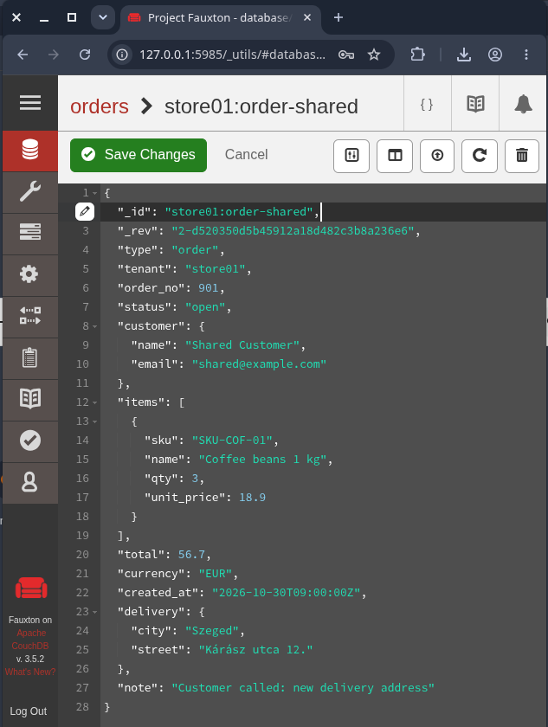
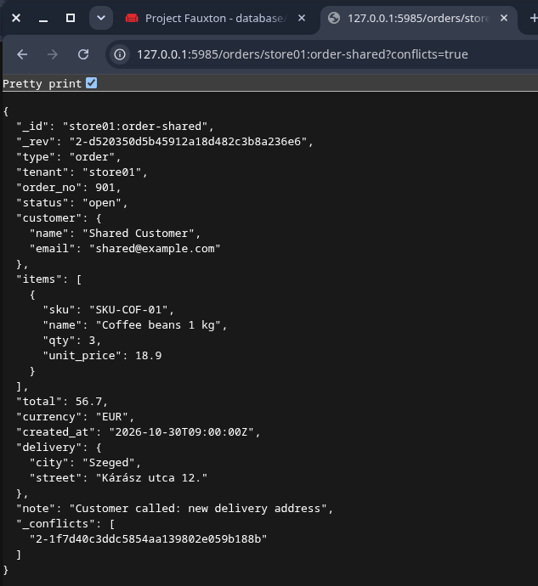
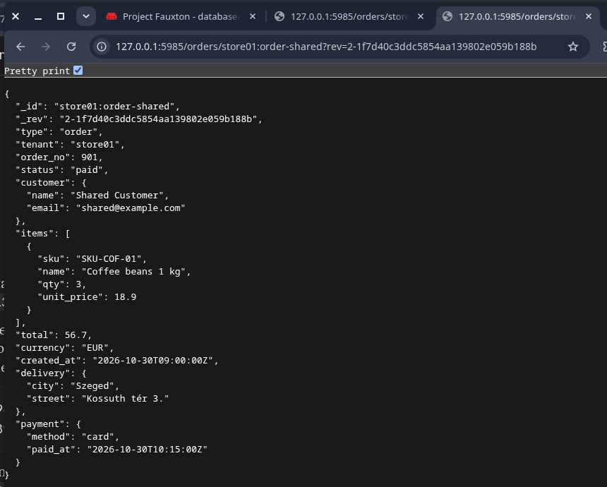
The conflict, seen from instance B
PART 5B · REPLICATION
Fauxton shows only the winner, 2-d520…
?conflicts=true reveals a second branch, 2-1f7d…
Fetched by its id, the loser turns out to be A’s payment.
Screenshots from python run.py B, taken before the merge step
Part 5B · Replication
Notes:
Daniel, about 1 minute 10 seconds: 30 seconds on the slide, then about 40 seconds in the terminal. The script is paused before the merge.
On the Slide:
Here’s the same situation as a user would see it, on instance B. When you open the document in Fauxton, you see only one version: B’s, with the corrected street address, but with the order still open. Nothing on this screen suggests there’s a conflict. Only when you ask with conflicts=true does the second branch show up, and fetching that branch by its revision id gives A’s version: the paid order with the old address. So the payment didn’t disappear; it was hidden, simply because of how the revision ids sort. That’s what the next step is about.
Terminal:
(return to the paused script; continue at step 24)
Step 24, merge:
CouchDB never merged anything, so we do it ourselves, field by field against the common start: the status comes from A, the street from B. We save that as a new revision on the winning branch, 3-8fc0.
Step 25, delete the loser:
Then we delete the losing branch, using its own revision id, not the new one, otherwise we’d delete the document we just fixed.
Step 26, verify:
After replication, both servers show revision 3-8fc0, paid and with the new street, and no remaining conflicts. The old branch only appears under deleted conflicts. Twenty-seven out of twenty-seven checks passed. With that, I’ll hand over to Csaba for partitioning.

Slide 12
Partitioned vs global queries
PART 5C · PARTITIONING
NORMAL DATABASE
PARTITIONED DATABASE
POST /orders_global/_find
=
POST /orders_partitioned/_partition/store01/_find
global index tenant-status
partitioned index tenant-status
10 ids
10 ids
Checked with limit 100 and over every bookmark page of 3: complete, identical id sets, data unchanged.
Needs a global view
Not claimed
Open orders of all stores on the partitioned DB: no usable index, a warning, 101 documents examined.
Physical distribution across servers or a speed-up: one node, n=1, q=2 for both databases.
C: 15 / 15 checks passed · evidence/30_partitioned_queries/
Part 5C · Partitioning
Notes:
Csaba, about 3 minutes: 30 seconds on the slide, about 2 minutes in the terminal (python run.py C), then 20 seconds back on the slide.
---
On the slide:
For partitioning, we compare two databases that hold exactly the same hundred orders. One is a normal database, the other is partitioned by store. Both have the same settings, so the only difference is the partitioning itself. We’ll ask both the same question and check that the answers match.
Terminal:
(start python run.py C)
Steps 1–4, two databases:
First the normal database, then the partitioned one. The database info confirms the settings: partitioned true on the second, and both have one copy and two shards. The same hundred orders go into each.
Step 5, partitions:
Each store is its own partition. Here’s what CouchDB reports for store01, store02 and store05: twenty orders each.
Step 6, id rule:
In a partitioned database, every id has to start with its partition key. An id without one is simply rejected with a 400.
Steps 7–8, indexes:
Each database gets an index on tenant and status: a normal, global index on the first, and a partitioned index on the second.
Steps 9–12, the question:
Now the question: the open orders of store01. Explain shows that each endpoint picks its own index, and both return ten orders. The partition endpoint never even looks outside store01.
Steps 13–14, complete results:
To be thorough, we don’t just compare one page. We page through both results three at a time using bookmarks, until we reach a short page. Ten orders on each side, the same ten.
Step 15, a cross-store question:
A question across all stores is a different matter. On the partitioned database, with only a partitioned index, CouchDB warns that there’s no matching index, and you can see it examined all 101 documents. The fix would be a global index next to the partitioned one.
Back on the slide:
So the partitioned query gives the same answer while staying inside one store. What we’re not claiming: on a single server this says nothing about spreading data over several servers, and we didn’t measure a speed-up. Fifteen out of fifteen checks passed.

Slide 13
Transactions stop at one document
PART 5D · TRANSACTIONS
D1 · STALE UPDATE
D2 · ONE _bulk_docs REQUEST
Writer 1 updates rev 1 → rev 2 (on_hand 8). Writer 2 still holds rev 1 and tries again.
bulk-a with its current rev, bulk-b with a stale rev:
HTTP 201 Created
[{"ok": true, "id": "bulk-a", …},
{"id": "bulk-b",
"error": "conflict"}]
HTTP 409 conflict
The stored value stays 8: no lost update.
Read-back: bulk-a new, bulk-b unchanged.
An overall 201 is not success: check every item. A bulk request is a batch, not a transaction.
D: 11 / 11 checks passed · database txn_test, no replication
Part 5D · Transactions
Notes:
Csaba, about 2.5 minutes: 20 seconds on the slide, then about 2 minutes in the terminal (python run.py D, steps 1–8).
---
On the slide:
This experiment is about where CouchDB’s transactions stop. We use a separate test database with no replication, so that what we see is purely about one server. The two halves of the slide are the two tests.
Terminal:
(start python run.py D)
Steps 1–2, two writers:
We create a stock document with ten items on hand, at revision 1. A first client updates it to eight, and gets revision 2.
Step 3, the stale write:
A second client still holds revision 1 and tries to set nine. CouchDB refuses with 409 Conflict, because that client hasn’t seen the latest version.
Step 4, read back:
Reading it back, the value is still eight, at revision 2, so the first update wasn’t overwritten. That’s optimistic concurrency, and it works well, but only within one document.
Steps 5–6, setup for D2:
Now two documents, bulk-a and bulk-b. We update bulk-b once, so the revision we saved for it is now out of date.
Step 7, one bulk request: We send one _bulk_docs request: a valid update for bulk-a and the outdated one for bulk-b. Look at the status: 201 Created, which looks like success. But inside the response, bulk-a is ok and bulk-b says conflict.
Step 8, read both: Reading both confirms it: bulk-a changed, bulk-b kept its previous value. So a bulk request is a batch of independent writes, not an all-or-nothing transaction. An overall 201 doesn’t mean every item succeeded; you have to check each one.
(Press Enter once more for step 9 and stay in the terminal; the next slide’s note starts with it.)

Slide 14
Order saved.
Stock not decremented.
PART 5D · WHAT IT MEANS FOR THE SHOP
“Create order + decrement stock” in one _bulk_docs request, with a stale stock revision, half-succeeded. Invariants across documents need retries or compensation, or one business event per document.
Notes:
Csaba, about 1 minute: 25 seconds in the terminal (step 9 of python run.py D), then 35 seconds on the slide.
---
Terminal:
Step 9:
Here’s what that means for a shop. At checkout we write two documents in one bulk request: the new order, and the stock count reduced by one. Just before that, another checkout updated the stock, so our stock revision is already out of date. Look at the response: the order is ok, the stock update is a conflict. And reading the stock back, it’s 7, so only the other checkout was counted. Our order went through without reducing the stock.
On the slide:
So the order is saved, the stock isn’t reduced, and the two no longer agree. CouchDB won’t roll this back for us. Either the application notices the failed item and retries or compensates, or we change the data model so that each business event lives in a single document. For example, the order itself could carry the stock reservation, and stock levels could be derived from the orders with a view. Eleven out of eleven checks passed.

Slide 15
What our results show
PART 6 · CONCLUSION
USE CASE
STRENGTH · SEEN IN 5B
LIMITATION · SEEN IN 5D
Offline-first order sync between shop branches or mobile tills.
Concurrent edits on A and B were detected, kept and resolved identically on both: no silent data loss.
Atomicity ends at one document: a bulk request half-succeeded and left order and stock inconsistent.
CouchDB fits data that is naturally one document per business event and must survive being edited in several places.
80 / 80 checks passed on Fedora 44 · reproduce with: python run.py
Part 6 · Conclusion
Notes:
Csaba, about 45 seconds, then leave the sources slide up for a few seconds.
---
To sum up:
we ran two independent CouchDB servers and showed CRUD with revisions and an indexed query. We set up two-way replication, created a real conflict and resolved it. We compared partitioned and global queries, and we found where CouchDB’s transactions end.
A realistic use case is synchronising orders between shop branches that are sometimes offline. The strength we actually saw is that conflicting edits are never silently lost, and both servers agree on the outcome. The limitation we saw is that two documents can’t be changed together in one transaction, so any rule that spans documents has to be enforced by the application.
All eighty automated checks passed, and anyone can repeat the whole run with one command, python run.py. Thank you for watching.

Slide 16
Sources
Apache CouchDB documentation (3.x)
History, licences, tools
Single node setup; Installation via Docker
Introduction to replication; Replicator database
Replication and conflict model
Partitioned databases
Mango: /{db}/_find and indexes
Bulk documents: transaction semantics
Document API: revisions, deletion
Wikipedia, “Apache CouchDB”: en.wikipedia.org/wiki/Apache_CouchDB
QCon San Francisco 2010, speaker profile of Damien Katz
Apache CouchDB downloads and Apache License 2.0: couchdb.apache.org
Docker: Docker Desktop WSL 2 backend; Docker Desktop licence
Course handout: NoSQL databases group project
docs.couchdb.org/en/stable
Project repository: scripts, data generator, README and evidence for every experiment.
Notes:
Leave this on screen for a few seconds at the end of the video. The full links are in the README.

Slide 17


