Slide 1
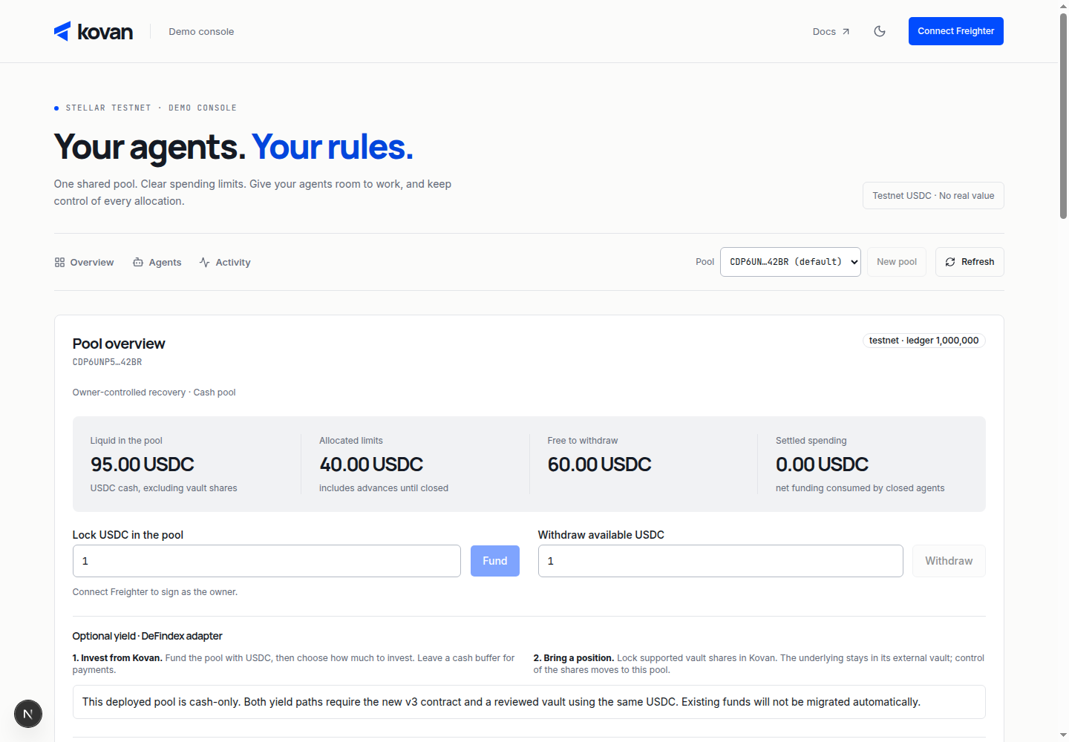

kovan
HACKMERIDIAN 2026 / LISBON
BACKUP 01 / 07
A / PRODUCT DEMO
The owner’s control surface.
REHEARSAL CHECKLIST
1. Inspect the rules
Show payee, cap and expiry.
2. Show the receipt
Open the explorer transaction.
3. Trigger a refusal
Explain why no funds move.
Actual dashboard UI from a browser check; balances and agent state are illustrative test fixtures, not live funds.
STELLAR TESTNET · HACKATHON PROTOTYPE
Notes:
BACKUP A · PRODUCT DEMO
This is the real dashboard UI captured in a browser check with API fixtures. The values are not chain activity or evidence of users. It is included to show the product surface, not to substitute for a transaction receipt.
The screenshot was already present in /tmp/kovan-design-review-qQWT0a/dashboard-light-1440.png; the associated script intercepts /api/state and /api/events. For the stage demo, use the running dashboard and real testnet records, or an explicitly labeled replay.
Prepare: funded testnet pool, approved payee, small cap, endpoint terms, explorer tabs, and backup recording. Use a fresh agent for repeat demos so spent caps and revocations do not invalidate the script.

Slide 2
kovan
HACKMERIDIAN 2026 / LISBON
BACKUP 02 / 07
B / AUTHORIZATION BOUNDARY
A policy the agent cannot remove.
01
02
03
Agent signs
Account verifies
Call executes
Its own Ed25519 key.
Signature + covenant.
Only inside the rules.
FIXED AT CREATION
OWNER CONTROLS
Signer, allowlists, policy binding.
No management rule to remove them.
Numeric limits, expiry, revocation.
Recovery without the agent’s key.
Source: README.md and agent-account/covenant-policy implementation. Recovery remains subject to the token allowance.
STELLAR TESTNET · HACKATHON PROTOTYPE
Notes:
BACKUP B · HOW THE BOUNDARY WORKS
The pool deploys an OpenZeppelin smart account with one context rule: the agent's External Ed25519 signer and the covenant policy. It has no management rule. The account cannot add a signer or remove the policy through an authorized self-call.
The policy is a separate contract from the pool to avoid Soroban re-entry constraints. It checks approved token transfers and configured contract calls, caps, expiry and revocation. The verifier checks the agent's signature.
Differentiation: Kovan combines shared allocation accounting, frozen agent accounts, narrower delegation and owner recovery. x402 is the payment transport; OpenZeppelin is the account primitive. They are foundations, not competitors Kovan replaces.
For a stolen key: the attacker still operates within the permitted destinations and caps, but may exhaust those budgets. Revoke quickly. Recovery can only recover the remaining balance and depends on the allowance, contract execution and available chain state.
Official reference: https://docs.openzeppelin.com/stellar-contracts/accounts/policies

Slide 3
kovan
HACKMERIDIAN 2026 / LISBON
BACKUP 03 / 07
C / POOL ACCOUNTING
Spent funds never become a new budget.
Example: one agent draws 10 USDC and spends 3.
10
3
7
DRAWN
SPENT
RECOVERED
Advanced to the agent
Settled as consumed
Returned on closure
Only the unused 7 is released for another allocation.
Illustrative arithmetic from README.md, “Deployed cash-pool accounting v2”; amounts are not usage metrics.
STELLAR TESTNET · HACKATHON PROTOTYPE
Notes:
BACKUP C · ACCOUNTING
For v2, locked is an accounting total: actual pool cash plus outstanding agent advances. It is not simply the pool's cash balance. sum_limits is the draw limit total for non-closed agents, and available funds are locked minus sum_limits.
Closing an agent freezes spending, pulls back its balance, records unrecovered advances as settled_spent and releases unused allocation. Spent funding cannot be counted twice. A child returns only unused allocation to its parent, and children close first.
The example assumes a 10-USDC allocation drawn in full, 3 spent and 7 left in the wallet. A raw transfer to the pool is an unattributed deposit; use return_funds for the agent's reconciliation history.
Permanent pool closure requires zero open agents, allocations and advances, and returns remaining pool cash to the original owner. Historical records remain. Source: README.md.

Slide 4
kovan
HACKMERIDIAN 2026 / LISBON
BACKUP 04 / 07
D / DELIVERY STATUS — 26 OCT 2026
What ships today. What comes next.
TESTNET
Shared pool + covenants
Cash-only v2; x402 payment evidence.
TESTNET
Native payment mandates
Exact or budget grants; on-chain receipts. Released 26 Oct.
LOCAL BUILD
DeFindex yield backing
Cash-first draws; shares held by pool.
NEXT
Distribution + pilots
SDK on npm; x402 rehearsal on the new release; pilots.
Sources: README.md; docs/MANDATES.md; docs/YIELD.md; docs/SDK.md. Local work does not upgrade immutable deployments.
STELLAR TESTNET · HACKATHON PROTOTYPE
Notes:
BACKUP D · COMPLETENESS WITHOUT OVERCLAIMING
Current default deployment: cash-only pool v2. Historical USDC x402 evidence and isolated v2 lifecycle evidence are linked in the evidence slide.
Native Kovan mandates: released on testnet on 2026-10-26 (policy CAQAHBSHKEUQCXUMFCD65GNRTKDNE5A7HOHA7XVOKVKTV4H4O63OWJYB; new pools use the release) and rehearsed end to end on an isolated pool with a direct payment. Facilitator acceptance of the mandate envelope over x402 is not yet rehearsed. They add owner-approved exact/budget grants, payment IDs, expiry and receipts, and intersect with covenant limits. They are not AP2 signed credentials, MCP, A2A, escrow or delivery verification. New compatible contracts and agents plus a funded facilitator rehearsal are required.
Yield v3: locally tested, not deployed/activated. Supports one compatible single-asset DeFindex vault and transferable shares using the exact pool asset. Cash is used before redemption. Backing discounts estimated vault value by 10%; this buffer is not insurance. Losses or unavailable liquidity may stop draws. No APY or live yield claim.
SDK: @kovan-protocol/sdk@0.1.0 is published on npm. Agent guides/plugin and owner signing flows exist.
General contract-call allowlisting is not equivalent to a completed Blend/Soroswap integration. No broad claims about MPP/AP2/A2A or reputation implementations.
This is a status snapshot from the repository, not a deployment verification run.

Slide 5
kovan
HACKMERIDIAN 2026 / LISBON
BACKUP 05 / 07
E / EVIDENCE, WITH SCOPE
Inspect the evidence.
USDC / LEGACY POOL
547
0.01 USDC paid over x402
781a5f2b… · API content returned
XLM / ISOLATED V2 POOL
tests passing on main
Complete cash lifecycle
152 contracts
267 dashboard
79 SDK · 49 signer
Pay, revoke, recover, close; testnet XLM
PRE-SUBMISSION SIMULATION
Unapproved payee refused
PayeeNotAllowed · no submitted transaction
547 = test run on main, 2026-10-26: 152 Rust, 267 dashboard, 79 SDK, 49 signer; excludes one optional ignored fixture test and six opt-in network tests.
STELLAR TESTNET · HACKATHON PROTOTYPE
Notes:
BACKUP E · EVIDENCE REGISTER
Test count is 152 Rust + 267 dashboard + 79 SDK + 49 signer = 547, run on main on 2026-10-26 (README, Testing). It includes the released mandates and the unactivated yield work, and excludes an optional ignored external fixture test. It does not establish an audit or a live production deployment.
Legacy USDC x402 payment: https://stellar.expert/explorer/testnet/tx/781a5f2b560df66d3d6c587ef4f2a283e82421ce16b54565a9a64a8ba662775d
Legacy USDC direct payment: https://stellar.expert/explorer/testnet/tx/263d05036ee5bcc7520cef1dc39fb36a85ab4c90d5eda2caa5a62e7d2b0f4fb0
Legacy USDC return: https://stellar.expert/explorer/testnet/tx/c455d6a3229fe29f82ecd00d26de2d0c86ee76f365a8230bb96b153db71665b3
Current default v2 deployment: https://stellar.expert/explorer/testnet/tx/b2b2f1f8fd3911504f91a5d9f959ffdb61a24e1b9a9fa9c29b56965eb26074f5
Separate isolated v2 XLM agent closure: https://stellar.expert/explorer/testnet/tx/4d1eb6b875096c799aefc9bbb6e7a50ce201e85a8330517c9fc4ea02a66969f4
Separate isolated v2 XLM pool shutdown: https://stellar.expert/explorer/testnet/tx/0a8d81a9006b5a53ec6676e0df72a99d0ce6a30812b65f075631db097accc0ae
Sources: README.md, docs/SDK.md, docs/MANDATES.md. Contract records were not independently re-queried in this deck task. Testnet history can reset.

Slide 6
kovan
HACKMERIDIAN 2026 / LISBON
BACKUP 06 / 07
F / ADOPTION
Built to be adopted by agents.
01
Give the agent the guide
agent.md · llms.txt · Claude Code plugin
02
Approve with your own wallet
Agent prepares. Owner reviews and signs.
03
Integrate the TypeScript SDK
Pools, payments, signing and recovery.
@kovan-protocol/sdk@0.1.0 is on npm. Guide: kovan-protocol.vercel.app/agent.md
STELLAR TESTNET · HACKATHON PROTOTYPE
Notes:
BACKUP F · INTEGRATION / PATH TO USERS
The agent guide and Claude Code plugin let an agent prepare owner transactions using kovan.mjs. Owner approvals are signed in Freighter through local or hosted signing interfaces. Runtime agents may supply their own public keys; app-managed keys are an optional convenience and the app retains its signing copy even after export.
The package name is @kovan-protocol/sdk, not @kovan/sdk. It is a local TypeScript/ESM package; do not show npm install as a published workflow until a package is actually released. Applications supply their own configuration and signers.
Go-to-market hypothesis: start with developers already running x402 API agents, publish reproducible examples, onboard pilot teams and measure useful paid tasks and repeat usage. No revenue, customer count or committed commercial model is asserted. A possible future business is hosted operations and monitoring; validate willingness to pay before putting pricing on a slide.

Slide 7
kovan
HACKMERIDIAN 2026 / LISBON
BACKUP 07 / 07
G / JUDGE Q&A
A spending boundary, not a guarantee.
Can prompt injection still do harm?
Yes—within an approved budget and payee list.
Does a receipt prove the task succeeded?
It proves payment, not delivery or correctness.
Can the owner get spent funds back?
Recovery returns the remaining wallet balance.
Is it ready for real customer funds?
Testnet prototype; review and audit come first.
STELLAR TESTNET · HACKATHON PROTOTYPE
Notes:
BACKUP G · TWO-SENTENCE ANSWERS
“Why not just x402?” x402 carries the payment request and settlement authorization. Kovan constrains who may be paid and how much, and coordinates many agents against one shared pool.
“Why not a standard wallet?” A raw signing key can authorize transfers from a classic account without Kovan's application policy. Kovan puts the restrictions in the smart account's authorization path, together with pool allocation accounting and recovery.
“What if the key is stolen?” The attacker remains subject to the approved payees, caps, expiry and revocation. The owner can revoke and recover the remaining funds, but a permitted payment can still be wasteful.
“Who holds keys?” Owners sign with their own wallet; runtime agents can supply their own signing keys. App-managed mode retains an application-side signing copy, so avoid a blanket claim that Kovan never holds any agent key.
“Why blockchain?” The recipient, asset and amount can be checked at the same execution boundary that moves the funds. The public settlement record makes those controls inspectable independently of the agent prompt and UI.
“Can you guarantee recovery?” Recovery does not reverse settled payments and depends on the token allowance and executable chain state. The default recovery allowance is valid for 3,000,000 ledgers from account creation.
“What about yield?” Yield is an opt-in, locally tested DeFindex integration, currently inactive. Vault losses and liquidity constraints can prevent draws; the 10% backing discount is not insurance.
“What would prove demand?” Onboard developers who already pay for agent inputs and track completed paid tasks and repeat use. The pitch currently demonstrates technical capability, not proven product-market fit.

