Slide 1
Multiscale Image Compression with
Attention-Enhanced
Discrete Cosine Transform Models
Oppangi Poojita (B21CS055), Kovidh Pothireddy (B21AI026)
under the supervision of Prof. Binod Kumar

Slide 2
Table of contents
01
02
03
04
05
06
Introduction
Dataset
Model Architecture
Training &
Loss Function
Visualization
Of Results
Comparison with Traditional Methods

Slide 3
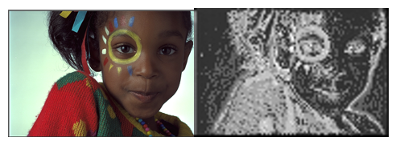
01
Introduction
Deep Learning revolution of Image compression

Slide 4
Deep learning has revolutionized image compression by using neural network architectures for transform, quantization, and entropy coding.
Deep learning-based image compression has made significant progress, achieving better rate-distortion (R-D) performance than traditional methods like JPEG and JPEG2000.
Traditional methods like JPEG and JPEG2000 have limitations in achieving compression in - achieving in maintaining high image quality.
Proposed Solution: We propose an efficient and effective image compression framework that achieves superior R-D performance with lower complexity. We combine Multi-Frequency Channel Attention (MFCA), Pyramid Multi-Convolution Network (PMCN), and Perceptual Quality Enhancement (PQF) to achieve efficient and effective image compression.

Slide 5

Dataset
The Kodak dataset, a standard benchmark for image compression algorithms, contains 24 high-quality images at 768x512 resolution. It is known for its high resolution and diversity, it’s ideal for evaluating image compression performance.
Data Preprocessing:
Images are resized to 384x384 and normalized.
Data Augmentation:
Random horizontal flipping and cropping to 384x384 are applied to increase the dataset size and diversity.

Slide 6
Multi-Frequency Channel Attention (MFCA)
This is a technique used in deep learning models to improve their focus on important features in images. It achieves this by analyzing the image in different frequency domains to highlight regions with significant information.
By breaking down an image into different frequency components, MFCA creates attention maps that guide the model to prioritize crucial parts of the image over less important ones.
Mechanism: We use Discrete Cosine Transform (DCT) to decompose the image into different frequency components and the resulting coefficients are used to generate attention maps.
These attention maps are then multiplied with the original features to emphasize important regions.
By focusing on important features, the MFCA module can improve the visual quality of the reconstructed images, leading to higher PSNR and SSIM values.

Slide 7
Why DCT?
Due to its efficient decomposition of images into frequency components, facilitating reduced data size with minimal perceptual loss.
Frequency Decomposition: DCT separates images into low and high frequencies, where low frequencies represent broad structures (color distribution) and high frequencies capture fine details ( textures and edges).
Spatial Correlation Reduction: By transforming spatially correlated pixel values into less correlated frequency components, DCT reduces redundancies, enhancing compression efficiency.
Energy Compaction: DCT concentrates most of the visual information in lower frequencies, allowing for significant data reduction by discarding high-frequency components.
Quantization and Compression: After DCT, quantization of high-frequency components further reduces data while retaining visual quality, as human perception is less sensitive to these components.

Slide 8
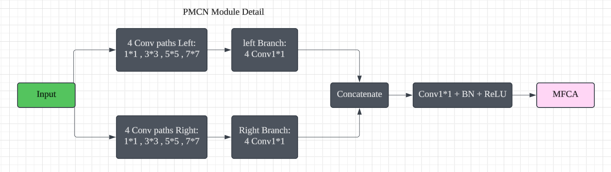
Pyramid Multi-Convolution Network (PMCN)
This aims to capture multi-scale features, allowing the model to process both detailed and global information from the input image.
It reduces spatial correlations in feature maps, improving the efficiency of the image compression process. It also enhances feature propagation through skip connections, mitigating the risk of vanishing gradients to ensure effective feature transfer throughout the network.
Architecture:

Slide 9
Quantization: It is a critical step in reducing the number of bits needed to represent the encoded features, making the compressed representation more efficient. During training, uniform noise is added for smooth gradient approximation through soft quantization. During inference, hard quantization rounds feature values to reduce precision and save space.
Entropy Coding: Following quantization, entropy coding further compresses the quantized features by encoding them more efficiently. Arithmetic coding encodes data into a continuous bit stream, reducing size without information loss. It compresses the importance map, and the Decoder reconstructs it losslessly.
Perceptual Quality Enhancement (PQF): It is essential to improve the visual quality of reconstructed images, particularly by addressing quantization errors that arise during compression. It uses a residual block with convolutional layers and ReLU activations to capture complex features. The enhanced features are passed to the decoder, improving image quality, robustness, and preserving key details.

Slide 10
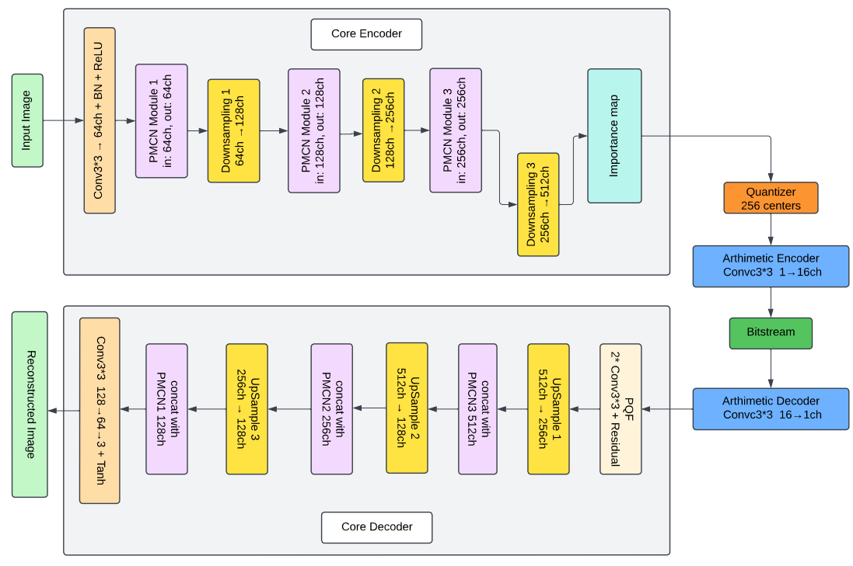
Network Architecture
The Core Encoder compresses the image by reducing spatial dimensions and enhancing feature abstraction using convolutions, PMCN blocks, and downsampling, while generating an importance map. The Decoder reconstructs the image by upsampling, applying PMCN blocks, and using skip connections for better feature propagation and quality. This design ensures efficient encoding and high-quality reconstruction.

Slide 11
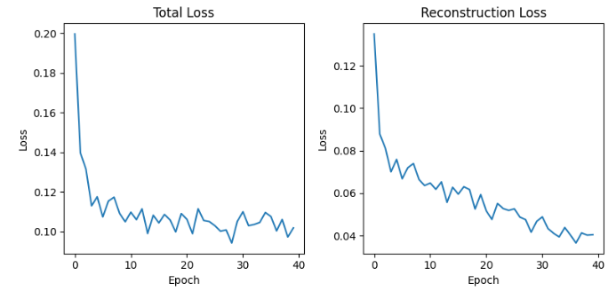
Loss Function and Training Setup
The combined loss function is a weighted sum of the below components, and the model is trained using the Adam optimizer to minimize it.
Reconstruction Loss: L1 loss between original and reconstructed images to preserve pixel accuracy.
Perceptual Loss: MSE to ensure human-perceived image quality.
Rate Loss: Sparsity constraint for efficient, low-bitrate encoding.
Quantization Loss: MSE between quantized and original encoded features to maintain quality post-quantization.
Total Loss = L1 Loss + 0.1 × MSE Loss +
0.5 × Rate Loss + 0.1 × Quantization Loss

Slide 12
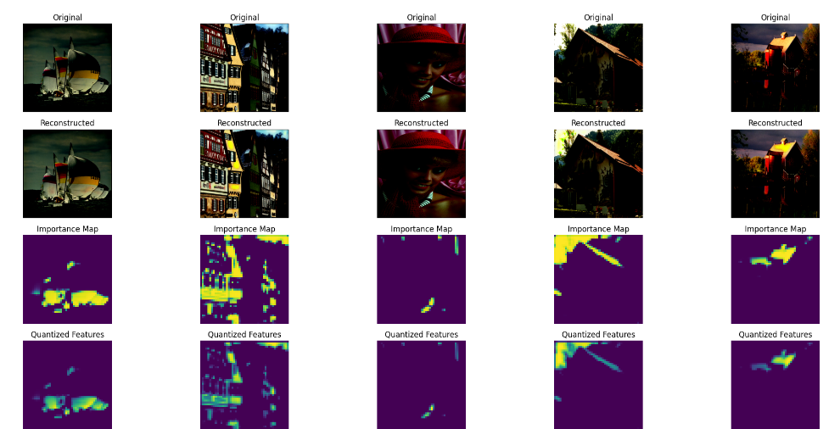
Visualization of Results
To visualize the results of the trained model on a sample image.

Slide 13
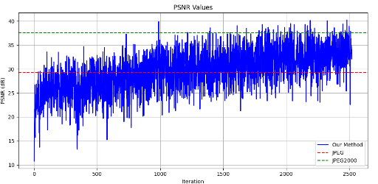
Performance Metrics
PSNR
Peak Signal-to-Noise Ratio measures the ratio of the maximum possible signal (original pixel values) to the noise introduced during compression.
PSNR mainly focuses on pixel-wise differences and does not consider structural integrity or perceptual factors, making it less sensitive to visual quality.

Slide 14
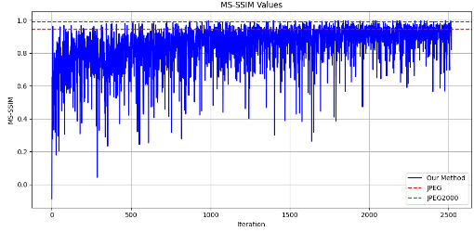
Performance Metrics
SSIM
Structural Similarity Index evaluates the visual quality of an image by considering structural elements such as luminance, contrast, and texture.
It is considered a more effective metric for evaluating how well the reconstructed image preserves important visual features like edges and textures, offering a better representation of human visual experience.

Slide 15
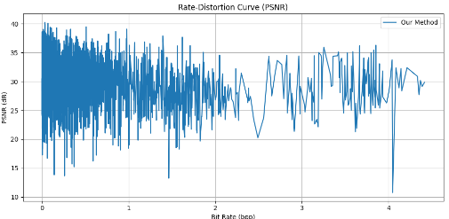
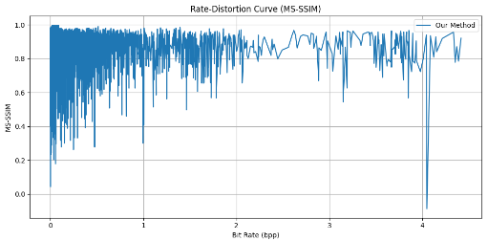
Rate-Distortion (R-D) Graphs
Both PSNR and SSIM values increase as the bit rate increases, indicating that higher bit rates result in better image quality.
The slopes of the our method's curves is steeper than that of JPEG and JPEG2000, indicating that the proposed method is able to achieve better compression efficiency.
Notes:
sdfghjk

Slide 16
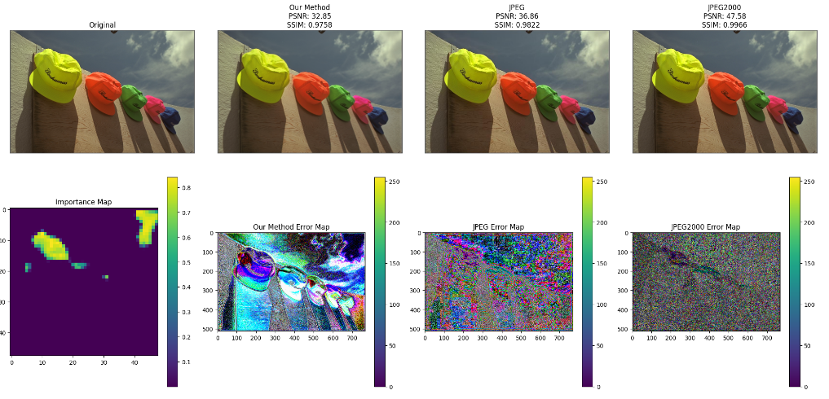
Comparing with JPEG, and JPEG2000
We compared the visual quality of images reconstructed by our model with those compressed using JPEG and JPEG2000, using PSNR and SSIM metrics.

Slide 17
Thank you!

