Slide 1
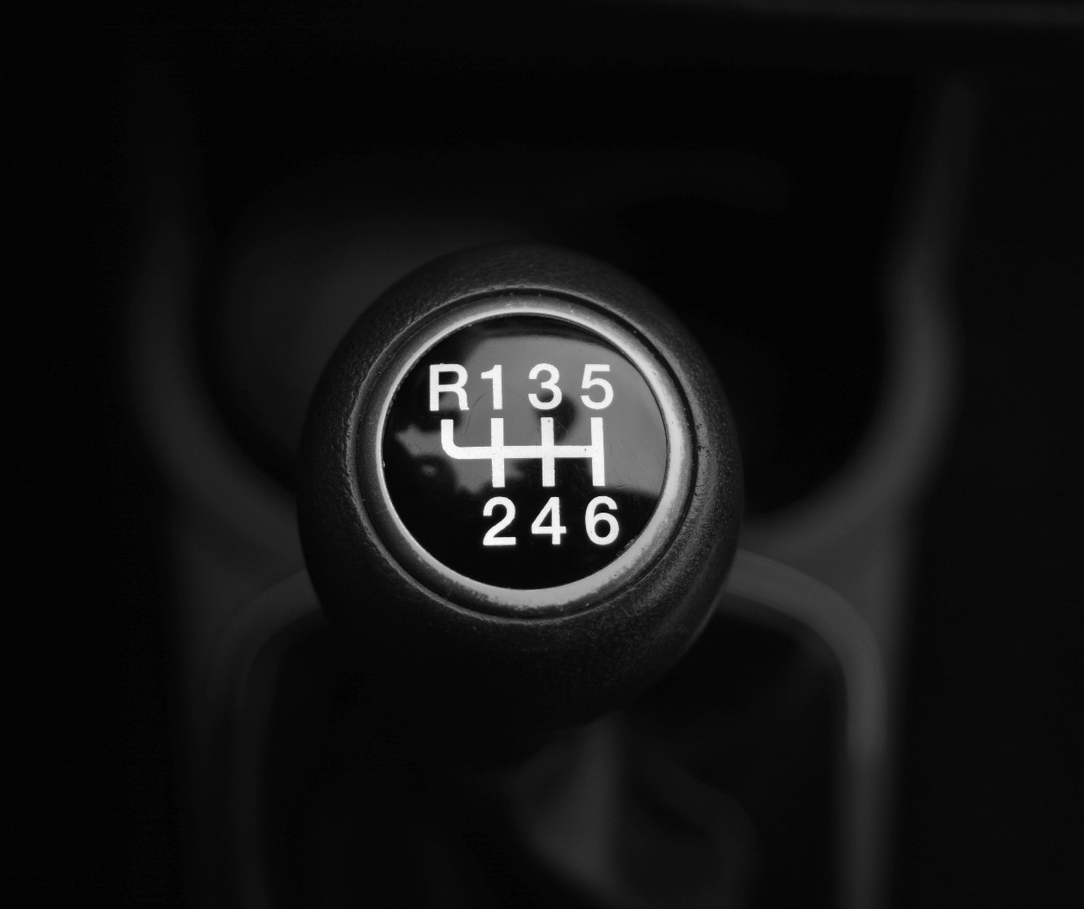
Predicting Fuel
Efficiency In Automobile
By
Karthik Kovuri

Slide 2
Introduction
The automobile industry has seen significant evolution over the decades
Innovations have transformed how vehicles are built, used, and perceived
Fuel efficiency has emerged as a critical focus in today’s transportation landscape
With the rising need for sustainability, understanding past trends becomes essential
We are exploring vehicle design and efficiency patterns from the 1970s to 1980s

Slide 3

Fuel Efficiency Trends: A Historical Data Analysis
This presentation explores fuel efficiency using car data from the 1970s and 1980s.
We bridge historical insights with modern automotive design, leveraging data analysis and machine learning to uncover key trends.

Slide 4
Research Gap & Problem Statement
Gap: Limited use of ML on older automotive datasets.
Problem:
  What features most significantly influence a car’s fuel efficiency (MPG)?
  Can we develop accurate machine learning models to predict MPG from historical car specs?
  How applicable are insights from 1970s–80s vehicles to today’s efficiency challenges?

Slide 5
Data Description
Dataset: Auto (397 entries, 9 variables)
Dataset Source: This dataset was taken from the StatLib library which is maintained at Carnegie Mellon University. The dataset was used in the 1983 American Statistical Association Exposition.
Target Variable: mpg (Miles Per Gallon – fuel efficiency)
Predictors: Cylinders, Displacement, Horsepower, Weight, Acceleration, Model Year, Origin

Slide 6
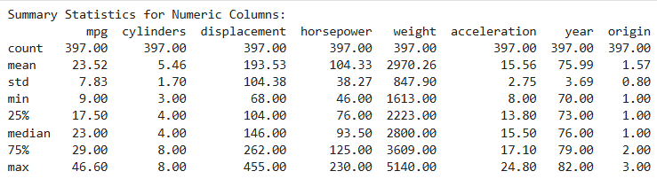
Summary Statistics

Slide 7





Methodology
Data Collection
Data Preprocessing
Exploratory data analysis(EDA)
Model Evaluation and Comparison
Model Training & Testing
Linear regression, Random Forest, XG Boost, Gradient Boosting, SVR

Slide 8
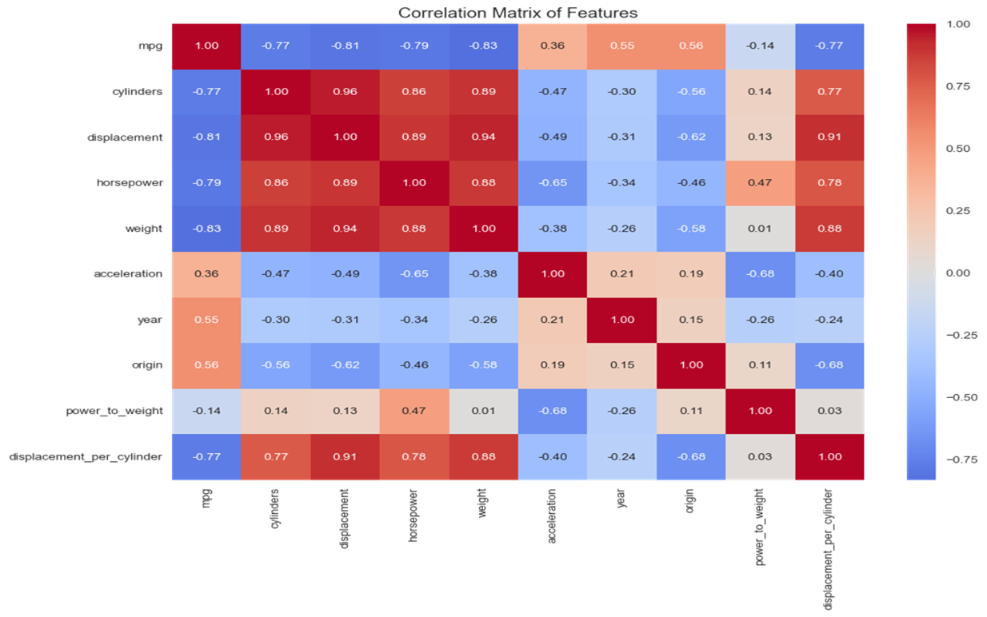
Correlation Matrix

Slide 9
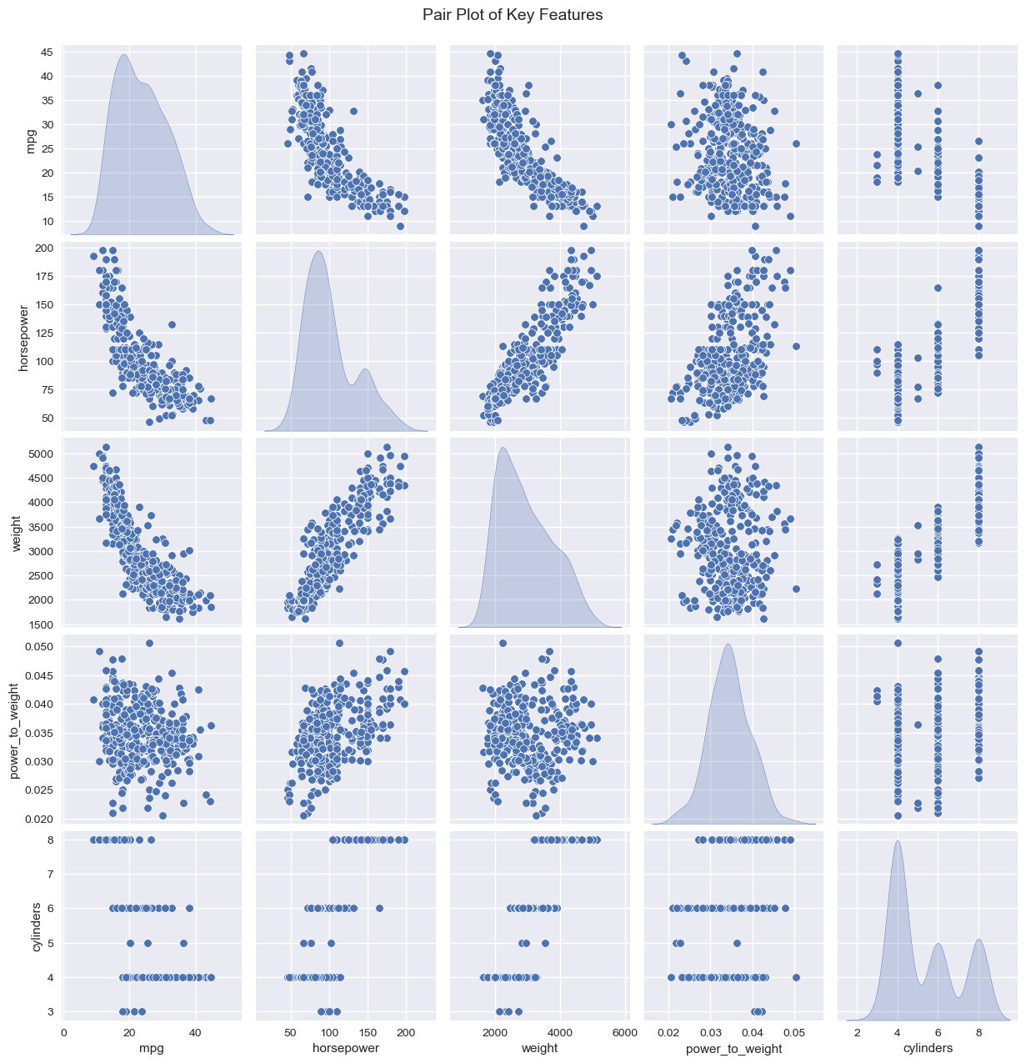
Pair Plot of Key Features

Slide 10
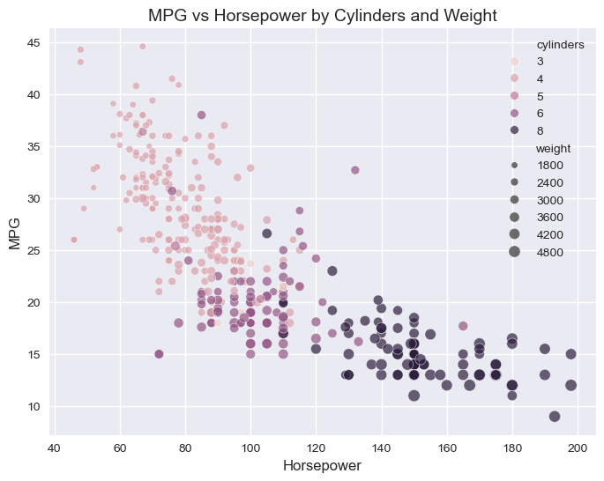
MPG vs Horsepower

Slide 11
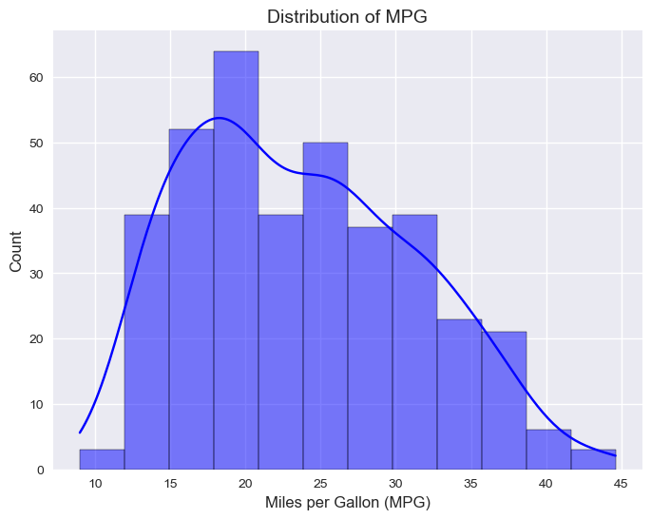
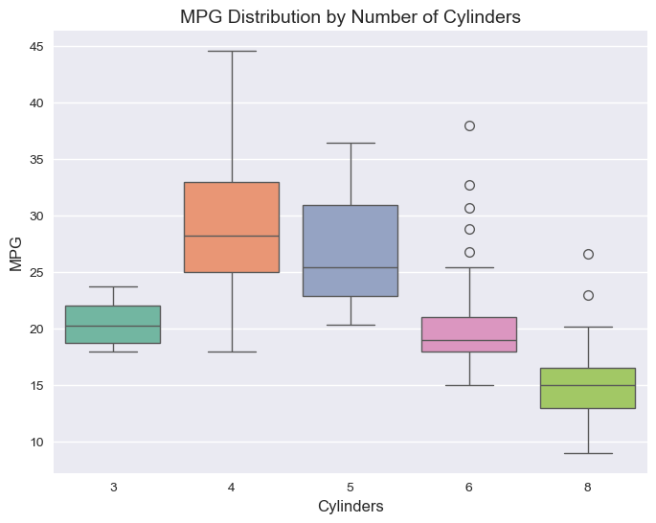
MPG Distribution​
​
MPG by Number of Cylinders​

Slide 12
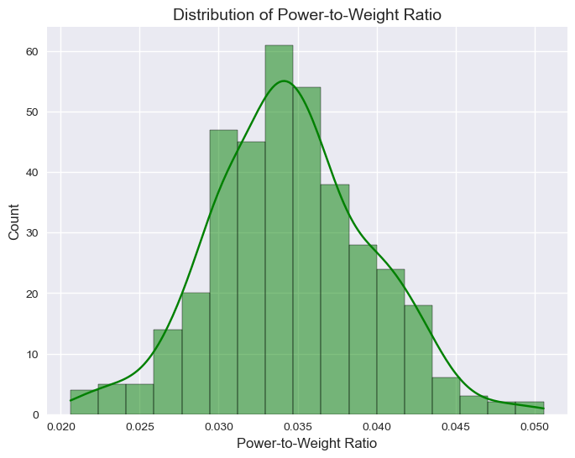
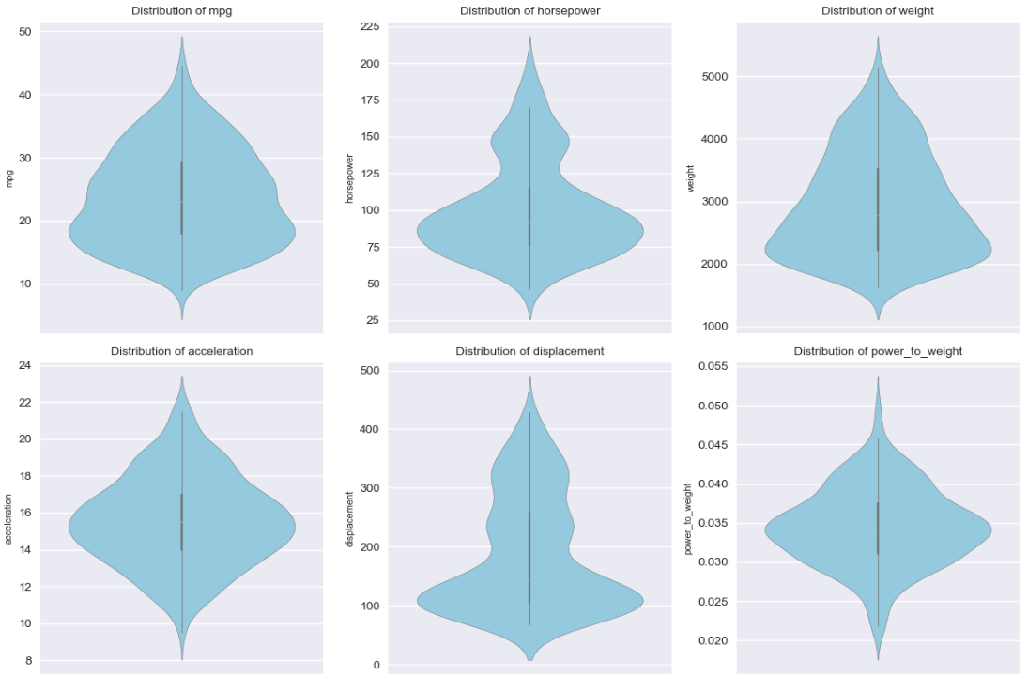
Power-to-Weight Ratio Distribution
Violin Plots of Numerical Features​

Slide 13
Linear Regression Coefficients
Feature | Coefficient | P-Value | Significance
Cylinder | -0.89 | 0.14
Displacement | 1.83 | 0.03 | *
Horsepower | -0.46 | 0.40
Weight | -5.66 | <0.01 | ***
Acceleration | 0.13 | 0.63
Year | 2.74 | <0.01 | ***
Origin | 0.77 | <0.01 | **

Slide 14
Model Performance Summary
Model | Test R² | Test RMSE | CV R² | CV RMSE | Test MAE
Linear Regression | 0.786 | 3.62 | 0.81 | 3.31 | 2.78
Random Forest | 0.817 | 3.34 | 0.87 | 2.68 | 2.02
Gradient Boosting | 0.812 | 3.38 | 0.88 | 2.62 | 2.29
SVR (Support Vector Regression) | 0.814 | 3.37 | 0.82 | 3.17 | 2.29
Xg Boost | 0.809 | 3.417 | 0.86 | 2.80 | 2.18

Slide 15



Feature Importance
Random Forest
Gradient Boosting
XG
Boost
  weight - 0.31
  cylinders - 0.29
  displacement - 0.12
  weight - 0.41
  cylinders - 0.30
  Year - 0.13
  Cylinders - 0.83
  Year - 0.05
  Weight - 0.04

Slide 16
Conclusion
Random Forest is the best model for predicting mpg, with the highest Test R² , lowest Test RMSE ,and lowest Test MAE, ensuring accurate and reliable predictions on unseen data.
Weight, cylinders, and year are the most inflsuential features affecting fuel efficiency.
The dataset shows a diverse range of cars with varying fuel efficiencies, weights, and manufacturing years, reflecting trends in the automotive industry from 1970 to 1982.

Slide 17
Business Implications
Design Optimization: Lightweight designs, smaller engines: RF (weight: 0.31, cylinders: 0.29), GB (weight: 0.41, cylinders: 0.30), XGB (cylinders: 0.83).Reduce weight by 500 lbs → ~1–2 mpg increase (LR coeff: -5.66).
Marketing Strategy: Highlight newer, lighter models with fewer cylinders (year 70–82, GB: 0.13; XGB cylinders: 0.83).Target eco-conscious buyers with high mpg.
Predictive Modeling: Use Random Forest for mpg predictions. Use XGBoost for minimal error applications (e.g., cost estimation).

Slide 18
Limitations Future Work
Outdated dataset (1970–1982), small size (397 entries).
Imbalanced origin (bias toward American cars).
Models need tuning, Linear Regression underperforms.
Lack of temporal dynamics (e.g., oil crises, regulations).
Update dataset with modern cars, add features (e.g., fuel type).
Build business tools (e.g., mpg prediction dashboard).
Balance origin data (e.g., oversampling, region-specific models).
Enhance Models

Slide 19
Thank you
Feel Free To ASK QUESTIONS!
With guidance from
Prof. Yue Gao

