Slide 1
SearchLens
A Reproducible Classical Search Engine with Positional Indexing & BM25
Presented by:
Karthik Kovi, Mohit Krishna Emani, Vignan Gadaley, Ram Venkat Sai Ritwick Vadlamudi
CECS 429/529: Search Engine Technology
California State University, Long Beach
Slide 1

Slide 2
The SearchLens Team
Mohit Krishna Emani - [Role: Project Lead & Core Engine]
Karthik Kovi - [Role: Preprocessing & Evaluation]
Vignan Gadaley - [Role: Web Interface & UI Design]
Ram Venkat Sai Ritwick Vadlamudi - [Role: Research & Testing]
Goal: To demystify the 'magic' behind information retrieval systems.
Slide 2

Slide 3
What is a Search Engine?
At its simplest, a search engine is a 'find' tool on steroids.
It solves three massive problems:
1. Speed: How to find data in milliseconds across millions of files.
2. Precision: How to make sure the best result is at the top.
3. Language: How to handle typos, phrases, and word meanings.
SearchLens focuses on the 'Ranked Retrieval' paradigm.
Slide 3

Slide 4
Motivation: Why Build This?
Modern search is dominated by 'Black Box' libraries (Lucene, Elasticsearch).
Understanding the 'lexical core' is essential for hybrid AI search.
Bridging the Gap: Connecting classroom theory to runnable, inspectable Python code.
Reproducibility: Proving that BM25 outperforms TF-IDF on technical data.
Slide 4

Slide 5
The Technical Challenge
Problem: Given a collection of 60 technical documents (SETC-60), how do we return the most relevant results for a user's natural language query?
Requirements:
Handle exact phrase matching (e.g. "search engine")
Support complex Boolean logic (AND, OR, NOT)
Rank results using probabilistic models (BM25)
Improve search automatically using user feedback loops
Slide 5

Slide 6
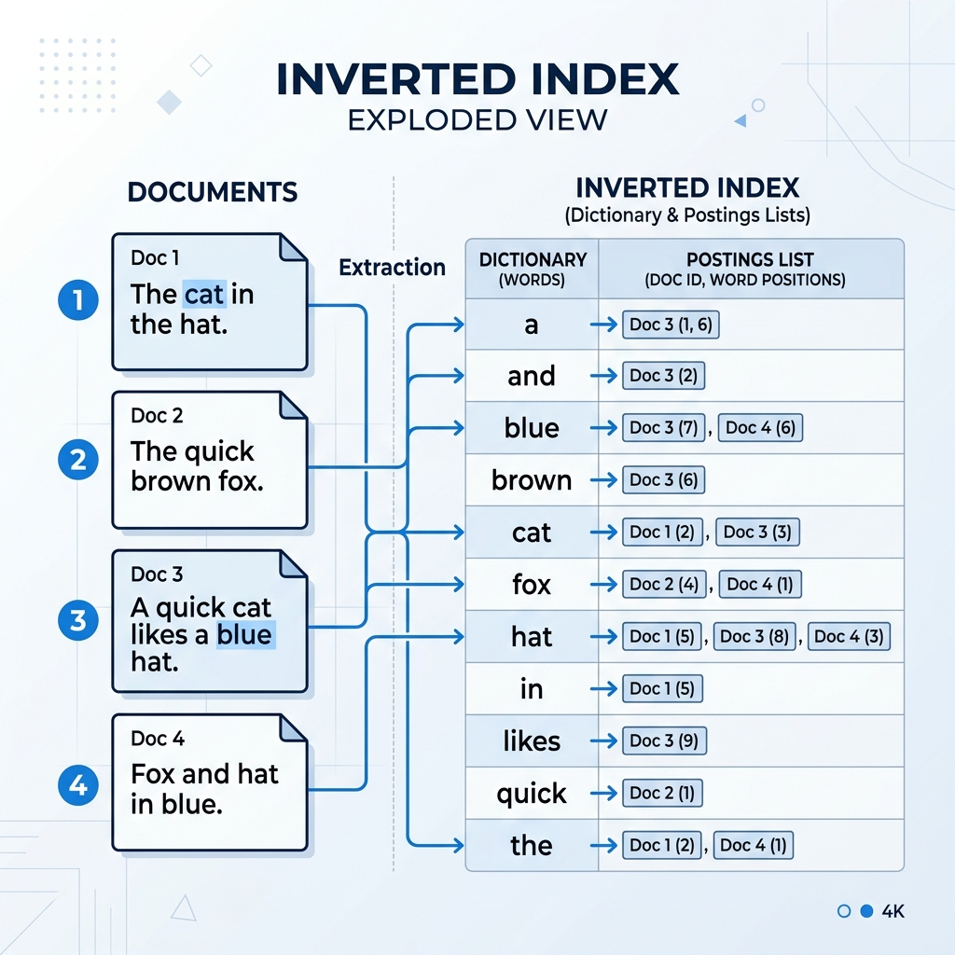
The 'Brain' of Search: Inverted Index
Searching every file for a word is slow (O(N)).
An Inverted Index maps words to their locations upfront (O(1)).
Positional Indexing: We don't just store which document has a word; we store the EXACT position of that word in the text.
Slide 6

Slide 7

The SearchLens Architecture
The system is built as a series of modular pipes:
1. Preprocessing (Cleaning the raw data)
2. Indexing (Building the data structure)
3. Retrieval (Finding candidates)
4. Ranking (Sorting by relevance)
Slide 7

Slide 8
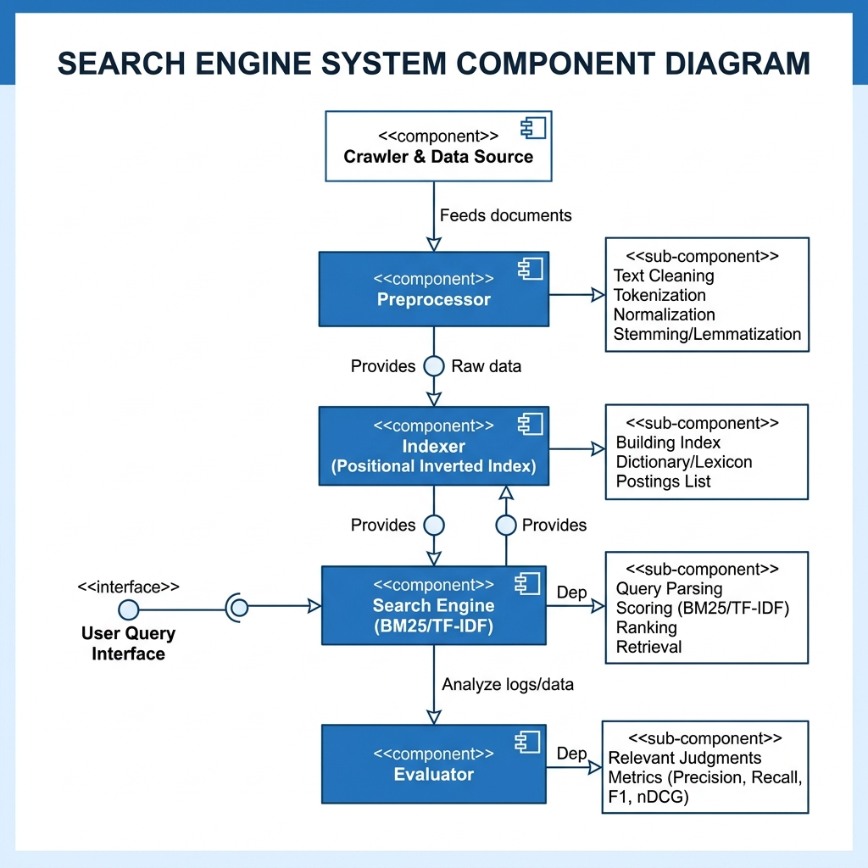
System Component Diagram
Slide 8

Slide 9
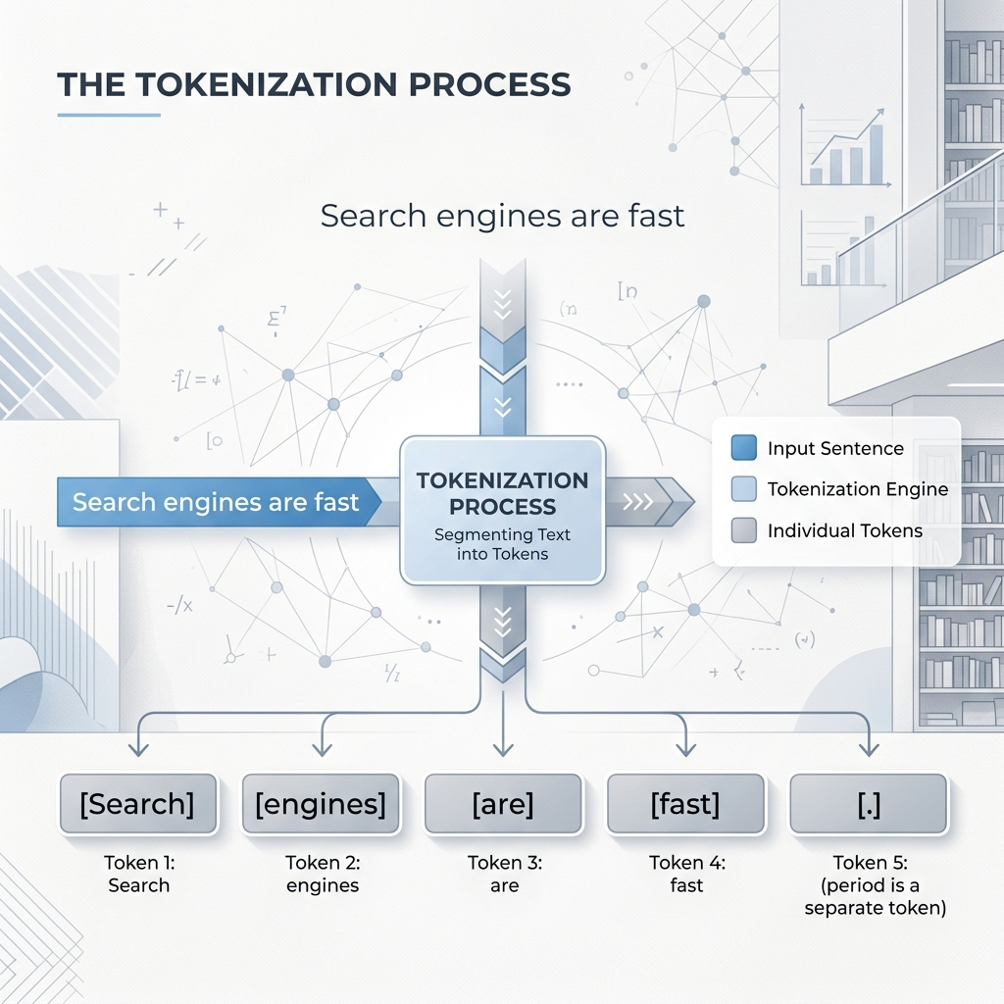
Preprocessing: Cleaning the Noise
Computers don't understand words; they see characters.
Tokenization: Splitting 'The search!' into ['the', 'search'].
Stopword Removal: Deleting common words ('the', 'a', 'is') that don't add meaning.
Normalization: Converting 'Searching' and 'Search' to the same root.
Slide 9

Slide 10
The Positional Indexer
Dictionary: A list of every unique word (lexicon).
Postings List: For each word, a list of [DocID, [Positions]].
Why Positions? This is how we support 'Phrase Search'.
Example: "Search Engine" is found if 'Search' is at pos 5 and 'Engine' is at pos 6 in the same doc.
Slide 10

Slide 11
Model 1: Boolean Overlap
The simplest ranking model.
It counts: 'How many of the user's query terms appear in this document?'
Formula: Score = |Query Terms ∩ Document Terms|
Weakness: It treats 'the' and 'algorithm' as equally important.
Slide 11

Slide 12
Model 2: TF-IDF Cosine
Term Frequency (TF): How often does the word appear in this doc?
Inverse Document Frequency (IDF): How rare is this word across the whole collection?
Wait weighting: Rare words (like 'Kullback-Leibler') get high scores; common words get low scores.
Similarity: We treat Docs and Queries as vectors and calculate the angle (cosine) between them.
Slide 12

Slide 13
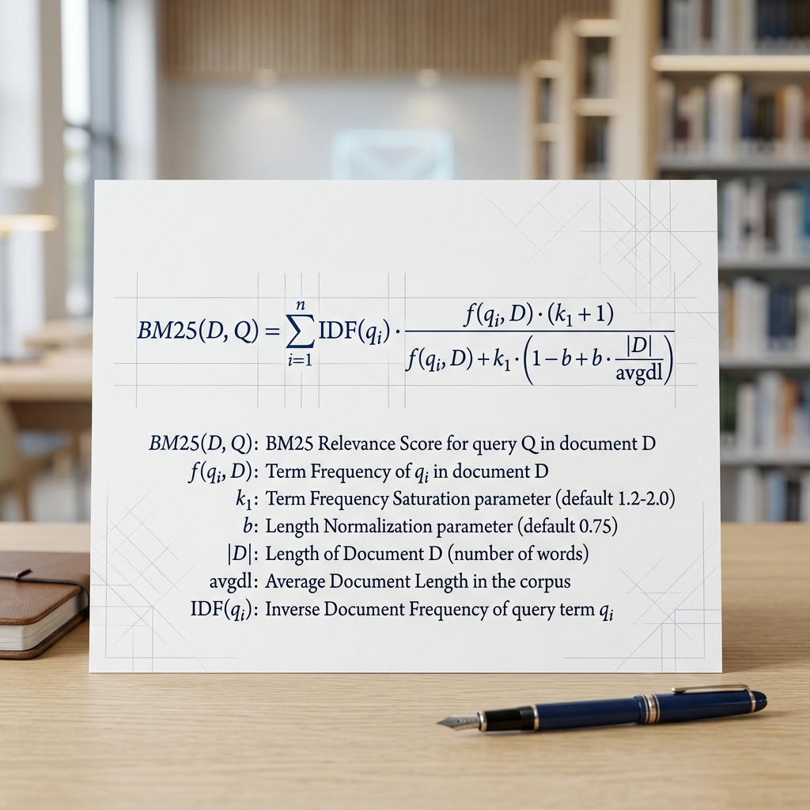
Model 3: Okapi BM25
Industry Standard: The default in Lucene/Elasticsearch.
Key Innovation: 'Term Saturation'.
If a doc has the word 'search' 100 times, it isn't 100x more relevant than a doc that has it 5 times.
Length Normalization: It penalizes very long documents (to avoid 'keyword stuffing').
Slide 13

Slide 14
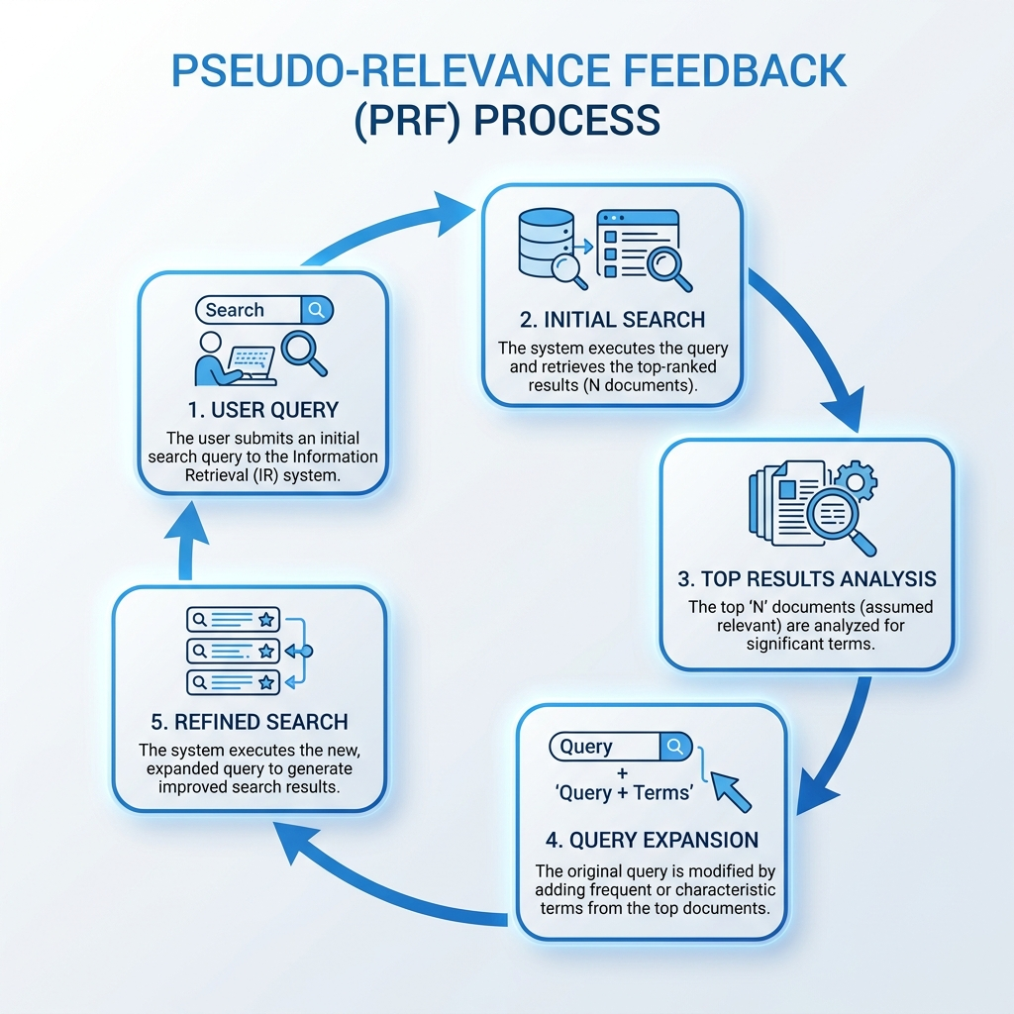
Pseudo-Relevance Feedback (PRF)
A self-improving search cycle.
The engine assumes the top 3 results are relevant.
It extracts 'meaningful' new words from those results.
It adds them to your query and searches again.
Result: Finds documents you would have missed with your original keywords.
Slide 14

Slide 15
Developer Interface: The CLI
Command Line Power: Search from your terminal.
Usage: python -m searchlens.cli search --query 'bm25' --method bm25
Returns: Ranked list, scores, and snippets with term highlighting.
Slide 15

Slide 16
User Interface: Web Demo
A fully functional search engine portal built using Python's native http library.
No external dependencies (Flask/Django) required for the engine logic.
Live interactivity: Toggle BM25, TF-IDF, or Boolean with a single click.
Slide 16

Slide 17
Experimental Setup (SETC-60)
Dataset: SETC-60 (Synthetic Search Engine Tech Collection).
Corpus: 60 technical documents covering 12 topics (Indexing, PageRank, etc.).
Queries: 12 standardized user-style queries.
Ground Truth: 75 graded relevance judgments for precise measurement.
Slide 17

Slide 18
How do we measure success?
P@5 (Precision at 5): Are the top 5 results relevant?
Recall@10: Did we find most of the relevant documents?
MAP (Mean Average Precision): The gold standard for overall ranking quality.
nDCG (Normalized Discounted Cumulative Gain): Measures how well the best docs were 'pushed' to the very top.
Slide 18

Slide 19
Experimental Results
Method | P@5 | Recall@10 | MAP | MRR | nDCG@10
Boolean Overlap | 0.8333 | 0.8216 | 0.7736 | 1.0000 | 0.8487
TF-IDF Cosine | 0.8667 | 0.8593 | 0.8242 | 1.0000 | 0.8842
BM25 (The Best) | 0.8833 | 0.8593 | 0.8276 | 1.0000 | 0.8851
BM25 + PRF | 0.8667 | 0.8641 | 0.8166 | 1.0000 | 0.8815
Slide 19

Slide 20
Deep Dive: BM25 vs TF-IDF
Observation: BM25 consistently outscored TF-IDF across all metrics.
Why? Because the SETC-60 documents are short and technical.
BM25's length normalization prevents short documents from being unfairly penalized.
TF-IDF remains a strong baseline, but fails to handle term saturation efficiently.
Slide 20

Slide 21
The PRF Paradox
Recall Advantage: BM25+PRF achieved the highest Recall@10 (0.8641).
Precision Trade-off: MAP actually decreased slightly (0.82 → 0.81).
Topic Drift: When the initial top results contain slightly unrelated technical terms, the query expands in the wrong direction.
Conclusion: PRF is powerful but requires careful parameter tuning (k=3 works best).
Slide 21

Slide 22
Limitations & Future Work
Limitations:
Dataset is synthetic and small (60 docs).
No semantic understanding (e.g., handling 'automobile' vs 'car').
Future Directions:
1. Semantic Search: Integrating BERT/LLM dense embeddings.
2. Index Compression: Using Variable Byte Encoding for scalability.
3. Live Evaluation: Real user-click tracking.
Slide 22

Slide 23
Target Venue & Live Demo
Target Venue: ACM SIGIR 2026 (System Demonstrations)
SIGIR is the premier venue for Information Retrieval research.
Live Demo URL: https://searchlens-demo.onrender.com
Key Demo Features:
Real-time BM25 vs TF-IDF ranking comparison.
Interactive 'Ranking Intelligence' explanations.
Optimized for production via Render & Docker.
Slide 23

Slide 24
Conclusion
SearchLens successfully demonstrates that a transparent Python implementation can rival industrial models like BM25.
The project proves the importance of term saturation and positional indexing for technical search tasks.
The system is demo-ready, fully tested, and reproducible.
Final URL: https://searchlens-demo.onrender.com
Slide 24

Slide 25
Thank You
Slide 25

