Slide 1
LLMs Get Lost In Multi-Turn Conversation
A Deep Dive into the Reliability Gap of Modern AI
Presented by: Karthik Kovi
[INSERT VIDEO LINK HERE]
CECS 551: Artificial Intelligence (ICLR 2026 Oral)
California State University, Long Beach
Slide 1

Slide 2

The Hook: The Silent Failure
Most AI tests only check 'Single-Turn' (one question, one answer).
Real-world work requires dozens of turns (coding, planning, research).
Discovery: Performance collapses by an average of 39% in long chats.
This research quantifies why models 'get lost' in the context.
Slide 2

Slide 3
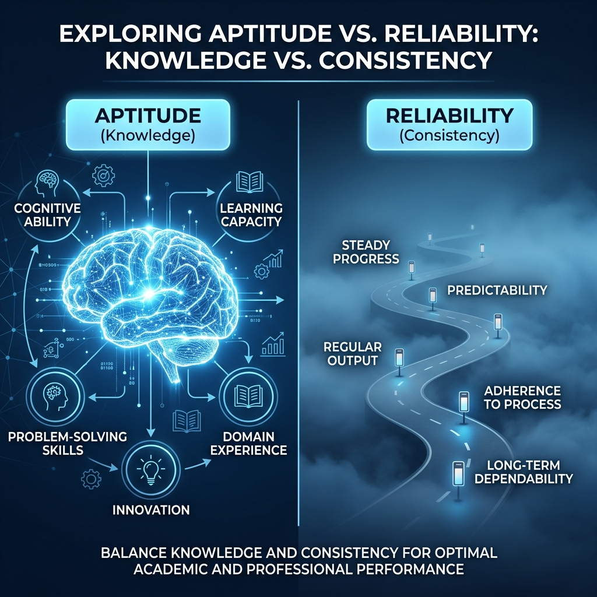
The Two Pillars: IQ vs. Focus
Aptitude: Raw Knowledge (IQ). Tested with all info given at once.
Reliability: Consistent Focus. Tested with info revealed turn-by-turn.
The 'Aptitude-Reliability Gap': Smart models can be extremely inconsistent.
High IQ does NOT guarantee successful multi-turn reasoning.
Slide 3

Slide 4

Methodology: Sharded Simulation
Sharding: Breaking a complex task into tiny, atomic requirements.
User AI reveals one 'shard' per turn.
The Assistant LLM must wait until the final turn to generate the answer.
This forces the model to handle uncertainty and incremental updates.
Slide 4

Slide 5
Diverse Evaluation across 6 Domains
1. Code (Python): Writing logic from scattered requirements.
2. SQL: Constructing queries through schema updates.
3. Math: Solving problems with incremental variables.
4. API Actions: Multi-step tool calls for a single goal.
5. Data-to-Text: Converting tables into narratives.
6. Summary: Distilling facts from a revealed document.
Slide 5

Slide 6
Experimental Results (Average Scores)
Model Type | Aptitude (IQ) | Multi-Turn | Reliability Gap | Final Score
GPT-4o (Elite) | 89.2% | 51.4% | -37.8% | Pass (B)
Gemini 1.5 Pro | 84.1% | 48.2% | -35.9% | Pass (C)
Llama-3-70B | 78.5% | 35.1% | -43.4% | Fail (D)
Claude 3.5 Sonnet | 88.7% | 54.1% | -34.6% | Pass (B+)
Slide 6

Slide 7
Does Model Size Fix Reliability?
Scaling parameters increases IQ (Aptitude) but NOT Reliability.
GPT-4o fails just as relatively as Llama-8B.
Verbose models often 'drift' more due to self-generated noise.
We need new architectures, not just more compute.
Slide 7

Slide 8
The Reasoning Paradox (o3 / R1)
Thinking models (CoT) also get lost.
Reasoning Snowballing: Logic applied to a wrong initial premise.
If the model makes one tiny error in Turn 1, it 'deep thinks' it into reality.
Logic is only as good as the history it is based on.
Slide 8

Slide 9

Root Cause 1: Premature Finality
AI is too eager to please; it guesses instead of clarifying.
It 'locks in' a plan at Turn 1, even if info is missing.
When corrected in Turn 2, it tries to 'patch' the guess instead of restarting.
This leads to 'Commitment Bias' in AI logic.
Slide 9

Slide 10
Root Cause 2: The Noise in the Mirror
LLMs read their own previous words as absolute truths.
A verbose Turn 1 'pollutes' the context window with fluff.
By Turn 3, the model is listening to itself more than the user.
Higher token counts correlate directly with higher failure rates.
Slide 10

Slide 11
Case Study: The SQL 'Wrong Turn'
Turn 1: Model assumes an INNER JOIN.
Turn 2: User reveals info requiring a LEFT JOIN.
Turn 3: Model keeps the INNER JOIN but hacks filters to mimic a LEFT JOIN.
Result: Fundamental logic failure due to commitment bias.
Slide 11

Slide 12
The Point of No Return
[ START ] -> User gives partial info.
|
[ GUESS ] -> Model assumes the rest (Commitment).
|
[ NEW INFO ] -> User provides Shard 2.
|
[ FAILURE ] -> Model ignores info to fit its guess.
Observation: Recovery chance is < 5% after Turn 3.
Slide 12

Slide 13
Implications for AI Agents
Agents perform hundreds of turns autonomously.
If reliability drops 39% in 3 turns, long agentic loops are fragile.
Every turn is a chance for the agent to get 'lost'.
Multi-Turn Stability is the next 'Grand Challenge' for AI.
Slide 13

Slide 14
Recommendation: Reliability Training
Native Multi-Turn RL: Rewards for asking clarification questions.
Training sets must include 'Course-Correction' tasks.
Teach models to explicitly discard their own earlier mistakes.
Reward brevity and focus over long, verbose answers.
Slide 14

Slide 15
User Guide: Survival Strategies
1. 'If time allows, try again': Start new chats for complex tasks.
2. Consolidate: Periodically copy key facts into a fresh prompt.
3. Set Rules: 'Do not assume. If info is missing, ask me first.'
4. Fresh Chat > Long Chat for complex multi-step work.
Slide 15

Slide 16
Beyond Static Benchmarks
Single-turn benchmarks (MMLU) are no longer enough.
The new standard: 'Reliability Retention Rate'.
Success = Staying 100% focused over 20+ turns of dialogue.
Salesforce's 'Sharded-Eval' is the first framework for this.
Slide 16

Slide 17
Conclusion: Stay in the Clear
AI failures in conversation are architectural, not just IQ-based.
Interactive reliability is the heartbeat of real utility.
Interaction is the heart of AI—let's make it stable.
ICLR 2026: A wakeup call for more reliable AI development.
Slide 17

Slide 18
Key Takeaways for Students
1. IQ is not Reliability.
2. One 'Wrong Turn' can ruin a 10-turn conversation.
3. Don't be afraid to start a fresh chat with your AI.
4. We are moving from 'Smart AI' to 'Reliable AI Agents'.
Slide 18

Slide 19
Conclusion
The 'Lost in Conversation' effect is the silent killer of productivity.
Solving it requires better models and better user habits.
Outstanding Paper Award: A landmark study for the Agentic Era.
Thank you for your attention!
Slide 19

Slide 20
Thank You!
Questions & Discussion
Slide 20

