Slide 1

Microsoft Silverlight
The Microsoft’s solution for building cross-platform Rich Internet Applications

Slide 2

Summary
The .NET technologies
C# and XAML
Windows Presentation Foundation (WPF)
Silverlight : the technical side
What is Silverlight?
Versions history
What can I do with Silverlight?
How can I develop Silverlight applications?
Live demonstration
Silverlight versus its alternatives
What are the alternatives?
Silverlight or Flash?
What about HTML5?
Questions? Comments?
Notes:
classic summary

Slide 3








The .NET Technologies : Introduction
Silverlight : a cross-platform version of the .NET Common Language Runtime (CLR) and libraries
Notes:
TOREAD : CSharp4 and .NET4 introduction
TO SAY :
Microsoft .NET : <framework, between the OS and the user application, provides simpler access to OS functions. Language independent (IL code), managed runtime. Relies on Windows, but Mono Linux project aims decreasing platform dependency. Very wide support and integration on Windows systems. Similar to Java, but development took different directions many times. > simple yet sophisticated set of languages, environments, and
developer tools, which makes it easy for developers to write state-of-the-art software.
*clic*
We are introducing .NET to you because Silverlight mostly relies on the .NET CLR. Indeed, Silverlight : a cross-platform version of the .NET Common Language Runtime (CLR) and libraries
*clic*
Roughly speaking, .NET is a
framework — an API — for programming on the Windows platform.
*clic*
.NET relies on several Microsoft technologies : WPF, WCF, ASP.NET, Visual Studio developer tools, C# ans XAML languages, etc…
The technologies that are relevant for Silverlight are first of all the C# and XAML language
*clic*
But also the WPF
*clic*

Slide 4

The .NET Technologies C# and XAML
Used along with the .NET Framework 4
C# : managed like java
XAML : XML-like language
Logic
Graphic
Notes:
C# and XAML are two different languages that are used for different purposes.
*clic*
The common point between thos is that they both are designed to work along with the .NET framework 4
*clic*
C# : managed like java, <--looks like C++-->, in some cases with extended and simplified solutions, but opposed to java, it is important to distinguish what are language features and CLR features
C# is a powerful and popular object-oriented language intended for use with .NET.
C# is a language that has been designed from scratch to work with .NET, as well as to take advantage of all the
progress in developer environments and in our understanding of object-oriented programming principles
that have taken place over the past 25 years.
*clic*
Extensible Application Markup Language : XAML is used as a user interface markup language to define UI elements, data binding, eventing, and other features. Anything that is created or implemented in XAML can be expressed using a more traditional .NET language, such as C#. Opposed to the imperative C#, XAML provides declarative programming, user interface programming (object instantiation is typical) is beneficial in this kind of system
So why do I present you both technologies? It’s because
*clic*
Silverlight is actually written in both C# and XAML. As you probably guessed it, C# is used for coding the logic of the application while XAML is used to code the UI elements.

Slide 5
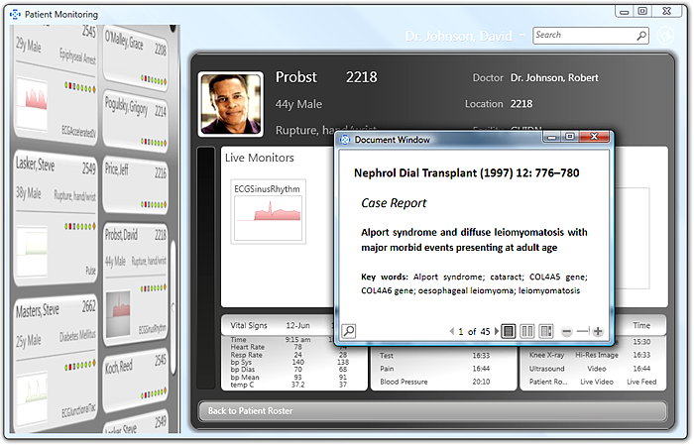
The .NET Technologies Windows Presentation Foundation
Silverlight : A subset of WPF
The Windows graphical subsystem
Uses XAML and C# or Visual Basic
supposed to replace WinForms
Based on DirectX
BetterUI Input-Integration
Notes:
The Windows Presentation Foundation is another feature of the .NET Framework (3.0-).
It is supposed to replace the old Win32 GUI API (WinForms) and provide a modern API for GUI development. It is accelerated by hardware, based on DirectX, better UI-Input integration (input events transformed, bubbling, multitouch etc)…
*clic*
We introduce you this technology because Silverlight is a subset of WPF, with some additions
*clic*
It is the Windows graphical subsystem used to create windows user-friendly application.
It is included into all versions of Windows since Windows Vista. It was introduced before Silverlight
*clic*
Like Silverlight, it uses both XAML and C# (or Visual Basic). WPF applications can be deployed as standalone desktop programs, or hosted as an embedded object in a website. It aims to unify a number of common user interface elements.
*clic*
Here is an screenshot of an application you can build using WPF.

Slide 6
Silverlight : the technical side What is Silverlight?
WPF
Silverlight
A cross-platform .NET runtime, cross-browser plug-in, and a set of Windows-based developer tools for building RIAs
An implementation of the concepts of WPF in a cross-platform version of the .NET CLR
Silverlight is smaller, tighter, and more platform-independent than WPF
Notes:
Now, here we are. What is Silverlight?
*clic*
To put it in a nutshell, A cross-platform .NET runtime, cross-browser plug-in, and a set of Windows-based developer tools for building RIAs. As told before, Silverlight applications are designed in C# and XAML, and use the .NET Framework… So why the hell should I use Silverlight, it is just like WPF? Well, not exactly
*clic*
Silverlight is indeed an implementation of WPF, but WPF was not suitable enough for web applications.
WPF is large and complex. It’s also deeply rooted in Windows, with no good way to substitute alternate stacks for those it relies on. WPF also relies on the rather outdated and web-unfriendly code access security model for application security. So, when Microsoft decided to enter the RIA space with a CLR based vector UI technology, they took the concepts and some of the code from WPF and reimplemented it in a smaller, tighter, and more platform-independent way.
Silverlight primarily is a subset of WPF with some additions. Some of the additions, such as the
Visual State Manager, have been migrated back from Silverlight into WPF. Others, such as Deep
Zoom, Media Stream Source, and the webcam and microphone APIs, are currently Silverlight-only features. Ignoring alternative solutions to the same problems, figure 1 shows this relationship using our friend, the Venn diagram.
Though Silverlight doesn’t have everything WPF has, Silverlight is an excellent, capable development platform and can cover many types of applications we would’ve previously written in Windows Forms, WPF, or even HTML.

Slide 7
Silverlight : the technical side Versions history
1
support for a small subset of XAML
JavaScript + XAML, no CLR
2
based on Microsoft .NET Framework 3.5
Cross-browser, cross-platform, and cross-device RIAs
3
Improved graphics capabilities
Enhanced media management
4
Line of Business (LoB) data-driven RIAs
Windows Phone 7 and out-of-browser applications
Notes:
Four versions of Microsoft Silverlight are available to date: Silverlight 1, Silverlight 2, Silverlight 3, and Silverlight 4, the up-to-date version.
*clic*
Silverlight 1
The initial release of Silverlight 1 did not have CLR or anywhere close to the capabilities provided by Silverlight 2. What it did have, though, is support for a small subset of XAML and a variety of capabilities that foreshadowed the future of Silverlight. Possibly the most obvious aspect of Silverlight 1 is that applications are written either completely in XAML or in a mix of XAML and JavaScript with a Document Object Model (DOM) to manipulate the UI. Since there is no CLR, there is no compilation step, and the JavaScript is interpreted on the client. All Silverlight versions, including Silverlight 1, require a plug-in on the client side.
The major features supported by Silverlight 1 include only one basic layout component (the Canvas), basic controls (the TextBlock) and geometry-based 2D graphics, but already support media features such as images and audio. In order to make the user interface friendlier, it also contains a set of animations, brushes and transforms.
*clic*
Silverlight 2
While Silverlight 1 could be used to develop some impressive and rich media-based applications, the possibilities greatly expanded with the ability to target the .NET platform and know that the application would run on multiple host platforms. The biggest missing feature from Silverlight 1.1 was a set of standard controls. This made developing useful user interfaces difficult. Handling input events was also difficult since events could only be captured on the root container. You then had to manually propagate the events to child objects. Input focus was also tricky. It was a big leap from the first basic version to version 2.
The following are some of the key features of Silverlight 2:
• Provides a platform to develop cross-browser, cross-platform, and cross-device RIAs.
• Silverlight 2 is based on Microsoft .NET Framework 3.5.
• Silverlight 2 provides effective media management, supporting secured multimedia streaming.
• Silverlight 2 provides networking support.
• Silverlight 2 supports rich graphics and animation.
*clic*
Silverlight 3
Silverlight 3 is an extension of Silverlight 2 and mainly provides improvements in graphics capabilities, media management, application development areas (additional controls, enhanced binding support, and out-of-browser functionality), and integration with the designers’ Expression Blend 3 tool.
In addition to the features mentioned in the Silverlight 2 section, the following are the key enhanced features in Silverlight 3:
• Improved graphics capabilities to support a richer and more interactive user interface. GPU acceleration appeared
• Enhanced media management supporting high-quality and secured multimedia streaming.
• Empowers developers to develop data-rich and media-rich interactive RIAs.
*clic*
Silverlight 4
Microsoft mainly focused on media-driven capabilities until the Silverlight 3 version. Silverlight 3 introduced key data integration capabilities to develop data-driven applications easily. However, if you want to develop Line of Business (LoB) data-driven RIAs with some core functionalities such as printing, documents integration, reporting, rich offline capabilities and local
devices integration, Silverlight 4 is the version to start with. Silverlight 4 is released on April 12, 2010 during the DevConnection conference.
In addition to the features mentioned in the Silverlight 3 section, the following are the key enhanced features of Silverlight 4:
• Introduction of new and enhanced LoB RIAs features.
• Allowing Silverlight applications to be “trusted” as out-of-browser applications.
• Inclusion of a few key enhancements to protect, process, and deliver media-richer RIAs.
• Integration capabilities with webcam and microphone.
• Silverlight 4 and Windows Phone development tools enable development of interactive Silverlight applications for Windows 7 Mobile Phone series.

Slide 8
Silverlight : the technical side What can I do with Silverlight? (1)
Entire application is written in Silverlight and all UI interaction is done through Silverlight
“Islands of Richness” into the web application but you don’t build the entire interaction using Silverlight
Out-of-browser (OOB) experience
Mobile application that is targeting the Windows 7 Series Phone
Notes:
When building Silverlight applications, you are likely to use one of the following scenarios:
*clic*
Your entire application is written in Silverlight, the player takes up 100 percent of the height
and width of the browser, and all UI interaction is done through Silverlight.
*clic*
➤➤ You implement an “Islands of Richness” scenario, in which your application is an ASP.NET
application (or any other type of HTML-rendered application), and you build islands of your
UI with Silverlight. Thus, you add richness to your web applications but you don’t build the
entire interaction using Silverlight.
*clic*
➤➤ You create an out-of-browser (OOB) experience, with the specific need to use elevated permissions
on the client machine. This means that you create more of a desktop-like experience
and you can access the local filesystem, use COM interoperability, keyboard in full screen
mode, and other out-of-browser–only features.
*clic*
➤➤ You are building a mobile application that is targeting the Windows 7 Series Phone.

Slide 9




Silverlight : the technical side What can I do with Silverlight? (2)
What kind of applications can I build?
Media
Business
Gaming
Notes:
What kind of applications can I build?
*clic*
Silverlight excels at media. When Silverlight 1.0 was first introduced, one of the few capabilities it had was an excellent media stack. Silverlight through version 4 has built upon that to include new media capabilities such as smooth streaming, pluggable codecs using the Media Stream Source API, and even the DRM technologies required for the large content producers to adopt Silverlight.
*clic*
Starting with versions 3 and 4, Silverlight gained serious business capabilities. From simple things such as sync and async validation, to patterns such as MVVM and Prism, and entire middle-tier frameworks such as WCF RIA Services, Silverlight showed itself to be a mature platform, able to absorb the best practices from other areas and build upon them.
*clic*
Though business and media applications certainly are great staples, another fun application type is games. Silverlight has good support for casual games, including the ability to generate bitmaps on the fly, create sound from bits, loop audio in the background, and more. The community has successfully ported over physics and gaming engines to Silverlight, making it even easier to create complex casual games. Future versions of Silverlight are expected to be even more gaming friendly; we’ve just seen the tip of the iceberg so far.
(Should we add some sample videos here?)

Slide 10


Silverlight : the technical side How can I develop Silverlight applications?
Visual Studio 2010
One of the most assisted IDE
Designed to work with msdn and the .NET Framework
Microsoft Expression Blend
UI design made simple
A lot of pre-existing patterns
Easy way to code XAML
Since Silverlight 3
Notes:
So I can buy several kinds of applications with Silverlight, but is it easy to do?
Microsoft actually provides different tools for developping Silverlight applicaitons
*clic*
Visual Studio, in its last version, is the most well known IDE from Microsoft.
It can be used to develop console and graphical user interface applications along with Windows Forms applications, web sites, web applications, and web services in both native code together with managed code. But here, we focus on the Silverlight applications.
Visual Studio includes a code editor supporting IntelliSense as well as code refactoring. Autocomplete suggestions are popped up in a modeless list box, overlaid on top of the code editor.
Provides a simple designer (drag and drop, properties window), also XAML and C# source code editor.
It also includes MSDN support, which is really helpful to access quickly the information you need about the .NET framework.
When starting a project, if the correct plug-in is installed, you can choose between several different pre-existing patterns, depending on what kind of application you want to create.
But there is another tool provided by Microsoft which is even more useful to create user interface
*clic*
Microsoft Expression Blend is not such an IDE as VS is, because you cannot debug with it. It is aimed to work along with VS10 to make the animation and graphics creation easier. Since Silverlight 3, you are able to use Blend along with VS. Current version is 4.
Blend auto-writes XAML while you just drag and drop or select the animation or design you need.
You have real-time preview of your modifications, so you know exactly how you are modifying the UI without having to actually run the application. It is not compulsory, but it makes the UI design really simpler.
Both applications can be used at the same time, making code and UI development more efficient.

Slide 11

Silverlight : the technical side Key Features : Screenshots (1)
Notes:
EventHandlers

Slide 12
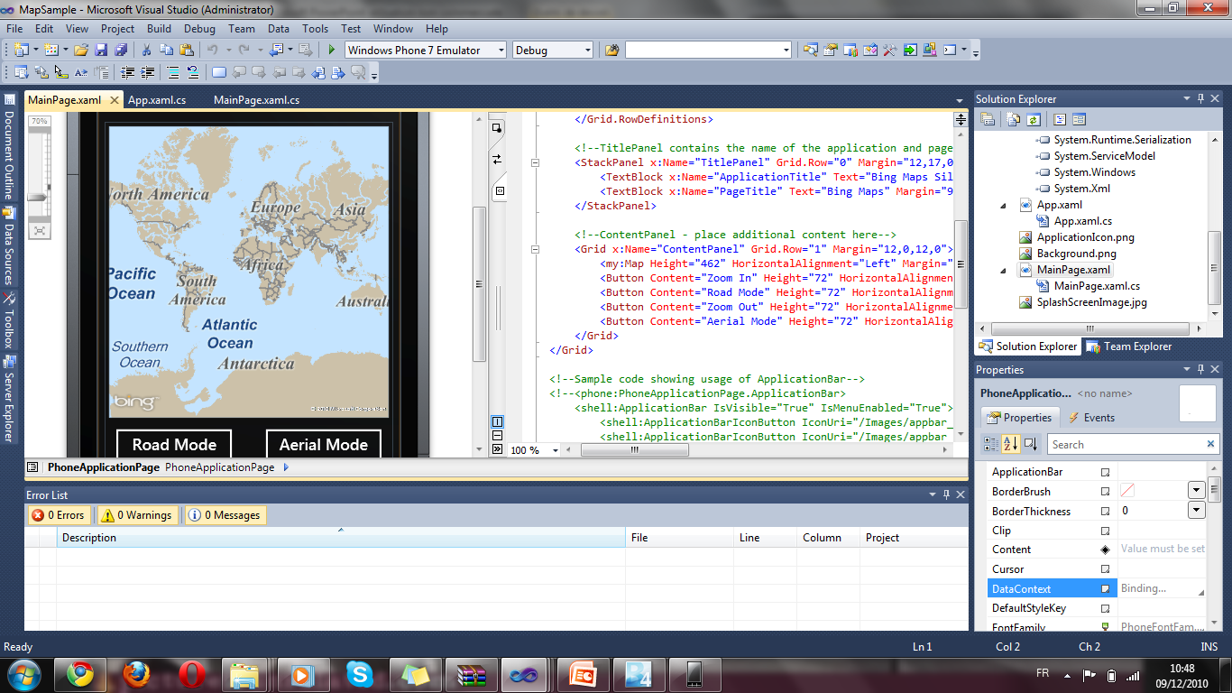
Silverlight : the technical side Key Features : Screenshots (2)
Notes:
MapSample

Slide 13
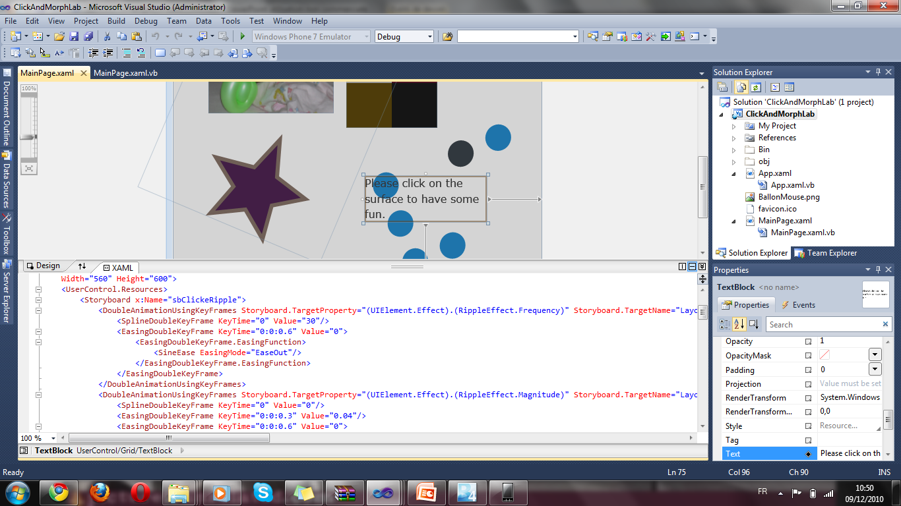
Silverlight : the technical side Key Features : Screenshots (3)
Notes:
StoryBoard Sample

Slide 14
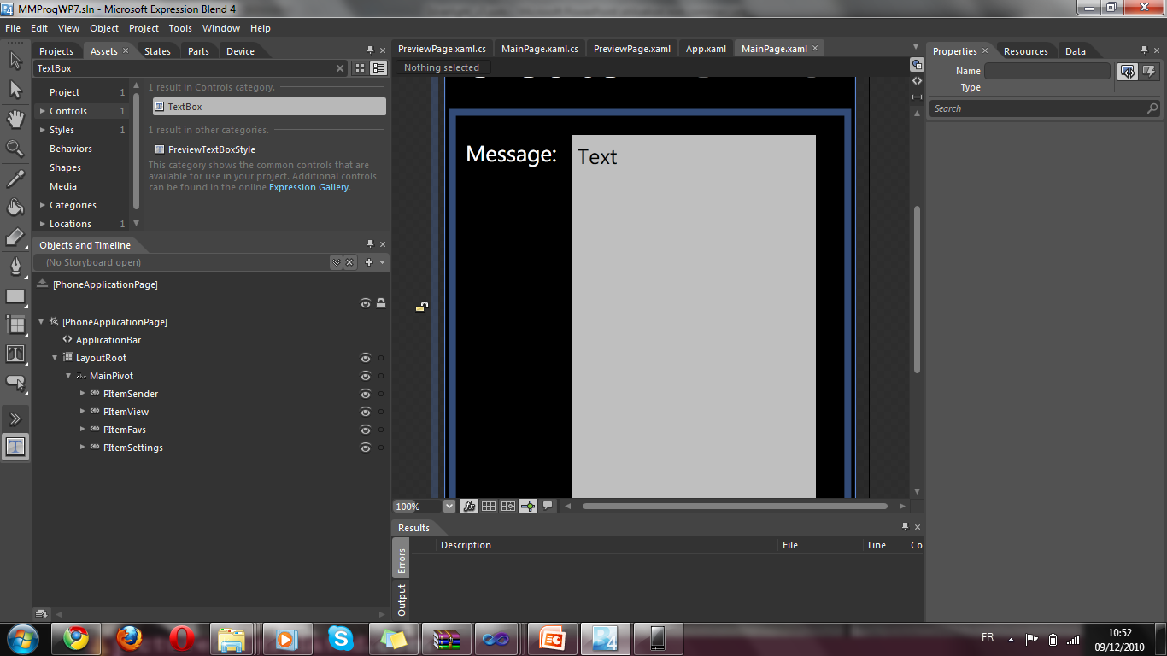
Silverlight : the technical side Key Features : Screenshots (4)
Notes:
Microsoft Expression Blend hides XAML

Slide 15
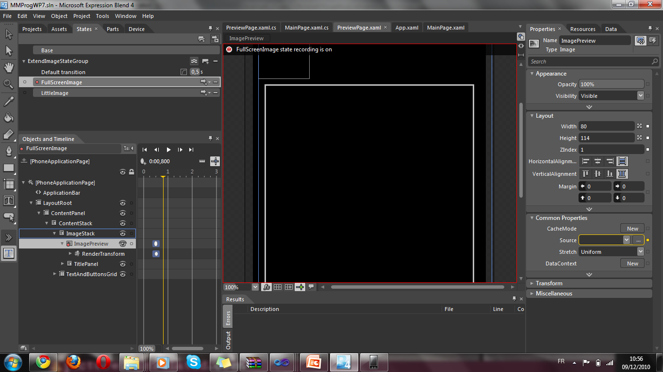
Silverlight : the technical side Key Features : Screenshots (5)
Notes:
Designing StoryBoards in Blend

Slide 16
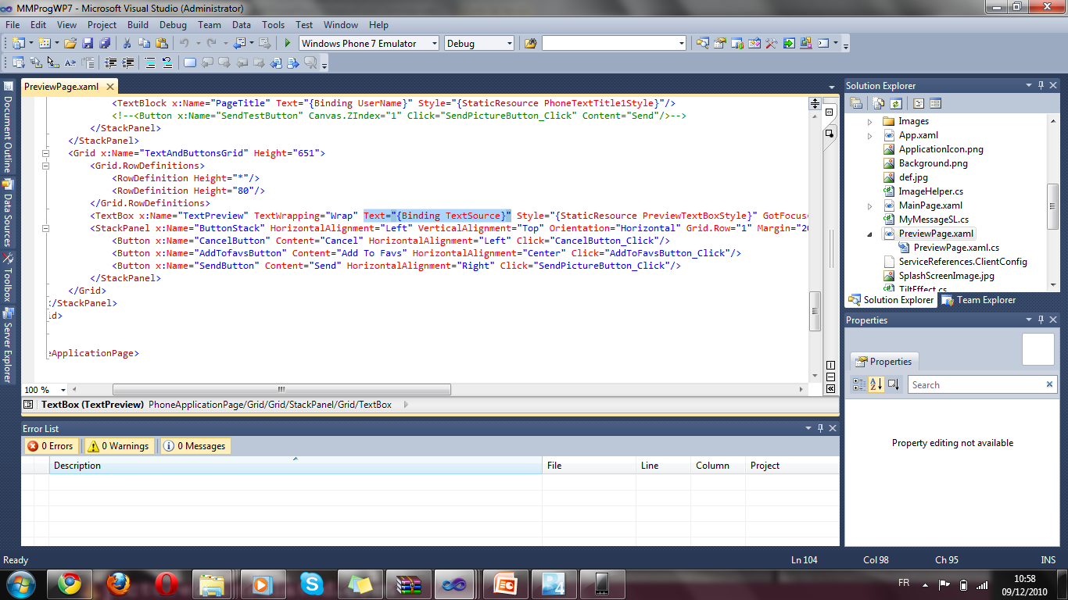
Silverlight : the technical side Key Features : Screenshots (6)
Notes:
DataBinding (XAML)

Slide 17

Silverlight : the technical side Key Features : Screenshots (7)
Notes:
DataBinding (C#)

Slide 18






Silverlight versus its alternatives What are the alternatives?
The other cross-platform frameworks
VS
Notes:
Silverlight is above all a cross-plateform .NET framework-based technologies. So its direct competitors are the other cross-platform frameworks.
*clic*
Qt
Qt (pronounced cute) is a cross-platform application development toolkit mainly for C++; however, it
has support for other languages, such as Java. The significant benefit of Qt is that programs execute
natively after compilation (i.e., no new virtual machine is needed). The cross-platform nature of Qt is
provided at the source level, as long as developers utilize Qt’s platform-agnostic API. The major
downsides to Qt are the learning curve for developers and the degree to which applications might
become intertwined with Qt (though this might be acceptable to many organizations). Visit
http://qt.nokia.com/products/ for more information.
*clic*
The Java Platform
The Java platform (mainly Java Applet and JavaFX) is possibly the closest comparison to Silverlight on
the market. Much like .NET Framework, the Java-based platform is a managed environment. Until
Silverlight, though, .NET is mainly available on Windows. Both platforms provide the ability to compile a
program and immediately execute it on multiple platforms. The Java platform and Silverlight approach
this similarly: an execution environment (known as a virtual machine) is developed for each platform
where programs might be run. Java source code is compiled to Java byte code, which is then executed by
the Java virtual machine in a sandbox environment. The downsides to this approach are the plethora of
virtual machines that can be created, each with potential quirks that sometimes affect existing
applications, and the time cost of starting up a Java virtual machine on a web site (you’ve no doubt seen
the gray rectangle and the loading symbol on web pages). Sun also has a more direct competitor of
Silverlight called JavaFX, a framework that includes a scripting language to more easily create Java
applications. This framework makes the most sense for institutions and developers who are already used
to working in the Java environment or need to extend their existing Java applications. Visit
http://java.sun.com/javafx/ if you are curious about learning more.
For general culture : One of the main reasons no one uses applets is that microsoft released their own java vm which broke the java standard. It was a disaster for Java Applet writers. Applications would work on one vm, but not the other.
Another internal Microsoft document indicates that the plan was not simply to blunt Java/browser cross-platform momentum, but to destroy the cross-platform threat entirely, with the "Strategic Objective" described as to "Kill cross-platform Java by grow[ing] the polluted Java market."http://www.usdoj.gov/atr/cases/f1700/1762.htm
*clic*
Adobe Flash/Flex/AIR
Adobe Flash is, by far, the most popular comparison to Silverlight. A browser plug-in that enables
execution of rich content for the Web—doesn’t that sound familiar? This comparison is made even more
explicit with Adobe releasing Flex, an environment for executing rich applications in the browser and on
the desktop. Adobe Flex provides a rich UI component library and uses MXML, a declarative XML-based
language, to develop rich, interactive user interfaces. While there are some feature differences between
Flex and Silverlight that can make one more appealing than the other, Flex is a viable alternative to
Silverlight; however, it caters to a different set of developers than Silverlight does. Flex capitalizes on the
languages people already know, including JavaScript, HTML, CSS, and ActionScript. Silverlight, however,
provides a markup language, but is an incredibly natural platform to develop on if you’re already a .NET
developer. Visit www.adobe.com/products/flex/ if you want to learn more about Flex.
In addition to Adobe Flash and Adobe Flex, in February 2008, Adobe introduced Adobe AIR for
developing desktop applications that you can extend as RIAs. Visit www.adobe.com/products/air/ to get
more information about Adobe AIR.
OR
Adobe Flash 10.1 and AIR 2 Adobe's Flash platform consists of the open source Flex SDK, a free Flex compiler, a proprietaryEclipse-based IDE called Flash Builder, the Flash Player browser plug-in, and Adobe AIR, a runtime for Windows, Mac, and Linux that allows rich Internet applications to be deployed directly to the desktop.
In addition, Adobe offers a suite of tools (available as part of CS5 or standalone) that enhance Flash development. In additon to the Flash Professional authoring tool, there's the new Flash Catalyst -- an interaction design tool for quick prototyping of user interfaces and behaviors -- and either LiveCycle Data Services or Adobe's open sourced BlazeDS for Java remoting and messaging.
*clic*
Microsoft ASP.NET AJAX
Microsoft ASP.NET AJAX, a set of JavaScript libraries built into ASP.NET 3.5 and 4.0, is available as a
separate download for ASP.NET 2.0. Being an integral part of ASP.NET 3.5 and 4.0 and the Ajax Library
(comes with AJAX Controls Toolkit for ASP.NET 3.5), now ASP.NET AJAX client- and server-side libraries
are more integrated with Visual Studio 2010 (and Visual Studio 2008). The client-side library allows you
to implement client-level processing such as processing and validating information entered by the end
user, refreshing a portion of the web page, and developing rich, interactive user interfaces. You can also
efficiently integrate the client-side library components with the server-side ASP.NET controls library in
asynchronous mode. The key technology driver of ASP.NET AJAX is scripting. In general, script-based
web applications face several challenges due to different browser settings (e.g., JavaScript is not enabled
by default) on PCs and mobile devices. As a result, scripting is often not always the best strategy for
enterprises to use to develop secured and scalable RIAs. ASP.NET AJAX also supports limited features of
RIAs and does not support effective multimedia integration, managed code-behind integration, or
metadata and information management. Microsoft ASP.NET AJAX is a widely accepted model for
building RIAs, but it is very likely that, having Silverlight as an option, .NET developers will migrate
ASP.NET AJAX applications to Silverlight RIAs. Visit www.asp.net/ajax/ if you want to learn more about
Microsoft ASP.NET AJAX.
*clic*
HTML5
HTML5 is the next major revision of the HTML standard, currently under development.
Like its immediate predecessors, HTML 4.01 and XHTML 1.1, HTML5 is a standard for structuring and presenting content on the World Wide Web. The new standard incorporates features like video playback and drag-and-drop that have been previously dependent on third-party browser plug-ins such as Adobe Flash and Microsoft Silverlight.
As it’s not an actual cross-platform framework, I will talk more in detail about HTML5 later,
*clic*
for the moment, let’s concentrate on Silverlight’s main competitor : Adobe’s Flash

Slide 19
Silverlight versus its alternatives Silverlight or Flash? (1)
Notes:
- We can do some can of live demo at this point with that set of applications, if possible http://www.shinedraw.com/ or http://bubblemark.com/
* Source http://www.infoworld.com/d/developer-world/infoworld-review-microsoft-silverlight-4-vs-adobe-flash-101-260?page=0,0
While commenting the graph :
Adobe Flash 10.1/AIR 2Microsoft Silverlight 4
Client platform support:
Runs on Windows XP SP3, Windows 7/Vista, Mac OS X, and Linux (Fedora Core 12, Ubuntu 9.10, OpenSuse 11.2); Flash Player 10.1 for Android. Mac support has improved with a shift to Cocoa framework (native graphics, sound, print). Still no 64-bit Flash Player for Windows.
Runs on Windows XP SP3, Windows 7/Vista, Windows Server 2003 SP2, Windows Server 2008 SP2, Windows Phone 7, Symbian, and most browsers on Windows and Mac. Not available on Linux, although an open source solution comprising Moonlight and Mono (for code execution) is a possible workaround for Silverlight 2 apps.
IDE:
Flash Builder is helpful for binding Flash and AIR apps to back-end data sources, but any transport mediation requires addition of BlazeDS or LiveCycle. ActionScript debugger is light compared to debugging in Visual Studio. Removal of Version Cue support leaves developers seeking an asset management solution.
Visual Studio 2010 with Silverlight 4 Toolkit with WCF RIA Services 1.0 provides good data access for n-tier, data-driven apps. Excellent debugging facilities. Supports cross-compile for .NET and Silverlight from a single codebase. A world-class toolkit.
UI designer and interaction coding:
Adobe Flash Catalyst offers good asset import from other CS5 design tools and helps wire triggers and behaviors to import into Flash Builder. Modified files can't be reopened in Catalyst. Interface is clumsy compared to Microsoft's tools.
Microsoft Expression Blend 4 wows with advanced features such as conditional behavior modeling. Code completion and drag-and-drop binding make Blend feel like a real dev tool. New XAML designer in Visual Studio 2010 means never having to leave the IDE.
Codec support:
Sorenson Spark, ON2 VP6, H.264, F4V. ADPCM, MP3, AAC, Speex.WMV/WMA, H.264, MP3, AAC. Third-party codecs supported via the new Raw AV pipeline.
DRM:
Adobe Flash Access 2 provides content security and device access controls via Flash and AIR clients. Good authentication and rules development. Supports HDCP flags. Works with Flash Media Server and HTTP dynamic streaming.
Windows Media Digital Rights Management 10 (WMDRM 10) and Microsoft PlayReady DRM (available with additional server for AES encryption and extending DRM to offline content) secure streams, downloads, subscriptions, and rentals. No support for Linux clients yet.
Flash or Silverlight? Adobe has long dominated the RIA scene thanks to the ubiquitous Flash Player, estimated to run in upward of 93 percent of the world's Web browsers. But that domination was born in a near-vacuum of competitive choice. Adobe has improved the developer experience and finally constructed a bridge to its formidable design suite, but Microsoft has come further faster. To be fair, although Microsoft has made great strides with each release of Silverlight, much of the distance it has crossed had already been trod by Adobe.
Ultimately, innovative feature sets and powerful development tools will eke out an RIA category killer. Development of a solid mobile framework will be essential for both vendors as data consumption continues to shift from traditional desktop and laptop computers to smaller, touch-screen devices. Time will tell how Flash and AIR will fare on Android and whether Silverlight will join them there or remain faithful to Windows Phone 7.
For the moment, the decision is between Microsoft's strong developer orientation and Adobe's emphasis on design. For any enterprise project requiring heavy programming or data access, especially in-house applications that would benefit from Windows desktop integration, Silverlight is the top choice. The available codecs are sufficient by today's standards, and in most cases the user interface designs can be ported from Adobe Photoshop or Adobe Illustrator without degradation -- although workflow will be somewhat encumbered.
However, if your application will be making basic service calls to feed data and won't require a lot of processing overhead, or if your goal is eye-popping layouts or 3D graphics for customer-facing communications -- i.e., whenever the development process is design-intensive -- then you'll benefit from Adobe's designer-oriented approach. If you're already an Adobe shop, or you've already begun with Silverlight, you're undoubtedly happy with what you've got. Both platforms are strong, and the competition will keep both vendors working hard to make them better.

Slide 20
Silverlight versus its alternatives Silverlight or Flash? (2)
Silverlight
Flash
Technical score : 8.3
Technical score : 7.8
Market penetration : 60%
Market Penetration : 93%
Windows Phone 7
Touch screen features
Notes:
Flash or Silverlight? Adobe has long dominated the RIA scene thanks to the ubiquitous Flash Player, estimated to run in upward of 93 percent of the world's Web browsers. But that domination was born in a near-vacuum of competitive choice. Adobe has improved the developer experience and finally constructed a bridge to its formidable design suite, but Microsoft has come further faster. To be fair, although Microsoft has made great strides with each release of Silverlight, much of the distance it has crossed had already been trod by Adobe.
Ultimately, innovative feature sets and powerful development tools will eke out an RIA category killer. Development of a solid mobile framework will be essential for both vendors as data consumption continues to shift from traditional desktop and laptop computers to smaller, touch-screen devices. Time will tell how Flash and AIR will fare on Android and whether Silverlight will join them there or remain faithful to Windows Phone 7.
For the moment, the decision is between Microsoft's strong developer orientation and Adobe's emphasis on design. For any enterprise project requiring heavy programming or data access, especially in-house applications that would benefit from Windows desktop integration, Silverlight is the top choice. The available codecs are sufficient by today's standards, and in most cases the user interface designs can be ported from Adobe Photoshop or Adobe Illustrator without degradation -- although workflow will be somewhat encumbered.
However, if your application will be making basic service calls to feed data and won't require a lot of processing overhead, or if your goal is eye-popping layouts or 3D graphics for customer-facing communications -- i.e., whenever the development process is design-intensive -- then you'll benefit from Adobe's designer-oriented approach. If you're already an Adobe shop, or you've already begun with Silverlight, you're undoubtedly happy with what you've got. Both platforms are strong, and the competition will keep both vendors working hard to make them better.

Slide 21

Silverlight versus its alternatives What about HTML5?
HTML5 : The greatest threat for Flash and Silverlight?
HTML5 does not provide such advanced media features as Silverlight does
HTML5 faces many challenges…
Proprietary add-ons versus W3C standards
Proprietary add-ons are available, reliable, known by the developers, NOW.
Notes:
I guess each one of you have heard about HTML5, but I’m going to explain why it is such a threat for the plug-in cross-platform technologies. Unlike JavaFX, Flash and of course Silverlight, HTML5 does not need any plug-in to work on the browser, as it is part of the W3C. So HTML5, with its promises of plug-in free browsing, a 3D graphics and animation API, built-in video and audio tags, an offline data store, and Web Workers to manage long-running background processes, would seem to spell the end of proprietary RIA (rich Internet application) platforms.
Some of you may not agree with me, but I think the reports of the death of Flash and Silverlight, as the saying goes, have been greatly exaggerated.
*clic*
First of all, Silverlight is better in media than HTML5 is : "Silverlight will still be necessary as it provides more advanced features -- such as a richer and faster programming model (C#), 3-D, and out-of-browser capabilities. With those features, Silverlight will ultimately provide a richer Internet experience.“
*clic*
Work on HTML5 was first started in 2004, and it isn't anticipated to have actual W3C Recommendation status until at least 2022.
"HTML5 is still a standard in progress and the makers of it say it will be five to ten years at least before it's done, so it's too early to make any comparisons at this time,“
*clic*
"HTML5 faces many challenges," says Dave Story, vice president of developer tools at Adobe. "The browser market remains highly fragmented, and incompatibilities between browsers reign. The HTML5 timeline states that it will be at least a decade before the evolving HTML5/CSS 3 efforts are finalized, and it remains to be seen what parts will be implemented consistently across all browsers. In the meantime, the Flash platform will continue to deliver a ubiquitous, consistent platform that enables ever richer, more engaging user experiences."
*clic*
For the W3C standards :
"They're single-vendor solutions [and] they don't really fit well into the Web platform," Hickson says. "It's always a problem when you're stuck with a single software provider -- what if they decide to abandon the product you're using? What if they decide to start charging? With an open platform, there's no such risk, since we have true competition, many vendors, and an open standard that anyone can implement.«
But the fact is : To meet the needs of a continually evolving Web, companies like Adobe and Microsoft can enhance their plug-ins far more quickly than any standards group can push new specs through a committee. The Web will continue to change, and it won't be the standards bodies who are leading the way.
*clic*
Today, the Web Hypertext Application Technology Working Group (WHATWG), a consortium aimed at driving new Web standards, can't even agree on which video codecs to support, leaving choices for interoperability to the individual browser makers. Support for the new HTML standard will come in dribs and drabs that only complicate the developer's job. Web content providers and developers of rich Internet apps will continue to gravitate toward the strongest RIA ecosystem -- the most complete development toolsets and the most reliable content delivery mechanisms, neither of which are addressed by HTML5. The richest RIA platforms today (and for the foreseeable future) come from clashing titans Adobe and Microsoft, whose Flash and Silverlight platforms both combine excellent tools for developers and designers, broad client support, strong support for server-side technologies, digital rights management capabilities, and the ability to satisfy use cases as varied as enterprise dashboards, live video streaming, and online games.

Slide 22
Any Question? Any comment?
?
Notes:
VIK: Maybe a very short demo, preparated, to show how easy it is to make animations, UI, and simple code-UI interaction?!
-Storyboard
-Binding
-3D?

