Slide 1
web2py
2015. 11.27
고 원 식

Slide 2
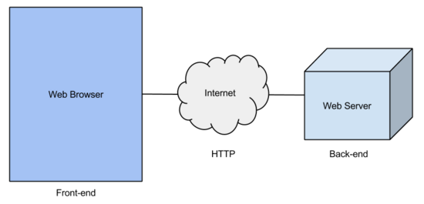
Web application Overview
Front-end
UI를 멋지게 구성하기 위해 사용
Back-end
HTTP 요청 처리
데이터베이스 관리
HTML 페이지 생성
- MS - ASP.NET
- Oracle, IBM - Java EE (JSP)
- Google - Google App Engine (Java, Python, Go)
- Open Source
- Ruby - Ruby on Rails
- Python - Django, Grok, web2py ...
- PHP - CakePHP, Symfony ...
- HTML,
- CSS,
- JavaScript
- Ajax

Slide 3
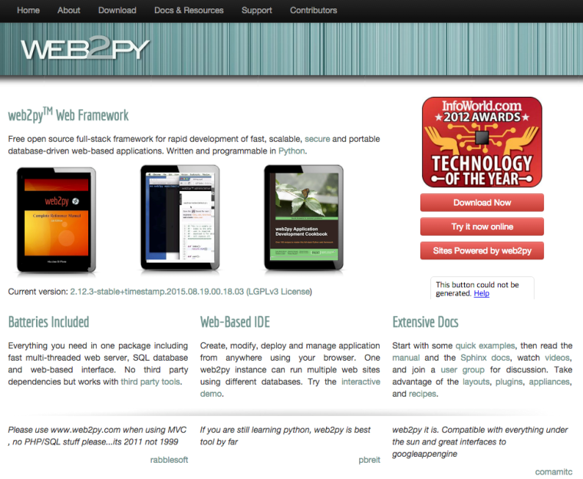
web2py
Web2py는 파이썬으로 프로그래밍 되는 오픈소스 웹 어플리케이션 프레임워크
Web2py focuses on rapid development, follows a model–view–controller (MVC) architectural pattern.
www.web2py.com

Slide 4
MVC Overview
Model–view–controller (MVC) is a software architecture pattern which separates the representation of information from the user’s interaction with it.
The model consists of application data, business rules, logic, and functions.
A view can be any output representation of data, such as a chart or a diagram. Multiple views of the same data are possible, such as a bar chart for management and a tabular view for accountants.
The controller mediates input, converting it to commands for the model or view.
The cetral ideas behind MVC are code reusability and separation of concerns

Slide 5
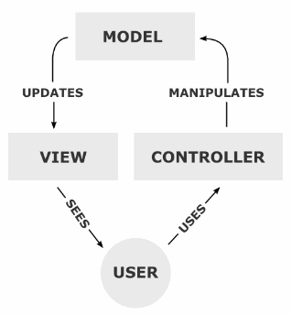
MVC
A controller can send commands to its associated view to change the view’s presentation of the model (e.g., by scrolling through a document). It can also send commands to the model to update the model’s state (e.g., editing a document)
A model notifies its associated views and controllers when there has been a change in its state. This notification allows the views to produce updated output, and the controllers to change the available set of commands.
A view requests from the model the information that it needs to generate an output representation to the user.”

