Slide 1
Digital Portfolio
STUDENT NAME:KOWSALYA S
REGISTER NO AND NMID: 24131061802522039and
0DF5D564EB6242284BA49789
DEPARTMENT: B.SC. COMPUTER SCIENCE(II YEAR)
COLLEGE: COLLEGE/ UNIVERSITY :SHREE RAGHAVENDRA ARTS & SCIENCE COLLEGE/
ANNAMALAI UNIVERSITY

Slide 2
PROJECT TITLE Problem Statement Many students and professionals struggle to present their work and skills in one place. A digital portfolio solves this by offering an organized, interactive way to showcase projects, achievements, and experiences online.

Slide 3


AGENDA
Problem Statement
Project Overview
End Users
Tools and Technologies
Portfolio design and Layout
Features and Functionality
Results and Screenshots
Conclusion
Github Link
3/21/2024 Annual Review

Slide 4

PROBLEM STATEMENT Problem Statement Many students and professionals struggle to present their work and skills in one place. A digital portfolio solves this by offering an organized, interactive way to showcase projects, achievements, and experiences online

Slide 5

PROJECT OVERVIEW portfolio project is a personal website that displays my skills, academic background, projects, and contact detaProject ils. It is designed to make it easier for others (e.g., recruiters or mentors) to view my work.

Slide 6

WHO ARE THE END USERS? work kowsalya herself As a self-branding tool and online preseThe portfolio is useful for: To quickly Recruiters / Employers evaluate kowsalya 's skills and projects To provide feedback Peers & Mentors or collaborate Clients To hire her for freelance or project nce

Slide 7

TOOLS AND TECHNIQUES Tools and Technologies HTML CSS JavaScript Git & GitHub Visual Studio Code Canva or Figma (for design, optional

Slide 8
POTFOLIO DESIGN AND LAYOUT
Portfolio Design and Layout The portfolio is divided into sections for easy navigation: 1. Header/Navbar - With links to sections (About, Skills, Projects, Contact) 2. Hero Section - Intro with name, role, and a "Hire Me" button 3. About Section - A short biography 4. Skills Section - List of technical skills 5. Projects Section - Showcase of key projects with descriptions 6. Contact Section Email, phone, and links 7. Footer - Copyright
8

Slide 9
FEATURES AND FUNCTIONALITY
Features and Functionality Links to different Responsive Navbar sections Interactive Button Shows alert ("Hire Me" functionality) Works on mobile, Hover Effects On skills and project cards Responsive Design tablet, desktop Clickable Contact Info Email and phone links.

Slide 10

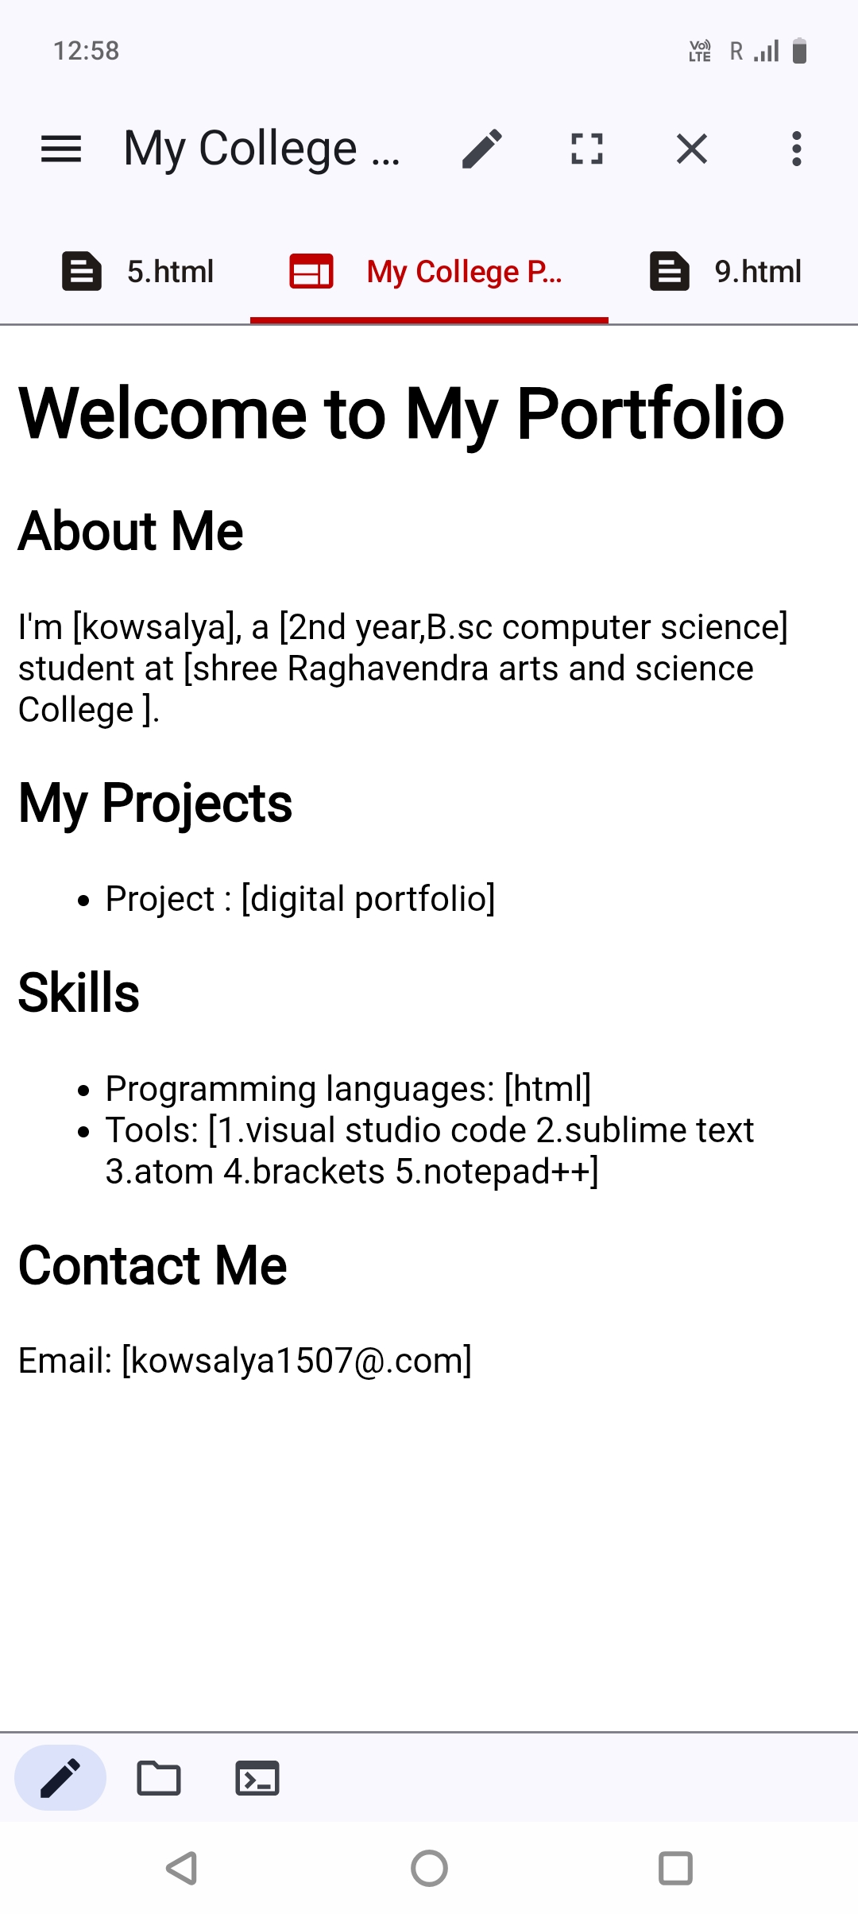
RESULTS AND SCREENSHOTS
10

Slide 11
CONCLUSION
Conclusion The Digital Portfolio project provides an effective and engaging platform for kowsalya to present her skills and achievements. Unlike a traditional resume, it is interactive, modern, and accessible online.
11

