Slide 1
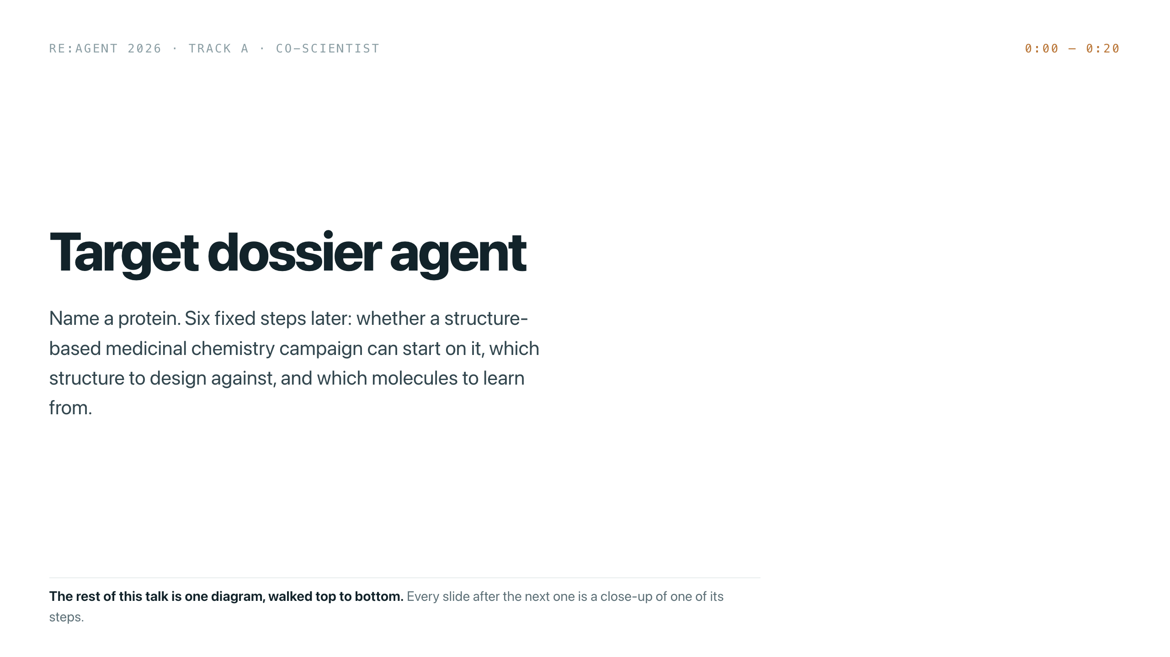
Notes:
Open with the input and the output, nothing else. "You give this a protein symbol. Four minutes later it tells you whether a structure-based medicinal chemistry campaign can start on that protein — and if it can, which structure to design against and which molecules to learn from."
Do not explain the architecture yet. Twenty seconds, then move. If you are already running late, this is the slide to cut to ten.

Slide 2
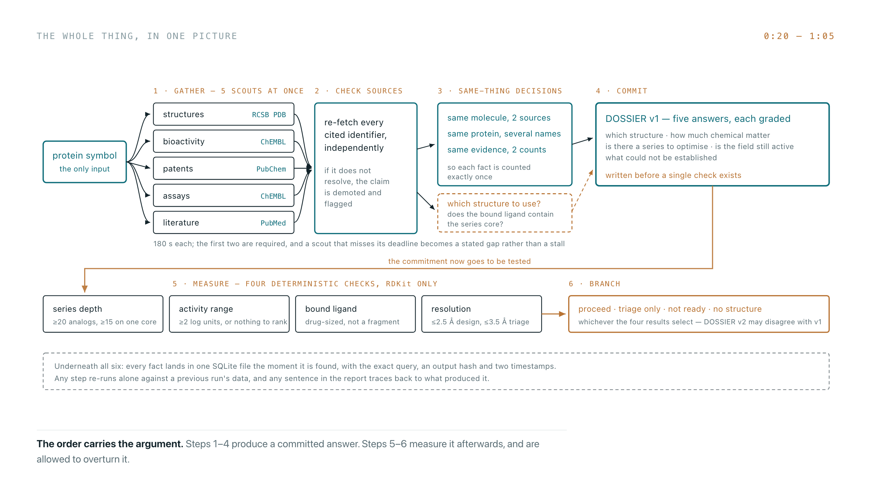
Notes:
This is the whole talk on one slide. Trace it with a finger: left to right along the top, then down and back along the bottom.
Say three things and no more. The five searches run at the same time, not in a planned sequence. The report is written at step 4, before any check exists. The checks at step 5 are allowed to overturn it.
Everything after this is a close-up of one box. Do not read the boxes aloud — the room can read faster than you can speak.

Slide 3
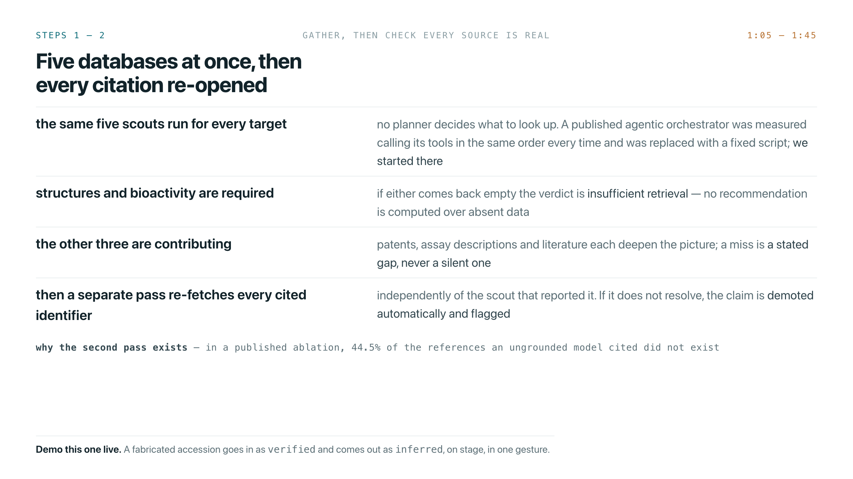
Notes:
Two points.
First, the pipeline is fixed: the same five scouts for every target. That is a deliberate choice, not laziness. A published agentic orchestrator was measured calling its tools in the same order every time, so its own authors replaced it with a straight script. We started there and spent the budget on verification instead.
Second, and this is the one to land: a separate pass re-opens every citation, independently of the scout that reported it. The 44.5% figure is why it exists.
If you are demoing live, do it here — a fabricated accession goes in as verified and comes out as inferred.

Slide 4
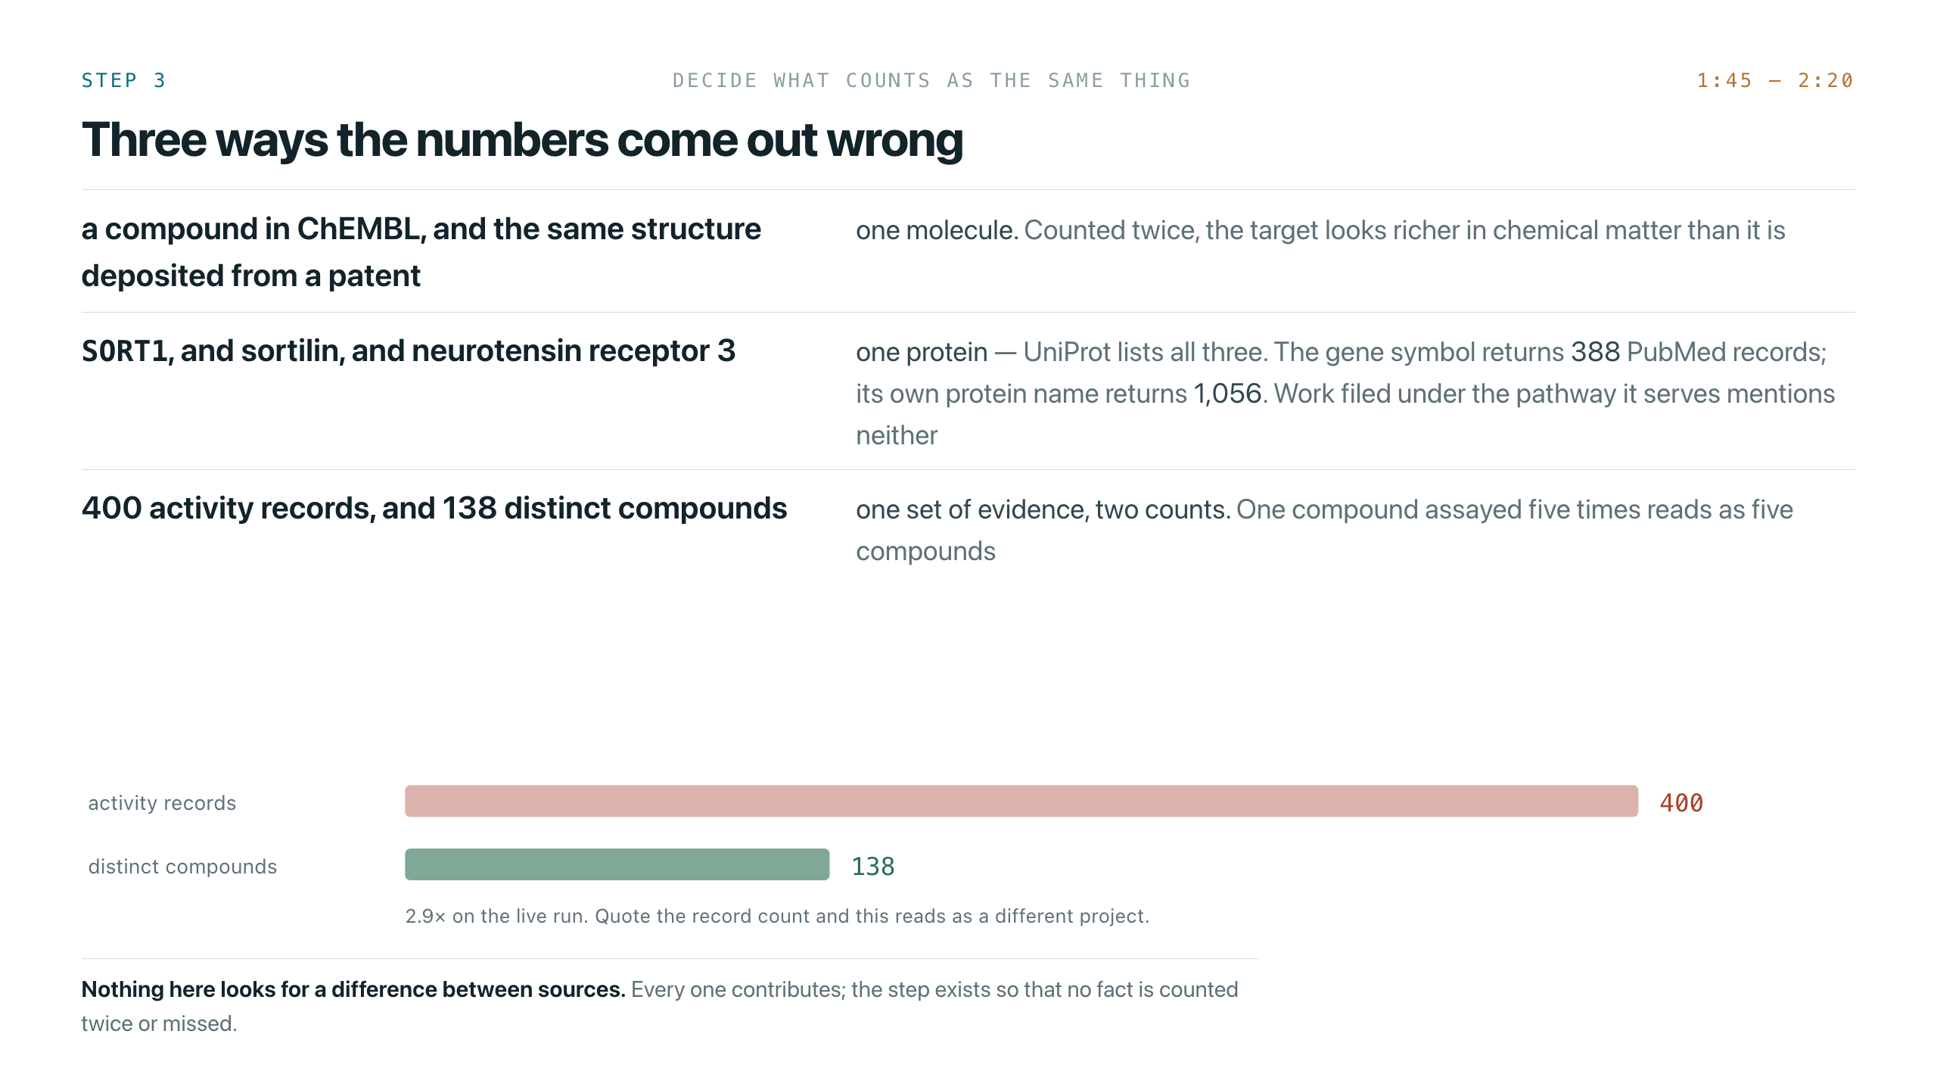
Notes:
Three counting failures. Lead with the numbers, not the concept.
400 activity records is 138 molecules. That is the same compound measured in several assays, and quoting the record count makes this look like a different project.
The alias row: SORT1 returns 388 PubMed records, sortilin returns 1,056, and it is the same protein — UniProt lists sortilin, neurotensin receptor 3 and gp95 under the one entry.
Expect a challenge on whether that count comparison is fair. The honest answer: PubMed expands search terms, so treat it as indicative of the size of the gap rather than a controlled measurement.

Slide 5
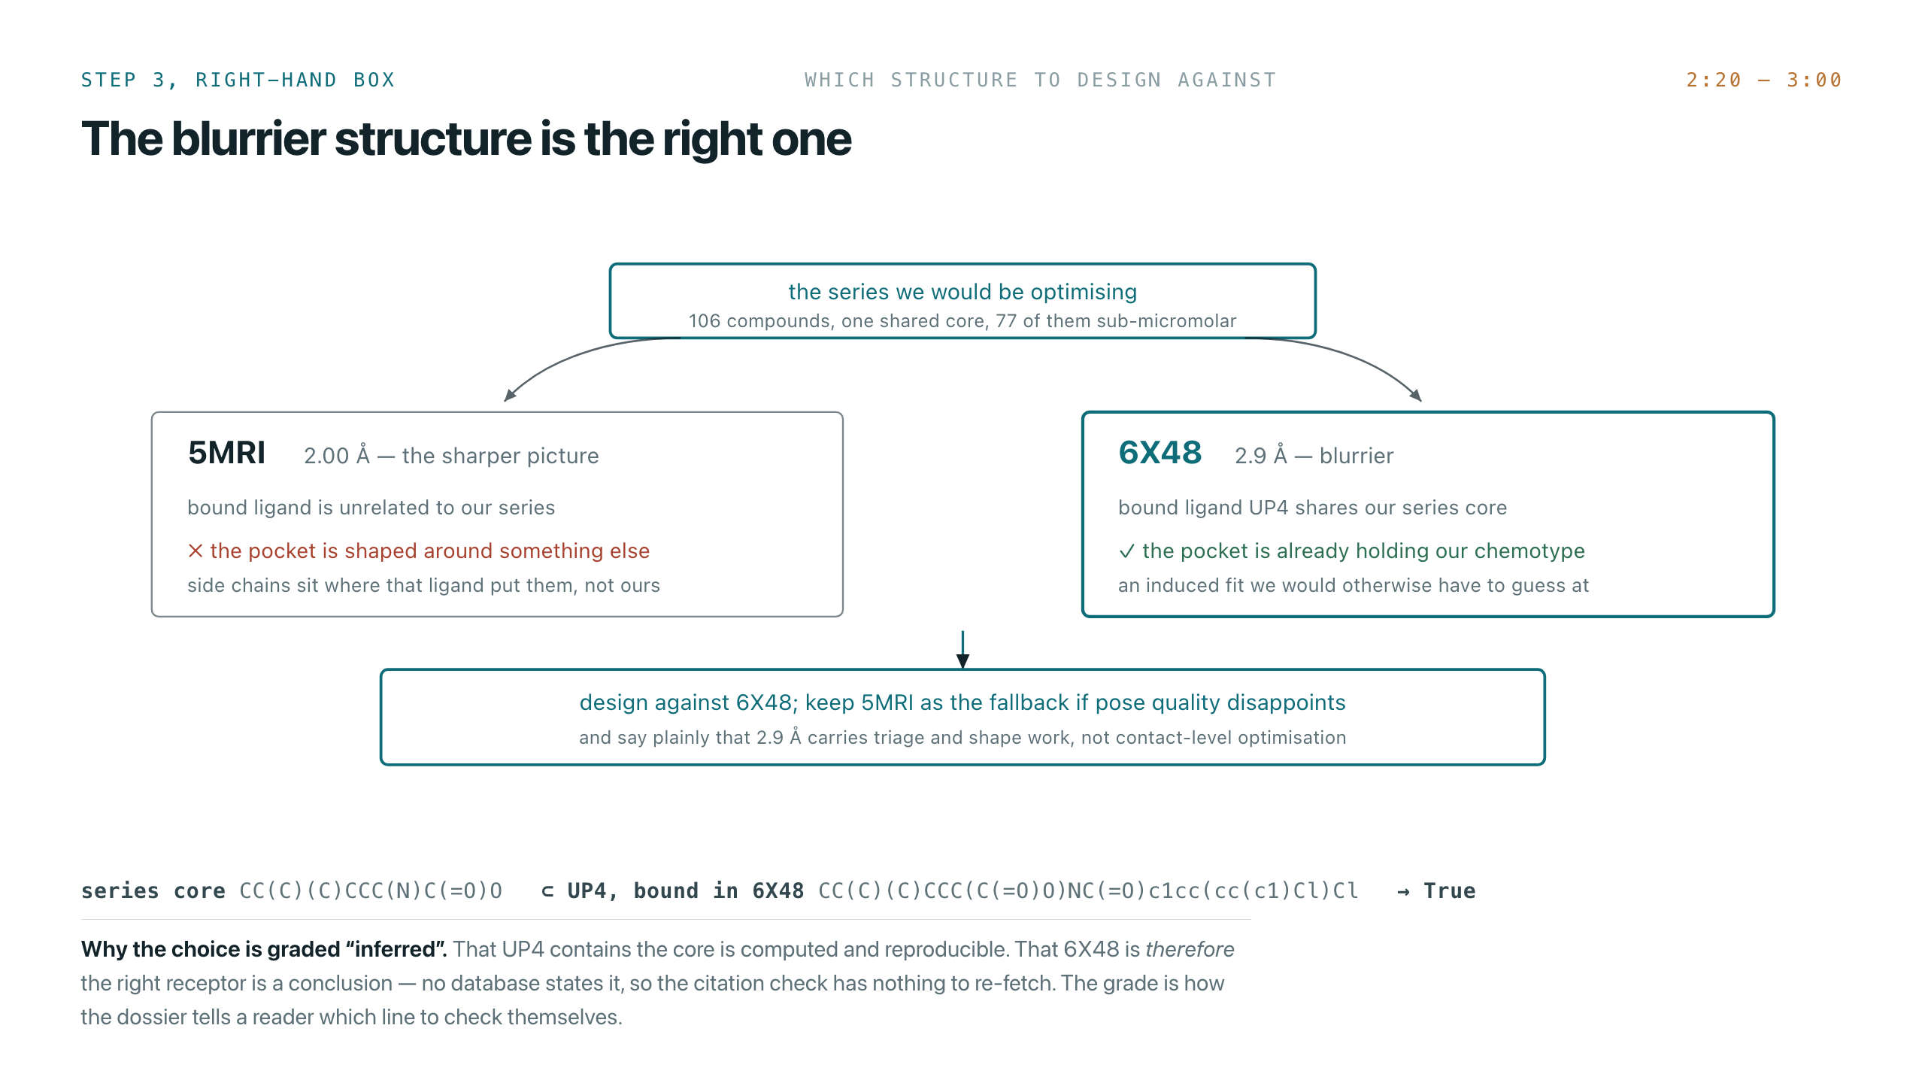
Notes:
The medicinal chemistry heart of the project, and the slide a chemist in the room will actually engage with.
Say it plainly: we recommend the blurrier structure. 6X48 at 2.9 Å over 5MRI at 2.00 Å, because the ligand bound in 6X48 contains the core our series is built on. The pocket is already holding our chemotype, side chains and all — an induced fit we would otherwise be guessing at.
Then the grading point. The substructure match is computed and reproducible. The conclusion that follows from it is not, so it is graded inferred. No database states "this is the right receptor", so the citation check has nothing to re-fetch. That distinction is what makes the dossier checkable rather than merely confident.

Slide 6
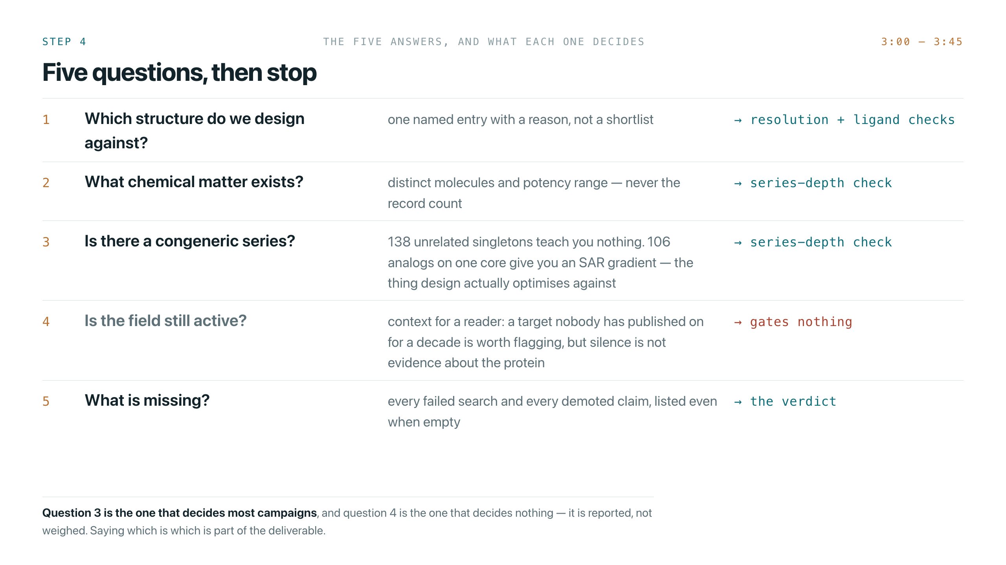
Notes:
Five questions, and what each one feeds.
Question 3 is the one that decides most campaigns. 138 unrelated singletons and 106 analogs on one core are the same compound count and completely different projects — only one of them gives you an SAR gradient to optimise against.
Question 4 is marked as gating nothing, deliberately. If someone asks why it is there at all, that is a fair hit and you should take it: it is context for a reader, it is not weighed, and replacing it with assay quality is already on the list. Saying it yourself is better than being caught.

Slide 7
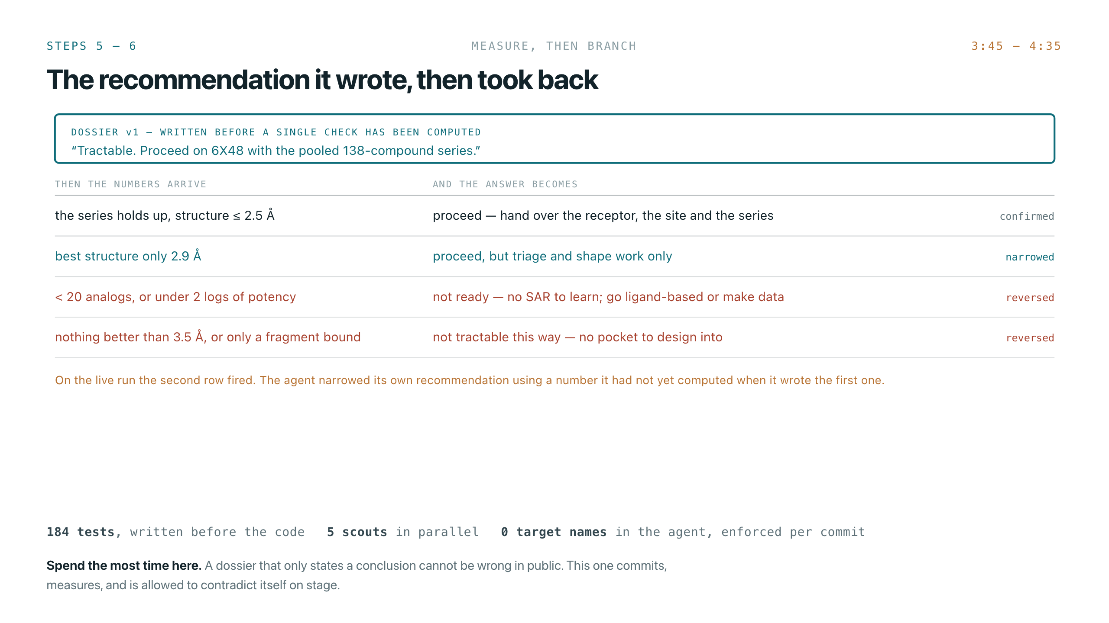
Notes:
The longest segment, and judging criterion one.
The top box was written before a single check existed. Say that twice — it is the whole point and it goes past people the first time.
Then walk the four rows and land on the second: on the live run the agent narrowed its own recommendation using a number it had not yet computed when it wrote the first version.
If you have both dossiers open, show v1 and v2 side by side here rather than describing them. The strip along the bottom is there if someone asks about rigour; do not read it out.

Slide 8
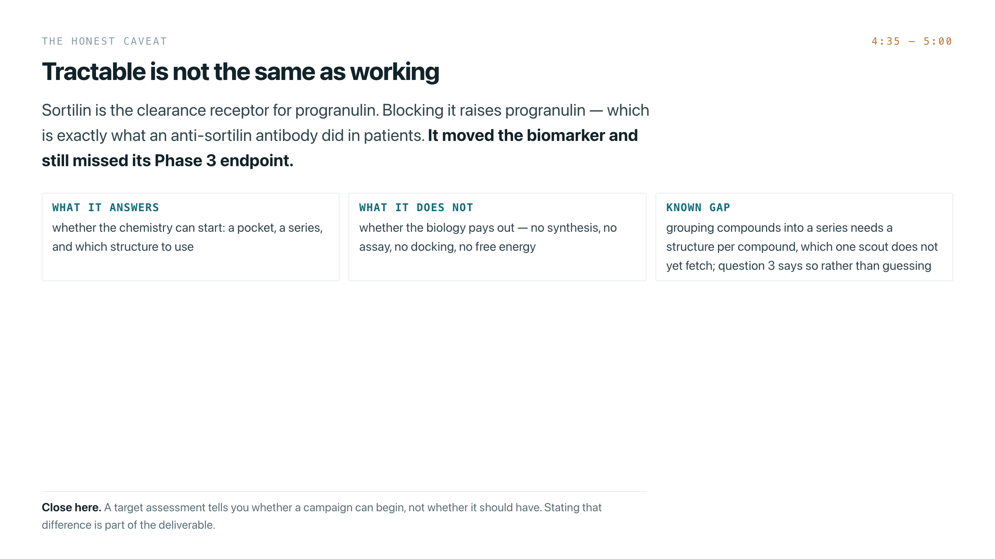
Notes:
Close on the caveat, not on a claim.
Sortilin clears progranulin. Blocking it raises progranulin. An anti-sortilin antibody did exactly that in patients and still missed its Phase 3 endpoint. So a tractability call tells you whether the chemistry can start — not whether it should have.
Name the known gap yourself: grouping compounds into a series needs a chemical structure per compound, and one scout does not fetch that yet, so question 3 says so rather than guessing.
Then stop. Do not add a summary slide.

