Slide 1
Oshawa Public Library Architecture Diagram

Slide 2
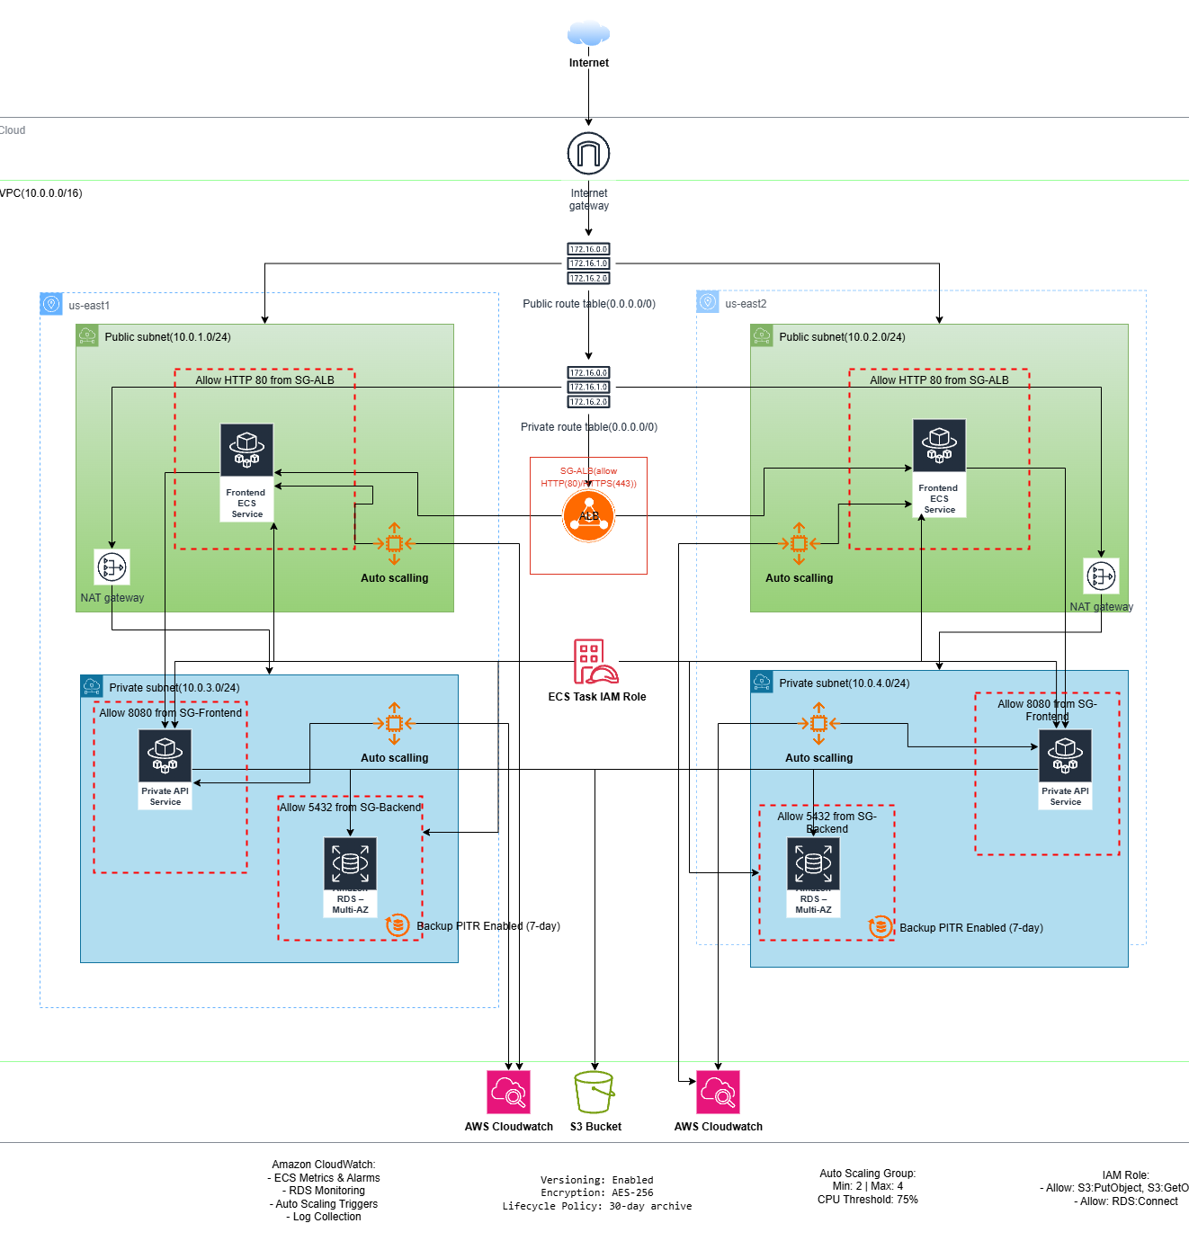
Architecture Design

Slide 3
Networks, High Availability, Redundancy & Security Groups
Network Design "Our architecture is built on a custom Virtual Private Cloud, or VPC, with the IP range 10.0.0.0/16. We’ve divided this VPC into two public subnets and two private subnets, each placed in a different Availability Zone for high availability. The public subnets host internet-facing components like the Application Load Balancer and NAT Gateways, while the private subnets host sensitive workloads such as the backend ECS services and our RDS PostgreSQL database. Public route tables are connected to the Internet Gateway to allow inbound and outbound traffic for public-facing services. Private route tables send outbound traffic through a NAT Gateway, which allows internal services to reach the internet for updates without exposing them publicly."

Slide 4
High Availability and Redundancy
"High availability ensures our services stay online even if one zone or component fails. We’ve deployed frontend and backend ECS services across both availability zones. The Application Load Balancer automatically distributes traffic between healthy resources in each zone. For the database, we use RDS Multi-AZ, which means there’s a fully synchronized standby in another zone ready to take over instantly if the primary fails." | "Redundancy eliminates single points of failure. At the compute layer, we run multiple ECS tasks across different subnets so that one task failing won’t affect the application. In the network layer, we use two NAT Gateways one in each public subnet so outbound internet connectivity is maintained even if one gateway fails. Our database layer is redundant through Multi-AZ RDS replication, and S3 storage automatically keeps redundant copies of files across multiple facilities."

Slide 5
Security Group
Security Groups "Security Groups add a virtual firewall around each resource, controlling exactly what traffic can enter or leave. We created separate security groups for each component: SG-ALB: Allows HTTP and HTTPS traffic from anywhere on the internet. SG-Frontend: Allows traffic only from the ALB security group, blocking all other sources. SG-Backend: Accepts requests only from the frontend security group, ensuring the backend is never exposed directly to the public. SG-RDS: Allows PostgreSQL connections only from the backend security group, protecting the database from any unauthorized access. This layered security approach ensures that each resource communicates only with trusted components."

Slide 6
Load Balancer and Auto Scaling
The Application Load Balancer (ALB) is responsible for distributing incoming HTTP traffic across multiple frontend ECS services that are deployed in public subnets spanning two separate Availability Zones (AZs). This distribution strategy not only balances the load efficiently among available containers but also enhances the system’s overall resilience. By leveraging multiple AZs, the deployment ensures high availability, redundancy, and fault tolerance, minimizing the risk of service disruption in the event of a failure in one zone and maintaining a consistent user experience during periods of fluctuating traffic. Key Component: Application Load Balancer (ALB) ALB is internet-facing, allowing users to access the application securely via HTTP (Port 80). Routes requests to Frontend ECS containers only. Integrated with Security Groups to tightly control inbound and outbound traffic: Allows HTTP from the internet to ALB ALB forwards only to Frontend ECS Why ALB? Supports dynamic container IPs (essential for ECS on Fargate) Enables path-based routing, scalability, and session stickiness Health checks ensure only healthy containers receive traffic

Slide 7
Load Balancer and Auto Scaling
Automatically adjusts the number of ECS tasks based on real-time CPU utilization, ensuring optimal performance and cost efficiency. Suggested Auto Scaling Policy Applied to both Frontend and Backend ECS services Scaling Policy: Min Tasks: 2 Max Tasks: 4 Trigger: CPU usage > 75% Backed by CloudWatch alarms to monitor performance metrics and trigger scaling events.

Slide 8
S3 Bucket and Backups
Amazon S3: Role in the OPL Cloud Architecture Purpose: Central object storage for media assets such as images, documents, and other digital files. Why S3? High Durability – 99.999999999% (11 9’s) object durability. Scalability – Handles unlimited storage and traffic without manual intervention. Integration – Natively integrates with ECS, RDS backups, and CloudWatch. Use in OPL Project: Stores all library media for public and backend use. Supports versioning to recover from accidental deletions/overwrites. Lifecycle policies reduce long-term storage costs. | S3 Security & Compliance Encryption: At Rest – AES-256 server-side encryption. In Transit – Enforced HTTPS for all object access. Access Control: IAM roles with least-privilege access (only S3:GetObject & S3:PutObject for ECS tasks). S3 bucket policies restrict public access to only authorized users and services. Compliance Alignment: Meets data protection standards for sensitive library assets. Fully integrated with AWS logging for audit trails.

Slide 9
S3 Bucket and Backups
Amazon S3: Role in the OPL Cloud Architecture Purpose: Central object storage for media assets such as images, documents, and other digital files. Why S3? High Durability – 99.999999999% (11 9’s) object durability. Scalability – Handles unlimited storage and traffic without manual intervention. Integration – Natively integrates with ECS, RDS backups, and CloudWatch. Use in OPL Project: Stores all library media for public and backend use. Supports versioning to recover from accidental deletions/overwrites. Lifecycle policies reduce long-term storage costs. | S3 Security & Compliance Encryption: At Rest – AES-256 server-side encryption. In Transit – Enforced HTTPS for all object access. Access Control: IAM roles with least-privilege access (only S3:GetObject & S3:PutObject for ECS tasks). S3 bucket policies restrict public access to only authorized users and services. Compliance Alignment: Meets data protection standards for sensitive library assets. Fully integrated with AWS logging for audit trails.

Slide 10
S3 Bucket and Backups
S3 Availability, Recovery & Cost Optimization High Availability: Data replicated across multiple Availability Zones. Seamless access even during hardware failures. Disaster Recovery: Versioning allows restoration of deleted/overwritten objects. Works with CloudWatch for monitoring storage usage & access patterns. Cost Optimization: Lifecycle Policy archives infrequently accessed files to S3 Glacier after 30 days. Reduces storage expenses without losing long-term data retention.

Slide 11
IAM roles and policy
An IAM Role in AWS is a set of permissions that define what actions are allowed or denied for a particular AWS resource. Unlike IAM users, roles are not tied to a specific person; instead, they are assumed by trusted entities like EC2 instances, Lambda functions, or ECS tasks to perform actions on your behalf. Why we Used It in This Project the ECS Task IAM Role is configured to allow the ECS containers/services to securely access other AWS resources without hardcoding credentials inside the application. Specifically, your role permissions include: Allow: S3:PutObject, S3:GetObject → Enables ECS tasks to store data (logs, backups, files) into S3 and retrieve them when needed. Allow: RDS Connect → Grants ECS tasks permission to connect to the RDS database securely. Benefits of Using the IAM Role Here Security – No need to store AWS credentials in code or configuration files. Principle of Least Privilege – Only the required permissions are granted (S3 and RDS access). Automatic Rotation – Temporary credentials are automatically rotated by AWS STS (Security Token Service). Scalability – As ECS tasks scale up/down, each one automatically gets the same secure permissions.

Slide 12
CloudWatch
Amazon CloudWatch Implementation for Oshawa Public Library Amazon CloudWatch is a pivotal component in the Oshawa Public Library’s (OPL) AWS architecture, providing comprehensive monitoring and logging to ensure operational excellence, performance efficiency, and reliability. Integrated across the architecture, CloudWatch enables real-time visibility into the containerized microservices, database, and scaling operations, ensuring the system remains robust, responsive, and cost-effective. Monitoring ECS Services CloudWatch collects key metrics from the Amazon ECS (Fargate) services hosting OPL’s frontend and backend microservices. Metrics such as CPU utilization, memory usage, and network throughput are tracked for both services deployed across public and private subnets. Custom dashboards display these metrics, allowing the OPL team to monitor application health and identify performance bottlenecks. For instance, CloudWatch alarms are configured to trigger when CPU utilization exceeds 75%, initiating auto-scaling actions to adjust ECS task counts dynamically, ensuring seamless handling of traffic spikes.

Slide 13
CloudWatch
Database Performance Monitoring Amazon RDS for PostgreSQL, deployed in a Multi-AZ configuration, is monitored via CloudWatch to ensure high availability and performance. Key metrics include database connections, read/write IOPS, and latency. CloudWatch tracks backup status and Point-In-Time Recovery (PITR) operations, providing alerts for any backup failures. This ensures the library’s critical data remains durable and recoverable, aligning with OPL’s disaster recovery requirements. Logging and Diagnostics CloudWatch Logs are configured to capture detailed logs from ECS tasks, including application logs from the frontend and backend services. These logs are instrumental for debugging issues, tracking user activity, and auditing system behavior. Log groups are organized by service (e.g., “OPL-Frontend-Logs” and “OPL-Backend-Logs”), with retention policies set to manage storage costs. CloudWatch Logs Insights enables the OPL team to query logs efficiently, facilitating rapid issue resolution.

