Slide 1

Physics Informed Neural Network for Real-Time Anomaly Detection in Power Dynamics
Authors: Koshik Debanath, Sagor Aich, and Azmain Yakin Srizon
Institution: Rajshahi University of Engineering & Technology, Department of Computer Science and Engineering
23/09/2025

Slide 2
Introduction
The Challenge: Modern power grids are critical infrastructure, but increasingly unstable due to renewable energy integration and complex interconnections [1].
The Need: Fast, reliable anomaly detection is essential to prevent cascading failures and widespread blackouts [2].
Our Approach: We propose a framework using Physics-Informed Neural Networks (PINNs) [3] that combines the power of deep learning with the fundamental laws of power system dynamics.

Slide 3
Problem Statement
Limitations of Data-Driven Models (e.g., LSTMs, Autoencoders) [4]:
Black Box Nature: They learn statistical correlations but lack physical interpretability. It's hard to understand why an anomaly is flagged.
Data Hungriness: They require vast datasets, especially of labeled fault events, which are rare and costly to obtain in real-world systems.
The Goal: To create an anomaly detection system that is:
Data-Efficient: Trains on sparse data from normal operations only.
Interpretable: The anomaly signal is directly linked to a violation of a known physical law.
Robust & Real-Time: Provides a clear, instantaneous signal upon fault detection.

Slide 4
Related Work - Traditional & Machine Learning
Model-Based Methods: Rely on state estimation and limit checking. Often too slow for fast-transient dynamics.
Unsupervised Learning:
Methods: Principal Component Analysis (PCA), one-class SVMs.
Concept: Identify deviations from normal operational clusters.
Limitation: Purely statistical; no intrinsic understanding of system physics.

Slide 5
Related Work - Deep Learning Approaches
Autoencoders & VAEs:
Concept: Trained to reconstruct normal data. A high reconstruction error signals an anomaly.
LSTMs (Our Baseline):
Concept: Predict the next state in a time series. A large prediction error signals an anomaly [5].
Shared Limitation: While powerful, these methods are still "black boxes" and fundamentally data-driven, missing the underlying physics.

Slide 6
Related Work - Physics-Informed Neural Networks (PINNs)
A Hybrid Paradigm: PINNs merge neural networks with differential equations [3].
How it Works: The governing physical equation (e.g., Navier-Stokes, or in our case, the Swing Equation) is embedded directly into the network's loss function.
Key Advantage: This forces the model's predictions to obey the laws of physics, making them highly data-efficient and generalizable [6].
Our Novelty: We adapt PINNs from their traditional role of solving equations to the new task of detecting violations of those equations for anomaly detection.

Slide 7
Research Questions
Can a PINN learn the complex oscillatory dynamics of a power system from only sparse, normal-operation data?
Can the physics residual of this trained PINN serve as a robust and instantaneous anomaly signal when a fault occurs?
How does this physics-informed approach compare to a standard data-driven method like an LSTM in terms of data efficiency, signal clarity (SNR), and interpretability?

Slide 8
Objectives
To develop a stabilized PINN framework that accurately models power system dynamics governed by the swing equation.
To validate that the physics residual provides a high-fidelity signal for real-time anomaly detection.
To quantitatively compare the performance of our PINN framework against a benchmark LSTM model.

Slide 9
Outcomes and Impacts
A Novel Framework: A physically-grounded, interpretable solution for smart grid monitoring.
Data-Efficiency: Overcomes the major hurdle of requiring large, labeled fault datasets.
Enhanced Reliability: A significant step towards more intelligent and resilient power grids, preventing costly blackouts.

Slide 10
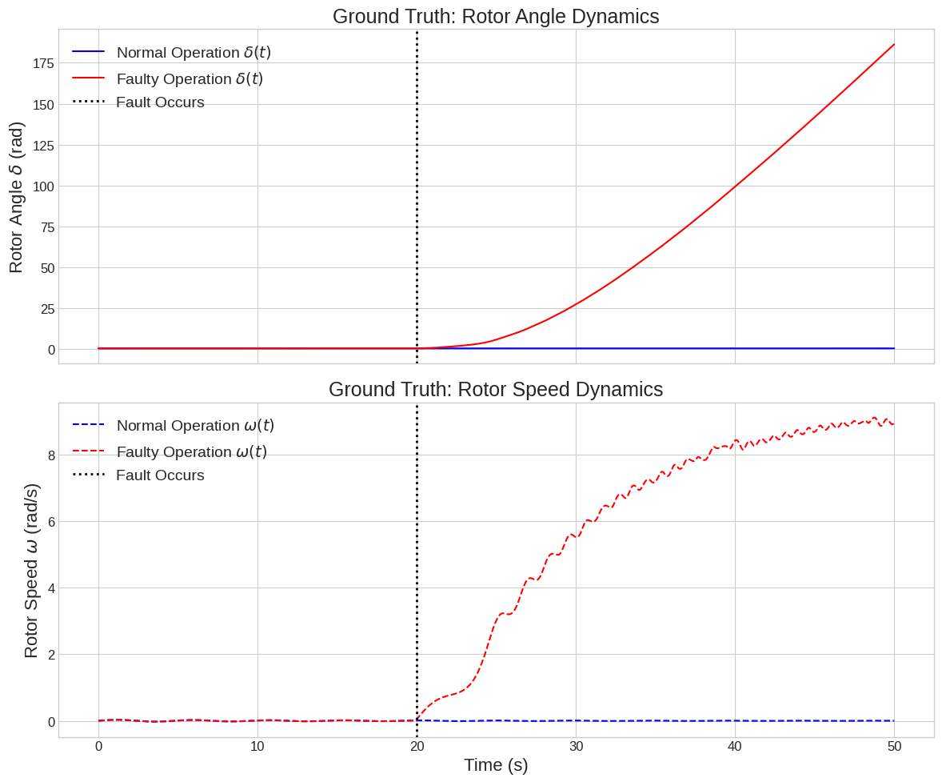
Methodology - Governing Physics & Data
System Model: We use a Single-Machine Infinite Bus (SMIB) system, a fundamental model in power systems.
Governing Law: The Swing Equation [1]$M\frac{d^{2}δ}{dt^{2}}+D\frac{dδ}{dt}=P_{m}-P_{e,\text{max}}sin(δ(t))$
This equation describes the rotor angle (δ) dynamics of a generator.
Fault Simulation: A fault is simulated at t=20s by suddenly reducing Pe,max.
Fig. 1. Ground truth dynamics of the simulated SMIB system. The top panel shows the rotor angle (δ) and the bottom panel shows rotor speed (ω). Under normal operation (blue), the system exhibits a stable, damped oscillation. A fault introduced at t=20s (red) causes a rapid loss of synchrony, demonstrating the instability we aim to detect.

Slide 11
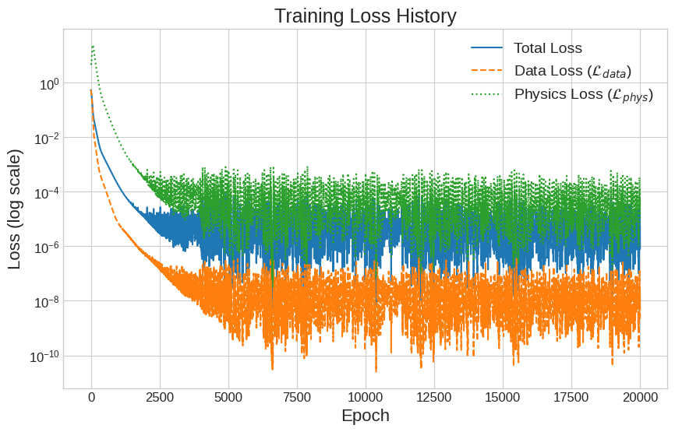
Methodology - PINN Anomaly Detection Concept
Training on Normal Data: We train the PINN using only a few sparse data points from the stable (blue) curve.
Dual Loss Function [3]: The model is trained to minimize two things simultaneously:
Data Loss (L_data): The error between the model's prediction and the sparse training data.
Physics Loss (L_phys): The residual of the swing equation. This forces the model to learn the underlying physics, not just fit the points.
The "Aha!" Moment:
Once trained, the PINN has learned the physical laws of normal operation.
When presented with faulty data, the system no longer obeys these learned laws.
The Physics Loss (Residual) spikes dramatically, becoming our anomaly signal.
Fig. 2. Training loss history for the PINN model over 20,000 epochs, shown on a logarithmic scale. The plot shows the total loss, data loss, and the unweighted physics loss. The stable convergence to a low value for all components indicates a successful and well-behaved training process, guided by both data and physics.

Slide 12
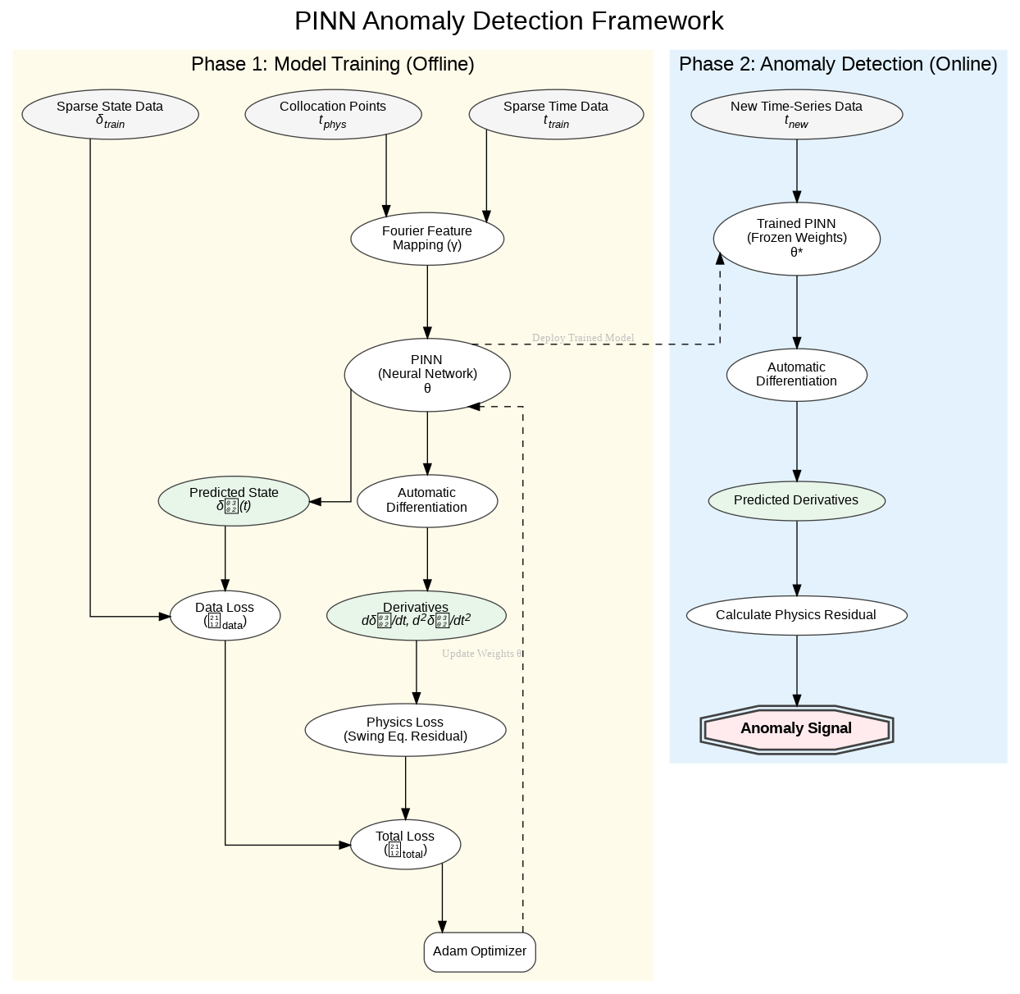
Methodology - Stabilized PINN Architecture
Walkthrough of the diagram:
Phase 1 (Offline Training):
Input t is passed through a Fourier Feature Mapping layer [7]. This is crucial for helping the standard network learn high-frequency oscillatory functions.
The PINN predicts the state δ(t).
We compute both Data Loss against sparse data and Physics Loss at many collocation points.
A loss weight annealing strategy [8] balances these two losses for stable training.
Phase 2 (Online Detection):
The trained model (with frozen weights) receives new time-series data.
It calculates the Physics Residual for this new data.
A large residual value is our Anomaly Signal.
Fig. 3. Conceptual architecture of the proposed Physics-Informed Anomaly Detec-
tion framework. During offline training, a PINN with Fourier Features is trained on
sparse normal data to minimize a weighted sum of data loss (Ldata) and physics loss
(Lphys). During online inference, the trained model processes new time-series data, and
a large physics residual signals a deviation from the learned physical laws, indicating
an anomaly.

Slide 13
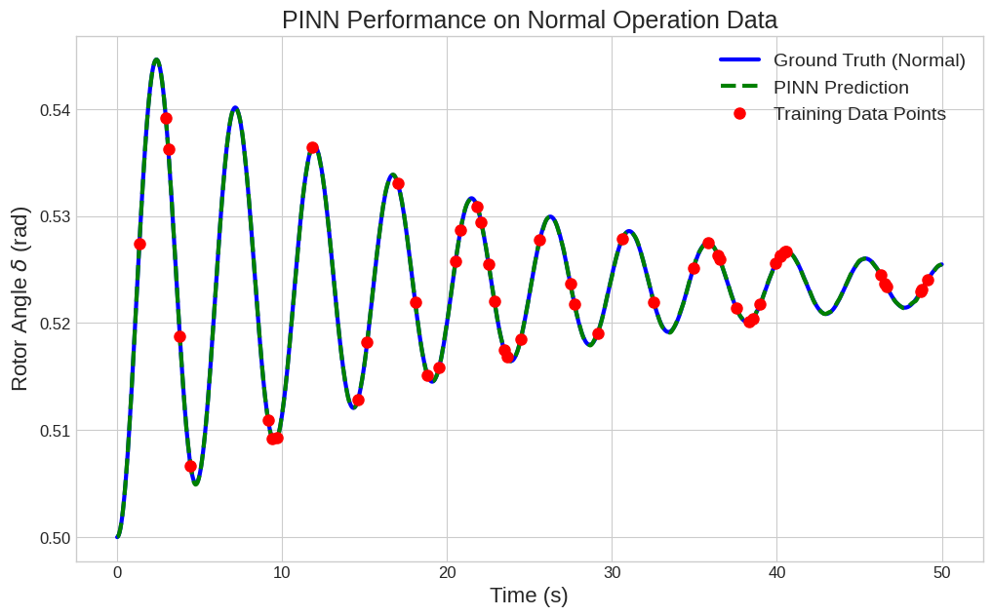
Experimental Results - Training & Reconstruction
Highly Data-Efficient: Trained on only 50 sparse data points from the normal operation curve.
Stable Training: Our stabilization techniques (Fourier Features, annealing) lead to smooth convergence.
Fig. 4. PINN performance on normal operation data. The model, trained on only 50 sparse points (red dots), accurately reconstructs the full, continuous dynamics (green dashed line) by learning the underlying physics. The prediction closely matches the ground truth (blue solid line), demonstrating high data efficiency

Slide 14
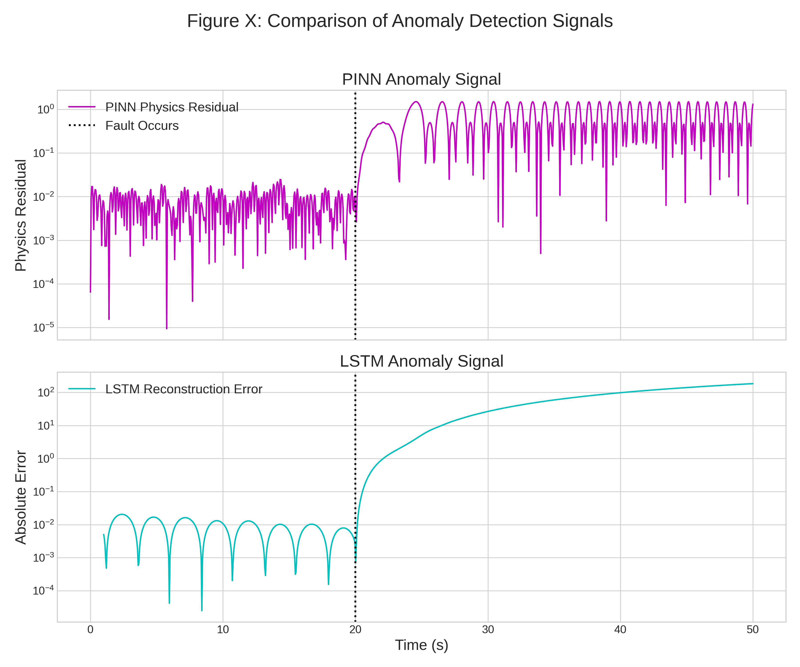
Experimental Results - Anomaly Detection Performance
The Central Result:
Top Panel (PINN): Look at the Physics Residual. Before the fault (t<20s), the signal is extremely low and stable. At the exact moment of the fault, there is a sharp, massive, and sustained spike. The signal is incredibly clean.
Bottom Panel (LSTM): The LSTM also detects the fault, but its reconstruction error is much noisier before the fault and the signal change is less distinct.
Fig. 5. Comparison of anomaly detection signals. The top panel shows the PINN’s
physics residual, which exhibits a sharp, sustained spike with a very low noise floor
immediately when the fault occurs at t=20s. The bottom panel shows the LSTM’s
reconstruction error, which also detects the fault but with a higher noise floor and a
less distinct signal change, resulting in a lower SNR.

Slide 15
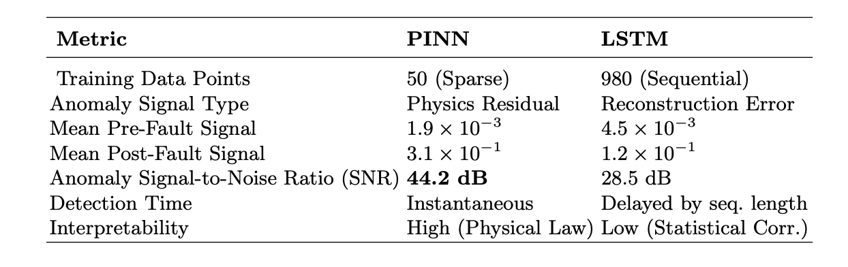
Experimental Results - Quantitative Comparison
Highlight Key Metrics:
Data Efficiency: PINN used 50 sparse points vs. LSTM's 980 sequential points.
Signal Clarity (SNR): PINN achieved an SNR of 44.2 dB, far superior to the LSTM's 28.5 dB. This means a much clearer and more reliable detection.
Detection Time: PINN is Instantaneous.
Interpretability: PINN is High (violation of a physical law) vs. LSTM's Low (statistical correlation).
Table 1. Quantitative Performance Comparison of PINN and LSTM Frameworks

Slide 16
Conclusion
We successfully developed a stabilized PINN framework for real-time anomaly detection in power systems.
Our method is exceptionally data-efficient, learning system dynamics from only 50 normal operation data points.
The physics residual serves as a robust, interpretable, and high-SNR anomaly signal, significantly outperforming a standard LSTM baseline.

Slide 17
Future Work
Scalability: Extend the framework from the simple SMIB model to complex, multi-machine power systems.
Real-World Validation: Apply and test the model on noisy, real-world Phasor Measurement Unit (PMU) data.
Model Complexity: Incorporate more comprehensive physical models, including voltage dynamics and control system actions, to create a more complete "digital twin" of the grid.

Slide 18
References
[1] Kundur, P., Balu, N.J., Lauby, M.G.: Power system stability and control. McGraw-Hill, New York (1994)
[2] Andersson, G., et al.: Causes of the 2003 major grid blackouts in North America and Europe... IEEE Trans. Power Syst. (2005)
[3] Raissi, M., et al.: Physics-informed neural networks: A deep learning framework for solving... J. Comput. Phys. (2019)
[4] Ma, Y., et al.: A review of data-driven-based methods for power system transient stability assessment. Int. Trans. Electr. Energ. Syst. (2019)
[5] Han, M., et al.: Real-time anomaly detection in power grids with LSTM-based forecasting. In: 2019 IEEE SmartGridComm (2019)
[6] Karniadakis, G.E., et al.: Physics-informed machine learning. Nat. Rev. Phys. (2021)
[7] Tancik, M., et al.: Fourier features let networks learn high frequency functions in low dimensional domains. In: NeurIPS (2020)
[8] Wang, S., et al.: Understanding and mitigating gradient flow pathologies in physics-informed neural networks. SIAM J. Sci. Comput. (2021)

Slide 19
Thank you! If you have any questions please feel free to ask?

