Slide 1
Agentic RAG Chatbot
Multi-Format Document QA using Model Context Protocol (MCP)

Slide 2
Architecture Overview (MCP-based)
Three-Agent Architecture:
• IngestionAgent: Parses documents
• RetrievalAgent: Embeds & retrieves context
• LLMResponseAgent: Calls Gemini and returns answer
All agents communicate via structured MCP messages:
{"type": "RETRIEVAL_RESULT", "sender": "RetrievalAgent", "receiver": "LLMResponseAgent", "trace_id": "rag-123", "payload": {"query": "...", "retrieved_context": ["..."]}}

Slide 3
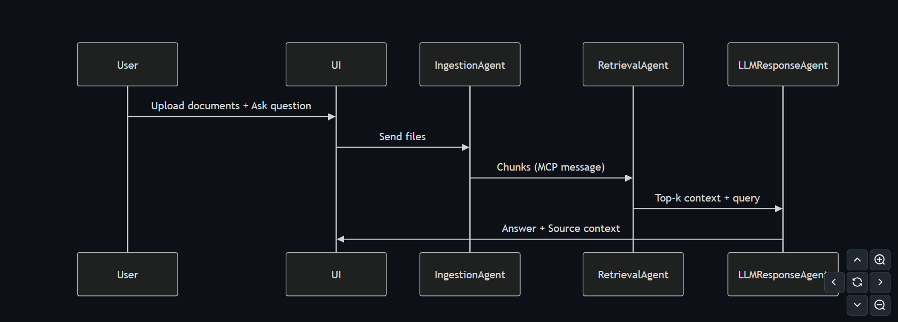
System Flow

Slide 4
Tech Stack
UI: Streamlit
Embeddings: HuggingFace Transformers (MiniLM)
Vector DB: FAISS
LLM: Google Gemini 2.5 Flash
Protocol: Model Context Protocol (MCP)
Document Parsing: PyMuPDF, python-docx, python-pptx, pandas

Slide 5
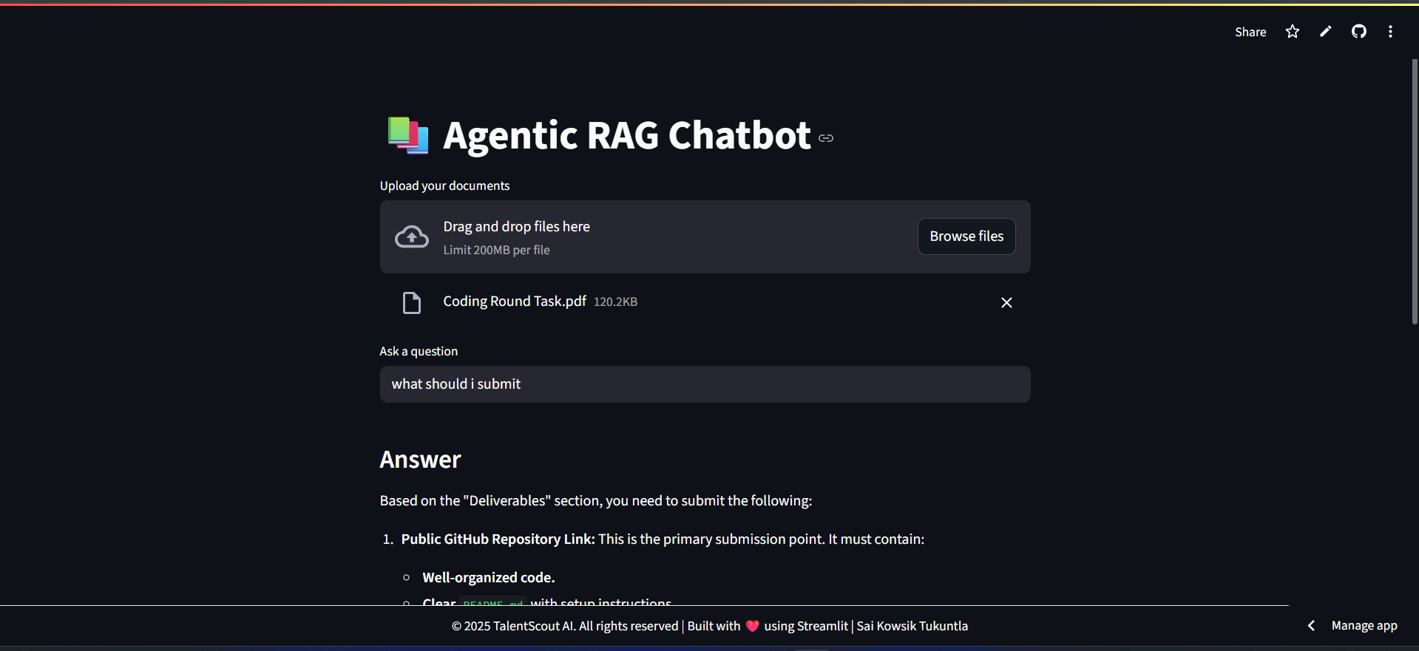
Screenshots

Slide 6
Challenges & Future Scope
Challenges:
Handling malformed documents
Preventing hallucinations in LLM answers
Avoiding tensor errors with Sentence Transformer
Future Scope:
Add a Ranking Agent or Summarizer Agent
Add multilingual support
Add real-time streaming using WebSocket's

