Slide 1
Virtual File System (VFS)
Virtual File System (VFS)

Slide 2
Agenda :
Agenda :
VFS
VFS Objects
VFS - Scenario1
VFS - Scenario2

Slide 3
VFS :
VFS :
Application
VFS
ext2
proc
vfat
One Hard disk with three partition
/dev/sda1
memory
/dev/sda3
Fig : File Hierarchy

Slide 4
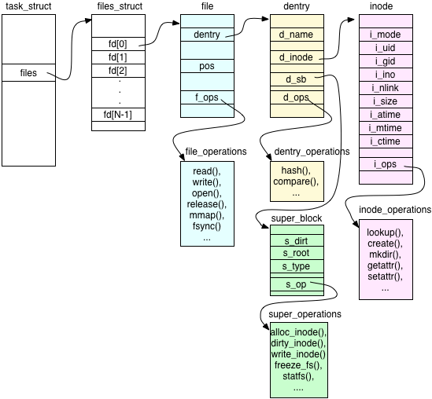
VFS Objects :
VFS Objects :
Super block
Inode
File
Dentry
Fig : VFS Objects

Slide 5
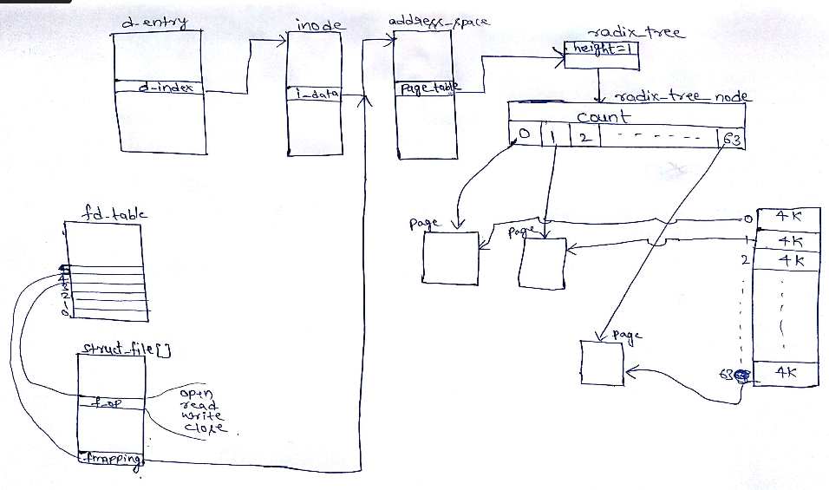
Scenario 1:
Scenario 1:
Fig : VFS scenario1 (File contents are already loaded in page cache)

Slide 6
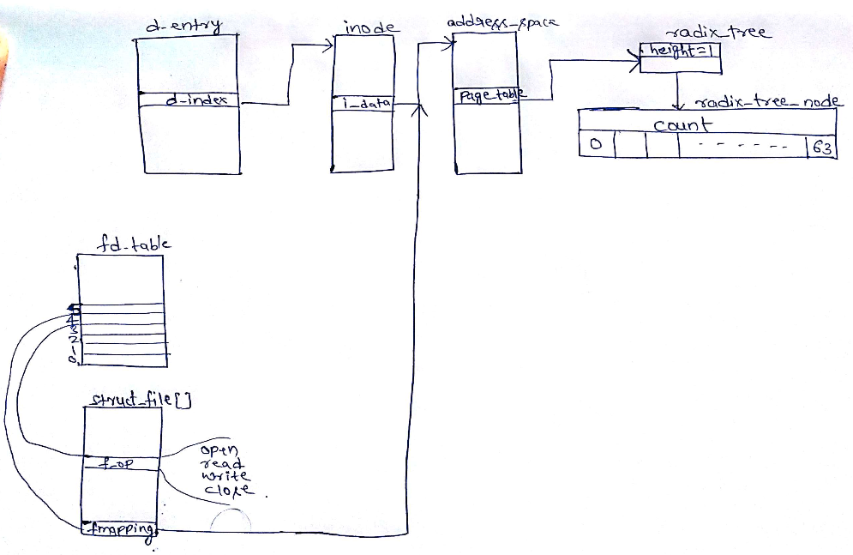
Scenario 2:
Scenario 2:
Fig : VFS scenario2 (File contents are not available in page cache)

Slide 7
ext2 file system

Slide 8
OBJECTIVE
OBJECTIVE
Brief history
ext2fs data structure
Conclusion (Brief of ext3fs)

Slide 9
History
History
MINIX (Offset: 16bits, Filename limit: 14)
Extended File System(Filesize: 2GB, limit: 255)
Second Extended File System(Filesize: Block dep)
Third Extended File System(Journaling)

Slide 10
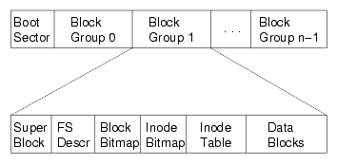
ext2fs data structure
ext2fs data structure
*FS Descr = Block Group Descriptor

Slide 11
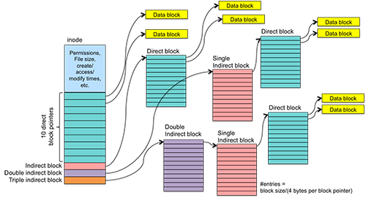
Inode data structure
Inode data structure

Slide 12
Conclusion of ext2 :
Conclusion of ext2 :
Victim of its own success
Feature of Journaling was added resulting to ext3

Slide 13
VFS -Continued.....
VFS -Continued.....
Fig : Data structures of /dev/sda1

Slide 14
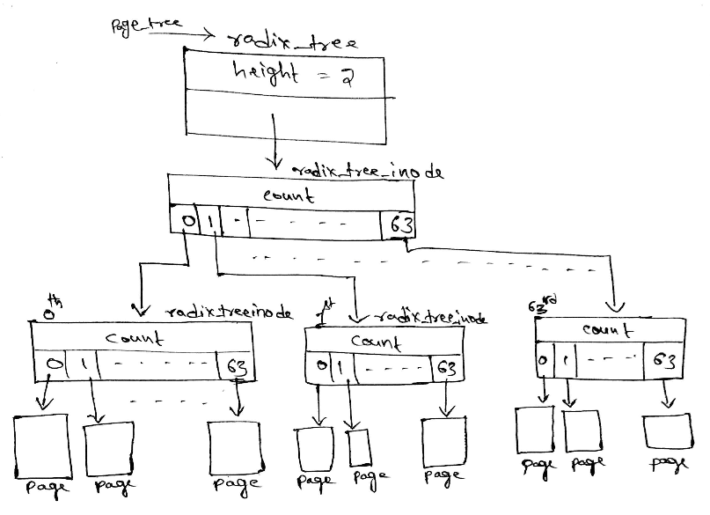
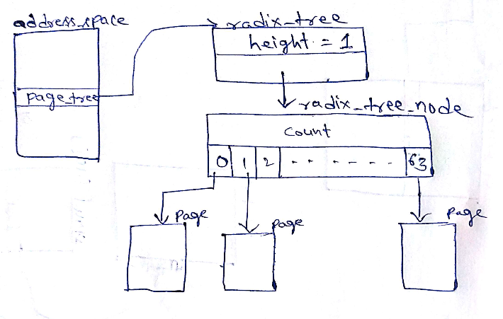
Continued.....
Continued.....
Fig : Radixtree (height = 1)
Fig : Radixtree (height = 2)
Page cache of/dev/sda1 contains

Slide 15
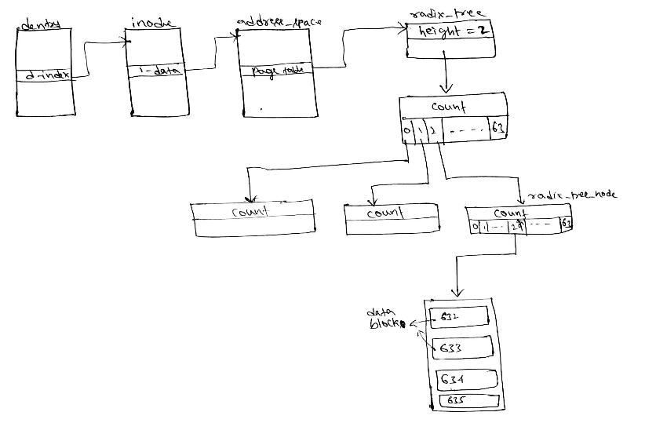
Continued.....
Continued.....
Fig : Page cache in /dev/sda1

Slide 16
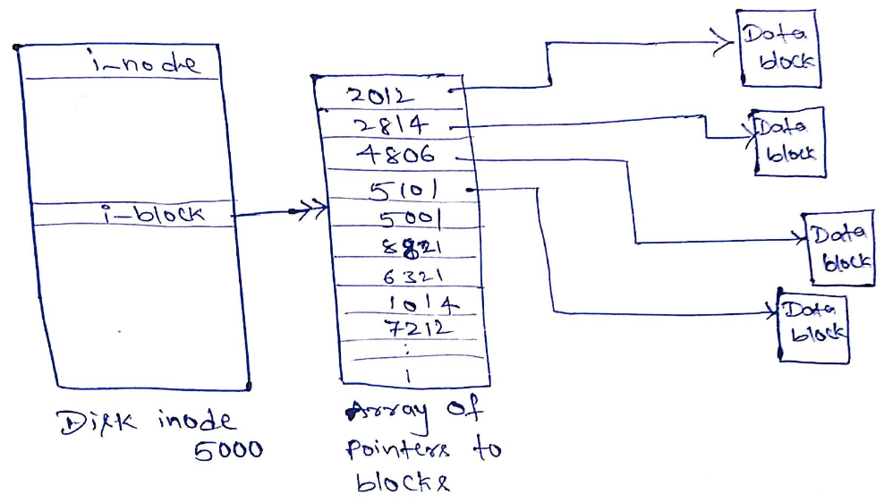
Continued.....
Continued.....
Fig : Arrangement of data in disc

Slide 17
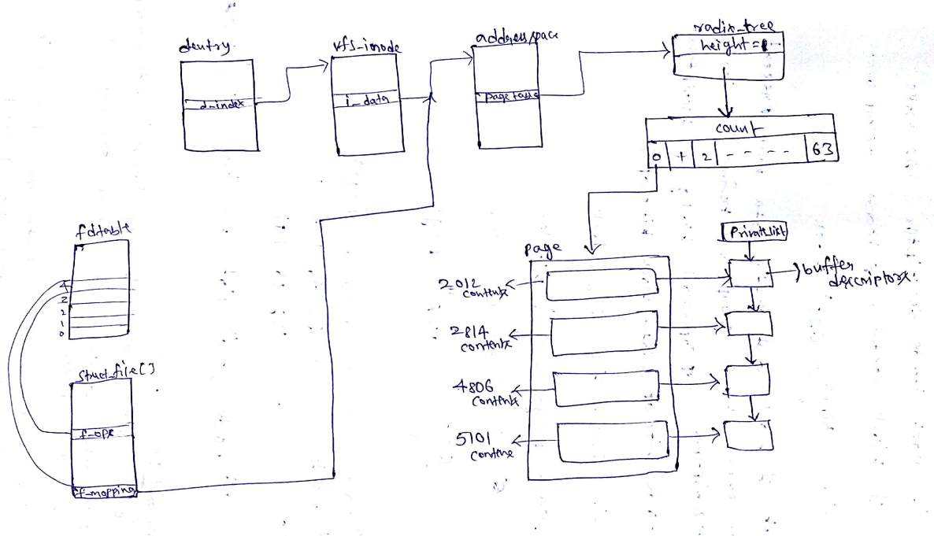
Continued.....
Continued.....
Fig : loading the data from disc to page cache of VFS

Slide 18

Any Queries...?
Any Queries...?

