Slide 1
METADATA.AI
GE HealthCARE : CONTEXTUAL CARE PROTOCOL

Slide 2
SCOPE & OVERVIEW
AIM : to assist doctors by providing proper guidelines in different stages of pregnancy to avoid late detection of problems.
Our main focus is to make it more dynamic to give proper medication at the earliest.
Machine learning algorithm to catch all possible variations like normally distributed data, Imbalanced data etc.
Making our algorithms PRO by learning from all deviations and giving competition by new algorithms.

Slide 3
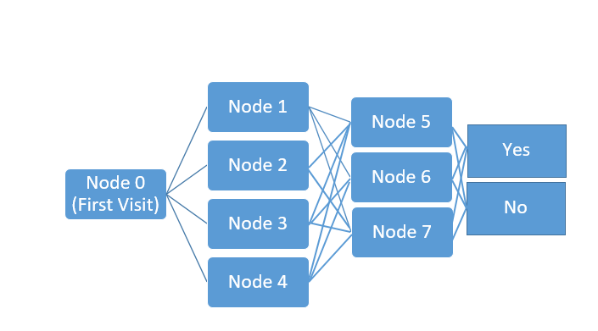
AIM : to assist doctors by providing proper guidelines in different stages of pregnancy to avoid late detection of problems.
Think in Neural Network’s way
Neural Network consists of Nodes, Layers, weights…
In a similar way –
Layers : Take it as different time phase (Here 3 Trimesters)
Nodes : Take it as different treatments given to patient in each trimester
Checkpoints : Regular checkups done by doctor in between trimester
How it works???
>A patient gives details of her condition, based on that model tells a particular treatment including tests and medicines to doctor (represented as different nodes)
>A doctor do regular checkups and models learn from them and can dynamically change the decisions and give correct treatment
>Records all the predicted and actual (treatment actually followed by doctor)outcomes and auto-learn from them.

Slide 4
Dynamic Approach
Our Model is flexible enough to ask number of regular checkups scheduled for patient(which can be different for different patients)
For Ex : N = 2
There are two checkups scheduled in first three months.
Case 1: Model gives treatment 4(Node 4). After first checkup – Normal –second checkup – Normal – Trimester over – set of new tests of node 4 scheduled
Case 2: Model gives treatment 4(Node 4). After first checkup – Normal –second checkup – Not Normal – changes treatment -- Trimester over – set of new tests of node 2 scheduled
1
2

Slide 5
Dynamic Approach
We have 2 types of features – STATIC | DYNAMIC
STATIC features are stored only once and are constants.(Ex- Age, Smoking, weight, height etc.)
DYNAMIC features are updated after each checkup and model predicts the best outcome based on new values(Ex – hemoglobin content, BP, Fever etc.)
Addition of new features in each node based on patient symptoms in past.

Slide 6
Assumptions
Specific treatment is followed for 1 trimester
Treatment and medication checkup may alter in each checkup
Features presented here are just a subset of actual features
No. of layers shall be decided by an expert or real data
No. of nodes shall be decided by an expert or real data
3-Layer presentation is just a subset of real world decision tree
Data is created under normal Gaussian distribution assumption
Data here has balanced classes ( Imbalanced classes is explained in learning part)
Doctor can choose the treatment among the prescribed nodes
Medication at each checkup is same for a particular treatment
We have a sufficient data available for each treatment (node or classifier)

Slide 7
Machine Learning (Dealing with artificial data)
We built Grid Search algorithm on Random Forest to tune hyper parameters and give best accuracy over a period of time.
We built Gradient Boosting Machine to perform well in classification
We can go for Over/Under Sampling to handle imbalanced datasets
We can go for other options as well based on real data like Neural Networks, Decision Trees, Xgboost, Logistic Regression with data preprocessing etc.
We have in total 8 classifiers in our protocol. Each of them gets updated in night considering new data points as well.

Slide 8
Model Learning
Our model learns every night including new data points as well
We decide performance threshold below which or model gets a tag of Faulty
We run a grid search algorithm on each classifier to tune the model parameters
We make new models as well when existing model goes below performance threshold
Replacement of model when new model performs better than existing model
Continuous addition of data after getting actual treatment done by doctor and feedback whether it was helpful or nots

Slide 9
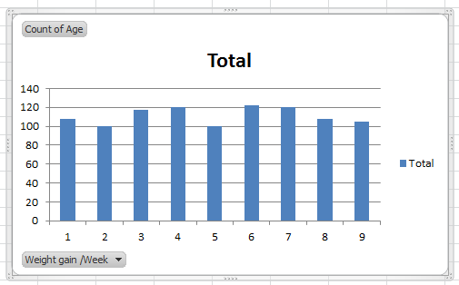
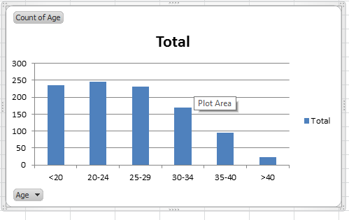
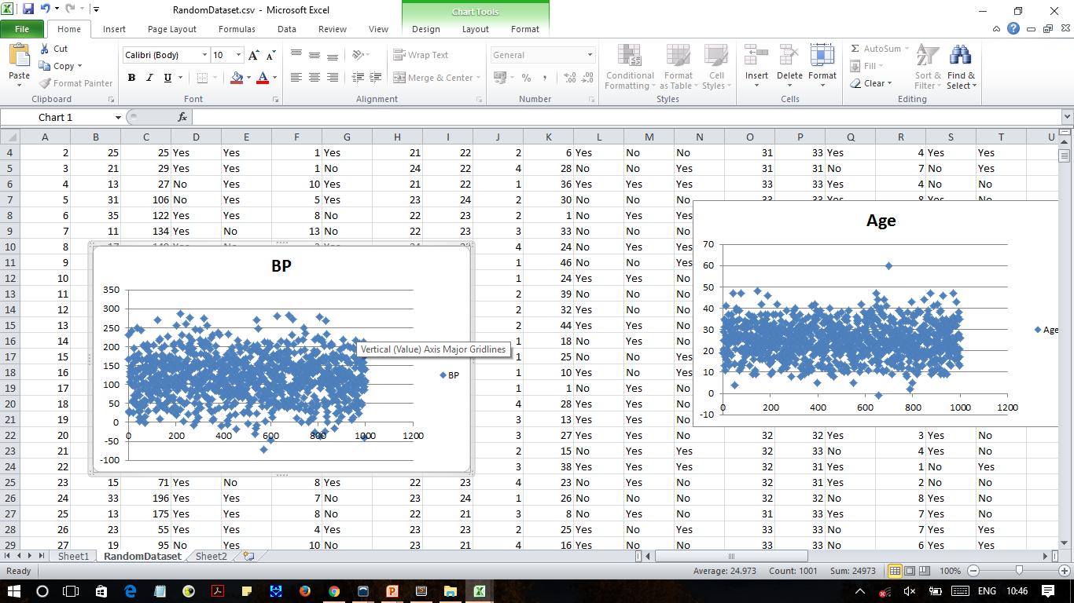
Data Visualization

Slide 10
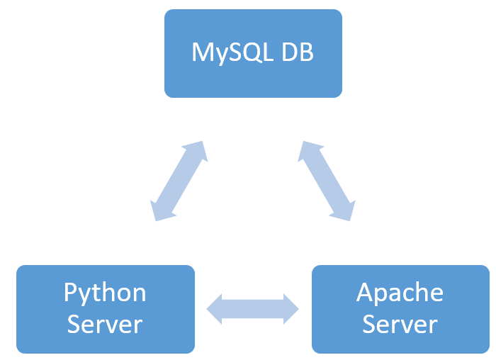
Database Architecture

Slide 11
Database Architecture
Both apache and python server are running in the same system
Apache server is used to run HTML, CSS, JS and PHP
Machine Learning algorithms are written on Python Server
Both have a common database which is MySQL
The communication between Python and Server server is through Flask API
The communication between Python and MySQL database is through python-mysql
The communication between Apache and MySQL database is through PHP

Slide 12
Thank You

