Slide 1
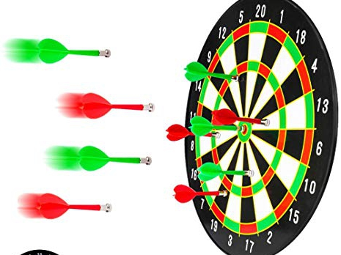
Experimental Design
Dart Madness

Slide 2
MENU
01
Design Introduction
02
Assumptions Checking
03
Data Analysis
04
Conclusion and Summary

Slide 3
01
Design Introduction

Slide 4
Goal
Our goal is to study four factors that could potentially impact our group's accuracy with respect to throwing darts. If all goes according to plan, we will find an optimal technique to wow all our friends.

Slide 5
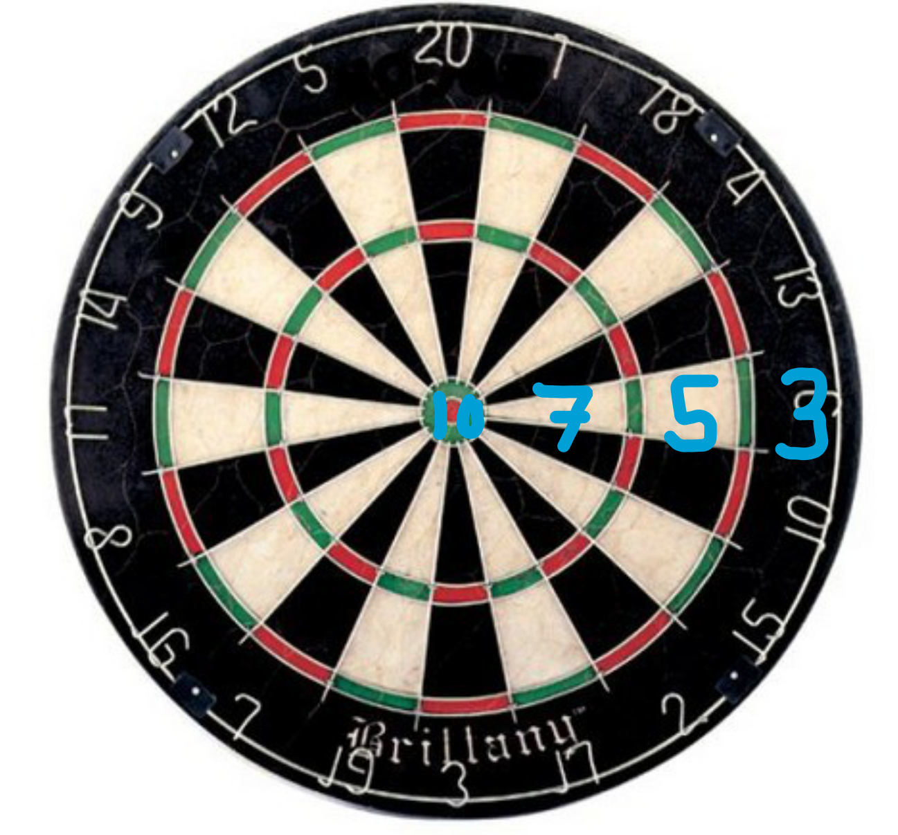
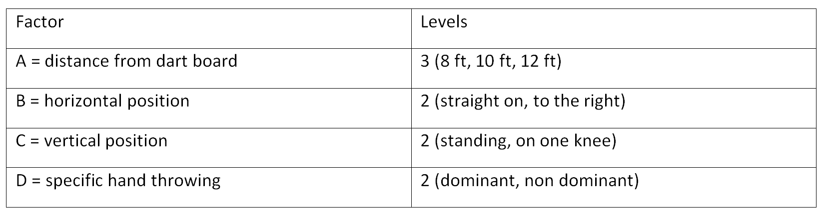
Response Variable and Controllable Factors

Slide 6
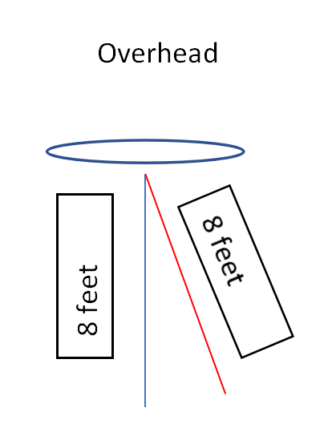
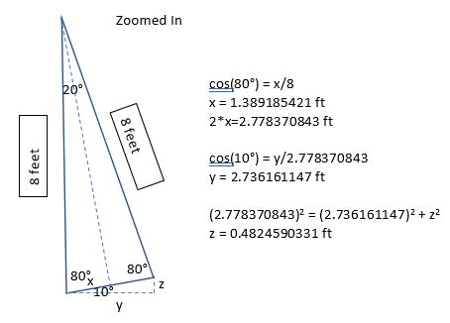
More Details for “to the right” Position
Overhead View
Calculations

Slide 7
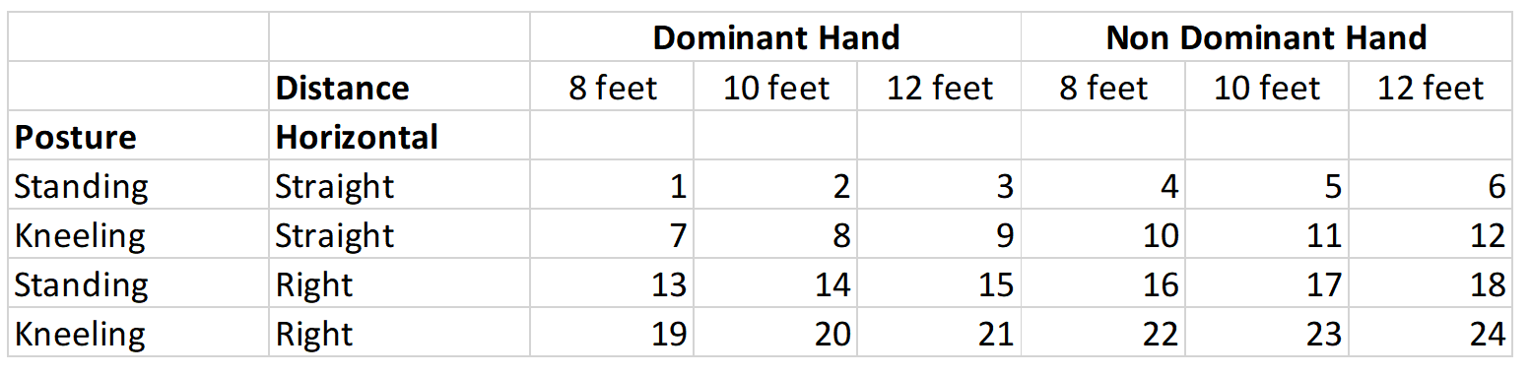
Treatment Combinations
Model: score~blocks+{(distance)*(horizontal)*(posture)*(hand)}​

Slide 8
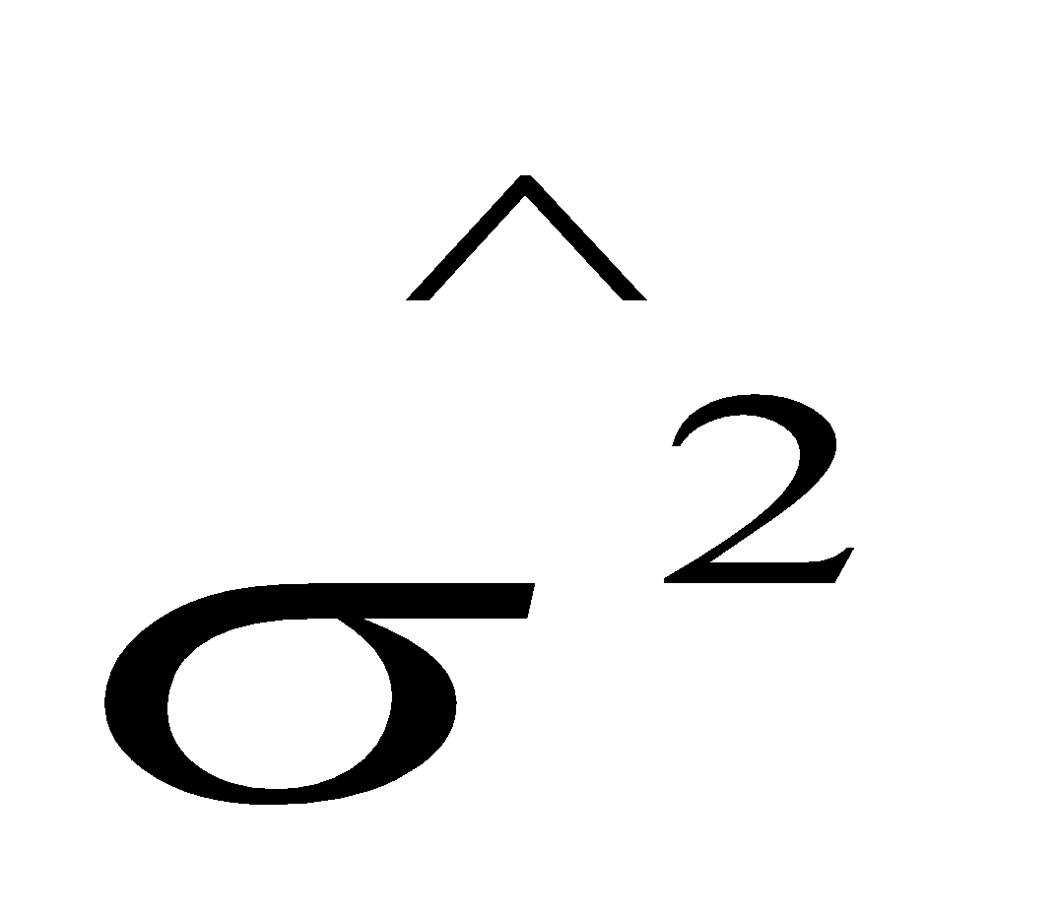
Original Proposal Number of Blocks
=11.86667
D_{A}=3, D_{B}=2
D_{C}=2, D_{D}=4
Number of Blocks=4
Power=0.8

Slide 9
Changes from Original Proposal
Few easily corrected mistakes (i.e. spelling, notation errors)
Larger increments of distance (8/9/10 feet vs 8/10/12 feet)
Clearly define the horizontal “to the right” position
Obtain new pilot sample
Recalculate number of blocks needed
D_{A}=4, D_{B}=3
D_{C}=3, D_{D}=5
=27.46667
Number of Blocks=5
Power=0.8

Slide 10
02
Assumptions Checking

Slide 11
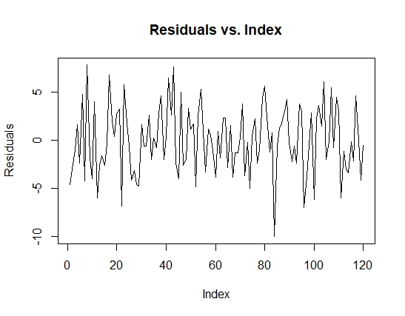
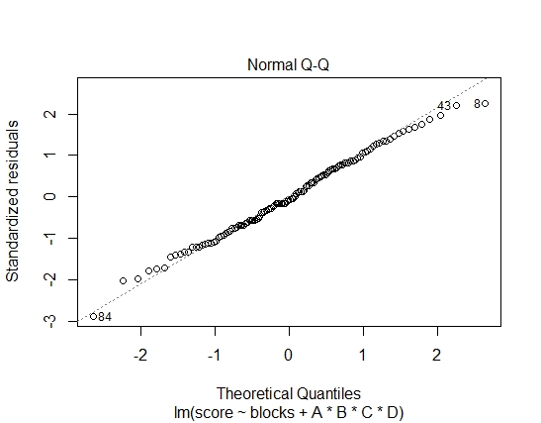
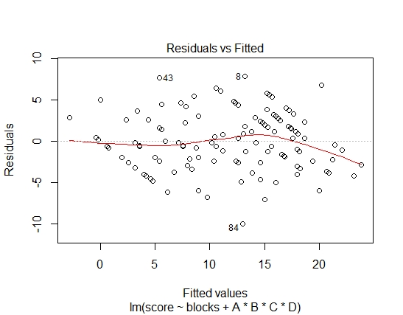
Assumptions Checking
Normality Assumption
Constant Variance
Independence

Slide 12
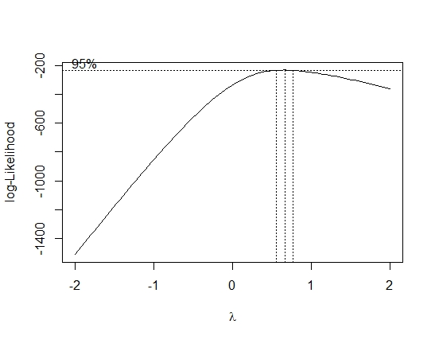
Box-Cox Transformation

Slide 13

Breusch-Pagan Test
Non-constant Variance Score Test
Variance formula: ~ fitted.values
Chisquare = 0.02546167, Df = 1, p = 0.87322

Slide 14
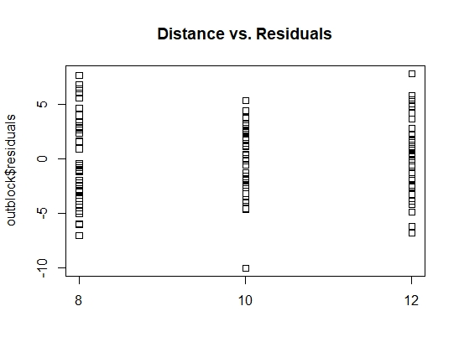
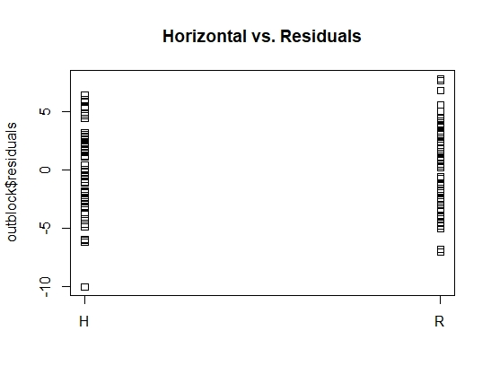
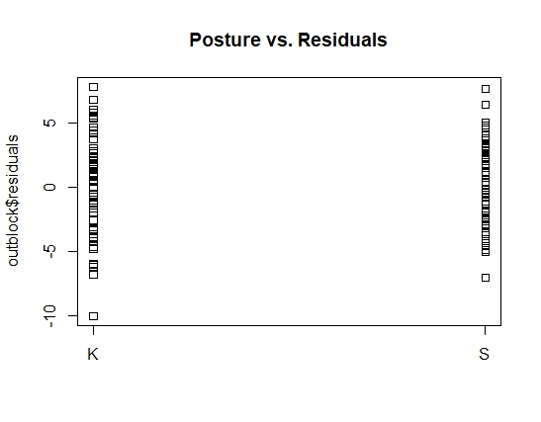
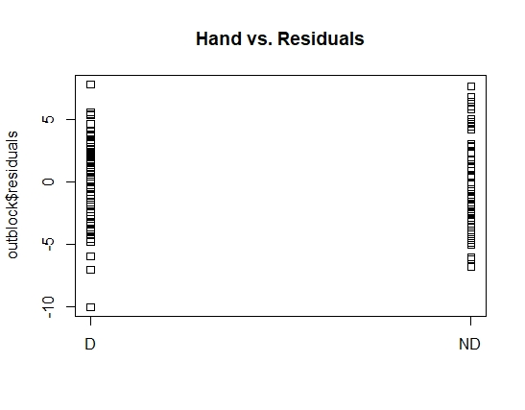
Plot of Factors vs Residuals

Slide 15
03
Data Analysis

Slide 16
Data Collection on Experiment Day
Collected at a local bar, Campus Quarters
Measured and marked our physical locations to throw from (6 unique locations)
Not much difficulty running experiment; picked opportune time to run experiment

Slide 17
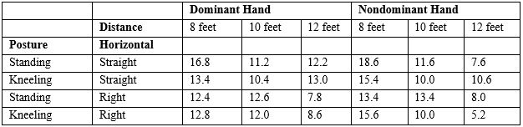
Table of Means

Slide 18
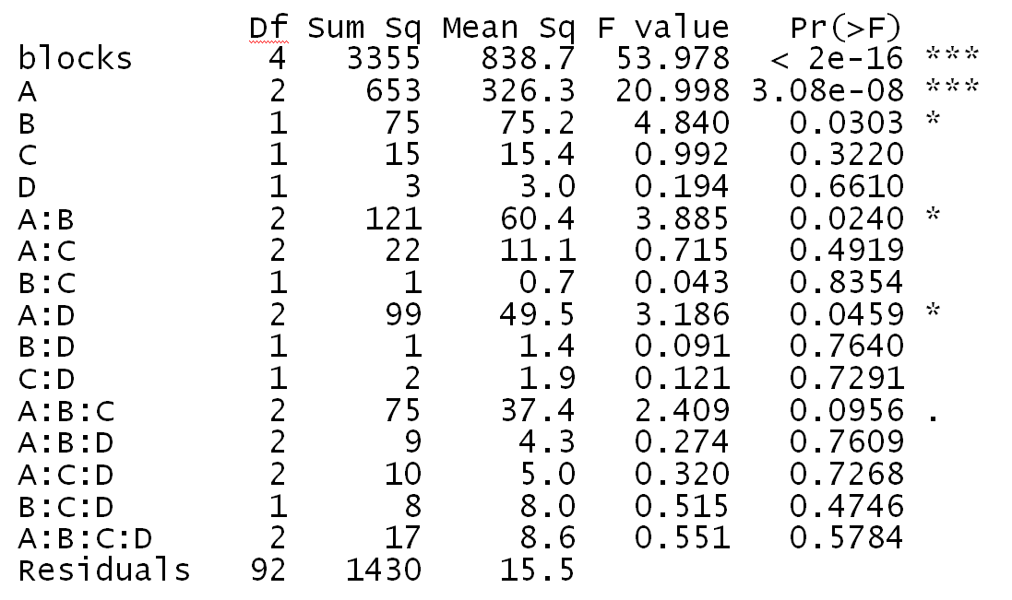
ANOVA Table
Significant variables:
Blocks
A (Distance)
B (Horizontal)
A:B (Distance and Horizontal Interaction)
A:D (Distance and Hand Interaction)

Slide 19
Relative Efficiency
•CRD vs RCBD~ The RCBD's p-value from ANOVA is 2e-16 which is highly significant to our “dart madness” model.​
•Relative efficiency obtained is 3.21 which states that “Blocking” effect is worthwhile to control unnecessary noise.​
Df Sum Sq Mean Sq F value Pr(>F)
blocks 4 3355 838.7 53.978 < 2e-16 ***
Residuals 92 1430 15.5

Slide 20
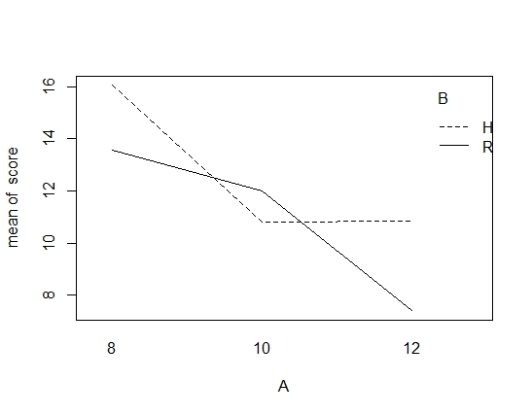
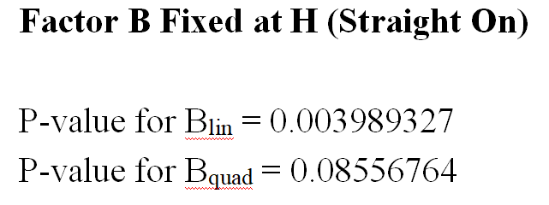

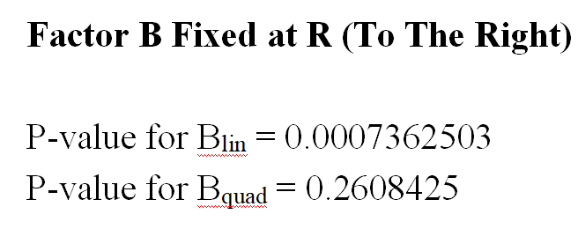
A:B Interaction Plot and Polynomial Contrasts

Slide 21
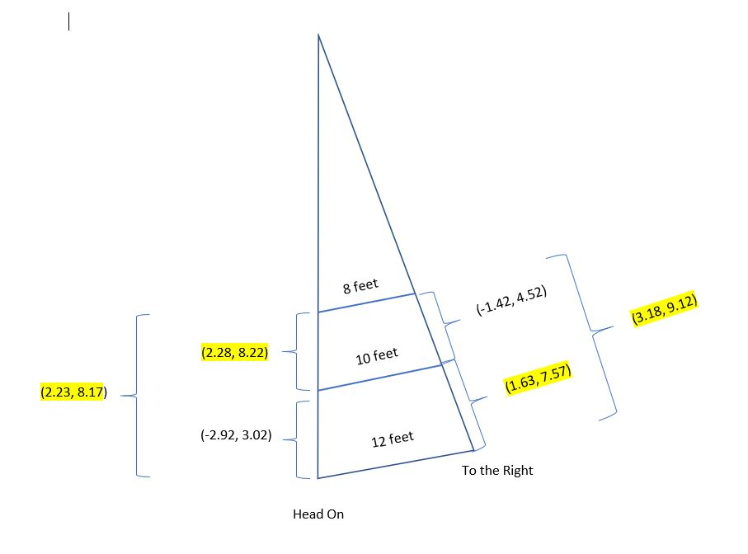
Confidence Intervals
Factor B fixed at H (Straight On)
8 feet-10 feet: (2.28, 8.22)
8 feet-12 feet: (2.23, 8.17)
10 feet-12 feet: (-2.92, 3.02)
Factor B fixed at R (To The Right)
8 feet-10 feet: (-1.42, 4.52)
8 feet-12 feet: (3.18 , 9.12)
10 feet-12 feet: (1.63, 7.57)

Slide 22
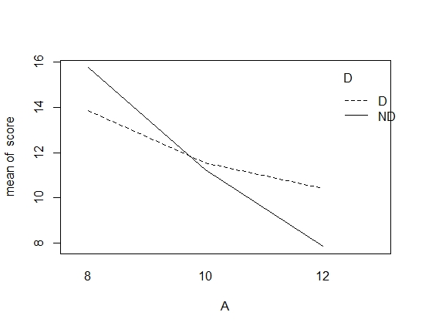

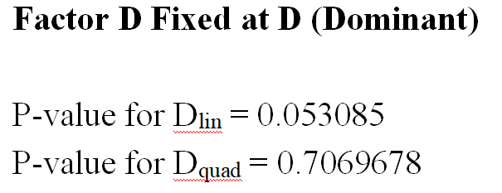
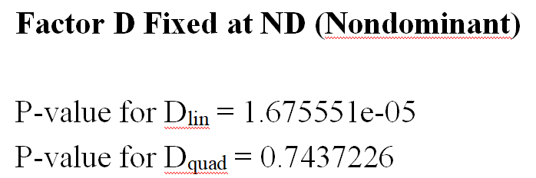

A:D Interaction Plot and Polynomial Contrasts
A:D Interaction Plot
Polynomial Contrasts

Slide 23
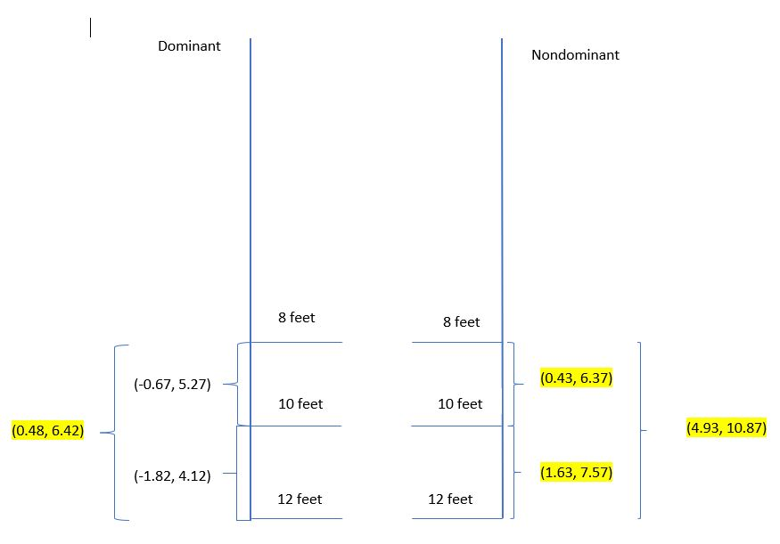
Confidence Intervals
Factor D fixed at D (Dominant)
8 feet-10 feet: (-0.67, 5.27)
8 feet-12 feet: (0.48, 6.42)
10 feet-12 feet: (-1.82, 4.12)
Factor D fixed at ND (Nondominant)
8 feet-10 feet: (0.43, 6.37)
8 feet-12 feet: (4.93, 10.87)
10 feet-12 feet: (1.63, 7.57)

Slide 24
04
Conclusion and Summary

Slide 25
Conclusion
Blocking was highly significant
Factor D (hand): individually insignificant but significant through A:D interaction
Factor B (horizontal position): individually significant and significant through A:B interaction
Nondominant hand prevails?

Slide 26
Difficulties
Keeping a fixed angle for our horizontal position “to the right” provided its challenges
Uncertainty with specious Box-Cox test
Difficulties in analysis

