Slide 1
ACADEMIC CAPSTONE PROJECT • IOT & SENSOR DATA PREDICTION
AI-Based Predictive Maintenance &
Remaining Useful Life (RUL) Prediction
End-to-End Machine Learning & Deep Sequential Modeling for Turbofan Engine Prognostics
Project Mandate: Pick up sensor telemetry from a device and perform real-time classification/prediction
Device: Turbofan Aircraft Jet Engine (NASA C-MAPSS FD001) • Stack: Python, PyTorch (LSTM), Scikit-Learn, Streamlit, Docker

Slide 2
CONTEXT & MOTIVATION
The Core Problem: Preventing Costly Machine Failures
Why Predictive Maintenance (PdM) represents a paradigm shift over traditional methods
The Flaws of Conventional Maintenance
The Solution: Predictive Maintenance (PdM)
Reactive Maintenance (Run-to-Failure): Equipment runs until it breaks. In mission-critical aerospace systems, sudden in-flight failure causes catastrophic safety risks and massive financial losses.
Preventive Maintenance (Time-Based): Parts are serviced/replaced at fixed calendar or usage intervals. This causes premature replacement of healthy parts, driving up operational overhead by 30-40%.
Lack of Real-Time Visibility: Static maintenance manuals do not account for individual operating stresses, weather conditions, or actual degradation state.
Condition-Based Monitoring: Continuously ingests multi-channel sensor telemetry from operating machinery to track internal physical wear in real time.
Remaining Useful Life (RUL) Prediction: RUL defines the exact number of operational cycles/hours remaining before component failure occurs ($RUL = Cycle_{failure} - Cycle_{current}$).
Just-in-Time Maintenance Action: Enables operators to service engines precisely when wear approaches safety margins—preventing breakdowns while maximizing component life.
Course Goal Fulfillment: Directly satisfies the objective of extracting telemetry from a real-world device and building an accurate prognostic ML/DL pipeline.

Slide 3
DEVICE TELEMETRY ACQUISITION
Device Under Study: Turbofan Engine & NASA C-MAPSS Dataset
Physics-based multi-sensor simulation from healthy operation to failure
21 Sensor Channels
Temperatures, Pressures, Speeds
100 Training Units
Full run-to-failure lifecycles
100 Test Units
Partial trajectories for RUL test
Turbofan Device Subsystems
Dataset Characteristics (NASA FD001)
Fan & Low-Pressure Compressor (LPC): Intake air compression, tracked via inlet temperature ($T_2$) and fan speed ($N_f$).
High-Pressure Compressor (HPC): High compression stage; degradation causes exit temperature ($T_{30}$) and static pressure ($P_{30}$) to surge.
Combustion Chamber & High-Pressure Turbine (HPT): High thermal stresses; tracked via HPT coolant bleed and turbine exit temperature ($T_{50}$).
Low-Pressure Turbine (LPT) & Exhaust Nozzle: Expands gas to produce thrust; tracked via bypass ratio and bypass pressure ($P_{15}$).
NASA C-MAPSS Benchmark: Gold standard benchmark from NASA Ames Research Center for Prognostics and Health Management (PHM).
Simulated Run-to-Failure: Each engine unit begins in varying states of initial manufacturing wear and runs until operational threshold violation.
Single Operating Condition: Operates at Sea Level with fixed throttle resolver angle, isolating degradation dynamics from environmental flight shifts.
Telemetry Frequency: Recorded on a discrete per-flight-cycle basis, forming a multivariate time-series trajectory.

Slide 4
DATA PREPROCESSING & FEATURE PIPELINE
Engineering Physics-Informed Features & Preventing Leakage
Raw sensor signals require stabilization, trend modeling, and strict isolation
1. Uninformative Sensor Pruning
2. Piecewise Linear RUL Target Formulation
Constant Channel Removal: Sensors 1, 5, 6, 10, 16, 18, and 19 exhibit near-zero variance across all cycles under FD001 condition.
Dimensionality Reduction: Dropped dead channels, preserving only the 14 responsive thermodynamic channels to eliminate dead weights and noise.
The Healthy Plateau Assumption: Engines do not degrade from cycle 1; wear only manifests after an initial burn-in period.
Target Clipping (RUL Cap = 125): Capped RUL at 125 cycles during early life, transitioning into linear degradation. Avoids forcing models to predict unrealistic 300+ cycle RULs early on.
3. Temporal Rolling Window Engineering
4. Strict Data Leakage Prevention
Smoothing Raw Sensor Noise: Sensor telemetry has high-frequency noise. We calculate a 5-cycle Rolling Mean to capture steady trend.
Degradation Momentum (Rolling Std): As components wear out, sensor fluctuations increase. Rolling Standard Deviation acts as an early indicator of mechanical instability.
Train-Only Scaler Fitting: StandardScaler parameters (mean, standard deviation) are strictly calculated on the training engines.
Zero Information Contamination: Test engine sets are only transformed using frozen train statistics. Preserves pure zero-leakage academic validity.

Slide 5
MODELING METHODOLOGY
Progressive Model Progression: Baseline to Deep Learning
Evaluating both tabular ensembles and temporal recurrent architectures
Linear Regression
Baseline Model
Random Forest
Ensemble Bagging
Gradient Boosting
XGBoost Regressor
PyTorch LSTM
Deep Recurrent Network
Nature: Ordinary Least Squares (OLS) regression.
Assumption: Assumes strictly linear correlation between sensor states and RUL.
Role: Provides an empirical baseline to justify higher-order model complexity.
Nature: Forest of 100 decision trees with feature subsampling.
Advantage: Captures non-linear sensor thresholds without scaling artifacts.
Limitation: Treats cycles independently without remembering prior trajectory.
Nature: Sequential boosting trees minimizing residual loss.
Advantage: High predictive accuracy on tabular data; tuned max_depth=3 to prevent overfitting.
Limitation: Still relies on engineered rolling stats to see past cycles.
Nature: 2-layer LSTM (hidden_dim=64) with Dropout (0.2).
Advantage: Maintains hidden cell memory across a 30-cycle sliding sequence window.
Key Edge: Directly models progressive mechanical wear over time.

Slide 6
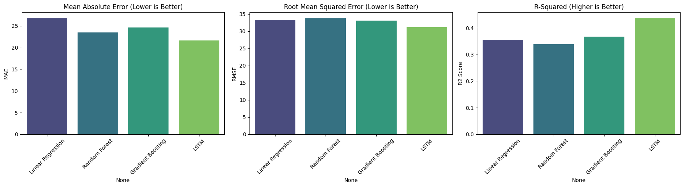
EXPERIMENTAL RESULTS & BENCHMARK
Model Performance Comparison on NASA Test Fleet
The Deep Sequential LSTM demonstrates superior predictive accuracy across all metrics
Empirical Evaluation Metrics
Model Benchmark Visualization
Model Architecture | MAE ↓ | RMSE ↓ | R² Score ↑
Linear Regression (Baseline) | 26.78 | 33.36 | 0.3556
Random Forest Regressor | 23.47 | 33.80 | 0.3385
Gradient Boosting (XGBoost) | 24.65 | 33.06 | 0.3670
PyTorch LSTM (Deep Learning) | 21.63 | 31.19 | 0.4365
Key Takeaways & Academic Findings:
• 19.2% MAE Reduction: LSTM achieves 21.63 error cycles vs 26.78 for Linear Baseline.
• Penalizing Critical Outliers: LSTM achieved the lowest RMSE (31.19), proving it makes far fewer dangerous catastrophic prediction errors.
• Variance Explained: R² surged to 0.4365, confirming the critical value of sequential window memory.

Slide 7
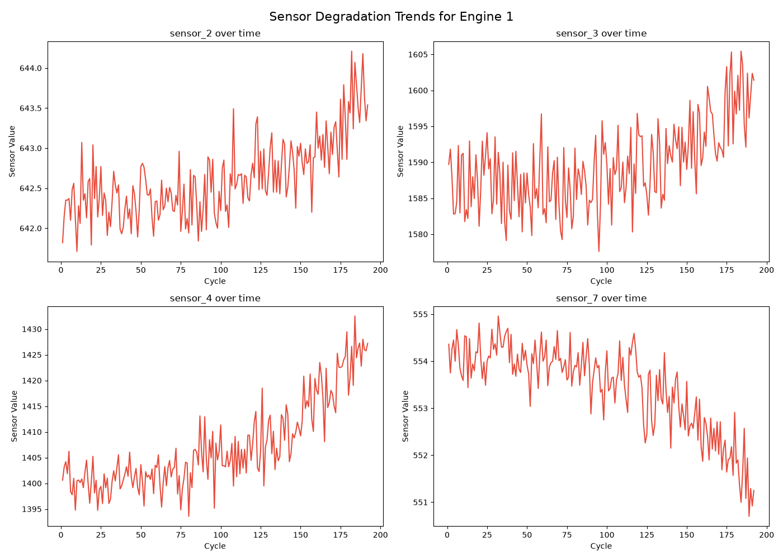
EXPLORATORY DATA ANALYSIS
Physicochemical Degradation Signatures in Engine Telemetry
Visual evidence of wear accumulation across operational lifecycles
Unit #1 Sensor Degradation Trajectory
Sensor Correlation & Failure Signatures
Monotonic Thermal Surge ($T_{30}, T_{50}$): High-Pressure Compressor outlet temperature and Low-Pressure Turbine exit temperature increase steadily as blade tip clearances widen and friction accumulates.
Spool Speed Decline ($N_f, N_c$): Physical core and fan rotational speeds degrade due to aerodynamic losses in the turbine stages, requiring higher fuel flow to maintain thrust.
Bypass & Pressure Shifts ($P_{30}, P_{15}$): Total pressure at HPC outlet drops progressively as compressor efficiency diminishes.
Early Detection Feasibility: Observable divergence from healthy baseline begins approximately 50-70 cycles before catastrophic failure—providing ample reaction time for maintenance crews.

Slide 8
DEPLOYMENT & LIVE DEMONSTRATION
Production Dashboard & Digital Twin Simulator
Fully containerized full-stack deployment enabling interactive RUL exploration
Interactive Fleet Simulator
Interactive Plotly Visualizer
Custom Telemetry Ingestion
Unit ID Selector: Switch between 100 test engines in real time.
Operating Cycle Slider: Simulate engine running cycle-by-cycle to observe RUL countdown.
Dynamic Health Status: Automatic triage into Healthy, Warning, or Critical Maintenance Required with color cues.
Degradation Trajectory: Displays ground truth wear vs. model predicted trajectory.
Predicted Failure Cycle: Extrapolates remaining lifetime diamond marker with instant recalculation.
Model Dropdown: Switch seamlessly between LSTM, XGBoost, Random Forest, and Linear Regression.
Live File Uploader: Upload arbitrary sensor log CSV files from physical devices or bench test rigs.
Automated Preprocessing: Applies scaling, rolling stats, and sequence windowing on the fly.
Instant Inference: Outputs immediate health diagnosis without manual code interaction.
CONTAINERIZED CLOUD / ON-PREM ARCHITECTURE
Container: Docker (Python 3.9 Debian) • Port: 8501 (Tornado / Streamlit WS) • Sub-second inference (<15ms per prediction) • Mounted Volumes for model checkpoints

Slide 9
ACADEMIC DEFENSE & TECHNICAL RIGOR
Anticipated Viva Questions & Technical Justifications
Addressing core machine learning theory, experimental design, and limitations
Q: Why Regression instead of Classification?
Maintenance planning requires knowing the EXACT time window remaining ($RUL$ in cycles). Binary classification ('Healthy' vs 'Broken') gives no lead time to order replacement parts or schedule hangar crews.
Q: Why MAE & RMSE rather than Accuracy?
Accuracy applies only to discrete classification classes. For continuous RUL values, MAE measures average cycle error, while RMSE heavily penalizes large dangerous outlier mispredictions.
Q: How was Data Leakage eliminated?
By strictly fitting the StandardScaler only on the training units. Normalization statistics were never calculated across the combined dataset. Sequences were grouped strictly within unit IDs.
Q: Why does LSTM outperform Random Forest?
Turbofan degradation is inherently non-Markovian: engine wear at cycle t depends on historical cumulative stress. LSTM remembers temporal degradation trajectories across sliding time windows.
Q: What are the primary project limitations?
FD001 simulates a single operating regime (Sea Level). Real-world aircraft experience multi-altitude conditions and varying thrust regimes (as simulated in C-MAPSS FD002-FD004 datasets).
Q: How was Overfitting controlled?
Utilized Dropout layers (0.2) in PyTorch, Early Stopping on validation loss, and 3-fold cross-validation with constrained tree depth in ensemble models.

Slide 10
PROJECT SUMMARY & DELIVERABLES
Requirement Fulfilled: Collected multi-channel sensor telemetry from an industrial device (Turbofan Jet Engine) and engineered an accurate predictive prognostic system.
Benchmarked ML & DL: Compared Linear Regression, Random Forest, XGBoost, and PyTorch LSTM. Demonstrated that temporal deep learning cuts prediction error down to 21.6 cycles.
Full-Stack Implementation: Delivered a containerized Streamlit digital twin with interactive visualization, dynamic health triage, and ad-hoc CSV ingestion.
Production & Defense Ready: Zero-leakage data pipelines, comprehensive unit test suite (pytest), and Dockerized deployment.
FUTURE ROADMAP & EXTENSIONS
Multi-Condition Datasets: Extend architecture to NASA FD002 & FD004 (6 flight regimes and 2 fault modes) utilizing regime-aware normalization.
Temporal Attention / Transformers: Implement Transformer encoder layers to capture long-range sensor attention and model cross-sensor coupling.
Edge Deployment (TinyML): Quantize PyTorch weights to INT8 for deployment on resource-constrained embedded aviation edge computers.
Bayesian Uncertainty Estimation: Output prediction confidence intervals (e.g. 95% RUL bounds) rather than single scalar predictions.
Thank You! Questions & Discussion

